Slide 1
Central tendency and measures of spread

Slide 2
Descriptive versus inferential statistics
Descriptive Statistics
Summarise observations
E.g., average monthly temperature
Inferential Statistics
Make estimates or predictions
E.g., predict temperature from latitude

Slide 3
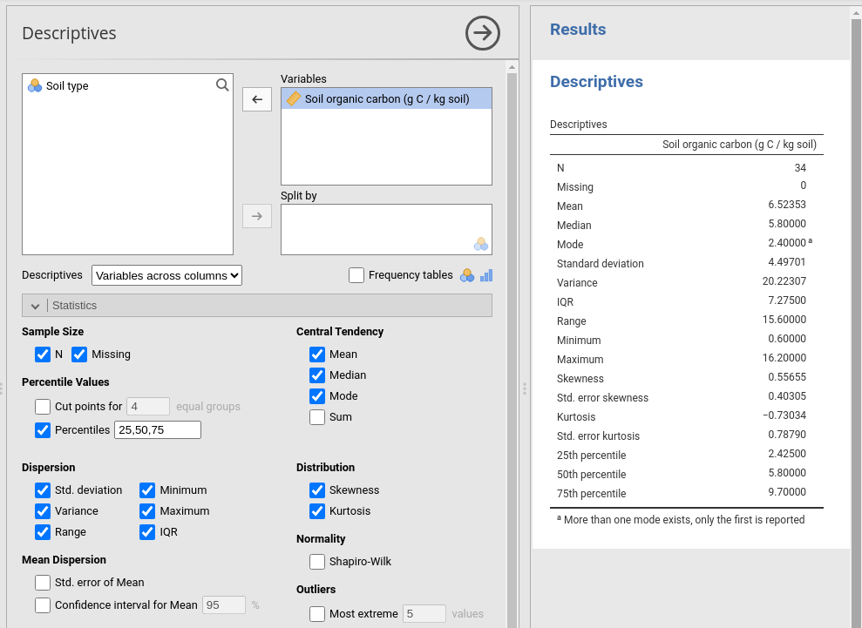
Descriptive statistics in jamovi

Slide 4
Descriptive statistics
Properties of distributions
Central tendency
Spread
Skew & Kurtosis
Will focus on samples rather than populations

Slide 5
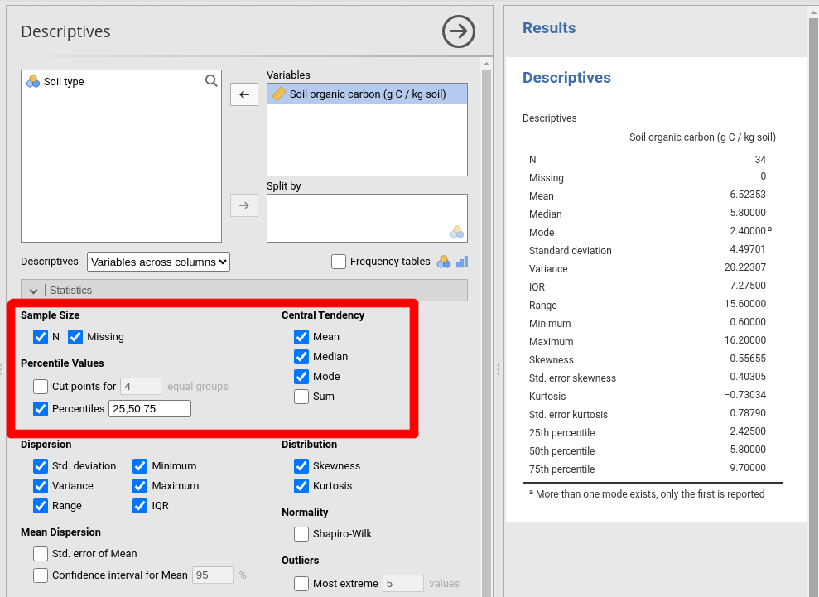
Descriptive statistics: Central tendency
Mean, median, and mode

Slide 6
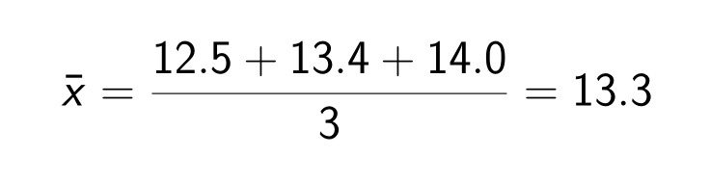
Arithmetic mean
Add values, divide by number (N)
For example, N = 3 temperatures:
12.5 °C
13.4 °C
14.0 °C

Slide 7
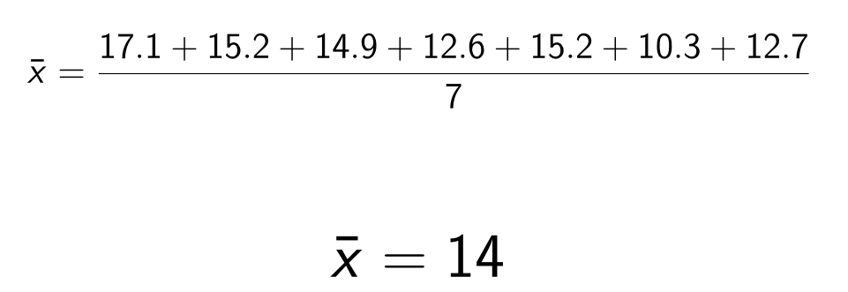
Calculating the mean of 7 temperatures °C
Table 1: Seven values (x) of soil temperature ( °C ) at a site.
x₁ | x₂ | x₃ | x₄ | x₅ | x₆ | x₇
17.1 | 15.2 | 14.9 | 12.6 | 15.2 | 10.3 | 12.7

Slide 8
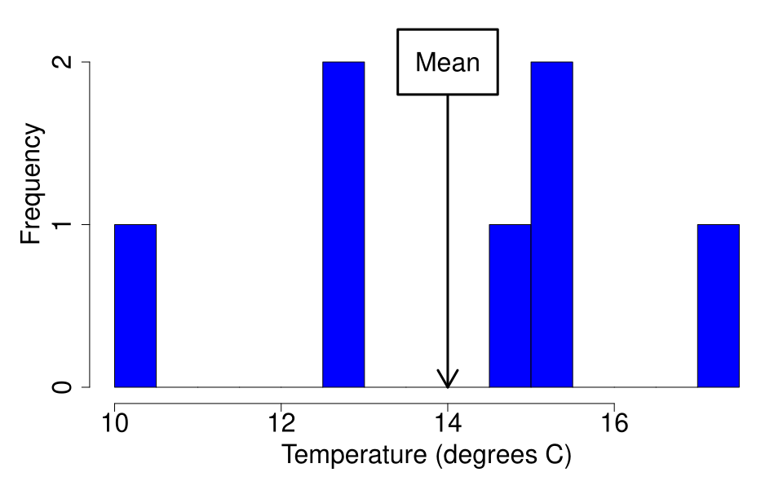
Arithmetic mean visualisation (histogram)

Slide 9

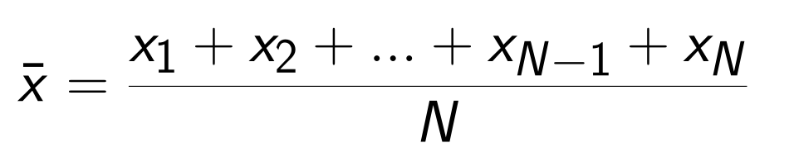
General formula for arithmetic mean
Sample mean:
Sample size: N

Slide 10
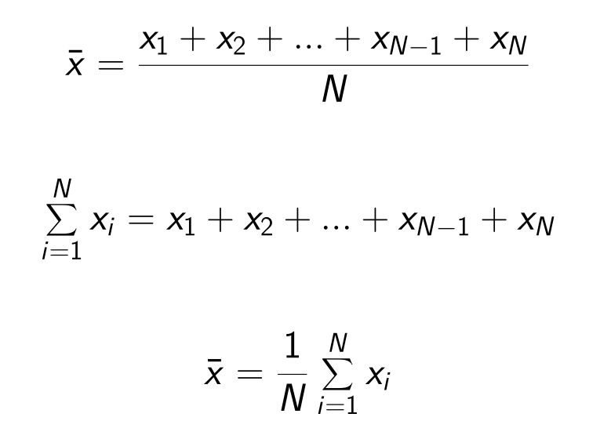
General formula for arithmetic mean

Slide 11
The mode
Most frequently occurring observation
x₁ | x₂ | x₃ | x₄ | x₅ | x₆ | x₇
17.1 | 15.2 | 14.9 | 12.6 | 15.2 | 10.3 | 12.7
Also applies to categorical data
x₁ | x₂ | x₃ | x₄ | x₅ | x₆
dog | cat | bird | cat | cat | dog

Slide 12
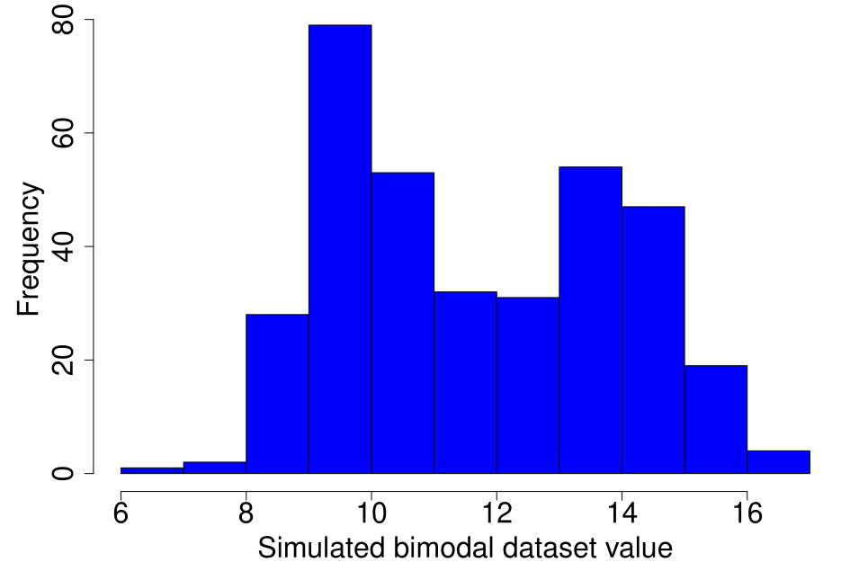
Visualising the mode
Figure 1: Hypothetical dataset that has a bimodal distribution

Slide 13
The median
Observation in the middle when the observations are arranged in ascending order
There are an equal number of observations lower and higher than the median

Slide 14
The median
x₁ | x₂ | x₃ | x₄ | x₅ | x₆ | x₇
17.1 | 15.2 | 14.9 | 12.6 | 15.2 | 10.3 | 12.7
Sorting the data:
x₆ | x₄ | x₇ | x₃ | x₂ | x₅ | x₁
10.3 | 12.6 | 12.7 | 14.9 | 15.2 | 15.2 | 17.1

Slide 15
The median
Median is a type of quantile (50%)
Can break distributions into other quantiles
First quartile (25% quantile)
Third quartile (75% quantile)
Quantiles also called 'percentiles'
x₁ | x₂ | x₃ | x₄ | x₅
2 | 4 | 5 | 6 | 8

Slide 16
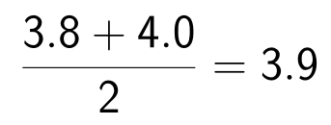
The median
If there is no middle value
x₁ | x₂ | x₃ | x₄ | x₅ | x₆
3.1 | 3.5 | 3.8 | 4.0 | 4.2 | 4.2
Take mean of middle values

Slide 17
The median
Multiple valid ways to calculate quantiles
No one 'right' way
Jamovi's approach might differ from other software
Hyndman, RJ, & Y Fan. 1996. American Statistician 50:361–65.

Slide 18
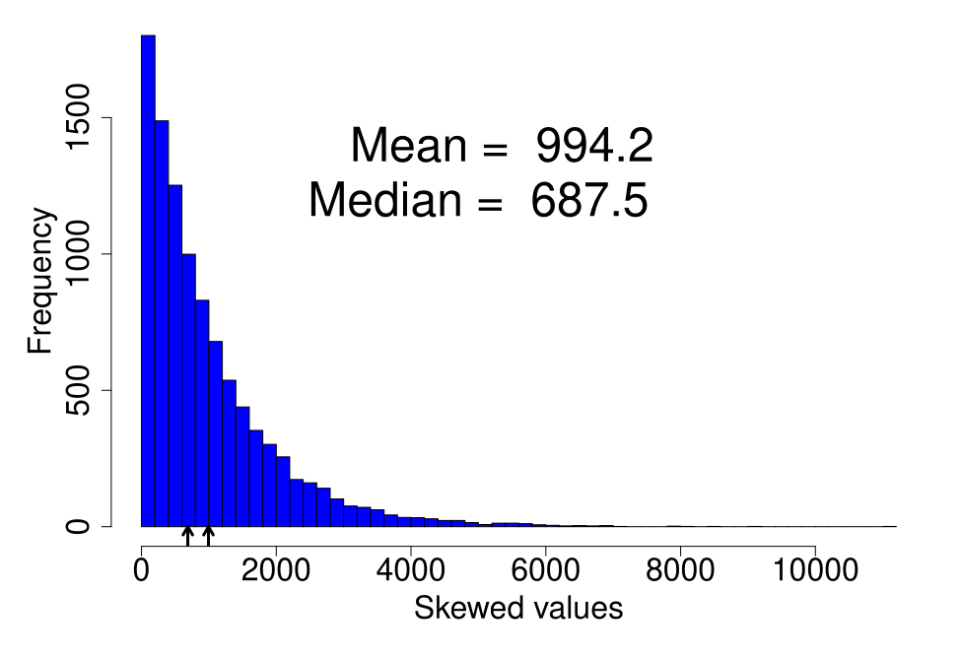
Median more robust to outliers

Slide 19
Measures of spread
Range
Interquartile range (IQR)
Variance (s²)
Standard deviation (s)
Coefficient of variation (CV)

Slide 20
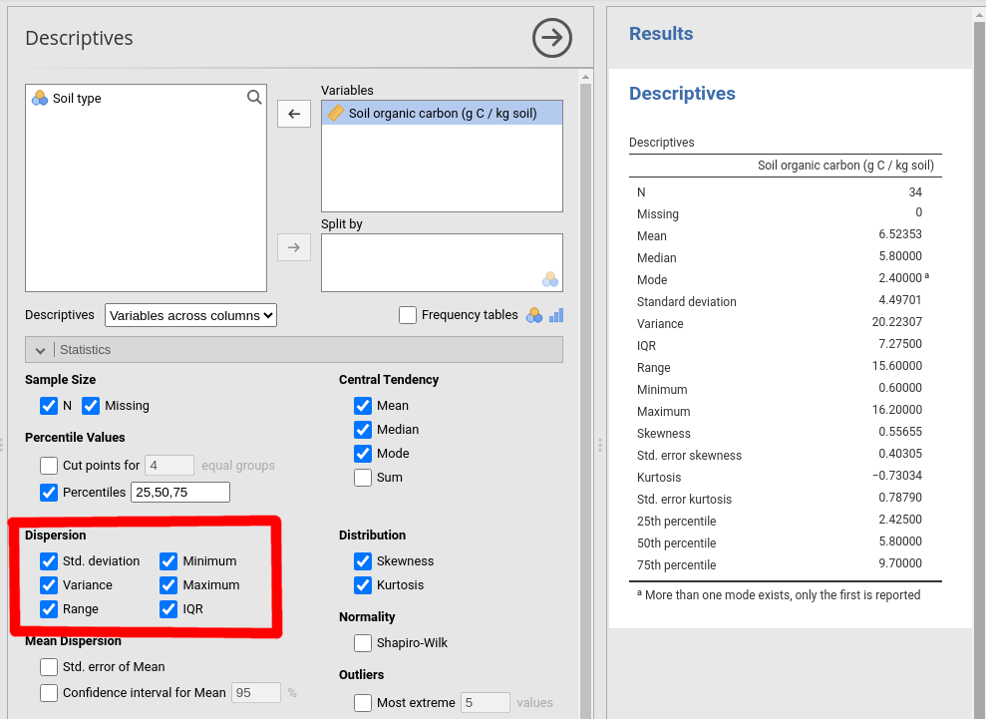
Measures of spread
Range, IQR, s², s, CV

Slide 21
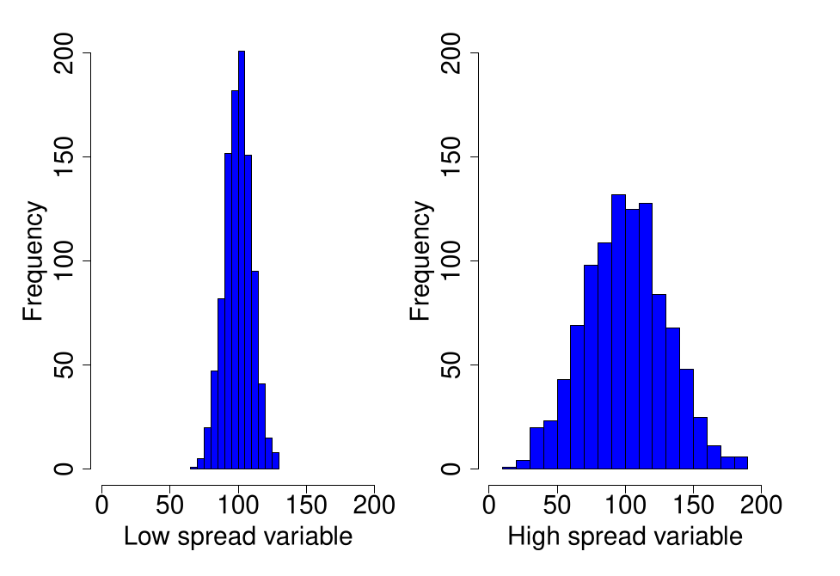
Measures of spread

Slide 22
Measures of spread: Range
Range(X) = Maximum(X) — Minimum(X)
x₁ | x₂ | x₃ | x₄ | x₅ | x₆ | x₇
17.1 | 15.2 | 14.9 | 12.6 | 15.2 | 10.3 | 12.7
Range(X) = 17.1 — 10.3 = 6.8

Slide 23
Measures of spread: Range
IQR(X) = Q₃(X) — Q₁(X)
x₁ | x₂ | x₃ | x₄ | x₅
2 | 4 | 5 | 6 | 8
IQR(X) = 6 — 4 = 2

Slide 24
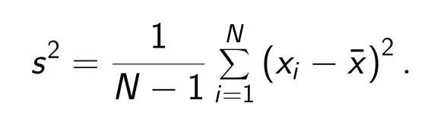
Measures of spread: Variance (s²)
Expected squared deviation from mean
More useful than range or IQR
Less intuitive than ranger or IQR1
Jamovi will calculate this for us
We can break this down step by step!
https://bradduthie.github.io/stats/app/forest/

Slide 25
Measures of spread: Variance (s²)
x₁ | x₂ | x₃ | x₄ | x₅ | x₆ | x₇
17.1 | 15.2 | 14.9 | 12.6 | 15.2 | 10.3 | 12.7
Take x₁ minus mean, squared (17.1 − 14)² = 9.61
Repeat step 1 for x₂ , x₃ , ..., x_{N}
Sum up all these (x_{i} − x̄ )² values
Multiply the sum by 1/(N − 1)

Slide 26
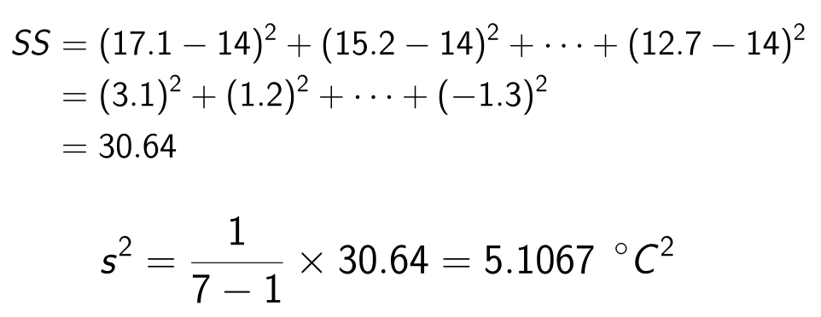
Measures of spread: Variance (s²)
x₁ | x₂ | x₃ | x₄ | x₅ | x₆ | x₇
17.1 | 15.2 | 14.9 | 12.6 | 15.2 | 10.3 | 12.7

Slide 27
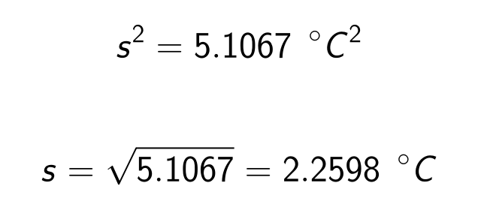
Measures of spread: Standard deviation (s)
Mean deviation from the mean
Square-root of the variance
Gets back to original units
https://bradduthie.github.io/stats/app/normal_pos_neg/

Slide 28
Arithmetic mean visualisation (histogram)

Slide 29
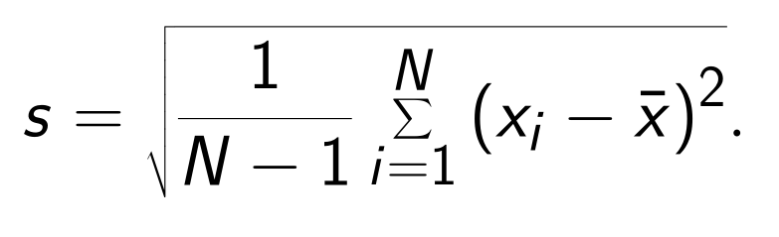
Standard deviation of the mean
One checkbox in jamovi
Spread of a variable

Slide 30
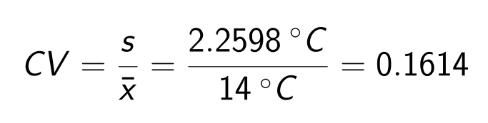
Coefficient of variation (CV)
Standard deviation divided by the mean
x₁ | x₂ | x₃ | x₄ | x₅ | x₆ | x₇
17.1 | 15.2 | 14.9 | 12.6 | 15.2 | 10.3 | 12.7
Note that the units cancel out.

Slide 31
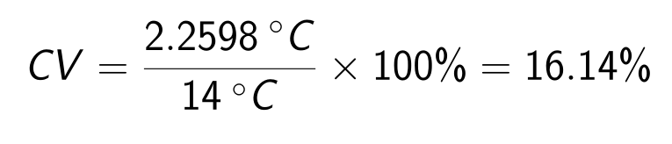
Coefficient of variation (CV)
Often expressed as a percentage
x₁ | x₂ | x₃ | x₄ | x₅ | x₆ | x₇
17.1 | 15.2 | 14.9 | 12.6 | 15.2 | 10.3 | 12.7
Useful for comparing variation across categories (e.g., species)

Slide 32
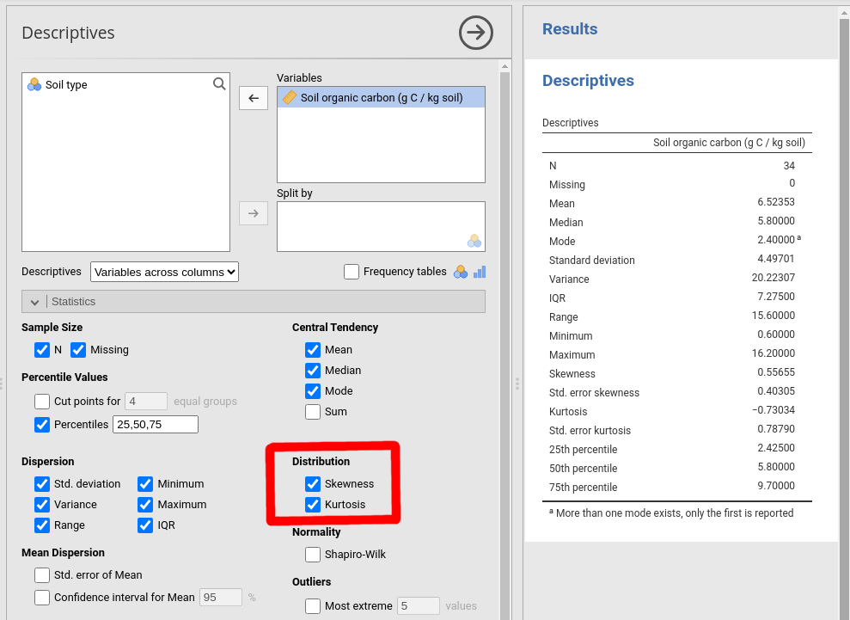
Descriptive statistics: Skew and Kurtosis

Slide 33
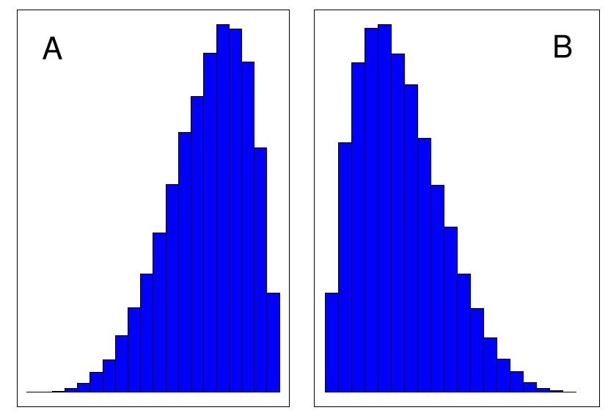
Skew is the asymmetry of a distribution
Figure 2: Histograms showing a (A) distribution that has a negative (i.e., 'left') skew and (B) distribution that has a positive (i.e., 'right') skew.

Slide 34
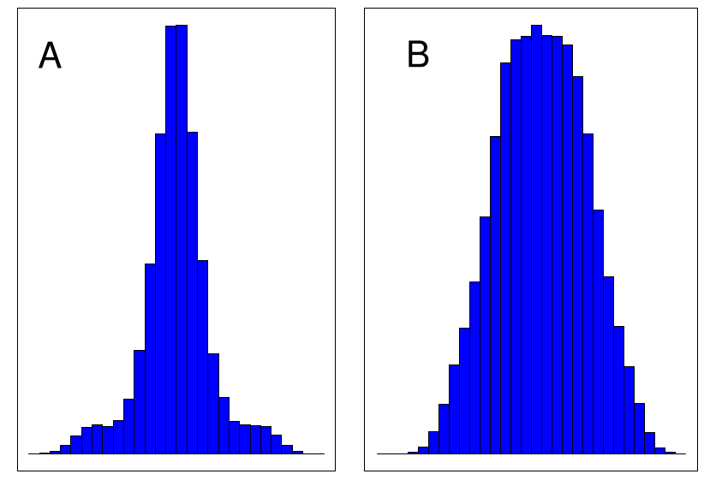
Kurtosis is the flattness of a distribution
Figure 3: Histograms showing a (A) leptokurtic distribution and (B) platykurtic distribution.

Slide 35
Statistical moments
Mean
Variance
Skew
Kurtosis
Mathematically, deviations from mean raised to some power give the shape of a distribution.

Slide 36
Descriptive statistics in jamovi

Slide 37
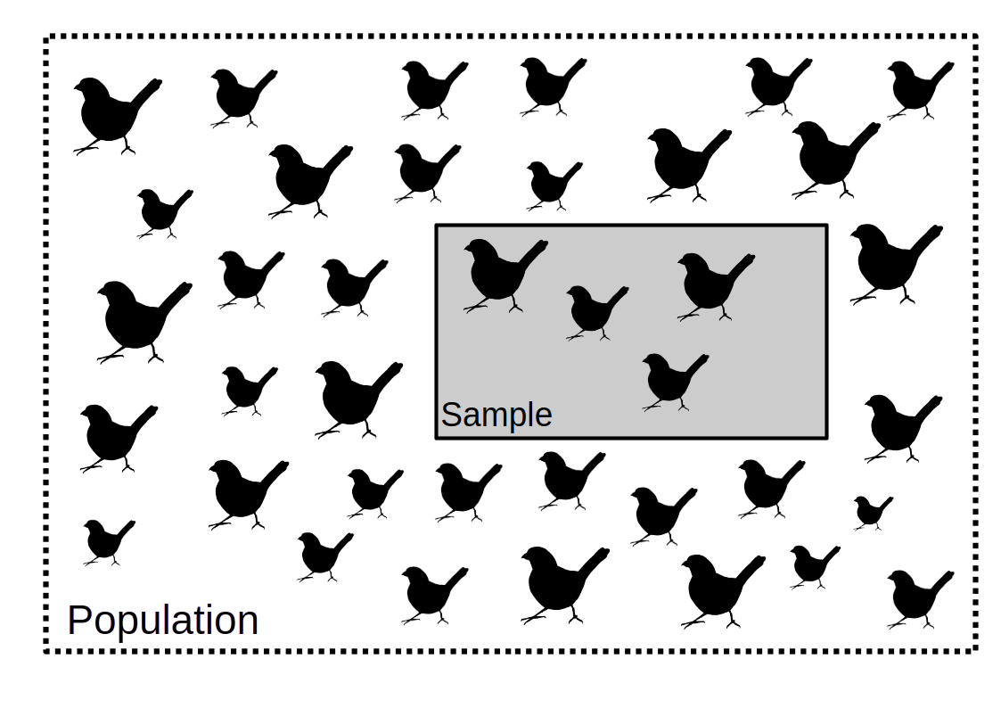
General idea of frequency statistics

Slide 38
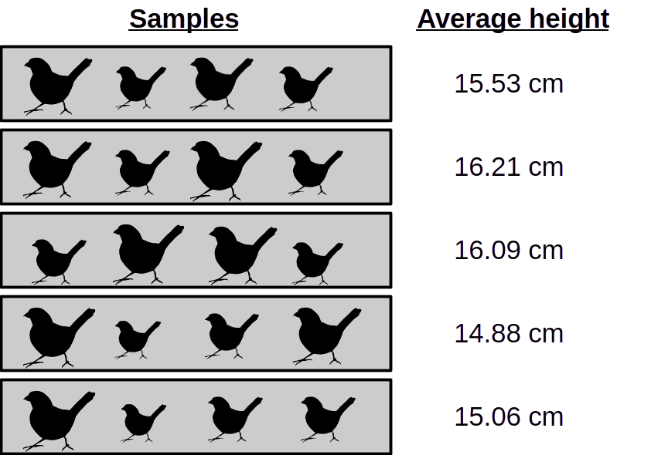
General idea of frequency statistics

Slide 39
General idea of frequency statistics
Repeated re-sampling
What is our expectation?
What is our uncertainty?
What is the distribution of the sample mean (x̄) around the population mean (µ_{x})?

Slide 40
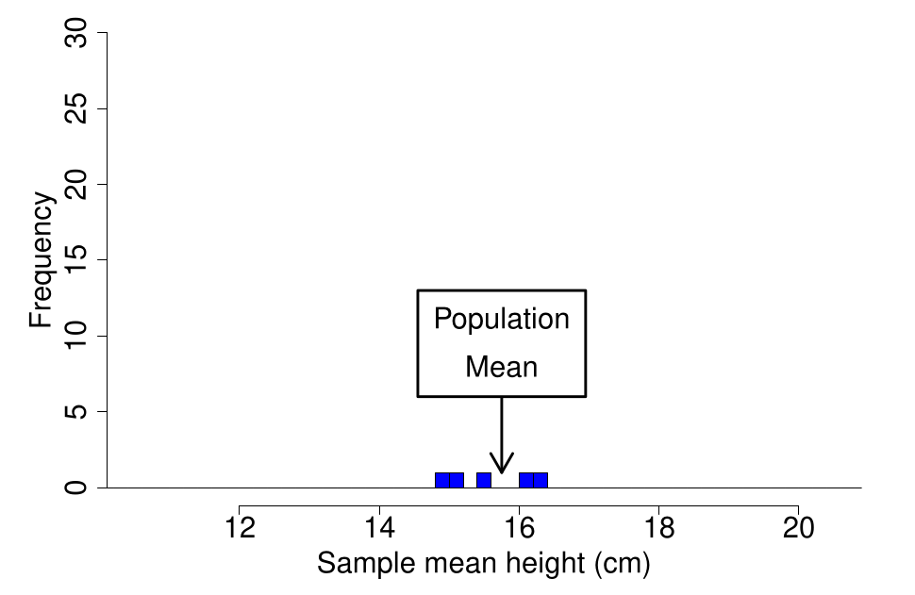
The standard error: Sample means and population mean

Slide 41
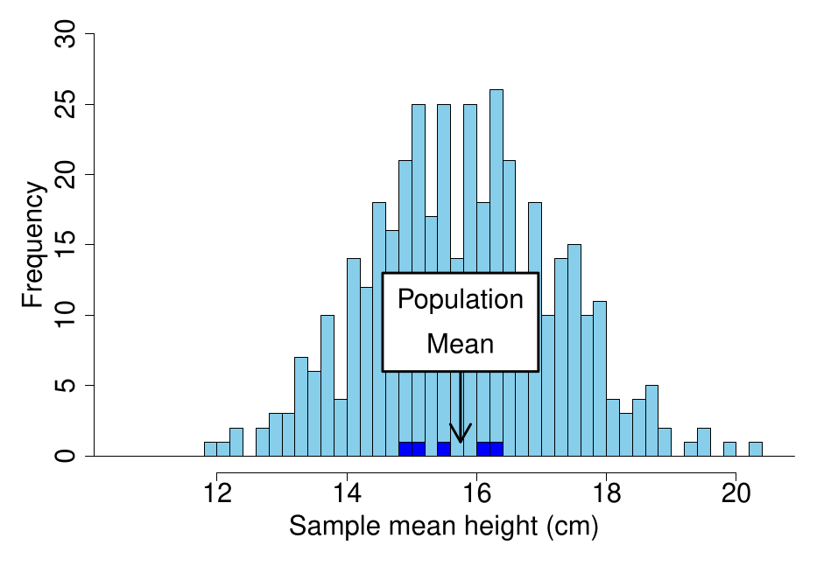
The standard error: Sample means and population mean

Slide 42
The standard error: Sample means and population mean
What is the distribution of the sample mean (x̄) around the population mean (µ_{x})?
Standard error: The standard deviation of sample means around the population mean

Slide 43
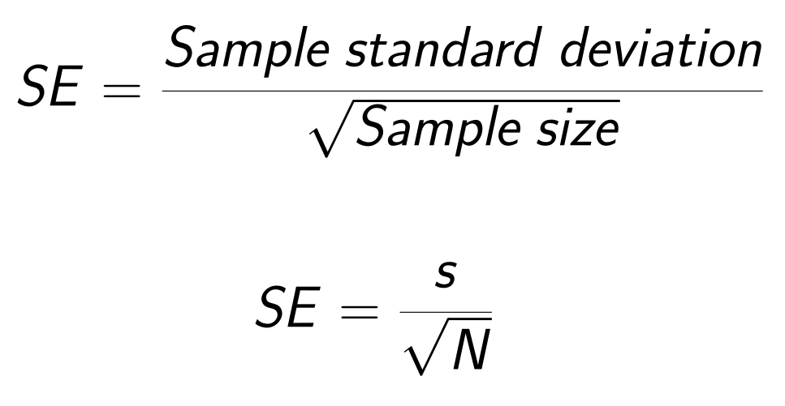
The standard error: Estimation

Slide 44
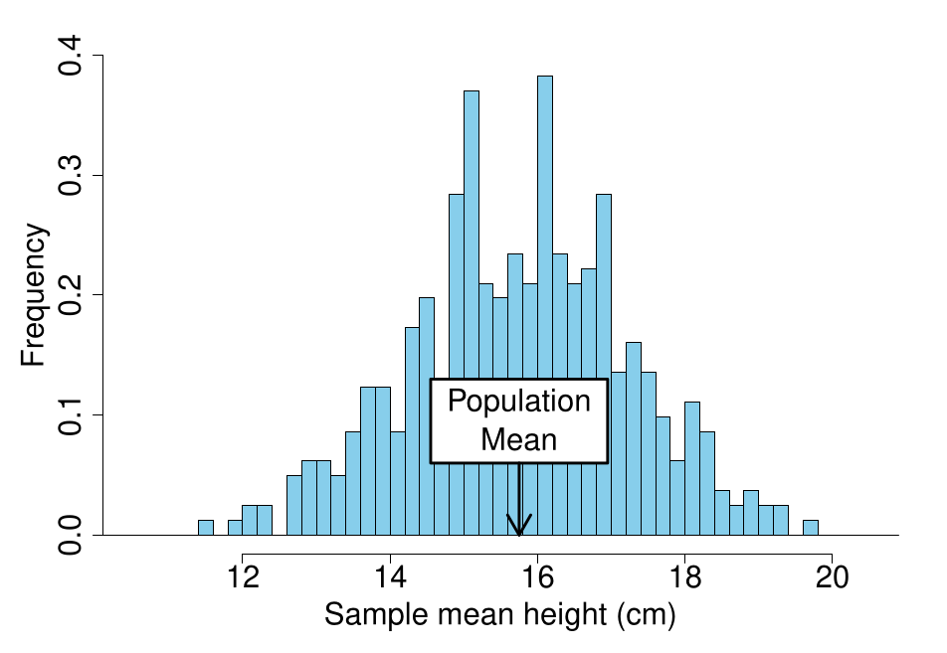
The standard error: Sample means and population mean

Slide 45
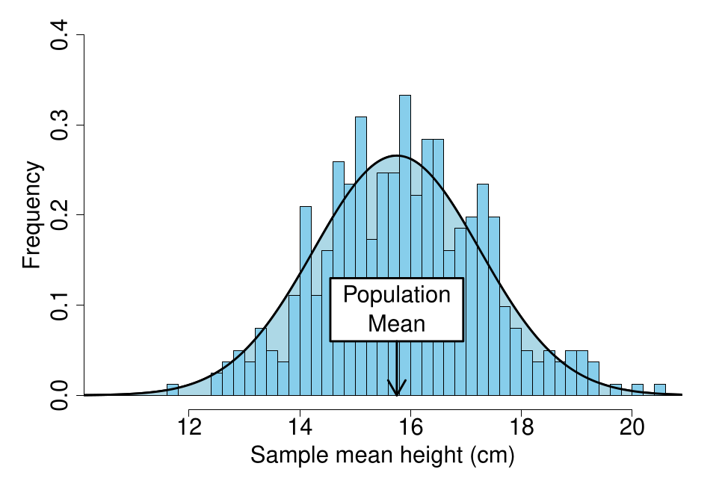
The standard error: Sample means and population mean

Slide 46
The standard error: Sample means and population mean
Standard error: The standard deviation of sample means around the population mean
Standard error measures the uncertainty of the sample mean

Slide 47
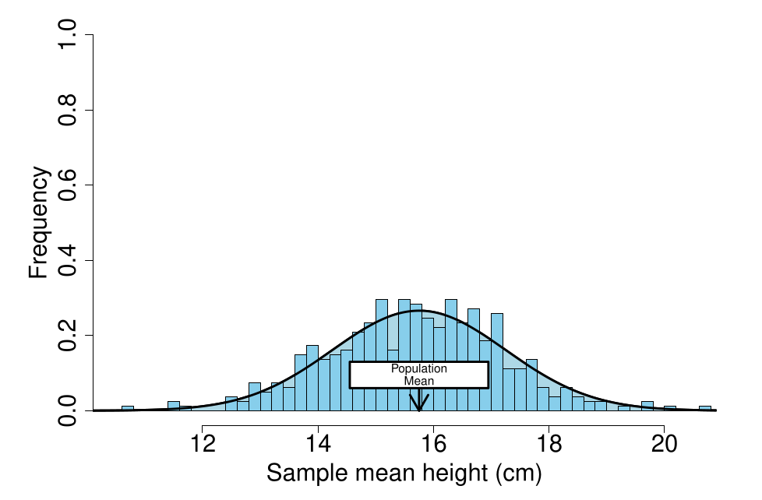
The standard error

Slide 48
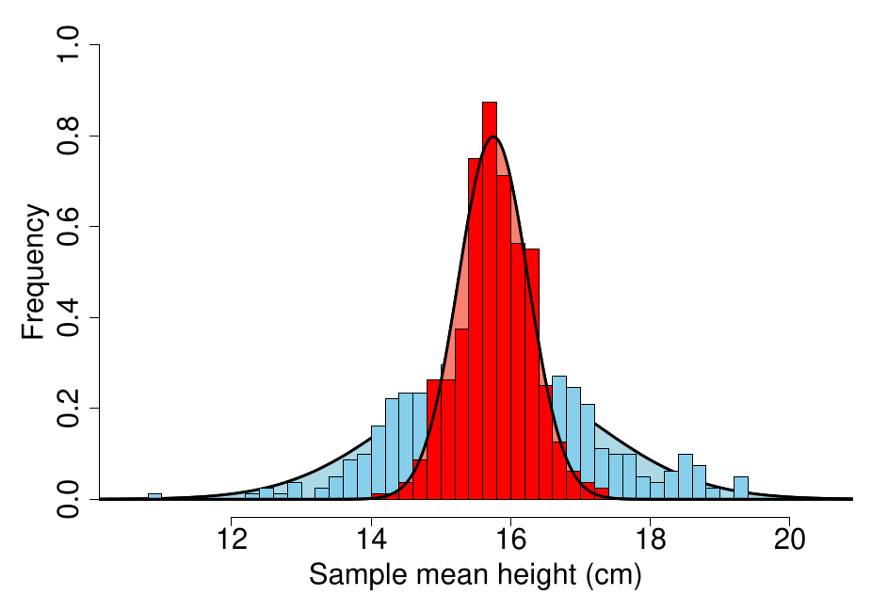
The standard error

Slide 49
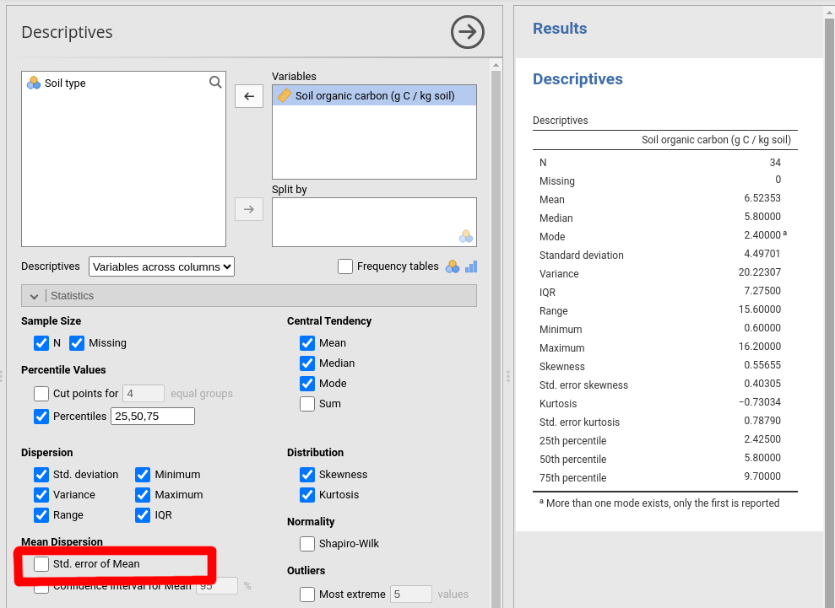
The standard error in jamovi

