Slide 1
The Central Limit Theorem (CLT)

Slide 2
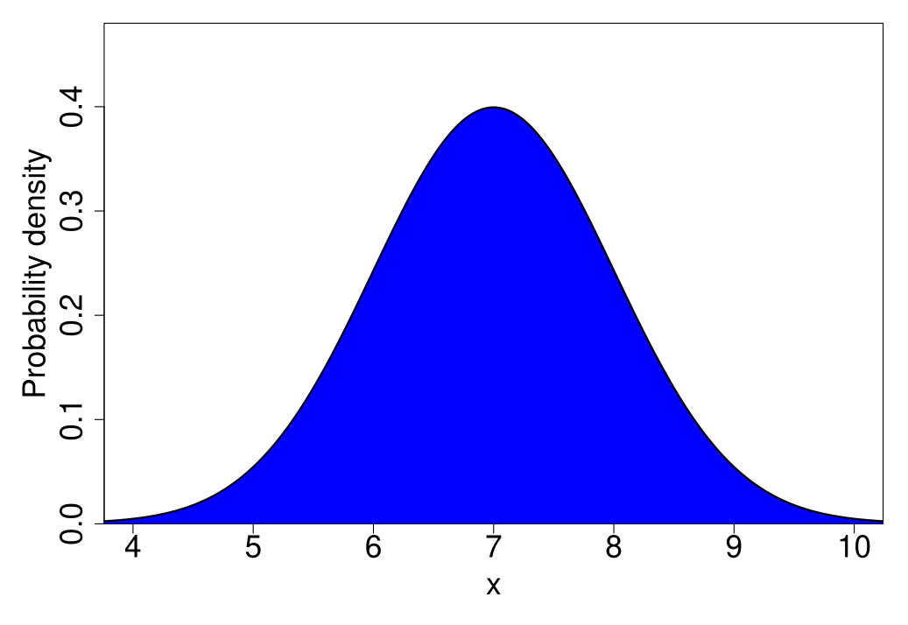
Normal distribution

Slide 3
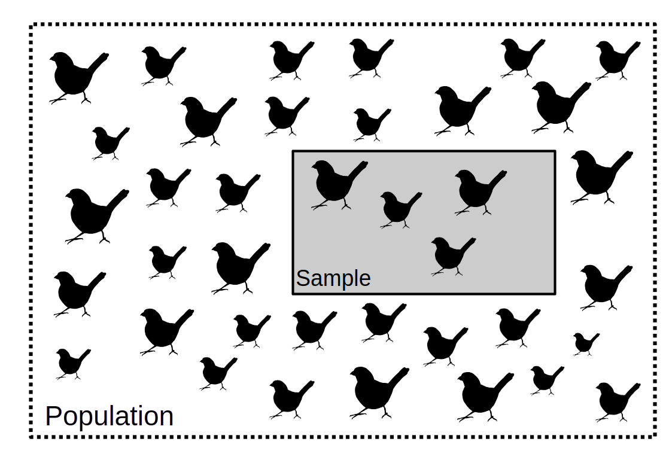
Sampling from a population (distribution)

Slide 4
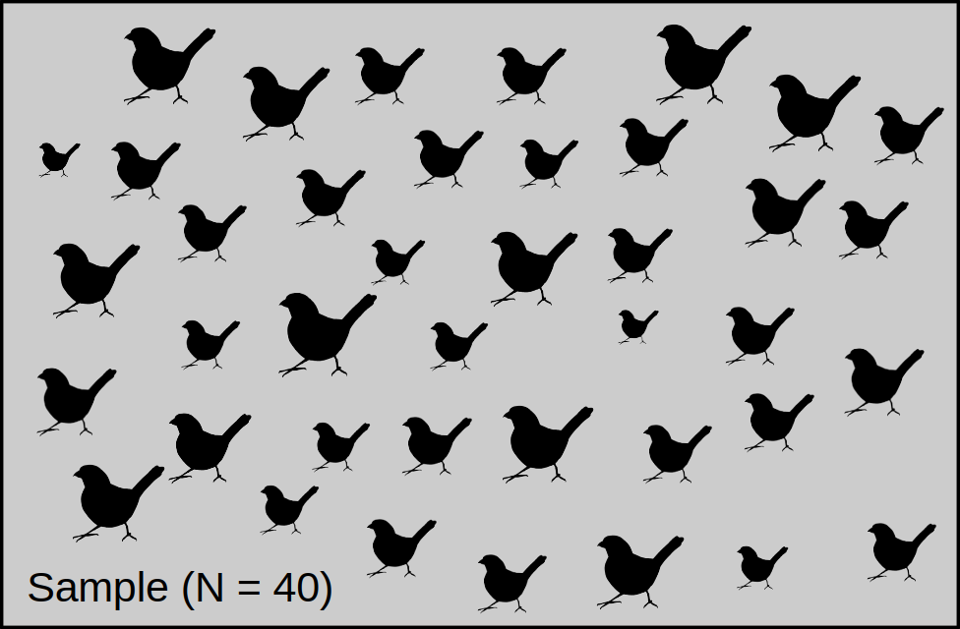
Consider the distribution of a sample of N = 40

Slide 5
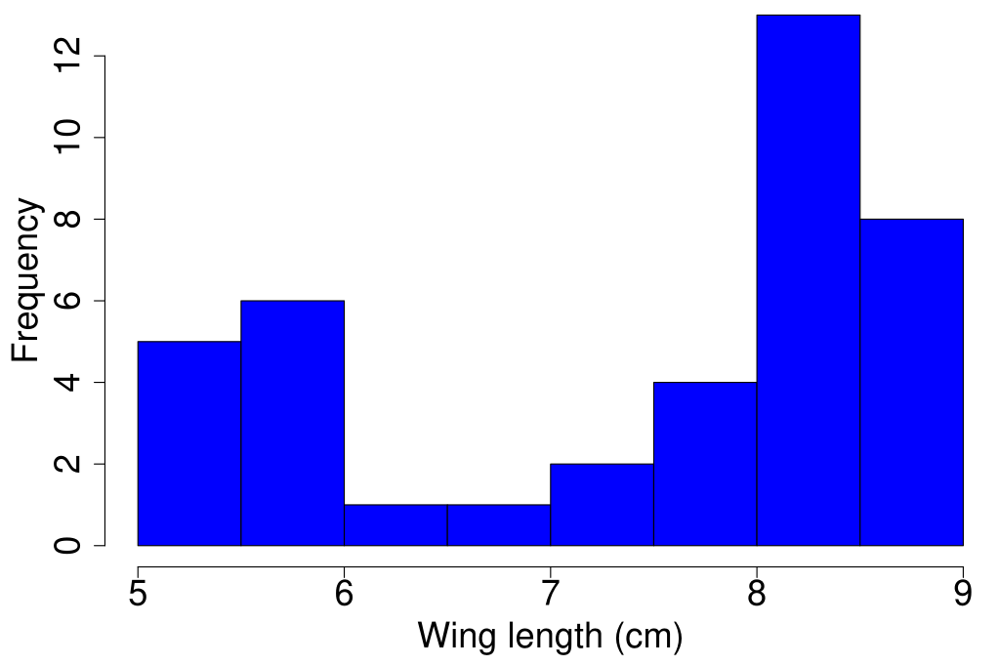
Consider the distribution of a sample of N = 40
Figure 1: Distribution of a sample of bird wing length (cm)

Slide 6
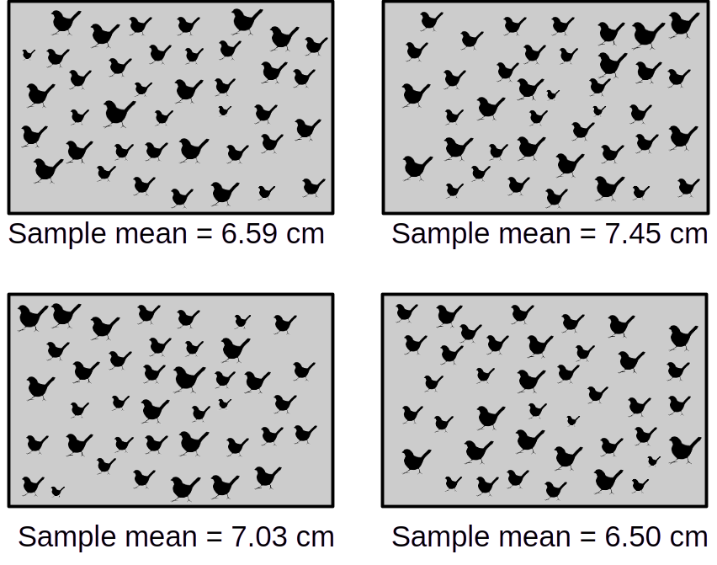
Sample means always distributed normally around true mean

Slide 7
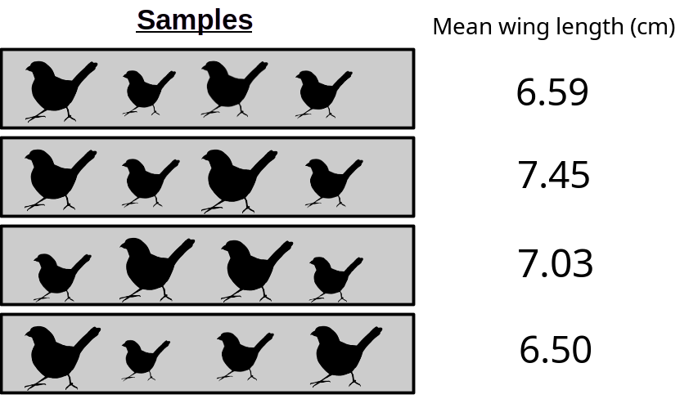
Sample means always distributed normally around true mean
What if we had 1000 sample means?

Slide 8
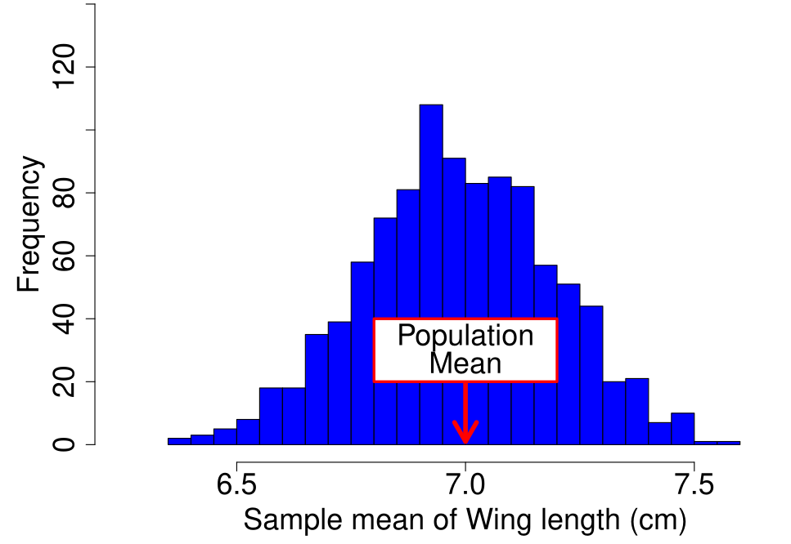
Sample means always distributed normally around true mean
Figure 2: Distribution of the mean of bird wing length (cm) samples (N = 40), with sampling repeated 1000 times.

Slide 9
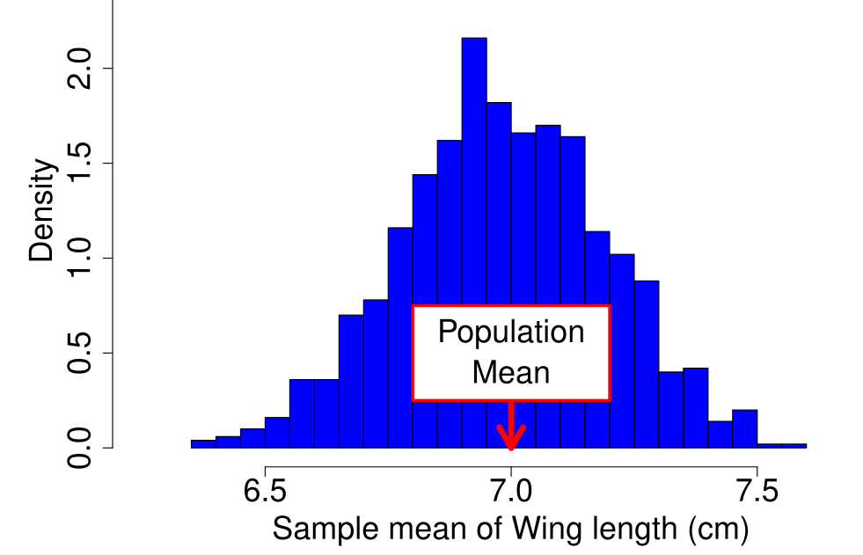
Sample means always distributed normally around true mean
Figure 3: Distribution of the mean of bird wing length (cm) samples (N = 40), with sampling repeated 1000 times.

Slide 10
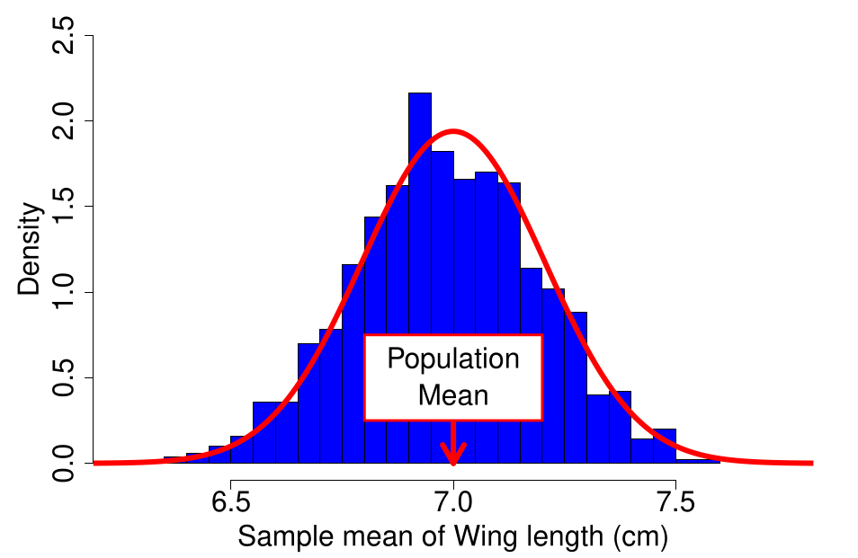
Sample means always distributed normally around true mean
Figure 4: Distribution of the mean of bird wing length (cm) samples (N = 40), with sampling repeated 1000 times.

Slide 11
Sample means always distributed normally around true mean
Distribution of sample means gets closer to the population mean with increasing N
Can demonstrate this ourselves with simulated data

Slide 12
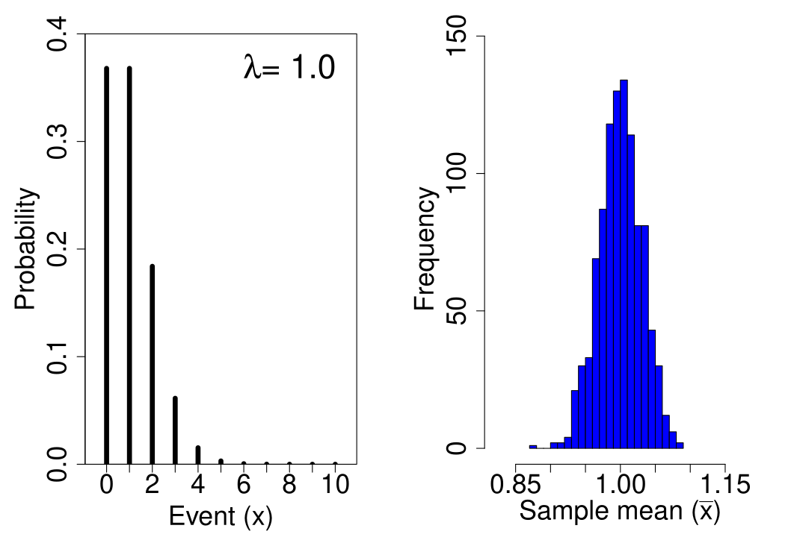
Sample means always distributed normally around true mean

Slide 13
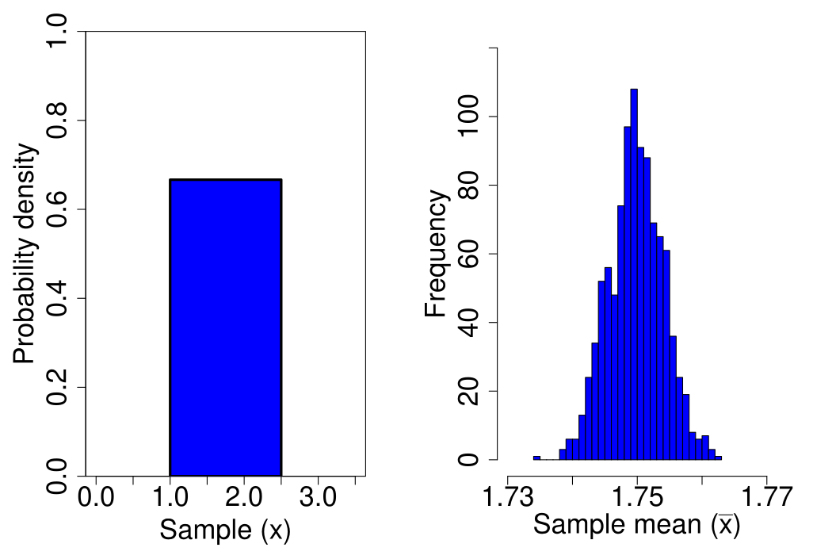
Sample means always distributed normally around true mean

Slide 14
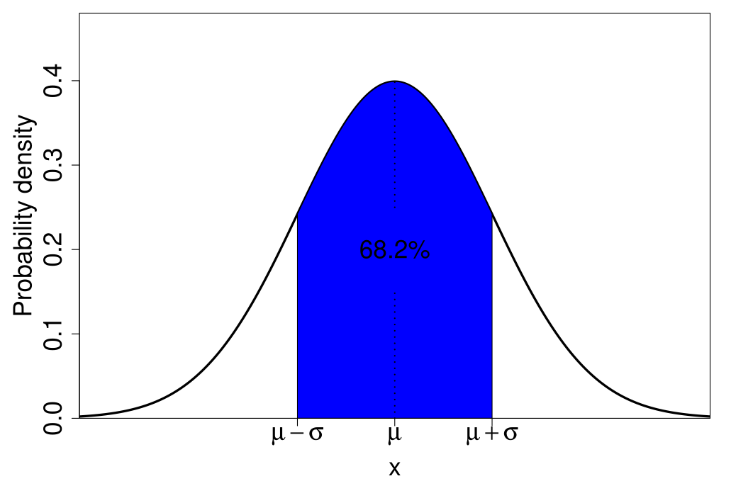
Probability density and the normal distribution

Slide 15
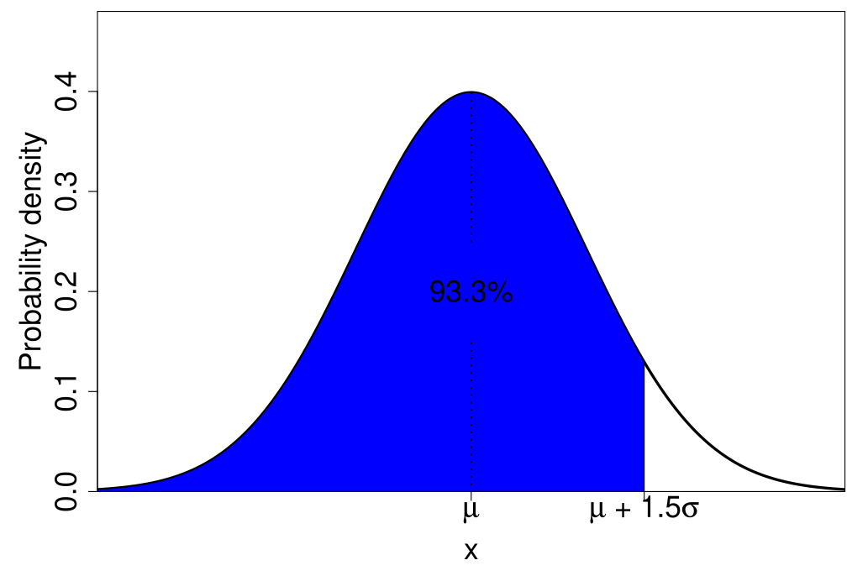
Probability density and the normal distribution

Slide 16
Standard normal distribution
Need some standard values of x to work out probability
Standard normal distribution
Mean (x̄) = 0
Standard deviation (s) = 1
Baseline for comparison

Slide 17
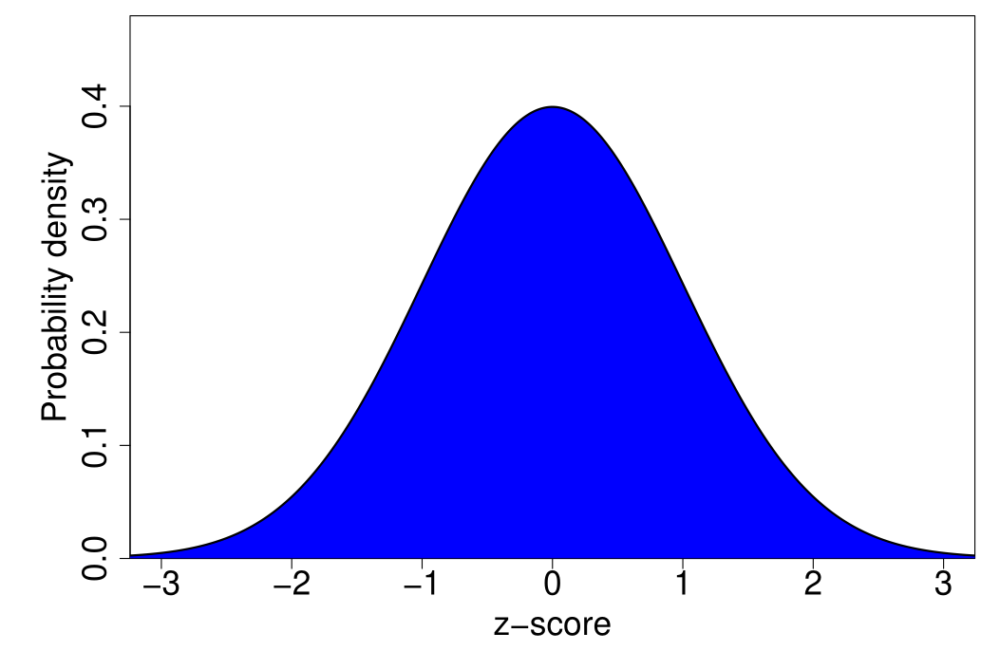
Standard normal distribution
https://bradduthie.github.io/stats/app/zandp/

Slide 18
Standard normal distribution
z-score: deviation from 0
Work out probability density
Basis for confidence intervals
Critical for hypothesis testing

Slide 19
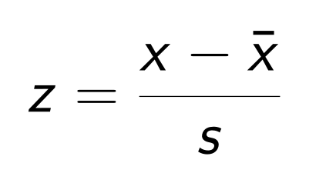
Translating a variable into a standard normal distribution
Subtract mean
Divide by standard deviation
Can turn x-values into z-scores

Slide 20
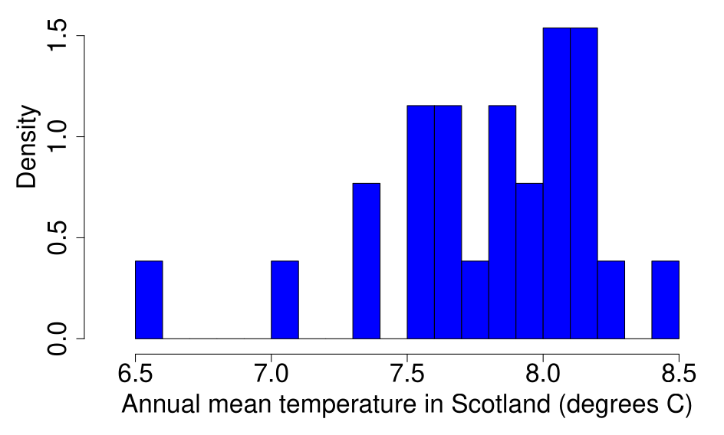
Turning a value into z-score
N = 26 x̄ = 7.789 s = 0.4124844
Met Office. (July 1, 2021). Annual mean temperature in Scotland from 1995 to 2020. In Statista. Retrieved February 10, 2026, from https://www.statista.com/statistics/367853/scotland-average-temperature/

Slide 21
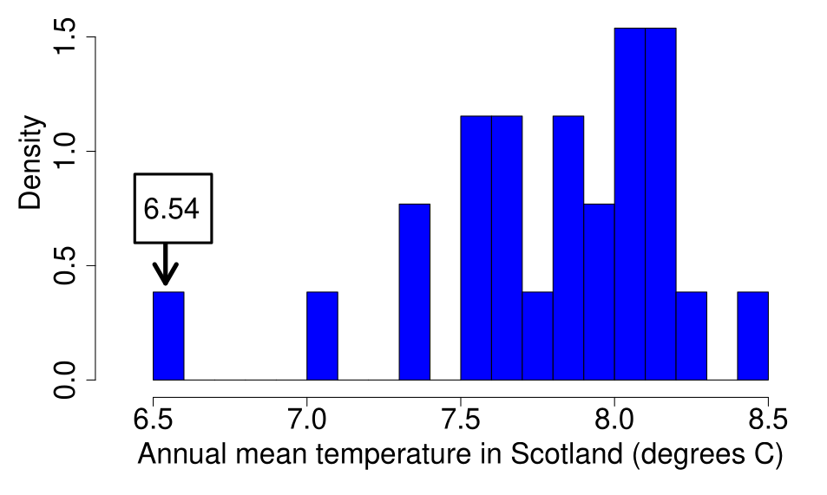
Turning a value into z-score
N = 26 x̄ = 7.789 s = 0.4124844
Met Office. (July 1, 2021). Annual mean temperature in Scotland from 1995 to 2020. In Statista. Retrieved February 10, 2026, from https://www.statista.com/statistics/367853/scotland-average-temperature/

Slide 22
Translating a variable into a standard normal distribution
Subtract mean
Divide by standard deviation
z = (6.54 - 7.789)/0.4124844 = -3.03
Over 3 standard deviations below the mean

Slide 23
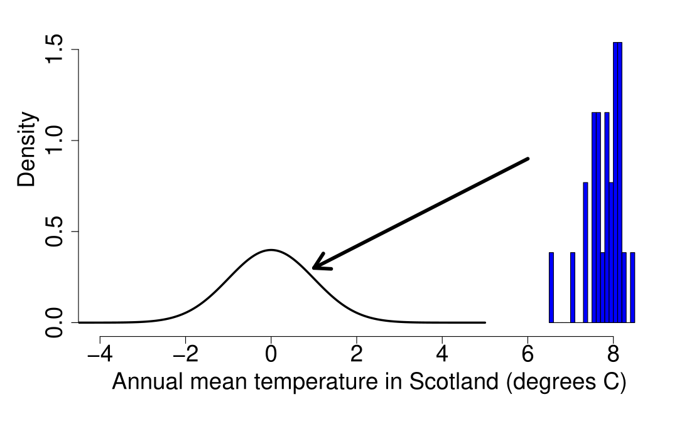
Turning a value into z-score

Slide 24
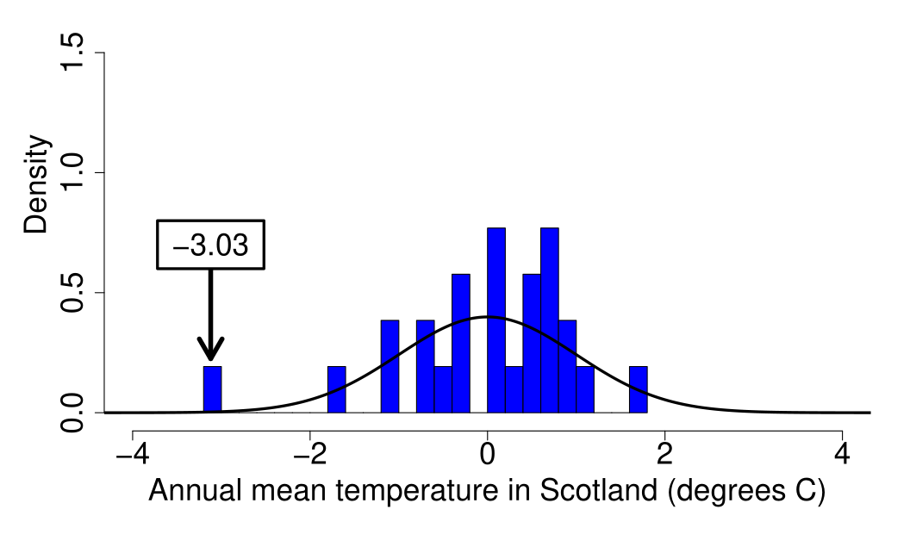
Turning a value into z-score

Slide 25
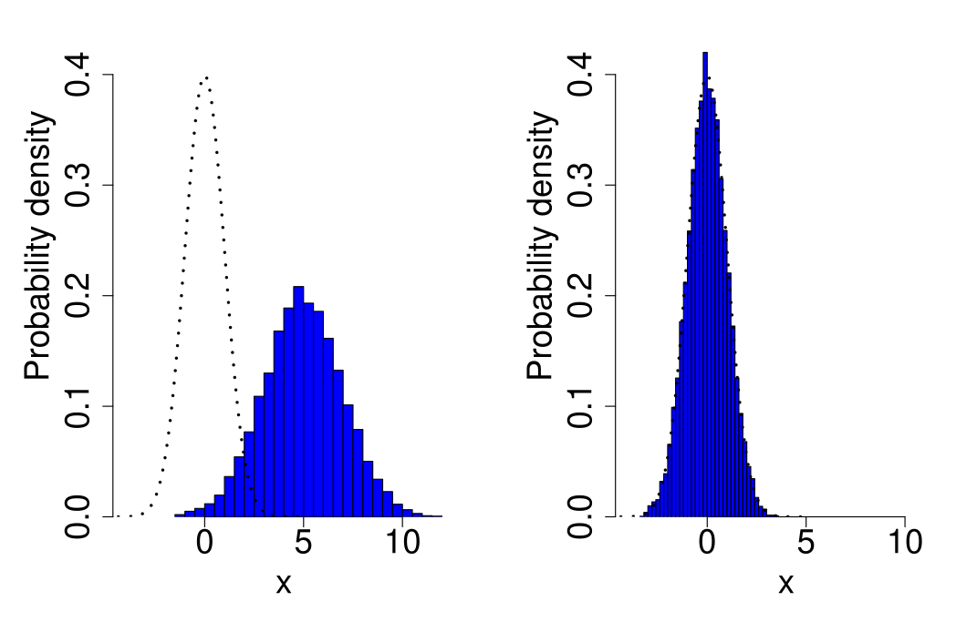
Turning a value into z-score

Slide 26
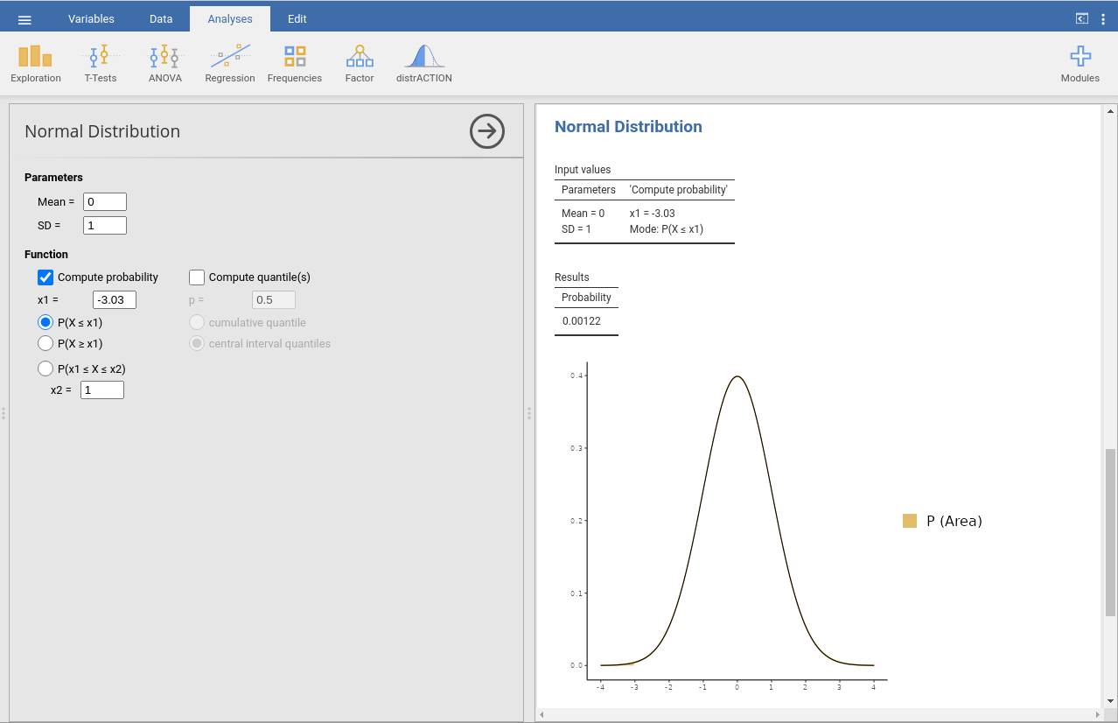
Exploring distributions in jamovi with distrACTION module

