Slide 1
Confidence intervals

Slide 2
Confidence in sampled mean value
How certain are we that our sample mean (x̄) is close to the population mean (μ_{x})?
Should express our uncertainty clearly
Confidence intervals reflect uncertainty of μ_{x}

Slide 3
Confidence in sampled mean value
Confidence in μ_{x}:
High: Mean wing length was x̄ = 7.2 cm ± 0.1
Low: Mean wing length was x̄ = 7.2 cm ± 2.0
Larger ± interval means less confidence in the true mean

Slide 4
Confidence in sampled mean value
Confidence in μ_{x}:
High: Mean wing length was x̄ = 7.2 cm (7.1, 7.3)
Low: Mean wing length was x̄ = 7.2 cm (5.2, 9.2)
Show the lower (7.1) and upper (7.3) confidence interval (CI)

Slide 5
Confidence in sampled mean value
The goal of CIs is to contain uncertainty:
How frequently will the CIs that we draw contain the population mean (μ_{x})?
Logic is again based on repeated resampling

Slide 6
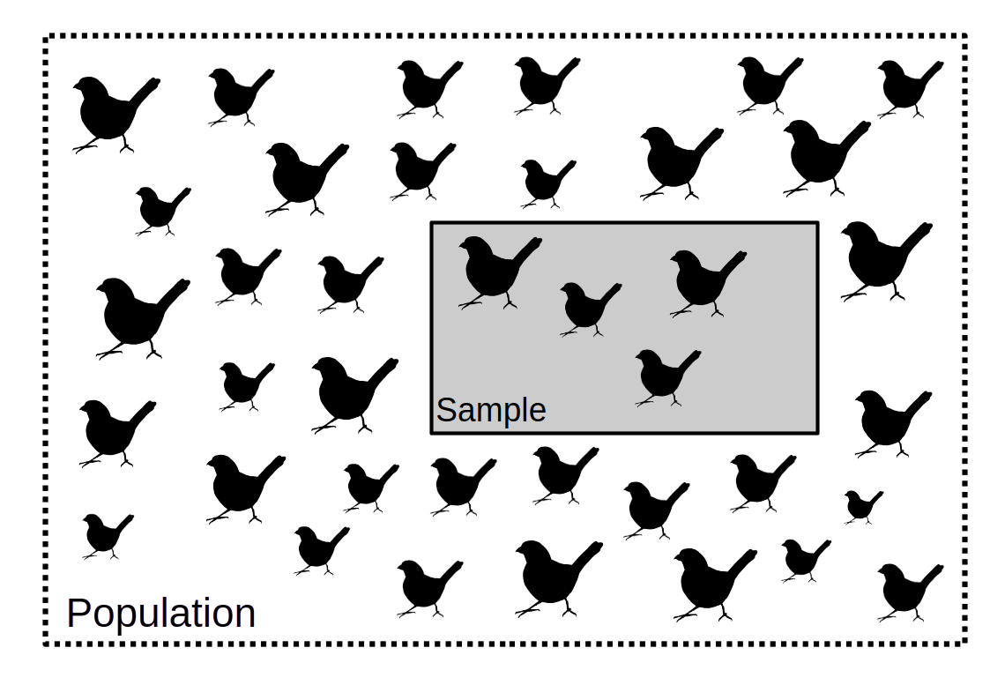
Sampling from a population (confidence intervals)

Slide 7
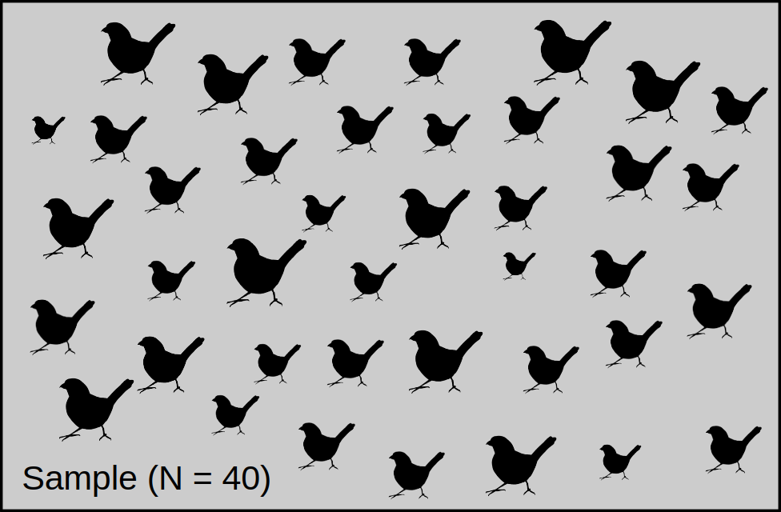
Consider the distribution of a sample of N = 40

Slide 8
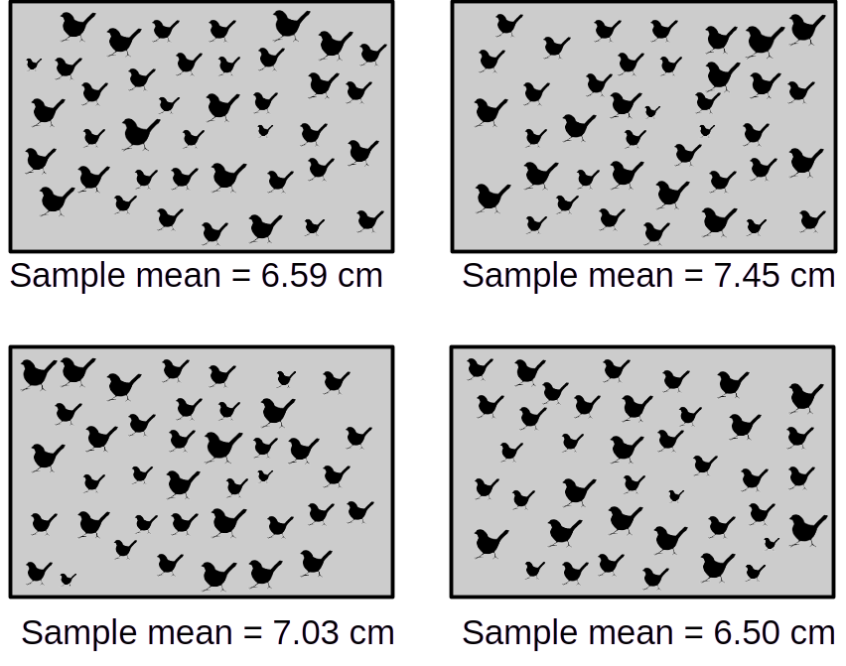
Sample means given true mean of 7.2 when N = 40

Slide 9
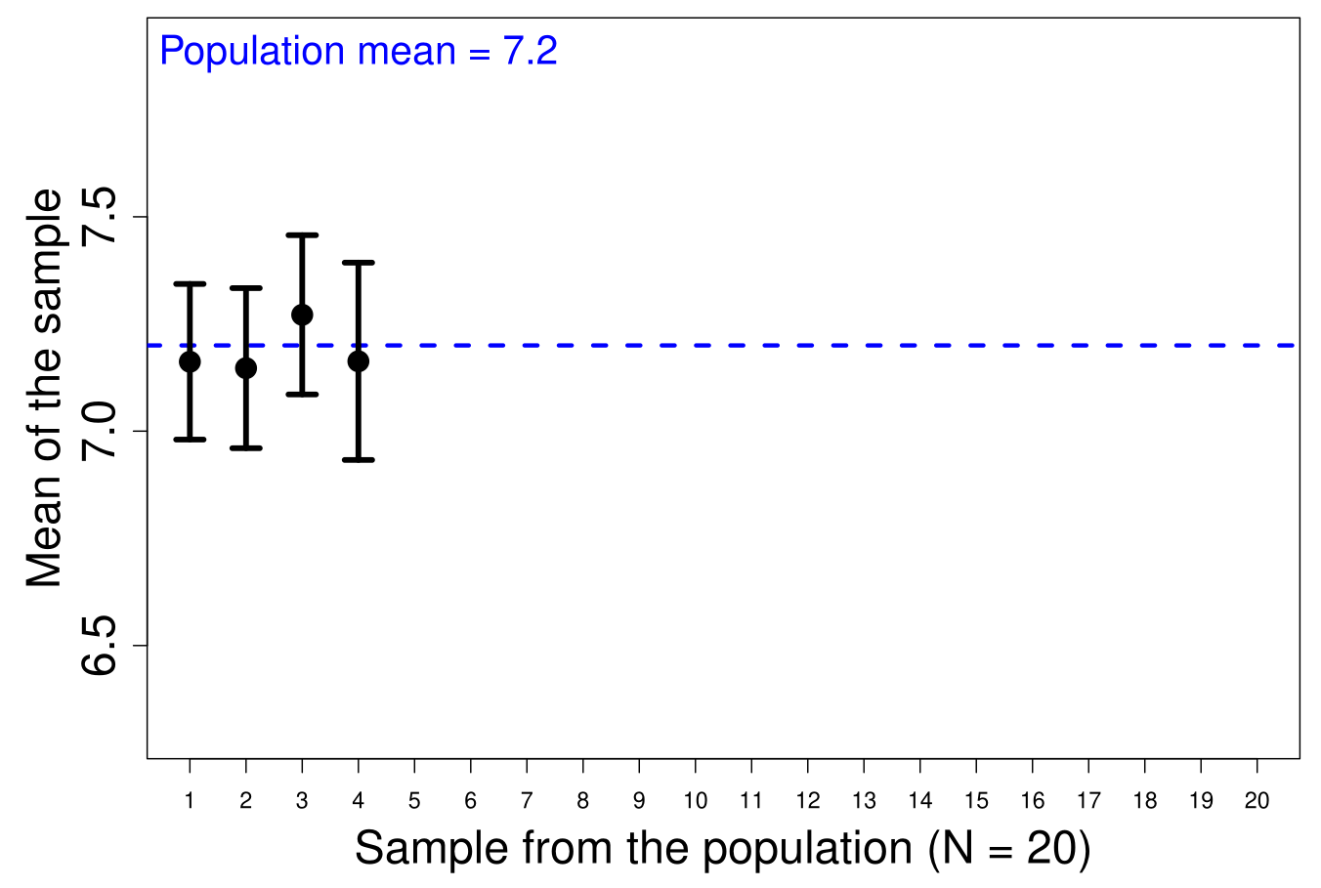
Confidence in a sampled mean value (80%)

Slide 10
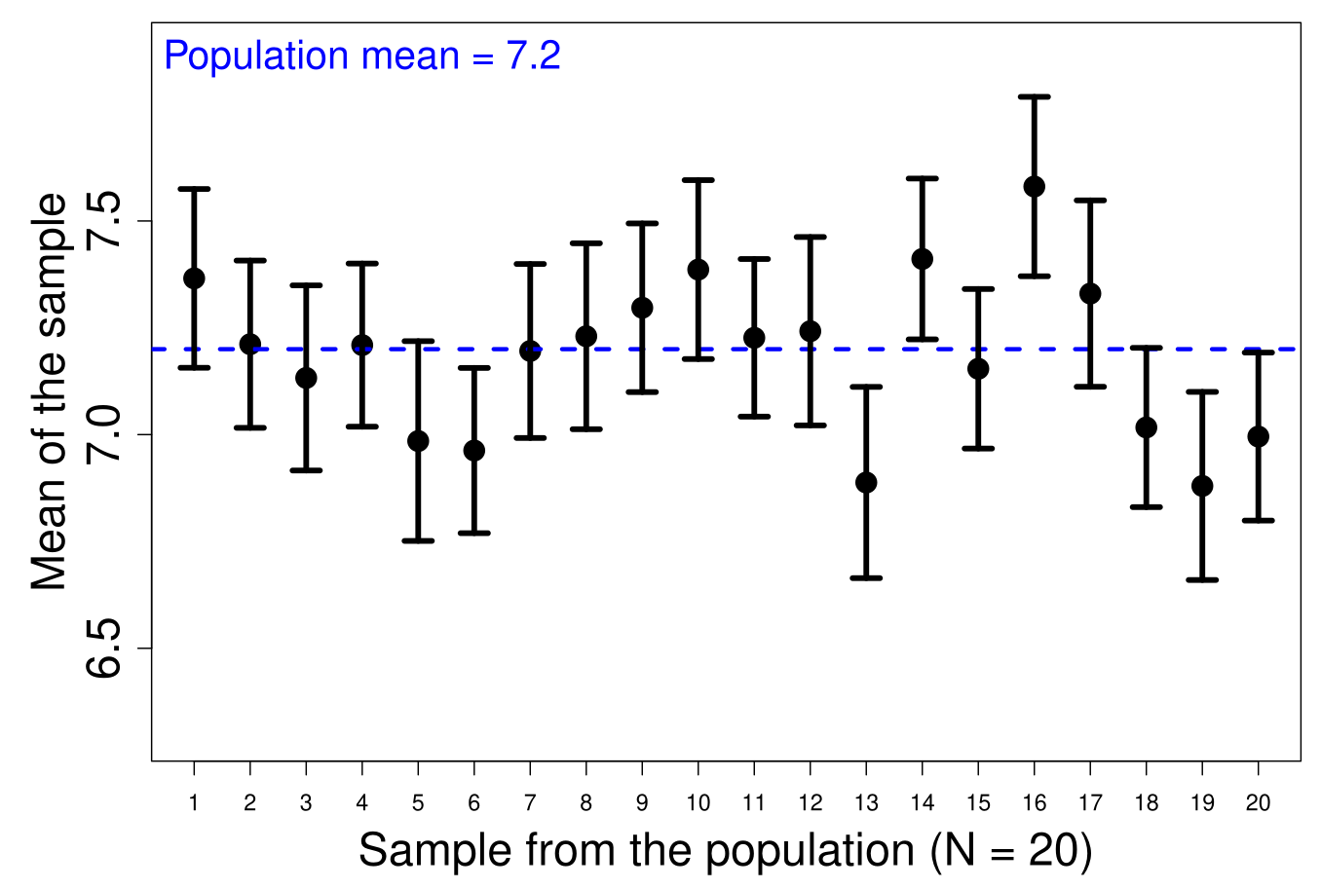
Confidence in a sampled mean value (80%)

Slide 11
Confidence in sampled mean value
The goal of CIs is to contain uncertainty:
How frequently will the CIs that we draw contain the population mean (μ_{x})?
Having higher confidence requires wider intervals

Slide 12
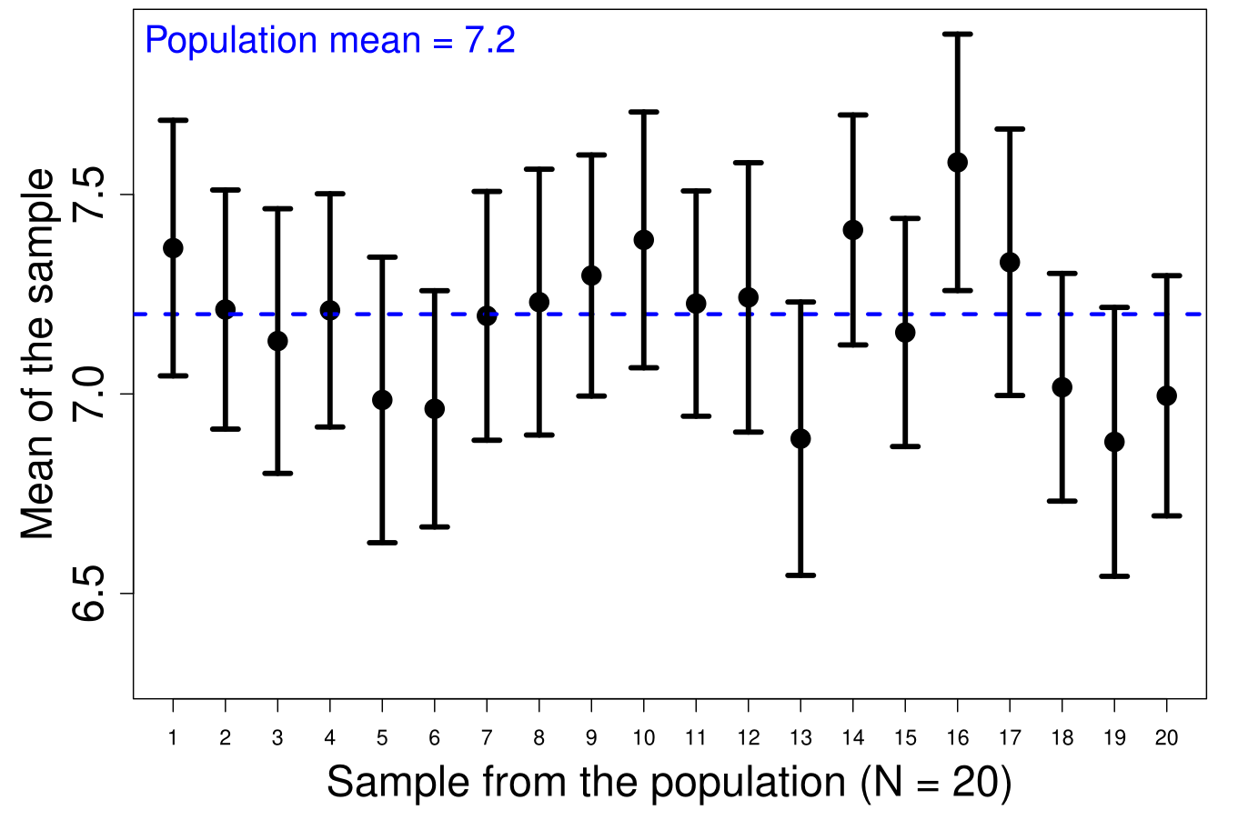
Confidence in a sampled mean value (80%)

Slide 13
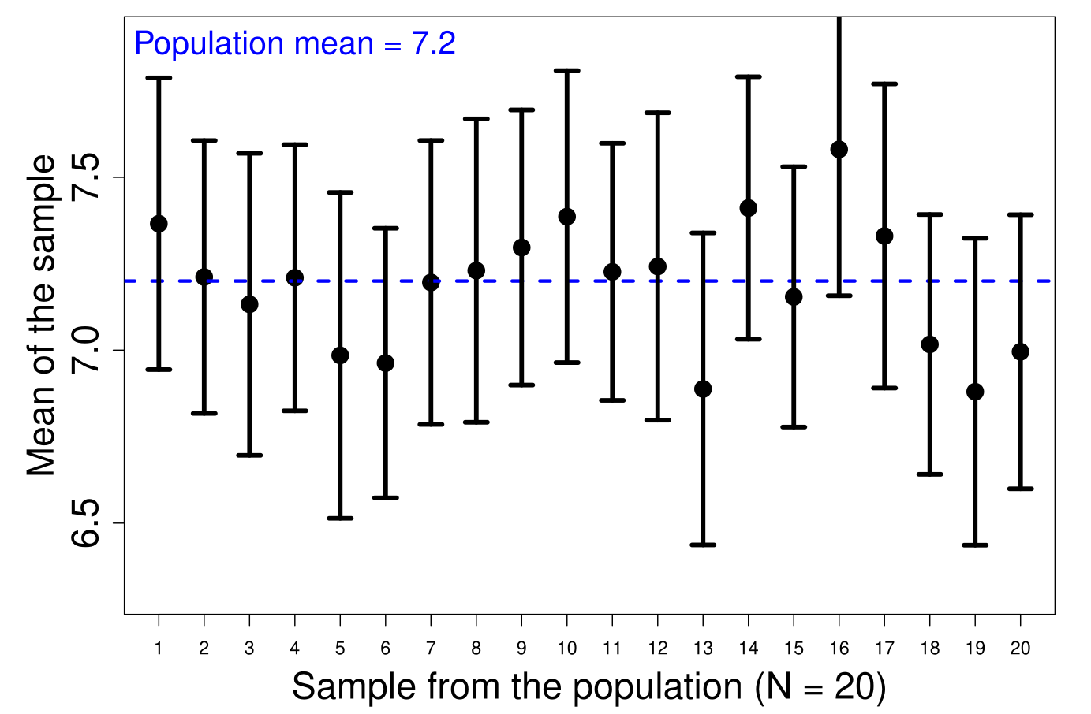
Confidence in a sampled mean value (80%)

Slide 14
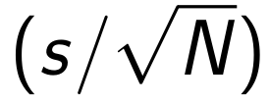
Confidence in a sampled mean value
Tools used to calculate CIs:
Distribution probabilities (e.g., z-scores)
The standard error

Slide 15
Concrete example: mean of 7 temperatures °C
Table 1: Seven values (x) of soil temperature ( °C ) at a site.
x₁ | x₂ | x₃ | x₄ | x₅ | x₆ | x₇
17.1 | 15.2 | 14.9 | 12.6 | 15.2 | 10.3 | 12.7
x̄ = 14
95% Confidence in x̄?

Slide 16
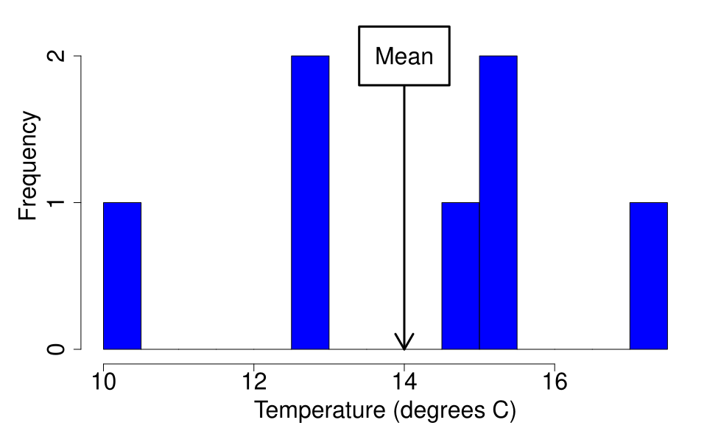
Sample mean could be far off the population mean

Slide 17
Concrete example: mean of 7 temperatures °C
x₁ | x₂ | x₃ | x₄ | x₅ | x₆ | x₇
17.1 | 15.2 | 14.9 | 12.6 | 15.2 | 10.3 | 12.7
x̄ = 14 ± 1.6740
95% CIs: (12.34, 15.67)

Slide 18
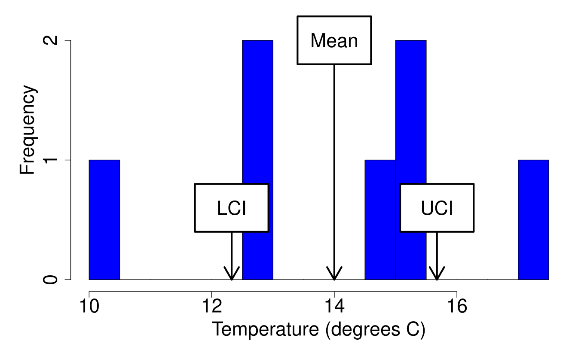
Sample mean could be far off the population mean

Slide 19
What do we actually mean by 95% confidence?
x₁ | x₂ | x₃ | x₄ | x₅ | x₆ | x₇
17.1 | 15.2 | 14.9 | 12.6 | 15.2 | 10.3 | 12.7
If we were to repeat our sample (N = 7) and calculate CIs over and over again, 95% of the time our intervals would contain the population mean (which we cannot know)
Not (quite) the same as 95% probability that the mean is between our CIs

Slide 20
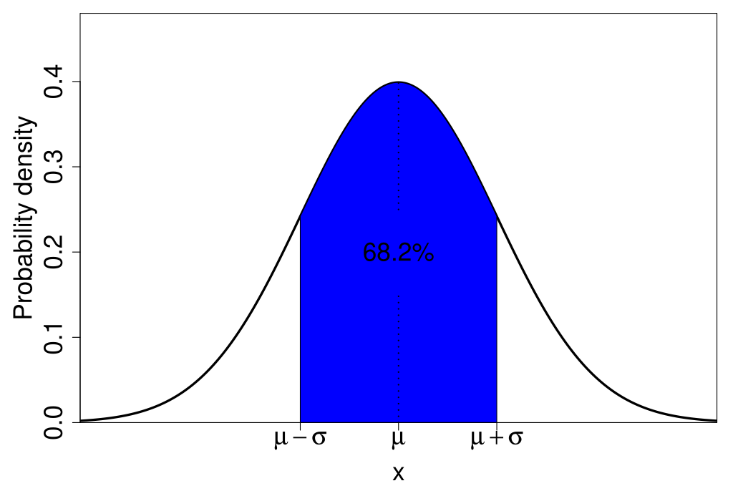
But what are we actually calculating?
https://bradduthie.github.io/stats/app/zandp/

Slide 21
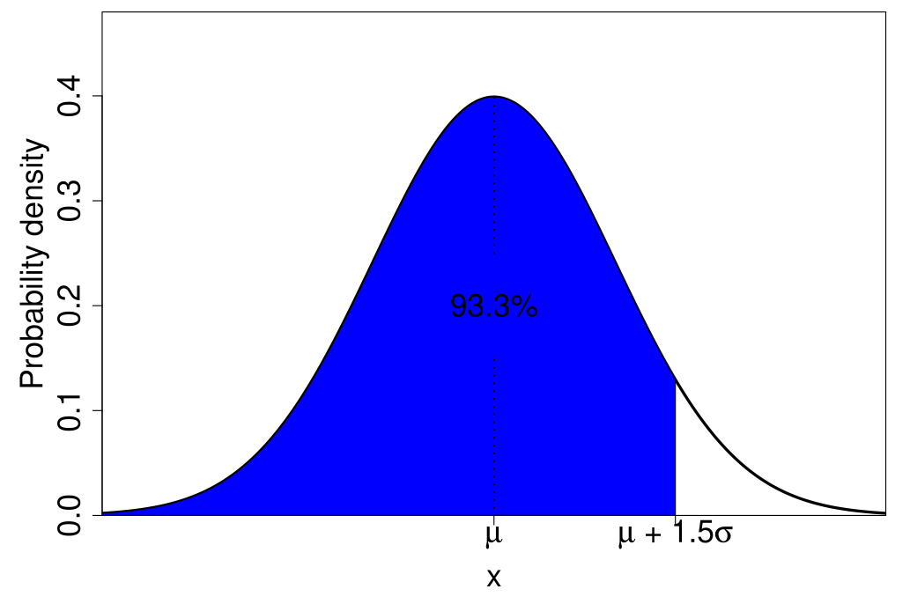
But what are we actually calculating?
https://bradduthie.github.io/stats/app/zandp/

Slide 22
How do we calculate confidence intervals?
General idea: Lower (LCI) and upper (UCI) confidence interval
Verbally
LCI = Mean — (z-score × standard error)
UCI = Mean + (z-score × standard error)
Mathematically
LCI = x̄ - z
UCI = x̄ + z

Slide 23
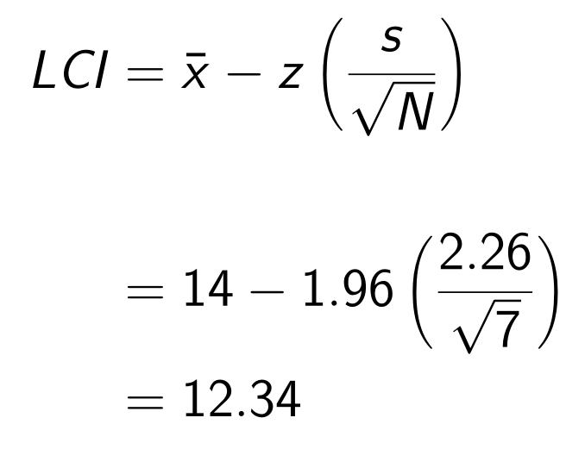
Concrete example: mean of 7 temperatures °C
x₁ | x₂ | x₃ | x₄ | x₅ | x₆ | x₇
17.1 | 15.2 | 14.9 | 12.6 | 15.2 | 10.3 | 12.7
N = 7 x̄ = 14 s = 2.26 z = 1.96

Slide 24
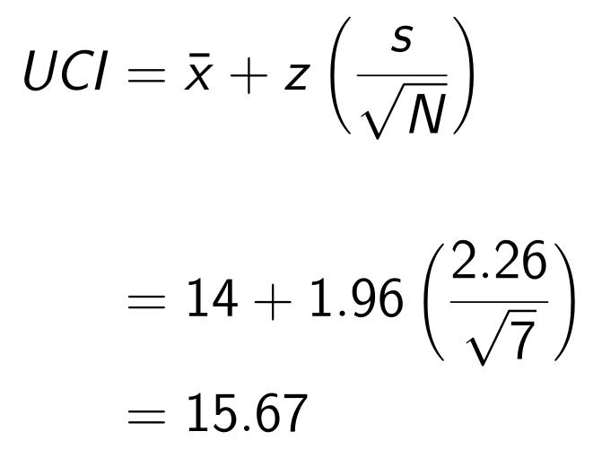
Concrete example: mean of 7 temperatures °C
x₁ | x₂ | x₃ | x₄ | x₅ | x₆ | x₇
17.1 | 15.2 | 14.9 | 12.6 | 15.2 | 10.3 | 12.7
N = 7 x̄ = 14 s = 2.26 z = 1.96

Slide 25
Concrete example: mean of 7 temperatures °C
x₁ | x₂ | x₃ | x₄ | x₅ | x₆ | x₇
17.1 | 15.2 | 14.9 | 12.6 | 15.2 | 10.3 | 12.7
N = 7 x̄ = 14 s = 2.26 z = 1.96
LCI = 12.34 UCI = 15.67

Slide 26
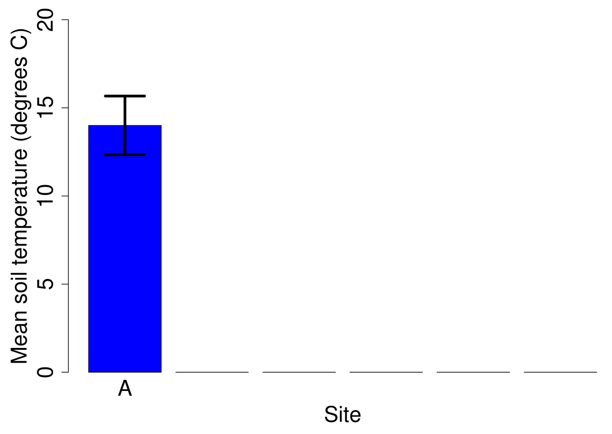
Visualising a confidence interval

Slide 27
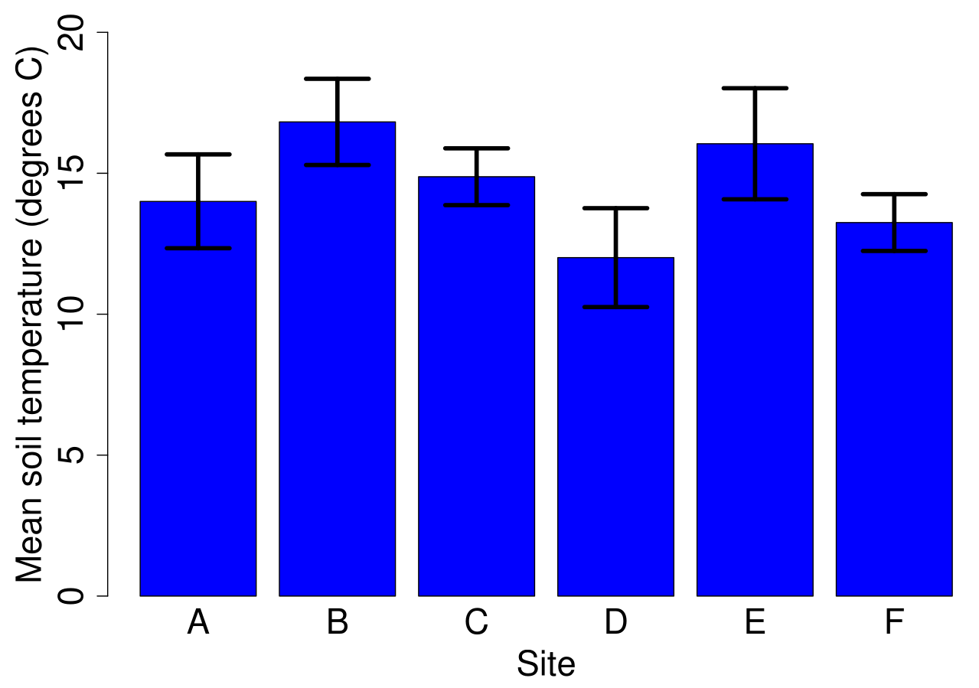
Visualising a confidence interval

Slide 28
Accuracy of confidence intervals
Assumes sample means are normally distributed around the population mean
Applies for high sample size due to central limit theorem
What if assumption is violated?

Slide 29
Confidence intervals of a proportion
What about for proportions?
Player ID | OS | Dam size | Biodiversity
1 | Android | Small | 0
2 | Android | Large | 34
3 | iPhone | Small | 14
4 | Android | Large | 72
5 | iPhone | Medium | 3
CIs around the proportion of Android users?

Slide 30
Confidence intervals of a proportion
Total players: N = 74
56 Android
18 iPhone
Pr(Android) = 56/74 = 0.757
CIs around the proportion of Android users?

Slide 31
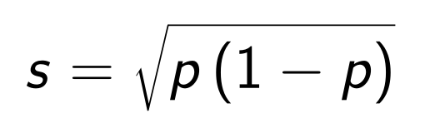
Confidence intervals of a proportion: Wald interval
Assume a normal distribution?
LCI = x̄ - z
UCI = x̄ + z
Standard deviation of a binomial:
p = 56/74 = 0.757

Slide 32
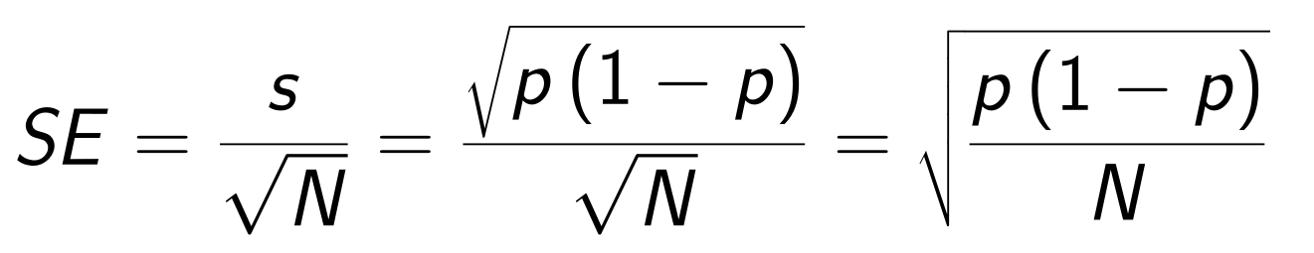
Confidence intervals of a proportion: Wald interval
Assume a normal distribution?
LCI = p – z × SE
UCI = p + z × SE
Standard deviation of a binomial:

Slide 33
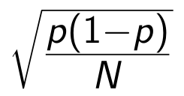
Confidence intervals of a proportion: Wald interval
Assume a normal distribution?
LCI = p – z × SE
UCI = p + z × SE
Standard deviation of a binomial:
LCI = p – z ×
UCI = p + z ×

Slide 34
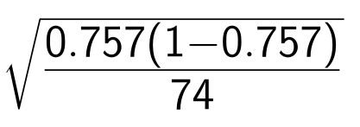
Confidence intervals of a proportion: Wald interval
Assume a normal distribution?
LCI = p – z × SE
UCI = p + z × SE
Standard deviation of a binomial:
LCI = 0.757 - 1.96
UCI = 0.757 + 1.96

Slide 35
Confidence intervals of a proportion: Wald interval
Assume a normal distribution?
LCI = p – z × SE
UCI = p + z × SE
Standard deviation of a binomial:
LCI = 0.659
UCI = 0.855

Slide 36
Confidence intervals of a proportion: Wald interval
Assume a normal distribution?
Wald interval is often inaccurate
Problematic when p near 0 or 1
Other ways to calculate proportion CIs
Compare methods with simulated data
Clopper-Pearson method used by jamovi
Clopper-Pearson wider than necessary
Based on the binomial distribution

Slide 37
A bigger problem with the normal distribution and CIs
Assuming we know population standard deviation (σ)
Only have sample estimate, s
Need to account for this uncertainty
Normal distribution will be biased
t-distribution will correct for bias

