Slide 1
Introduction to Correlation

Slide 2
Introduction to correlation
We often want to investigate the relationship between pairs of variables.
Vegetation height and mean annual temperature
Animal body size and metabolic rate
Number of automobiles in a location and carbon emissions
The correlation between pairs of variables, such as those listed above, describes how the variation of each variable is related to the other variable.

Slide 3
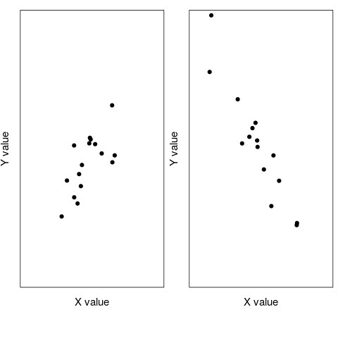
Introduction to correlation
Two plots of hypothetical variables illustrating a positive (left) and negative correlation

Slide 4
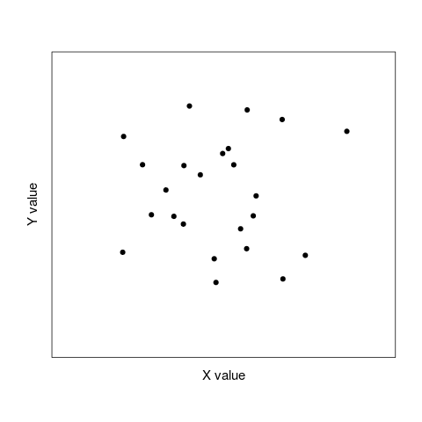
Introduction to correlation
A plot of two hypothetical variables that are not correlated

Slide 5
Introduction to correlation
Formalised with the correlation coefficient (r)
Provides a statistical measure of strength and direction of correlation
Only describes association between variables (not cause and effect)
The value r ranges between -1 and 1
Negative numbers indicate a negative correlation
Positive numbers indicate a positive correlation
Avalue of zero indicates no correlation
We can get a more intuitive understanding of the correlation coefficient with this application

Slide 6
Introduction the correlation coefficient equation
Here we will consider the Pearson product-moment correlation coefficient.
Several equations are to follow
Will walk through them step by step
Explain each step verbally
Relate the equation back to previous material
You will not need to memorise any of the equations you see here, but you should be able to recognise and understand the equation for the correlation coefficient.

Slide 7


How is the correlation coefficient defined?
The covariance between two variables X and Y, Cov(X, Y), divided by the standard deviation of X times the standard deviation of Y,
But what is Cov(X, Y), exactly?
Let's break this down a bit further!

Slide 8
What is the covariance?
The covariance between two variables X and Y, Cov(X, Y), divided by the standard deviation of X times the standard deviation of Y,
But what is Cov(X, Y), exactly?
Let's break this down a bit further!

Slide 9
What is the covariance?
Assume 'x' is bird length and 'y' is bird mass. How would we calculate this, explained verbally?
1. For each bird, calculate its length minus mean bird length
2. For each bird, calculate its mass minus mean bird mass
3. Multiply the two steps above together
4. Do the above for all birds, and add up all the values
5. Divide what you added up by the total number of birds
This is the numerator part of the correlation coefficient

Slide 10


Back to the definition of the correlation
Now we can expand that covariance
We already know the formula for standard deviation

Slide 11

The Pearson's correlation coefficient

Slide 12
Testing whether or not a correlation is significant
Null Hypothesis: There is no correlation between two variables X and Y
Alternative Hypothesis: There is a correlation between two variables X and Y
Degrees of Freedom: Number of data points minus two (lose a degree of freedom for calculating each mean)
To test whether or not to reject the null hypothesis, we can obtain a p-value in SPSS or use a table of critical values to look up the value of r for a specific degrees of freedom

Slide 13
Testing whether or not a correlation is significant
We often want to test whether or not the correlation between two variables is significant
Test of Pearson product moment correlation assumes variables are normally distributed
Test of Spearman's rank correlation coefficient (i.e., correlation of ranks) does not assume normality
To test whether or not two variables are correlated, we first must test the null hypothesis that the two variables are normally distributed.

Slide 14
A data set of soil depths and root densities
Sample number | Soil depth (m) | Root density (g per m^3)
1 | 0.8 | 13
2 | 2.0 | 8
3 | 2.3 | 4
4 | 2.7 | 6
5 | 0.5 | 18
6 | 1.8 | 7
7 | 1.5 | 9
8 | 2.1 | 3
9 | 1.2 | 7
10 | 1.1 | 10
In the above table, soil depth is measured in metres and root density is measured in grams per cubic metre.

Slide 15
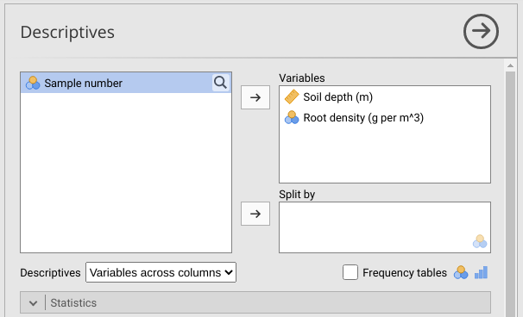
Testing for normality in jamovi
Select 'Exploration > Descriptives', then move both variables to the Variables list. Select 'Shapiro-Wilk' from the statistics pulldown
Figure 1: Jamovi input for testing normality

Slide 16
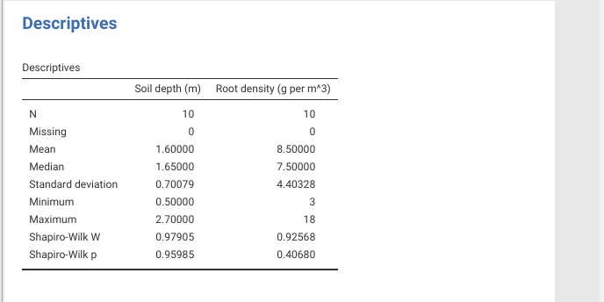
Testing for normality in jamovi
Below shows the output of the tests for normality in jamovi.
Figure 2: Jamovi output for tests of normality on two variables.

Slide 17
Plotting soil depth versus root density in Jamovi
How to make a scatterplot in jamovi
Select 'Exploration > Scatterplot'
A panel will pop up with the dataset variables
Move 'Soil depth (m)' to 'X-Axis'
Move Root density (g per m^3) to 'Y-Axis'

Slide 18
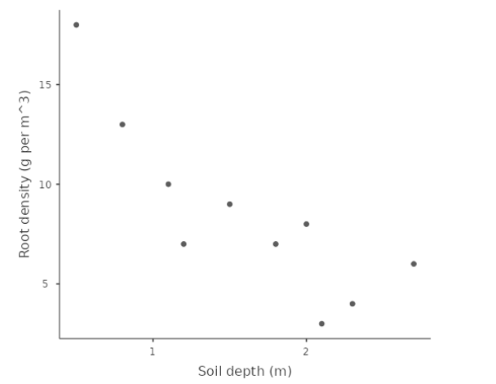
Plotting soil depth versus root density in jamovi
Figure 3: Jamovi output of a scatterplot for Soil Depth vs Root Density

Slide 19
Testing whether soil depth and root density are correlated
Test whether or not our variables soil depth and root density are correlated.
Hypothesis for Pearson's correlation coefficient
Null: There is no correlation between root density and soil depth
Alternative: There is a significant correlation between root density and soil depth
We will reject the null hypothesis if, assuming that the null hypothesis is true, the probability of getting an r value as or more extreme than the one we obtained from our sample (i.e., the p-value) is less than or equal to 0.05.

Slide 20
Testing whether soil depth and root density are correlated
Test the null hypothesis that this correlation is not significant
Selecting 'Regression > Correlation Matrix'
Move both variables into the box to the right
Make sure 'Pearson' selected for Correlation Coefficients
Test 'Correlation' (two-tailed test for statistical significance

Slide 21
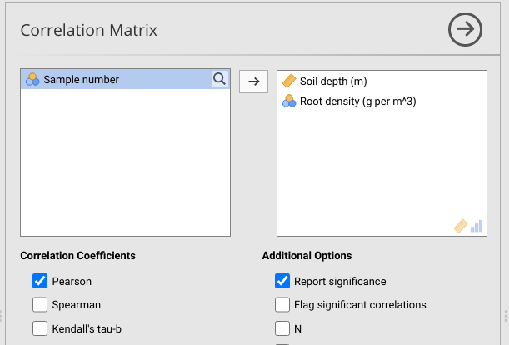
Testing whether soil depth and root density are correlated
Figure 4: Jamovi box showing how to run a test of the correlation coefficient.

Slide 22
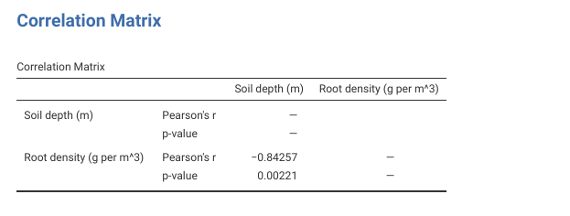
Testing whether soil depth and root density are correlated
A table of output that looks like the one below.
Figure 5: Jamovi table showing output of a parameteric test of the significance of a correlation coefficient.

Slide 23
Spearman rank correlation coefficient
If either variable is not normally distributed, we need a non-parametric test
The Spearman rank correlation coefficient is a non-parametric alternative.
Calculate the correlation of the ranks of the values
Test whether this Spearman rank correlation coefficient is significant
Consider some measurements of per cent dissolved oxygen and ammonia concentration (in mg per litre) from eight locations in Scotland.

Slide 24
A data set of soil depths and root densities
Sample | %O_2 | Rank %O_2 | NH_3 Conc. | Rank NH_3 Conc.
1 | 95.9 | 8 | 0.080 | 2
2 | 81.9 | 3 | 0.100 | 3
3 | 80.9 | 2 | 0.210 | 6
4 | 77.9 | 1 | 0.579 | 8
5 | 90.7 | 6 | 0.250 | 7
6 | 88.2 | 4 | 0.130 | 5
7 | 93.6 | 7 | 0.070 | 1
8 | 89.1 | 5 | 0.121 | 4

Slide 25
Testing whether per cent O₂ and Ammonia are correlated
Test whether or not our variables per cent O₂ and Ammonia concentration are correlated.
Hypothesis for Spearman's correlation coefficient
Null: There is no correlation between per cent dissolved oxygen and ammonia concentration
Alternative: There is a significant correlation between per cent dissolved oxygen and ammonia concentration
We will reject the null hypothesis if, assuming that the null hypothesis is true, the probability of getting an r value as or more extreme than the one we obtained from our sample (i.e., the p-value) is less than or equal to 0.05.

Slide 26
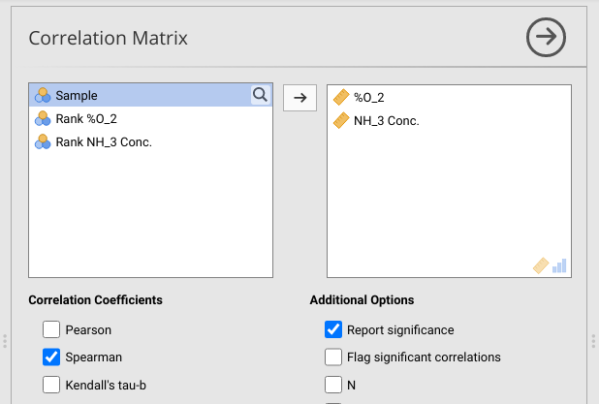
Testing whether per cent O₂ and Ammonia are correlated
Figure 6: Jamovi box showing how to run a test of the Spearman rank correlation coefficient.

Slide 27
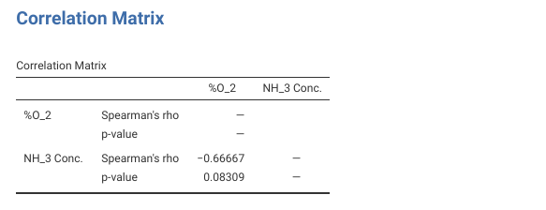
Testing whether per cent O₂ and Ammonia are correlated
Spearman rank correlation coefficient between the variables per cent dissolved oxygen and ammonia concentration is -0.667, and the p-value for this test is 0.083, meaning that we cannot reject our null hypothesis that the two variables are uncorrelated.
Jamovi output table showing output of a test of the significance of a Spearman rank correlation coefficient.

