Slide 1
Regression

Slide 2
Introduction to regression
In regression, our objective is to understand some dependent variable Y based on an independent variable X. Regression is a tool for predicting the value of Y as a function of X. We can use this tool to do the following,
Support hypotheses of causation of changes in y values due to changes in x values
Predict y values as a function of x values
To explain the variation of y values using x values
Regression analysis can be used to support causal hypotheses, but it cannot, by itself be used to determine causality.

Slide 3
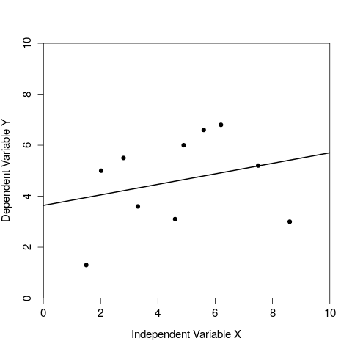
Visualising a regression of y values against x values
Figure 1: A regression of one dependent variable y against the independent variable x.

Slide 4
Regression includes independent and dependent variables
It is critical to correctly distinguish between the independent and dependent variables.
Independent variable (X) is free to vary
Dependent variable (Y) is predicted to change given a change in the independent variable
Different results will be obtained if the two variables are confused
In an experiment, the independent variable is something that we as researchers have control over (e.g., amount of fertiliser to put down on a field), whereas the dependent variable is something that we would measure when collecting our data (e.g., total crop yield of the field).

Slide 5
Regression line
The line of best fit in a regression can be described mathematically with a simple equation,
y = a + bx
This equation includes the variables x and y, and two coefficients
a is the intercept; the value of y that is predicted when x = 0
b is the slope; how much y changes for a change one unit of x
Note that data points rarely will sit right on the regression line. The residual is defined by the difference between the measured value of y (i.e., the data point) and the y value predicted by the regression line (i.e., the vertical distance between the data point and the line).

Slide 6
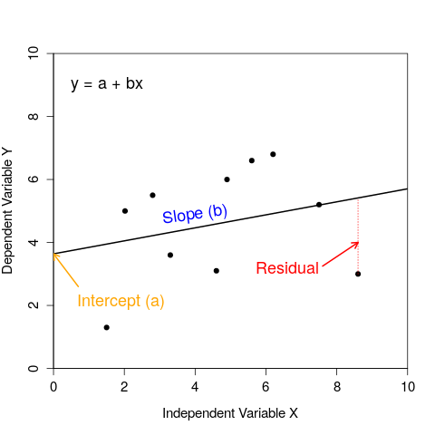
Visualising a regression of y values against x values
Figure 2: A regression of one dependent variable y against the independent variable x.

Slide 7
How do we decide what is the best fit line?
Now we can turn to how we calculate where the regression line should be through our data.
How do we know what our intercept (a) and slope (b) should be?
Use the method of least squares regression
Minimise the sum of squares of all the residual values
To get an intuitive sense for how the regression line minimises the sum of squares, use this interactive application to adjust the slope and intercept to try to find the line of best fit (it will turn blue when you succeed).

Slide 8
Assumptions of regression
Regression is a widely used, but also often misused, statistical technique. It is important to be aware of the assumptions underlying linear regression.
The independent variable x is measured without error
The relationship between X and Y is linear
For any value of X, Y is normally distributed
For all values of X, the variance of the residuals is identical
Note that even if our assumptions are not perfectly met (indeed, they rarely if ever will be), this does not completely invalidate the method of linear regression. But large violations of one or more of these assumptions might indeed be problematic.

Slide 9
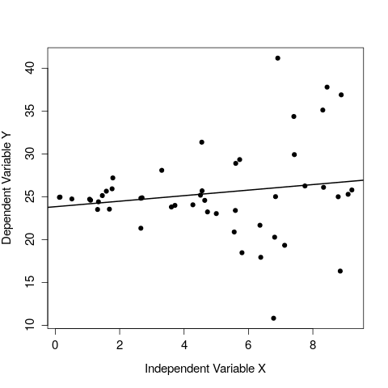
Assumptions of regression
Figure 1: A regression of one dependent variable y against the independent variable x in which there is clear heteroscedasticity.

Slide 10
How good is the fit of our model?
We often want to know how well a regression line fits to the data.
Coefficient of determination (R²)
R² tells us how much of the variation in y is explained by the regression equation
E.g., if R² = 0.83, then 83% of the variation in y is accounted for by the fitted regression line
Visually, how tightly the data points in a scatterplot fit to the regression line
See the examples below of four different R² values to see what this looks like.

Slide 11
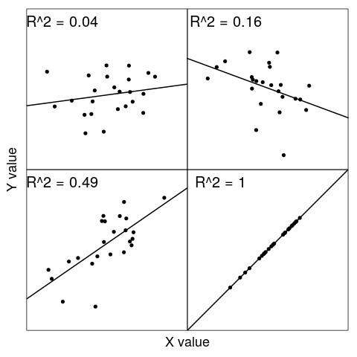
Scatterplots of different coefficients of determination
Figure 1: Four sample regressions showing different coefficients of determination

Slide 12

More understand of the coefficient of determination
Understanding that the coefficient of determination tells us how much variation in y is explained by the regression equation is the important point.
Coefficient of determination compares the sum of squared residuals from the linear model (SS_{res}) to what the sum of squared residuals would be if we had just use the mean value of y (SS_{tot}).
Conveniently, R² is also just the Pearson product moment correlation (r) squared.

Slide 13
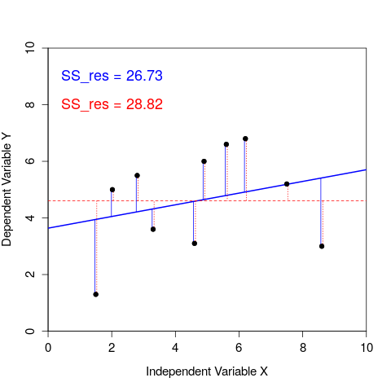
Visualising the coefficient of determination
Figure 2: A regression of one dependent variable y against the independent variable x. Blue vertical lines show residuals of the linear model, while red dotted vertical lines show residual deviations of from the mean of y.

Slide 14
The F-test of overall significance
Test the significance of our overall regression model using an F-test of overall significance
Determines whether or not our linear regression provides a better fit to the data than a model that does not contain any independent variables
Hypothesis for F-test of overall significance of a linear model
Null: The model with no independent variables fits the data as well as the linear model
Alternative: The linear model fits the data better than the model with no independent variables
Understand is how to interpret the F-test of overall significance

Slide 15
The F-test of overall significance
Test the significance of individual parameters in the linear model (β₀ and β₁; recall that y = β₀ + β₁x).
For both coefficients β₀ and β₁, we can state the null and alternative hypotheses
Hypothesis for coefficient of a linear model
Null: The value of the coefficient equals 0.
Alternative: The value of the coefficient does not equal 0.
Statistical software such as jamovi will calculate p-values to test our null hypothesis for both β₀ and β₁ coefficients. Lecture notes include the details of how this is done (you do not need to know these details).

Slide 16
Assessing the practical validity of regression
The practical validity of the regression model is assessed by comparing the predicted values with the observed data. We can do this in several ways:
Plotting the fitted regression line and checking that the observed data lie close to the line (i.e., high coefficient of determination).
Plotting observed versus predicted values and observing a linear relationship between the independent and dependent variable.
Examining the data for large residuals (i.e., outliers), which might be distorting the regression line.
Ideally, test the regression model on new observational data to examine how close the predicted values are to the observations

Slide 17
Prediction with linear regression
Regression equations can be used to calculate additional y values when values of x are substituted in a regression equation.
Interpolation: Predictions made within the measurement range of the data
Extrapolation: Predictions made outside the measurement range of the data
Care should be taken when extrapolating beyond the measured data because the relationship between the two variables might change.

Slide 18
Scatterplots of different coefficients of determination
Figure 3: A regression of one dependent variable y against the independent variable x.

