Slide 1
Multiple regression

Slide 2
Introduction to multiple regression
Often more than one variable is required to explain variation in a dependent variable.
Soil infiltration rates depend on rainfall intensity and soil moisture content
Carbon emissions depend on the number of automobiles and the number of trees in a location
Multiple regression can be used to differentiate between the effects of variables and to ascertain which factors are most important.

Slide 3
Introduction to multiple regression
Multiple regression models the change in the dependent variable y when more than one independent variable has a significant influence,
y = b₀ + b₁x.
In the simple linear regression above,
Predict y from the intercept (b₀), one independent variable (x) and a slope (b₁).
Change in x corresponds to a change of b units in y.

Slide 4
Introduction to multiple regression
Equation for multiple regression with two independent variables,
y = b₀ + b₁x₁ +b₂x₂.
Extended to any number of k independent variables,
y = b₀ + b₁x₁ + b₂x₂ + ... + b_{k}x_{k}.

Slide 5
Introduction to multiple regression
Equation for multiple regression with two independent variables,
y = b₀ + b₁x₁ +b₂x₂.
Extended to any number of k independent variables,
y = b₀ + b₁x₁ + b₂x₂ + ... + b_{k}x_{k}.

Slide 6
Adjusted coefficient of determination
The proportion of variation in y explained by a model can only increase with independent variables.
New independent variables cannot explain negative variation
Random variables will explain some variation by chance
Need to account for spurious improvement of fit
Want to retain only relevant predictors in a model
To help account for spurious improvement of fit, we can use an adjusted R squared.

Slide 7
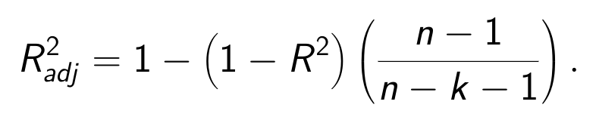
Adjusted coefficient of determination
An adjusted R squared value,
R is the coefficient of determination
k is the number of independent variables in the model
n is the number of samples

Slide 8

Multiple regression in SPSS
In 1993, monthly amounts of nitrate (as tonnes of nitrogen) were measured in the River Thames, together with mean daily evaporation and rainfall (in mm) for 12 months of the year.
We wish to examine if evaporation and rainfall can be used to predict nitrate amounts in the river.
Image: Public Domain

Slide 9
Multiple regression in SPSS
Month | Nitrogen_(tonnes) | Evaporation_(mm) | Rainfall_(mm)
Jan | 22 | 0.3 | 2.1
Feb | 26 | 0.4 | 1.5
Mar | 27 | 0.9 | 2.0
Apr | 18 | 1.9 | 1.5
May | 12 | 2.7 | 1.7
Jun | 9 | 3.3 | 1.9
Jul | 7 | 3.4 | 1.5
Aug | 6 | 3.4 | 1.4
Sep | 7 | 2.3 | 1.7
Oct | 8 | 1.2 | 1.9
Nov | 12 | 0.5 | 2.4
Dec | 21 | 0.3 | 2.2

Slide 10
Fitting the full model
Include both evaporation and rainfall as independent variables.
Nitrogen = b₀ + b₁Evaporation + b₂Rainfall.
Select 'Regress', then 'Linear regression' from pulldown menu.

Slide 11
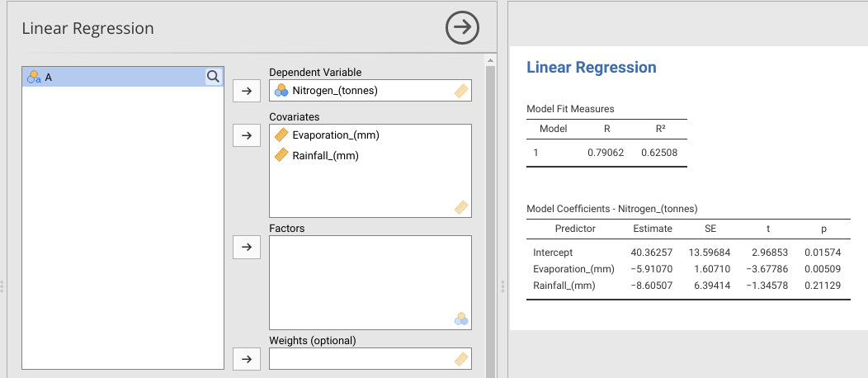
Fitting the full model

Slide 12
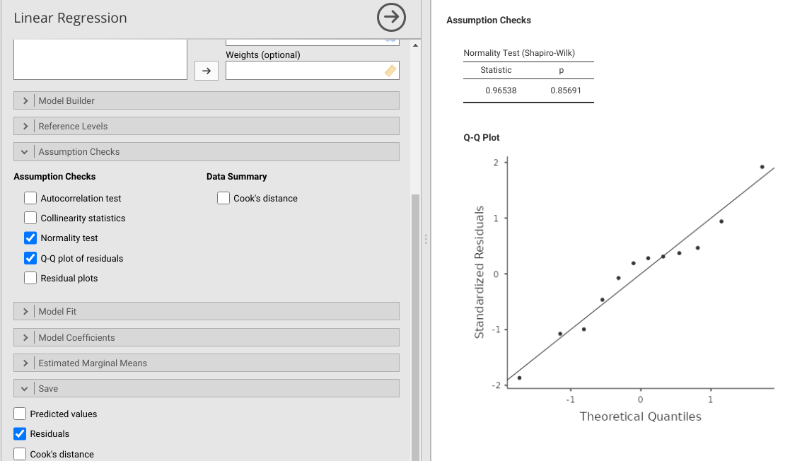
Check model assumptions

Slide 13
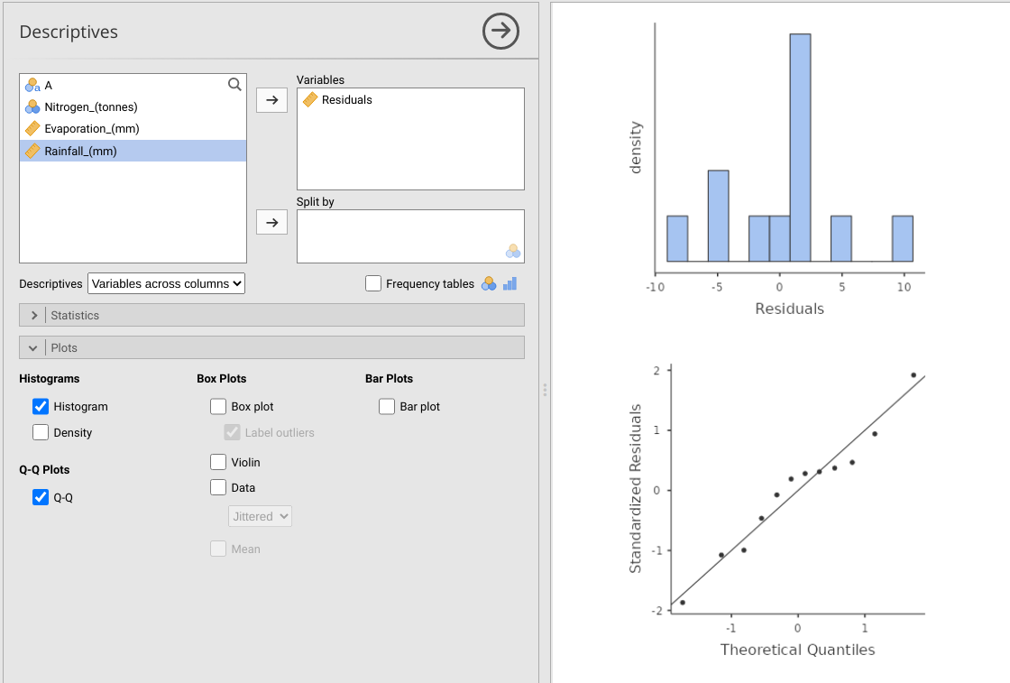
Check model assumptions

Slide 14
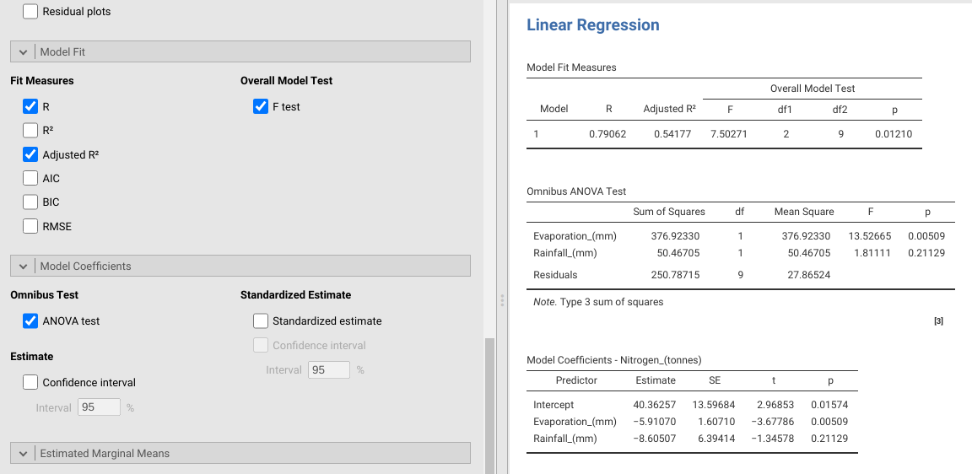
Model output

Slide 15
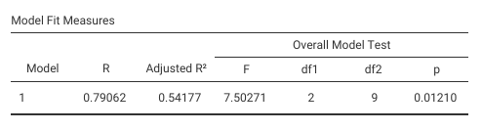
Model output: Overall and adjusted R-squared

Slide 16
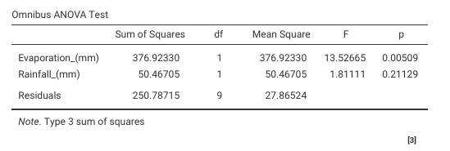
Model output: Omnibus

Slide 17
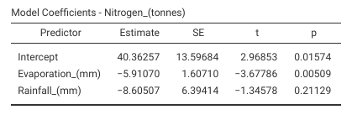
Check model assumptions

Slide 18
Conclusions from the multiple regression model
According to the multiple regression
Overall model is significant
High R-squared value
Evaporation has a significant effect
Rainfall does not have a significant effect
There is a relationship between evaporation and nitrogen, but not rainfall and nitrogen.

