Slide 1
The Traveling Salesman: Intelligent Brute Force Branch &Bound
Brad Catlett-Rossen
Michael Weidemann

Slide 2
Summary
Travelling salesman problem
There are n cities connected by roads
Find the shortest path to visit all of the cities once
All Pairs Shortest Path
Given a table of intersection points and distances to their directly accessible neighbors
Find the shortest paths between all nodes
Extract all the nodes needed from resulting table

Slide 3
TSP Algorithm Approaches: Brute Force
Start with first possible path and continue from there while all permutations are exhausted
Check all permutations and keep track of the best path found
Pros:
Uses very small amount of memory
Cons:
Requires the checking of all possible solutions

Slide 4
TSP Algorithm Approaches: Branch and Bound
Branch and bound
Steps:
At each iteration, remove the best candidate of all nodes explored so far and expand it
Calculate the lower bound of expanded node’s children
Recursively call BranchAndBound function on them if they have a better lower bound than the lowest so far
Pros:
Doesn’t waste cycles exploring nodes that aren’t the best current lead
Cons
Huge memory usage If nodes are not properly pruned from the node tree

Slide 5
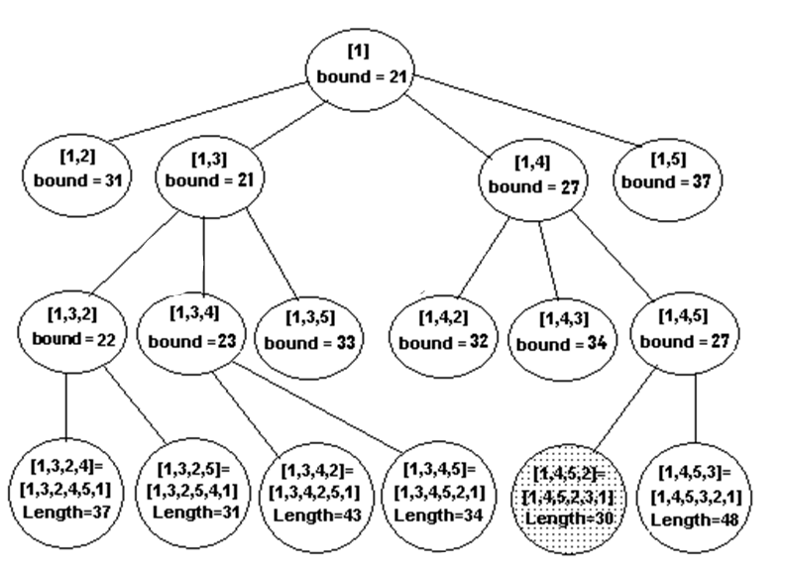
Branch And Bound Illustration

Slide 6
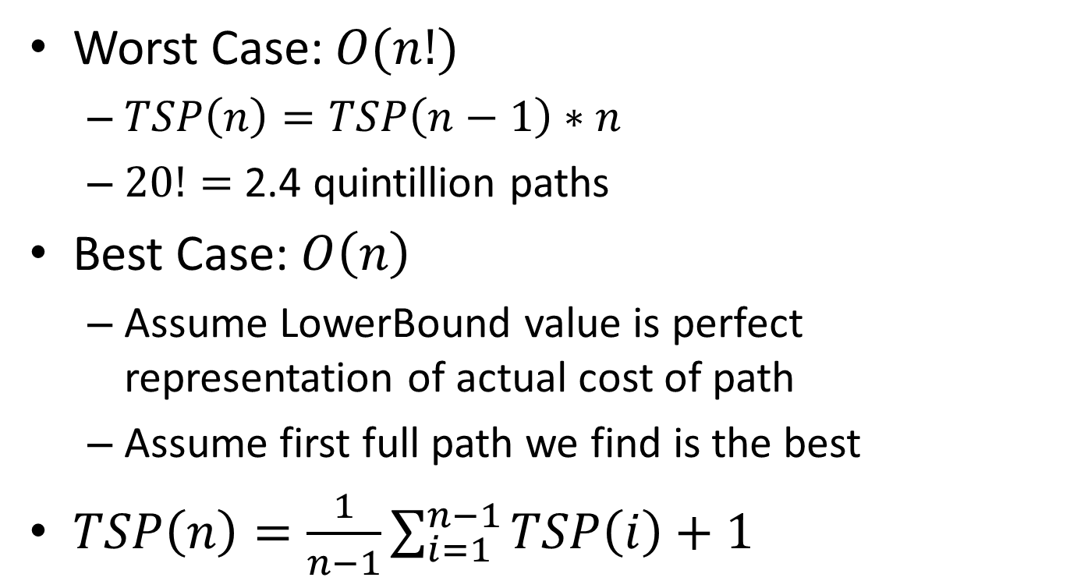
Analysis
Worst Case: $O(n!)$
$TSP\left(n\right)=TSP\left(n−1\right)∗n$
$20!=$ 2.4 quintillion paths
Best Case: $O\left(n\right)$
Assume LowerBound value is perfect representation of actual cost of path
Assume first full path we find is the best
$TSP\left(n\right)=\frac{1}{n−1}\sum_{i=1}^{n−1}{TSP\left(i\right)+1}$

Slide 7
What went right/wrong?
Data Collection using Google Maps
Few human errors on All Pairs
Memory issues with Branch and Bound
Due to the shear number of possible paths, the algorithm takes a while to complete
The algorithm still found better solutions to the original route

Slide 8
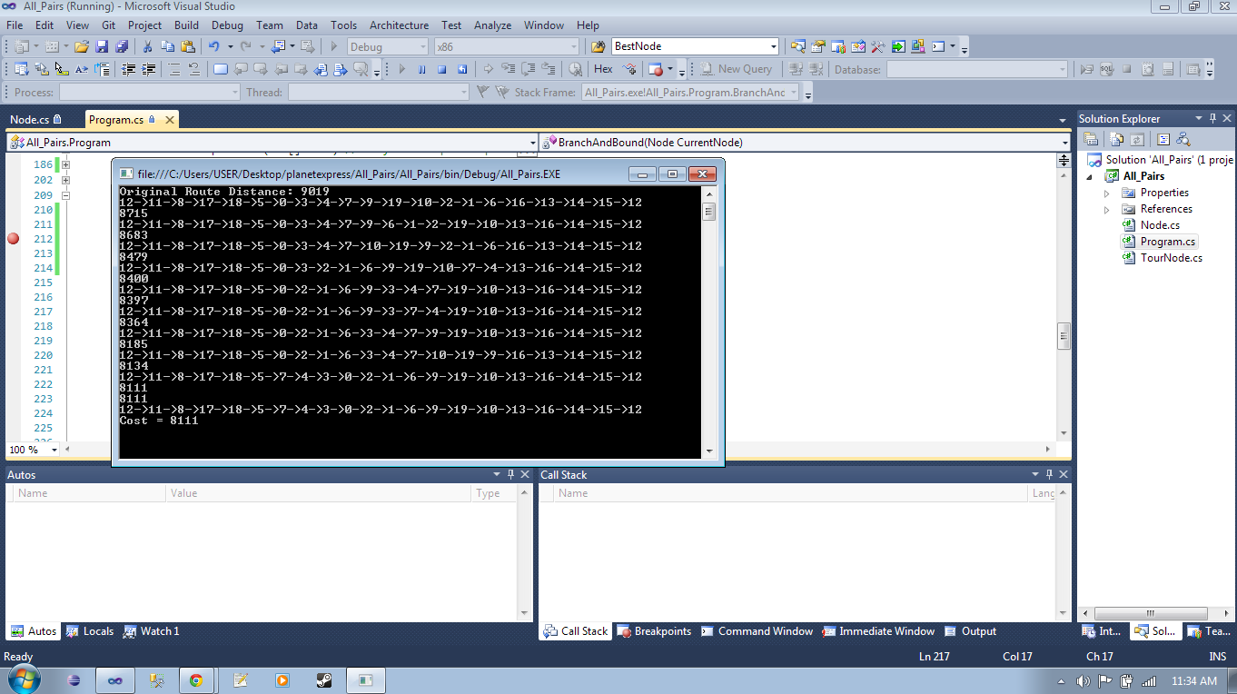
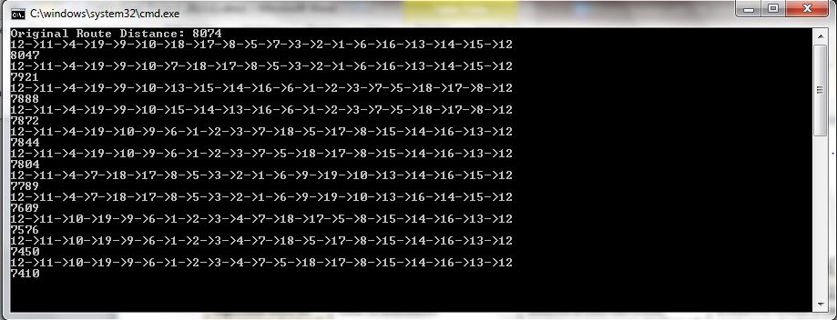
Path Results
Path With New Recreation Building
Path Without New Recreation Building

Slide 9
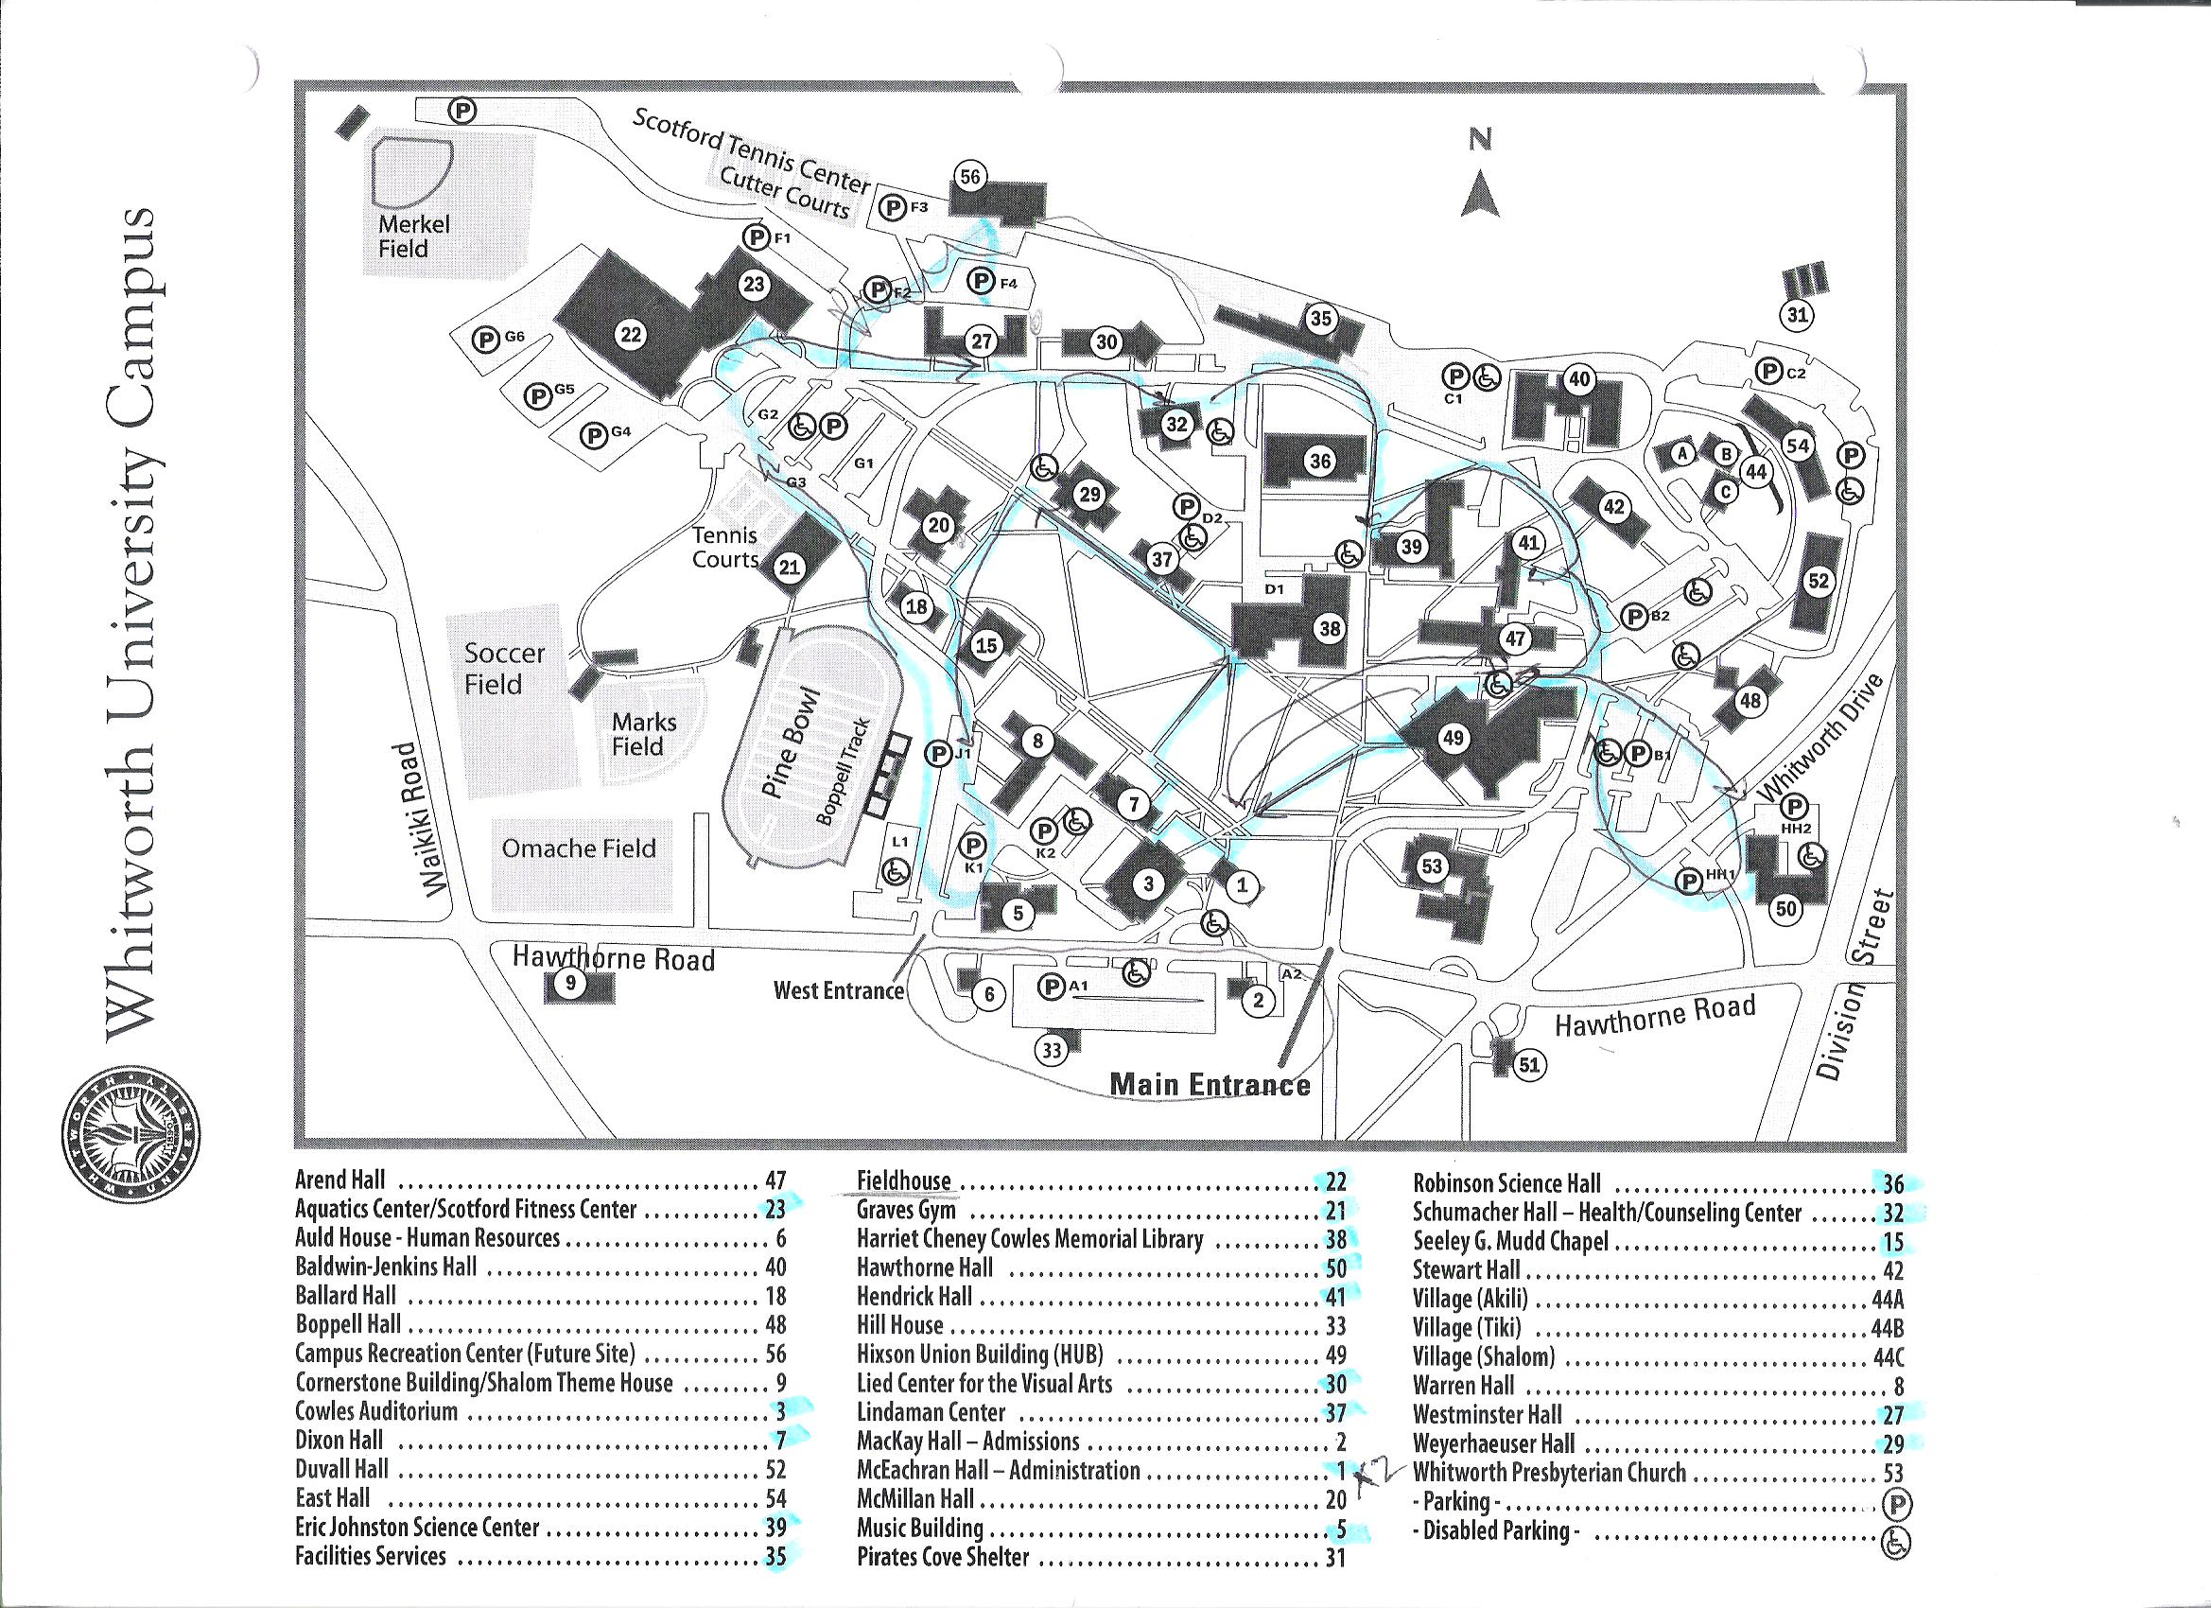
Current Mail Route

Slide 10
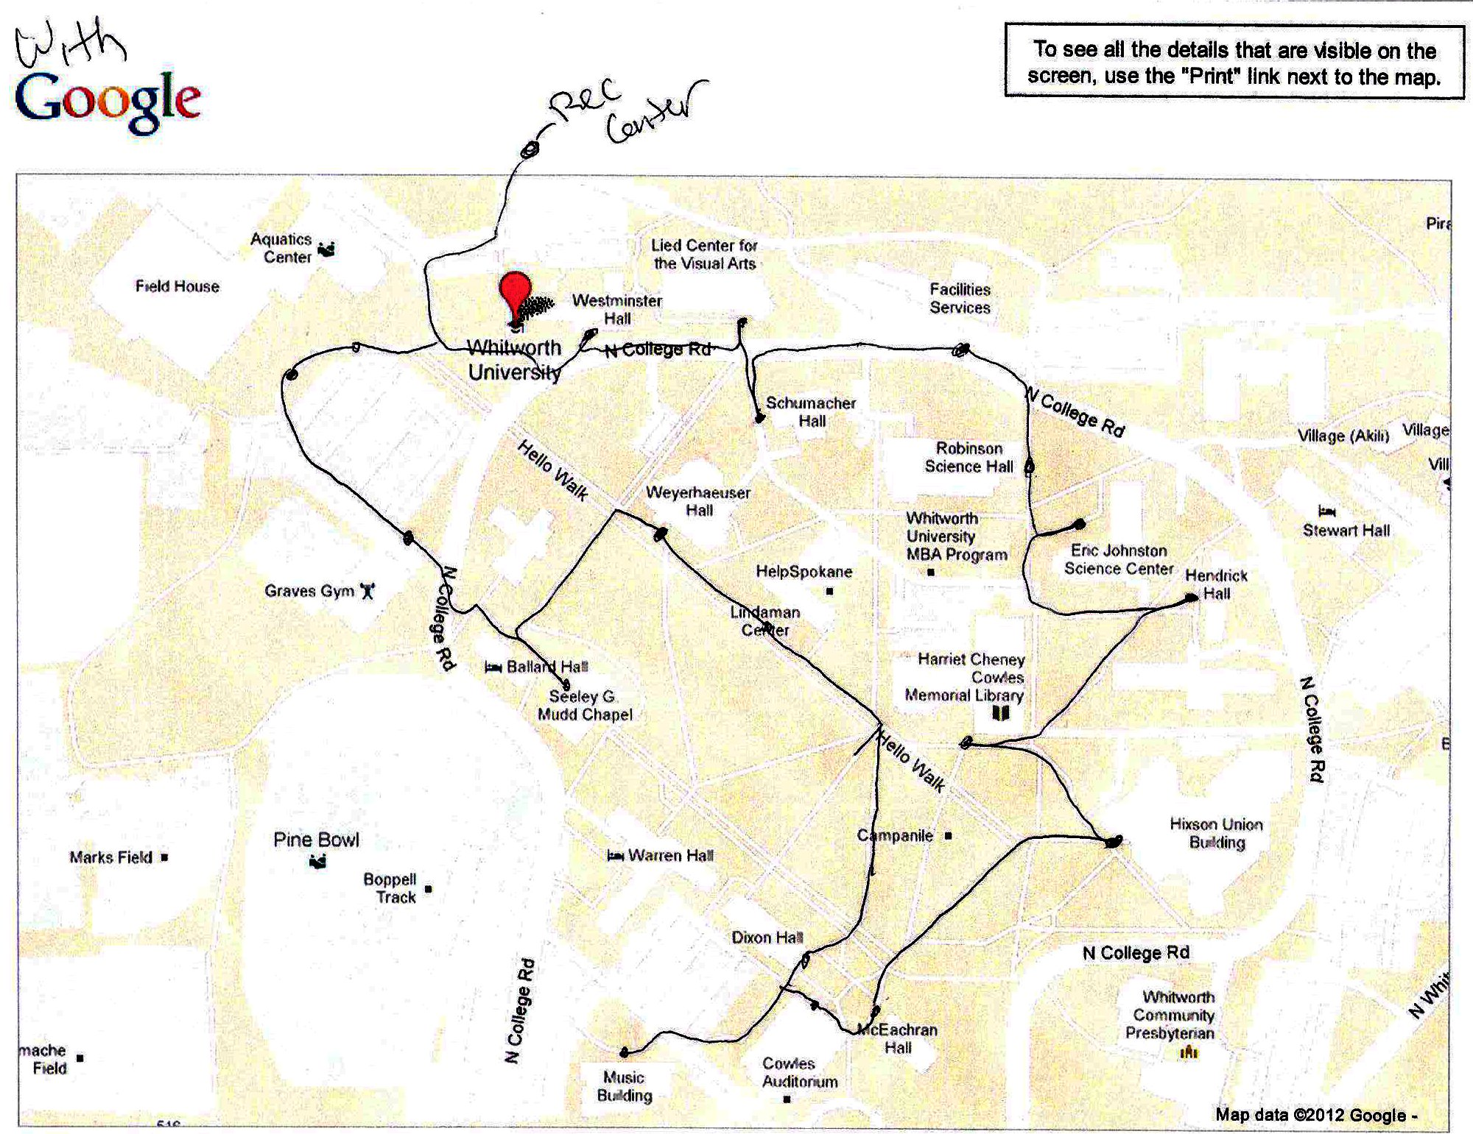
With New Recreation Center

Slide 11
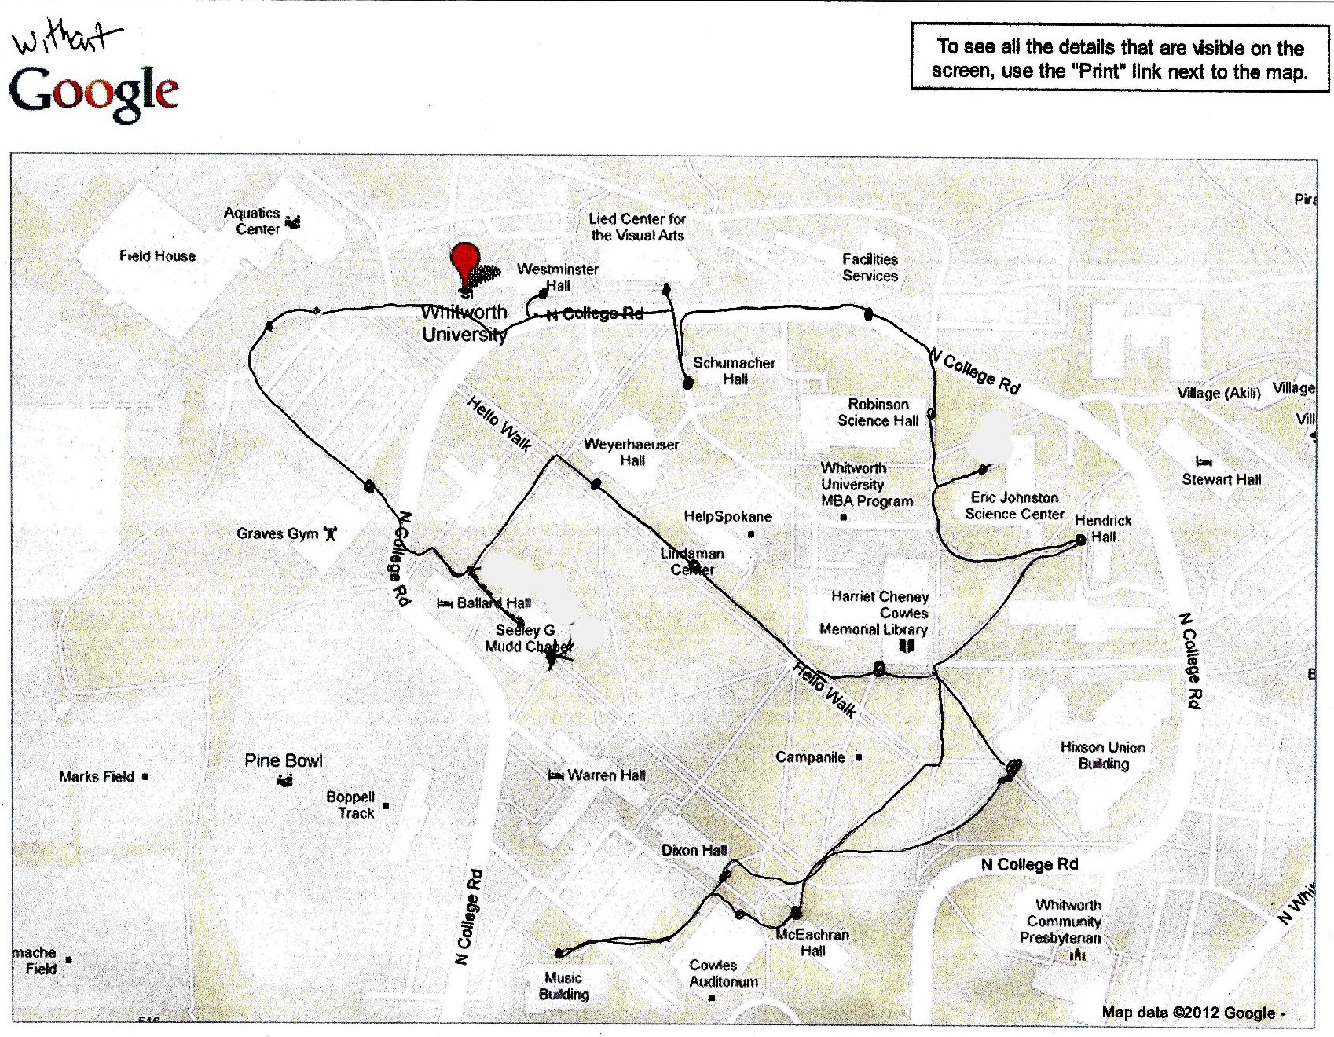
Without New Recreation Center

