Slide 1
Moodle Log Analysis SMU Senior Project
By: Braden Baker
Presentation Link: https://www.youtube.com/watch?v=YKMLm05_LEk

Slide 2
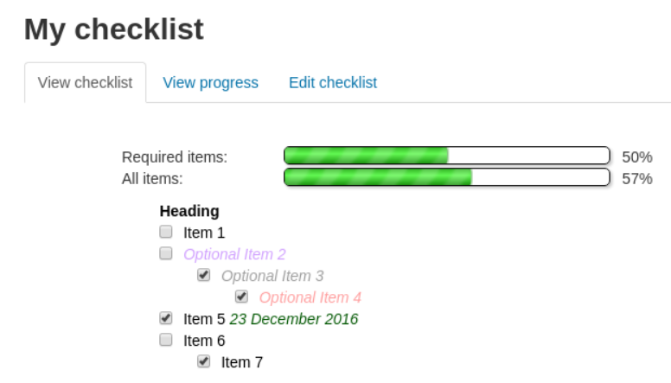
Moodle Log Analysis Introduction
Team
Project lead: Braden Baker, Information Technology major
Project client: Sarah Faulkner, Instructional Designer at Saint Martin’s University
Research Goal
Saint Martin’s staff wants to improve the effectiveness of their Learning Management System, Moodle
To do this, Saint Martin’s staff will be using test plugins for Moodle courses during the Spring semester
Moodle plugins add new features and functions to Moodle
More exam question types and layouts
Integration with other systems
Extra administrator options
A plugin for a checklist

Slide 3
Project Purpose
The purpose of the project is to provide analysis for the project client that can help the client in improving the instructional ability of Moodle for students and instructors
My role is to use Moodle logs to track the activity of students in both the test classes and in normal classes
In test classes, the focus will be on analyzing how much students are using the new plugins
How often did students interact with the plugins?
When did they use the plugins?
Did plugin usage increase or decrease during the semester?
In normal classes, the focus will be analyzing key questions proposed by the client
How long does it take for students to view assignment feedback?
When are students watching recording lectures?
Which Moodle resources are students interacting with the most?
This will be done using the R programming language to capture, clean, aggregate, and visualize the data contained in Moodle logs
The findings of the analysis will be used to advise instructors on their class structures and aid in deciding which plugins should be added to future courses

Slide 4
Role and Responsibility
Solo project
I will be responsible for
All communication with the project client
All communication with Saint Martin’s information technology
Writing code to gather and clean Moodle log data
Writing code to create visualizations and analysis of Moodle log data
Presentation of visualizations and analysis

Slide 5
Relevant Technical and Qualitative Restraints
Data must be anonymized
Spring semester will be ongoing during the project
Moodle logs are stored by a third-party vendor, eThink
Only data captured by the logs can be analyzed

Slide 6
Risks
Researchable level of Plugins
Not all plugins were able to be implemented by SMU ITS
Not all plugins that were implemented were capture by the logs
Resulted in the focus shifting to general analysis of Moodle logs rather than plugin analysis
Limited data to draw decisive conclusions
Only a semester of online/hybrid learning to compare results
Only a few test classes for each plugin
Resulted in some class structures provided skewed data
Project scalability will be a challenge
Code is reusable for all course logs
ITS will have to use resources
Resulted in being unable to regularly receive data from eThink for future semesters

Slide 7
Schedule
September – October: communication with Information technology staff and planning with project client
November: build framework for data cleaning and analysis using sample data
December – January: Work with project client, ITS, and eThink to gather data from previous semesters classes and from courses using new plugins in the Spring
February: Receive access to Fall logs, begin analyzing Fall classes for general student activity trends in areas requested by client

Slide 8
Schedule
March: Receive access to Spring logs from test classes, analyze plugin usage, continue analyzing Fall classes for general student activity trends in areas requested by client
April: Finalize code, presentation, and documentation

Slide 9
Budget
Actual budget: 0.00 $
Only using logs gathered by Moodle automatically
Logs are accessed through Saint Martin’s University information technology staff and eThink support
All software used was free
Potential Budget
Enterprise RStudio: $995/year
Enterprise Github: $21/year

Slide 10
Next Steps
Present findings to project client and team
Client will use findings to decide on plugins to permanently implement
Client will use general class analysis to improve instructional design
Improve reusability of code
Turn more code into functions
Improve documentation

Slide 11
Additional Information
R Markdown file of code to clean, analyze, and visualize the Moodle Logs
https://rpubs.com/braden1/751094
Github Pages link to the presentation view of the log analysis findings with no code
https://braden126.github.io/CSC481-SeniorProject/
Sample of the log files captured by Moodle
https://github.com/braden126/CSC481-SeniorProject/blob/main/LogSampleData.csv

