Slide 1
Text Analysis and Machine Learning Workshop
Jason Kiley
Oklahoma State University
Part 2: Python Basics

Slide 2
github.com/jtkiley/

Slide 3
Jupyter and Python
Jupyter Notebook features.
Python object types: string, int, float.
Other types: bool and datetime.
Data structures: lists and dictionaries.
Methods and mutability.

Slide 4
Jupyter Notebooks

Slide 5
Jupyter Notebooks
Format combines code, output, rich text, and images in a helpful way for doing research.
Cell-based design enables the non-linear and iterative work that we often do.
Interface handles other common tasks, like code editing, and adds convenience features.

Slide 6
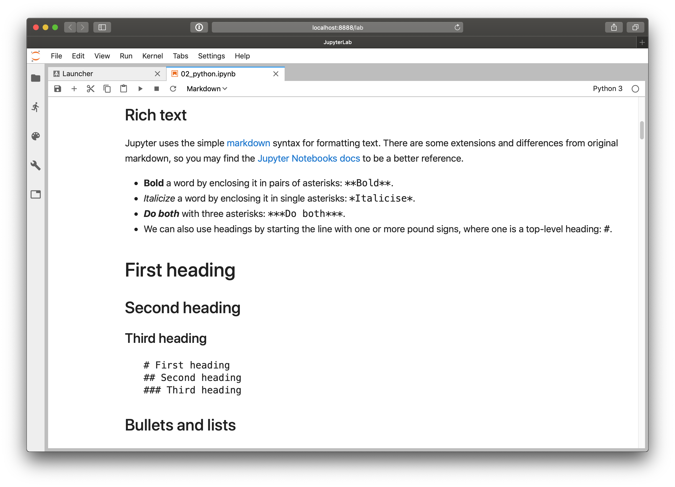

Slide 7
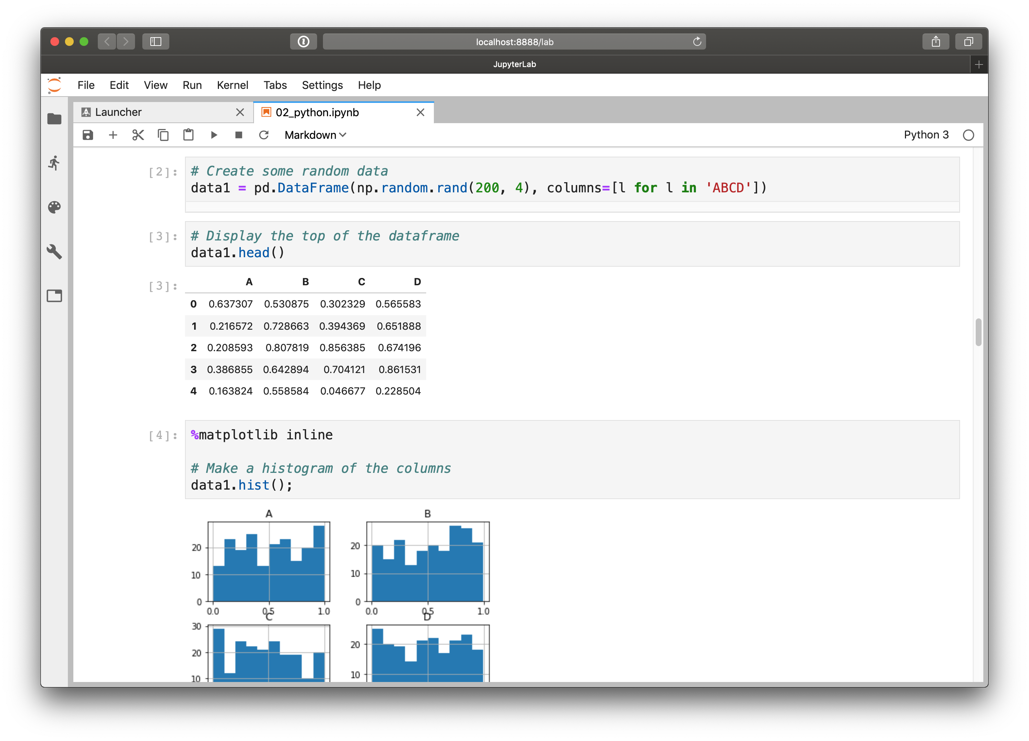

Slide 8
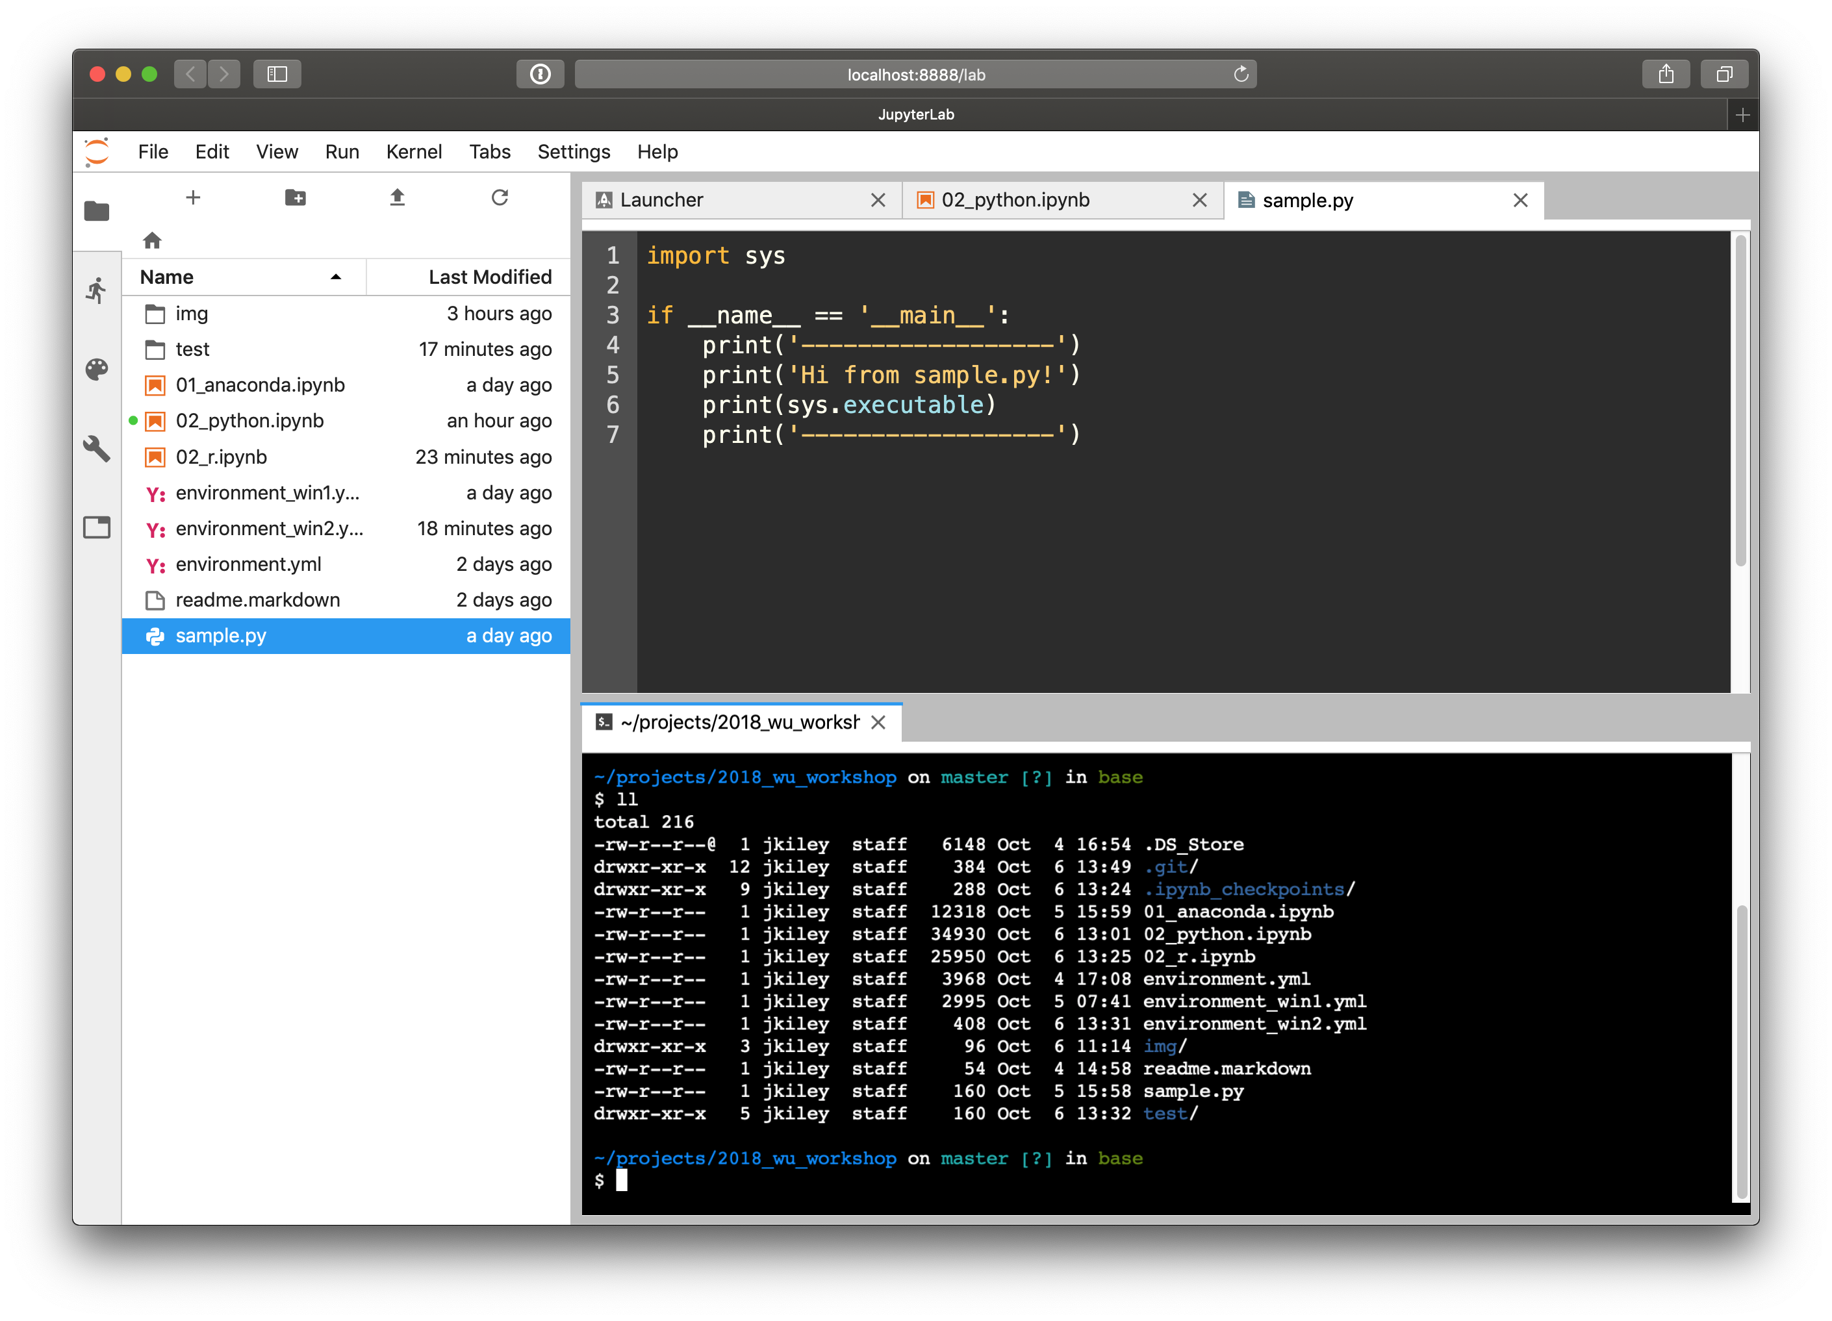

Slide 9
Python Objects

Slide 10
Assignment
Variables in Python can be thought of as names we give to objects.
Everything in Python is an object.
Objects have attributes and methods that allow us to work with them. More on that later.

Slide 11
What you already know
You have likely worked with data type issues in your existing stats software.
For example, Stata often requires some type of format change for dates in datasets to be recognizable to us as dates.
You may have used destring to change a number represented as a character string into a number datatype that Stata can use.

Slide 12
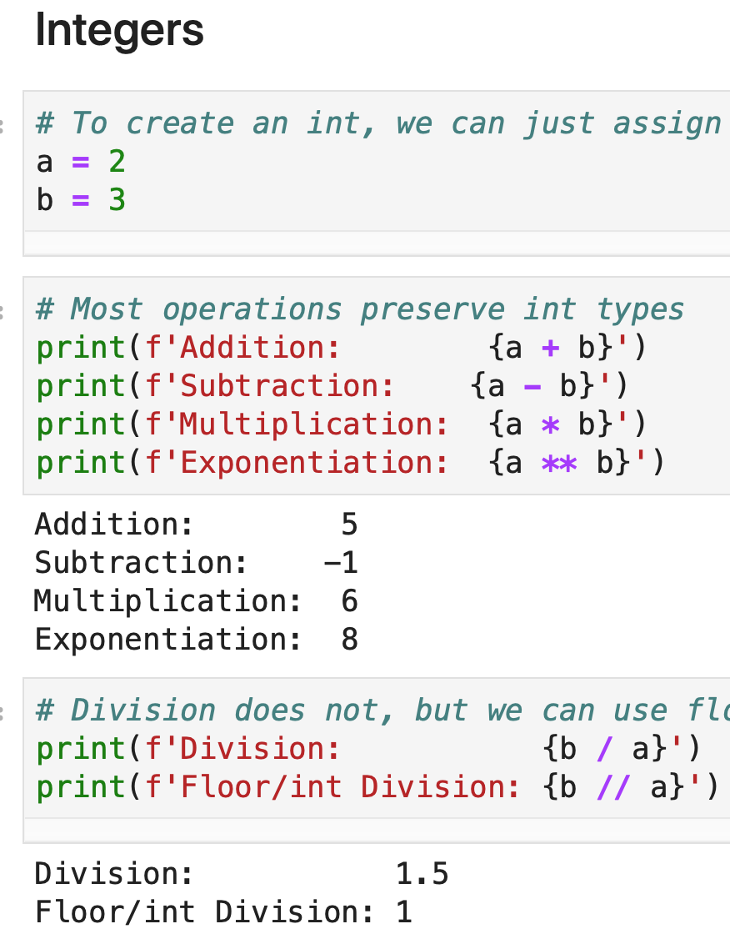
Integers
Same as math: counting numbers, zero, and negatives.
Literals are numbers without decimals.
Convert with int().

Slide 13
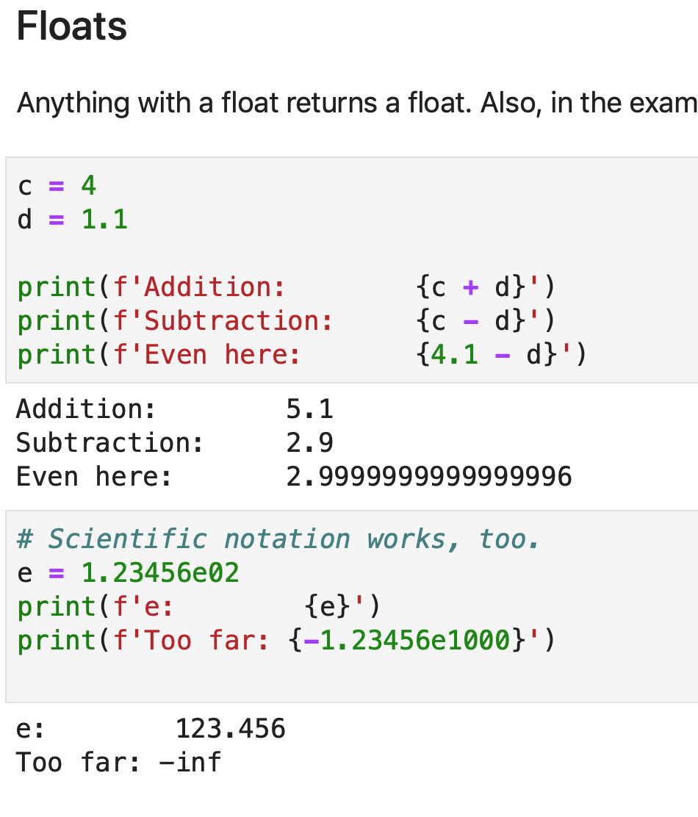
Floating point numbers
Any number with a decimal.
Stored as an approximation, but it’s rarely an issue.
Scientific notation also works.
Convert with float().

Slide 14
ints and floats
ints can be added, subtracted, multiplied, and exponentiated.
Anything with a float or int division returns a float.
In pandas, ints with missing values are converted to float.

Slide 15
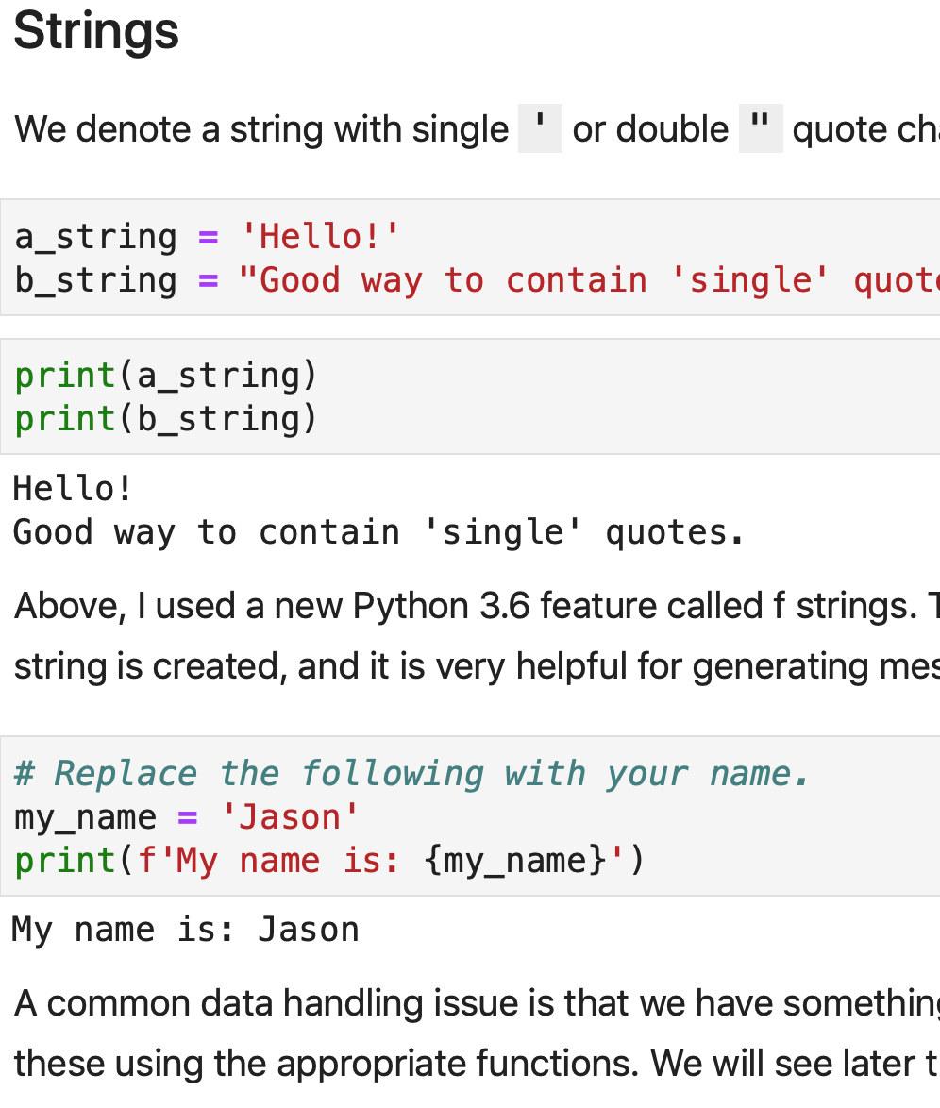
Strings
One or more characters.
That includes special characters like newlines.
Convert with str().

Slide 16
Many object types
datetime for representing dates and times and differences in dates and times.
Boolean values for True or False.
Packages add many many more.
As you may have guessed, we can make our own object types, though that is mostly beyond our scope for today.

Slide 17
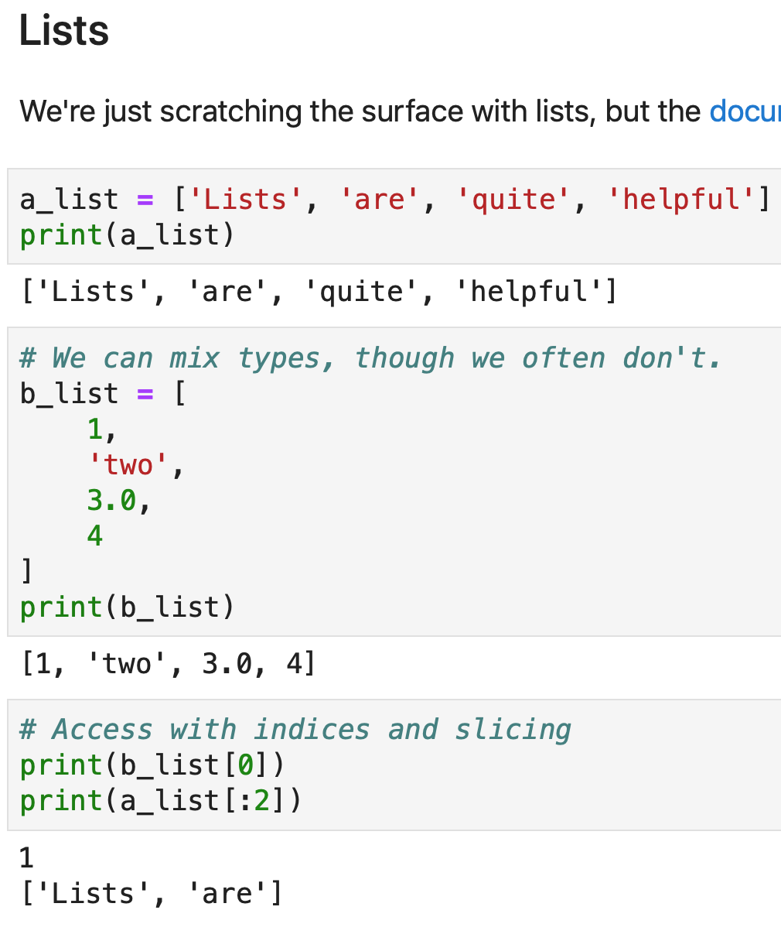
Lists
Lists are data structures that contain a sequence of objects.
They can contain many types of objects (though usually one).
Very versatile.

Slide 18
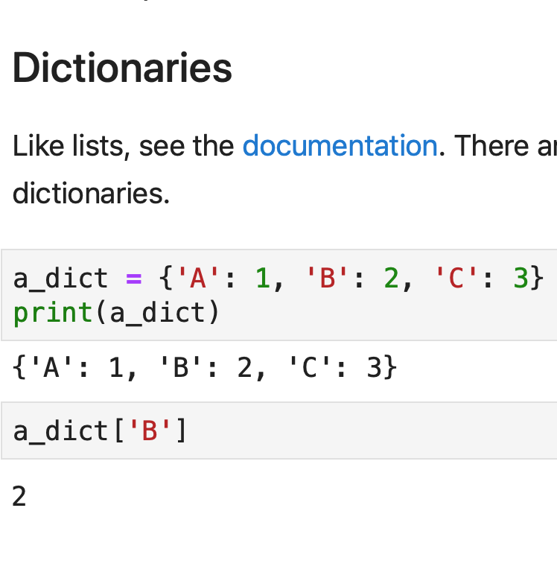
Dictionaries
Dictionaries are data structures with key-value pairs.
Keys must be unique and immutable.
We often use them to store associations for lookups or as a primitive representation of a row of data.

Slide 19
Methods and mutability

Slide 20
Functions
Much like math, functions are objects that take input and map that input to a particular output for a given input.
In programming, we tend to refer to input as arguments, and output as returns.
There are many built in, and we can make our own.

Slide 21
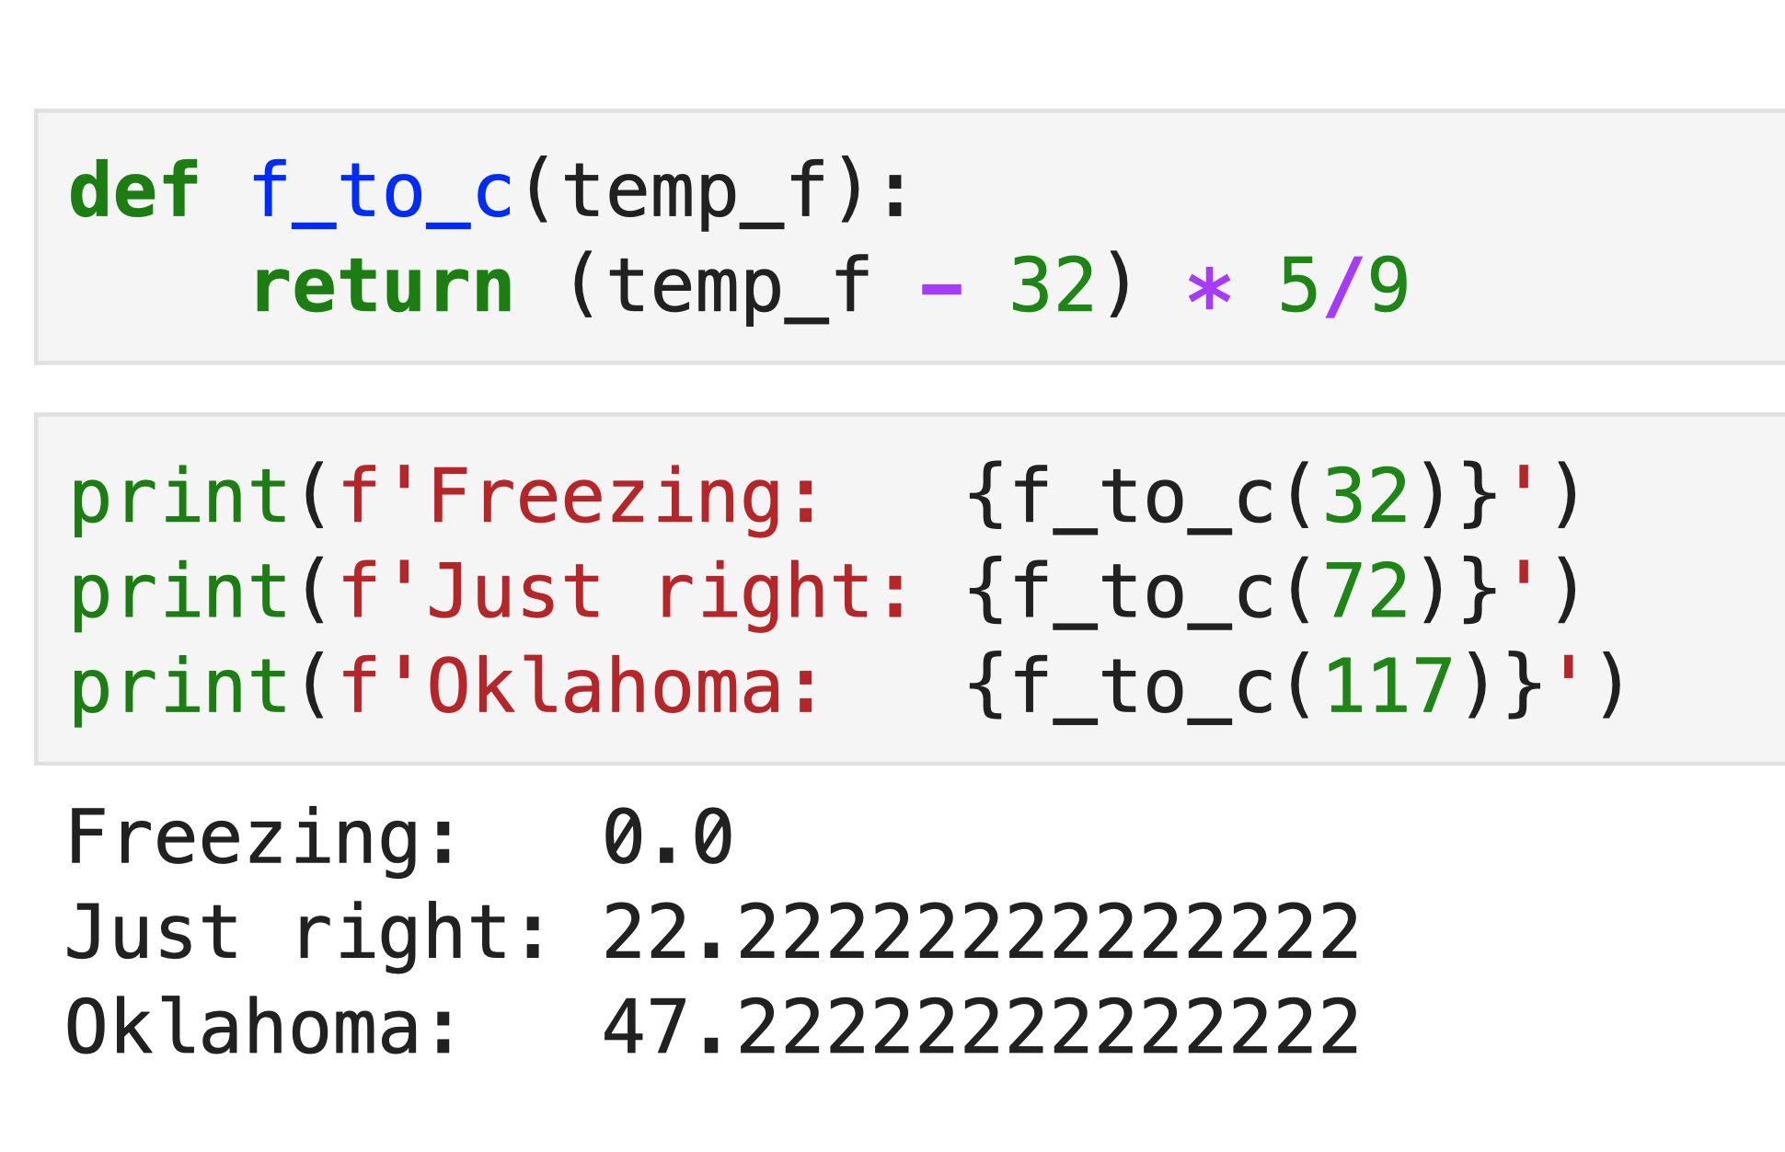

Slide 22
Methods
Remember that everything in Python is an object.
Objects have methods, which are just functions attached to objects and defined with their type in mind.
For example, strings have the .lower() method that returns the string transformed to lower case.

Slide 23
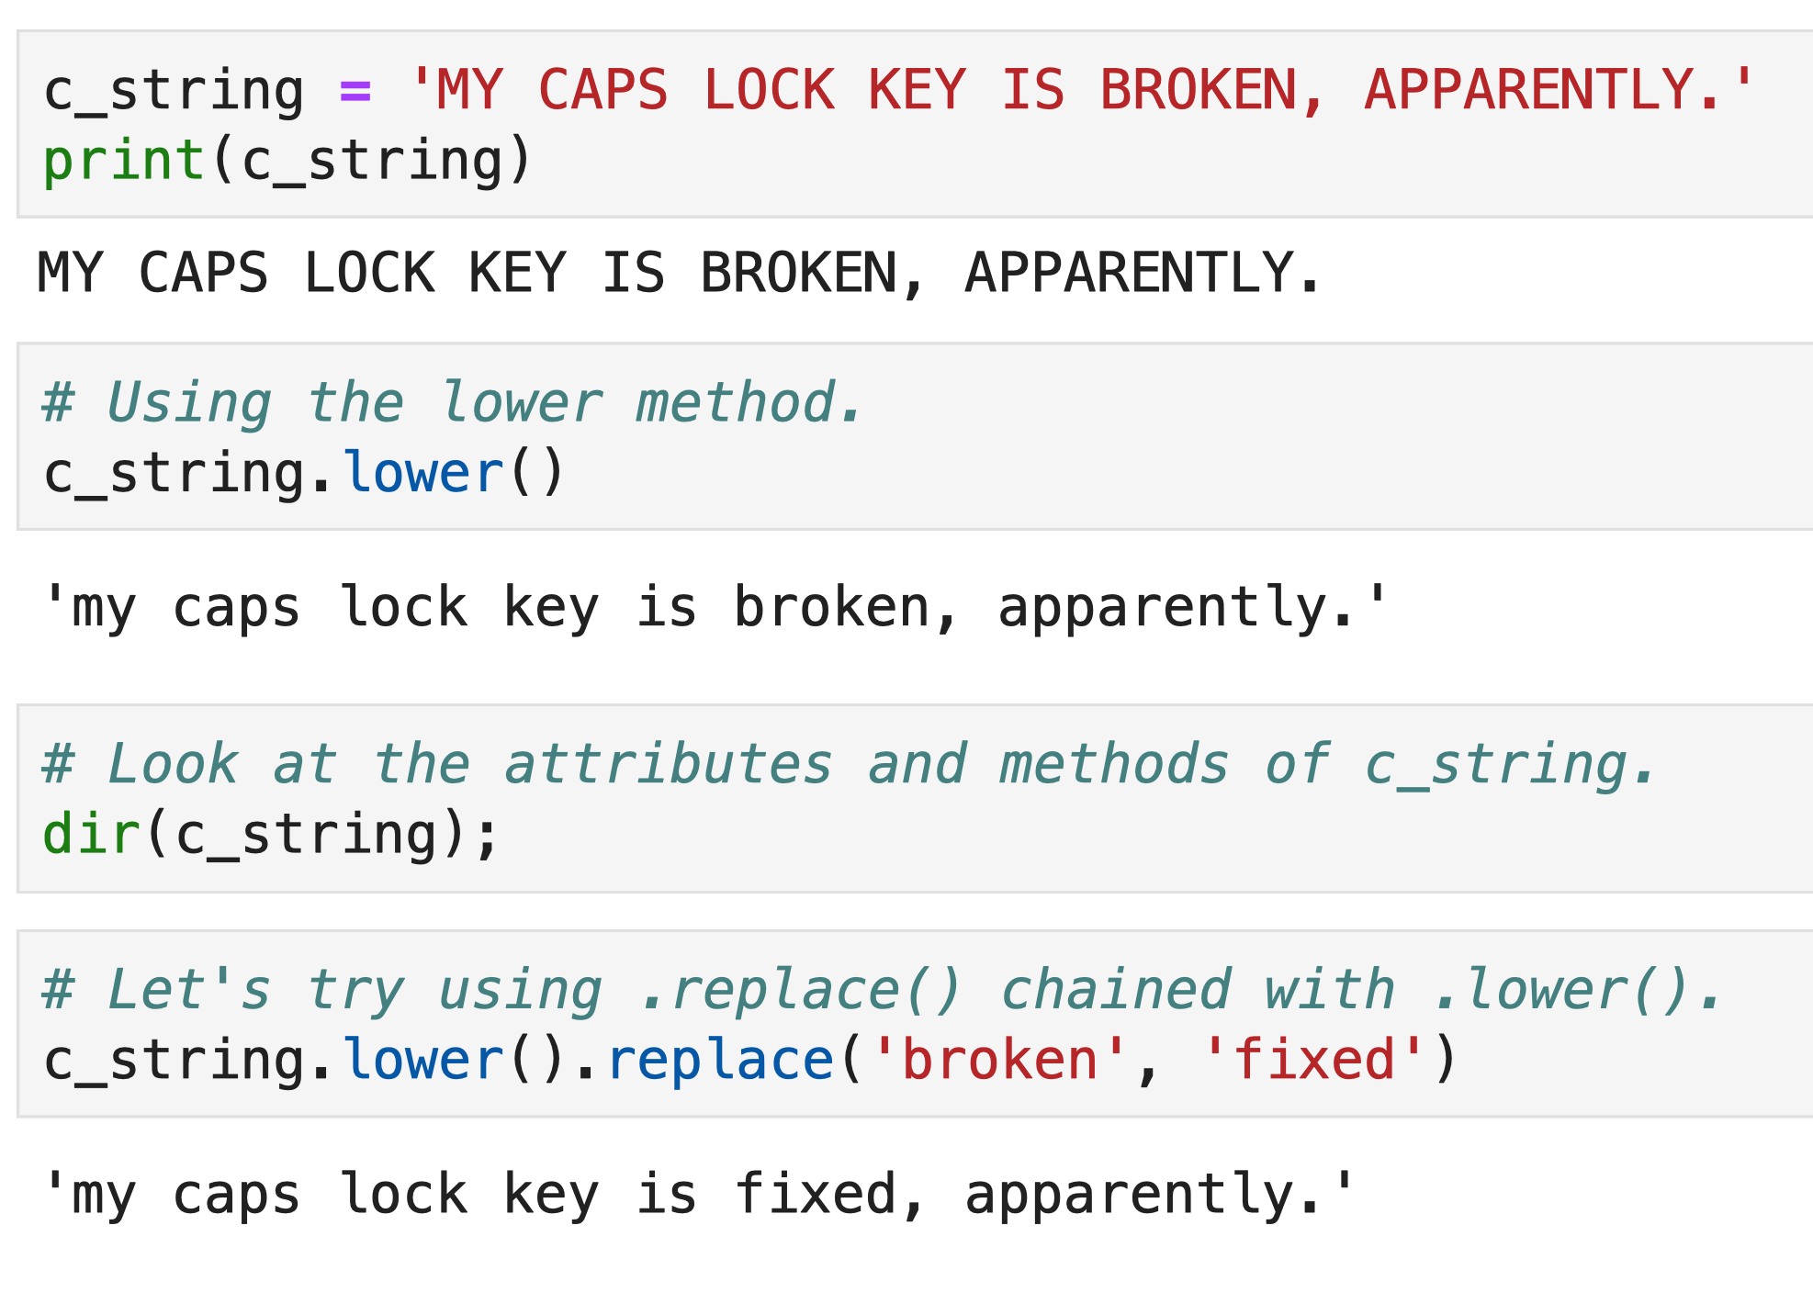

Slide 24
Mutability
Mutability describes whether objects themselves can be changed.
Note that this is different from changing the object that a name points to.
Warning: this is sometimes a bit tricky.
Examples in hands-on portion.

Slide 25
Hands-on
Jupyter features.
Python data types.
Python data structures.
Functions and methods.
Mutability.

Slide 26
Hands-on

Slide 27
Summary
Jupyter notebooks are tools that are well-designed for how we actually go about conducting empirical research.
Python basic data types should be generally familiar.
Data structures like lists and dictionaries are an upgrade in functionality from most stats software.
Mutability is sometimes tricky, but, generally, basic types are immutable and data structures are mutable.

Slide 28
Questions

Slide 29
Lunch until 12:30

