Slide 1
Text Analysis and Machine Learning Workshop
Jason Kiley
Oklahoma State University
Part 4: Text Analysis

Slide 2
github.com/jtkiley/

Slide 3
Text analysis (part 1)
What are we trying to accomplish?
Demonstrating validity.
Human coding.
Dictionary methods.
Pre-trained machine learning models.

Slide 4
What are we trying to accomplish?

Slide 5
Common text analysis goals
Classification: sort texts into groups that we define.
Sentiment analysis/attribute scoring: assess the levels of some construct in the text.
Topic modeling: let topics emerge from the corpus of text.

Slide 6
Do what works
It’s easy to look at simpler methods and criticize them.
However, the question is whether that simplicity compromises the results.
There is a lot of work published with dictionary-style methods.
While we understand the limitations, it does work well for a number of applications.

Slide 7
Demonstrating validity

Slide 8
Demonstrating validity
It is your responsibility to demonstrate that your measures are valid.
One straightforward way is to use measures for which there is already some validation.
Another is to carefully validate the measure yourself.
Validity is a key deficiency that I see as a frequent reviewer of content analysis papers.

Slide 9
Existing measures
You should be able to rely on previous validation to the extent that it applies to your study.
Are you using the same measure, for the same construct, on the same kinds of texts, at similar points in time, at the same level of analysis?
To the extent that the answer to any of those questions is no, you need to demonstrate validity.

Slide 10
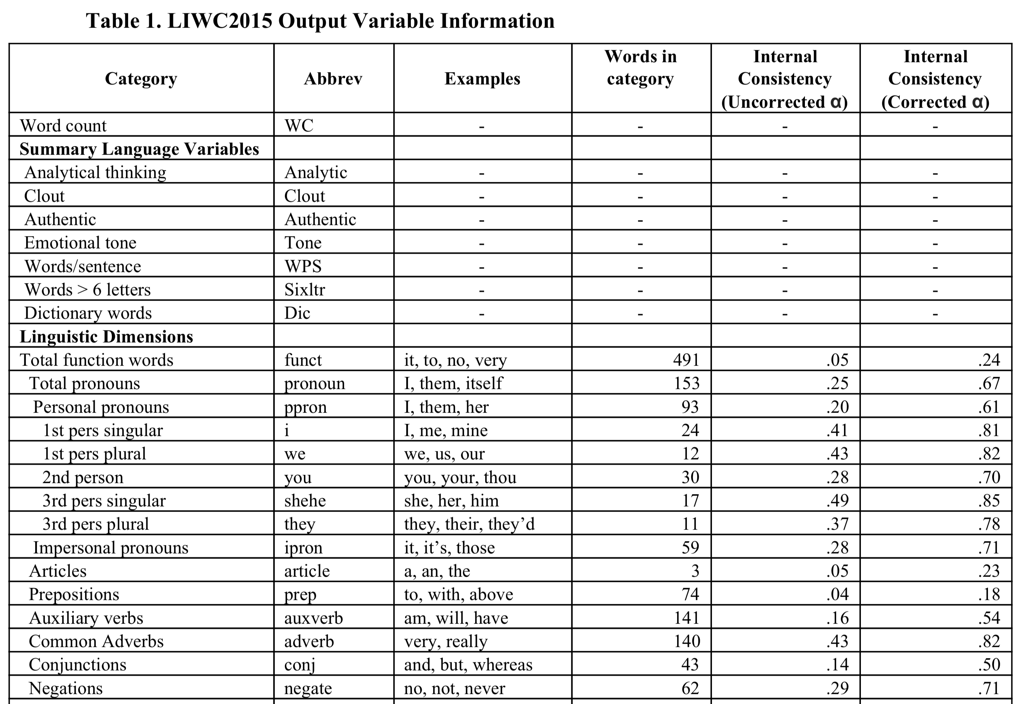

Slide 11
New measures
Human inter-rater reliability: is your definition specific enough that others code the same way you do?
Experts: do expert evaluations of words in dictionaries converge with your own?
Algorithm IRR: are human scores and algorithm scores reasonably reliable?
Reviewer test: is your procedure plausible and well-described to reviewers?

Slide 12
Common issues
Using a measure for a different construct: this is usually suspect, though some measures can change slightly with referent (e.g., texts written by someone or about someone).
Different document types: it may be fine if there’s a plausible argument that the measure is general, but be prepared to validate it.
Inadequate validation: you must demonstrate validity, whether by reference or your own work.

Slide 13
Advice
There are a lot of poorly-done content analysis papers submitted to good journals.
Be very thorough and careful in documenting your procedure and demonstrating validity.
Reviewers who publish these studies get a lot of reviews, and this is an easy attack vector.
Look at successful papers and follow their lead. It’s a small enough world (for now) that you’re likely to cite one (or more) of your reviewers.

Slide 14
Human coding

Slide 15
Wait, I thought we were here to make the computer do everything for us?!?

Slide 16
Why we human code
Validation: even if we have an algorithmic measure, we need a comparison for validity.
Supervised machine learning: training, validation, test data. We need labeled data, and a lot of it.
Nuance: some things are hard to capture with simpler methods (but see machine learning).
Practicality: a few thousand rows does not take that long.

Slide 17
Training data for ML
How much labeled data do I need for supervised ML? More!
A number of things increase the amount needed, including number of categories, rare categories, noise, number of features, and non-linear models.
Consider examples where there is naturally-coded or heuristically-coded data. ML is often surprisingly resilient to noisy training data.

Slide 18
Efficiency example
In my 2016 AMJ, we human-coded around 10,000 rows of data (press releases).
Coding (~30) categories was very time-intensive. However, the measure was aggregated.
So, we gave coders (spoiler: all researchers, no hired labor) a chart and let them code a value corresponding to the aggregated version, increasing speed by 10x.
Like data collection design, time spent designing coding processes has a very high ROI.

Slide 19
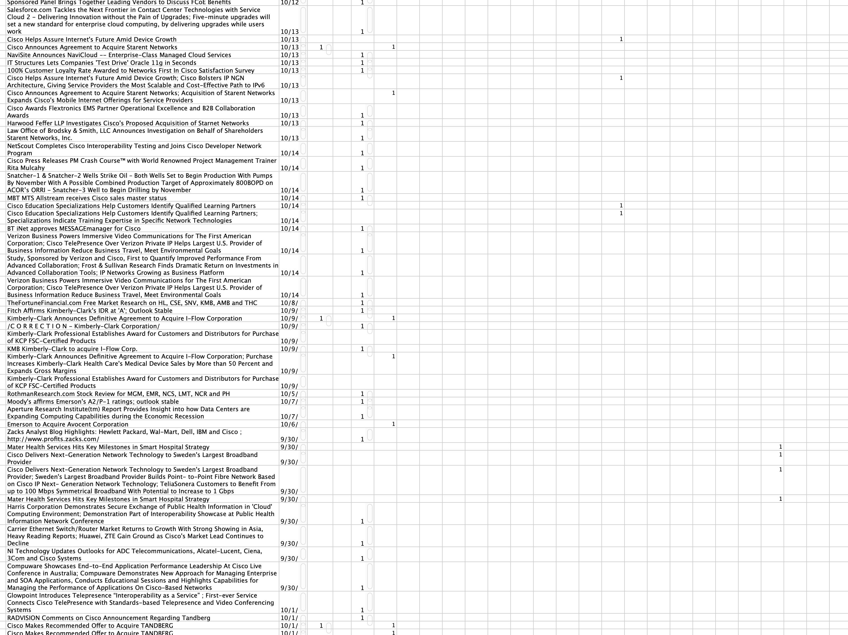

Slide 20
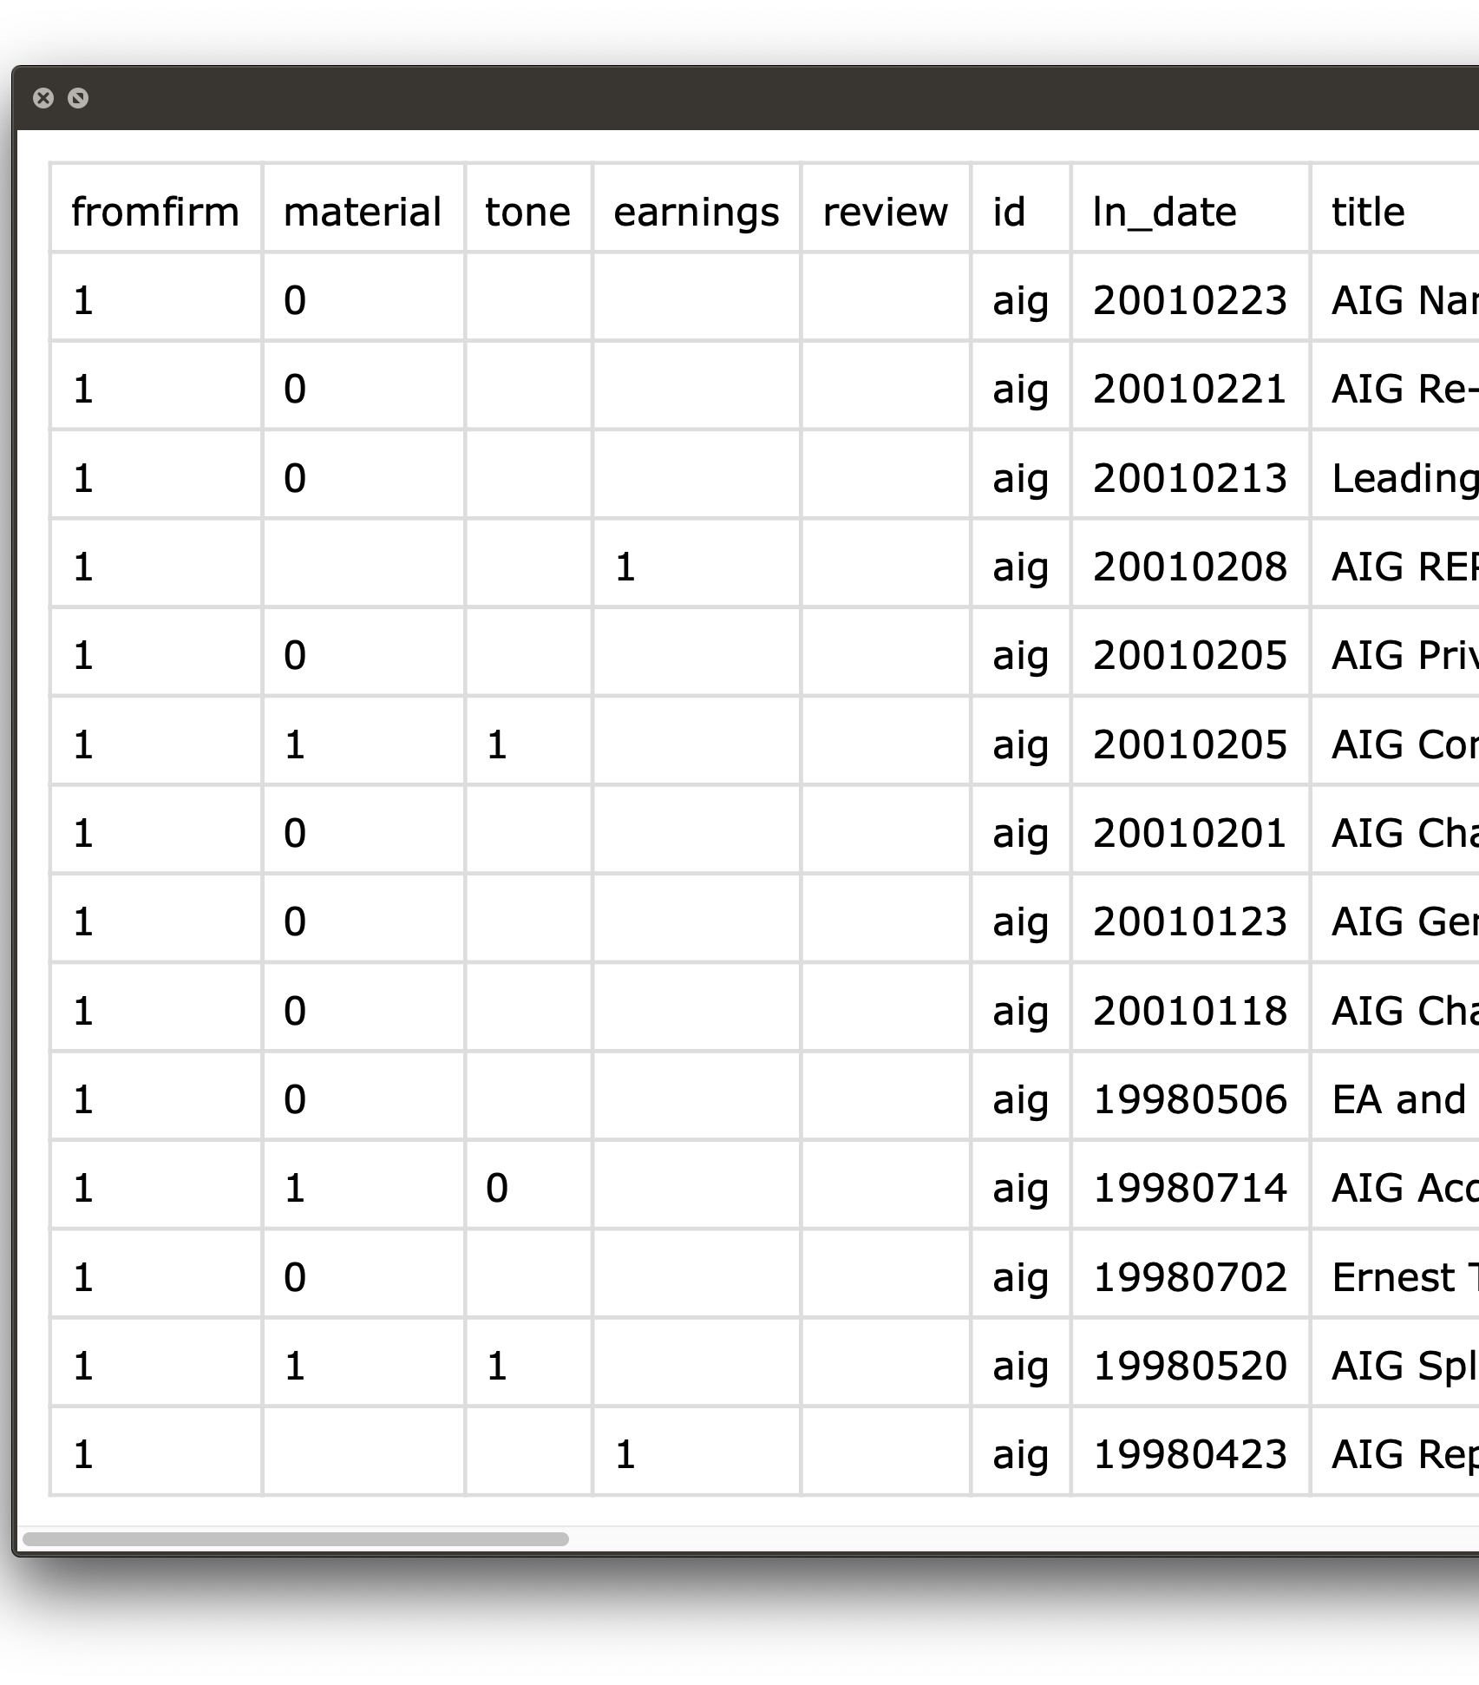
Practical advice
Spreadsheets are a fast, easy way to human code.
Output just what coders need along with IDs to merge data back in.
If you have a simple heuristic, try pre-filling answers and letting coders review them.

Slide 21
Dictionary methods

Slide 22
Dictionary methods
LIWC is commonly used for its many built-in, validated dictionaries or custom ones for measuring attributes.
This is a relatively simple method, but it works well in a number of contexts.
If there is an on-point dictionary, it is a good place to start.

Slide 23
Dictionary tradeoffs
It tends to struggle on short texts (e.g., tweets) unless the construct really has a limited set of words.
A workaround is longer, more comprehensive dictionaries, as shorter texts are more sensitive to dictionary completeness.
Another issue, more prominent with short texts, is semantic structures, such as negation. It tends to wash out given enough text, but it can lead to bad results in short text.

Slide 24
Pre-trained machine learning models

Slide 25
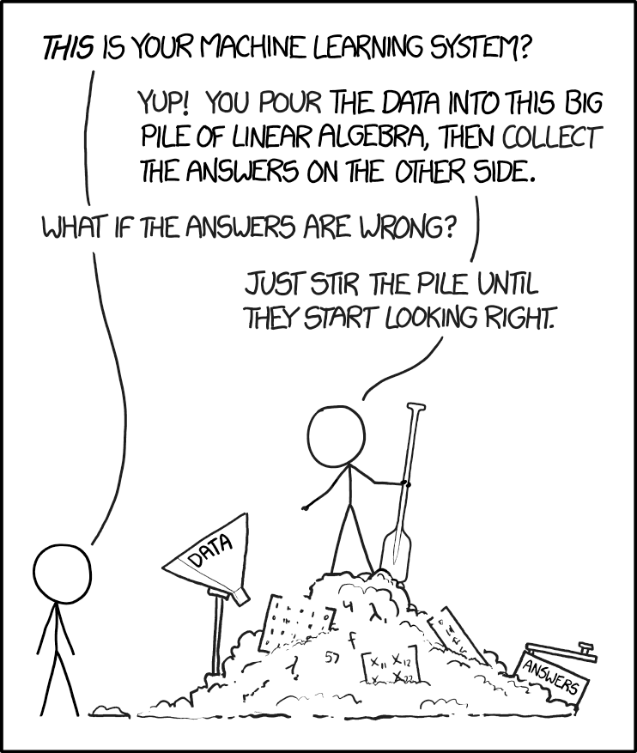
Pre-trained ML
There are available models that have been trained on widely-available datasets.
We usually get measures of broad constructs, like polarity (i.e. negative to positive).
Notes:
Permanent link to this comic: https://xkcd.com/1838/

Slide 26
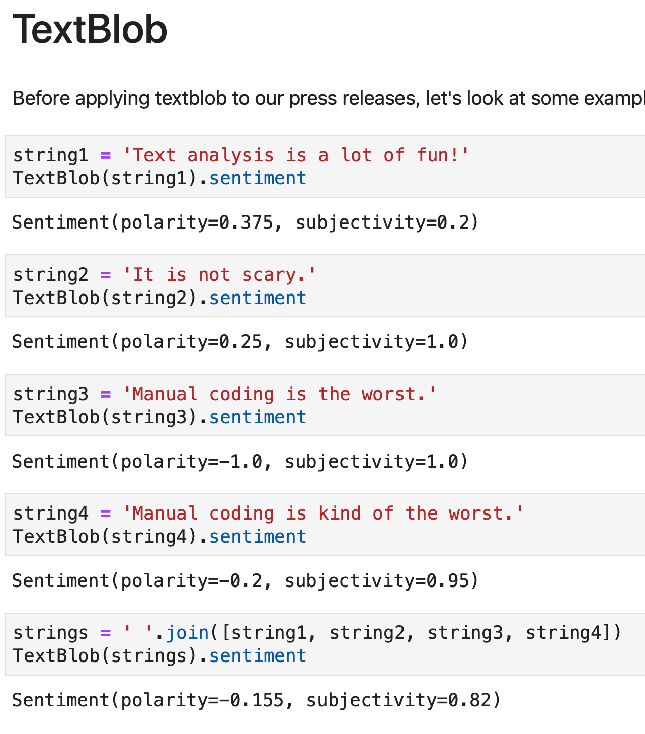
TextBlob
User-friendly Python package for text.
Pre-trained scoring for polarity and subjectivity.
Convenient features for easily training your own model.

Slide 27
Hands-on
Calculating IRRs.
Exporting for human and LIWC.
Reading and merging.
TextBlob built-in measures.

Slide 28
Hands-on

Slide 29
Summary
Validation is vitally important, but stand on the shoulders of others when possible.
Human coding is often needed, so use strategies and technology to make it as painless as possible.
When using non-Python software, we can often export something made for that purpose and then re-import it to continue the pipeline.

Slide 30
Questions

Slide 31
Break until 15:15

