Slide 1
Text Analysis and Machine Learning Workshop
Jason Kiley
Oklahoma State University
Part 5: Machine Learning

Slide 2
github.com/jtkiley/

Slide 3
Text analysis (part 2)
Machine learning overview.
Supervised and unsupervised learning.
Model accuracy.
Feature extraction.
Future directions.

Slide 4
Machine learning

Slide 5
What is machine learning?
A class of techniques that automate model building.
We say it is “supervised” when we provide data on inputs and outcomes.
“Unsupervised” learning is when we ask an algorithm to make sense of the data itself.

Slide 6


Slide 7
Prediction versus inference
Machine learning is largely the product of computer science, and it is generally focused on creating accurate predictions on new data.
From statistics, we tend to use regression models to make statistical inferences about populations of interest.
The boundary is somewhat blurred and arbitrary, and there is emerging work to weaken it further.

Slide 8
Led by practitioners
Only some of the tools that are available are led by, or designed for, academics.
Instead, we see a number of advances made by practitioners.
Practitioners tend to be very focused on predictive accuracy, not theory testing.
So, we often need some adaptation for academic use, and ensuring validity is our responsibility.

Slide 9
Supervised learning
In supervised learning, we are looking to associate input and output variables.
You can think of features as independent variables and target variables as dependent variables.
Classification is for categorical outcomes and regression is for continuous outcomes.

Slide 10
Supervised examples
Classifying firm press releases according to announcement type.
Scoring sentiment or other constructs.
Regression-type models for a variety of outcomes.

Slide 11
Unsupervised learning
In unsupervised learning, we have no labels, so the algorithm has to uncover the patterns.
Examples: clustering, principal components, topic modeling.
We generally ask the model to give us a number of groups, and we have to interpret them.

Slide 12
Model accuracy

Slide 13
Model accuracy
Data segmentation: train, validate, and test.
Predictive accuracy.
Confusion matrix.
Performance metrics.

Slide 14
Segmented data
Training data: this is the data that the model is trained on.
Validation data: this data is used to evaluate the model’s accuracy on data it has not seen. We use it iteratively to tune hyperparameters.
Test data: like validation data, except we can use it only once. It helps us avoid overfitting by optimizing for the validation data.

Slide 15
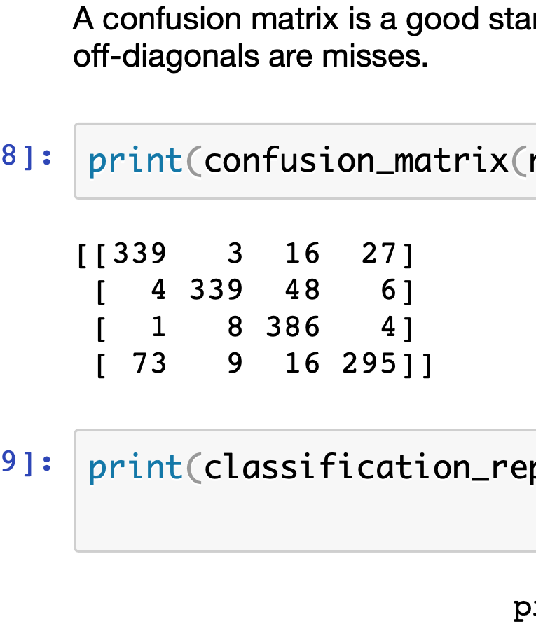
Measuring performance
Accuracy: the proportion of test cases that the model correctly classifies.
However, this breaks down with unbalanced categories.
Alternative: confusion matrix and associated metrics.

Slide 16
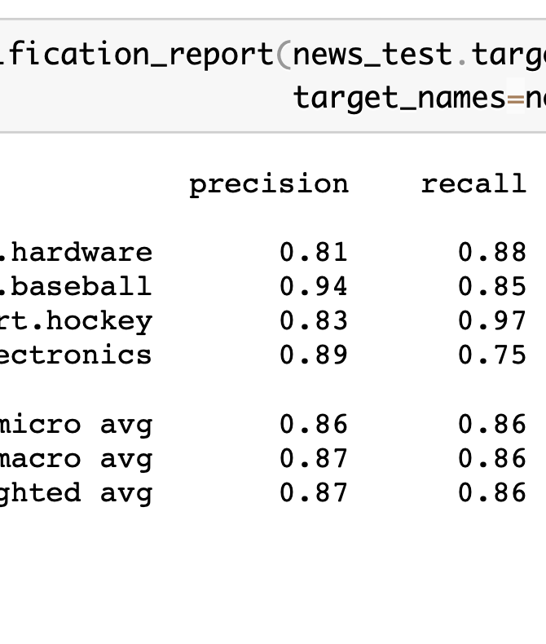
Performance Metrics
Precision: what proportion of the items that the model predicted are correct?
Recall: what proportion of correct items are predicted?

Slide 17
Hyperparameter tuning
The parameters that we have to provide for models are called hyperparameters.
We tend to run a number of models with a goal of picking the best one (usually by an automated process).
However, this creates another possibility of overfitting (i.e. to the validation set), and that is why we use the test set.

Slide 18
Feature extraction

Slide 19
Feature extraction
Our models need numerical representations of text in order to run.
A common method is using term frequencies in documents with some further adjustments.
Word vectors are a really interesting way to represent words in order to capture and infer relationships.

Slide 20
Term frequencies
Term frequencies: for each document, we construct a vector of frequencies for each word.
Inverse document frequencies: we weight words that occur in many documents lower than less common words.
We call these techniques tf and tf-idf.

Slide 21
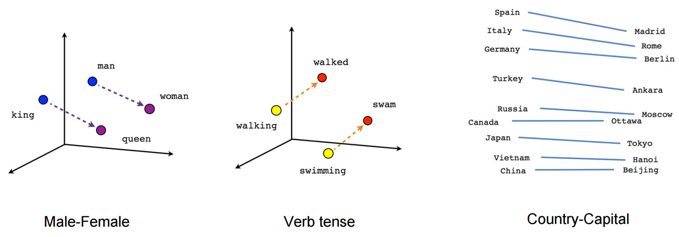
Word vectors
Represent words in vector spaces and infer similarity from location.
We can capture semantic relationships.

Slide 22
Hands-on
Preprocess text.
Extract features.
Build classification models.
Evaluate performance and tune hyperparameters.
Use topic modeling.

Slide 23
Hands-on

Slide 24
Summary
Machine learning can do a number of tasks for us that are practically difficult.
A lot of the tools and advances in this area come from practice, so we often have some work to do for academic use.
Simpler models often work well “out of the box,” and more complex models achieve state-of-the-art performance with a higher burden of hyperparameter tuning.

Slide 25
Future directions

Slide 26
pandas
pandas generally works really well, but it has performance issues under the hood that should improve as Apache Arrow matures.
Memory use: more efficient representations and out-of-core support should help data between 10GB and 100GB.
Speed: query planning will reduce wasted computations, and multicore execution will better utilize modern processors.

Slide 27
Cloud services
Currently, we have to choose between high computer power (and a lot of setup), or little setup (and some beta-level software rough edges) but low computer power.
Products like Azure Notebooks moving to production maturity will help considerably.
Better collaboration tools (i.e. more user-friendly) are likely coming, but further out.

Slide 28
Higher-level tools
These tools tend to either make pipelines easier to assemble or adding further automation to pipelines.
Tools like Azure ML Studio reduce coding needs.
Emerging tools further automate feature engineering and model selection choices.

Slide 29
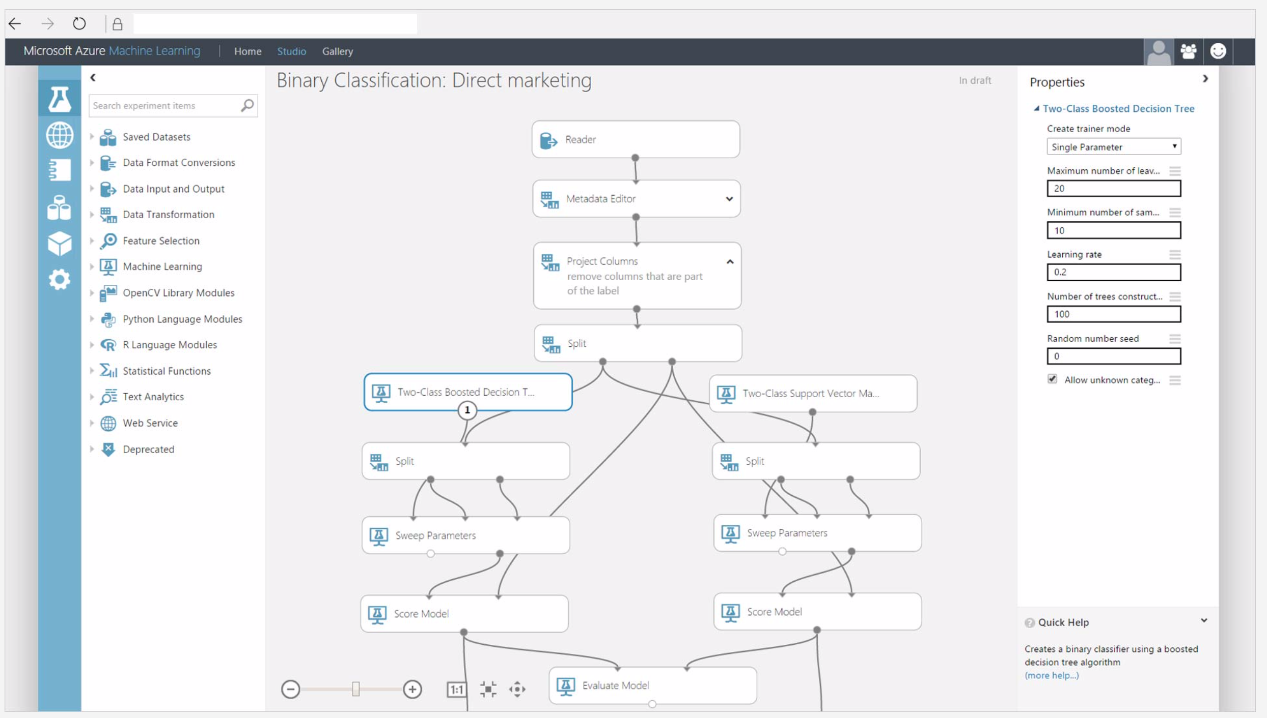

Slide 30
Questions

Slide 31
The end. Thank you!

