Slide 1
Adzuna Job Salary Prediction Competition
Braden Simpson, Jordan Ell

Slide 2
Competition
Kaggle.com hosts international competitions for data science
Adzuna, UK based advertisement website posted the challenge
$6,000 prize to the winner
Lots of competition
Notes:
Adzuna is UK based advertisement aggregator

Slide 3
Salary Predictions
What is it?
Classifying Job Salaries from an advertisement.
Notes:
Adzuna is UK based advertisement aggregator

Slide 4
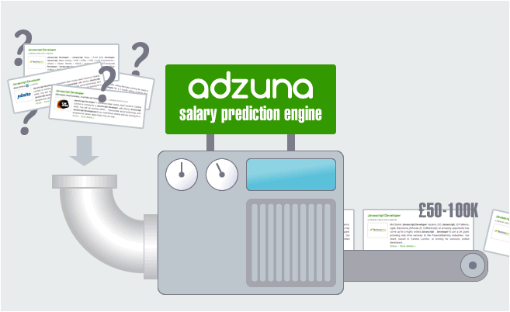
Salary Predictions
What is it?
Classifying Job Salaries from an advertisement.
Notes:
Adzuna is UK based advertisement aggregator

Slide 5
Data
Adzuna offered a dataset
Train.csv
ID | Title | FullDescription | Loc Raw | Loc norm | ContractType | Company | Salary
Int | String | String | String | String | String | String | Int
Notes:
Talk about attributes

Slide 6
Data
Adzuna offered a dataset
Train.csv
Over 244,000 training instances
ID | Title | FullDescription | Loc Raw | Loc norm | ContractType | Company | Salary
Int | String | String | String | String | String | String | Int
Notes:
Talk about attributes

Slide 7
Data
Adzuna offered a dataset
Train.csv
Over 244,000 training instances
Approximately 40,000 test instances
Mostly String attributes, two very important ones, FullDescription, and Title
ID | Title | FullDescription | Loc Raw | Loc norm | ContractType | Company | Salary
Int | String | String | String | String | String | String | Int
Notes:
Talk about attributes

Slide 8
Data Preparation
How to interpret the data
Notes:
Talk about attributes

Slide 9
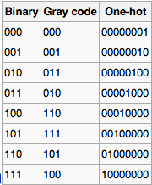
Data Preparation
How to interpret the data
Binarized Attributes
Encode the categorical attributes to a binary one-hot vector (mainly done to save space & time)
Notes:
Talk about attributes

Slide 10
Data Preparation
How to interpret the data
Binarized Attributes
Encode the categorical attributes to a binary one-hot vector (mainly done to save space & time)
Tokenized
Convert these (potentially large) strings to a bag of words representation.
Notes:
Talk about attributes

Slide 11
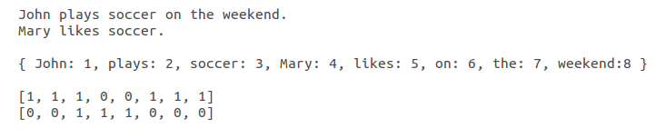
Bag-of-words
Representation which uses a dictionary and simplifies full text. Removes grammar and word order.
Notes:
Talk about attributes

Slide 12
Method
Need a fast method of classifying with very high number of features
Vowpal Wabbit
Notes:
Talk about attributes

Slide 13
Vowpal Wabbit
Linear learner which applies a gradient descent algorithm
Developed at Yahoo Research, then aqcuired by MSFT Research
Used for quickly doing linear model machine learning
Notes:
Talk about attributes

Slide 14
Data / Process Flow
Given Data
Python Preparation Scripts
Vowpal Wabbit
Python Cleanup Scripts
Kaggle Submission
Notes:
Talk about attributes

Slide 15
Results
Output in the form of a csv with 2 columns, { ID, SalaryNormalized }
Kaggle Rankings
Measurement is MAE
Mean Absolute Error from the actual normalized salary.
Notes:
Talk about attributes

Slide 16
Results
Performed multiple different attempts to lower the MAE
Best result submitted was 6733.83 MAE
Notes:
Talk about attributes

Slide 17
Results
Free Text (description) | Logarithmic(MAE) | Square Root(MAE)
None | 12172.17 | 13293.12
All | 7350.44 | 6733.83
Keywords (local) | 8149.91 | 7744.84
Keywords (global) | 8360.31 | 8135.83
Notes:
We’ve learned that a dumber algorithm with more features is better than a clever algorithm with less data.
Local == keywords in each bag of words field
Global == top 500 keywords from every bag of words field in all training instances

Slide 18
Results
The result 6733.83 MAE scored a place of 102/285 teams on the leaderboards.
Notes:
Talk about attributes

Slide 19
Questions?
Notes:
Talk about attributes

