Slide 1
Adzuna Job Salary prediction Competition
Braden Simpson, Jordan Ell

Slide 2
Competition
Kaggle.com hosts international competitions for data science
Adzuna, UK based advertisement website posted the challenge
$6,000 prize to the winner
Lots of competition
Notes:
Adzuna is UK based advertisement aggregator

Slide 3
Salary Predictions
What is it?
Classifying Job Salaries from an advertisement.
Notes:
Adzuna is UK based advertisement aggregator

Slide 4
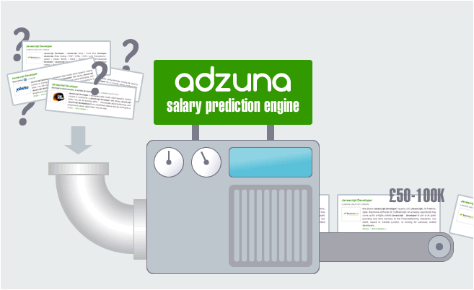
Salary Predictions
What is it?
Classifying Job Salaries from an advertisement.
Notes:
Adzuna is UK based advertisement aggregator

Slide 5
Methods
Notes:
Adzuna is UK based advertisement aggregator

