Slide 1


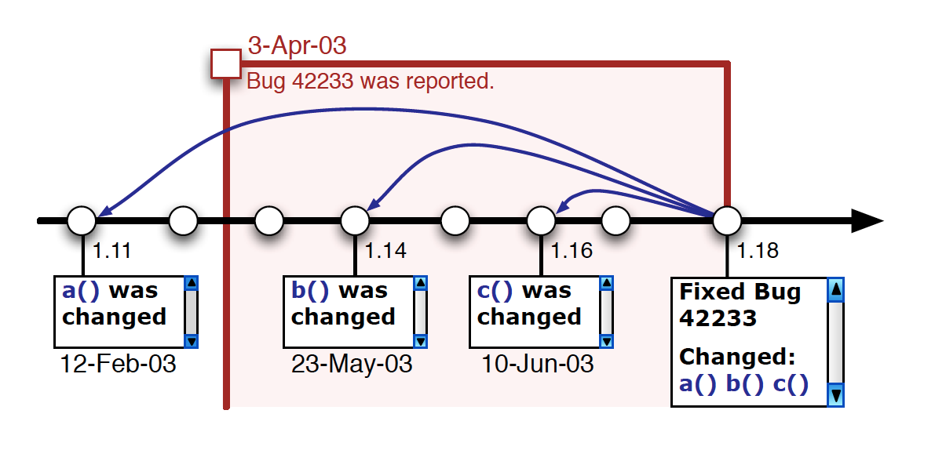
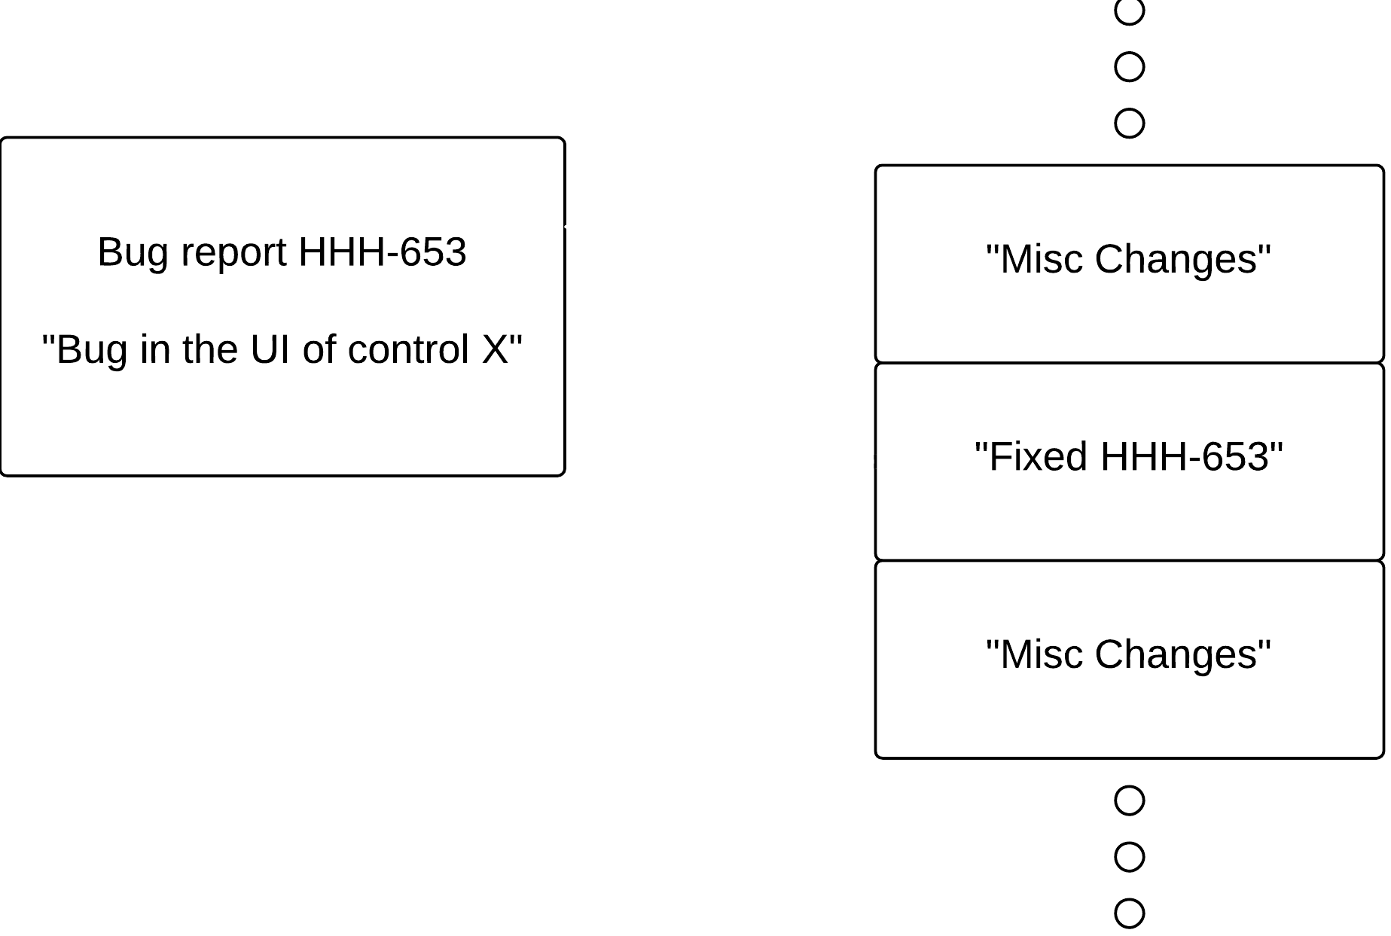
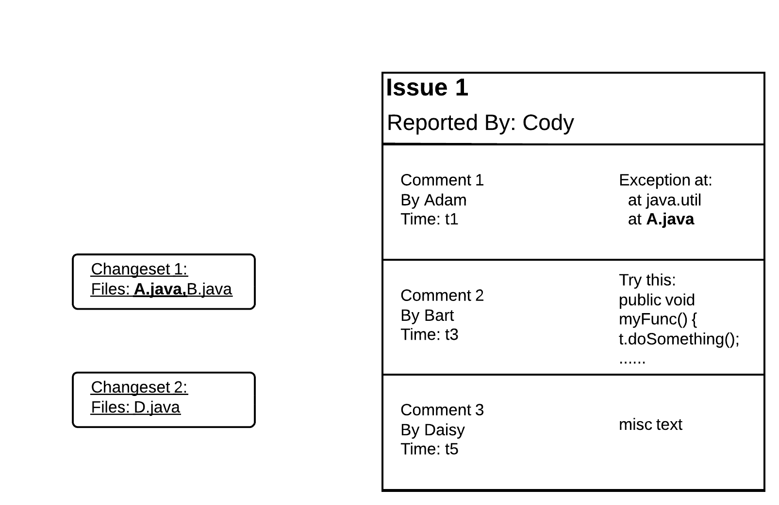
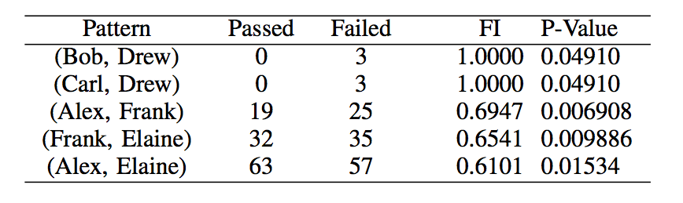
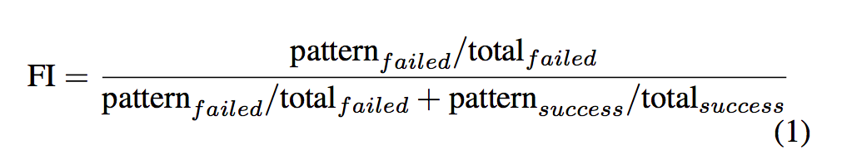

Changeset Based Developer Communication to Detect Software Failures Braden Simpson
University of Victoria
Braden Simpson
Keywords
Research Question
Changeset Success
Communication, social networks, software failures, bug prediction, software engineering, version control, bug reports
Can we identify failure-inducing communication patterns in social networks based on changesets and communications artifacts?
Another crucial aspect of this study is to determine whether or not the changset was a success or failure. This binary decision is done by finding the fix-inducing changes in a repository.[1]
Problem
Methodology
The method developed by Sliwerski et al. to find fix-inducing changes
Software systems that solve complex problems and have large code bases can require a large amount of communication and coordination tasks.
There are multiple methods used to construct links between communication artifacts and the changesets.
The methods are:
1) Analyzing Changeset Message
Results &
Future Work
The unique bug identifier in the commit message is matched to the bug ID. Most concrete way to link, but doesn’t map everything
2) Parsing Communication Artifacts
After establishing a link to the communication artifact, the contributor pairs are formed. In Ex 2. at time t2, the contributor pairs would be
{(Bart, Adam), (Bart, Cody), (Adam, Cody)} . Once the patterns are obtained for each changeset. Over the course of the project, The number of times each contributor pair communicated, they received a binary pass or fail.
Hibernate ORM (a medium sized open source project) was used project was studied.
The next step is to parse through all the information given in the communication, and try to match with the commit meta information.
At time t1, changeset 1 is committed, then all the comments prior to that are checked for keywords, stacktraces, patches, or code snippets.
Changeset commit message to bug iD
Other factors could cause miscommunication, such as habits of communication, social practices, language barriers, etc.
References
In this example, Adam posted a stacktrace including File A.java which corresponds to the file in Changeset 1. Now the bug report can be linked to this changeset.
The top five results, based on a normalized failure metric, FI which is calculated by:
[1] T. Wolf, A. Schro ̈ter, D. Damian, and T. Nguyen, “Predicting Build Failures Using Social Network Analysis on Developer Communication,” in Proceedings of the 31st International Conference on Software Engineering, ser. ICSE ’09. Washington, DC, USA: IEEE Computer Society, 2009, pp. 1–11. [Online]. Available: http://dx.doi.org/10.1109/ICSE.2009.5070503
[2] T. Wolf, A. Schro ̈ter, D. Damian, L. Panjer, and T. Nguyen, “Mining task-based social networks to explore collaboration in software teams,” Software, IEEE, vol. 26, no. 1, pp. 58 –66, jan.-feb. 2009.
[3] N. Bettenburg, R. Premraj, T. Zimmermann, and S. Kim, “Extracting Structural Information from Bug Reports,” in Proceedings of the 2008 International Working Conference on Mining Software Repositories, ser. MSR ’08. New York, NY, USA: ACM, 2008, pp. 27–30. [Online]. Available: http://doi.acm.org/10.1145/1370750.1370757
[4] J. S ́liwerski, T. Zimmermann, and A. Zeller, “When Do Changes Induce Fixes?” in Proceedings of the 2005 International Workshop on Mining Software Repositories, ser. MSR ’05. New York, NY, USA: ACM, 2005, pp. 1–5. [Online]. Available: http://doi.acm.org/10.1145/1082983.1083147
[5] A. Schro ̈ter, “Predicting Build Outcome with Developer Interaction in Jazz,” in Proceedings of the 32nd ACM/IEEE International Conference on Software Engineering - Volume 2, ser. ICSE ’10. New York, NY, USA: ACM, 2010, pp. 511–512. [Online]. Available: http://doi.acm.org/10.1145/1810295.1810456
[6] T. Zimmermann and N. Nagappan, “Predicting defects Using Network Analysis on Dependency Graphs,” in Proceedings of the 30th International Conference on Software Engineering, ser. ICSE ’08. New York, NY, USA: ACM, 2008, pp. 531–540. [Online]. Available: http://doi.acm.org/10.1145/1368088.1368161
This study yielded good results, but there were ~5000 contributors, most of which gave <5 contributions. Resulting in a large amount of insignificant results.
In the future work, I plan to study closed source project with higher contributions per person.
Ex. 2. Bug report with timeline demonstrating linking
Contact
Email: brsmp@acm.org
LinkedIn: http://linkedin.com/in/brsmp
For more information, visit http://thesegalgroup.org

