Slide 1


Changeset Based Developer Communication to Detect Software Failures
Braden Simpson
Notes:
Hello I’m braden simpson and I’m here to talk about _____
This project was done with the guidance of dr. daniela damian

Slide 2
Problem
Big product, complex software, complex code
Many employees, more room for communication failures
Notes:
With large companies, and complex products, confusion around bug fixes and feature implementation can arise. Communication efficacy is a paramount concern and we the problems

Slide 3
Problem

Slide 4
Problem

Slide 5
Research Question
Are there communication patterns that are harmful (i.e. have a high likelihood to produce a software failure).

Slide 6

Study
Hibernate ORM
Open source project
Over 5000 contributors
Almost 4000 commits
Notes:
If the changeset was a *fail* then classify it.
P_f is the number of times that pattern failed.
Explain Failure Index
a metric used to normalize the failure of a pattern

Slide 7
Methodology
Find changes (commits) that introduce bugs
Link the commits to corresponding bug reports
Construct contributor pairs for each commit
Examine pairs over time for patterns
Notes:
Make a picture

Slide 8
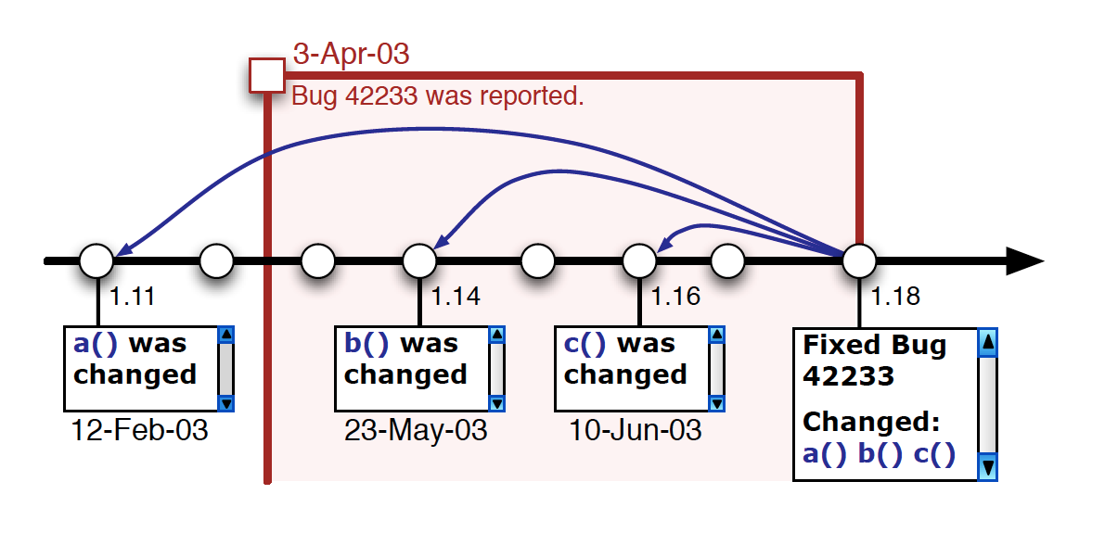
Fix-inducing Changes
Locating fix-inducing changes for bug 42233
Figure from Sliwerski et al[0]
Notes:
How do we find fix-inducing changes?
Use SZZ algorithm and
----- Meeting Notes (4/30/13 15:22) -----
accuracies, stats, fix inducing background work

Slide 9
Link Commits to Bug Reports
Notes:
Want to find out how to link the commits / changesets
Changeset one linked to comment 1 & therefore linked to the bug report.
add other slide to link the body of the comments to the changeset (via other paper).

Slide 10
Social Patterns
Create the social patterns at each commit
For example…
Notes:
Create Social network at each commit
At a commit, consider all communication in a scope of time before that commit to be potentially valid (30 days)

Slide 11

Social Patterns
Time : t2
(Adam, Cody) (Adam, Bart),
(Bart, Cody)
Notes:
Create Social network at each commit
At a commit, consider all communication in a scope of time before that commit to be potentially valid (30 days)

Slide 12
Social Patterns
Time : t4
(Adam, Cody), (Adam, Bart),
(Bart, Cody),
(Daisy, Adam)
Notes:
Create Social network at each commit
At a commit, consider all communication in a scope of time before that commit to be potentially valid (30 days)

Slide 13
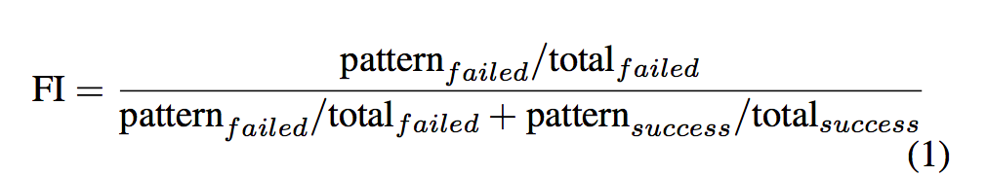
Analyze Patterns
Failure Index Equation
Notes:
If the changeset was a *fail* then classify it.
P_f is the number of times that pattern failed.
Explain Failure Index
a metric used to normalize the failure of a pattern

Slide 14
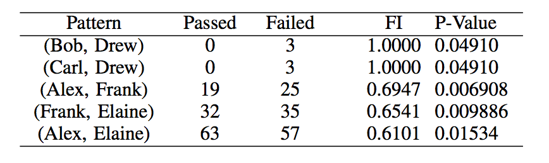
Results
3968 Changesets Total
3076 Changesets Linked to Communication
4537 Distinct Patterns (i.e. {bob, drew})
178 Significant Patterns
55 Failure Inducing Patterns
Notes:
Top 5 FI with statistical significance

Slide 15
Future Work
Different Project
Smaller contributor group
Combine with technical networks
Notes:
Smaller group == more significant patterns
This group had over 5000 contributors, most of which had <5 communication artifacts.
Combine with technical networks to find STC
Potentially create recommender systems

Slide 16
References
[0] J. Sliwerski, T. Zimmermann, and A. Zeller, “When Do Changes Induce Fixes?” in Proceedings of the 2005 International Workshop on Mining Software Repositories, ser. MSR ’05. New York, NY, USA: ACM, 2005, pp. 1–5. [Online]. Available: http://doi.acm.org/10.1145/1082983.1083147
[1] A. Schroeter, “Predicting Build Outcome with Developer Interaction in Jazz,” in Proceedings of the 32nd ACM/IEEE International Conference on Software Engineering - Volume 2, ser. ICSE ’10. New York, NY, USA: ACM, 2010, pp. 511–512. [Online]. Available: http://doi.acm.org/10.1145/1810295.1810456

Slide 17

Questions
Notes:
Smaller group == more significant patterns
This group had over 5000 contributors, most of which had <5 communication artifacts.
Combine with technical networks to find STC
Potentially create recommender systems

