Slide 1


Introduction to Programming

Slide 2
Outline
What you will get out of this class?
What is a program?
What is a programming language?
What is Python?
A tour of Python and IDLE.

Slide 3
What you will get out of this class
Throughout the class we will be building pong using the concepts we learn each class
Each class we will release source for a new step in pong
Each class homework will be assigned to help you cement your knowledge of the concepts covered
Demo time

Slide 4
What is a program?
A program is a series of instructions to be executed
Source code is text the machine can translate into instructions
Source gets translated into machine readable code which the machine then executes

Slide 5
What is a programming language?
Artificial language designed to express computations that can be performed by a machine
Can be compiled or interpreted
Compiled languages are translated to machine code before being run
Interpreted languages are translated into machine code while the program runs

Slide 6
What is Python?
An cross-platform interpreted programming language
Created by Guido van Rossum
Especially good for scripting, prototyping and it makes a great first language

Slide 7
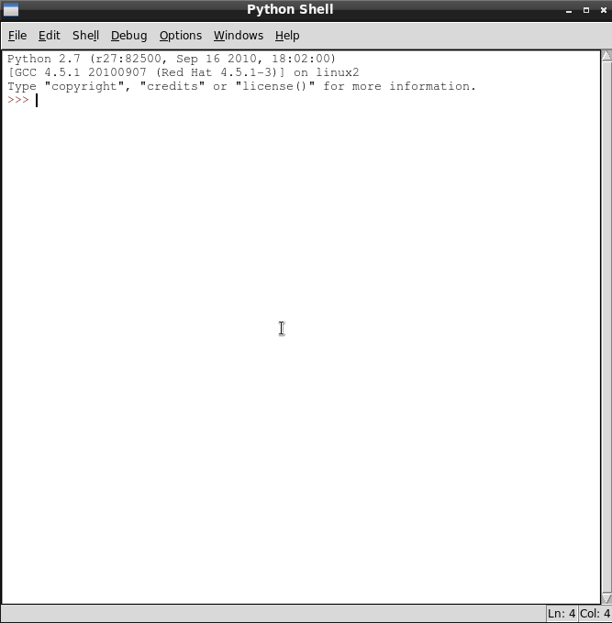
A Tour of Python And IDLE

Slide 8
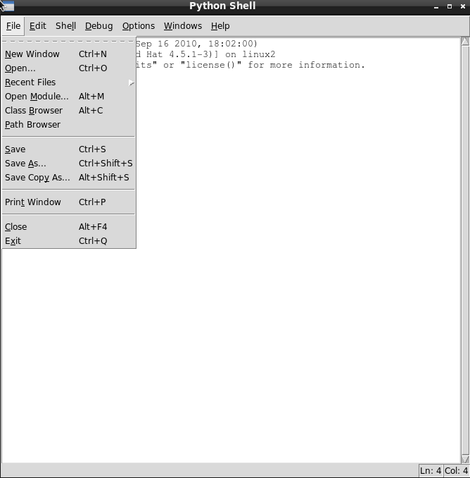
A Tour of Python And IDLE (cont.)

Slide 9
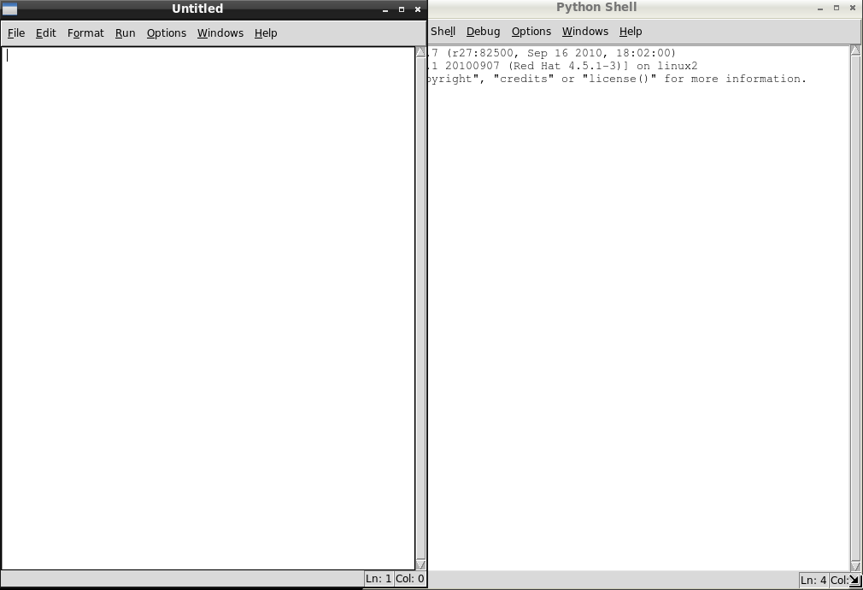
A Tour of Python And IDLE (cont.)

Slide 10
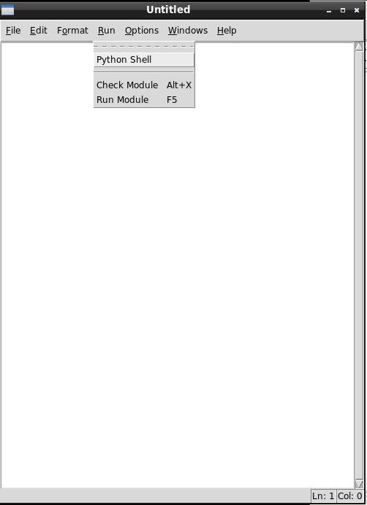
A Tour of Python And IDLE (cont.)

Slide 11
Hello World
x = “Hello World”
print(x)

Slide 12
Dissecting Hello World
x is a variable
“Hello World” is a string
x = “Hello World” stores the string in x
print is a function
print takes a string as an argument
print(x) replaces x with “Hello World” and prints it

Slide 13
Primary Data Types
Words and Letters
  Strings - “Hello World”, “C”, 'c', 'This is great!'
Numbers
  Integers – 12, 23
  Floating point – 2.7, 3.14159
  Complex - 2j
Booleans – True, False

Slide 14
Strings
Single double or triple quotes work
String can be indexed - “abc”[0] is “a”
Strings can be added together - “abc” + “def” is “abcdef”
Strings can be multiplied - “h4cdc” * 3 is HacDC's wireless password!
Strings have length – len(“abc”) is 3

Slide 15
Numbers
The regular arithmetic functions all work - '+', '-', '*', '/', '%', '**'
1 + 1 is 2
(1 * 3) ** 2 / 2 is 4 (what?)
An integer divided by an integer is an integer – 7/2 is 3
An integer divided by a float is a float – 7/2.0 is 3.5
A float divided by an integer is a float – 7.0/2 is 3.5
A float divided by a float is a float – 7.0/2.0 is 3.5

Slide 16
Booleans
Either True of False
Are good for testing things
True == True is True
True == False is False

Slide 17
Logical Expressions
Evaluate to a boolean
Logical operators are 'and', 'or', 'not', 'is', 'in', '==', '!=', '<=', '>='
True == not False is True
True is False is False
3 >= 4 is False
“a” in “abc” is True

Slide 18
Workshop Time!
Download wrapper_turtle.py
There are 6 functions: forward, backward, left, right, penup, pendown.
from wrapper_turtle.py import *

