Slide 1
Unification of Michele, Jeff, & Brad Ideas
How to formalize the description of messages and transfer procedures By Bradford G. Van Treuren 7/20/2021

Slide 2
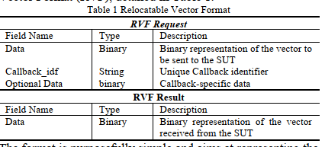
Michele’s RVF Proposal
Data exposes the context of the message. This violates “Separation of Concerns” software rules.
Callback_idf is similar to my “metaname” in my RVFMessage.
There should be no need for optional data if the “transport layer” encapsulates the context.
There should be no difference between Request and Response messages to the “transport layer.”

Slide 3
Brad’s RVF Proposal
enum RVFType { ERROR = 0; STATUS = 1; REQUEST = 2; RESPONSE = 3; WRAPPER = 4; } message RVFMessage { uint32 UID = 1; RVFType rvf_type = 2; string metaname = 3; bytes serialized = 4; }
RVFMessage is a “transport layer” wrapper around the underlying protocol message
Adheres to the “Separation of Concerns” rules for OOD
UID contains the identifier of the child (address) sending the message so host knows on which channel the message came from
Metatname specifies the handler context required to process the message
Serialized contains the content of the message being transported
Host Node just routes the RVFMessage to the “transfer module” associated with it
“transfer module” is responsible for deserializing RVFMessage and routing content to appropriate transfer procedure based on metaname

Slide 4
P2654 Influence on P1687.1 Bottom-Up Messaging
P2654 Host Node
P2654 Transport Layer Channel
P2654 Client Node
message RVFMessage { uint32 UID = 1; RVFType rvf_type = 2; string metaname = 3; bytes serialized = 4; }
All DOMAIN messages reside in Serialized as wrapped messages. It does not matter what the context is.
Metaname is used to identify the routing to the appropriate transfer procedure

Slide 5
P2654 Influence on P1687.1 Bottom-Up Messaging
Routes RVFMessage from channel to associated Transfer Module
Routes RVFMessage to channel from associated Transfer Module
P2654 Host Node
P2654 Transport Layer Channel
P2654 Client Node
Decodes RVFMessage and calls appropriate transfer procedure associated with metaname or returns an ERROR response
message RVFMessage { uint32 UID = 1; RVFType rvf_type = 2; string metaname = 3; bytes serialized = 4; }
Creates context specific message from a transfer procedure and packages it in an RVFMessage for channel
Response is just the reverse flow with same RVFMessage type
Transfer Library
Transfer Library

Slide 6
P2654 Influence on P1687.1 Top-Down Messaging
P2654 Client Node
P2654 Transport Layer Channel
P2654 Host Node
message RVFCommand {
uint32 IID = 1;
RVFType rvf_type = 2;
string metaname = 3;
bytes serialized = 4;
}
All DOMAIN messages reside in Serialized as wrapped messages. It does not matter what the context is.
Metaname is used to identify the routing to the appropriate transfer procedure

Slide 7
P2654 Influence on P1687.1 Top-Down Messaging
Routes RVFCommand from channel to associated Inject Module
Routes RVFCommand to channel from associated Inject Module
P2654 Client Node
P2654 Transport Layer Channel
P2654 Host Node
Decodes RVFCommand and calls appropriate transfer procedure associated with metaname or returns an ERROR response
message RVFCommand {
uint32 IID = 1;
RVFType rvf_type = 2;
string metaname = 3;
bytes serialized = 4;
}
Creates context specific message from a transfer procedure and packages it in an RVFCommand for channel
Response is just the reverse flow with same RVFCommand type
Inject Library
Inject Library

Slide 8
Transfer Library Logic
Transfer Procedure
MessageType1 Transfer Procedure
Transfer Library RVFMessage Handler
metaname
MessageType2 Transfer Procedure
MessageType3 Transfer Procedure

Slide 9
Additional Slides since 20210720
20210801 Content

Slide 10
P2654 Node Structure
Injection Library
Injection Library
P2654 Node
P2654 Node
RVFCommand Request
Insertion from Top
RVFCommand Request
RVFCommand Request
Insertion from Top
RVFCommand Response
RVFCommand Response
RVFCommand Response
RVFMessage Request
Insertion from Bottom
RVFMessage Request
Insertion from Bottom
RVFMessage Request
RVFMessage Response
RVFMessage Response
RVFMessage Response
Transfer Library
Transfer Library

Slide 11
Top-Down to Bottom-Up Flow Ian: This flow chart may capture the core of what the P2654 standards needs to describe in terms of "process"; the remainder is likely to be standardising the form in which inputs to the process are provided and the interface between nodes (since the code implementing the node may come from any source).
P2654 RVFCommand Sent from Application
Is Node top level controller
?
Transform RVFMessage and pass to next higher level
Process RVFCommand with Injection Handler
NO
Is Node target of RVFCommand
?
YES
Is Node command request node
?
Create RVFMessage Request to begin Bottom-Up processing for this Node
Transform RVFMessage into HW Controller sequences and apply to HWIF
YES
NO
NO
YES
Send RVFMessage to next lowest level
Send RVFCommand to next Node
Send RVFMessage as bottom-up request
Create RVFMessage Response from HWIF response and return Response to requester
Create RVFCommand response and return response to command application

Slide 12
Additional Slides since 20210720
20210803 Content

Slide 13
Correlating P2654Demo2 to Concept How it correlates to slide 10
Insertion from Bottom Half of P2654Node
Injection
Library
Model Node
Injection Strategy
Transfer Library
Debug
Library
Host
Client/Host AccessInterface
Injection Interface
Debug Strategy
Debug Interface
Model Node
Transformation Interface
Transformation Strategy
Host/Client AccessInterface
TestInjectionInterface
Model Node
Model Node
Injection Node
Injection Node
Clients
o o o
o o o
Insertion from Top Half of P2654Node

Slide 14
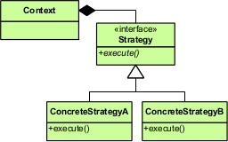
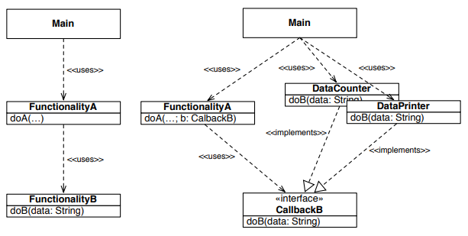
P2654 and P1687.1 Callbacks are really Strategy Pattern and not Callback Pattern
Handle processing a message based on the Metaname parameter to select which ConcreteStrategy to perform
Strategy Pattern https://en.wikipedia.org/wiki/Strategy_pattern
Callback Pattern https://www.win.tue.nl/~wstomv/edu/2ip15/downloads/Series_04/callbacks.pdf

Slide 15
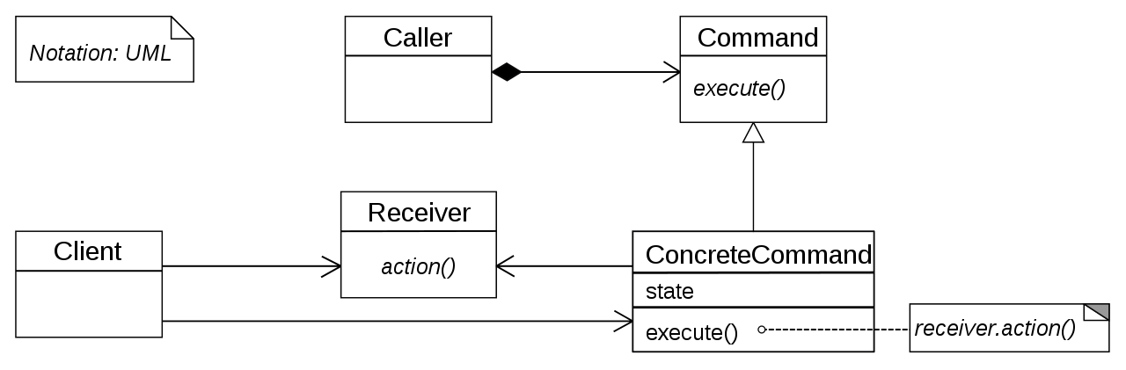
P2654 and P1687.1 Callbacks are not really Command Pattern
Command uses the same method and parameters to call a command (same API) that in turn calls the specialized behaviors of that ConcreteCommand. This may be useful for library API to HANDLER procedure that decodes the Metaname.
Strategy Pattern https://en.wikipedia.org/wiki/Strategy_pattern
Command Pattern https://en.wikipedia.org/wiki/Command_pattern

Slide 16
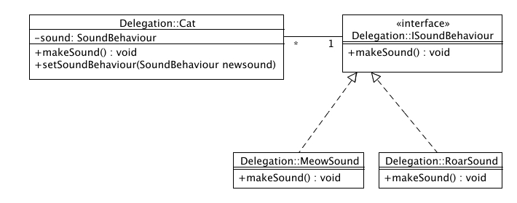
P2654 and P1687.1 Nodes use Delegation Pattern to Call Plug-In Library
Delegation Pattern http://best-practice-software-engineering.ifs.tuwien.ac.at/patterns/delegation.html
Delegation defers the implementation of a method to a delegate for processing. setSoundBehaviour() is like setStrategy().

Slide 17
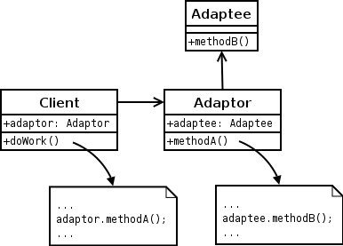
P2654 and P1687.1 ModelPoint Node uses Adapter Pattern to Transform External Formats
ModelPoint
(adapter)
ModelPoint
(adapter)
Custom Model
Device EDA Tool
ModelPoint
(adapter)
JTAG Model
Adapter Pattern https://en.wikipedia.org/wiki/Adapter_pattern
Adapts a different interface and format to look like another interface and format. This is not a transformation as the context remains the same.

