Slide 1

Ray Tracing vs. Rasterization
Is this the right question to ask?

Slide 2


History of Predicting the Future
I think there is a world market for maybe 5 computers. - Thomas J. Watson, 1943.
I can assure you on the highest authority that data processing is a fad and won't last out the year. - A Prentice-Hall editor, 1957.
There is no reason anyone would want a computer in their home. - Ken Olson, DEC, 1977.
I could never render images using hardware - anonymous Animator, 2001.

Slide 3
What do they use? Pencils?
CPUs are hardware, too
  Hardware is necessary to run SW - programmable HW
  SW renderers runs on CPUs
GPUs are programmable HW
  Can run SW on GPUs now
  Cg is a high-level language for GPUs
GPUs are already “Turing complete" processors
  !!! can compute any image that a CPU can !!!
All that we need is
  Faster GPUs – double perf every 6 months
  More flexible GPUs – more programmability

Slide 4
nVIDIA Historicals
Season | Product | Fill rate | Yr rate | Tri rate | Yr rate
2H97 | Riva 128 | 20M | - | 3M | -
1H98 | Riva ZX | 31M | 2.4 | 3M | 1.0
2H98 | Riva TNT | 50M | 2.6 | 6M | 4.0
1H99 | TNT2 | 75M | 2.3 | 9M | 2.3
2H99 | GeForce | 120M | 2.6 | 15M | 2.8
1H00 | GeForce2 | 200M | 2.6 | 25M | 2.8
2H00 | GF2 Ultra | 250M | 1.6 | 31M | 1.5
1H01 | GeForce3 | 500M | 4.0 | 30M | 1.0
2H01 | GeForce4 | 1000M | 4.0 | 75M | 5.0
 |  |  | 2.75 |  | 2.55
Yearly Growth well above Moore’s Law
Notes:
Note that period between products has moved from 2-4 years to ½ year. Due both to competitive environment AND to the integration on a single die, which allows incremental improvement due to complete control of process.
Note that aggregate numbers are similar to those for second generation features on SGI machines. Again well above Moore’s law.

Slide 5
Semiconductor Scaling Rates
Parameter | Current Value | Yearly Factor | Years to Double (Half)
Moore’s Law (grids on a die)** | 1 B | 1.49 | 1.75
Gate Delay | 150 pS | 0.87 | (5)
Capability (grids / gate delay) |  | 1.71 | 1.3
Device-length wire delay |  | 1.00
Die-length wire delay / gate delay |  | 1.71 | 1.3
Pins per package | 750 | 1.11 | 7
Aggregate off-chip bandwidth |  | 1.28 | 3
** Ignores multi-layer metal, 8-layers in 2001
From: Digital Systems Engineering, Dally and Poulton
Notes:
Capability is product of Moore’s Law and gate delay. This is a very impressive rate of improvement.
Wire delay looks acceptable

Slide 6
GPU vs. CPU
Semiconductor “Capability” grows at ~1.7x per year
CPU performance compounding at ~1.4-1.5x per year (not bad, but wasting .2-.3x EVERY year)
GPU performance compounding at 2.5 – 2.75x per year
Why is this?

Slide 7
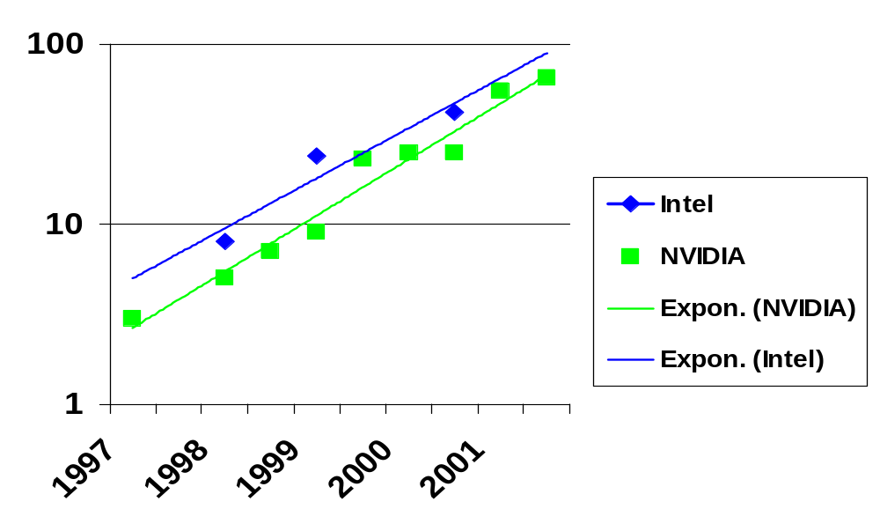
Millions of Transistors vs. Year

Slide 8
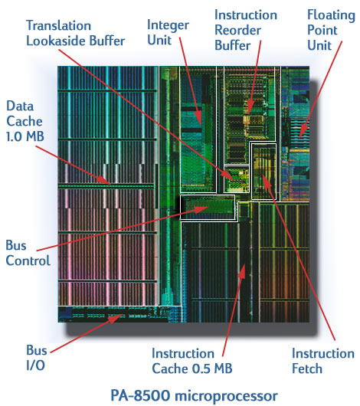
There’s a
LOT of
Cache here!
http://www-vlsi.stanford.edu/group/chips_micropro.html

Slide 9
Speed Gap between DRAM and CPU - Memory Wall
1000
μPU
60%/year
100
Increasing
The Gap
Performance(Speed Ratio)
10
1
DRAM
7%/year
80
85
90
95
00
Year
Slide courtesy of Mark Horowitz, from Junji Ogawa 1998 presentation
Notes:
There is debate on this point, though.
Peter Glaskowski (Microprocessor Report) believes that DRAM is keeping up with microprocessor needs, at least with cache taken into account.
RDRAM changed the base rate, but does it keep up better?

Slide 10
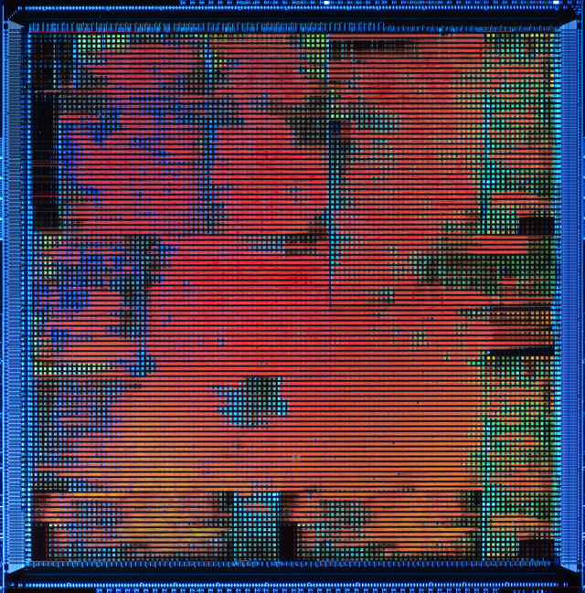
NVIDIA GeForce3 – almost ALL logic

Slide 11
“Stream” Processors
Dedicated peak
Input bandwidth
X
Dedicated peak
Processing power
Dedicated peak
Output bandwidth

Slide 12
Now: The GeForce3/GeForce4/XBOX Graphics Pipeline
programmable vertex
processing
vertex
setup
polygon setup &
rasterization
polygon
rasterizer
per-pixel
interpolation
pixel
programmable per-
pixel math, blending
texture
Z-buffer, blending &
anti-alias
image

Slide 13
The Next Generation – Cinematic Realism in Real-time
Full 32-bit Precision IEEE Floating Point, throughout the pipeline
Much more programmability
  Longer shader programs
  Branching/looping
Much more parallelism and shading IPS
Still some hardwired components:
  Rasterization, Texture Filtering, Z-buffer/Stencil/Blend
  Hardwired logic is FAST and SMALL

Slide 14
Algorithms Running on GPUs
Ray Tracing (you’ve seen it!)
Image Based Rendering
Volume Rendering
Radiosity (form factors, gathering)
Using
  Programmable elements
  Hardwired elements, too
So, is it really Ray Tracing vs. Rasterization?

