Slide 1
When Will Ray Tracing Replace Rasterization?
Tim Purcell
Stanford University

Slide 2
Programmable Graphics Processor
Application
Fragment
Input
Command
Textures
Fragment
Program
Geometry
Rasterization
Registers
Texture
Fragment
Fragment
Output
Display
Rasterization with programmable fragment processing
and dependent texutre mapping

Slide 3
Stream Programming Model
Programmable fragment processor is essentially a stream processor
Kernels and streams
  Stream is a set of data records
  Kernels operate on records
  Streams connect kernels together
  Kernels can read global memory
input
record
stream
kernel
globals
kernel
globals
output
record
stream

Slide 4
Ray Tracing Can Stream Too
Generate Eye Rays
Camera
rays
Traverse Acceleration Structure
Grid
ray-voxel pairs
Intersect Triangles
Triangles
hits
Shade Hits and Generate Shading Rays
Materials
pixels

Slide 5
Who wins? Both!
Ray tracing and rasterization are both tools
  Use the right tool for the job
Hybrid rendering
  Standard OpenGL pass for initial visibility
  Shading computed by ray tracing
    Accurate shadows
    Global illumination

Slide 6
Demo

Slide 7
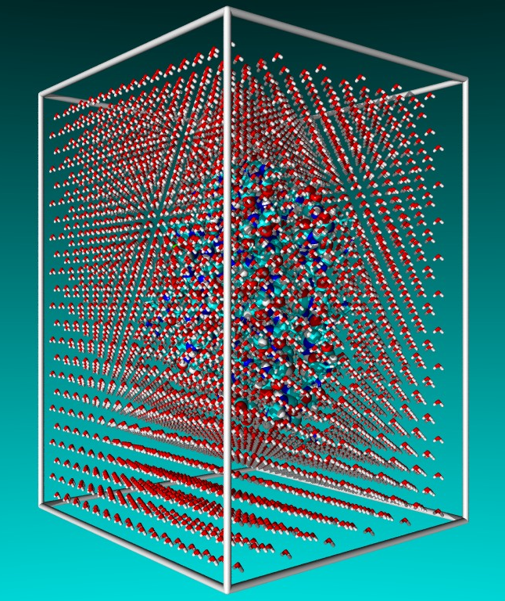
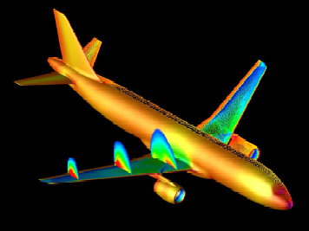
Open Issues
Immediate mode ray tracing?
Is streaming really the best architecture for ray tracing?
Do other interesting computations map well to stream processing?
Molecular Dynamics
Fluid Flow

Slide 8
Shameless Plug
Ray Tracing on Programmable Graphics Hardware
Tim Purcell, Ian Buck,
Bill Mark, Pat Hanrahan
Friday 11:20

