Slide 1
When Will Ray-tracing Replace Rasterization?
SIGGRAPH 2002 Panel
Notes:
Welcome SIGGRAPH 2002 Attendees
Thanks for joining us for the panel session “When …”
For your reference, this is Ballroom C3 and our panel will finish around 12:15.
After the introduction, each panelist will make a 10-to-15 minute presentation in turn, and then it will be our privilege to answer your questions.

Slide 2
Brad Grantham - Silicon Graphics
Philipp Slusallek - Saarland University
Tim Purcell - Stanford University
David Kirk - NVIDIA
Kurt Akeley - NVIDIA, Stanford
Larry Seiler - ATI
Notes:
I’ve tried to gather an interesting and varied group of industry and community experts for your entertainment… um, I mean, edification.
Phil - RT for years, Stanford 1998-1999, Ph.D. University Erlangen
Tim Purcell - RT paper in this year’s SIGGRAPH, PhD Stanford?
David Kirk - CTO NVIDIA, previous ray-tracing experience at Apollo, PhD California Institute Technology
Kurt Akeley - designer OpenGL, high end graphics Reality Engine, ACM SIGGRAPH CG Achievement award 1995, working on PhD at Stanford
Larry Seiler - hardware architect at ATI, VolumePro RT volume ray-casting, PhD Massachusetts Institute Technology

Slide 3
Panel Focus
(When) will ray-tracing replace rasterization for interactivity?
  Visualization
  Design
  Digital content creation preview
  Games

Slide 4
Focus: Ray-tracing Versus Rasterization
Very naïve form of the question
  “What does the future hold?”
  There’s a large continuum
What are the differences/benefits?
What alternatives are available?

Slide 5
History of Interactive Techniques
Vector displays
Scanline techniques
Rasterization with texturing and depth buffering is just the newest
Easier/cheaper always wins when it becomes “good enough”
Ivan Sutherland said in 1974 that Z-buffering was "hopelessly inefficient".
Notes:
Late 1960s - GE. Raster scanline technique based on polyhedral edges - IC module PER EDGE
by 1990, Zbuffering obviously fast enough

Slide 6
Rasterization
for each rendering pass {
for each object {
for covered pixels {
shade
update framebuffer
}
}
}
Notes:
Loop through all objects for each illumination effect
reflections
shadows (map, or to draw shadow volumes)
all pixels conceptually done for one object before the next one
alpha sorting is a problem

Slide 7
Rasterization
for each rendering pass {
for each object {
for covered pixels {
shade
update framebuffer
}
}
}

Slide 8
Rasterization
Triangle Parameters
Linearly Interpolated
Takes Advantage Of
Screen Space Coherence

Slide 9
Rasterization
for each rendering pass {
for each object {
for covered pixels {
shade
update framebuffer
}
}
}

Slide 10
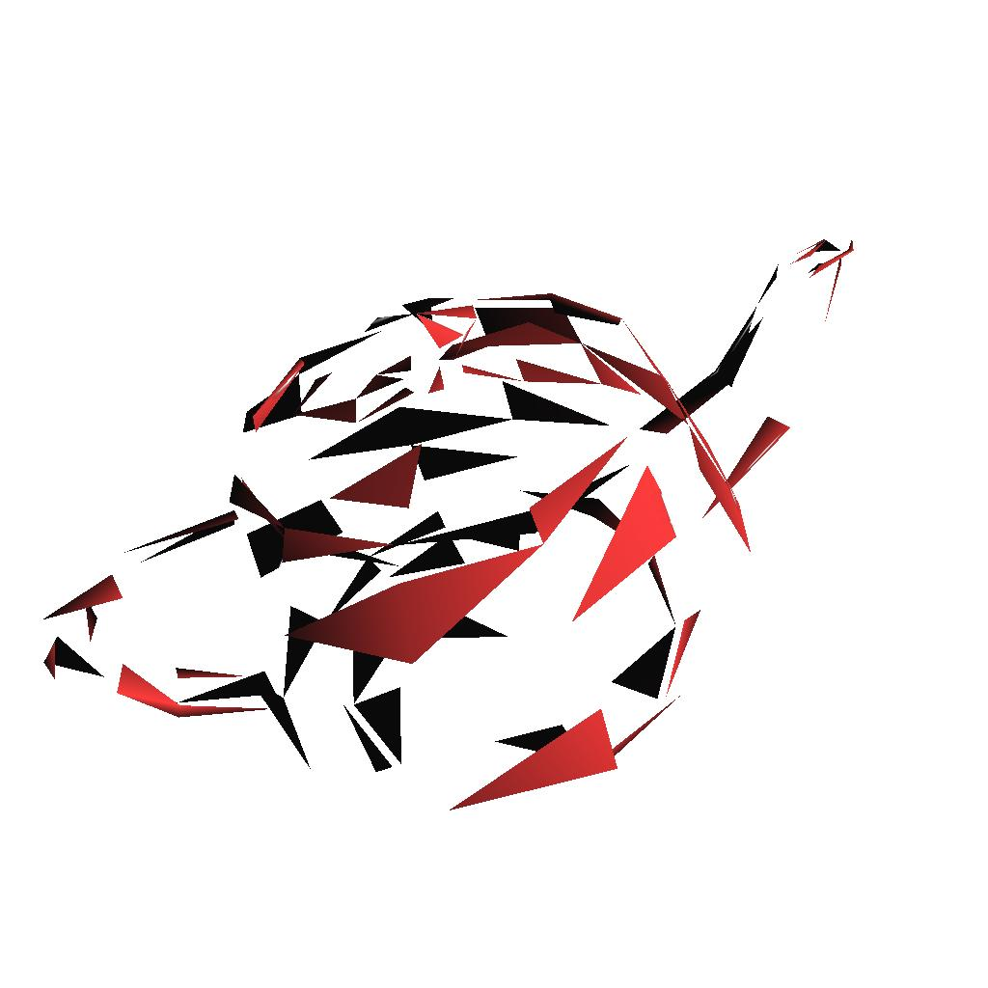
Rasterization
100 triangles rendered
Notes:
Information about other triangles may/may not be available as one is rendered, certainly not from anything but eye viewpoint (e.g. reflection viewpoint, light viewpoint)

Slide 11
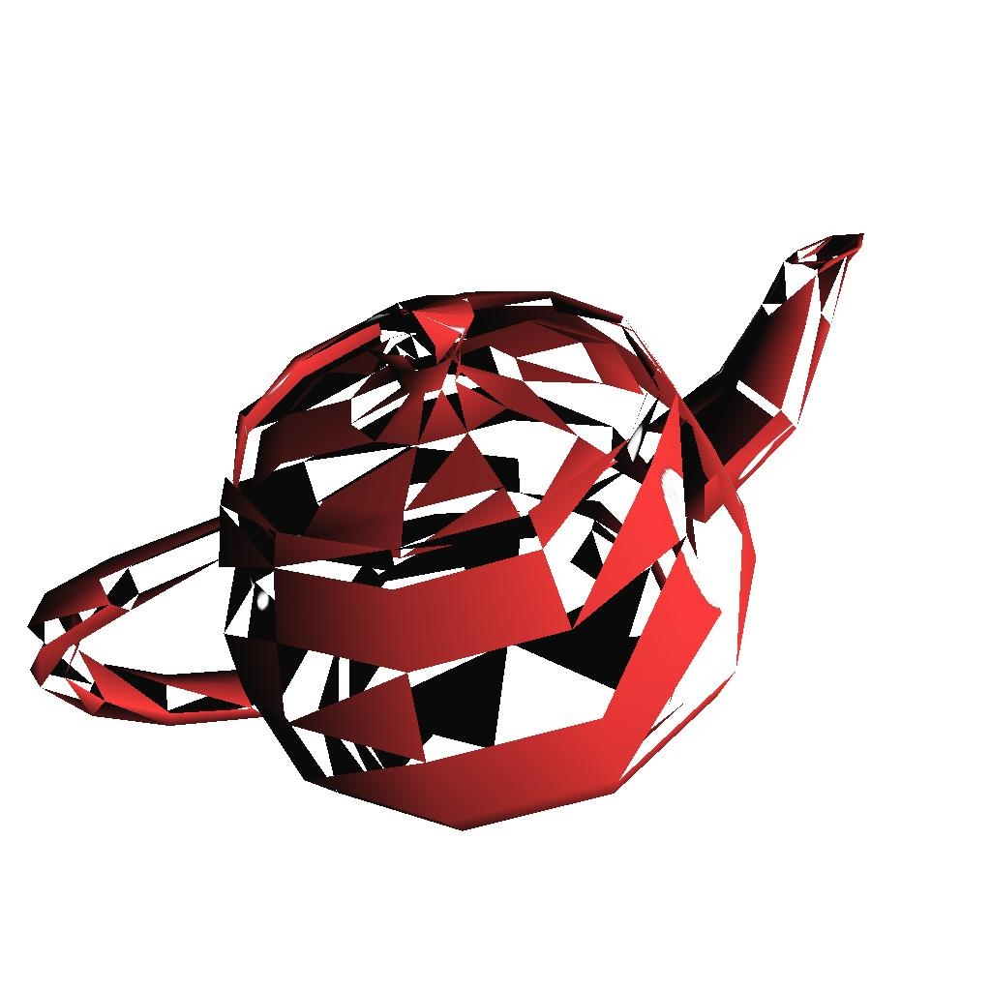
Rasterization
300 triangles rendered

Slide 12
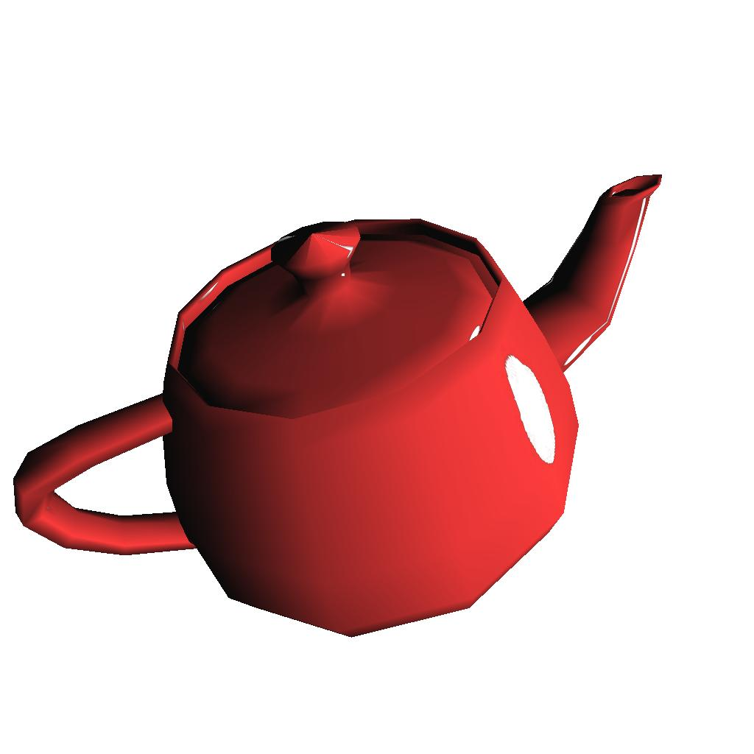
Rasterization
576 triangles rendered

Slide 13
Rasterization
Many different variations
  Multiple pixels at a time
  Multiple triangles at a time
  Could even cast rays per-pixel
For purpose of argument:
  App feeds primitives one at a time

Slide 14
Rasterization
Quality can be quite high
  Reflections, refractions, bump-mapping
  Various lighting models, shadows
  Motion blur, anti-aliasing, depth-of-field
  At what cost?
    Implementation
    Accuracy
    Rendering time
Notes:
Technically, can reproduce all effects ray-tracing has through pre-rendering and texture mapping

Slide 15
Ray-tracing
for all pixels {
for each ray in path {
find intersected object {
shade
}
}
update framebuffer
}

Slide 16
Ray-tracing
for all pixels {
for each ray in path {
find intersected object {
shade
}
}
update framebuffer
}

Slide 17
Ray-tracing
Reflected
Ray
Shadow
Test Ray
Eye
Image
Plane
Refracted
Ray

Slide 18
Ray-tracing
for all pixels {
for each ray in path {
find intersected object {
shade
}
}
update framebuffer
}

Slide 19
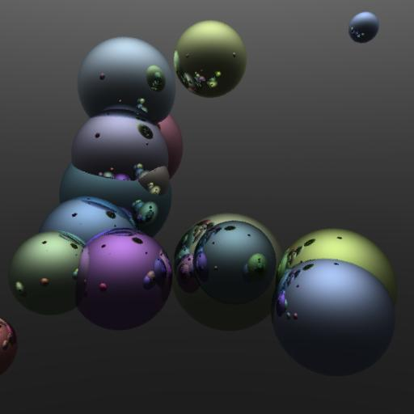
Ray-tracing
Each pixel rendered fully and independently

Slide 20
Ray-tracing
Many different variations
  Trace bundle of rays at a time (partially invert the loop)
  Use Z-buffer results as first pass
For purpose of argument:
  Each pixel fully evaluated

Slide 21
Ray-tracing
Complex effects easy to implement
  But may require significant math per intersection
Secondary interactions need help
  e.g. Caustics, color bleeding
  Solutions exist - Photon mapping, Metropolis

Slide 22
Ray-tracing
Acceleration is necessary
  Hierarchy
  Gridding, static and dynamic
  Locality - cache coherence
  Bundling
  Parallelization

Slide 23
Ray-tracing Versus Rasterization
Rasterization is FAST (on GPU)
  > 100 million polygons per second
  > 1 billion pixels per second
  Pipelined, parallelized hardware
Ray-tracing is SLOW (on CPU)
  10s of M of raw tri intersections/sec
  Not including add texture accesses, shading...

Slide 24
Why Use Ray-tracing?
Is it simply easier to implement?
Raytracing can rely on Moore's law
  Hardware implementation?
Quality of rasterization depends on cleverness
  Pixel shaders
  Multipass
Notes:
Rasterization is so fast it’s almost fast enough! It will soon matter less how fast the program runs and more how high the quality is.
In my mind, RT Is easier to implement and understand, but a whole generation of programmers are growing up with high-speed depth buffer cards in their PCs with programmable pixel processing - will they care about ray-tracing?

Slide 25
When Will Ray-Tracing Replace Rasterization?
SIGGRAPH 2002 Panel
Notes:
Welcome SIGGRAPH 2002 Attendees
Thanks for joining us for the panel session “When …”
For your reference, this is Ballroom C3 and our panel will finish around 12:15, when we will break for lunch.
After my introduction, each panelist will make a 10-to-15 minute presentation in turn, and then it will be our privilege to answer your questions.

