Slide 1
Toon/Cel Shading
Brad Boswell

Slide 2
What is toon shading?
Non-Photorealistic rendering
Uses few colors with large changes
Characterized by outline

Slide 3
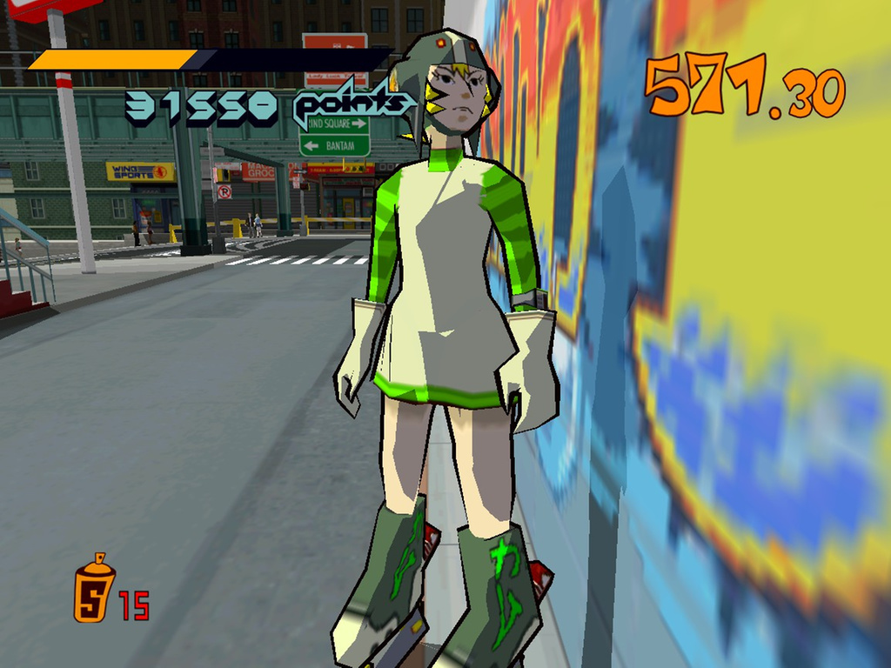
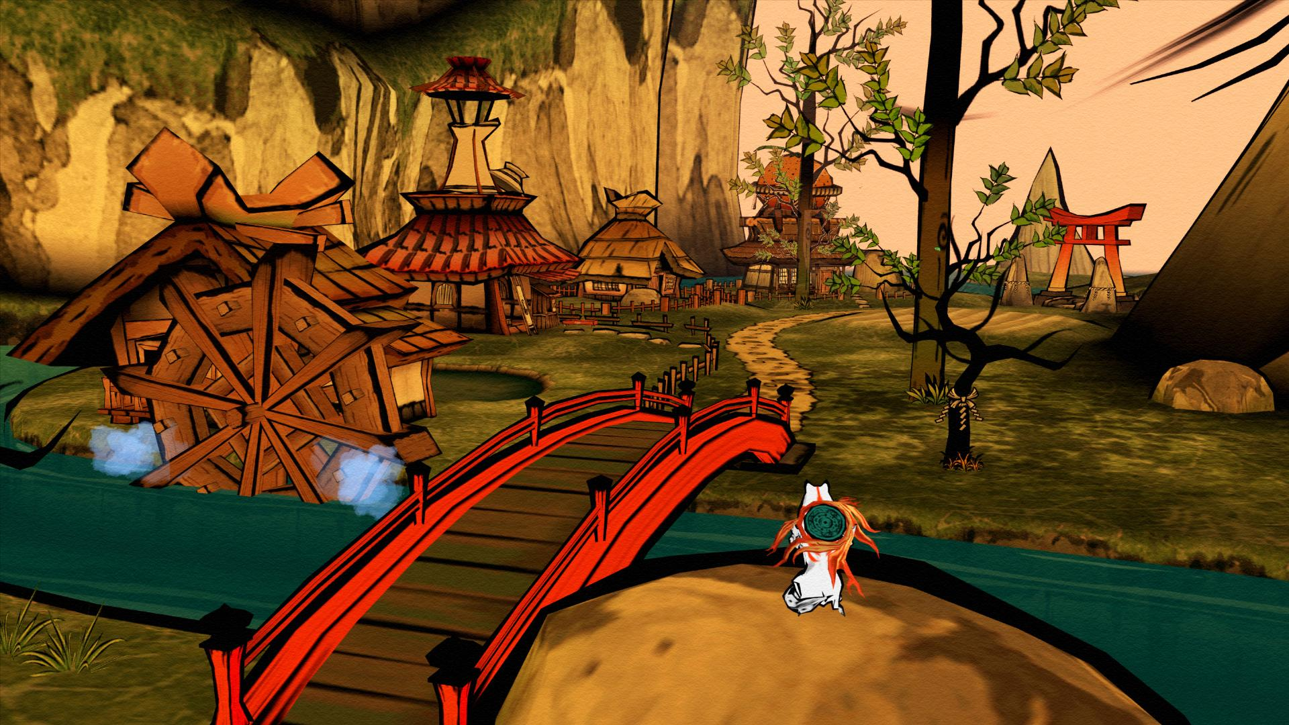
http://images.akamai.steamusercontent.com/ugc/593664045469743463/47CEC995ED7FB7E41B4AC1C3725E622F41117A6C/?interpolation=lanczos-none&output-format=jpeg&output-quality=95&fit=inside|1024:768&composite-to%3D%2A%2C%2A%7C1024%3A768&background-color=black
http://media.gamerhub.tv/editorial/2012/11/original.jpg

Slide 4
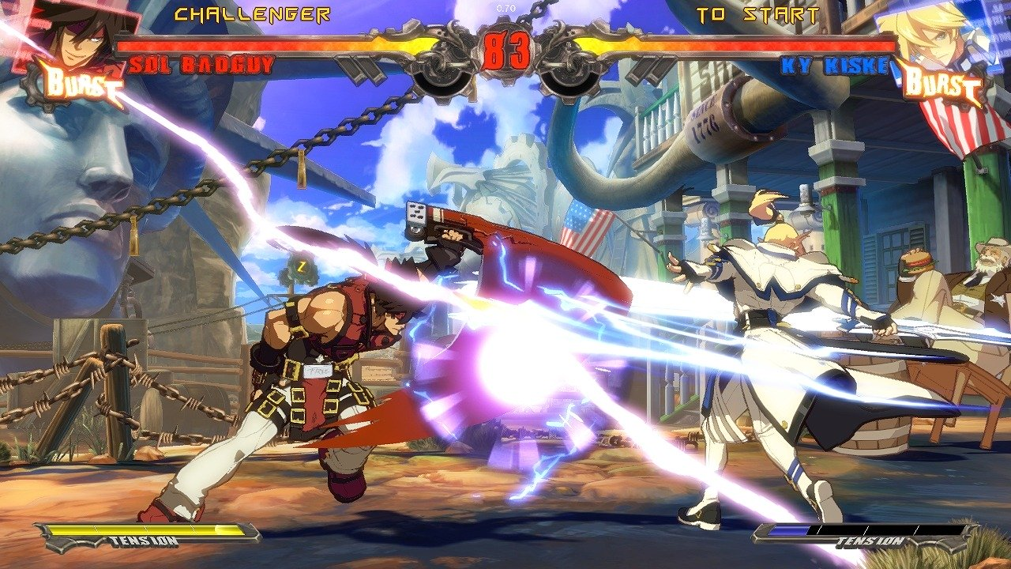
http://www.play-mag.co.uk/wp-content/uploads/2013/12/1386295522-10.jpg

Slide 5
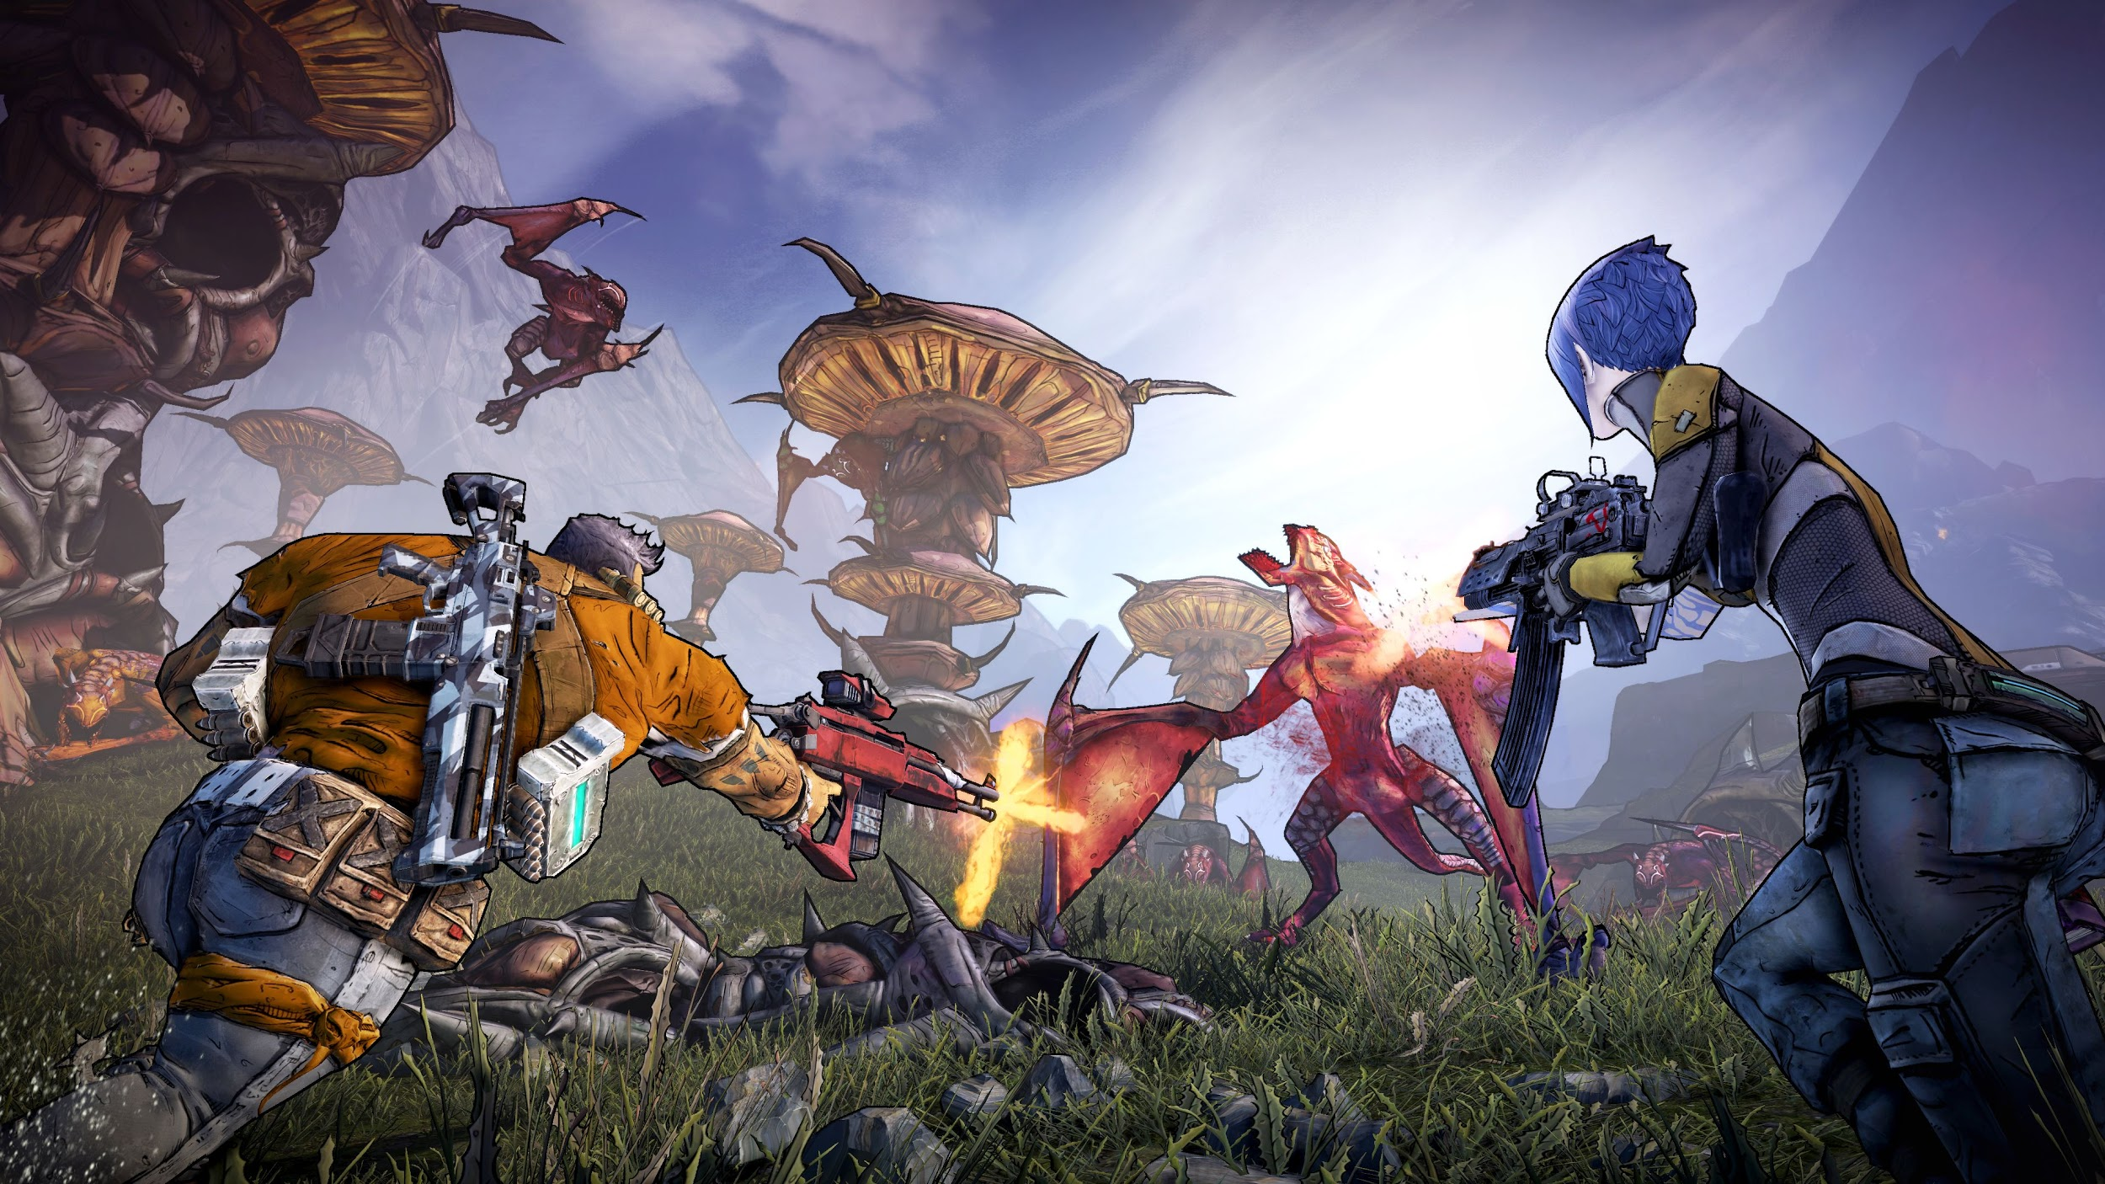

Slide 6
Drawing the outline

Slide 7
Inverse hull
Render object as wireframe with front faces culled, normals slightly shifted
Render front faces normally

Slide 8
Another implementation
Pack into vertex shader
Scale along normals
Render with black fragment shader
This is how I implemented it (and Guilty Gear Xrd, Jet Set Radio, etc)
gl_Position = projection * view * model * a_Position + (vec4(fN, 1.0) * 0.04);

Slide 9
Benefits
Very easy to implement
Easier to view during work
Can control with vertex shader easily (controlling width and offset)
More control in general

Slide 10
Drawbacks
Inconsistent results
Sharp edges such as cubes form spaces between outlines
Need another algorithm for inner lines

Slide 11
Image processing: Sobel operator
“G-Buffer”
Create texture for scene
Create framebuffer for depth information
Render texture to screen filling quad and store depth in color values
Calculate outlines with Sobel operator

Slide 12
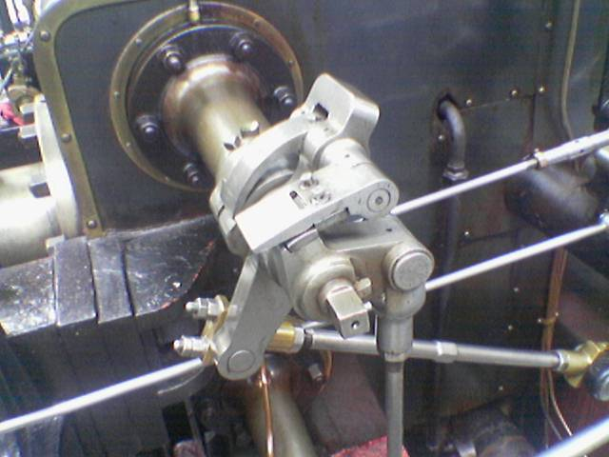
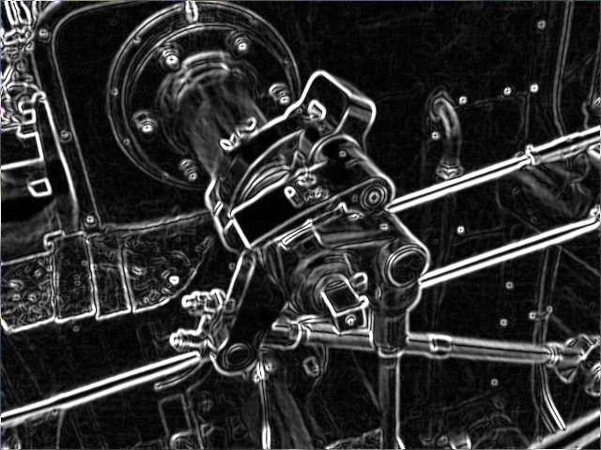
Sobel Operator
Texture sampled six times in one pass
Apply “Kernels” to samples
Vertical kernel calculates vertical outlines by xx
Horizontal calculates horizontal
Both new images composed to give an outline of the scene
https://en.wikipedia.org/wiki/File:Valve_sobel_(3).PNG

Slide 13
Implementation
texCoords0 = a_TexCoord0 + vec2(-1.0 / size.x, 1.0 / size.y);
texCoords1 = a_TexCoord0 + vec2(-1.0 / size.x, 0.0);
texCoords2 = a_TexCoord0 + vec2(-1.0 / size.x, -1.0 / size.y);
texCoords3 = a_TexCoord0 + vec2(1.0 / size.x, 1.0 / size.y);
texCoords4 = a_TexCoord0 + vec2(1.0 / size.x, 0.0);
texCoords5 = a_TexCoord0 + vec2(1.0 / size.x, -1.0 / size.y);
texCoords6 = a_TexCoord0 + vec2(0.0, 1.0 / size.y);
texCoords7 = a_TexCoord0 + vec2(0.0, -1.0 / size.y);

Slide 14
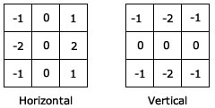
Implementation
float depthh =
abs(unpack_depth(-1.0 * texture2D(depthTexture, texCoords0))
+ unpack_depth(-2.0 * texture2D(depthTexture, texCoords1))
+ unpack_depth(-1.0 * texture2D(depthTexture, texCoords2))
+ unpack_depth(1.0 * texture2D(depthTexture, texCoords3))
+ unpack_depth(2.0 * texture2D(depthTexture, texCoords4))
+ unpack_depth(1.0 * texture2D(depthTexture, texCoords5)));

Slide 15
Implementation
// Merge by using the formula for the operator
float depth = sqrt(pow(depthh, 2.0) + pow(depthv, 2.0));
// Check threshold of how detailed you want edges
if(depth > 0.0004){
gl_FragColor = vec4(0.0,0.0,0.0,1.0);
} else{
gl_FragColor = vec4(1.0,1.0,1.0,0.0);
}

Slide 16
Advantages
CPU does not traverse any edge lists
Handles all primitives
Handles meshes really well because it’s image based
Very sharp and accurate

Slide 17
Disadvantages
Small changes (piece of paper)
Falsely detect edge in some rare cases
Two pass
Not much control

Slide 18
Lighting
If surface normal is facing light source, it’s lit
If surface normal is facing some threshold value away from light source, it’s not
NdotL = smoothstep(Threshold, floor(dot(Normal, light vector)));
gl_FragColor = color * NdotL;

Slide 19
Lighting
Make sure normals are correct!
Lots of room for variation (adding in some phong shading principles)
Watch for cubes

Slide 20
Summary
Toon shading and other forms of non photorealistic rendering have endless variation
NPR is still somewhat unexplored
Many things to consider while implementing Toon Shading!

Slide 21
Demo

