Slide 1
Wireless for the Internet of Things Lab 1 - Wireshark Lab
While we get started, take the quiz on canvas!
CS/ECE 4501
Spring 2023
UVA
[Pannuto, Ghena, Campbell]

Slide 2
Today’s Lab
Everything linked from the modules tab on canvas
Fill in the post lab report from the assignment
You are submitting individually, but you are welcome to work with your neighbors!

Slide 3
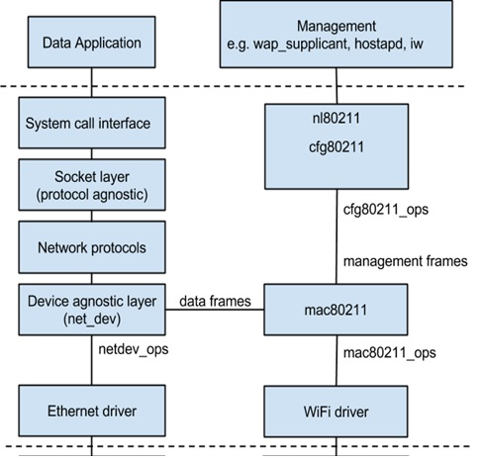
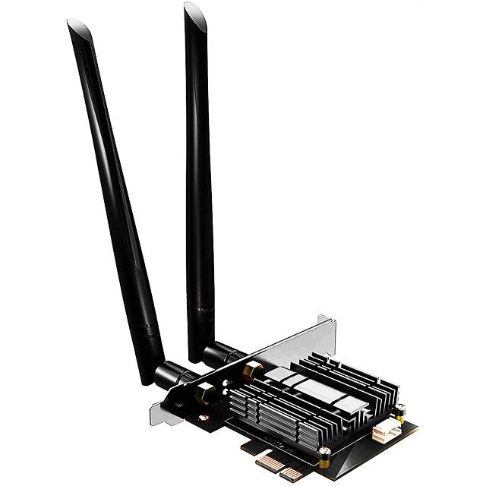
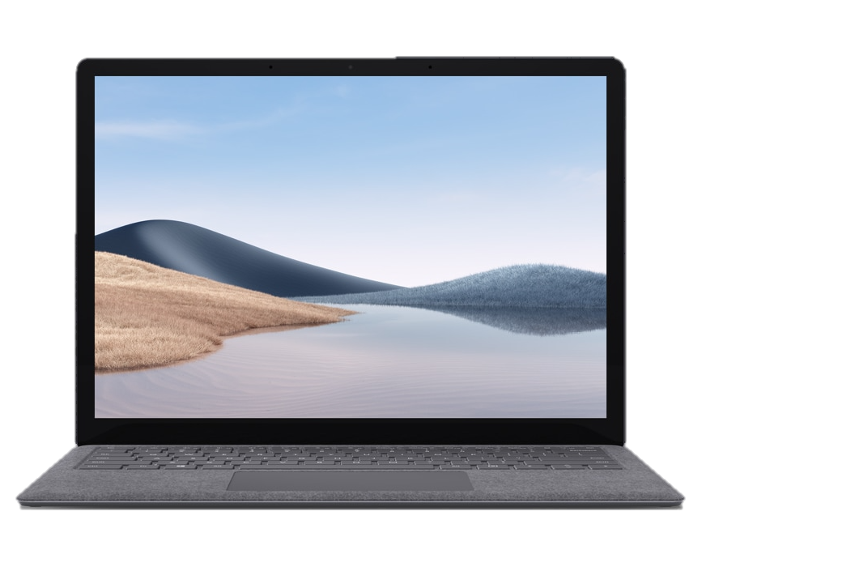


Wireshark Overview
Apps
OS
HW

