Slide 1
Lab 2b – BLE Connections

Slide 2
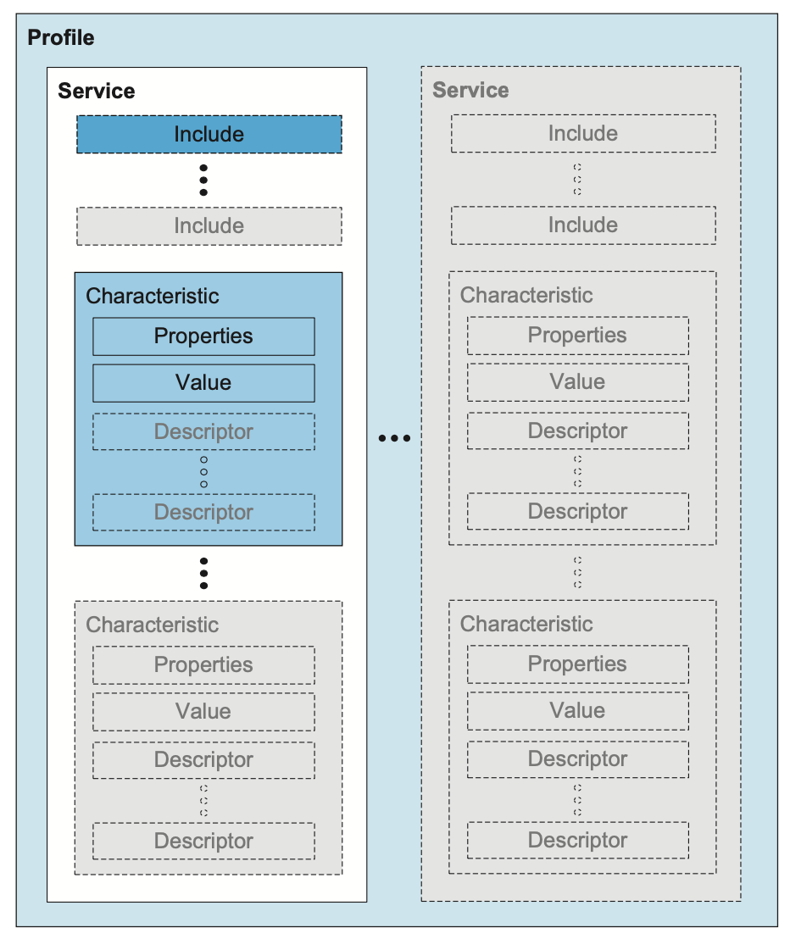
BLE GATT
“Generic ATTribute Profile”

Slide 4
Global Names
Local Names
UUIDs
Handles
Service:
5678A691-A396-498D-9912-7A9F48A9070F
Service handle: 0x07
Service handle: 0x01
Characteristic:
5678A691-A396-498D-9912-7A9F48000001
Characteristic handle: 0x02
Characteristic value handle: 0x03
Descriptor handle: 0x04
Heart Rate Service:
0x180D
Characteristic:
5678A691-A396-498D-9912-7A9F48000002
Characteristic handle: 0x05
Why Global names?
Need unique name for resources that works on any device with the same service.
Why Local names?
Want shorthand (16 bit handle vs. 128 bit UUID), and names for attributes without UUIDs.

Slide 5
void start_read() {
read_params.func = read_func;
read_params.handle_count = 1;
read_params.single.handle = bt_gatt_attr_value_handle(attr);
read_params.single.offset = 0U;
err = bt_gatt_read(conn, &read_params);
if (err) {
printk("Read failed (err %d)\n", err);
}
}

