Slide 1
Wireless for the Internet of Things IEEE 802.15.4 - Introduction
Take the quiz!
CS/ECE 4501
Spring 2024
UVA
[Pannuto, Ghena, Campbell]

Slide 2
Today’s Goals
Introduce the IEEE 802.15.4 standard
Specifically designed for low power applications
Overview of physical layer details
Exploration of link layer
Network topologies
Communication structure

Slide 3
References
802.15.4 Specification [2006]
“Part 15.4: Wireless Medium Access Control (MAC) and Physical Layer (PHY) Specifications for Low-Rate Wireless Personal Area Networks (WPANs)”
Other helpful references:
Paper introducing the 802.15.4 draft
NXP 802.15.4 Stack User Guide
2005 presentation on 802.15.4

Slide 4
Outline
Overview
Physical Layer
Link Layer

Slide 5
Comparison of networks
Data
Throughput
Range

Slide 6
Comparison of networks
Data
Throughput
Range

Slide 7
Comparison of networks
WiFi
Cellular
Data
Throughput
Bluetooth
BLE
802.15.4
LPWANs
Range

Slide 8
Comparison of networks
There are some missing qualities here. Why be closer to the origin?
WiFi
Cellular
Data
Throughput
Bluetooth
BLE
802.15.4
LPWANs
Range

Slide 9
Comparison of networks
WiFi
Cellular
Higher Power & Higher Cost
Data
Throughput
Bluetooth
BLE
802.15.4
LPWANs
Lower Power & Lower Cost
Range

Slide 10
IEEE 802….
Anyone heard “Eight-Oh-Two Dot” ?
Where?
What is it?

Slide 11
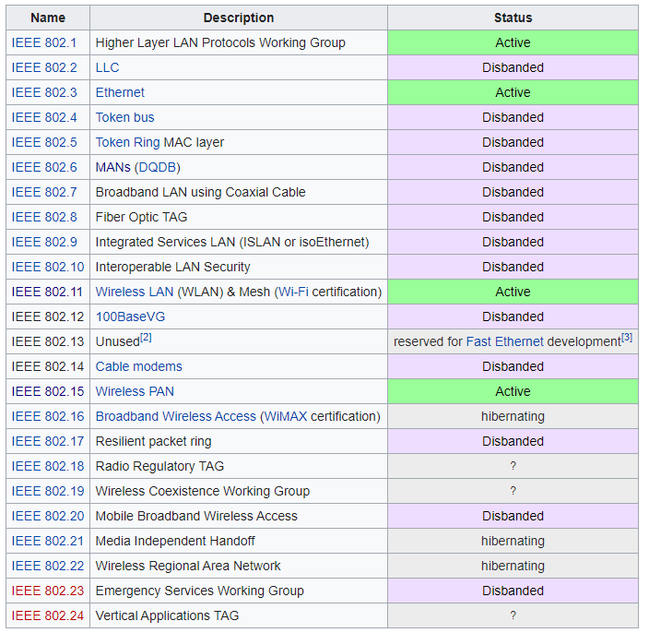
IEEE 802
Network standards for variable-sized packets
Ethernet
WiFi
WPANs
E.g. not networks that send periodic constant-sized packets
Specifies PHY and Link layers
Another example standard:
IEEE 754: Floating Point

Slide 12
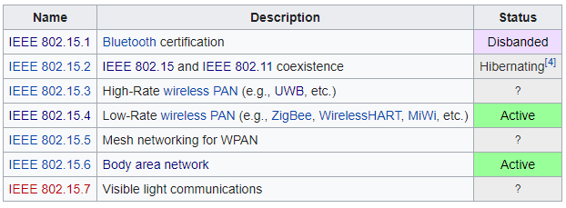
IEEE 802.15
Wireless Personal-Area Networks (WPAN)
All the things within the workspace of a person
Conceptually smaller domain that the Local Area Network
Realistically about the same thing as a LAN
Formerly included a Bluetooth spec
Bluetooth SIG took over governance

Slide 13
802.15.4 (LR-WPANs) Overview “Low-Rate Wireless Personal Area Networks”
Goals
“The IEEE 802.15 TG4 was chartered to investigate a low data rate solution with multi-month to multi-year battery life and very low complexity.” [TG4]
Applications
“Potential applications are sensors, interactive toys, smart badges, remote controls, and home automation.” [TG4]
Ultimately home automation, industrial control/monitoring, vehicular sensing, agriculture; really most machine-to-machine (M2M) sensor applications
Other contemporary technologies
WiFi 802.11b and Bluetooth Classic
Too complex in specification and overachieving in capability

Slide 14
IEEE 802.15.4
Low-Rate Wireless PAN
250 kbps, ~100 m range
Radio hardware available with low-power and low-cost
Specification: 2003
Also 2006, 2011, 2015, and 2020 revisions
Mostly various added capabilities such as extra PHY layers
Also define optional security, scheduling, and larger frame sizes
We’ll mostly work off of the 2006 version
Thread is based on 2006 version
Zigbee is based on the original 2003 version
Roughly 200 pages of meaningful specification (100 of appendices)
Compare to 3000 pages of Bluetooth/BLE

Slide 15
Outline
Overview
Physical Layer
Link Layer

Slide 16
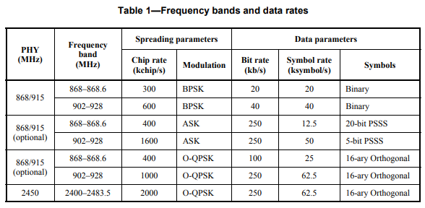
802.15.4 Physical Layers
Multiple options of physical layers are supported
We’ll focus on 2.4 GHz (2400 MHz)

Slide 17
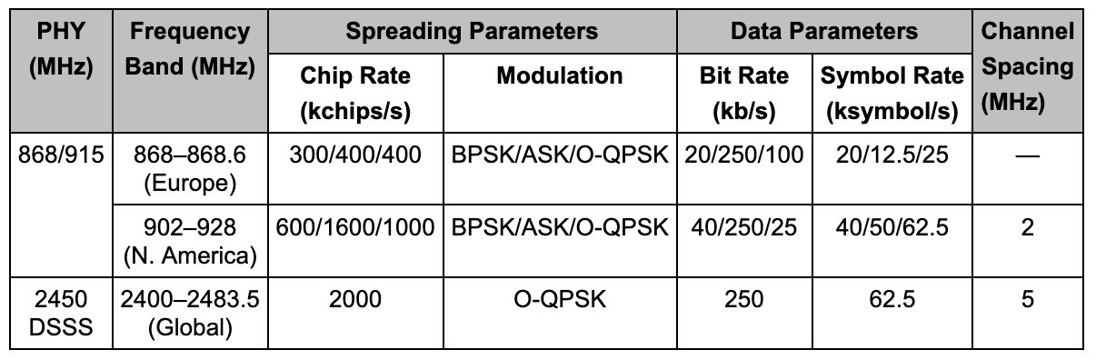
Physical Layer
O-QPSK modulation
Offset Quadrature Phase-Shift Keying
Twice the data rate of BPSK for same BER
Cost: most complicated design of receivers
Which is pretty minimal with all the transistors we’ve got
Plus the ability to reuse previous designs
4 bits per symbol
Symbols versus bits
A symbol is the unit of data transfer for a modulated signal
Does not necessarily correspond 1:1 with bits
The rate of symbols per second is a baudrate
802.15.4 bit rate at 2.4 GHz: 2000 kchips/s, which is 250 kbps, which is 62.5 kBaud
Notes:
https://rfmw.em.keysight.com//wireless/helpfiles/n7610b/Content/Main/IEEE%20802.15.4%20ZigBee.htm

Slide 18
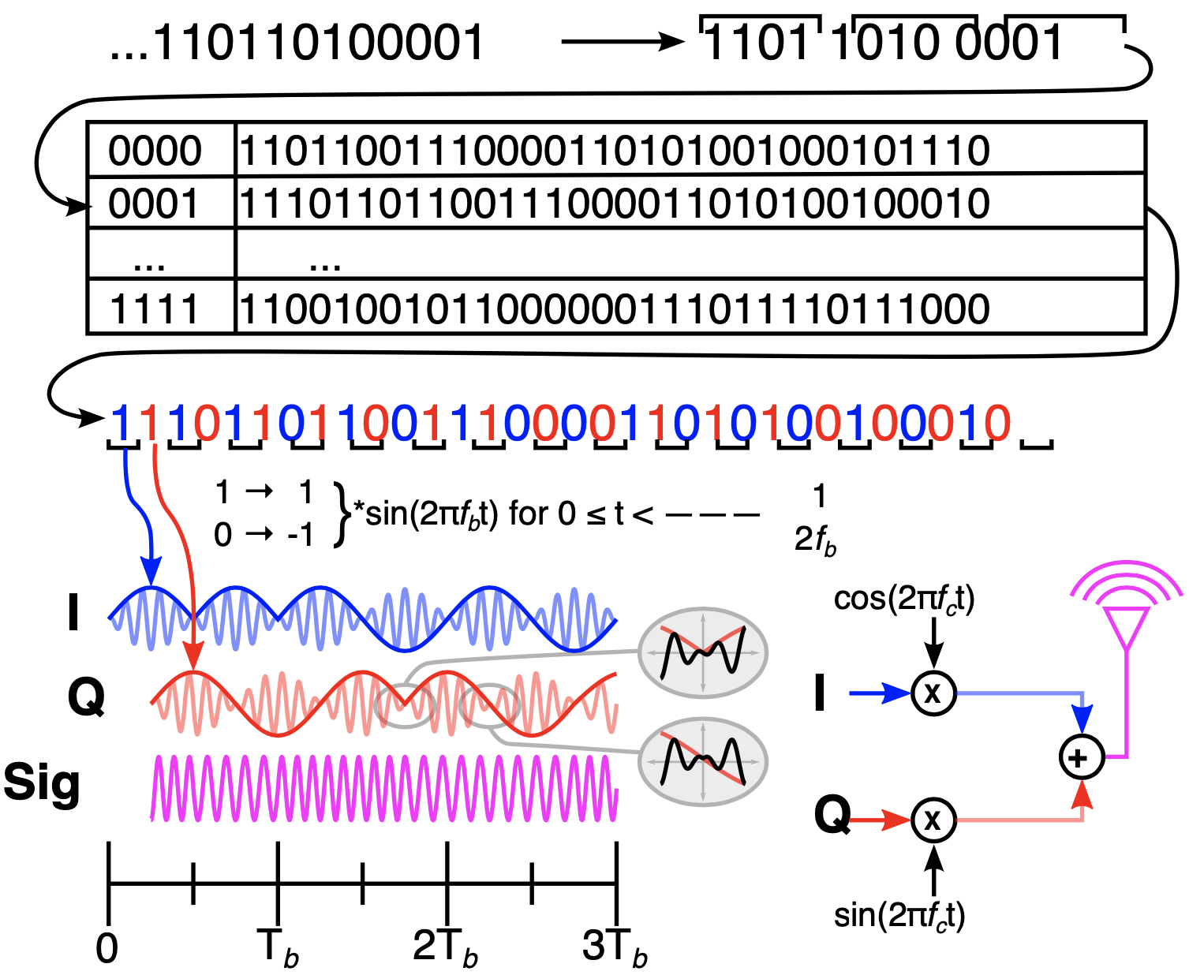
802.15.4 Modulation (@2.4 GHz f_{c}) O-QPSK with half-sine shaping is MSK!
Notes:
https://www.dsprelated.com/showarticle/1016.php – For reconvincing myself that yes, it really does boil down to MSK (Minimum Shift Keying) (a subset of FSK) on the air, which is insane.
https://arxiv.org/pdf/1611.03482.pdf – Also this for the same

Slide 19

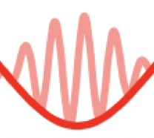
802.15.4 Modulation (@2.4 GHz fc) O-QPSK with half-sine shaping is MSK!
Broken into 4-bit symbols
Each symbol maps to a 32-bit pseudo-noise code (PN-code) or sometimes pseudo-random sequence
Input bit stream
Each bit of the PN code is called a chip
I and Q half-sines are baseband, which are mixed with the carrier
Each chip encodes half a sine wave
I and Q carriers are combined to create the final on-air signal
Chips alternate in-phase and quadrature
Signal is MSK, which is a special, optimal case of FSK!
Quadrature component is offset π/2
Notes:
https://www.dsprelated.com/showarticle/1016.php – For reconvincing myself that yes, it really does boil down to MSK (minimal shift keying) (a subset of FSK) on the air, which is insane.
https://arxiv.org/pdf/1611.03482.pdf – Also this for the same

Slide 20
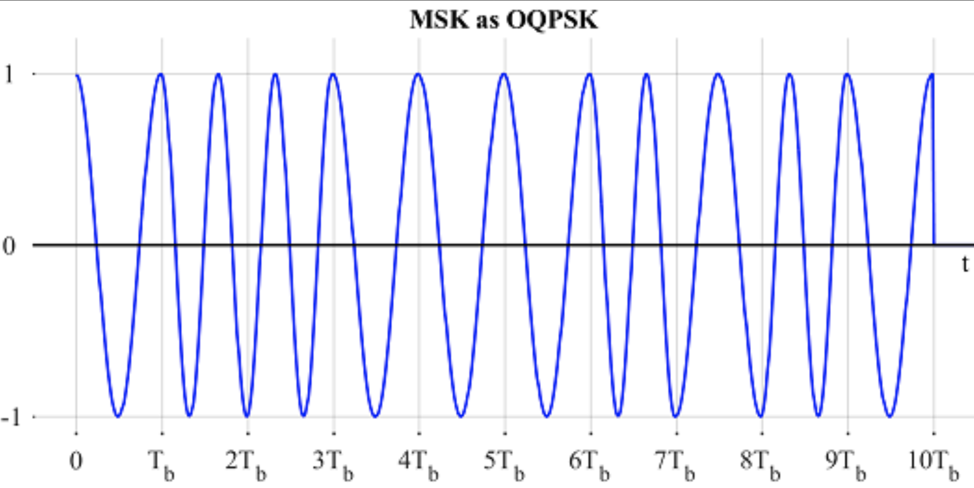
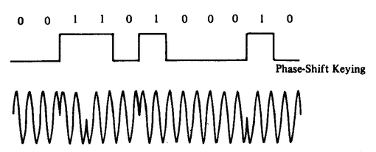
O-QPSK results in continuous wave
Standard BPSK
O-QPSK (MSK)

Slide 21
The magic of I and Q channels are that we get two dimensions
This is called a “constellation diagram”
Notes:
If digging into constellation, the M of MSK is the essence of not going 00<>11 or 01<>10, decoding is measuring which way around the circle you move (+ or – π/2)

Slide 22
Why do we map symbols to chips?
We took the 4 bits we want to send…
… and sent 32 bits instead??
Why?

Slide 23
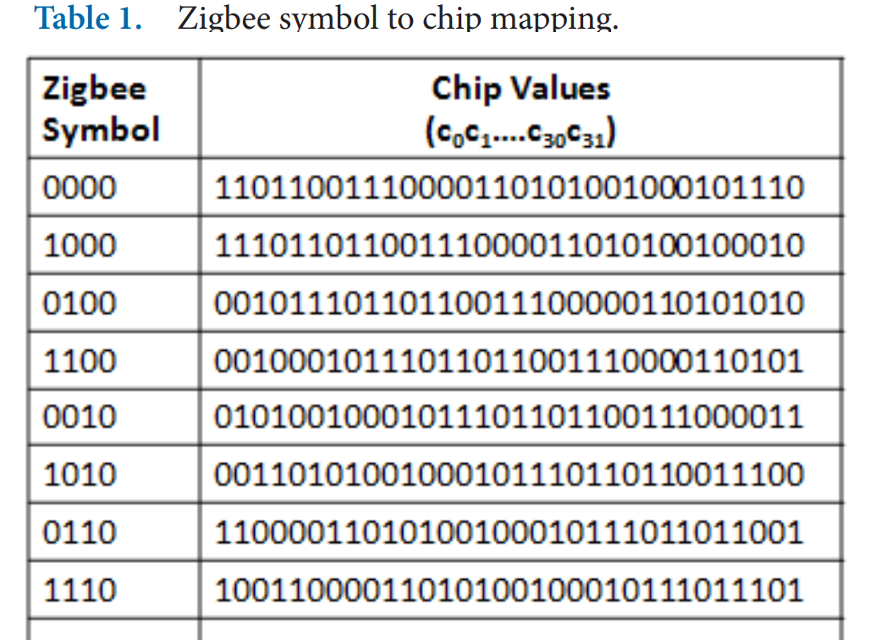
Direct Sequence Spread Spectrum (DSSS)
Increases the signal bandwidth of a transmission beyond information bandwidth
Send sequences of chips, which are a translation of one symbol to a pattern of many bits
Chips are transmitted much faster than symbols, essentially increasing the data rate
Enables better interference avoidance
Received bits are correlated against codes to see which is most likely
802.15.4 tolerates 13-15 bit flips (almost half!)
Notes:
n.b. 802.15.4 channels 5 MHz wide
BT Classic 1 MHz, BLE 2 MHz

Slide 24
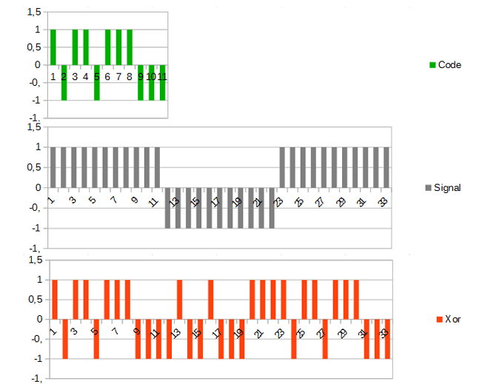
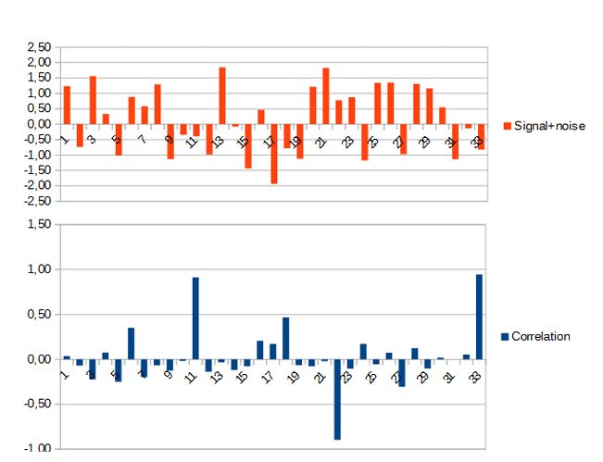
DSSS example
Data sent is 101
Code is longer than data, so we replicate bits
Data is recoverable, even with noise
https://circuitcellar.com/research-design-hub/dsss-in-a-nutshell/

Slide 25
Show me the money: what is the actual data rate of 802.15.4 (2.4 GHz)?
Chip rate: 2000 kchips/sec
pollev.com/wiotbc

Slide 26
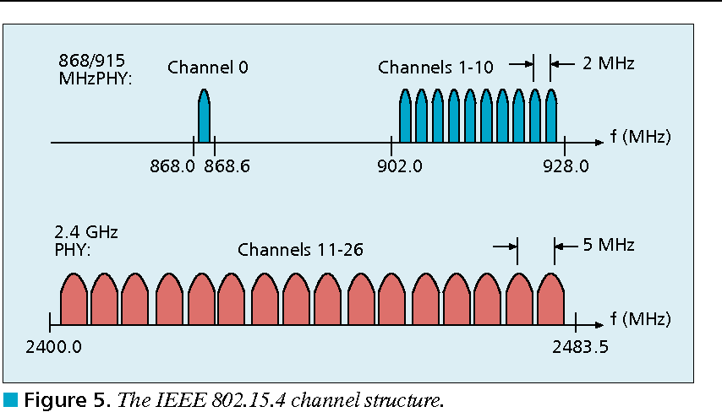
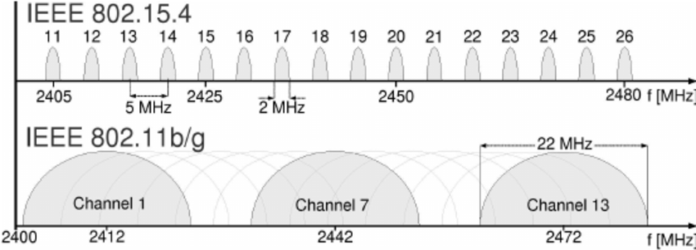
802.15.4 RF channels
27 channels across three bands
5 MHz channel separation at 2.4 GHz
Compare to 2 MHz for BLE
(or to 1 MHz for BT Classic)

Slide 27
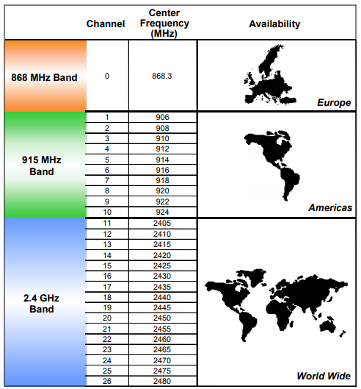
Regional bands
Different RF bands have different regional availability
Also have different rules
915 MHz: 400 ms dwell time
868 MHz: 1% duty cycle

Slide 28
Signal strength
Transmit power
Typical: 0 dBm (remember: 1 mW)
Receiver sensitivity
nRF52840 802.15.4: -100 dBm
Compare to BLE sensitivity of -95 dBm
Minimum acceptable: -85 dBm
Circa-2006 radios (CC2420): -95 dBm
Which has longer range, 802.15.4 or BLE? Why?
802.15.4 with +5 dBm more margin; lower bit rate plays into this

Slide 29
Outline
Overview
Physical Layer
Link Layer

Slide 30
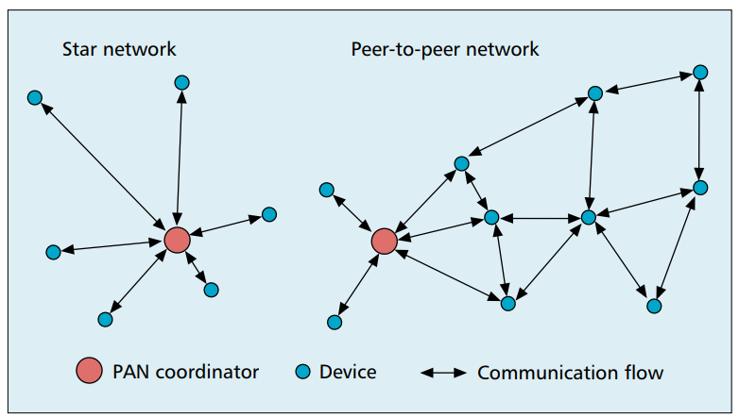
802.15.4 network topologies
Only specifies PHY and MAC, but has use cases in mind

Slide 31
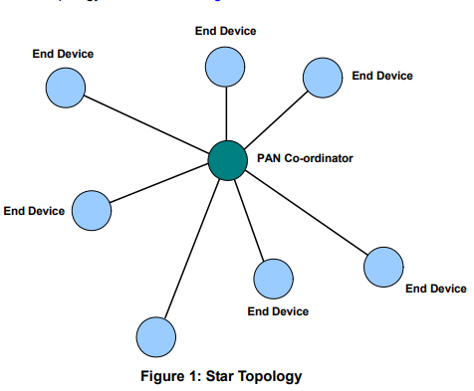
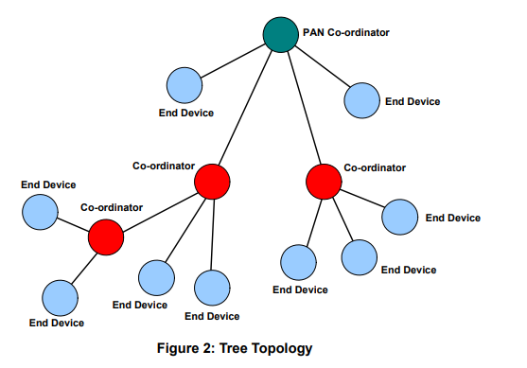
Star and Tree topologies
PAN Coordinator
Receives and relays all messages
Most capable and power-intensive
Coordinators (a.k.a. Routers)
Control “clusters”
Receives and relays to its children
Communicates up to parent coordinator
End Devices
Only communicate with single parent coordinator
Least capable and power intensive

Slide 32
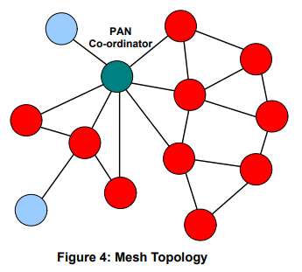
Mesh networks
Most devices are capable of communicating with multiple neighbors
What are advantages of mesh?
What are disadvantages of mesh?

Slide 33
Mesh networks
Most devices are capable of communicating with multiple neighbors
What are advantages of mesh?
Devices can communicate over longer distances
Device failures less likely to collapse the entire network
What are disadvantages of mesh?
Some nodes have to spend more energy communicating
Network protocol becomes more complicated to manage routing

Slide 34
Reminder: CSMA/CA Carrier Sense Multiple Access with Collision Avoidance
First, wait a random amount (collision avoidance part)
Then, listen for a duration and determine if anyone is transmitting (carrier sense part)
If idle, you can transmit
If busy, repeat step 1 (often increasing maximum wait time)
Can be combined with notion of slotting
Synchronize to slots (smaller than transmit times)
Wait for a number of slots
Listen for idle slots

Slide 35
Modes of operation
Beacon-enabled PAN
Slotted CSMA/CA
Structured communication patterns
Optionally with some TDMA scheduled slots
Non-beacon-enabled PAN
Unslotted CSMA/CA
No particular structure for communication
Could be defined by other specifications, like Thread or Zigbee

Slide 36
Beacon-enabled superframe structure
Beacon
Beacon
…
Contention Access Period
Inactive Period
Beacons occur periodically [15 ms – 245 seconds]
Devices must listen to each beacon
Contention Access Period
Slotted CSMA/CA synchronized by beacon start time
Inactive Period
No communication occurring. Assumes sleepy devices

Slide 37
Guaranteed Time Slots (GTS)
Beacon
Beacon
…
Contention Access Period
Guaranteed Time Slots
Inactive Period
PAN Coordinator may create a Contention Free Period with Guaranteed Time Slots
TDMA schedule assigned to specific devices
Slots eat up part of the Contention Access Period
No CSMA/CA within a slot

Slide 38
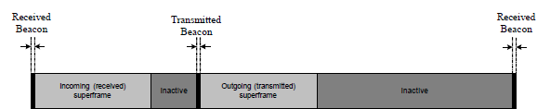
Handling tree-based topologies
All coordinators listen to beacon from PAN coordinator
And can participate in that contention period
Send their own beacons to leaf devices during inactive period
Leaves participate in that contention period

Slide 39
Non-beacon-enabled PAN
…
Contention Access Period
Same idea, just no beacons
Which removes synchronization benefit (and slotted CSMA/CA)
Also removes beacon listening cost
Devices only need to check for activity before transmitting
Still need an algorithm to determine when it should receive data
All the time is a huge energy drain
Algorithms can get complicated here
Does BLE mechanism of listen-after-send apply?
Only if sending to a high-power device, not among equals

Slide 40
Receiving messages
Listen during entire contention period
Can receive direct messages from any other device
Can immediately respond to messages as well
Request messages from Coordinator
Make all communication go through Coordinator
Send a request-for-data packet to coordinator to get information
Coordinator can include list of devices with pending data in beacon
More complicated listening algorithms are possible

Slide 41
Clear Channel Assessment (CCA)
The “listen” part of CSMA/CA
Variety of implementations are acceptable
Energy above threshold
Energy for 8 symbol durations above threshold (RSSI)
Carrier sense
Valid 802.15.4 carrier signal
Energy AND/OR Carrier

Slide 42
Slotted CSMA/CA operation
Have data to send
Wait for next backoff slot (synchronized from beacon)
Wait for 0-7 backoff slots (slot is 20 symbol durations: 320 us)
Listen for two empty slots
Idle: Transmit
Occupied: wait 0-15 backoff slots and repeat
Next time: 0-31 backoff slots and repeat
Next time: 0-31 backoff slots and repeat (upper limit configurable)
Next time: 0-31 backoff slots and repeat
Next time: 0-31 backoff slots and repeat
Timeout

Slide 43
Unslotted CSMA/CA operation
Have data to send
Wait for next backoff slot (synchronized from beacon)
Wait for 0-7 backoff slots (slot is 20 symbol durations: 320 us)
Listen for two empty slots
Idle: Transmit
Occupied: wait 0-15 backoff slots and repeat
Next time: 0-31 backoff slots and repeat
Next time: 0-31 backoff slots and repeat (upper limit configurable)
Next time: 0-31 backoff slots and repeat
Next time: 0-31 backoff slots and repeat
Timeout

Slide 44
Break + Question
What are benefits/costs of using or not using beacons?

Slide 45
Break + Question
What are benefits/costs of using or not using beacons?
Beacons
Enable energy savings by designating period with radios off
Enable structured communication like Guaranteed Slots
Require some central coordinator within range of all devices
Tradeoff in inactive period:
communication latency vs beacon-listening costs
No beacons
Enable all devices to be identical (no coordinator needed)
Require / permit custom communication scheme

