Slide 1
Wireless for the Internet of Things IEEE 802.15.4 – Packets & Lab3a
CS/ECE 4501
Spring 2024
UVA
[Pannuto, Ghena, Campbell]

Slide 2
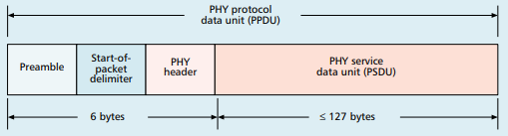
Base packet format – IEEE 802.15.4
Synchronization
Preamble: four bytes of zeros
Q: How many chips?
Start-of-Packet: 0xA7
PHY Header
One field: length 0-127
Why still 8 bits?
Because computers depend on bytes

Slide 3
MAC frame format
Frame control
Header
Sequence number
8-bit monotonically increasing
Addressing fields
PAN and addresses
Varies based on frame type
Frame payload
Depends on frame type
Frame check sequence
16-bit CRC

Slide 4
Frame control
Frame type
Type of payload included
Security enabled
Packet is encrypted
(extra 0-14 byte header)
Frame pending
Fragmented packet
Why no length field?
Acknowledgement required
PAN ID compression
No PAN ID if intra-network
Addressing modes
Which fields to expect
Already in prior header

Slide 5
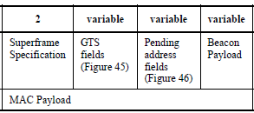
Frame types - Beacon
Beacon
Information about the communication structure of this network
Sent in response to requests from scanning devices
Sent periodically at start of Superframes (if in use)
Sent without CSMA/CA
MAC Header
Source address only, broadcast to everyone
Packet contents
Superframe details, including Guaranteed Time Slots (if any)
Pending addresses lists devices for which Coordinator has data

Slide 6
Frame types - Data
Data
Data from higher-layer protocols
MAC Header
Source and/or Destination addresses as necessary
Packet Contents
Whatever bytes are desired (122 bytes – address sizes)
May be fragmented across packets

Slide 7
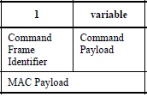
Frame types – MAC Command
MAC Command
Various commands for supporting link layer
Join/leave network
Change coordinator within network
Request data from coordinator
Request Guaranteed Time Slot
MAC Header
Source and/or Destination addresses as necessary

Slide 8
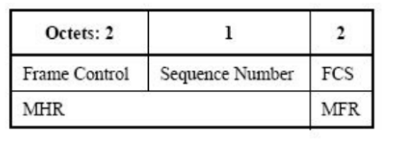
Frame types - Acknowledgement
Acknowledgement
Acknowledges a Data or MAC Command packet
Not beacons or other acknowledgements
What happens if acknowledgement isn’t received?
Packet will be transmitted again
MAC Header
Repeats Sequence Number of acknowledged packet
No Source or Destination addresses
Sent T_{IFS} after the packet it is acknowledging (immediately)

