Slide 1
Wireless for the Internet of Things IEEE 802.15.4 – Packets & MAC
CS/ECE 4501
Spring 2023
UVA
[Pannuto, Ghena, Campbell]

Slide 2
Today’s Goals
IEEE 802.15.4 packet format
Investigate a decade of low power MAC research

Slide 3
Outline
Packets
MAC Protocols

Slide 4
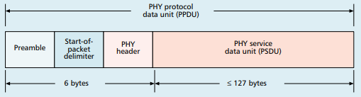
Base packet format
Synchronization
Preamble: four bytes of zeros
Q: How many chips?
Start-of-Packet: 0xA7
PHY Header
One field: length 0-127
Why still 8 bits?
Because computers depend on bytes
Q: How long does it take to transmit the preamble?
pollev.com/wiotbc

Slide 5
MAC frame format
Frame control
Header
Sequence number
8-bit monotonically increasing
Addressing fields
PAN and addresses
Varies based on frame type
Frame payload
Depends on frame type
Frame check sequence
16-bit CRC

Slide 6
Frame control
Frame type
Type of payload included
Security enabled
Packet is encrypted
(extra 0-14 byte header)
Frame pending
Fragmented packet
Why no length field?
Acknowledgement required
PAN ID compression
No PAN ID if intra-network
Addressing modes
Which fields to expect
Already in prior header

Slide 7
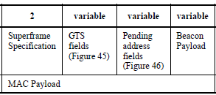
Frame types - Beacon
Beacon
Information about the communication structure of this network
Sent in response to requests from scanning devices
Sent periodically at start of Superframes (if in use)
Sent without CSMA/CA
MAC Header
Source address only, broadcast to everyone
Packet contents
Superframe details, including Guaranteed Time Slots (if any)
Pending addresses lists devices for which Coordinator has data

Slide 8
Frame types - Data
Data
Data from higher-layer protocols
MAC Header
Source and/or Destination addresses as necessary
Packet Contents
Whatever bytes are desired (122 bytes – address sizes)
May be fragmented across packets

Slide 9
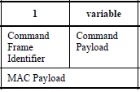
Frame types – MAC Command
MAC Command
Various commands for supporting link layer
Join/leave network
Change coordinator within network
Request data from coordinator
Request Guaranteed Time Slot
MAC Header
Source and/or Destination addresses as necessary

Slide 10
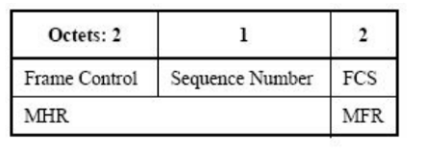
Frame types - Acknowledgement
Acknowledgement
Acknowledges a Data or MAC Command packet
Not beacons or other acknowledgements
What happens if acknowledgement isn’t received?
Packet will be transmitted again
MAC Header
Repeats Sequence Number of acknowledged packet
No Source or Destination addresses
Sent T_{IFS} after the packet it is acknowledging (immediately)

Slide 11
Analysis: maximum goodput
Assume best possible case for data transmission
122 Bytes per packet
At 250 kbps -> 3.904 ms
Plus Inter-frame spacing of 40 symbols
At 62.5 kBaud -> 0.640 ms
122 Bytes / 4.544 ms -> 214 kbps
Compare to BLE advertisements: 9.92 kbps
Compare to BLE connections: 520 kbps

Slide 12
Outline
Packets
MAC Protocols

Slide 13
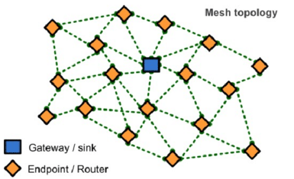
Enabling full mesh networks
All nodes:
Can send and receive data
Route and forward data in the network
Nodes connect with their neighbors
Gateway provides access to other networks/internet
We’re interested in meshes that
Use low power nodes (battery powered)
Are low data rate with small packets
802.15.4 provides foundation to build mesh on top
Contention Access Period

Slide 14
Mesh network layers
PHY Layer
802.15.4 physical layer
MAC Layer: 802.15.4
802.15.4 spec gives us the option of implementing our own
Technically this layer is here, but we generally ignore it
MAC Layer
Need to allow to TWO low power devices to communicate
Devices are off most (~99%) of the time
No assumption of energy asymmetry (as with PAN coordinator or BLE)
Network Layer: Mesh
Handles organizing the network
How should packets travel from nodes to the gateway?
How should packets travel from the gateway to nodes?
How should packets travel from node to node?
Network Layer Mesh Routing
MAC Layer Low Power
802.15.4 Contention MAC
PHY Layer O-QPSK - 2.4 GHz

Slide 15
Asynchronous MAC principles
Communication is possible if one device is receiving while other is transmitting
Both devices want to minimize the time they are receiving or transmitting (i.e. their radio is on) to reduce power draw
Devices can only coordinate using the data communication channel (i.e. no out-of-band communication)
No global synchronization mechanism
Goal: scheme to schedule TX and RX to permit communication while minimizing energy
Energy is paramount, but additional metrics:
Latency
Throughput
Reliability
Network scale
A
B

Slide 16


Slide 17

Early 2000s

Slide 18
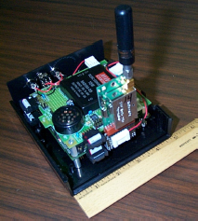

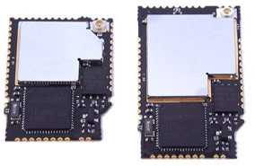
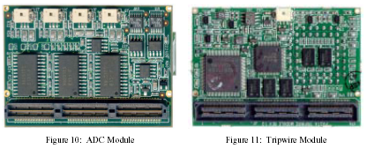
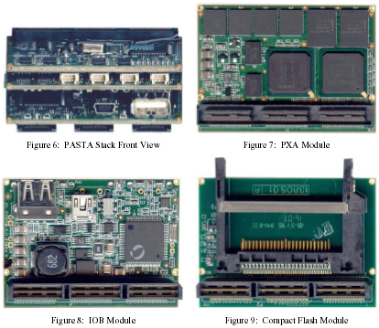
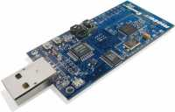
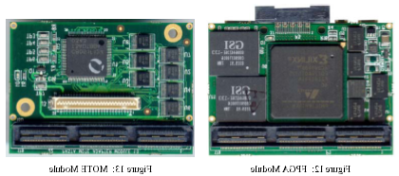
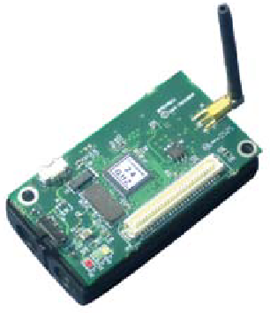
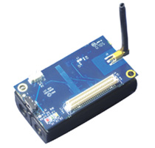
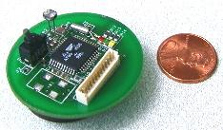
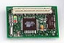
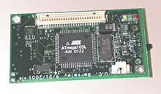
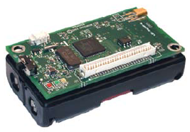
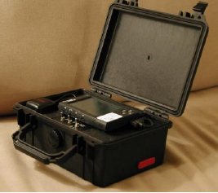
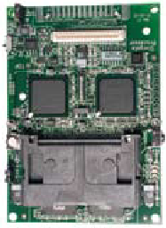
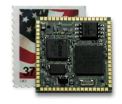
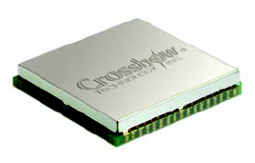
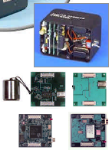

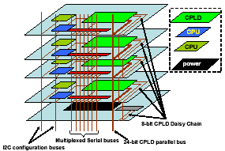
Early days of low power sensor nodes
Tmote Mini
[Sentilla07]
Telos/Tmote
[Polastre05]
PC/104 [Cerpa01]
PASTA [Bajura05]
Mica [Hill01]
Mica2 [Xbow03]
MicaZ [Xbow05]
Iris [Xbow07]
WeC [Hill98]
Rene [Hill99]
MicaZ Stamp
[Xbow06]
Iris OEM
[Xbow07]
WINSng [Pottie00]
Stargate [Intel]
WINS [Rockwell]
mPlatform[Lymberopoulos07]

Slide 19
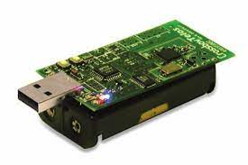
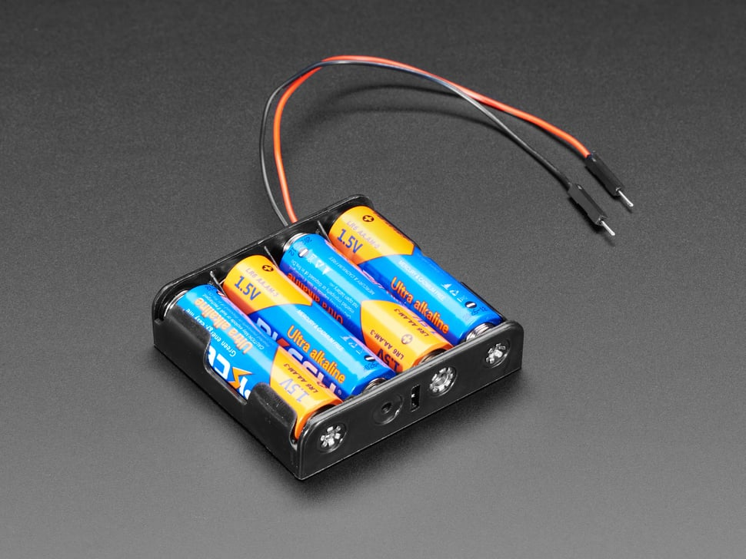
Low power: multiple year operation using batteries
P_{node} = P_{CPU} + P_{TX} + P_{RX} + P_{SLEEP}
E_{BATT} = P_{node} * lifetime
Lifetime ⬆️, P_{node}⬇️
P_{CPU} ≫ P_{SLEEP}
P_{TX} ≫ P_{SLEEP}
P_{RX} ≫ P_{SLEEP}
_{→ Minimize compute, TX, RX}
_{→ Maximize sleep}

Slide 20
Low power MAC principles
Communication is possible if one device is receiving while other is transmitting
Devices can only coordinate using the data communication channel (i.e. no out-of-band communication)
No global synchronization mechanism
Goal: scheme to schedule TX and RX to permit communication while minimizing energy
Energy is paramount, but additional metrics:
Latency
Throughput
Reliability
Network scale
A
B
Both devices want to minimize the time they are receiving or transmitting (i.e. their radio is on) to reduce power draw

Slide 21
Low Power Listening (LPL) - B-MAC (2004)
CCA
CCA
CCA
RX
TX ACK
CCA
Sleep
Sleep
Sleep
Sleep
Sleep
Receiver
Preamble
TX
RX ACK
Sleep
Sleep
Transmitter
Method:
Receiver periodically samples the channel
Transmitter sends a preamble long enough to ensure receiver will detect it
Upon detection, receiver stays awake to receive transmitted packet
Receiver ACKs if packet received correctly
Versatile Low Power Media Access for Wireless Sensor Networks. Joseph Polastre, Jason Hill and David Culler. SenSys 2004

Slide 22
LPL performance
CCA check interval
Too small: energy wasted on idle listening
Too large: energy wasted on transmissions (long preambles)
In general, it’s better to have larger preambles than to check more often!
Sensor sample period – controls the packet rate
Time between listening
(checking if the channel is idle)
Versatile Low Power Media Access for Wireless Sensor Networks. Joseph Polastre, Jason Hill and David Culler. SenSys 2004

Slide 23
LPL Drawback
A
CCA
CCA
CCA
RX
TX ACK
CCA
Sleep
Sleep
Sleep
Sleep
Sleep
Receiver
B
Preamble
TX
RX ACK
Sleep
Sleep
Transmitter
C
CCA
CCA
CCA
RX
DROP
CCA
Sleep
Sleep
Sleep
Sleep
Sleep
Receiver
Spend time listening to packets for someone else!
A
C
B
Versatile Low Power Media Access for Wireless Sensor Networks. Joseph Polastre, Jason Hill and David Culler. SenSys 2004

Slide 24
X-MAC: Shorter preambles and destination information
A
RX
RX
TX ACK
RX
TX ACK
RX
Sleep
Sleep
Sleep
Sleep
Receiver
B
TX (DST ID)
TX (DST ID)
TX (DST ID)
RX ACK
TX
RX ACK
Sleep
Sleep
Transmitter
Method
Transmitter sends a short “I have a packet for this address” packet
Nodes periodically listen, and ACK if the packet is for them
Upon receiving the ACK, the transmitter sends full packet
Receiver successfully receives the full packet.
X-MAC: A Short Preamble MAC Protocol for Duty-Cycled Wireless Sensor Networks. Michael Buettner, Gary V. Yee, Eric Anderson, Richard Han. SenSys 2006.

Slide 25
X-MAC: Overhearing node drops out early
A
RX
RX
TX ACK
RX
TX ACK
RX
Sleep
Sleep
Sleep
Sleep
Receiver
B
TX (DST ID)
TX (DST ID)
TX (DST ID)
RX ACK
TX
RX ACK
Sleep
Sleep
Transmitter
C
RX
RX
Sleep
Sleep
Sleep
Overhearer
X-MAC: A Short Preamble MAC Protocol for Duty-Cycled Wireless Sensor Networks. Michael Buettner, Gary V. Yee, Eric Anderson, Richard Han. SenSys 2006.

Slide 26
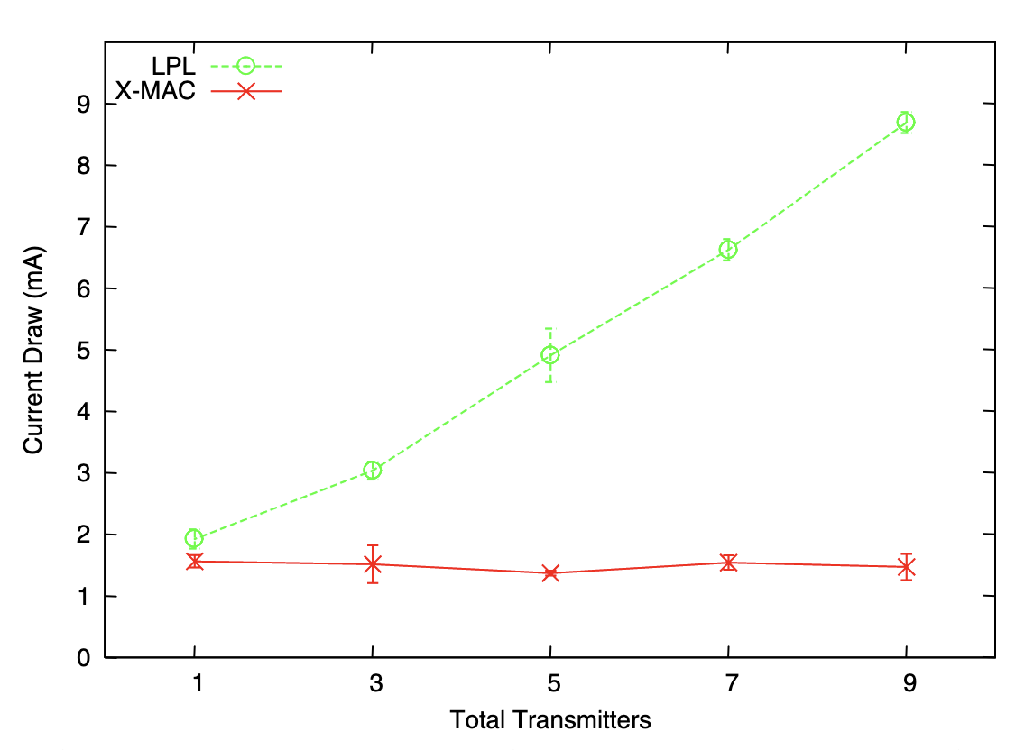
X-MAC: lower power draw than LPL with multiple nearby transmitters
X-MAC: A Short Preamble MAC Protocol for Duty-Cycled Wireless Sensor Networks. Michael Buettner, Gary V. Yee, Eric Anderson, Richard Han. SenSys 2006.

Slide 27
LPL (B-MAC) and X-MAC are transmitter initiated MAC protocols
Receiving nodes continuously periodically sample the wireless channel
When they detect a transmission they listen to receive packets
Transmitting nodes are only active when they want to transmit
Receiving nodes prone to unnecessary wakeups
Have to receive all nearby transmissions to see if the packet happens to be for them
Unnecessary wakeups lead to increasing receive energy → shorter lifetime
In general, difficult for receiver to know if it should stay awake or go back to sleep

Slide 28
Low Power Probing (LPP) is receiver initiated
A
TX Probe
TX Probe
RX
TX ACK
TX Probe
Sleep
Sleep
Sleep
Sleep
Receiver
B
RX
TX
RX ACK
Sleep
Sleep
Transmitter
Method
Receiver periodically transmits a probe, listens afterward
Transmitter listens for probe packet from intended recipient
Transmitter sends packet after receiving the correct probe packet
RI-MAC: A Receiver-Initiated Asynchronous Duty Cycle MAC Protocol for Dynamic Traffic Loads in Wireless Sensor Networks. Yanjun Sun, Omer Gurewitz, David B. Johnson. SenSys 2008.
Koala: Ultra-Low Power Data Retrieval in Wireless Sensor Networks. Razvan Musaloiu-E., Chieh-Jan Mike Liang, Andreas Terzis. IPSN 2008.

Slide 29
LPP introduces a new challenge for multiple nodes. What happens with multiple transmitters?
RX
TX
Sleep
Sleep
Transmitter
TX Probe
TX Probe
RX
TX Probe
Collision!!
Sleep
Sleep
Sleep
Sleep
Receiver
RX
TX
Sleep
Sleep
Transmitter
If multiple transmitters receive a probe, they both transmit, leading to a collision and a lost packet
Receiver is unsure if there actually was a packet, or just noise/interference on the channel
RI-MAC: A Receiver-Initiated Asynchronous Duty Cycle MAC Protocol for Dynamic Traffic Loads in Wireless Sensor Networks. Yanjun Sun, Omer Gurewitz, David B. Johnson. SenSys 2008.
Koala: Ultra-Low Power Data Retrieval in Wireless Sensor Networks. Razvan Musaloiu-E., Chieh-Jan Mike Liang, Andreas Terzis. IPSN 2008.

Slide 30
A-MAC resolves this with backcast constructive interference
RX
TX ACK
TX
RX
CCA
CCA
TX
RX ACK
Sleep
Sleep
Sleep
Transmitter
TX ACK
Listen
RX
TX Probe
TX Probe
RX ACK
RX
TX Probe
Listen
RX
TX Probe
TX ACK
Collision!!
Sleep
Sleep
Sleep
Receiver
RX
TX ACK
TX
RX
CCA
TX
RX ACK
Sleep
Sleep
Transmitter
Method
Transmitters send an ACK in response to a probe packet
With multiple transmitters, the ACKs collide, but interfere non-destructively, so the receiver still receives an ACK
The receiver stays awake to receive a packet, but the packet collides
The receiver sends a new probe, informing transmitters there was a collision
Transmitters use CSMA/CA to send packets
Design and Evaluation of a Versatile and Efficient Receiver-Initiated Link Layer for Low-Power Wireless. Prabal Dutta, Stephen Dawson-Haggerty, Yin Chen, Chieh-Jan Mike Liang, and Andreas Terzis. SenSys 2010.

Slide 31
Summary: asynchronous low power MAC protocols
Transmitter initiated protocols
Receivers periodically sample the channel
Transmitters transmit sufficiently to ensure recipients heard
Examples: LPL, X-MAC
Pros:
Simple, intuitive
Can balance TX and RX energy with sample interval
Cons:
Receivers prone to false wake-ups
High idle listening energy costs
Receiver initiated protocols
Receivers periodically transmit probes
Transmitters listen for a probe before sending a packet
Examples: RI-MAC, Koala, A-MAC
Pros:
Fixed, small listening energy cost for receivers
Cons:
Multiple transmitters leads to collisions

Slide 32
Mesh network layers
PHY Layer
802.15.4 physical layer
MAC Layer: 802.15.4
802.15.4 spec gives us the option of implementing our own
Technically this layer is here, but we generally ignore it
MAC Layer
Need to allow to TWO low power devices to communicate
Devices are off most (~99%) of the time
No assumption of energy asymmetry (as with PAN coordinator or BLE)
Network Layer: Mesh
Handles organizing the network
How should packets travel from nodes to the gateway?
How should packets travel from the gateway to nodes?
How should packets travel from node to node?
Network Layer Mesh Routing
MAC Layer Low Power
802.15.4 Contention MAC
PHY Layer O-QPSK - 2.4 GHz

