Slide 1
Wireless for the Internet of Things IEEE 802.15.4 – Mesh
CS/ECE 4501
Spring 2023
UVA
[Pannuto, Ghena, Campbell]

Slide 2
Today’s Goals
Deep dive on mesh protocols
Flip mesh on its head

Slide 3
Outline
Mesh Motivation
Simple Routing
Mesh Routing
Better Flooding

Slide 4
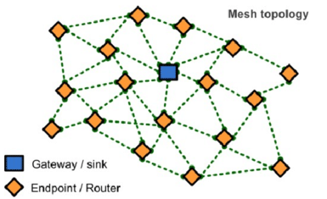
Mesh network layers
PHY Layer
802.15.4 physical layer
MAC Layer: 802.15.4
802.15.4 spec gives us the option of implementing our own
Technically this layer is here, but we generally ignore it
MAC Layer
Need to allow to TWO low power devices to communicate
Devices are off most (~99%) of the time
No assumption of energy asymmetry (as with PAN coordinator or BLE)
Network Layer: Mesh
Handles organizing the network
How should packets travel from nodes to the gateway?
How should packets travel from the gateway to nodes?
How should packets travel from node to node?
Network Layer Mesh Routing
MAC Layer Low Power
802.15.4 Contention MAC
PHY Layer O-QPSK - 2.4 GHz

Slide 5
Mesh networks
Most devices are capable of communicating with multiple neighbors
What are advantages of mesh?
Devices can communicate over longer distances
Device failures less likely to collapse the entire network
What are disadvantages of mesh?
Some nodes have to spend more energy communicating
Network protocol becomes more complicated to manage routing

Slide 6
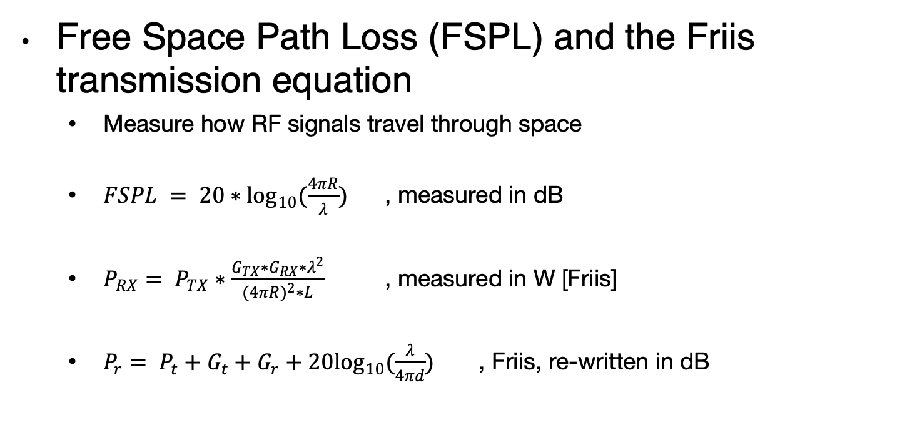
Quantitative intuition of ‘why bother meshing’
Free Space Path Loss (FSPL) and the Friis transmission equation
Measure how RF signals travel through space
$FSPL = 20∗\log_{10}(\frac{4πR}{λ})$ , measured in dB
$P_{RX}= P_{TX}∗\frac{G_{TX}∗G_{RX}∗λ^{2}}{(4{πR)}^{2}∗L}$ , measured in W [Friis]
$P_{r}= P_{t}+G_{t}+G_{r}+20\log_{10}(\frac{λ}{4πd})$ , Friis, re-written in dB
Traditionally written as transmit distance
Image: https://www.sciencedirect.com/topics/computer-science/transmitting-antenna

Slide 7
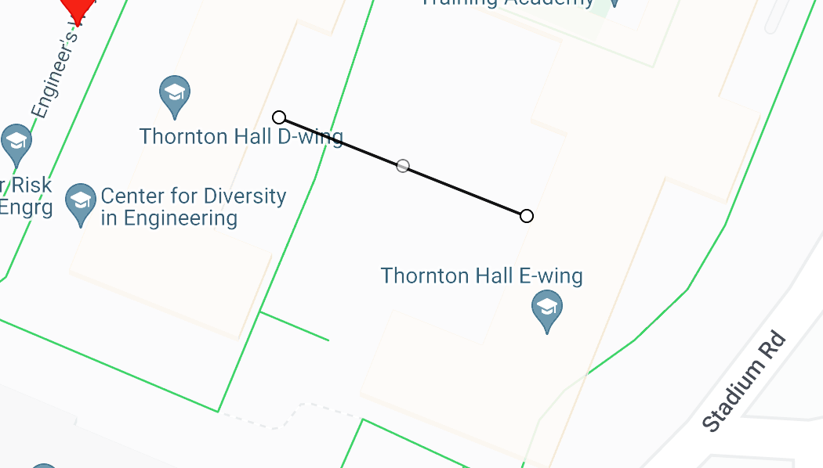




A hand-wavy quantitative analysis of ‘why bother meshing’
D-wing to E-wing is ~40m wide; how to get from one side to the other?
$$\frac{3e8 m/s}{2.4e9 Hz}=0.125 m= λ$$
0 dBm
1 mW
$$20 ∗ \log_{10}\left(\frac{4π∗40}{0.125}\right)≈72 dB$$
-72 dBm (6.3e-8 mW)
-68 dBm (1.6e-7 mW)
$$0 dBm+2.15 dBi+2.15 dBi+20\log_{10}\left(\frac{0.125}{4π∗40}\right)≈68 dBm$$
$$0 dBd=2.15 dBi$$
”reference dipole”
$$20 ∗ \log_{10}\left(\frac{4π∗20}{0.125}\right)≈66 dB$$
$$__ dBm+2.15 dBi+2.15 dBi+20\log_{10}\left(\frac{0.125}{4π∗20}\right)≈68 dBm$$
Multi-hop mesh…
Reduces TX power
But adds RX, sync cost!
Improves aggregate network coverage
Can improve robustness
Reduces collision domain
-5.2 dBm
0.3 mW

Slide 8
Outline
Mesh Motivation
Simple Routing
Mesh Routing
Better Flooding

Slide 9
Routing goals
Have a packet, have a destination, how do we connect them?
Simple techniques
Broadcast, tree structures
Mesh techniques
Understand the available routes and select a “good” one

Slide 10
Simple routing solutions
Broadcast
The link-layer solution for everything
Star topology
Only one location to send to: parent
Single parent needs to store information about all children
Addresses, schedules, etc.
Tree topology
“Star of stars”
Two choices: send to descendent or send to parent
Each parent needs to store information about all children beneath it
Original ZigBee approach (knowledge built into addressing scheme)

Slide 11
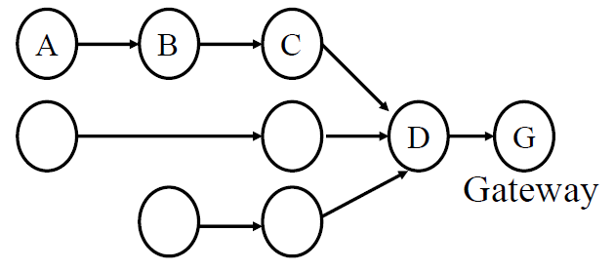
Many-to-one routing e.g. Collection Tree Protocol (CTP)
Tree optimization for sensor networks
Keep all devices except the “gateway” as simple as possible
Each device only needs to remember hop to gateway
If gateway wants to send message back, it must include a full hop path

Slide 12
Outline
Mesh Motivation
Simple Routing
Mesh Routing
Better Flooding

Slide 13
Mesh Routing
Mesh topology makes routing question more complicated
Multiple hops in a route
Multiple routes between source and destination
Becomes a graph theory question based on cost metric
B
C
A
D
F
E

Slide 14
Naïve “routing” via flooding
Mesh equivalent of broadcast
Each node sends to each other node
Eventually packets will reach the desired destination
Not really routing at all…
Question: how do we make it stop?
Maximum retransmissions counter on each packet
Decrement at each hop. Drop packet when it hits zero
Need some guess for how many hops to destination
Keep some history of recently flooded packets
Don’t retransmit a recently sent packet

Slide 15
Reactive routing
Build up a map of the routes through a network
Hopefully the “optimal” routes
Map routes in reaction to a packet arrival
Sensor devices are slow and limited
Most likely to resend to same prior address
Discover a route when it is needed, then cache for next time
B
C
A
D
F
E
B Neighbor Table
A | c7:e3:45:00:1f:e4
C | c7:e3:45:ab:44:c6
D | 54:99:10:aa:b1:c3
B Forwarding Table
DST | Next Hop
F | C
A | A

Slide 16
Neighbor discovery
Which nodes are nearby to me?
i.e. within one packet transmission range
General Techniques
Periodically listen for nearby transmissions
Overhear packets
Source addresses indicate neighbors
Periodically send neighbor discovery probes
Announce your existence
Ask for neighbors to respond
Centrally collect neighbor information
Gateway disseminates to nodes as needed
B Neighbor Table
A | c7:e3:45:00:1f:e4
C | c7:e3:45:ab:44:c6
D | 54:99:10:aa:b1:c3
B
C
A
D
F
E

Slide 17
Ad-hoc On-demand Distance Vector Routing (AODV)
On-demand: Construct routes only when needed
Modern ZigBee routing approach (for Mesh topology)
Routing table
Destination node -> Next hop (for all cached destinations)
Store only next hop instead of full route
All routers along the path must also have Destination->Next mappings
Also keep hops-to-destination and last-seen-destination-sequence-number
Route discovery
Upon demand: check table
If not cached send Route Request (RREQ) via Flooding
Route is unknown, so flooding is needed

Slide 18
AODV Route Requests (RREQs)
Request ID | Source Address | Destination Address | Source SeqNo | Destination SeqNo | Hop Count
Request ID identifies this RREQ
Used to discard duplicates during flooding
Sequence Numbers are per-device, monotonically increasing
Used as a notion of “how recently” device has been seen
Source SeqNo is the source’s most recent sequence number
Destination SeqNo is the most recently seen from the destination by the source. (Defaults to zero)
Hop Count is the number of hops this request has taken
Starts at 1 and incremented by each transmitter along the path

Slide 19
Example AODV RREQ (A to F)
Request ID | Source Address | Destination Address | Source SeqNo | Destination SeqNo | Hop Count
A wants to find a route to F, so it sends out an RREQ
B
C
A
D
F
E

Slide 20
Example AODV RREQ (A to F)
Request ID | Source Address | Destination Address | Source SeqNo | Destination SeqNo | Hop Count
1 | A | F | 1 | 0 | 1
B and D also opportunistically add a routing table entry for A
B
C
A
D
F
E

Slide 21
Example AODV RREQ (A to F)
Request ID | Source Address | Destination Address | Source SeqNo | Destination SeqNo | Hop Count
1 | A | F | 1 | 0 | 2
B goes first via some access control protocol (D also in contention)
A and D ignore duplicate Request ID C opportunistically adds a routing table entry to A
B
C
A
D
F
E

Slide 22
Example AODV RREQ (A to F)
Request ID | Source Address | Destination Address | Source SeqNo | Destination SeqNo | Hop Count
1 | A | F | 1 | 0 | 2
D goes next by some access control protocol (C also in contention)
A, B, and C ignore duplicate Request ID E and F opportunistically adds a routing table entry to A
B
C
A
D
F
E

Slide 23
Example AODV RREQ (A to F)
Request ID | Source Address | Destination Address | Source SeqNo | Destination SeqNo | Hop Count
1 | A | F | 1 | 0 | 3
C and E repeat this process with Hop Count 3 (but everyone ignores them)
They go one-at-a-time, but I’m getting tired of drawing these
Actually, they’re in contention with the response from F
B
C
A
D
F
E

Slide 24
AODV Route Response (RREP)
Source Address | Destination Address | Destination SeqNo | Hop Count
Reply is sent unicast back to the source via newly constructed route
Each node along the way already knows the route back
Includes most recent destination sequence number as a sense of recency
No need for source sequence number anymore

Slide 25
Example AODV RREP (F to A)
Source Address | Destination Address | Destination SeqNo | Hop Count
F | A | 7 | 2
F sends response back to A via D
D opportunistically adds a routing table entry for F
B
C
A
D
F
E

Slide 26
Activity – Reactive routing
Every student is a node
Communication range is one seat
i.e. to people sitting immediately adjacent

Slide 27
Break + Practice
C wants to send a packet to E
What RREQ(s) are sent and what RREP(s) are sent?
B
C
A
D
F
E

Slide 28
Break + Practice
C wants to send a packet to E
What RREQ(s) are sent and what RREP(s) are sent?
RREQs:
C -> (B,D,F)
(B or D) -> A
(D or F) -> E
RREPs:
E -> (D or F) -> C
Network could have multiple configurations
B
C
A
D
F
E

Slide 29
RREP optimization
An intermediate node responds with RREP if it has a path to destination with a more recent Destination sequence number
Source may get multiple RREP responses with different recency and hop counts
Note: we’re optimizing for some combination of most recent and lowest hop count

Slide 30
Route maintenance in AODV
If a link in the routing table breaks, all active neighbors are informed with Route Error (RERR) messages
After some number of retransmissions and timeouts
RERR contains destination address that broke
Nodes receiving RERR can start RERQ for destination address
Which lets them find a new path through the network
And updates everyone’s cached next-hops

Slide 31
Dynamic Source Routing (DSR)
Another reactive routing technique
Similar design as AODV
In DSR, routing tables have full route to destination
Each packet transmission includes a list of hops to destination
So the route to an important destination only has to be stored on the source device that cares about it
Intermediate nodes do not need any route storage for that destination
Cost is extra bytes used in each packet for route
During discovery, all paths are returned by destination
So source gets a full list of possible route choices

Slide 32
Tradeoffs for reactive routing
Upside: no transmissions unless there is demand
Routes might appear, disappear, reappear, but no need to update if no one actually wants to transmit anything
Downside: large, variable delay when actually sending a packet
Full RREQ/RREP protocol before data can actually be sent
Route might have broken at some point
So data will be sent based on cached information
RERR will occur
RREQ/RREP will occur
Then data will be sent again

Slide 33
Proactive routing
Alternative to reactive is to know the routes ahead of time
Periodically query for the possible routes in the network
Save all routes that are important (maybe just all routes?)
Also redetermine routes whenever topology changes (nodes join/leave)
Upside: when a packet arrives, route to destination is already known
Downside: requires more memory and effort on part of routers
Wastes some network bandwidth on checking for route changes

Slide 34
Distance-Vector
Keep routes as “next hops” rather than full routes
AODV uses this method (DV for Distance Vector)
Can be combined with proactive techniques too
Each router periodically informs neighbors of its shortest paths to each destination (in terms of hop count)
Essentially just broadcast your routing table
Routers choose the best route available
Old next-hop it was already aware of
New next-hop through neighbor (with cost of their hops + 1)
Need to be careful to avoid loops!

Slide 35
Break + Discussion
Hop count is one possible metric for determining routes
What else might be considered?

Slide 36
Reliability as a cost metric
Link quality can very from node to node
Fewest hops might not be the “fastest” or “most reliable” path
ETX: minimize “expected transmissions”
Measure link quality over time to determine each link’s reliability
B
C
A
D
F
E

Slide 37
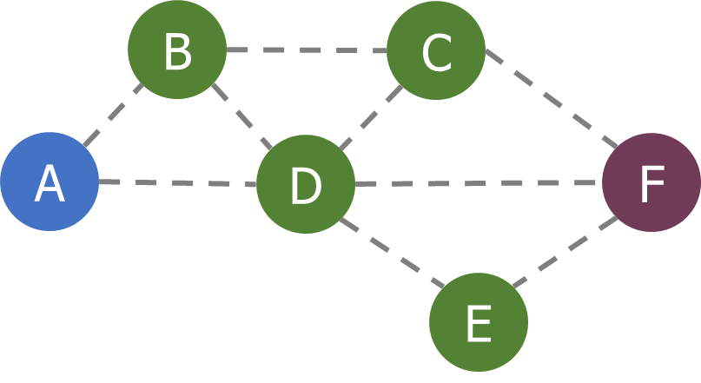
Alternative cost metrics
Spatial reuse
Prefer transmission on links that do not interfere with each other
Improves ability to pipeline data through network
Example: A<->B and E<->F
Energy availability
Prefer routing through nodes with more remaining available energy
Prefer wall-powered nodes over battery-powered
Arbitrarily complex combinations possible

Slide 38
Outline
Mesh Motivation
Simple Routing
Mesh Routing
Better Flooding

Slide 39
Traditional flooding is a ’mesh-local broadcast’
Goal: get information to all nodes
This is the problem of “data dissemination”
Problem: difficult in Mesh topologies
Packet loss, retransmission delays
Really, the desire for data dissemination is just to broadcast to all nodes
But broadcast transmissions don’t reach far enough to cover entire mesh

Slide 40
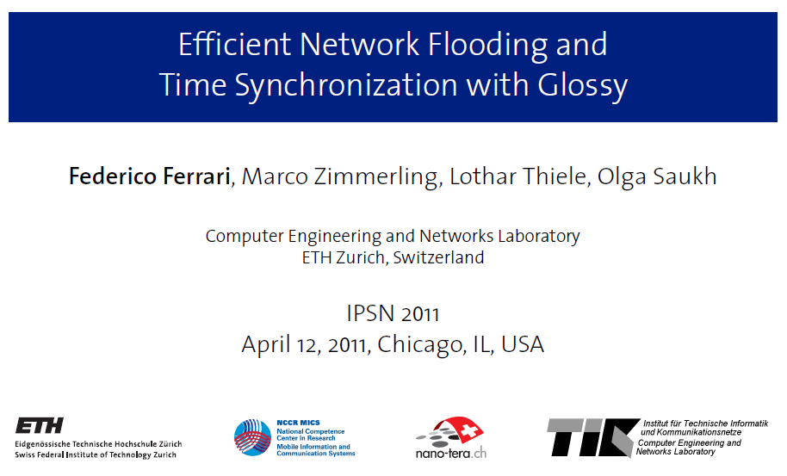
Glossy: What if we expand broadcast range by having multiple nodes participate?

Slide 41
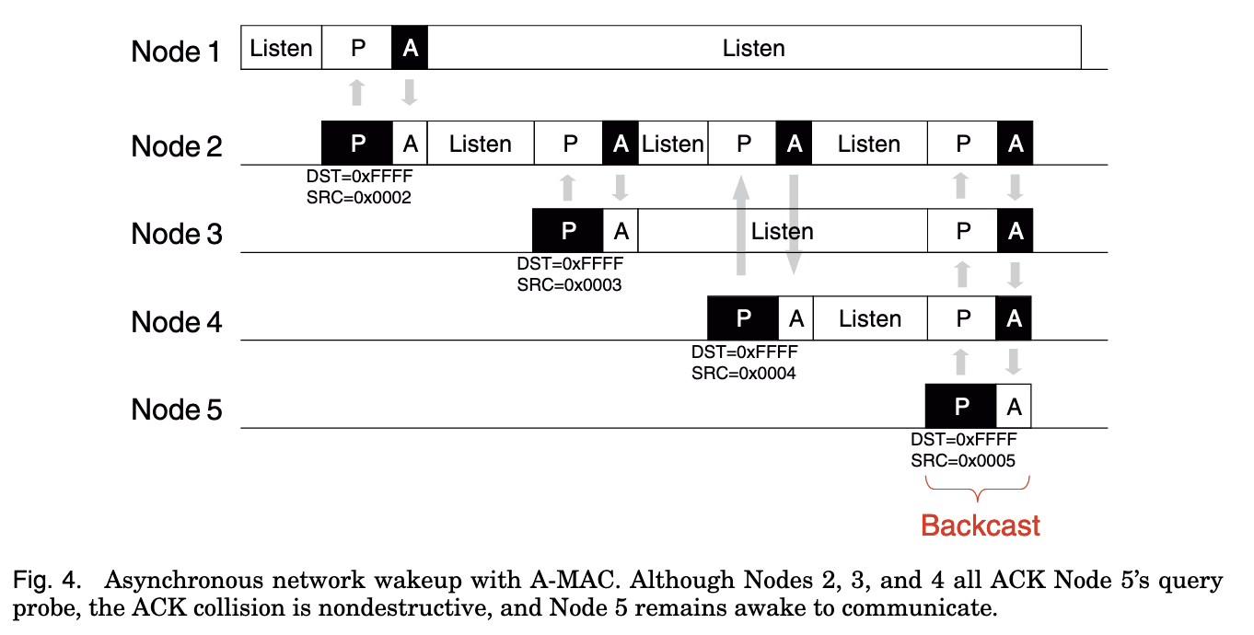
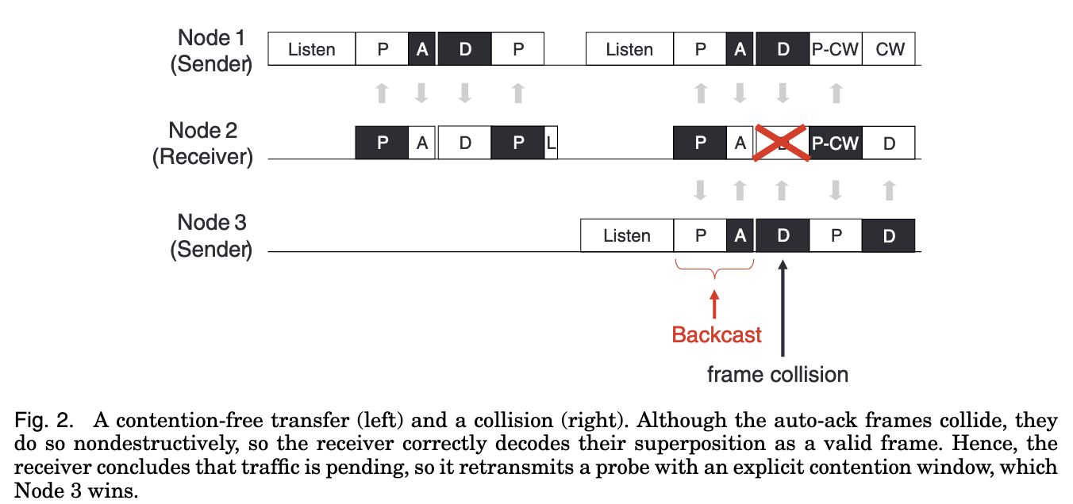
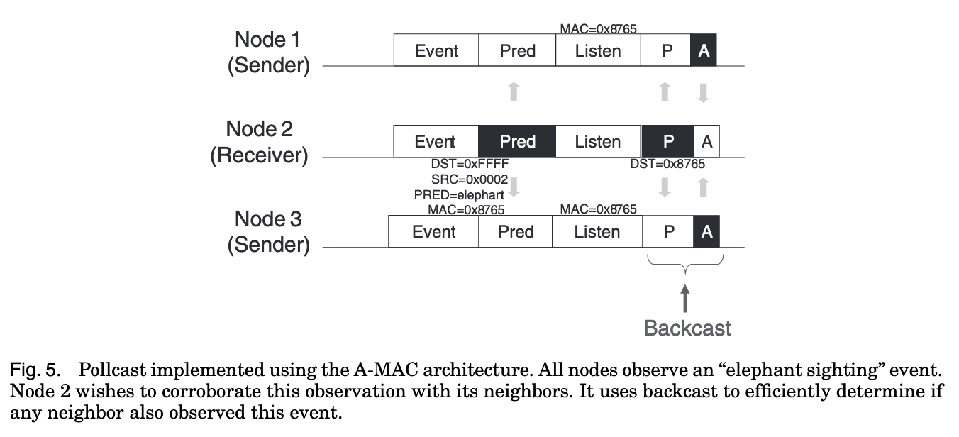
Glossy foundations: A-MAC and Backcast
A few lectures back I mentioned ‘broadcast ACKs can work’, here’s how:

Slide 42
Fundamental Insight: Say exactly the same thing at exactly (enough) the same time → coherence not interference
In 802.15.4, an ACK is sent exactly 192 µs after receiving
The ACK packet contains only the sequence number being ACK’d
Does not contain source address of the ACK-er
Which is why this works:

Slide 43
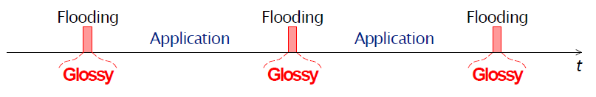
Glossy key techniques
Temporally decouple network flooding from application tasks
Exploit synchronous transmissions for fast network flooding

Slide 44
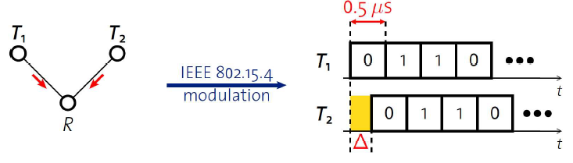
Synchronous transmissions
Multiple nodes transmit same packet at same time
R can receive packet with high probability if Δ is small
May even improve probability of reception (more energy at receiver)
500 ns is 1/32 of a symbol for 802.15.4 (chip duration)

Slide 45
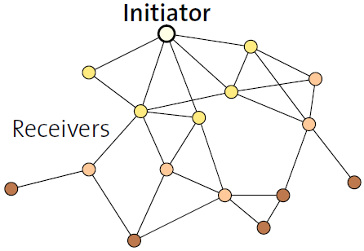
Fast packet propagation in Glossy

Slide 46
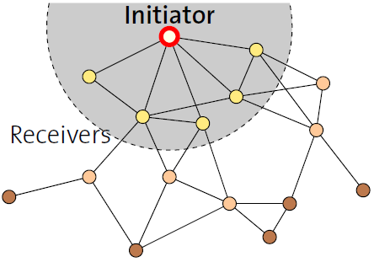
Fast packet propagation in Glossy

Slide 47
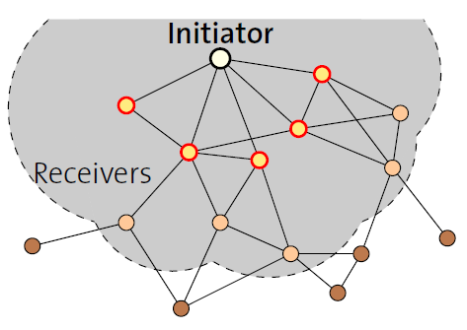
Fast packet propagation in Glossy

Slide 48
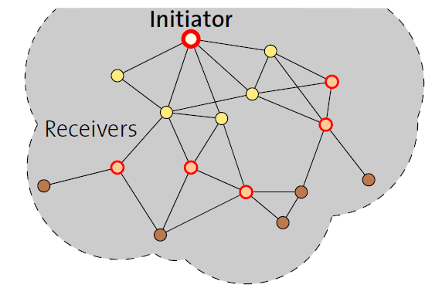
Fast packet propagation in Glossy

Slide 49
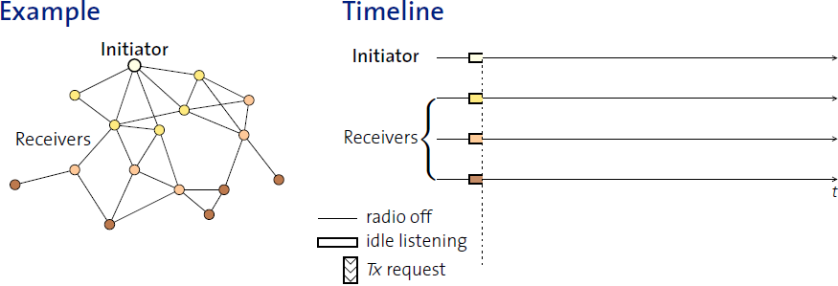
Glossy details
When Glossy starts
All nodes turn on radios to receive

Slide 50
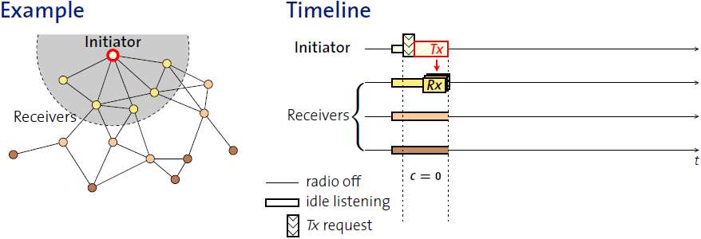
Glossy details
Initiator
Set relay counter in packet, C = 0
Broadcast packet

Slide 51
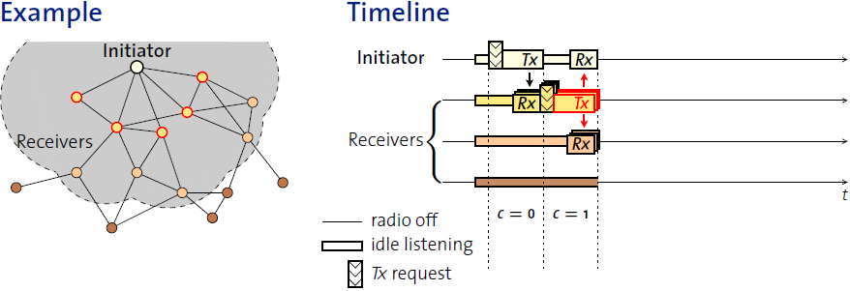
Glossy details
At packet reception:
Increment relay counter C
Transmit synchronously (at a fixed period after the reception)

Slide 52
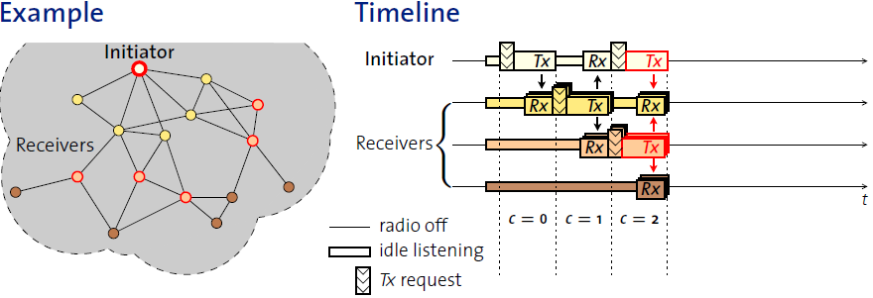
Glossy details
At packet reception:
Increment relay counter C
Transmit synchronously (at a fixed period after the reception)

Slide 53
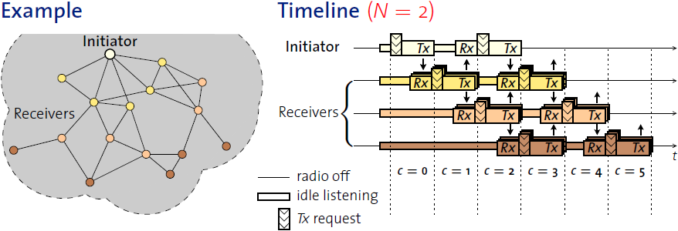
Glossy details
Stop rebroadcasting and turn off radio when
Already transmitted N times
Networks pick N for reliability/energy tradeoff

Slide 54
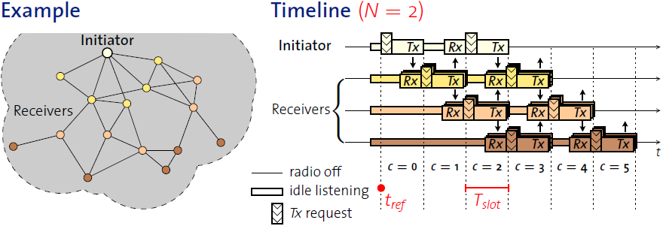
Glossy details
T_{slot} is constant by design
Needs to be to make constructive interference work
Beginning of slot (t_{ref}) provides synchronization point
As a bonus, all nodes are synchronized after flooding event

Slide 55
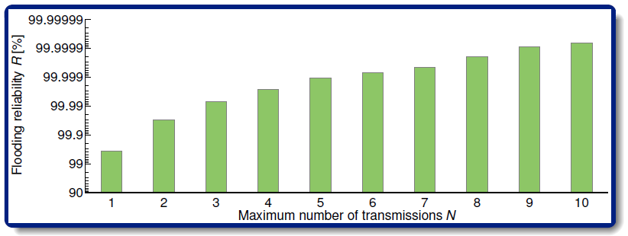
Glossy implementation
Device must be able to have tight time bounds on rx/tx
500 ns wiggle room maximum
Includes receive, processing, transmission
Need to pick an N for reliability

Slide 56
Application of Glossy: avoid routing altogether
Low-Power Wireless Bus (LWB)
Federico Ferrari, Zimmerling, Mottola, Thiele. SenSys’12
Use Glossy for all device communication
Make one broadcast domain (a bus) where all nodes communicate
Avoids all issues of routing, everything is a broadcast
Works for unicast, multicast, anycast, and broadcast transmissions
General idea: TDMA Glossy floods
Synchronization is already given to nodes by Glossy
One coordinator makes the TDMA schedule

Slide 57
Break + Implications of Flooding
Synchronous Transmission Protocols were a major disruption
Showed that flooding data from A → F used less net energy than routing A → F
(Net here is energy consumed by all nodes in the network)
Why??
What kinds of applications, traffic patterns would synchronous transmissions be worse than routing for?
B
C
A
D
F
E

