Slide 1
CS6501/ECE6501 IoT Sensors and Systems
August 28, 2017
Brad Campbell – bradjc@virginia.edu
http://www.cs.virginia.edu/~bjc8c/class/cs6501-f17/

Slide 2
Outline
Picking research problems
Things to keep in mind
Computer science issues in ubiquitous computing and the IoT

Slide 3
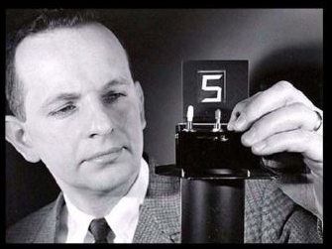
The Heilmeier Catechism
George H. Heilmeier
Director of DARPA, 1975-1977
Invented LCD displays
DARPA funds research projects
But which ones to take risks on?

Slide 4
The Heilmeier Catechism
What are you trying to do? Articulate your objectives using absolutely no jargon.
How is it done today, and what are the limits of current practice?
What is new in your approach and why do you think it will be successful?
Who cares? If you succeed, what difference will it make?
What are the risks?
How much will it cost?
How long will it take?
What are the mid-term and final “exams” to check for success?

Slide 5
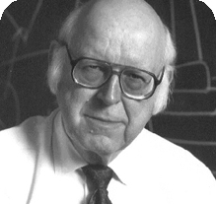
Allen Newell
Researcher at CMU
Pioneer in Artificial Intelligence
Turing Award winner
Developed pre-cursor to Lisp

Slide 6
Allen Newell’s Research Style
Good science responds to real problems
Good science is in the details
Good science makes a difference

Slide 7
Good science responds to real problems
Good scientific problems are those that reflect real phenomena in the world.
Real problems that need to be solved.
Clear statement of the real phenomena or application it addresses.

Slide 8
Good science is in the details
Takes the form of a working model
The artifact is about understanding, not building
Must build when analysis is too complex
Includes detailed analysis or implemented models
Allows others to benefit from work at an abstract level
Enables comparisons between different approaches

Slide 9
Good science makes a difference
Measures of contribution:
How it solves a real problem
How it shapes the work of other
Solves a real problem
The problem sets the crucial context for the work
A million ideas to pursue, but which ones are worth doing?
Shapes the work of others
Highest goal: change other people’s thinking
Paradigm changes are the most impactful [Kuhn]

Slide 10
Outline
Picking research problems
Things to keep in mind
Computer science issues in ubiquitous computing and the IoT

Slide 11
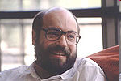
Mark Weiser
Who is Mark Weiser?
Researcher at Xerox PARC
Father of ubiquitous computing
Work is incredibly influential
What are the principles of ubiquitous computing?
The purpose of a computer is to help you do something else.
The best computer is a quiet, invisible servant.
The more you can do by intuition the smarter you are; the computer should extend your unconscious.
Technology should create calm (technology that doesn’t demand our focus or attention).

Slide 12
Hypothesis of the article?
Advances in low power hardware, low power wireless radios, UI hardware, and networking protocols will enable “invisible computing” and enable office workers to be more effective.

Slide 13
Approach in the CSL at PARC
“The research method of ubiquitous computing is standard experimental computer science: the construction of working prototypes of the necessary infrastructure in sufficient quantity to debug the viability of the systems in everyday use.”
“A key part of our design philosophy is to put devices in everyday use, not just demonstrate them.”
This exposes challenges that wouldn’t otherwise appear.

Slide 14
Weiser’s Vision – Are we there yet?
For each person:
Hundreds of Tabs
Tens of Pads
One or two Boards
Migrating displays
Collaborative editing
Real-time people maps

Slide 15
The computer science of Ubicomp
Low power computer architecture
Vastly improved, but work still continues today
Wireless radios
Metric: bits/sec/m³ --> better bandwidth in close proximity
Pen hardware
How to write on walls?
Wireless MAC
Lot of WSN research focused on this topic
Networking
High-speed (many small devices add up!)
Real-time
Mobile

Slide 16
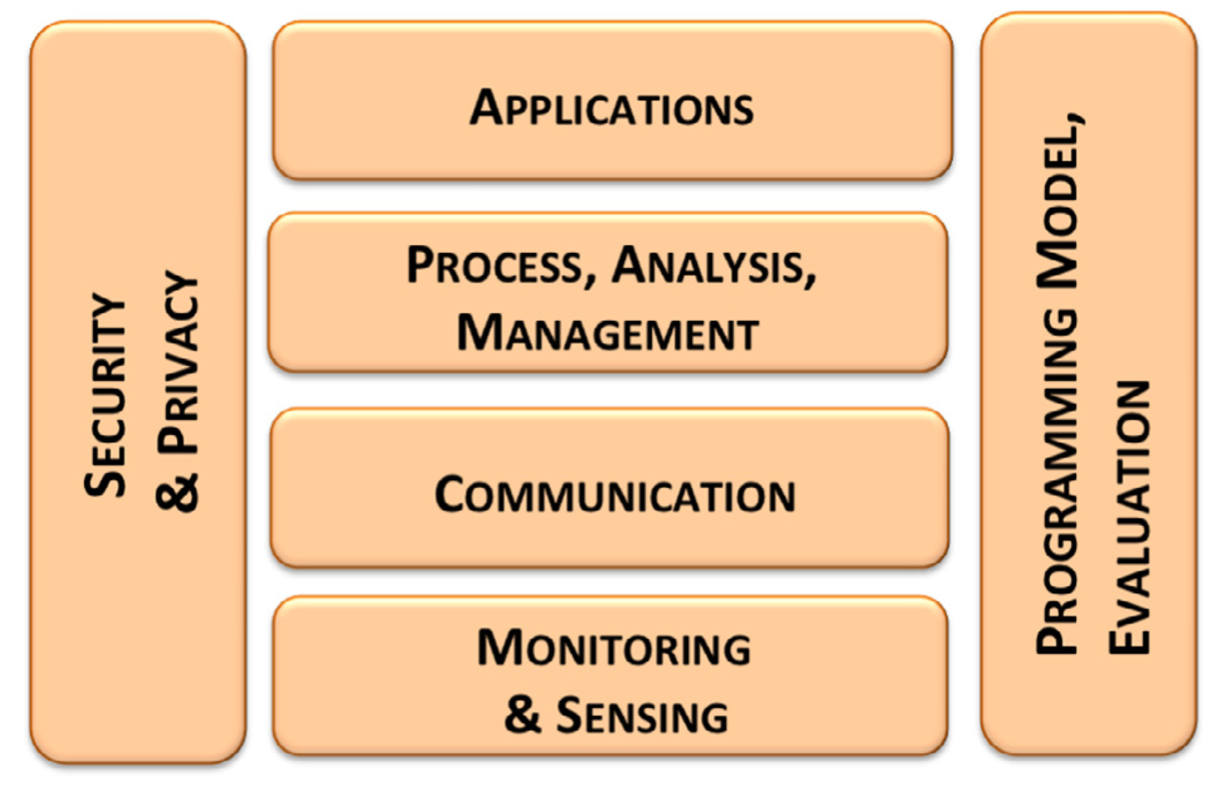
The research issues of the Internet of Things

Slide 17
What issues are still issues today?
Need for energy-efficient hardware and sensors
Wireless radio technologies
Privacy preserving techniques for user data
Human interaction patterns

Slide 18
What new issues characterize the IoT?
Issues of heterogeneity
Communication
Management and discovery
Secure systems
Programming models
Distributed or cloud based

Slide 19
What did you find most interesting/compelling?

Slide 20
For Wednesday
Two reviews
An Analysis of a Large Scale Habitat Monitoring Application
Information Bang for the Energy Buck: Towards Energy- and Mobility-Aware Tracking
Email them to bradjc@virginia.edu
Come prepared to discuss, critique, and debate

