Slide 1
CS6501 Embedded OS
September 10, 2018
Brad Campbell – bradjc@virginia.edu
http://www.cs.virginia.edu/~bjc8c/class/cs6501-f18/

Slide 2
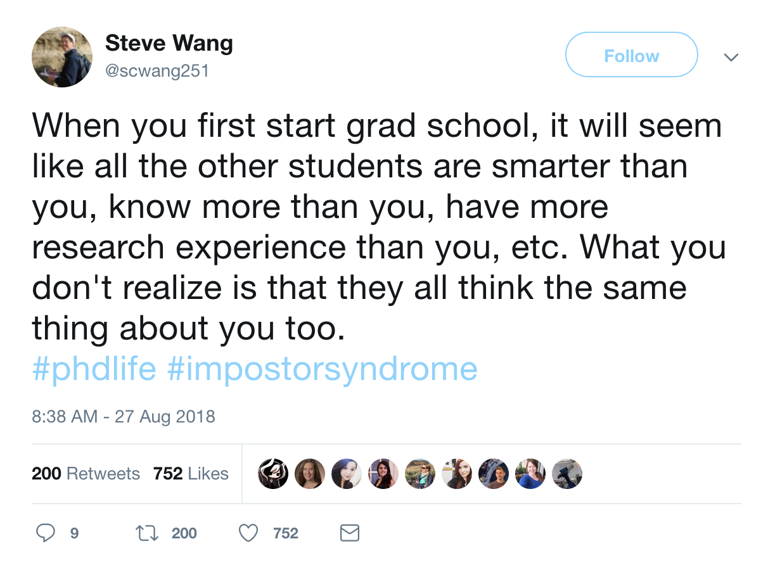
https://twitter.com/scwang251/status/1034057440583712768

Slide 3
Writing good captions

Slide 4
Captions (and figures) are important
Very few people will read a document in its entirety.
Easiest way to quickly “read” a paper is to look at the figures.
Putting key information in captions will get it to more readers.

Slide 5
Good captions do three things.
Identify what the figure is.
Explain what the figure is showing.
Tell you what the takeaway is.
This is the hard one!

Slide 6
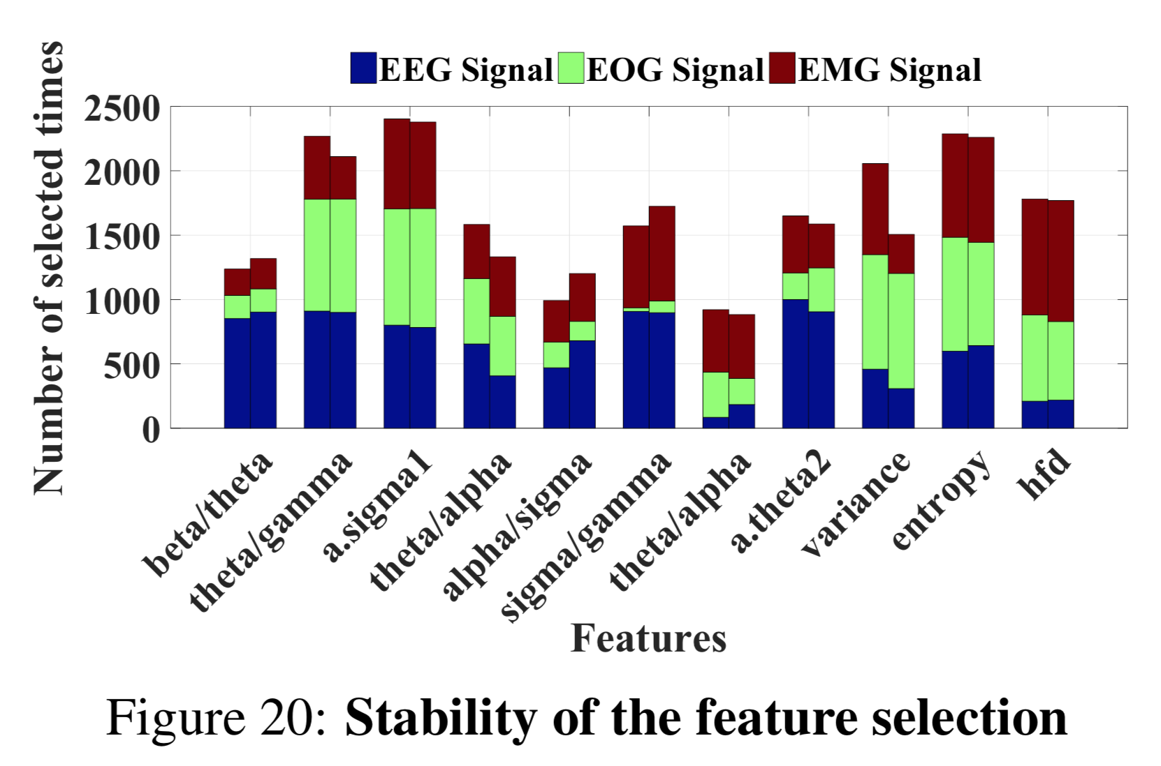
What is this figure showing?

Slide 7
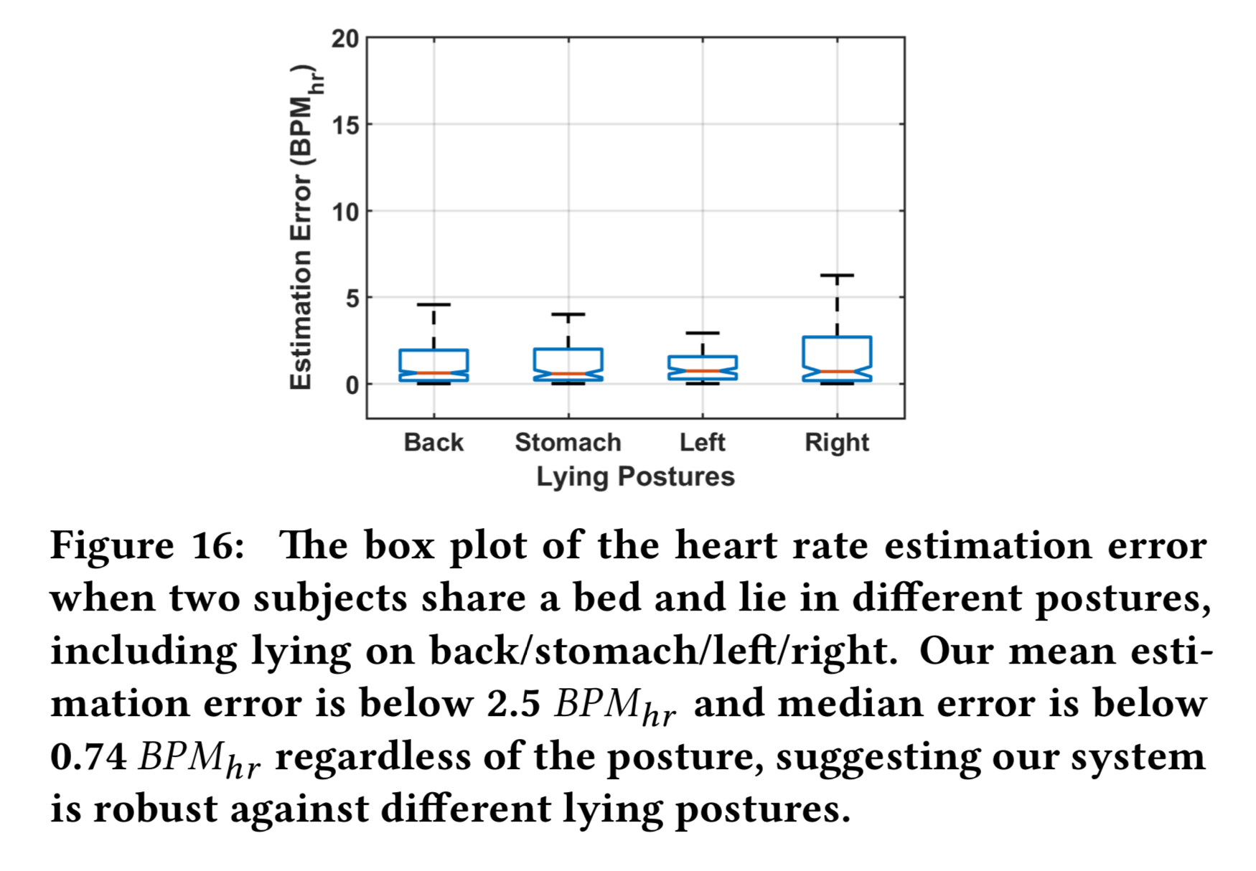
What is this figure showing?

Slide 8
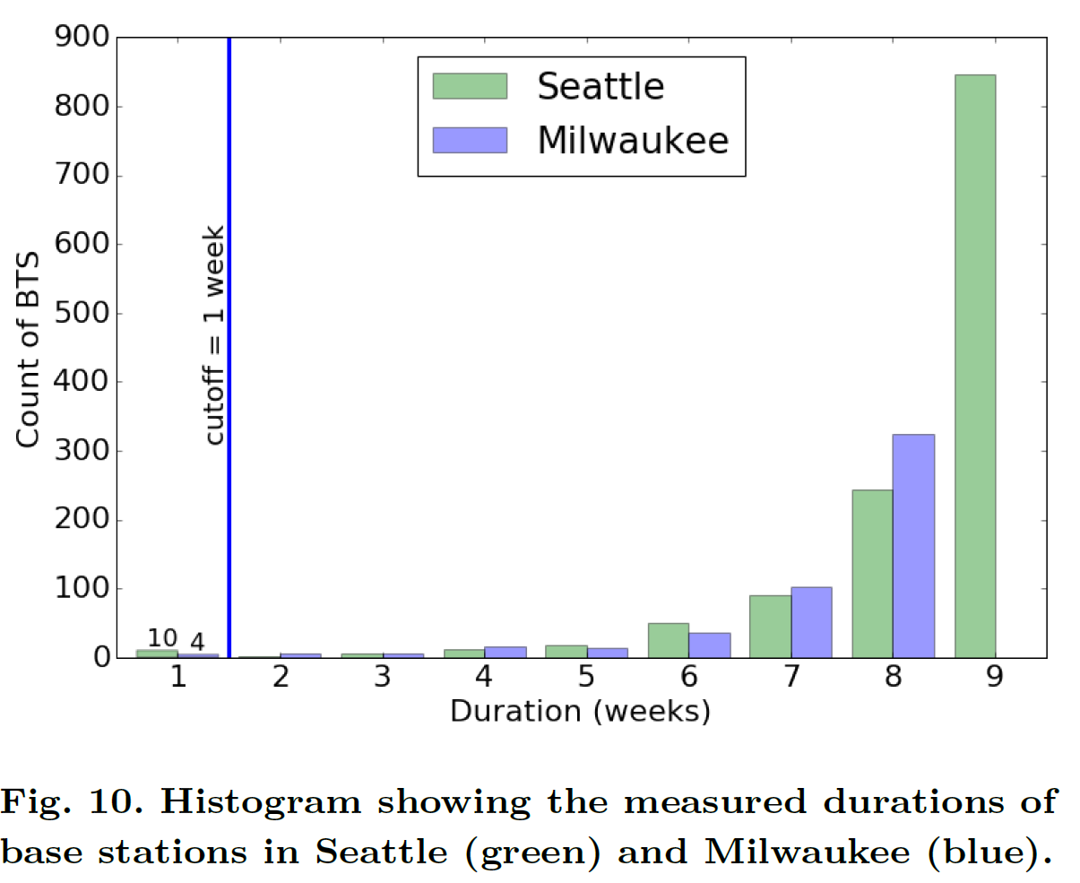
This is a bad caption

Slide 9
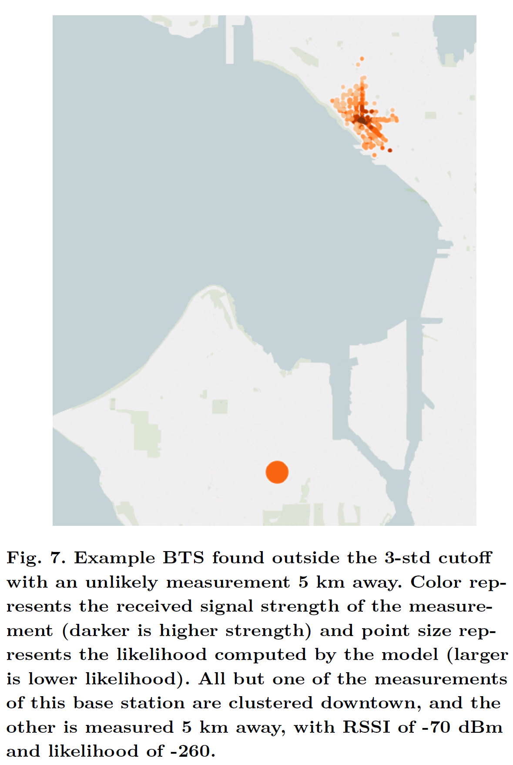
This is better

Slide 10
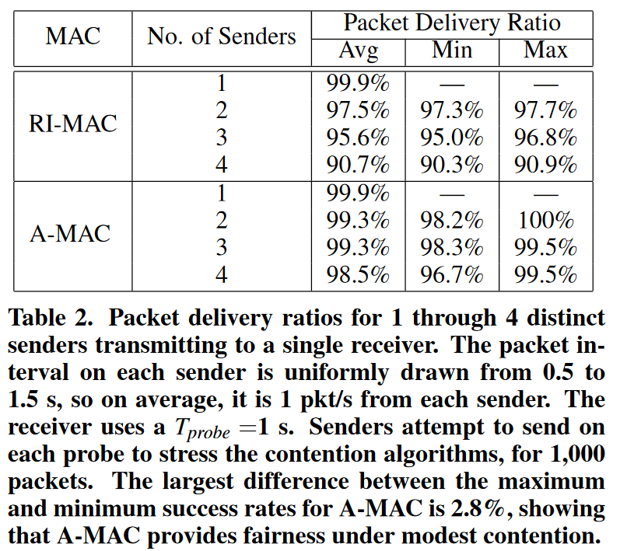
This is a good caption

Slide 11
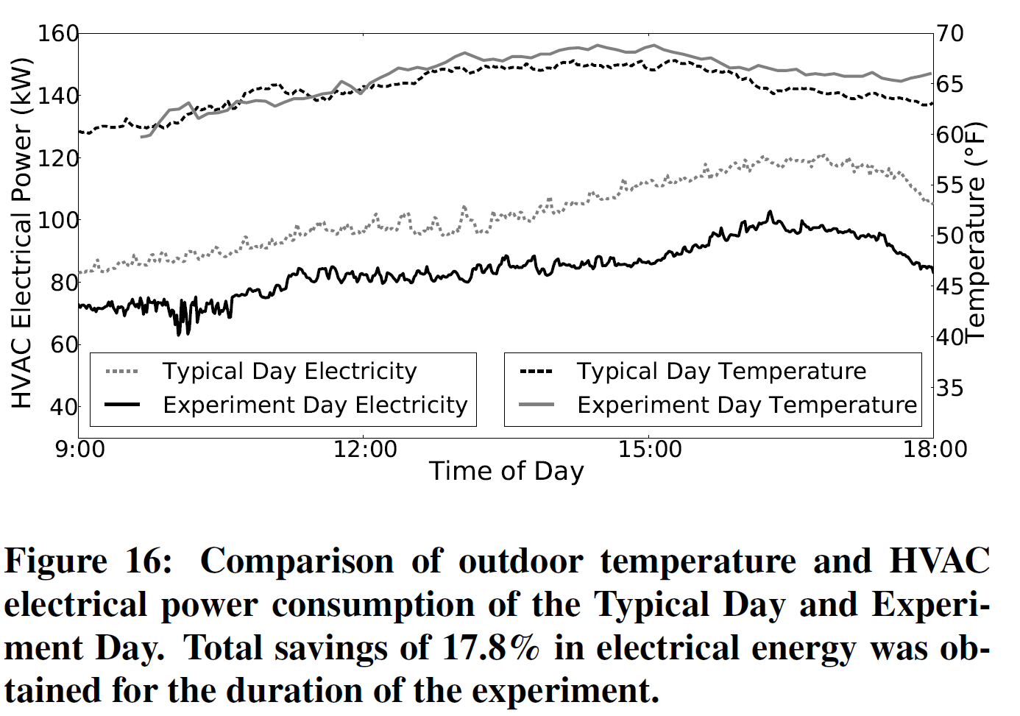
Thoughts?

Slide 12
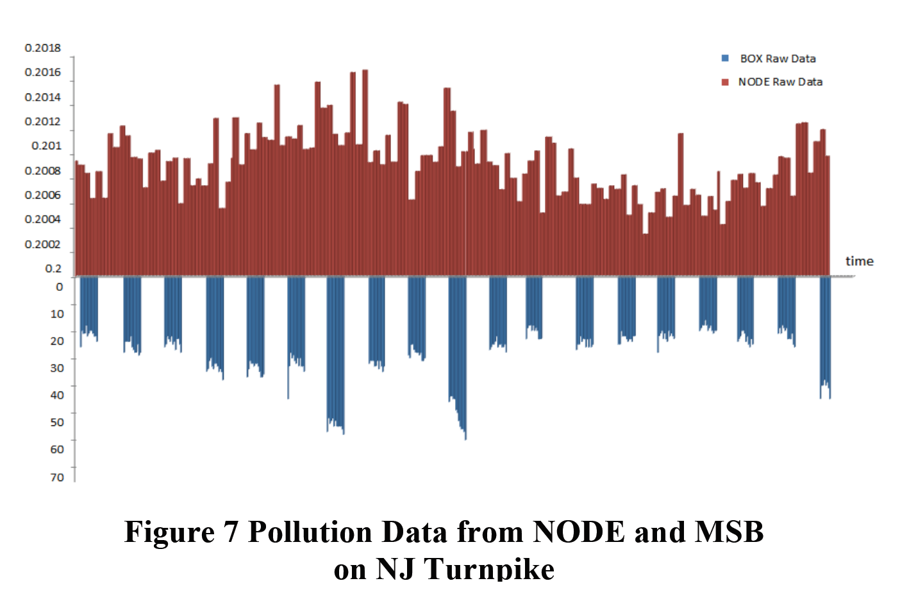
Thoughts?

Slide 13
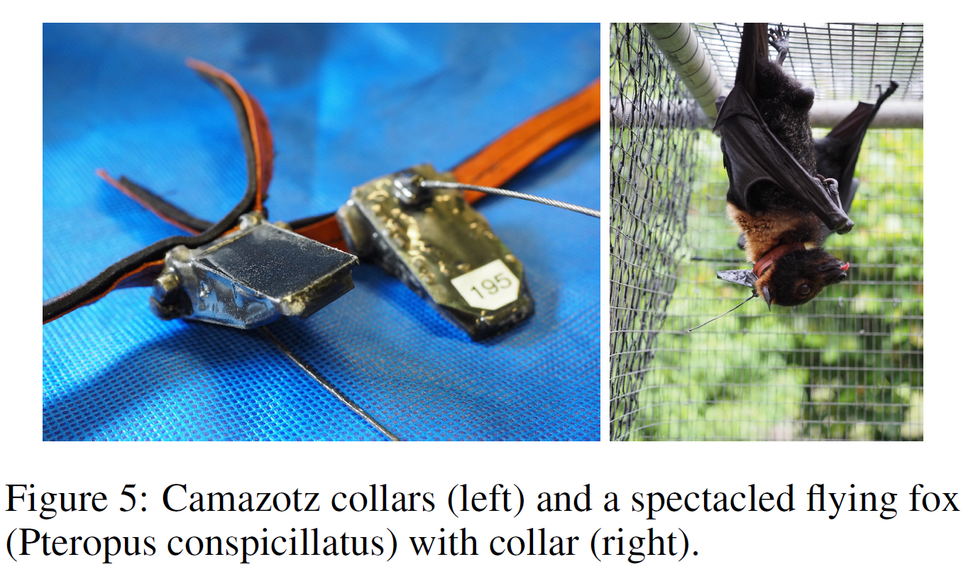
Thoughts?

Slide 14
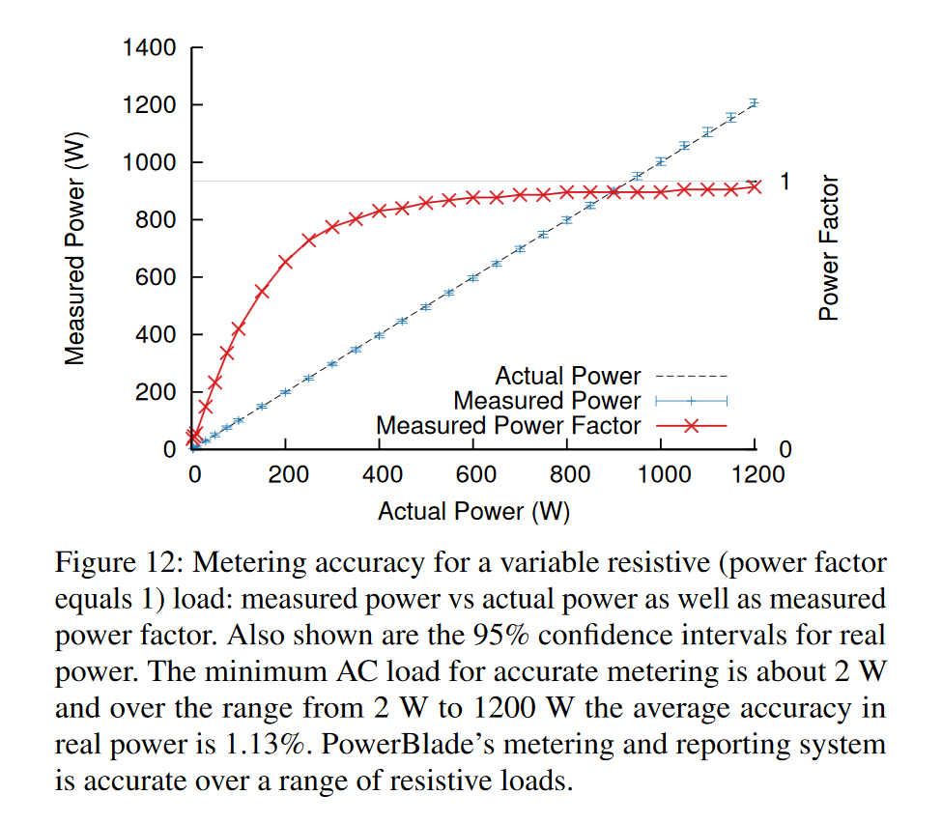
Thoughts?

