Slide 1
CS6456: Graduate Operating Systems
Brad Campbell – bradjc@virginia.edu
https://www.cs.virginia.edu/~bjc8c/class/cs6456-f19/

Slide 2
What is virtualization?
Virtualization is the ability to run multiple operating systems on a single physical system and share the underlying hardware resources¹
Allows one computer to provide the appearance of many computers.
Goals:
Provide flexibility for users
Amortize hardware costs
Isolate completely separate users
¹ VMWare white paper, Virtualization Overview

Slide 3
Formal Requirements for Virtualizable Third Generation Architectures
“First, the VMM provides an environment for programs which is essentially identical with the original machine;
second, programs run in this environment show at worst only minor decreases in speed;
and last, the VMM is in complete control of system resources.”

Slide 4
Native and Hosted VM Systems
Guest Applications
Guest OS
VMM
Host OS
Hardware
Guest Applications
Guest OS
VMM
Host OS
Hardware
Guest Applications
Guest OS
VMM
Hardware
Applications
OS
Hardware
Nonprivileged
modes
Privileged
modes
Traditional
Uniprocessor
System
Native
VM System
User-mode
Hosted
VM System
Dual-mode
Hosted
VM System

Slide 5
VMM Platform Types
Hosted Architecture
Install as application on existing x86 “host” OS, e.g. Windows, Linux, OS X
Small context-switching driver
Leverage host I/O stack and resource management
Examples: VMware Player/Workstation/Server, Microsoft Virtual PC/Server, Parallels Desktop
Bare-Metal Architecture
“Hypervisor” installs directly on hardware
Acknowledged as preferred architecture for high-end servers
Examples: VMware ESX Server, Xen, Microsoft Viridian (2008)

Slide 6
Virtualization: rejuvenation
1960’s: first track of virtualization
Time and resource sharing on expensive mainframes
IBM VM/370
Late 1970s and early 1980s: became unpopular
Cheap hardware and multiprocessing OS
Late 1990s: became popular again
Wide variety of OS and hardware configurations
VMWare
Since 2000: hot and important
Cloud computing
Docker containers

Slide 7
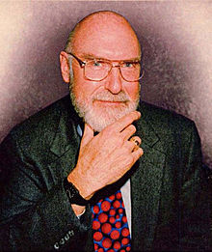
IBM VM/370
Robert Jay Creasy (1939-2005)
Project leader of the first full virtualization hypervisor: IBM CP-40, a core component in the VM system
The first VM system: VM/370

Slide 8
IBM VM/370
Conversational Monitor System (CMS)
Specialized VM subsystem (RSCS, RACF, GCS)
Mainstream OS (MVS, DOS/VSE etc.)
Another copy of VM
Virtual machines
Hypervisor
Control Program (CP)
Hardware
System/370

Slide 9
IBM VM/370
Technology: trap-and-emulate
Application
Problem
Kernel
Privileged
Trap
Emulate
CP

Slide 10
Virtualization on x86 architecture
Challenges
Correctness: not all privileged instructions produce traps!
Example: popf
popf does different things in kernel mode vs. user mode
Performance:
System calls: traps in both enter and exit (10X)
I/O performance: high CPU overhead
Virtual memory: no software-controlled TLB

Slide 11
Virtualization on x86 architecture
Solutions:
Dynamic binary translation & shadow page table
Para-virtualization (Xen)
Hardware extension

Slide 12
Dynamic binary translation
Idea: intercept privileged instructions by changing the binary
Cannot patch the guest kernel directly (would be visible to guests)
Solution: make a copy, change it, and execute it from there
Use a cache to improve the performance

Slide 13
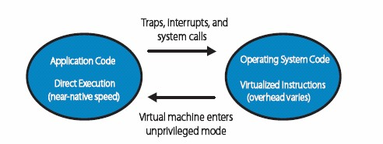
Binary translation
Directly execute unprivileged guest application code
Will run at full speed until it traps, we get an interrupt, etc.
“Binary translate” all guest kernel code, run it unprivileged
Since x86 has non-virtualizable instructions, proactively transfer control to the VMM (no need for traps)
Safe instructions are emitted without change
For “unsafe” instructions, emit a controlled emulation sequence
VMM translation cache for good performance

Slide 14
How does VMWare do this?
Binary – input is x86 “hex”, not source
Dynamic – interleave translation and execution
On Demand – translate only what about to execute (lazy)
System Level – makes no assumptions about guest code
Subsetting – full x86 to safe subset
Adaptive – adjust translations based on guest behavior

Slide 15
Convert unsafe operations and cache them
Input: BB
55 ff 33 c7 03 ...
Each Translator Invocation
• Consume a basic block (BB)
• Produce a compiled code fragment (CCF)
Store CCF in Translation Cache
• Future reuse
• Capture working set of guest kernel
• Amortize translation costs
• Not “patching in place”
translator
Output: CCF
55 ff 33 c7 03 ...

Slide 16
Dynamic binary translation
Pros:
Make x86 virtualizable
Can reduce traps
Cons:
Overhead
Hard to improve system calls, I/O operations
Hard to handle complex code

Slide 17
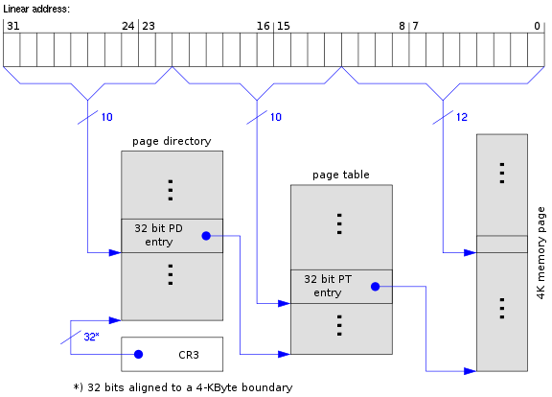
Shadow page table

Slide 18
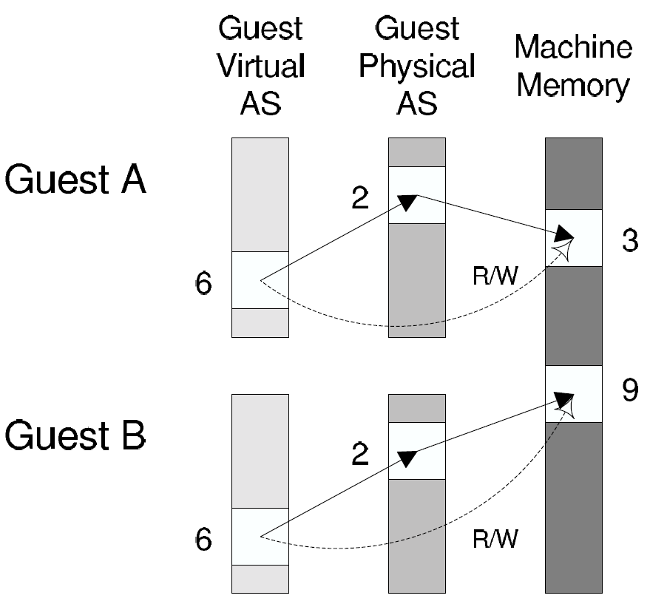
Shadow page table
Guest page table
Shadow page table

Slide 19
Shadow page table
Pros:
Transparent to guest VMs
Good performance when working set is stable
Cons:
Big overhead of keeping two page tables consistent
Introducing more issues: hidden fault, double paging …

Slide 20
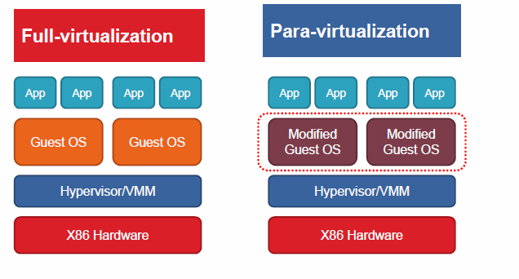
Para-virtualization
Full vs. para virtualization

Slide 21
Xen and the art of virtualization
SOSP’03
Very high impact (data collected in 2013)
8807
3090
2116

Slide 22
Overview of the Xen approach
Support for unmodified application binaries (but not OS)
Keep Application Binary Interface (ABI)
Modify guest OS to be aware of virtualization
Get around issues of x86 architecture
Better performance
Keep hypervisor as small as possible
Device driver is in Dom0

Slide 23
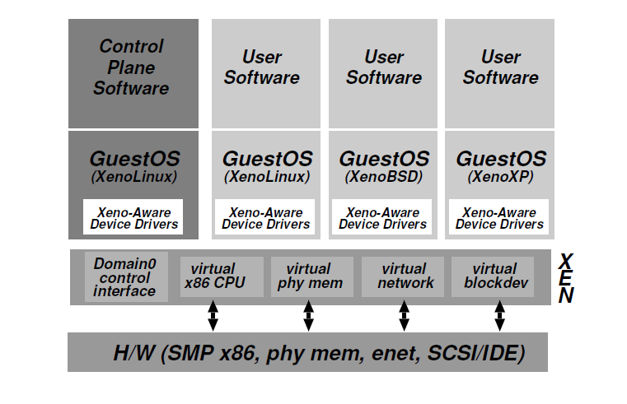
Xen architecture

Slide 24
Virtualization on x86 architecture
Challenges
Correctness: not all privileged instructions produce traps!
Example: popf
Performance:
System calls: traps in both enter and exit (10X)
I/O performance: high CPU overhead
Virtual memory: no software-controlled TLB

Slide 25
CPU virtualization
Protection
Xen in ring0, guest kernel in ring1
Privileged instructions are replaced with hypercalls
Exception and system calls
Guest OS registers handles validated by Xen
Allowing direct system call from app into guest OS
Page fault: redirected by Xen

Slide 26
CPU virtualization (cont.)
Interrupts:
Lightweight event system
Time:
Interfaces for both real and virtual time

Slide 27
Memory virtualization
Xen exists in a 64MB section at the top of every address space
Guest sees real physical address
Guest kernels are responsible for allocating and managing the hardware page tables.
After registering the page table to Xen, all subsequent updates must be validated.

Slide 28
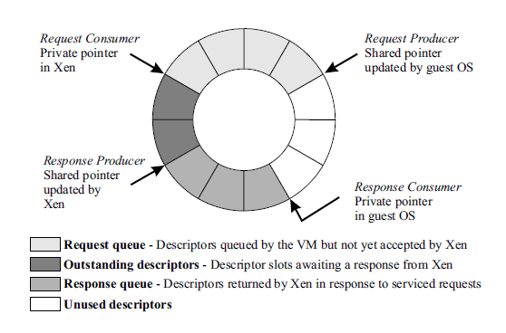
I/O virtualization
Shared-memory, asynchronous buffer descriptor rings

Slide 29
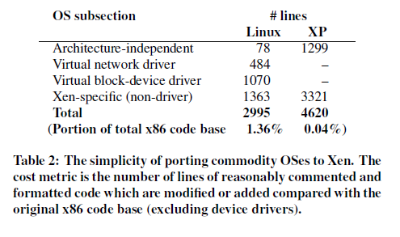
Porting effort is quite low

Slide 30
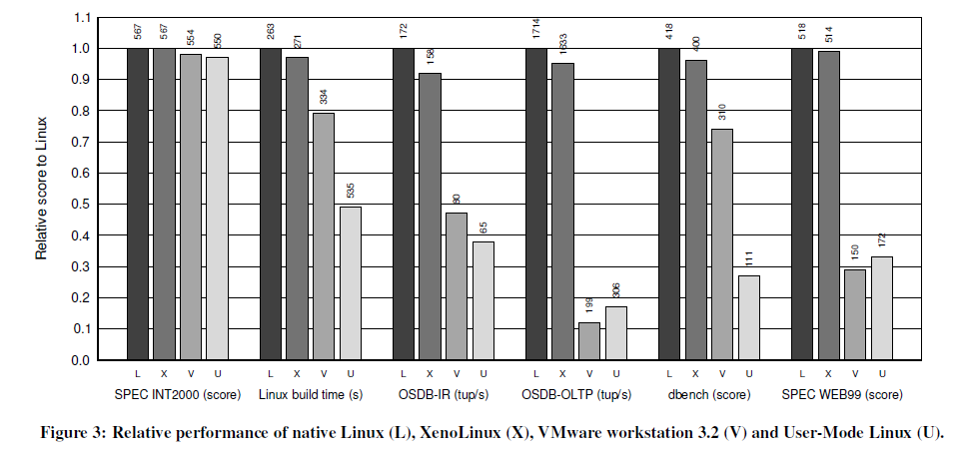
Evaluation

Slide 31
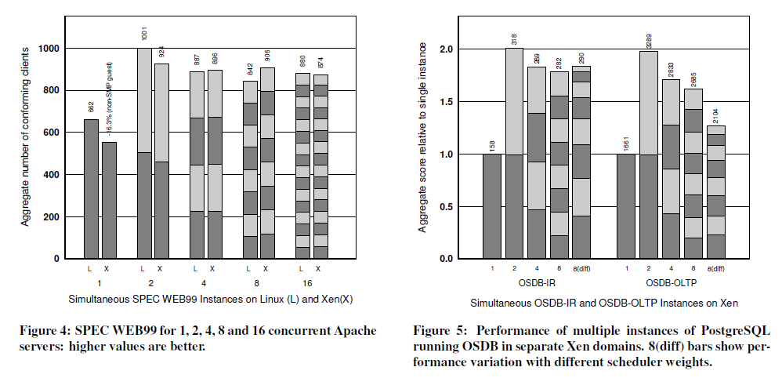
Evaluation

Slide 32
Conclusion
x86 architecture makes virtualization challenging
Full virtualization
unmodified guest OS; good isolation
Performance issue (especially I/O)
Para virtualization:
Better performance (potentially)
Need to update guest kernel
Full and para virtualization will keep evolving together

Slide 33
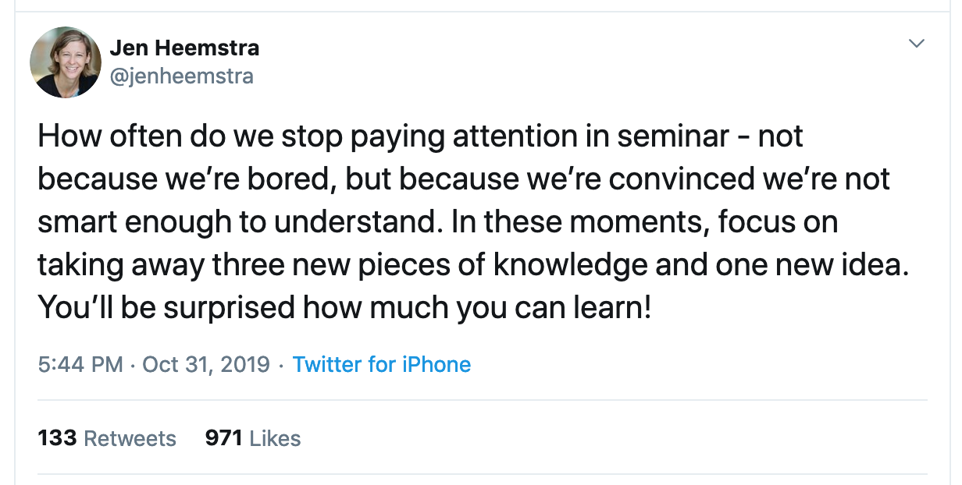
Corollary: How often do we lose our audience?
My tip: put the point of the slide directly in the title
“Evaluation” vs.
“Xen is 1.1x to 3x more performant than VMWare”

Slide 34
Instead: Leverage hardware support
First generation - processor
Second generation - memory
Third generation – I/O device

Slide 35
IA Protection Rings (CPL)
Actually, IA has four protection levels, not two (kernel/user).
IA/X86 rings (CPL)
Ring 0 – “Kernel mode” (most privileged)
Ring 3 – “User mode”
Ring 1 & 2 – Other
Linux only uses 0 and 3.
“Kernel vs. user mode”
Pre-VT Xen modified to run the guest OS kernel to Ring 1: reserve Ring 0 for hypervisor.
CPU Privilege Level (CPL)
[Fischbach]

Slide 36
Why aren’t (IA) rings good enough?
VM
CPL 3
guest kernel
CPL 1
hypervisor
CPL 0
???

Slide 37
A short list of pre-VT problems
Early IA hypervisors (VMware, Xen) had to emulate various machine behaviors and generally bend over backwards.
IA32 page protection does not distinguish CPL 0-2.
Segment-grained memory protection only.
Ring aliasing: some IA instructions expose CPL to guest!
Or fail silently…
Syscalls don’t work properly and require emulation.
sysenter always transitions to CPL 0. (D’oh!)
sysexit faults if the core is not in CPL 0.
Interrupts don’t work properly and require emulation.
Interrupt disable/enable reserved to CPL0.

Slide 38
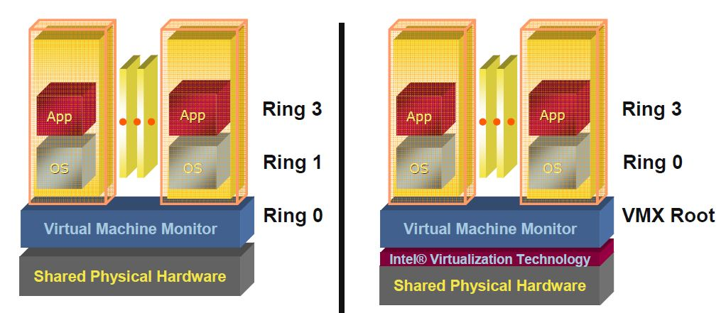
First generation: Intel VT-x & AMD SVM
Eliminating the need of binary translation or modifying OSes
Host mode
Guest mode
Ring3
Ring3
VMRUN
Ring2
Ring2
Ring1
VMEXIT
Ring1
Ring0
Ring0

Slide 39
VT in a Nutshell
New VM mode bit
Orthogonal to CPL (e.g., kernel/user mode)
If VM mode is off → host mode
Machine “looks just like it always did” (“VMX root”)
If VM bit is on → guest mode
Machine is running a guest VM: “VMX non-root mode”
Machine “looks just like it always did” to the guest, BUT:
Various events trigger gated entry to hypervisor (in VMX root)
A “virtualization intercept”: exit VM mode to VMM (VM Exit)
Hypervisor (VMM) can control which events cause intercepts
Hypervisor can examine/manipulate guest VM state and return to VM (VM Entry)

Slide 40
CPU Virtualization With VT-x
Two new VT-x operating modes
Less-privileged mode (VMX non-root) for guest OSes
More-privileged mode (VMX root) for VMM
Two new transitions
VM entry to non-root operation
VM exit to root operation
Virtual Machines (VMs)
Ring 3
Apps
Apps
Ring 0
OS
OS
VM Exit
VM Entry
VMX Root
VM Monitor (VMM)
Execution controls determine when exits occur
Access to privilege state, occurrence of exceptions, etc.
Flexibility provided to minimize unwanted exits
VM Control Structure (VMCS) controls VT-x operation
Also holds guest and host state

Slide 41
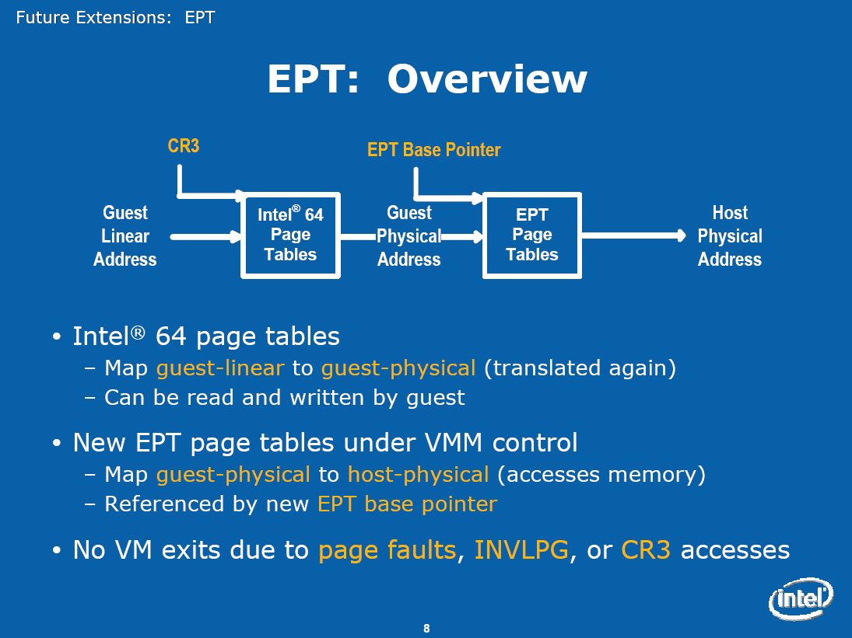
Second generation: Intel EPT & AMD NPT
Eliminating the need to shadow page table

Slide 42
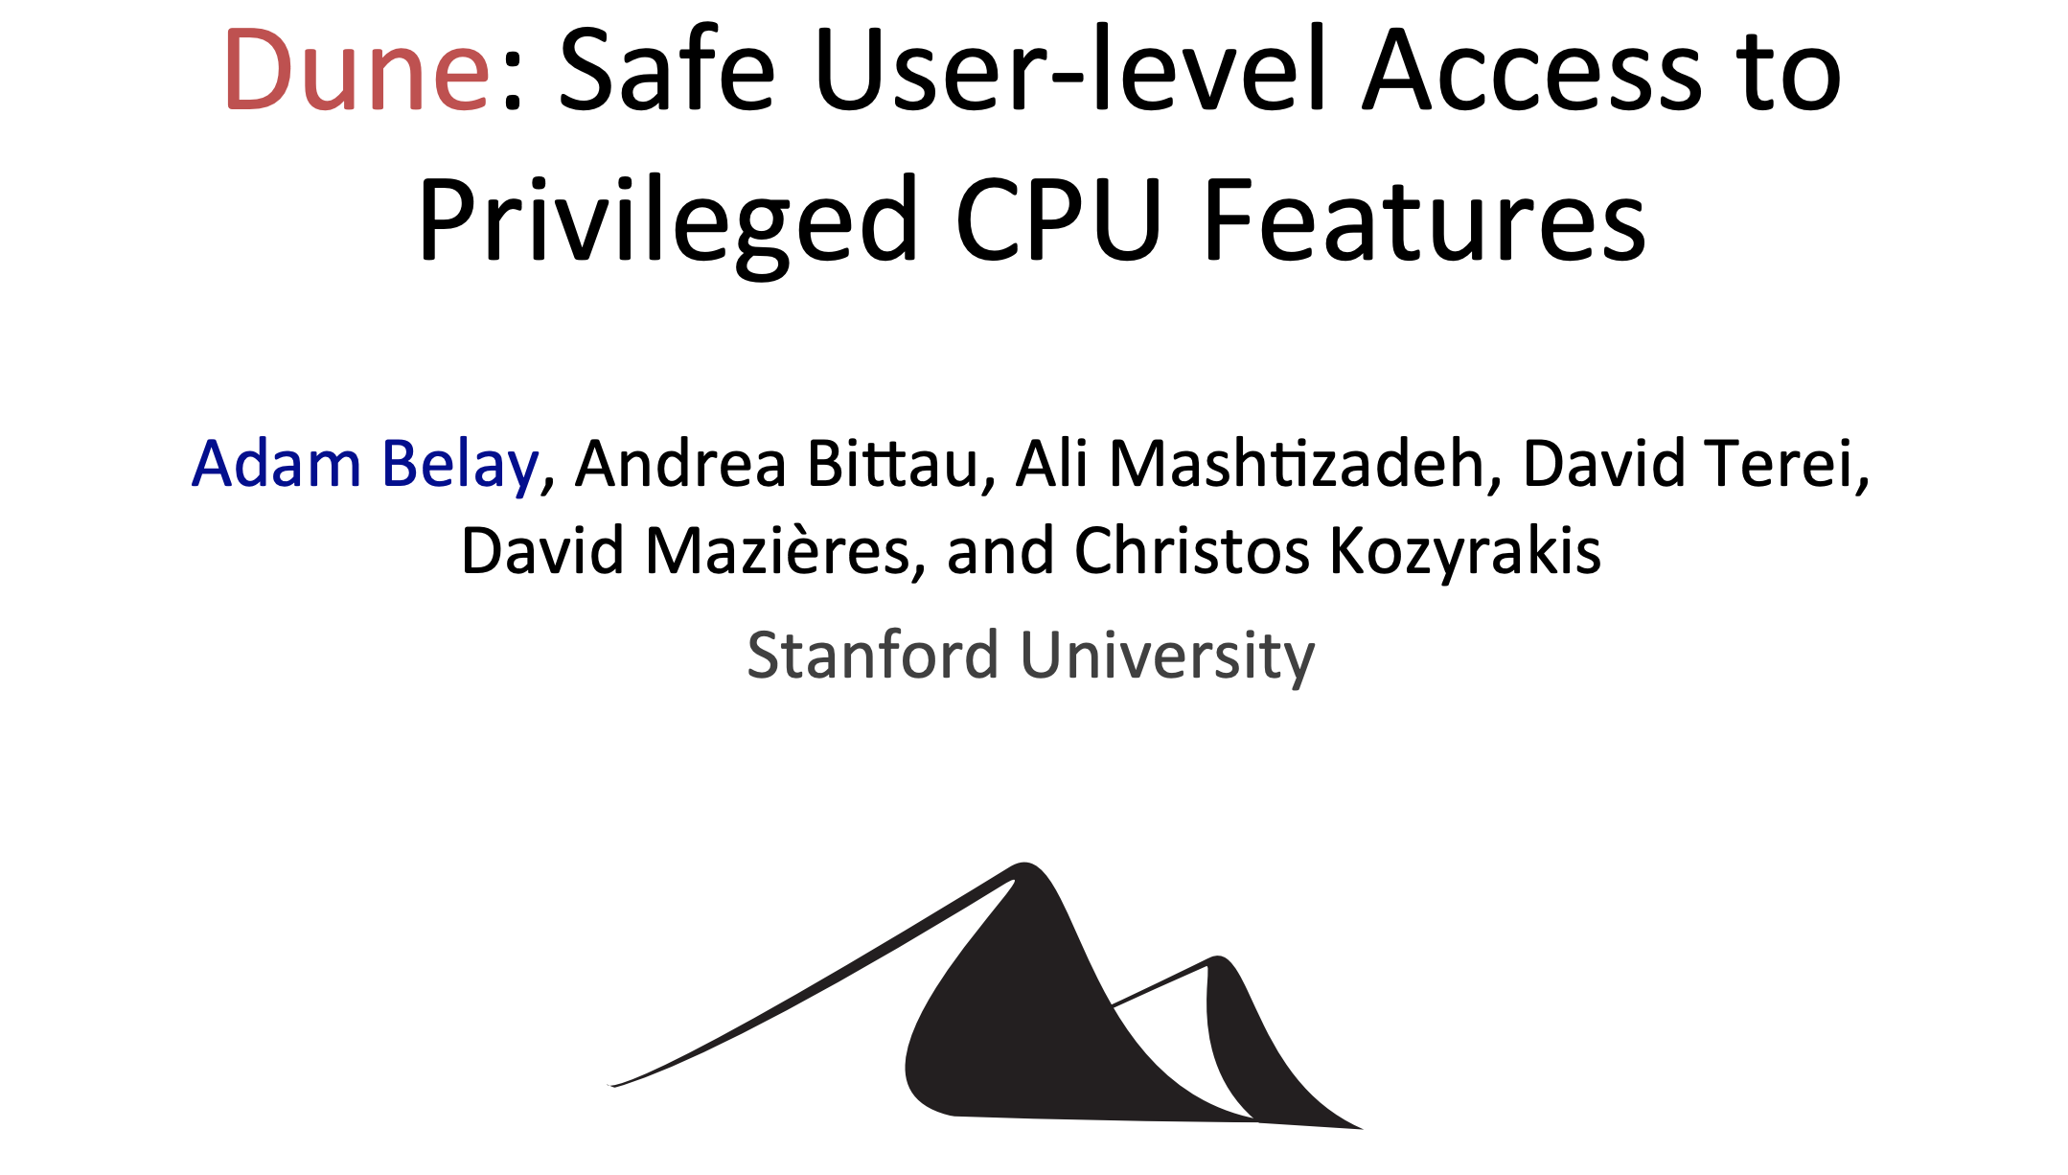
Third generation: Intel VT-d & AMD IOMMU
I/O device assignment
VM owns real device
DMA remapping
Support address translation for DMA
Interrupt remapping
Routing device interrupt
OSDI’12

Slide 43
Run App as a “process” in guest mode, and let it use all CPLs.

Slide 44
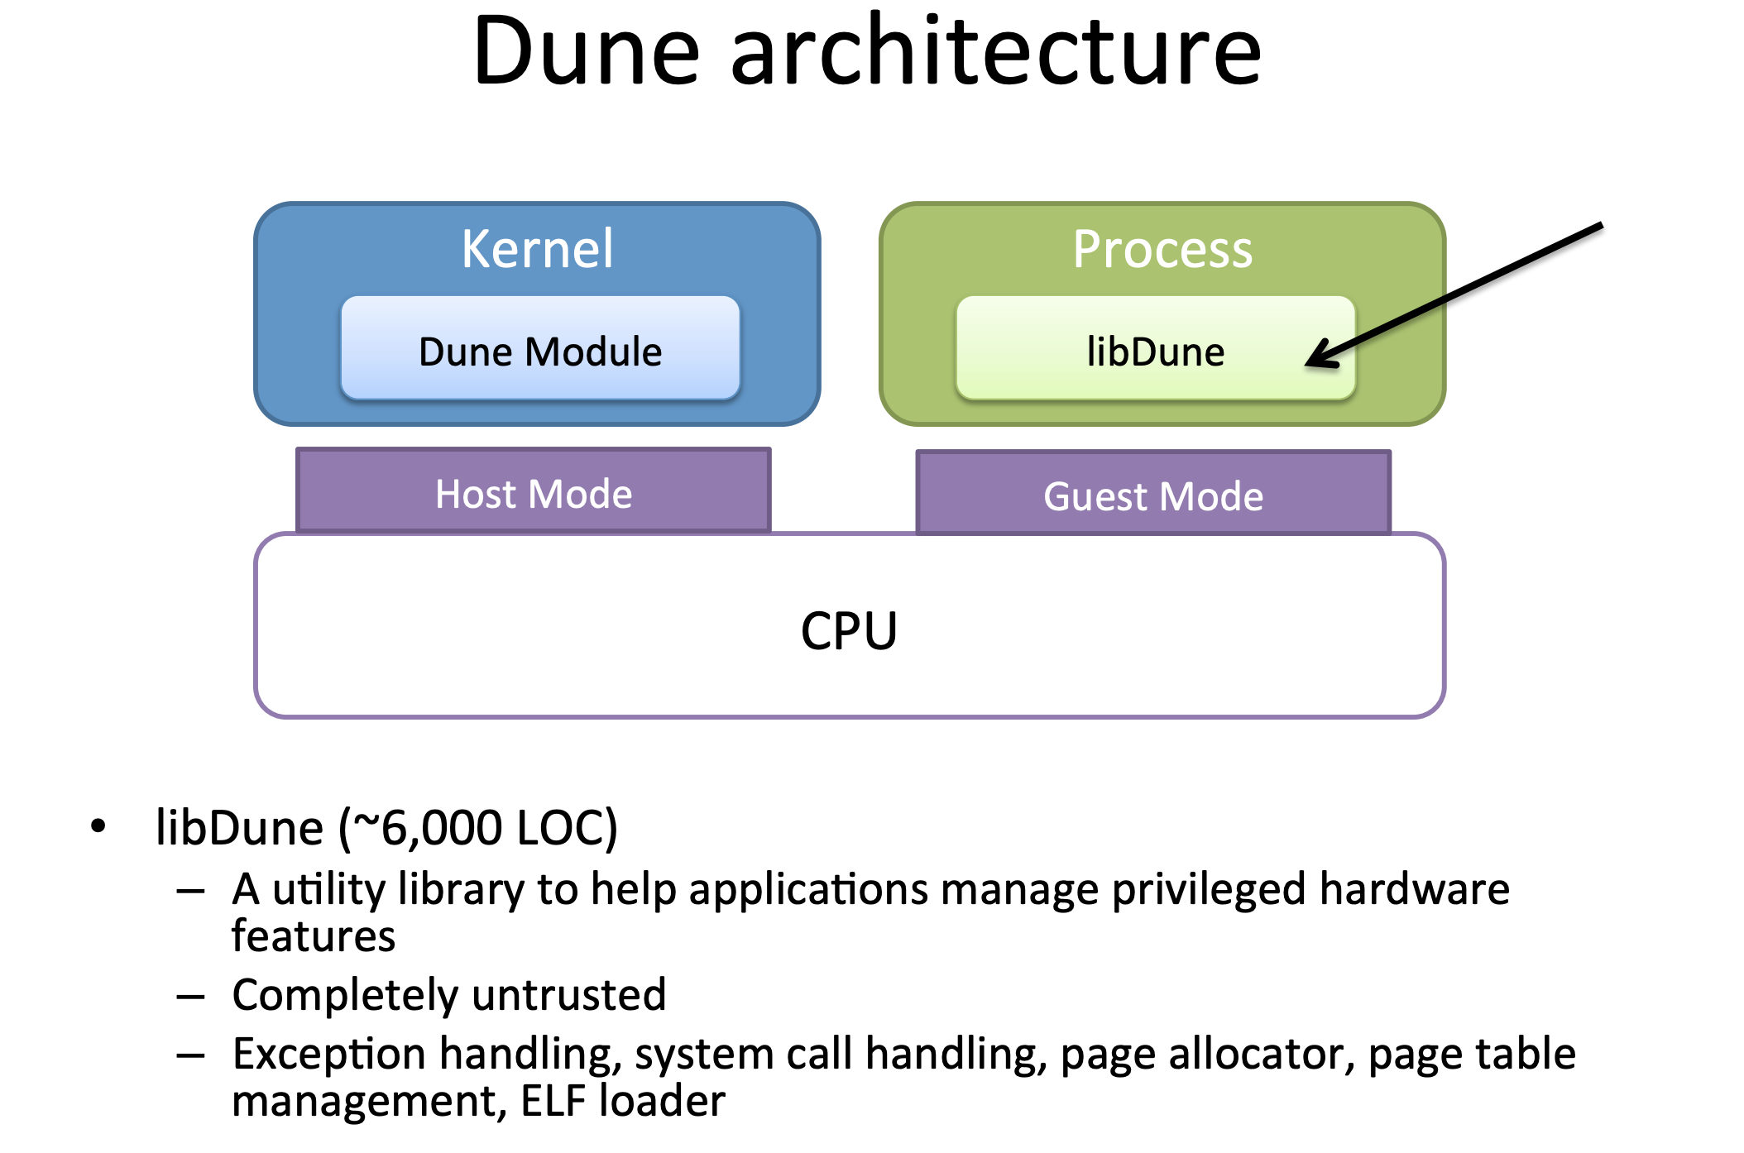

Slide 45
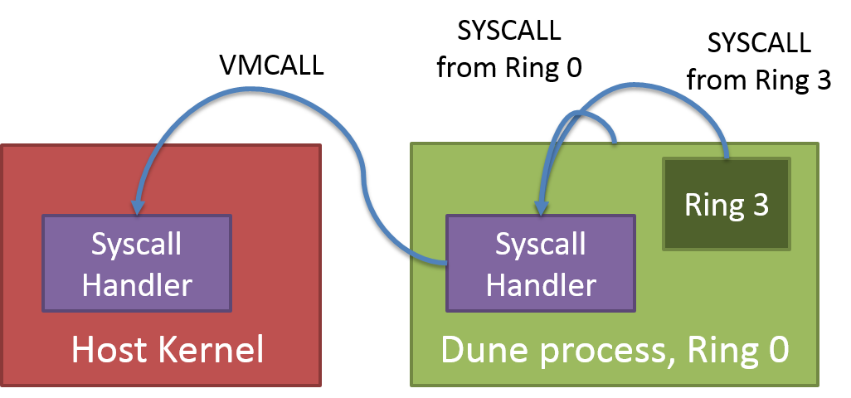
Hypervisor calls
VT VMCALL operation (an instruction) voluntarily traps to hypervisor.
Similar to SYSCALL to trap to kernel mode.
Not needed for transparent virtualization: but Dune uses it to call the “real” kernel.

Slide 47
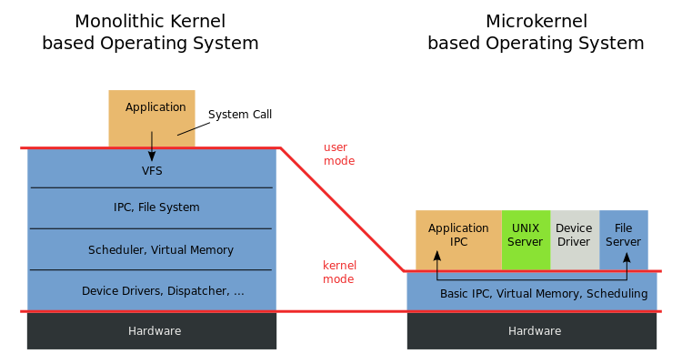
Microkernel vs. VMM(Xen)
Virtual Machine Monitor (VMM): “… software which transforms the single machine interface into the illusion of many. Each of these interfaces (virtual machines) is an efficient replica of the original computer system, complete with all of the processor instructions …“
-- Robert P. Goldberg. Survey of virtual machine research. 1974
Microkernel: "... to minimize the kernel and to implement whatever possible outside of the kernel…“
-- Jochen Liedtke. Towards real microkernels. 1996

Slide 48
Are Virtual Machine Monitors Microkernels Done Right?
Steven Hand, Andrew Wareld, Keir Fraser
HotOS’05
VMMs (especially Xen) are microkernels done right
Avoid liability inversion:
Microkernels depend on some user level components
Make IPC performance irrelevant:
IPC performance is the key in microkernels
Treat the OS as a component
Hard for microkernels to support legacy applications

Slide 49
Are Virtual Machine Monitors Microkernels Done Right?
VMMs (especially Xen) are microkernels done right.
Avoid liability inversion:
Microkernels depend on some user level components
Make IPC performance irrelevant:
IPC performance is the key in microkernels
Treat the OS as a component
Hard for microkernels to support legacy applications
Gernot Heiser, Volkmar Uhlig, Joshua LeVasseur
ACM SIGOPS’06
Really??
Xen also relies on Dom0!
Xen performs the same number of IPC!
Look at L4Linux!

Slide 50
Discussion
What is the difference between VMMs and microkernels?
Why do VMMs seem to be more successful than microkernels?

Slide 51
Conclusion (again)
Virtualization: creating a illusion of something
Virtualization is a principle approach in system design
OS is virtualizing CPU, memory, I/O …
VMM is virtualizing the whole architecture
What else? What next?

