Slide 1
CS6456: Graduate Operating Systems
Brad Campbell – bradjc@virginia.edu
https://www.cs.virginia.edu/~bjc8c/class/cs6456-f19/
Slides modified from CS162 at UCB

Slide 2
Recall: What is an OS?
Referee
Resource sharing, protection, isolation
Illusionist: clean, easy to use abstractions
Infinite memory, dedicated machine
Higher level objects: files, users, messages
Masking limitations, virtualization
Glue: Common Services
Storage
Window system
Networking
Authorization

Slide 3

OS Bottom Line: Run Programs
0xFFF…
Executable
Program Source
OS
int main()
{ … ;
}
compiler
data
Load & Execute
stack
editor
Memory
instructions
heap
a.out
data
foo.c
instructions
Load instruction and data segments of executable file into memory
Create stack and heap
“Transfer control to program”
Provide services to program
While protecting OS and program
0x000…
PC:
registers
Processor

Slide 4
Four Fundamental OS Concepts
Thread: Execution Context
Program Counter, Registers, Execution Flags, Stack
Address space (with translation)
Program's view of memory is distinct from physical machine
Process: an instance of a running program
Address Space + One or more Threads
Dual mode operation / Protection
Only the “system” can access certain resources
Combined with translation, isolates programs from each other

Slide 5
Threads of Control
Definition: A single, unique execution context
Program counter, registers, stack
A thread is executing on a processor when it is resident in that processor's registers
Registers hold the root state of the thread:
The rest is "in memory"
Including program counter – the currently executing instruction
Registers point to thread state in memory:
Stack pointer to the top of the thread's (own) stack

Slide 6
Multiprogramming - Multiple Threads of Control
Thrd. 1
Thrd. 2
Thrd. n
stack
…
heap
Static Data
OS
code
stack
heap
Static Data
code
stack
heap
Static Data
code

Slide 7
Illusion of Multiple Processors
vCPU1
vCPU2
vCPU3
vCPU1
vCPU2
vCPU3
vCPU1
vCPU2
Shared Memory
Time
Multiple threads: Multiplex hardware in time
Contents of virtual core (thread):
Program counter, stack pointer
Registers
Where is it?
On the real (physical) core, or
Saved in memory – called the Thread Control Block (TCB)

Slide 8
Very Simple Multiprogramming
All vCPU's share non-CPU resources
Memory, I/O Devices
Each thread can read/write data of others
Threads can overwrite OS functions
Unusable? No. This approach is used in
Embedded applications (but not all!)
MacOS 1-9/Windows 3.1 (switch only with voluntary yield)
Windows 95-ME (switch with yield or timer)

Slide 9
Four Fundamental OS Concepts
Thread: Execution Context
Program Counter, Registers, Execution Flags, Stack
Address space (with translation)
Program's view of memory is distinct from physical machine
Process: an instance of a running program
Address Space + One or more Threads
Dual mode operation / Protection
Only the “system” can access certain resources
Combined with translation, isolates programs from each other

Slide 10
Second OS Concept: Address Space
0xFFF…
Definition: Set of accessible addresses and the state associated with them
2³² = ~4 billion on a 32-bit machine
What happens when you read or write to an address?
Perhaps nothing
Perhaps acts like regular memory
Perhaps causes I/O operation
(Memory-mapped I/O)
Crash
Communicate with another program
stack
heap
Static Data
code
0x000…

Slide 11
Address Space Translation
Program operates in an address space that is distinct from the physical memory space of the machine
“physical address”
0x000…
“virtual address”
Processor
translator
Memory
Gives every process the whole address range
Breaks memory into pages (~4K chunks)
Allows unallocated "holes" and other tricks
0xFFF…

Slide 12
Four Fundamental OS Concepts
Thread: Execution Context
Program Counter, Registers, Execution Flags, Stack
Address space (with translation)
Program's view of memory is distinct from physical machine
Process: an instance of a running program
Address Space + One or more Threads
Dual mode operation / Protection
Only the “system” can access certain resources
Combined with translation, isolates programs from each other

Slide 13
The Process
Definition: execution environment with restricted rights
Address Space with One or More Threads
Owns memory (address space)
Owns file descriptors, file system context, …
Encapsulate one or more threads sharing process resources
Why processes?
Protected from each other!
OS protected from them
Tradeoff: protection vs. efficiency
Threads more efficient than processes (more later)
Application: one or more processes

Slide 14
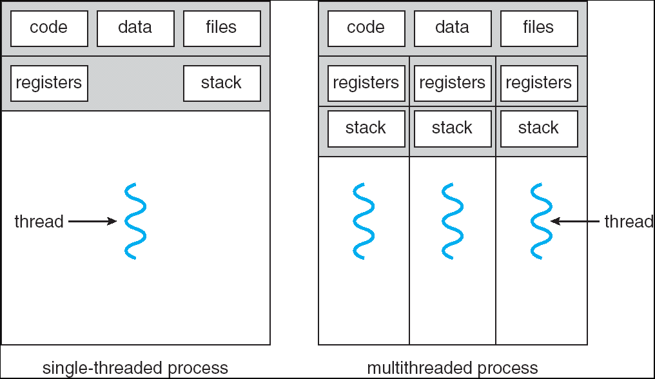
Single and Multithreaded Processes
Threads encapsulate concurrency: “Active” component
Address spaces encapsulate protection: “Passive” part
Keeps buggy program from trashing the system
Why have multiple threads per address space?

Slide 15
Protection
Why?
Reliability: buggy programs only hurt themselves
Security and privacy: trust programs less
Fairness: enforce shares of disk, CPU
Mechanisms:
Address translation: address space only contains its own data
Privileged instructions, registers
Syscall processing (e.g., enforce file access rights)

Slide 16
Four Fundamental OS Concepts
Thread: Execution Context
Program Counter, Registers, Execution Flags, Stack
Address space (with translation)
Program's view of memory is distinct from physical machine
Process: an instance of a running program
Address Space + One or more Threads
Dual mode operation / Protection
Only the “system” can access certain resources
Combined with translation, isolates programs from each other

Slide 17
Dual Mode Operation: HW Support
1 bit of state (user/kernel mode bit)
Always?
Certain actions only permitted in kernel mode
User->Kernel mode sets kernel mode, saves user PC
Only transition to OS-designated addresses
OS can save the rest of the user state if necessary
Kernel->User mode sets user mode, restores user PC

Slide 18
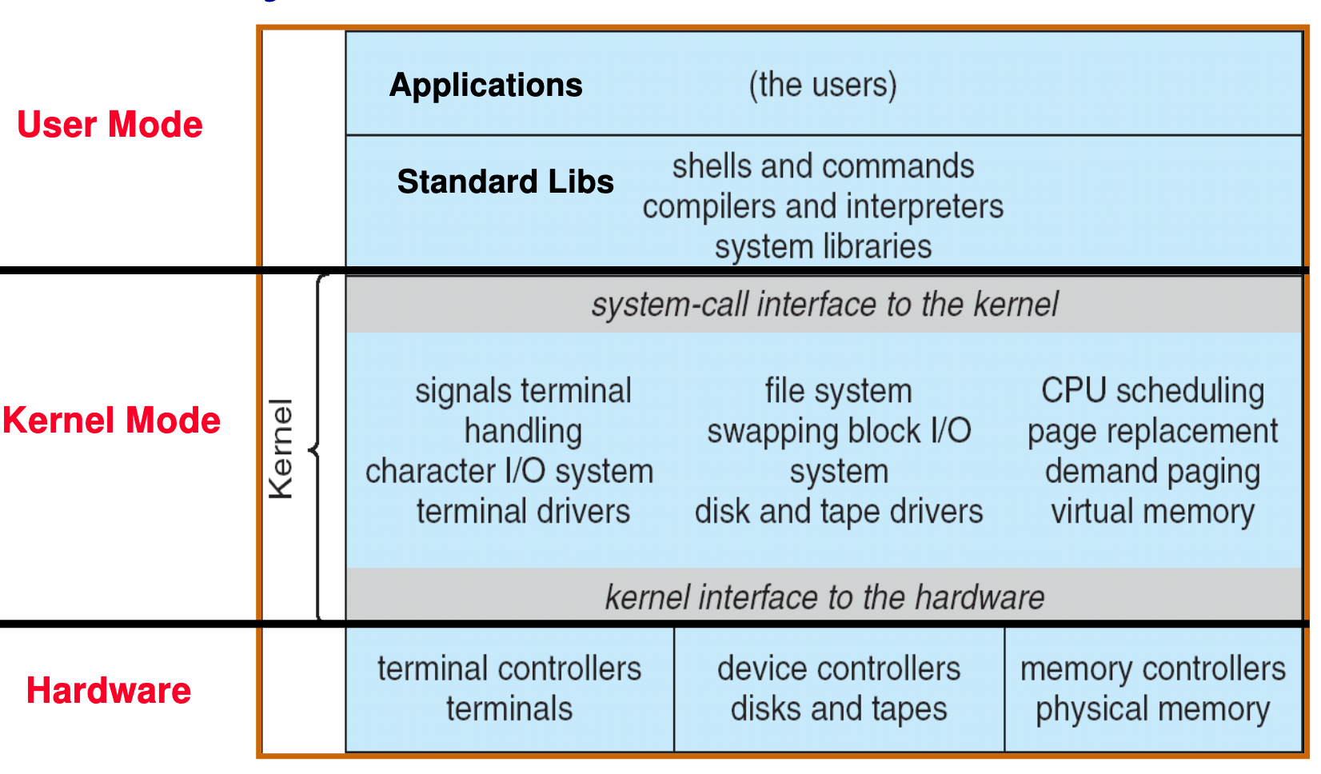
UNIX Structure

Slide 19
3 Types of U→K Mode Switches
System Call (syscall)
"Function call" into the kernel
Example: exit, read
Kernel reads syscall id # and arguments from user registers
Interrupt
External asynchronous events: Timer, I/O
Trap or Exception
Special event in process
Protection violation (segfault), divide by zero
All 3 are an implicit transfer of control

Slide 20
Where do mode transfers go?
Cannot let user program specify (why?)
Solution: Interrupt Vector
Address and properties of each interrupt handler
interrupt number (i)
intrpHandler_i () {
…
}

Slide 21
Implementing Safe Kernel Mode Transfers
Carefully constructed kernel code packs up the user process state and sets it aside
Must handle weird/buggy/malicious user state
Syscalls with null pointers
Return instruction out of bounds
User stack pointer out of bounds
Should be impossible for buggy or malicious user program to cause the kernel to corrupt itself
User program should not know interrupt has occurred (transparency)
Can a user program find out?

Slide 22
The Kernel Stack
Two-stack model
Each OS thread has kernel stack (located in kernel memory) plus user stack (located in user memory)
Place to save user registers during interrupt

Slide 23
Before Interrupt

Slide 24
During Interrupt

Slide 25
How do we take interrupts safely?
Interrupt vector
Limited number of entry points into kernel
Kernel interrupt stack
Handler works regardless of state of user code
Interrupt masking
Handler is non-blocking
Atomic transfer of control
“Single instruction”-like to change:
Program counter
Stack pointer
Memory protection
Kernel/user mode
Transparent restartable execution
User program does not know interrupt occurred

Slide 26
Kernel System Call Handler
Vector through well-defined syscall entry points!
Table mapping system call number to handler
Locate arguments
In registers or on user (!) stack
Copy arguments
From user memory into kernel memory – carefully checking locations!
Protect kernel from malicious code evading checks
Validate arguments
Protect kernel from errors in user code
Copy results back
Into user memory – carefully checking locations!

Slide 27
Example: Context switch and interrupt
0000…
Proc 1
Proc 2
Proc n
code
…
Static Data
OS
heap
stack
sysmode
1
1000…
code
Static Data
heap
uPC
xxxx…
Start: OS running
stack
1100…
PC
code
3000…
regs
Static Data
…
heap
stack
3080…
FFFF…

Slide 28
About to Switch
0000…
Proc 1
Proc 2
Proc n
code
…
Static Data
OS
heap
stack
sysmode
1
1000…
code
Static Data
heap
uPC
0001…
stack
1100…
PC
code
3000…
regs
00FF…
Static Data
…
heap
Privileged Inst: set special registers
stack
3080…
FFFF…

Slide 29
User Code Running
0000…
Proc 1
Proc 2
Proc n
code
…
Static Data
OS
heap
stack
sysmode
0
1000…
code
Static Data
heap
uPC
xxxx…
stack
1100…
PC
code
3000…
regs
Static Data
…
heap
stack
3080…
FFFF…

Slide 30
Handling Interrupt
0000…
Proc 1
Proc 2
Proc n
code
…
Static Data
OS
heap
stack
sysmode
1
1000…
code
Static Data
heap
uPC
0000 1234
stack
1100…
PC
IntrpVector[i]
code
3000…
regs
00FF…
Static Data
Save registers and set up system stack
…
heap
stack
3080…
FFFF…

Slide 31
How do we switch between processes?
We already have all the necessary machinery!
Just requires two mode transfers

Slide 32
Representing Processes: PCB
0000…
Proc 1
Proc 2
Proc n
code
RTU
…
Static Data
OS
heap
stack
sysmode
0
1000…
code
Base
1000 …
0000…
Static Data
Bound
1100 …
FFFF…
heap
1000 …
uPC
xxxxxx
1100 …
stack
1100…
PC
0000 100
0000 1234
code
3000…
regs
Static Data
…
heap
00FF…
stack
3080…
FFFF…

Slide 33
Process Control Block
Kernel representation of each process
Status (running, ready, blocked)
Register state (if not running)
Thread control block(s)
Process ID
Execution time
Memory translations
Scheduler maintains a data structure of PCBs

Slide 34
Scheduler
if ( readyProcesses(PCBs) ) {
nextPCB = selectProcess(PCBs);
run( nextPCB );
} else {
run_idle_process();
}
Scheduling: Mechanism for deciding which processes/threads receive the CPU
Lots of different scheduling policies provide …
Fairness or
Realtime guarantees or
Latency optimization or ..

Slide 35
Process Operations
Question: How does a process start?
Processes need to manipulate other processes:
Start a new process
Exit
Wait for another process to terminate
Can a process start another without OS help?
A thread, yes, but not another process
Process must use syscalls to interact with kernel

Slide 36
What does "syscall" really mean?
Application programmers generally don’t write syscalls directly
Can’t in C without inline assembly, etc.
Instead, OS libraries do this on our behalf

Slide 37
OS Run-Time Library
Proc 1
Proc 2
Proc n
…
OS
Appln
login
Window Manager
…
OS library
OS library
OS library
OS

Slide 38
A Narrow Waist
Word Processing
Compilers
Web Browsers
Email
Databases
Web Servers
Application / Service
Portable OS Library
OS
User
System Call
Interface
System
Portable OS Kernel
Software
Platform support, Device Drivers
Hardware
x86
PowerPC
ARM
PCI
Ethernet (1Gbs/10Gbs)
802.11 a/g/n/ac
SCSI
Graphics
Thunderbolt

Slide 39
POSIX/Unix
Portable Operating System Interface [X?]
Defines “Unix”, derived from AT&T Unix
Created to bring order to many Unix-derived OSs
Interface for application programmers (mostly)
Notes:
http://stallman.org/articles/posix.html

Slide 40
Example: pid.c
#include <stdlib.h>
#include <stdio.h>
#include <unistd.h>
#include <sys/types.h>
int main(int argc, char *argv[]) {
/* get current process’s PID */
pid_t pid = getpid();
printf(“My pid: %d\n”, (int) pid);
exit(0);
}

Slide 41
Process Management
Syscalls:
fork – copy the current process
exec – change the program being run by the current process
wait – wait for a process to finish
kill – send a signal (interrupt-like notification) to another process
sigaction – set handlers for signals
Lot of legacy here.
Further reading: https://www.microsoft.com/en-us/research/uploads/prod/2019/04/fork-hotos19.pdf

Slide 42
Creating Processes
pid_t fork(); -- copy the current process
New process has different pid
Return value from fork(): pid (int)
When > 0:
Running in (original) Parent process
return value is pid of new child
When = 0:
Running in new Child process
When < 0:
Error! Must handle somehow
Running in original process
State of original process duplicated in both Parent and Child!
Memory, File Descriptors (covered later), etc…

Slide 43
What happens when we use fork?
0000…
Parent
Child
code
Static Data
OS
heap
stack
1000 …
sysmode
1
1000…
code
1100 …
Base
1000 …
0000…
Static Data
0000 1234
Bound
1100 …
FFFF…
heap
regs
uPC
0000…
stack
1100…
00FF…
PC
code
3000…
3000 …
Static Data
3080 …
…
heap
0000 1234
stack
3080…
regs
FFFF…
00FF…

Slide 44
Example: fork1.c
#include <stdlib.h>
#include <stdio.h>
#include <unistd.h>
#include <sys/types.h>
int main(int argc, char *argv[]) {
pid_t cpid, mypid;
pid_t pid = getpid(); /* get current processes PID */
printf("Parent pid: %d\n", pid);
cpid = fork();
if (cpid > 0) { /* Parent Process */
mypid = getpid();
printf("[%d] parent of [%d]\n", mypid, cpid);
} else if (cpid == 0) { /* Child Process */
mypid = getpid();
printf("[%d] child\n", mypid);
} else {
perror("Fork failed");
}
}

Slide 45
Process Management
fork – copy the current process
exec – change the program being run by the current process
wait – wait for a process to finish
kill – send a signal (interrupt-like notification) to another process
sigaction – set handlers for signals

Slide 46
fork2.c
int status;
pid_t tcpid;
…
cpid = fork();
if (cpid > 0) { /* Parent Process */
mypid = getpid();
printf("[%d] parent of [%d]\n", mypid, cpid);
tcpid = wait(&status);
printf("[%d] bye %d(%d)\n", mypid, tcpid, status);
} else if (cpid == 0) { /* Child Process */
mypid = getpid();
printf("[%d] child\n", mypid);
}
…

Slide 47
Process Management
fork – copy the current process
exec – change the program being run by the current process
wait – wait for a process to finish
kill – send a signal (interrupt-like notification) to another process
sigaction – set handlers for signals

Slide 48
fork3.c
…
cpid = fork();
if (cpid > 0) { /* Parent Process */
tcpid = wait(&status);
} else if (cpid == 0) { /* Child Process */
char *args[] = {“ls”, “-l”, NULL};
execv(“/bin/ls”, args);
/* execv doesn’t return when it works.
So, if we got here, it failed! */
perror(“execv”);
exit(1);
}
…

Slide 49
Process Management

Slide 50
Shell
Job control system
Allows user to create/manage applications to do tasks
User’s wrapper around process management functions
Windows, OS X, Linux all have shells

Slide 51
Process Management
fork – copy the current process
exec – change the program being run by the current process
wait – wait for a process to finish
kill – send a signal (interrupt-like notification) to another process
sigaction – set handlers for signals

Slide 52
inf_loop.c
#include <stdlib.h>
#include <stdio.h>
#include <sys/types.h>
#include <unistd.h>
#include <signal.h>
void signal_callback_handler(int signum) {
printf(“Caught signal!\n”);
exit(1);
}
int main() {
struct sigaction sa;
sa.sa_flags = 0;
sigemptyset(&sa.sa_mask);
sa.sa_handler = signal_callback_handler;
sigaction(SIGINT, &sa, NULL);
while (1) {}
}

Slide 53
Common POSIX Signals
SIGINT – control-C
SIGTERM – default for kill shell command
SIGSTP – control-Z (default action: stop process)
SIGKILL, SIGSTOP – terminate/stop process
Can’t be changed with sigaction
Why?

Slide 54


Slide 55
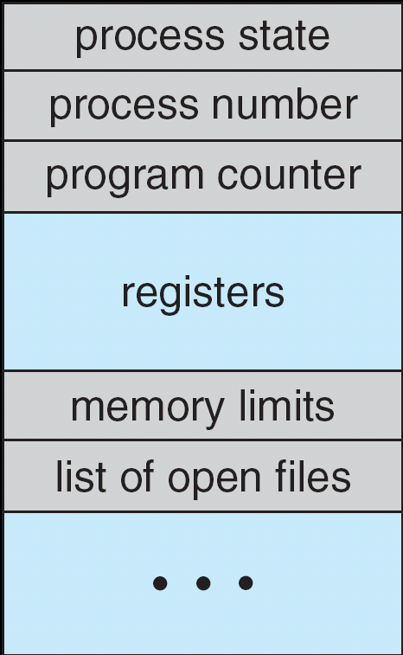
Multiplexing Processes
Snapshot of each process in its PCB
Only one active at a time (per core…)
Give out CPU to different processes
Scheduling
Policy Decision
Give out non-CPU resources
Memory/IO
Another policy decision
Process Control
Block

Slide 56
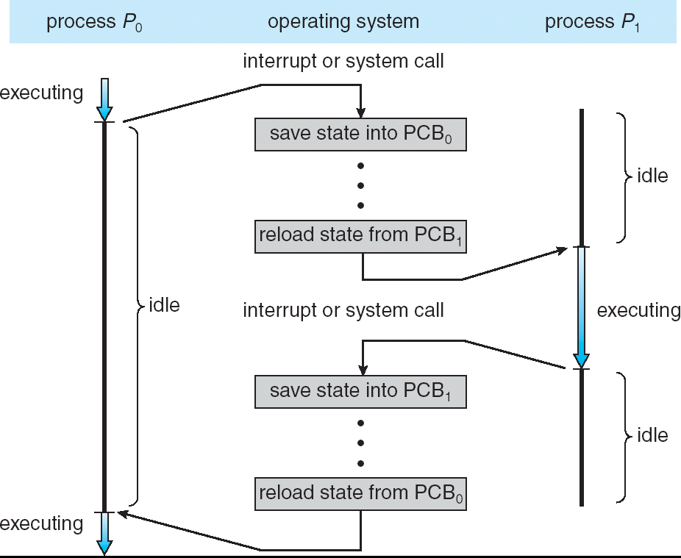
Context Switch
Overhead!

Slide 57
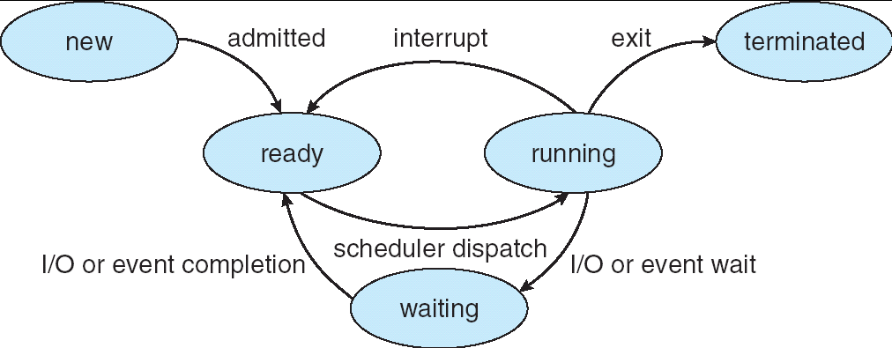
Lifecycle of a Process
As a process executes, it changes state:
new: being created
ready: waiting to run
running: instructions executing on the CPU
waiting: waiting for some event to occur (e.g., keypress)
terminated: finished execution

Slide 58
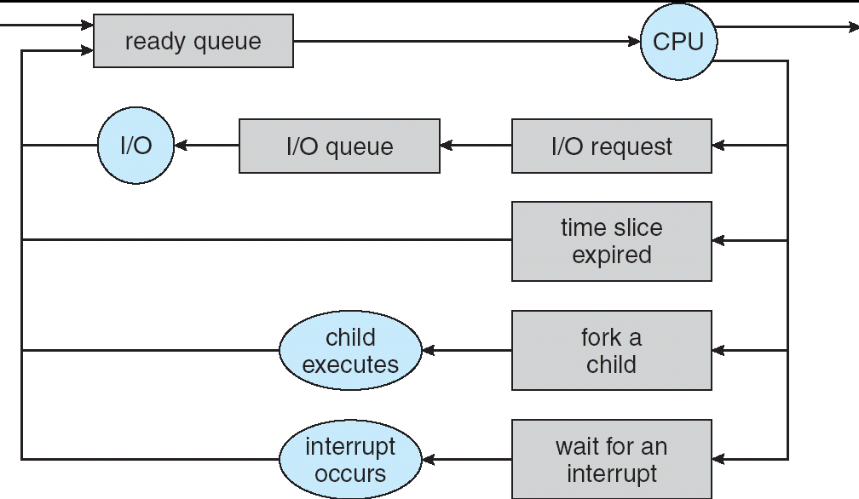
Scheduling: All About Queues
PCBs move from queue to queue
Scheduling: which order to remove from queue

Slide 59
Modern Processes: Multiple Threads
Thread: execution stream within a process
Used to be called "lightweight processes"
Shares address space with other threads belonging to the same process
Why separate concepts of threads and processes?
Threads: Concurrency
Processes: Protection

Slide 60
So does the OS schedule processes or threads?
Usually it's threads (e.g., in Linux)
One point to notice: switching threads vs. switching processes incurs different costs:
Switch threads: Save/restore registers
Switch processes: Change active address space too!
Expensive
Disrupts caching

Slide 61
Thread vs. Process State
Process-wide state:
Memory contents (global variables, heap)
I/O bookkeeping
Thread-"private" state:
CPU registers including program counter
Execution stack
Kept in Thread Control Block

Slide 62
Execution Stack Review
A(int tmp) {
if (tmp<2)
B();
printf(tmp);
}
B() {
C();
}
C() {
A(2);
}
A(1);
A: tmp=1
ret=exit
B: ret=A+2
C: ret=b+1
A: tmp=2
ret=C+1
Stack
Pointer
Stack Growth
Stack holds temporary results
Used to implement recursion

Slide 63
Shared vs. Per-Thread State

Slide 64
Memory Footprint: Two Threads
Two sets of CPU registers
Two sets of Stacks
Issues:
How do we position stacks relative to each other?
What maximum size should we choose for the stacks?
What happens if threads violate this?
How might you catch violations?
Stack 1
Stack 2
Address Space
Heap
Global Data
Code

Slide 65
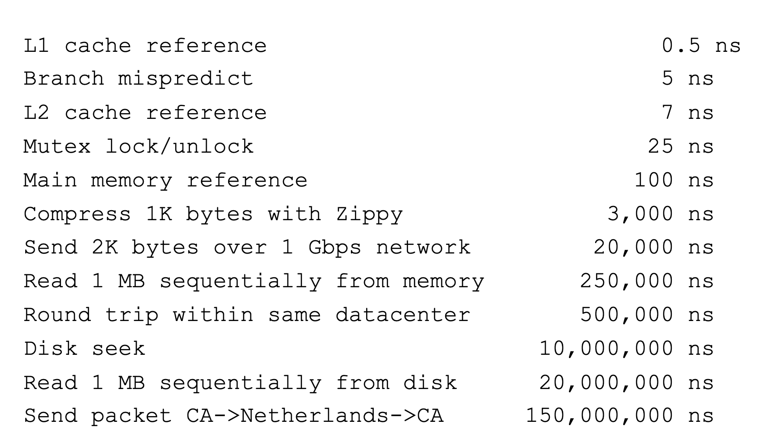
Threads Motivation
Back to Jeff Dean's "Numbers everyone should know"
Handle I/O in separate thread, avoid blocking other progress

Slide 66
Example for Threads
Imagine the following program:
main() {
…
ReadLargeFile(“pi.txt”);
RenderUserInterface();
}
What is the behavior here?
Still respond to user input
While reading file in the background

Slide 67
Dispatch Loop
Loop {
RunThread();
ChooseNextThread();
SaveStateOfCPU(curTCB);
LoadStateOfCPU(newTCB);
}
Conceptually all the OS executes
Infinite Loop
When would we ever "exit?"
Can we assume some thread is always ready?

Slide 68
Dispatch Loop
Loop {
RunThread();
ChooseNextThread();
SaveStateOfCPU(curTCB);
LoadStateOfCPU(newTCB);
}
How to run a new thread?
Load thread's registers into CPU
Load its environment (address space, if in different process)
Jump to thread's PC
How does dispatch loop get control again?
Thread returns control voluntarily – yield, I/O
External events: thread is preempted

Slide 69
Thread switching
I/O – e.g. keypress
Waiting for a signal from another thread
Thread makes system call to wait
Thread executes thread_yield()
Relinquishes CPU but puts calling thread back on ready queue

Slide 70
Stack for Yielding Thread
ComputePI
yield
Trap to OS
kernel_yield
Stack growth
run_new_thread
switch
Cyan = User Stack; Red = Kernel Stack
run_new_thread() {
newThread = PickNewThread();
switch(curThread, newThread);
ThreadHouseKeeping(); /* Do any cleanup */
}

Slide 71
The Context Switch Itself
Switch(tCur,tNew) {
/* Unload old thread */
TCB[tCur].regs.r7 = CPU.r7;
…
TCB[tCur].regs.r0 = CPU.r0;
TCB[tCur].regs.sp = CPU.sp;
TCB[tCur].regs.retpc = CPU.retpc; /*return addr*/
/* Load and execute new thread */
CPU.r7 = TCB[tNew].regs.r7;
…
CPU.r0 = TCB[tNew].regs.r0;
CPU.sp = TCB[tNew].regs.sp;
CPU.retpc = TCB[tNew].regs.retpc;
return; /* Return to CPU.retpc */
}

Slide 72
Summary
Variety of process management syscalls
fork, exec, wait, kill, sigaction
Process consists of two pieces
Address Space (Protection)
One or more threads (Concurrency)
Scheduling: Threads move between queues
Threads: multiple stacks per address space
Context switch: Save/Restore registers, "return" from new thread's switch routine

