Slide 1
CS6456: Graduate Operating Systems
Brad Campbell – bradjc@virginia.edu
https://www.cs.virginia.edu/~bjc8c/class/cs6456-f19/
Slides modified from CS162 at UCB

Slide 2
Processes vs. Threads
Process 1
Process N
threads
threads
Switch overhead:
Same process: low
Different proc: high
Protection
Same proc: low
Different proc: high
Sharing overhead
Same proc: low
Different proc: high
Mem.
Mem.
…
IO
state
…
…
IO
state
CPU
state
CPU
state
CPU
state
CPU
state
CPU sched.
OS
4 threads at a time
Core 1
Core 2
Core 3
Core 4

Slide 3
Example: Multithreaded Server
serverLoop() {
connection = AcceptNewConnection();
thread_fork(ServiceWebPage, connection);
}
One thread per connection
Problem: How fast is creating threads?
Better than fork(), but still overhead
Problem: What if we get a lot of requests?
Might run out of memory (thread stacks)
Schedulers usually have trouble with too many threads

Slide 4
Web Server: Thread Pools
Bounded pool of worker threads
Allocated in advance: no thread creation overhead
Queue of pending requests
Master Thread
Client
Request
Queue
Thread Pool
Response

Slide 5
Multiprocessing vs Multiprogramming
Multiprocessing: Multiple cores
Multiprogramming: Multiple jobs/processes
Multithreading: Multiple threads/processes
What does it mean to run two threads concurrently?
Scheduler is free to run threads in any order and interleaving
A
Multiprocessing
B
C
A
B
C
Multiprogramming
A
B
C
A
B
C
B

Slide 6
Today
Going to talk about concurrency!
But, need some mechanism to enable running different code simultaneously
Therefore...threads!

Slide 7
How does a thread get started?
Can't call switch() without starting a thread
How do we make a new thread?
Other Thread
ThreadRoot
A
SetupNewThread(tNew) {
…
TCB[tNew].regs.sp = newStack;
TCB[tNew].regs.retpc = &ThreadRoot;
}
B(while)
Stack growth
yield
run_new_thread
New Thread
switch
ThreadRoot stub

Slide 8
How does a thread get started?
So when does the new thread really start executing?
Other Thread
ThreadRoot
A
run_new_thread() selects this thread's TCB, "returns" into beginning of ThreadRoot
B(while)
Stack growth
yield
run_new_thread
New Thread
switch
ThreadRoot stub

Slide 9
Bootstrapping Threads: ThreadRoot
ThreadRoot() {
DoStartupHousekeeping();
UserModeSwitch(); /* enter user mode */
call fcnPtr(fcnArgPtr);
ThreadFinish();
}
Stack will grow and shrink with execution of thread
ThreadRoot() never returns
ThreadFinish() destroys thread, invokes scheduler
ThreadRoot
*fcnPtr
Stack growth
Running Stack

Slide 10
Switching threads example
CopyFile
read
Trap to OS
Stack growth
kernel_read
run_new_thread
switch
User code invokes syscall
IO operation initiated (more later)
Run new thread, switch
Really, same thing as before
Just put the thread on a different queue

Slide 11
Preempting a Thread
What happens if thread never does any I/O, never waits, and never yields control?
Must find way that dispatcher can regain control!
Interrupts: signals from hardware or software that stop the running code and jump to kernel
Timer: like an alarm clock that goes off every some milliseconds (tick)
Interrupt is a hardware-invoked mode switch
Handled immediately, no scheduling required

Slide 12
Example: Network Interrupt
Raise priority
(set mask)
Reenable All Ints
Save registers
Dispatch to Handler
…
Transfer Network Packet from hardware to Kernel Buffers
…
Restore registers
Clear current Int
Disable All Ints
Restore priority
(clear Mask)
RTI
...
add $r1,$r2,$r3
subi $r4,$r1,#4
slli $r4,$r4,#2
...
PC saved
Disable All Ints
Kernel Mode
External Interrupt
Pipeline Flush
“Interrupt Handler”
...
lw $r2,0($r4)
lw $r3,4($r4)
add $r2,$r2,$r3
sw 8($r4),$r2
...
Restore PC
Enable all Ints
User Mode
An interrupt is a hardware-invoked context switch
No separate step to choose what to run next
Always run the interrupt handler immediately

Slide 13
Switching Threads from Interrupts
Prevent thread from running forever with timer interrupt
TimerInterrupt() {
DoPeriodicHouseKeeping();
run_new_thread(); }
Same thing from IO interrupts
Example: immediately start process waiting for keypress
Some Routine
Interrupt
TimerInterrupt
Stack growth
run_new_thread
switch

Slide 14
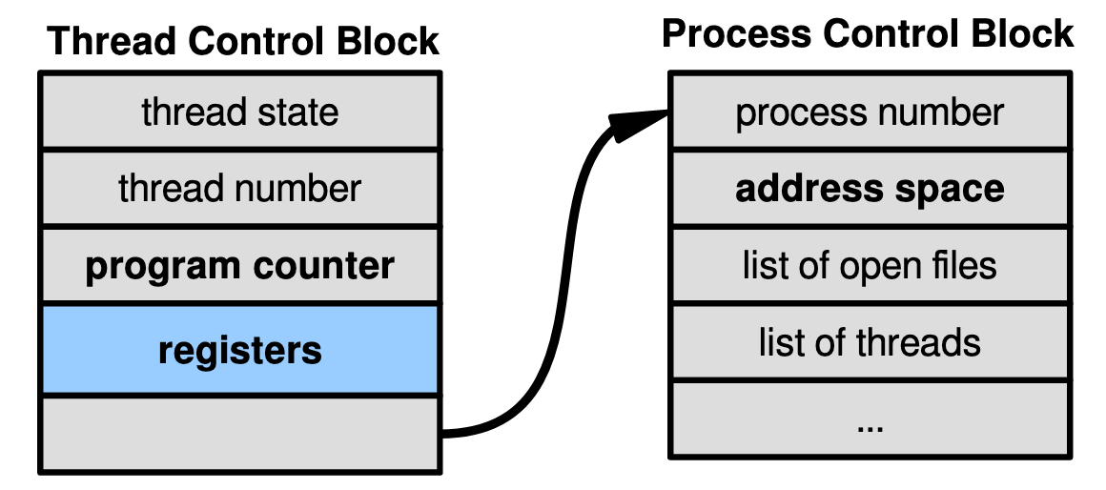
So Far: Kernel-Supported Threads
Each thread has a thread control block
CPU registers, including PC, pointer to stack
Scheduling info: priority, etc.
Pointer to Process control block
OS scheduler uses TCBs, not PCBs

Slide 15
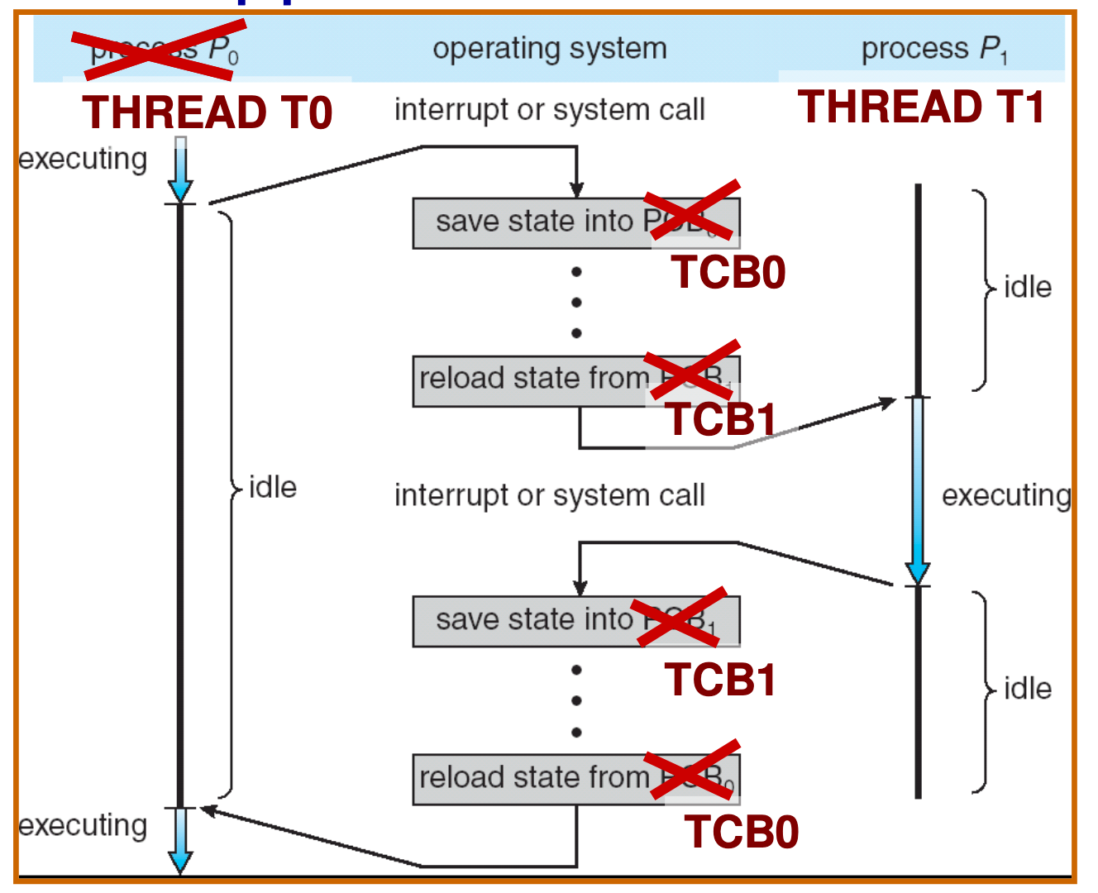
Kernel-Supported Threads

Slide 16
Kernel-Supported Threads
Threads run and block (e.g., on I/O) independently
One process may have multiple threads waiting on different things
Two mode switches for every context switch (expensive)
Create threads with syscalls
Alternative: multiplex several streams of execution (at user level) on top of a single kernel thread

Slide 17
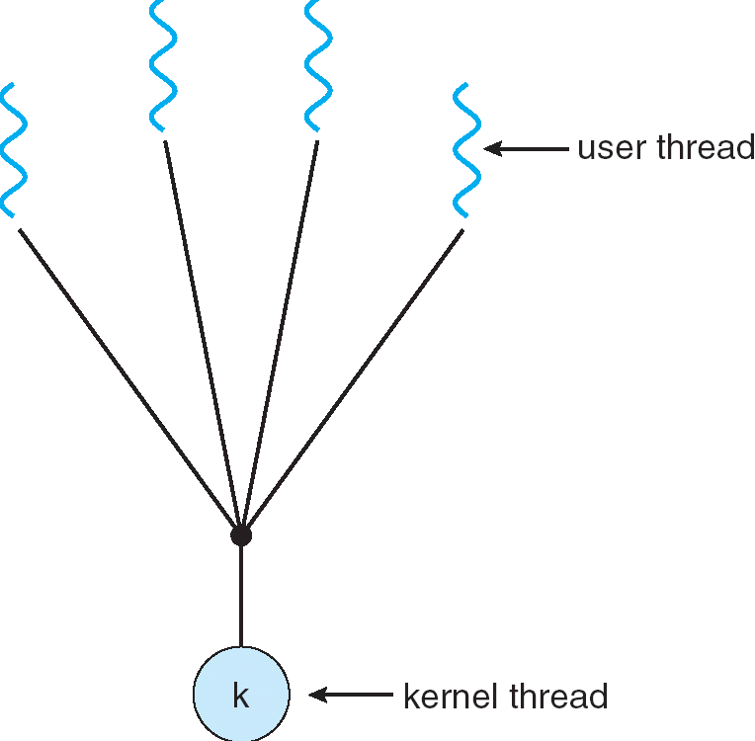
User-Mode Threads
User program contains its own scheduler
Several user threads per kernel thread
User threads may be scheduled non-preemptively
Only switch on yield
Context switches cheaper
Copy registers and jump (switch in userspace)

Slide 18
User-Mode Threads: Problems
One user-level thread blocks on I/O: they all do
Kernel cannot adjust scheduling among threads it doesn’t know about
Multiple Cores?
Can't completely avoid blocking (syscalls, page fault)
Solution: Scheduler Activations
Have kernel inform user-level scheduler when a thread blocks

Slide 19
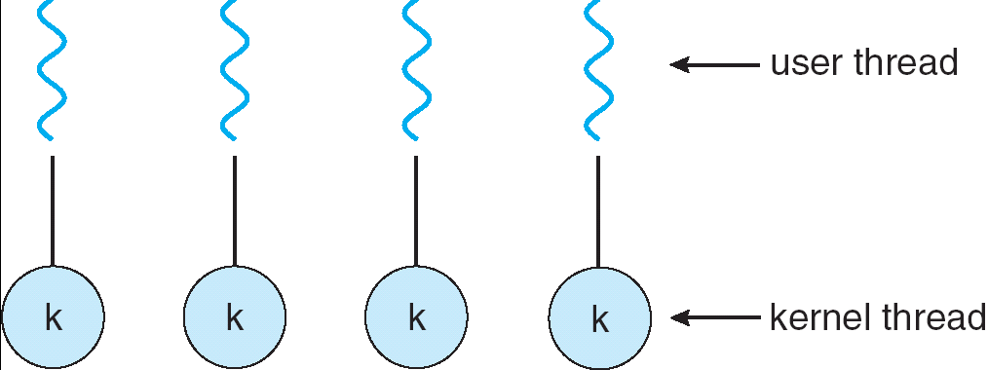
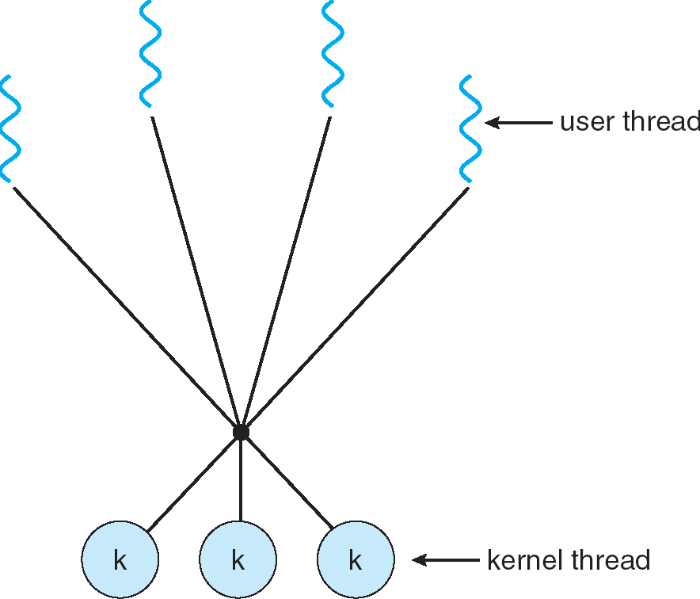
Some Threading Models
Simple One-to-One
Threading Model
Almost all current implementations
Many-to-One
Many-to-Many

Slide 20
Thread abstraction…and its limitations
Illusion: Infinite number of processors
Reality: Threads execute with variable “speed”
Programs must be designed to work with any schedule

Slide 21
Programmer vs. Processor View

Slide 22
Possible executions due to multiprogramming
A
B
C
Multiprogramming
A
B
C
A
B
C
B
Scheduler can run threads in any order
And with multiple cores:
Even more interleaving
Could truly be running at the same time

Slide 23
Correctness with Concurrent Threads
Non-determinism:
Scheduler can run threads in any order
Scheduler can switch threads at any time
This can make testing very difficult
Independent Threads
No state shared with other threads
Deterministic, reproducible conditions
Cooperating Threads
Shared state between multiple threads
Goal: Correctness by Design

Slide 24
Remember: Multiprogramming
A
B
C
Multiprogramming
A
B
C
A
B
C
B
Scheduler can run threads in any order
And with multiple cores:
Even more interleaving
Could truly be running at the same time

Slide 25
Race Conditions
What are the possible values of x below?
Initially x = y = 0;
Thread A
x = y + 1;
Thread B
y = 2;
y = y * 2;
1 or 3 or 5 (non-deterministic)
Race Condition: Thread A races against Thread B

Slide 26
Race Conditions
What are the possible values of x below?
Initially x = 0;
Thread A
x = 1;
Thread B
x = 2;
Why not 3?
Write a bit at a time

Slide 27

https://twitter.com/scwang251/status/1034057440583712768

Slide 28
My experience...
Some people excel at projecting confidence and hiding their uncertainties
Or they don’t know what they don’t know
Everyone comes from different backgrounds with different experiences and different skills
Positive outcome: find environment where you can learn from others (and teach as well!)
It is normal to feel jealous or inferior or unqualified when others succeed
I remind myself that its important to support others, and that their success does not imply anything about me

Slide 29
Atomic Operations
Definition: An operation that runs to completion or not at all
Need some to allow threads to work together
Example: Loading or storing words
Result of 3 is not possible on most machines
Some instructions are not atomic
Ex: double-precision floating point store

Slide 30
Real-Life Analogy: Too Much Milk
Time
Person A
Person B
3:00
Look in Fridge. Out of milk
3:05
Leave for store
3:10
Arrive at store
Look in Fridge. Out of milk
3:15
Buy milk
Leave for store
3:20
Arrive home, put milk away
Arrive at store
3:25
Buy milk
3:30
Arrive home, put milk away

Slide 31
Too Much Milk: Correctness
At most one person buys milk
At least one person buys milk if needed

Slide 32
Solution Attempt #1
Leave a note
Place on fridge before buying
Remove after buying
Don’t go to store if there’s already a note
Leaving/checking a note is atomic (word load/store)
if (noMilk) {
if (noNote) {
leave Note;
buy milk;
remove Note;
}
}

Slide 33
Attempt #1in Action
Alice
if (noMilk) {
if (noNote) {
leave Note;
buy milk;
remove Note;
}
}
Bob
if (noMilk) {
if (noNote) {
leave Note;
buy milk;
remove note;
}
}

Slide 34
Solution Attempt #2
leave Note;
if (noMilk) {
if (noNote) {
leave Note;
buy milk;
}
}
remove Note;
But there’s always a note – you just left one!
At least you don’t buy milk twice…

Slide 35
Solution Attempt #3
Leave a named note – each person ignores their own
Alice
leave note Alice
if (noMilk) {
if (noNote Bob) {
buy milk
}
}
remove note Alice;
Bob
leave note Bob
if (noMilk) {
if (noNote Alice) {
buy milk
}
}
remove note Bob;

Slide 36
Attempt #3 in Action
Alice
leave note Alice
if (noMilk) {
if (noNote Bob) {
buy milk
}
}
remove note Alice
Bob
leave note Bob
if (noMilk) {
if (noNote Alice) {
buy milk
}
remove note Bob
At least you didn’t buy too much!

Slide 37
Solution Attempt #4
Alice
leave note Alice
while (note Bob) {
do nothing
}
if (noMilk) {
buy milk
}
remove note Alice;
Bob
leave note Bob
if (noNote Alice) {
if (noMilk) {
buy milk
}
}
remove note Bob;
This is a correct solution

Slide 38
Issues with Solution 4
Complexity
Proving that it works is hard
How do you add another thread?
Busy-waiting
Alice consumes CPU time to wait

Slide 39
Relevant Definitions
Mutual Exclusion: Ensuring only one thread does a particular thing at a time (one thread excludes the others)
Critical Section: Code exactly one thread can execute at once
Result of mutual exclusion

Slide 40
Relevant Definitions
Lock: An object only one thread can hold at a time
Provides mutual exclusion
Offers two atomic operations:
Lock.Acquire() – wait until lock is free; then grab
Lock.Release() – Unlock, wake up waiters

Slide 41
Using Locks
MilkLock.Acquire()
if (noMilk) {
buy milk
}
MilkLock.Release()
But how do we implement this?

Slide 42
Implementing Locks: Single Core
Idea: A context switch can only happen (assuming threads don’t yield) if there’s an interrupt
“Solution”: Disable interrupts while holding lock

Slide 43
Naïve Interrupt Enable/Disable
Acquire() {
disable interrupts;
}
Release() {
enable interrupts;
}
Problem: User can stall the entire system
Lock.Acquire()
While (1) {}
Problem: What if we want to do I/O?
Lock.Acquire()
Read from disk
/* OS waits for (disabled) interrupt)! */

Slide 44
Implementing Locks: Single Core
Idea: Disable interrupts for mutual exclusion on accesses to value indicating lock status
Acquire() {
disable interrupts;
if (value == BUSY) {
put thread on wait queue;
run_new_thread()
// Enable interrupts?
} else {
value = BUSY;
}
enable interrupts;
}
Release() {
disable interrupts;
if (anyone waiting) {
take a thread off queue;
} else {
Value = FREE;
}
enable interrupts;
}

Slide 45
Reenabling Interrupts When Waiting
Acquire() {
disable interrupts;
if (value == BUSY) {
put thread on wait queue;
run_new_thread()
} else {
value = BUSY;
}
enable interrupts;
}
enable interrupts
enable interrupts
Before on the queue?
Release might not wake up this thread!
After putting the thread on the queue?
Gets woken up, but immediately switches away

Slide 46
Reenabling Interrupts When Waiting
Acquire() {
disable interrupts;
if (value == BUSY) {
put thread on wait queue;
run_new_thread()
} else {
value = BUSY;
}
enable interrupts;
}
enable interrupts
Best solution: after the current thread suspends
How?
run_new_thread() should do it!
Part of returning from switch()

Slide 47
A Better Lock Implementation
Interrupt-based solution is ok for single core
But doesn't work well on multi-core machines
Solution: Hardware support for atomic operations

Slide 48
More Powerful Atomic Ops
Atomic load/store not good enough to build a lock
Instead: Hardware instructions that atomically read a value from (shared) memory and write a new value
Hardware responsible for making this work in spite of caches

Slide 49
Read/Modify/Write Instructions
test&set (&address) { result = M[address]; // return result from “address” and M[address] = 1; // set value at “address” to 1 return result; }
swap (&address, register) { temp = M[address]; // swap register’s value to M[address] = register; // value at “address” register = temp; }
compare&swap (&address, reg1, reg2) { if (reg1 == M[address]) { // If memory still == reg1, M[address] = reg2; // then put reg2 => memory return success; } else { // Otherwise do not change memory return failure; } }

Slide 50
Locks with Test & Set
int value = 0; // Free
Acquire() {
while (test&set(value)); {
// Do nothing }
Release() {
value = 0;
}
Lock Free: test&set reads 0, sets value to 1, returns 0 (old value), acquires
Lock Busy: test&set reads 1, sets value to 1, returns 1 (old value), repeats
Remember:
test&set (&address) { result = M[address];
M[address] = 1; return result; }

Slide 51
Locks with Test & Set
int value = 0; // Free
Acquire() {
while (test&set(value)); {
// Do nothing }
Release() {
value = 0;
}
Busy Waiting: Consumes CPU time while waiting
Keeps other threads from using CPU
Maybe even the thread holding the lock
These are known as spin locks

Slide 52
Memory Traffic
test&set requires communication among CPU cores
Why? Caching
Local cache needs to "own" memory address to write to it
So something like while(test&set(…)); generates a lot of communication

Slide 53
Test, Then Test&Set
int value = 0; // Free
Acquire() {
do {
while(value); // Wait until might be free
} while(test&set(&value)); // exit if get lock
}
Release() {
value = 0;
}
while(value) reads from local cache only
Hardware knows that this value is shared with others
Wait for cache invalidation from lock holder
Still busy waiting, but fewer test&set operations

Slide 54
Recall: Using Interrupts
Idea: Disable interrupts for mutual exclusion on accesses to value indicating lock status
Acquire() {
disable interrupts;
if (value == BUSY) {
put thread on wait queue;
run_new_thread()
// Enable interrupts?
} else {
value = BUSY;
}
enable interrupts;
}
Release() {
disable interrupts;
if (anyone waiting) {
take a thread off queue;
} else {
Value = FREE;
}
enable interrupts;
}

Slide 55
Locks with test&set
Use spin locks rather than interrupts to build the "real" locks everyone will use
int guard = 0;
int value = 0;
Acquire() {
// Short busy-wait time while(test&set(guard)); if (value == 1) {
put thread on wait-queue;
go to sleep() & guard = 0; } else { value = 1; guard = 0; } }
Release() { // Short busy-wait time while (test&set(guard)); if anyone on wait queue { take thread off wait-queue Place on ready queue; } else { value = 0; } guard = 0; }

Slide 56
Semaphore
Another tool for synchronization (generalized lock)
Definition: A non-negative integer value with two possible operations
P() or down() or wait(): atomically wait for semaphore to become positive, then decrement it by 1
V() or up() or signal(): atomically increment semaphore (waking up a P() thread)

Slide 57
Semaphores Like Integers But…
Cannot read/write value directly
down() and up() only
Except when initializing semaphore
Never negative: -- something waits instead
Two down operations can't go below 0, some thread wins, and the other blocks (atomic)

Slide 58
Simple Semaphore Patterns
Mutual Exclusion: (Same as lock)
Called a "binary semaphore"
initial value of semaphore = 1;
semaphore.P(); // Critical section goes here semaphore.V();
Signaling other threads, e.g. ThreadJoin
Initial value of semaphore = 0
ThreadJoin {
semaphore.P(); }
ThreadFinish {
semaphore.V(); }

Slide 59
Intuition for Semaphores
What do you need to wait for?
Example: Critical section to be finished
Example: Queue to be non-empty
Example: Array to have space for new items
What can you count that will be 0 when you need to wait?
Example: # of threads currently in critical section
Example: # of items currently in queue
Example: # of free slots in array
Then: Use semaphore operations to maintain count

