Slide 1
CS6456: Graduate Operating Systems
Brad Campbell – bradjc@virginia.edu
https://www.cs.virginia.edu/~bjc8c/class/cs6456-f19/
Slides modified from CS162 at UCB

Slide 2
Today: Scheduler
if ( readyThreads(TCBs) ) {
nextTCB = selectThread(TCBs);
run( nextTCB );
} else {
run_idle_thread();
}
Scheduler: Which thread should run on the CPU next?

Slide 3
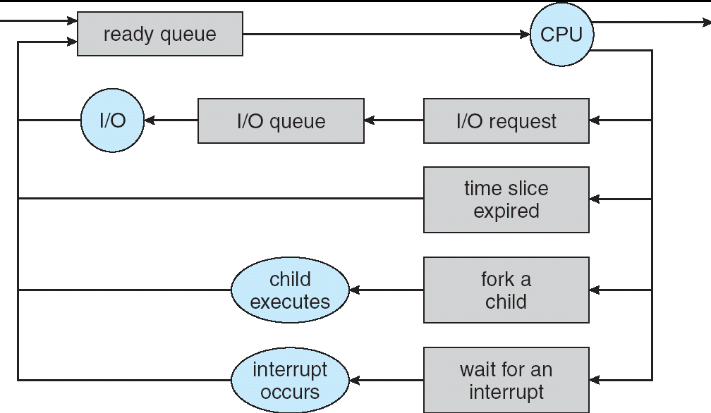
Scheduling: All About Queues
Scheduling: Which thread to remove from ready queue?

Slide 4
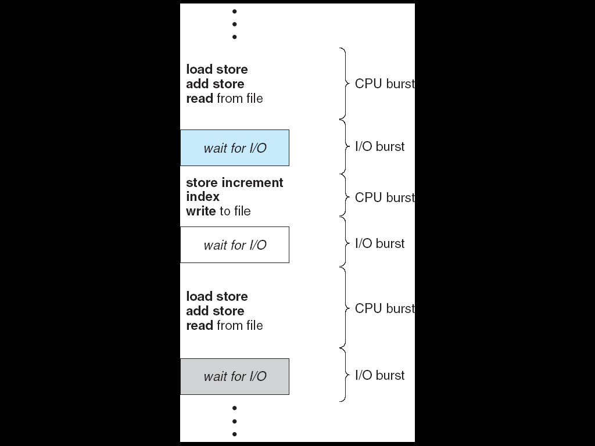
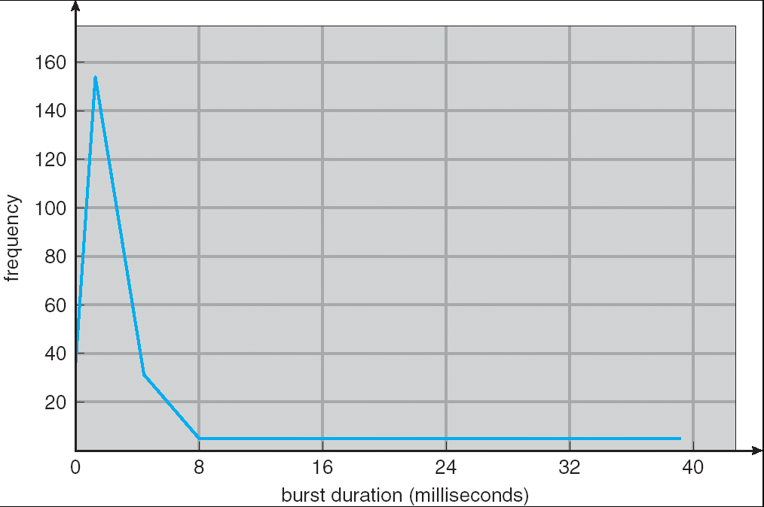
CPU & I/O Bursts
Programs alternate between bursts of CPU, I/O activity
Scheduler: Which CPU burst to run next?
Reason: Interactive programs

Slide 5
Evaluating Schedulers
★Defining key metrics
Response Time (ideally low)
What user sees: from keypress to character on screen
Throughput (ideally high)
Total operations per second
Problem: Overhead (e.g. from context switching)
Fairness
Conflicts with best avg. throughput/resp. time

Slide 6
First-Come First-Served (FCFS)
Also: "First In First Out"
Example: Process Burst Time
P₁ 24 P₂ 3 P₃ 3
Arrival Order: P₁, P₂, then P₃
P₁
P₂
P₃
0
24
27
30

Slide 7
First-Come First-Served (FCFS)
P₁
P₂
P₃
0
24
27
30
Response Times: P1 = 24, P2 = 27, P3 = 30
Waiting times: P1 = 0, P2 = 24, P3 = 27
Average Response Time = (24+27+30)/3 = 27
Average Wait Time = (0 + 24 + 27)/3 = 17
Convoy Effect: Short processes stuck behind long processes

Slide 8
What if the arrival order changes?
P₂
P₃
P₁
0
3
6
30
Waiting Time: P1 = 6, P2 = 0, P3 = 3
Average Waiting Time = (6+0+3)/3 = 3
Response Time: P1 = 30, P2 = 3, P3 = 6
Last Time: 17
Average Response Time = (30 + 3 + 6)/3 = 13
Last Time: 27

Slide 9
Round Robin
Give out small units of CPU time ("time quantum")
Typically 10 – 100 milliseconds
When quantum expires, preempt, add to end of the queue
Each of N processes gets 1/N of CPU
With quantum length Q ms, process waits at most (N-1)*Q ms to run again
Downside: More context switches
What should Q be?
Too high: back to FCFS, Too Low: context switch overhead

Slide 10
Round Robin Example (Q = 20)
P₁
P₂
P₃
P₄
P₁
P₃
P₄
P₁
P₃
P₃
0
20
28
48
68
88
108
112
125
145
153
Example: Process Burst Time P₁ 53 P₂ 8 P₃ 68 P₄ 24
Waiting time for P₁=(68-20)+(112-88)=72 P₂=(20-0)=20 P₃=(28-0)+(88-48)+(125-108)=85 P₄=(48-0)+(108-68)=88
Average waiting time = (72+20+85+88)/4 = 66.25
Average response time = (125+28+153+112)/4 = 104.5
And don't forget context switch overhead!

Slide 11
Round Robin Overhead
Typical Context Switch: 0.1ms – 100ms
With 10ms – 100ms time quantum (Q): ~1% Overhead

Slide 12
Round Robin Quantum
Assume there is no context switching overhead
What happens when we decrease Q?
Avg. response time…
increases
decreases
stays the same
or some combination?

Slide 13
Decrease Response Time
P₁: Burst Length 10
P₂: Burst Length 1
Q = 10
Average Response Time = (10 + 11)/2 = 10.5
Q = 5
Average Response Time = (6 + 11)/2 = 8.5
P₁
P₂
0
10
11
P₁
P₂
P₁
0
5
6
11

Slide 14
Same Response Time
P₁: Burst Length 1
P₂: Burst Length 1
Q = 10
Average Response Time = (1 + 2)/2 = 1.5
Q = 1
Average Response Time = (1 + 2)/2 = 1.5
P₁
P₂
0
1
2
P₁
P₂
0
1
2

Slide 15
Increase Response Time
P₁: Burst Length 1
P₂: Burst Length 1
Q = 1
Average Response Time = (1 + 2)/2 = 1.5
Q = 0.5
Average Response Time = (1.5 + 2)/2 = 1.75
P₁
P₂
0
1
2
0
2

Slide 16
Priority Scheduling
Priority 3
Job 1
Job 2
Job 3
Priority 2
Job 4
Priority 1
Priority 0
Job 5
Job 6
Job 7
Always run the ready thread with highest priority
Systems may try to set priorities according to some policy goal
Example: Give shell higher priority than long calculation
Prefer jobs waiting on I/O to those consuming lots of CPU
Try to achieve fairness: elevate priority of threads that don't get CPU time (ad-hoc, bad if system overload)

Slide 17
What if we know how much time each process needs in advance?
Non-preemptive: Shortest Job First
Like FCFS if we always chose the best possible ordering
Preemptive Version: Shortest Remaining Time First
A newly ready process (e.g., just finished an I/O operation) with shorter time replaces the current one

Slide 18
Shortest Job/Remaining Time First
Provably Optimal with respect to Response Time
Key Idea: remove convoy effect
Short jobs always stay ahead of long ones
Starvation is possible
What if new short jobs keep arriving?

Slide 19
SRTF Example
Three jobs in system
A and B are CPU calculations that take 1 week to run
C: Continuous loop of 1ms CPU time, 9ms of I/O time
FCFS? A or B starve C
I/O throughput problem: lose opportunity to do work for C while CPU runs A or B
A or B
C
C’s
I/O
C’s
I/O
C’s
I/O

Slide 20
SRTF Example
Disk Utilization:
9/201 ~ 4.5%
C
A
B
C
RR 100ms time slice
Disk Utilization:
~90% but lots of wakeups!
C’s
I/O
C’s
I/O
CABAB…
C
RR 1ms time slice
C’s
I/O
C’s
I/O
Disk Utilization:
90%
C
A
A
A
SRTF
C’s
I/O
C’s
I/O

Slide 21
Shortest Job/Remaining Time First
How do we know the time a job/process will take?
Usually, we don't
Ask the users?
They can try to estimate…
Or just lie
Observe past process behavior
Past behavior is good indicator of future behavior

Slide 22
Observing Process Behavior
Consider jobs scheduled by Round Robin
Process exhausts quantum, has to be preempted
Consuming all of the CPU time it can, "CPU-Bound"
Process blocks on I/O before quantum exhausted
"I/O-Bound"
Past behavior is good indicator of future behavior
I/O-bound now, likely to be I/O-bound later

Slide 23
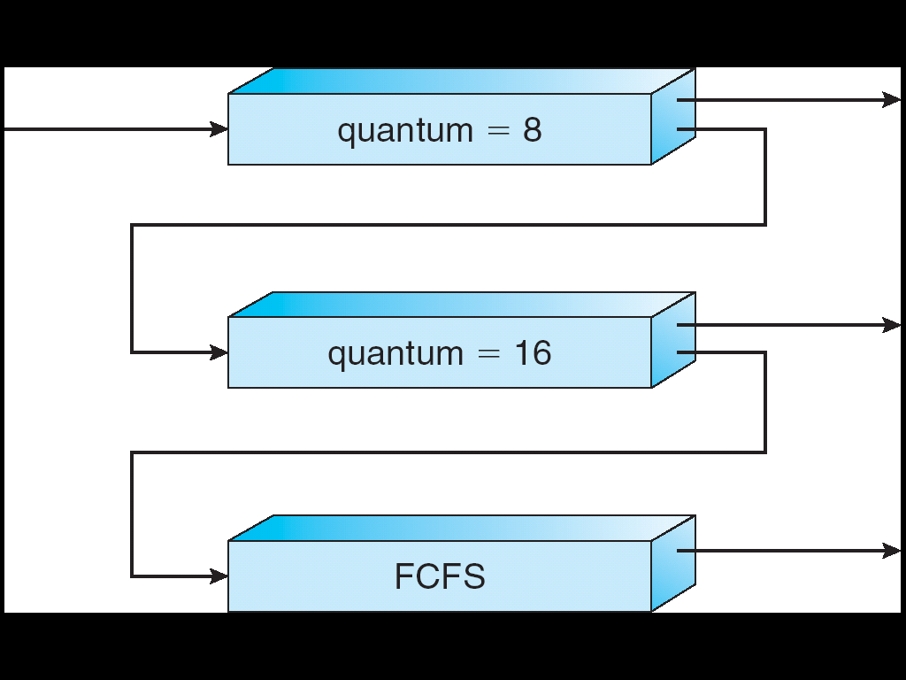
Multi-Level Feedback Scheduling
Multiple queues, each of different priority
Round Robin within each queue
Different quantum length for each queue
Favor I/O-bound jobs
Long-Running Compute Tasks Demoted to Low Priority

Slide 24
Multi-Level Feedback Scheduling
Intuition: Priority Level proportional to burst length
Job Exceeds Quantum: Drop to lower queue
Job Doesn't Exceed Quantum: Raise to higher queue
Long-Running Compute Tasks Demoted to Low Priority

Slide 25
Multi-Level Feedback Scheduling
Approximates Shortest Remaining Time First
CPU-bound have lowest priority (run last)
I/O-bound (short CPU bursts) have highest priority (run first)
Low overhead
Easy to update priority of a job
Easy to find next ready task to run
Can a process cheat?
Yes, add meaningless I/O operations

Slide 26
Multi-Level Feedback Scheduling
What about starvation?
Long-running jobs fall into low priority, may never get the CPU
Time-slice among the queues (e.g., 70% to highest priority, 20% to middle, 10% to low)
Artificially boost priority of a starved job
These solutions improve fairness but hurt response time

Slide 27
Linux O(1) Scheduler
Kernel/Realtime Tasks
User Tasks
0
100
139
MLFQ-Like Scheduler with 140 Priority Levels
40 for user tasks, 100 "realtime" tasks
All algorithms O(1) complexity – low overhead
Active and expired queues at each priority
Once active is empty, swap them (pointers)
Round Robin within each queue (varying quanta)

Slide 28
Linux O(1) Scheduler
Kernel/Realtime Tasks
User Tasks
0
100
139
Lots of ad-hoc heuristics
Try to boost priority of I/O-bound tasks
Try to boost priority of starved tasks

Slide 29

https://twitter.com/GoingGrayTA/status/1090065890253656064

Slide 30
Brad’s thoughts…
Unfortunate property of grad school: if you aren’t working on your work, no one else is
It is your degree you are pursuing
However, success is not equivalent to constant work
Important to remember that progress often comes in spurts
Things that helped me:
Realizing that that there are a lot of metrics for “progress”
Using conferences as an excuse to explore new places
Having a pre-scheduled weekly fun event to look forward to

Slide 31
Linux Completely Fair Scheduler
Goal: Each process gets an equal share of CPU
N threads "simultaneously" execute on 1/N^{th} of CPU
At any time t we would observe:
CPU Time
t/N
T₁
T₂
T₃

Slide 32
Linux Completely Fair Scheduler
Can't do this with real hardware
Still need to give out full CPU in time slices
Instead: track CPU time given to a thread so far
Scheduling Decision:
"Repair" illusion of complete fairness
Choose thread with minimum CPU time
T₁
CPU Time
t/N
T₃
T₂

Slide 33
Linux CFS
Constraint 1: Target Latency
Period of time over which every process gets service
Preserves response time
Target Latency: 20ms, 4 Processes
Each process gets 5ms time slice
Target Latency: 20 ms, 200 Processes
Each process gets 0.1ms time slice
Recall Round-Robin: Huge context switching overhead

Slide 34
Linux CFS
Constraint 2: Minimum Granularity
Minimum length of any time slice
Protects throughput
Target Latency 20ms, Minimum Granularity 1ms, 200 processes
Each process gets 1ms time slice

Slide 35
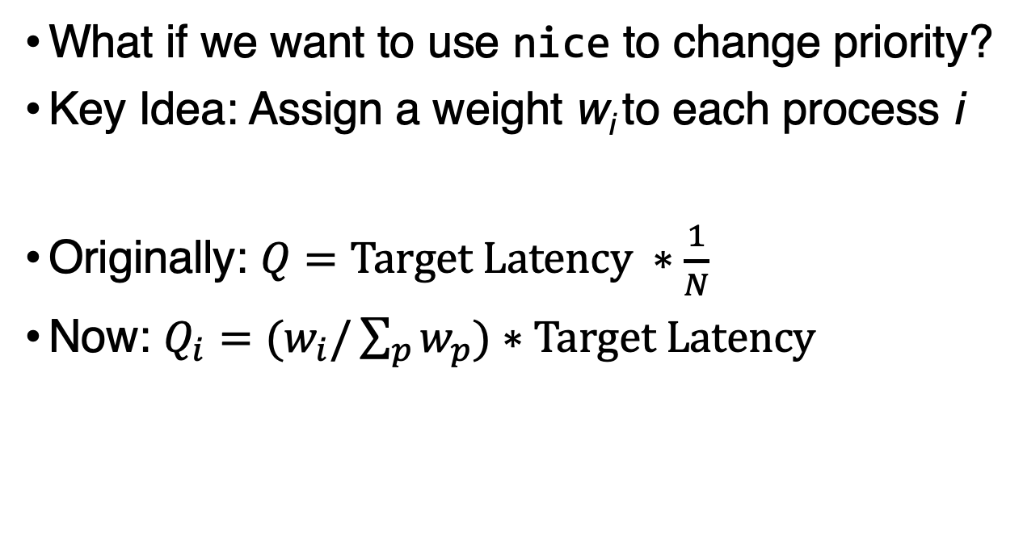
Linux CFS
What if we want to use nice to change priority?
Key Idea: Assign a weight w_{i} to each process i
Originally: $Q=Target Latency ∗\frac{1}{N}$
Now: $Q_{i}=(w_{i}/\sum_{p}{w_{p})∗Target Latency}$

Slide 36
Linux CFS
Target Latency = 20ms,
Minimum Granularity = 1ms
Two CPU-Bound Threads
Thread A has weight 1
Thread B has weight 4
Time slice for A? 4 ms
Time slice for B? 16 ms

Slide 37
Linux CFS
Track a thread's virtual runtime rather than its true physical runtime
Higher weight: Virtual runtime increases more slowly
Lower weight: Virtual runtime increases more quickly
16
B
Physical
CPU Time
4
A

Slide 38
Linux CFS
Track a thread's virtual runtime rather than its true physical runtime
Higher weight: Virtual runtime increases more slowly
Lower weight: Virtual runtime increases more quickly
B
A
Actually Used for Decisions
Virtual
CPU Time

Slide 39
Real-Time Scheduling
Goal: Guaranteed Performance
Meet deadlines even if it means being unfair or slow
Limit how bad the worst case is
Hard real-time:
Meet all deadlines (if possible)
Ideally: determine in advance if this is possible

Slide 40
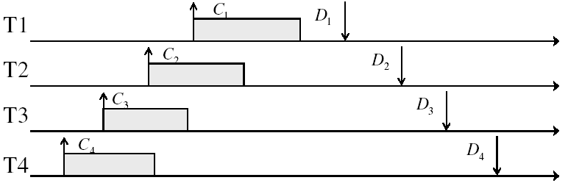
Real-Time Example
Preemptible tasks with known deadlines (D) and known burst times (C)

Slide 41
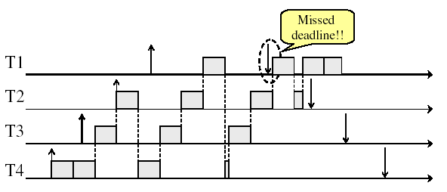
What if we try Round-Robin?

Slide 42
Earliest Deadline First
Priority scheduling with preemption
Priority proportional to time until deadline
Example with periodic tasks:
0
5
10
15

Slide 43
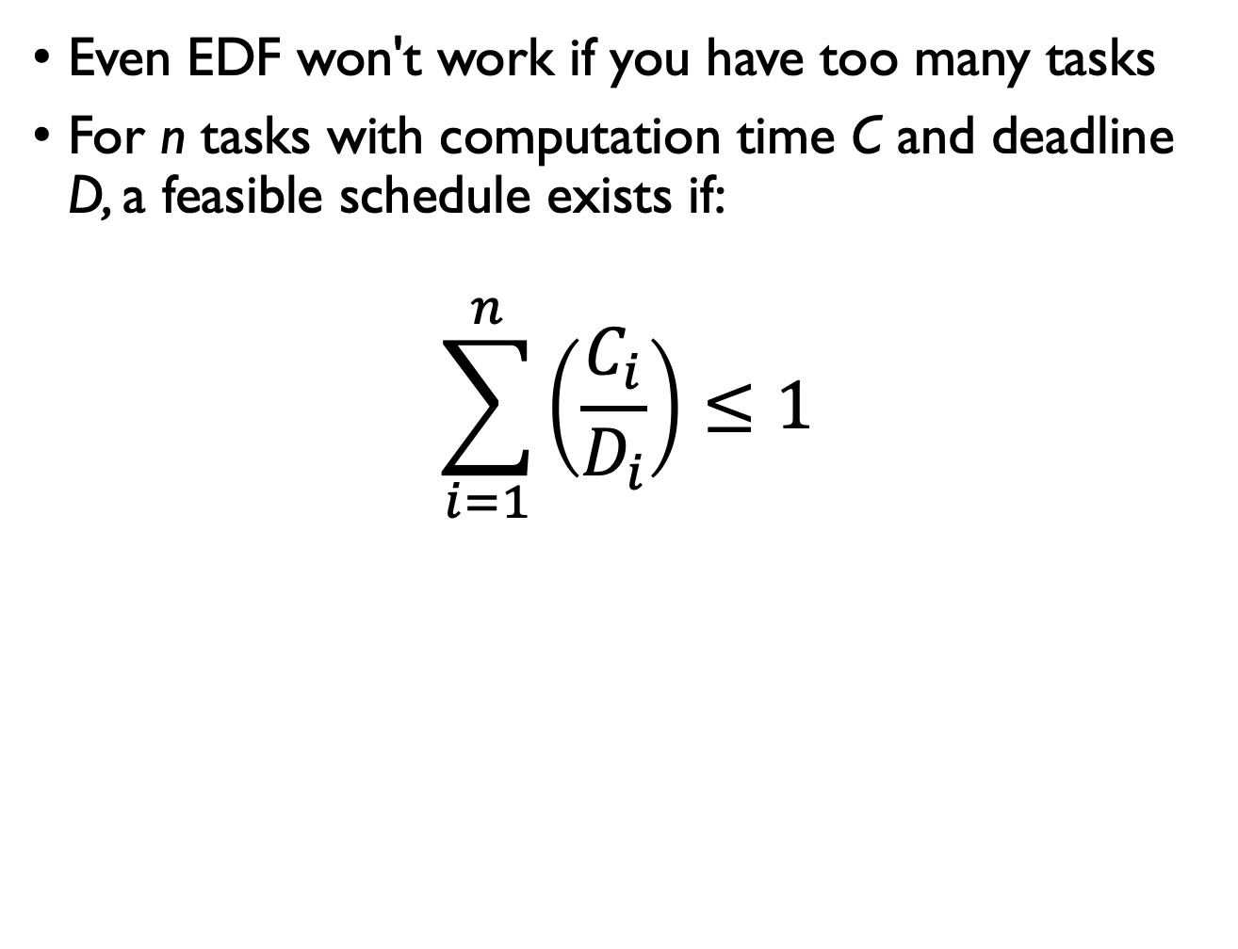
EDF: Feasibility Testing
Even EDF won't work if you have too many tasks
For n tasks with computation time C and deadline D, a feasible schedule exists if:
$$\sum_{i=1}^{n}{\left(\frac{C_{i}}{D_{i}}\right)}≤1$$

Slide 44
Choosing the Right Scheduler
I Care About: | Then Choose:
CPU Throughput | FCFS
Avg. Response Time | SRTF Approximation
I/O Throughput | SRTF Approximation
Fairness (CPU Time) | Linux CFS
Fairness (Wait Time to Get CPU) | Round Robin
Meeting Deadlines | EDF
Favoring Important Tasks | Priority

Slide 45

Priority and Locks
Priority 3
Job 3
Priority 2
Job 2
Priority 1
Job 1
holds
At this point, which job does the scheduler choose?
Job 3 (Highest Priority)

Slide 46
Priority and Locks
Priority 3
Job 3
Acquire()
Priority 2
Job 2
Priority 1
Job 1
Job 3 attempts to acquire lock held by Job 1

Slide 47
Priority and Locks
Job 3
Blocked on Acquire
Priority 3
Priority 2
Job 2
Priority 1
Job 1
At this point, which job does the scheduler choose?
Job 2 (Medium Priority)
Priority Inversion

Slide 48
Solution: Priority Donation
Priority 3
Job 1
Release()
Priority 2
Job 2
Priority 1
Job 3 temporarily grants Job 1 its highest priority to run on its behalf

Slide 49
Priority and Locks
Priority 3
Job 3
Priority 2
Job 2
Priority 1
Job 3 acquires lock, runs again

