Slide 1
CS6456: Graduate Operating Systems
Brad Campbell – bradjc@virginia.edu
https://www.cs.virginia.edu/~bjc8c/class/cs6456-f19/
Slides modified from CS162 at UCB

Slide 2
Memory: Questions to start with
What is the fundamental problem?
Why is it the OS’s job to manage?

Slide 3
Memory Multiplexing Goals
Protection
Private memory of other processes/OS remains private
Even from malicious processes
Controlled Overlap
Want processes and OS to share memory for communication, cooperation
Or just to save space (e.g., shared libraries)
Uniform View of Memory
No need to change binary file's addresses when we want to execute two instances of it
No need to change a program to let it use more memory

Slide 4
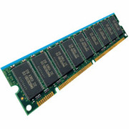
General Address Translation
Virtual
Addresses
Physical
Addresses
CPU
MMU
Each process, kernel have a different address space
Address Space = All addresses a process can touch
Two views of memory:
View from the CPU – what the program sees (virtual)
View from physical memory (physical)
MMU is hardware that converts between the two

Slide 5
Base and Bound w/ Translation
0000…
code
0000…
code
Static Data
heap
Static Data
heap
stack
0100…
stack
Base Address
1000…
code
1000…
0010…
Program
address
0010…
Static Data
1010…
heap
Bound
<
stack
1100…
0100…
Program cannot touch OS
Program cannot touch other progs.
FFFF…

Slide 6
Problems with Base and Bound
process 6
process 6
process 6
process 6
process 5
process 5
process 5
process 9
process 9
process 11
process 2
process 10
OS
OS
OS
OS
External Fragmentation – no contiguous free region big enough to accommodate new process
Not every process needs the same amount of space
Needs change over time
No way to plan memory layout ahead of time

Slide 7
Problems with Base and Bound
Internal Fragmentation
Large gap in address space between stack and heap
Range of memory is unused, but still allocated to process
Stack
Heap

Slide 8
Base and Bound: Sharing
Want to share code to save space
Example: OS Libraries
May also want to share memory for communication
Process 1
libc.so
Process 2
libc.so
Process 2
libc.so
OS

Slide 9
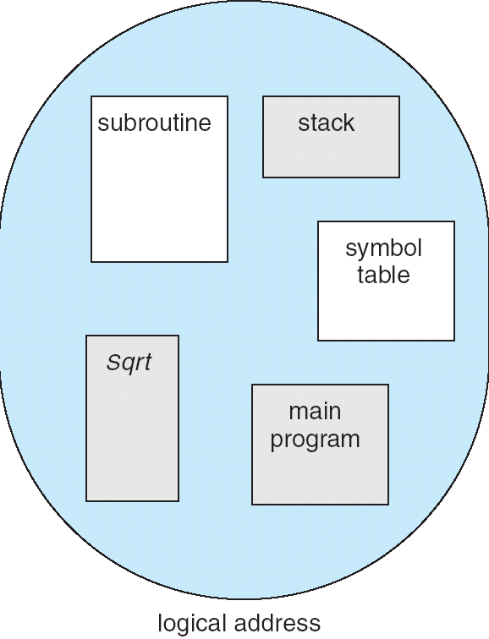
Segmentation
1
1
1
4
2
3
2
2
4
3
user view of
memory space
physical
memory space
Manage each region of address space as an independent unit
One process uses multiple contiguous allocations of memory, called segments

Slide 10
Segmentation Implementation
Virtual
Address
offset
>
Error
Seg #
Offset
Base0
Limit0
V
Base1
Limit1
V
Base2
Limit2
V
Base2
Limit2
V
Physical
Address
Base3
Limit3
N
+
Base4
Limit4
V
Base5
Limit5
N
Base6
Limit6
N
Base7
Limit7
V
Segment map stored in processor
Segment # extracted from virtual address
Base added to generate physical address
Bound checked, error if out of range

Slide 11
Segmentation Implementation
Virtual
Address
offset
>
Error
Seg #
Offset
Base0
Limit0
V
Base1
Limit1
V
Base2
Limit2
V
Base2
Limit2
V
Physical
Address
Base3
Limit3
N
+
Base4
Limit4
V
Base5
Limit5
N
Base6
Limit6
N
Base7
Limit7
V
Check Valid
Access
Error
Valid Bit: Did we actually allocate this region of mem?
Access error if No
Can’t have a negative bound

Slide 12
Example: Four Segments (16-bit Addresses)
Seg ID # | Base | Limit
0 (code) | 0x4000 | 0x0800
1 (data) | 0x4800 | 0x1400
2 (shared) | 0xF000 | 0x1000
3 (stack) | 0x0000 | 0x3000
Seg
Offset
15
14
13
0
Virtual Address Format
SegID = 0
0x0000
0x0000
SegID = 1
0x4000
0x4000
0x4800
0x5C00
0x8000
Space for
Other Apps
0xC000
0xF000
Virtual
Address Space
Physical
Address Space

Slide 13
Segmentation
Internal fragmentation?
We can have large, unused gaps in virtual address space that don’t correspond to any allocated segment
But segments must be contiguous in physical memory
Reserve extra space at beginning?
Expansion is difficult
External fragmentation?
Yes – may need to rearrange chunks of memory
Segments are smaller than full process memory image, hopefully less work
Sharing?
Yes! Allow virtual addresses in two processes to map to same segment in physical mem.
But can only share at segment granularity
One shared library per segment?
Will we run out of segments?
0x0000
0x4000
0x4800
0x5C00
0xF000
Virtual
Address Space

Slide 14
Swapping
Problem: What if all segments don’t fit in memory?
Breaks the illusion of a dedicated machine
Potential solution: When process isn’t running, move one or more segments to disk
Load segment back into main memory before resuming
An “extreme context switch”
Need to track whether or not a segment is resident in memory in processor segment map
For modern systems, swapping performance is unacceptable
Maybe swap some idle memory to disk, but never something active

Slide 15
How can we do better?
Allocate at finer granularity than segments
Allocate memory in fixed-size chunks: pages
All allocations are full pages
All holes are multiples of a page size
Expanding memory footprint: allocate new page
No need to relocate existing allocations
No struggle to find free region of proper size

Slide 16
What’s the catch?
More bookkeeping
Need to track physical memory location of each page
Need to track metadata (valid, permissions) per page
Page size represents a tradeoff
Larger: Fewer pages to keep track of, more internal fragmentation
Smaller: Less wasted space, more pages to track
Less locality: Sequential access in virtual space is not necessarily sequential in physical space
Jumping across page boundaries

Slide 17
Implementing Paging
Virtual Address:
Virtual
Page #
Offset
PageTablePtr
page #0
V,R
Physical
Frame #
Offset
page #1
V,R
page #1
V,R
page #2
V,R,W
Physical Address
PageTableSize
>
page #3
V,R,W
Check Perm
Access Error
page #4
N
page #5
V,R,W
Access
Error
Page Table: Process-Specific map for bookkeeping
Tells us in which physical page frame our virtual page is stored
Virtual page number is index into table
Table itself resides in physical memory
Trigger fault if page access is not permitted

Slide 18
Paging: Address Mapping
Virtual Address:
Virtual
Page #
Offset
PageTablePtr
page #0
V,R
Physical
Frame #
Offset
page #1
V,R
page #1
V,R
page #2
V,R,W
Physical Address
PageTableSize
>
page #3
V,R,W
Check Perm
Access Error
page #4
N
page #5
V,R,W
Access
Error
Offset: copied from virtual addr to physical addr
Example: 4K pages require a 12-bit offset
Virtual page # is all remaining bits
32-bit address space with 4K Pages: 2²⁰ = 1 Million pages
Physical page # replaces virtual page # to form physical addr
May be different length (fewer physical frames than virtual pages)

Slide 19
Address Translation: Overhead
Segmentation: Segment Table
One table entry per segment
Few segments, so typically small
Potentially store in registers
Paging: Page Table
Allocate physical memory to store table
Extra memory access per operation
Once to translate address, second to do actual work
Tables can get large (1 million entries on 32-bit machine)

Slide 20
Simple Page Table Example
Example (4-byte pages)
0x00
0000 0000
0x00
a
b
c
d
0001 0000
0x04
0
4
i
j
k
l
0x04
0000 0100
1
0000 1100
0x05!
e
f
g
h
3
2
1
0000 0100
0x08
0x06?
0x08
0000 1000
Page
Table
0x0C
i
j
k
l
e
f
g
h
0x09?
0x0E!
0x10
Virtual
Memory
0000 0110
0000 1110
a
b
c
d
0000 1001
0000 0101
Physical
Memory

Slide 21
What about Sharing?
Virtual Address
(Process A):
Virtual
Page #
Offset
PageTablePtrA
page #0
V,R
page #1
V,R
page #2
V,R,W
page #2
V,R,W
page #3
V,R,W
Shared
Page
page #4
N
page #5
V,R,W
PageTablePtrB
page #0
V,R
page #1
N
This physical page
appears in address
space of both processes
page #2
V,R,W
page #3
N
page #4
V,R
page #4
V,R
page #5
V,R,W
Virtual Address
(Process B):
Virtual
Page #
Offset

Slide 22
Paging: Allocation
Virtual memory view
Page Table
11111 11101
11110 11100
11101 null
11100 null
11011 null
11010 null
11001 null
11000 null
10111 null
10110 null
10101 null
10100 null
10011 null
10010 10000
10001 01111
10000 01110
01111 null
01110 null
01101 null
01100 null
01011 01101
01010 01100
01001 01011
01000 01010
00111 null
00110 null
00101 null
00100 null
00011 00101
00010 00100
00001 00011
00000 00010
Physical memory view
1111 1111
stack
1110 0000
stack
1110 0000
1100 0000
What happens if stack grows to 1110 0000?
heap
1000 0000
heap
0111 000
data
data
0101 000
0100 0000
code
code
0001 0000
0000 0000
0000 0000
page #
offset

Slide 23
Summary: Paging
Virtual memory view
Page Table
11111 11101
11110 11100
11101 10111
11100 10110
11011 null
11010 null
11001 null
11000 null
10111 null
10110 null
10101 null
10100 null
10011 null
10010 10000
10001 01111
10000 01110
01111 null
01110 null
01101 null
01100 null
01011 01101
01010 01100
01001 01011
01000 01010
00111 null
00110 null
00101 null
00100 null
00011 00101
00010 00100
00001 00011
00000 00010
Physical memory view
1111 1111
stack
1110 0000
stack
1110 0000
1100 0000
stack
Allocate new pages where room!
heap
1000 0000
heap
0111 000
data
data
0101 000
0100 0000
code
code
0001 0000
0000 0000
0000 0000
page #
offset

Slide 24
Paging: Hardware Support
Special Register to store page table pointer
Modified in kernel mode only
Change register values on context switch
Page Table Lookup
Two physical memory accesses per virtual access
Later: making this faster
Modern systems do all of this in hardware

Slide 25
Page Table Issues
What if address space is mostly unused?
Say we have 4K pages and 2GB of virtual address space
512K page table entries
Megabytes of space for table itself
How about 64-bit x86 machine? ~256 TB of virt addr space
64 billion page table entries
Gigabytes of space for table itself
Even though most of this address space is unused by the process in its lifetime
Apply tree structure to virtual memory: Multilevel Page Tables

Slide 26
Two-Level Page Tables
Physical
Address:
Physical
Page #
Offset
10 bits
10 bits
12 bits
Virtual
Address:
Virtual
P1 index
Virtual
P2 index
Offset
4KB
PageTablePtr
4 bytes
A tree of page tables
Each "node" has a fixed size
x86: 1024 4-byte entries
Still just one register to change on context switch
4 bytes

Slide 27
Two-Level Page Tables
Physical
Address:
Physical
Page #
Offset
10 bits
10 bits
12 bits
Virtual
Address:
Virtual
P1 index
Virtual
P2 index
Offset
4KB
PageTablePtr
4 bytes
Big gaps in virtual address space don't need second level page tables
4 bytes

Slide 28
Two-Level Page Tables
Physical
Address:
Physical
Page #
Offset
10 bits
10 bits
12 bits
Virtual
Address:
Virtual
P1 index
Virtual
P2 index
Offset
4KB
PageTablePtr
4 bytes
But we're also making two memory accesses just for translation
4 bytes

Slide 29
Two-Level Paging Example
Virtual memory view
Page Table
(level 1)
Page Tables
(level 2)
Physical memory view
1111 1111
stack
11 11101
10 11100
01 10111
00 10110
1111 0000
stack
1110 0000
1100 0000
stack
111
110 null
101 null
100
011 null
010
001 null
000
11 null
10 10000
01 01111
00 01110
heap
1000 0000
heap
0111 000
11 01101
10 01100
01 01011
00 01010
data
data
0101 000
0100 0000
11 00101
10 00100
01 00011
00 00010
code
page2 #
code
0001 0000
0000 0000
0000 0000
page1 #
offset

Slide 30
Summary: Two-Level Paging
Virtual memory view
Page Table
(level 1)
Page Tables
(level 2)
Physical memory view
stack
11 11101
10 11100
01 10111
00 10110
stack
1110 0000
stack
111
110 null
101 null
100
011 null
010
001 null
000
11 null
10 10000
01 01111
00 01110
1001 0000
(0x90)
heap
heap
1000 0000
(0x80)
11 01101
10 01100
01 01011
00 01010
data
data
11 00101
10 00100
01 00011
00 00010
code
code
0001 0000
0000 0000

Slide 31
Page Table Discussion
Good Points:
Easy memory allocation (fixed size chunks)
Easy sharing among processes
No physical memory used for holes in virtual address sp.
Bad Points:
Overhead: At least 1 pointer per 4K page
Page tables need to be contiguous (tricky allocation)
Clever design (x86) can limit them to one page
Several memory accesses per translation
Later: making this faster

Slide 32
Page Tables for Huge Address Spaces
Want full 64 bits of address space?
How many levels of indirection needed?
Overhead: Extra space for tables in phys. mem.
And additional memory accesses per translation
64-bit x86 does not do this
Virtual Addresses are 48 bits long
4-level page table
2 bits
10 bits
10 bits
10 bits
10 bits
10 bits
12 bits
Virtual P2 Index
Virtual P3 Index
Virtual P4 Index
Virtual P5 Index
Virtual P6 Index
Offset

Slide 33
Alternative: Inverted Page Table
Until Now: Size of page table proportional to size of virtual address space
New Structure: Size of page table proportional to size of physical address space
Good if most of address space not in use
Particularly 64-bit address space
Bad: Complexity
How do we deal with hash collisions?
Virtual
Page #
Offset
Hash
Table
Physical
Page #
Offset

Slide 34
Combining Segments & Pages
One approach: Each segment has its own page table
Fragmentation/allocation advantages of pages
Virtual
Address:
Virtual
Seg #
Virtual
Page #
Offset
page #0
V,R
Base0
Limit0
V
page #1
V,R
Physical
Page #
Offset
page #2
V,R,W
Base1
Limit1
V
page #2
V,R,W
Physical Address
Base2
Limit2
V
page #3
V,R,W
Base2
Limit2
V
Base3
Limit3
N
page #4
N
Base4
Limit4
V
page #5
V,R,W
Check Permissions
Base5
Limit5
N
Base6
Limit6
N
Base7
Limit7
V
>
Access
Error
Access
Error

Slide 35
Sharing a Segment
Process A:
Virtual
Seg #
Virtual
Page #
Offset
page #0
V,R
page #1
V,R
page #2
V,R,W
Base0
Limit0
V
page #3
V,R,W
Base1
Limit1
V
page #4
N
Base2
Limit2
V
Base2
Limit2
V
page #5
V,R,W
Base3
Limit3
N
Base4
Limit4
V
Shared Segment
Base5
Limit5
N
Base6
Limit6
N
Base0
Limit0
V
Base7
Limit7
V
Base1
Limit1
V
Base2
Base2
Limit2
Limit2
V
V
Base3
Limit3
N
Base4
Limit4
V
Base5
Limit5
N
Base6
Limit6
N
Base7
Limit7
V
Process B:
Virtual
Seg #
Virtual
Page #
Offset

Slide 36
Combining Segments & Pages
Good:
Just need one page table per segment, even if shared
Easy memory allocation (no external fragmentation)
Easy sharing of segments, just change segment table entry
Can still share at page granularity if necessary
Bad
Overhead: 1 pointer per page
At least two extra lookups per memory access

Slide 37
Address Translation Comparison
 | Advantages | Disadvantages
Simple Segmentation | Fast context switching: Segment mapping maintained by CPU | External fragmentation
Paging (single-level page) | No external fragmentation, fast easy allocation | Large table size ~ virtual memory Internal fragmentation
Paged segmentation | Table size ~ # of pages in virtual memory, fast easy allocation | Multiple memory references per page access
Two-level pages
Inverted Table | Table size ~ # of pages in physical memory | Hash function more complex No cache locality of page table

Slide 38
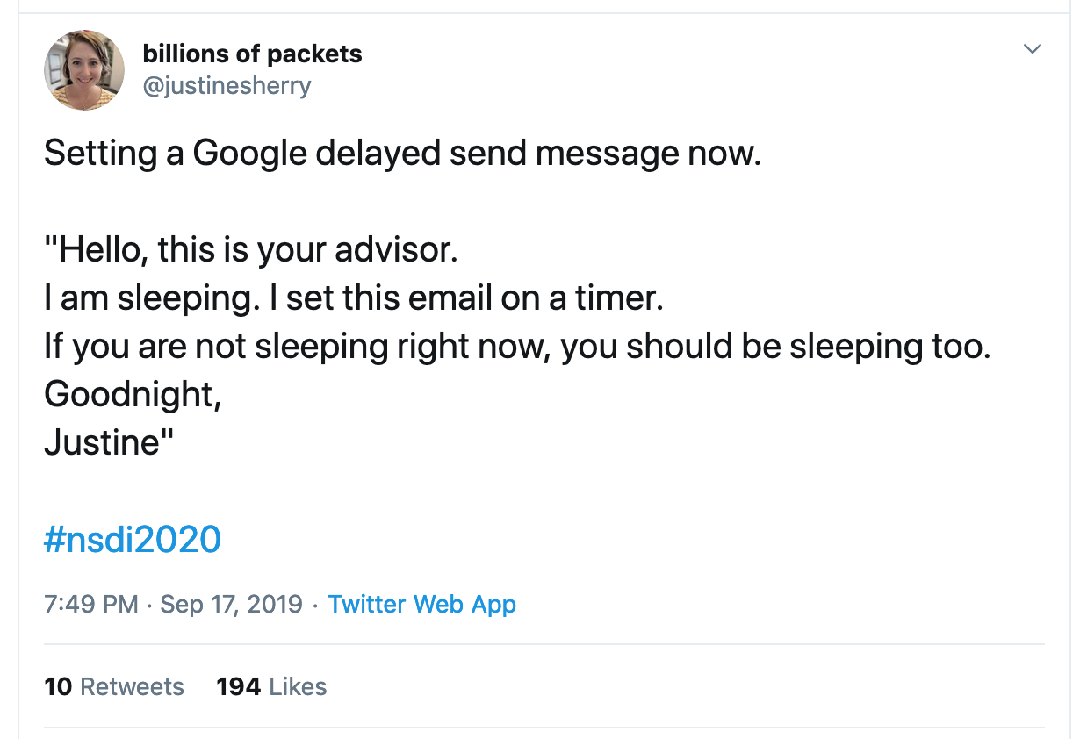

Slide 39
Real World: 32-bit x86
Has both segmentation and paging
Segmentation different from what we've described
Segment identified by instruction, not address
Note: x86 actually offers multiple modes of memory operation, we'll talk about common one

Slide 40
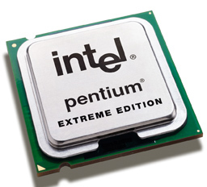
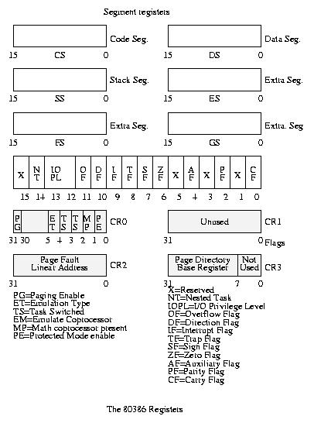
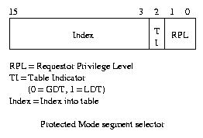
Real Example: Intel x86 (Old Days)
80386 Special Registers
Today: Register points to segment table in physical memory

Slide 41
Intel x86
Six segments: cs (code), ds (data), ss (stack), es, fs, gs (extras)
Instructions identify segment to use
mov [es:bx], ax
Some instructions have default segments, e.g. push and pop always refer to ss (stack)
Underused in modern operating systems
In 64-bit x86, only fs and gs support enforcement of base and bound

Slide 42
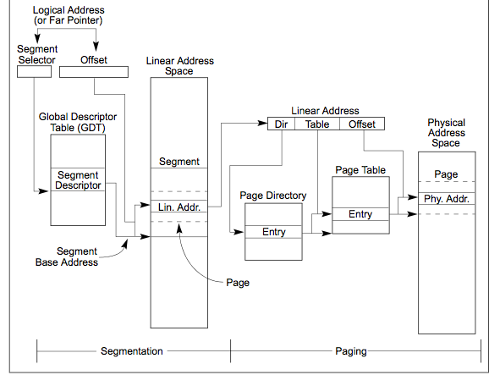
x86 Memory Model With Segmentation (32-bit)

Slide 43
Ok…but it’s all about the details
Remainder of today:
Making paged virtual memory usable
Enabling protection
Increasing performance

Slide 44
Real Page Table Entries
So far, we've said they contain a physical frame #
Or the frame # of a page table lower on the "tree"
But we want some extra information
Present/valid bit: indicate unallocated regions of physical address space
Protection bits, e.g. to set certain regions of memory to read-only for sharing

Slide 45
32-bit x86 Page Table Entry
10/10/12 Split of Virtual Address
Top-level page tables called directories
PFN: Physical Page number of page or next page table
P: Present Bit (Is page mapping valid?)
W: Is this page writable?
U: Can we access this page while in user mode?
A: Set by hardware when page is first accessed
D: Page marked dirty if it is ever modified
PWT: Write-through cache behavior
PCD: Disable caching for this page
Page Frame Number
(Physical Page Number)
Free
(OS)
0
L
D
A
PCD
PWT
U
W
P
31-12
11-9
8
7
6
5
4
3
2
1
0

Slide 46
Paging Tricks
What does it mean if a page table entry doesn't have the valid (present) bit set?
Region of address space is invalid or
Page is not loaded and ready yet
When program accesses an invalid PTE, OS gets an exception (a page fault or protection fault)
Options
Terminate program (access was actually invalid)
Get page ready and restart instruction

Slide 47
Example Paging Tricks
Demand Paging: Swapping for pages
Keep only active pages in memory
Not common on modern systems, except perhaps when first loading program
Response: Load in page from disk, retry operation
Copy on Write (remember fork?)
Temporarily mark pages as read-only
Allocate new pages when OS receives protection fault
Zero-Fill on Demand
Slow to overwrite new pages with all zeros
Page starts as invalid, zero it out when it's actually used

Slide 48
What Happens in the MMU?
Virtual
Addresses
Physical
Addresses
CPU
MMU
Option 1: Hardware Traversal (e.g., x86)
Hardware reads page tables itself for translation
If we have a problem (e.g., page is marked invalid), invoke page fault handler
Handler (software) decides how to react

Slide 49
What Happens in the MMU?
Virtual
Addresses
Physical
Addresses
CPU
MMU
Option 2: Software Traversal (e.g., MIPS)
Look through page tables in software
Software may generate page fault to run handler

Slide 50
Software vs Hardware Traversal
Hardware traversal is fast but inflexible
Hardware is already complex just to do basic lookup
Software traversal slower but much more customizable (a "simple" matter of code)
But every translation prompts a fault so we can invoke handler to traverse tables
In either case: lots of memory accesses, particularly for multi-level schemes

Slide 51
Recall: Dual-Mode Operation
Process cannot modify its own page tables
Otherwise, it could access all physical memory
Even access or modify kernel
Hardware distinguishes between user mode and kernel mode with special CPU register
Protects Page Table Pointer
Kernel has to ensure contents of page tables themselves are not pointed to by any mapping
Remember: Page table can mark some frames as off limits for user-mode processes

Slide 52
Synchronous Exceptions
System calls are on example of a synchronous exception (a "trap" into the kernel)
Other exceptions: page fault, access fault, bus error
rerun the triggering instruction
After fixing something
Relies on precise exceptions
Faulting Inst.
Faulting Inst.
User
OS
Load Page

Slide 53
Precise Exceptions
Definition: Machine's state is as if the program executed up to the offending instruction
Hardware has to complete previous instructions
Remember pipelining
May need to revert side effects if instruction was partially executed
OS relies on hardware to enforce this property

Slide 54
Starting a Program: Steps
Allocate Process Control Block
Read (some of) program off disk and store in memory
Allocate Page Table
Set up entries for code so program can execute
Set up machine registers
Includes page table pointer
Set HW to user mode and jump to code

Slide 55
Caching
Cache: Repository for copies that can be accessed more quickly than the originals
Goal: Improve performance
We'll see lots of applications!
Memory
Address translations
File contents, file name to number mappings
DNS records (name to IP addr mappings)

Slide 56
Why Bother with Caching?
Growing latency gap between CPU and Memory
1000
µProc
60%/yr.
(2X/1.5yr)
“Moore’s Law”
CPU
100
Processor-Memory
Performance Gap: (grows 50% / year)
Performance
10
“Less’s Law?”
DRAM
9%/yr.
(2X/10 yrs)
DRAM
1
1980
1981
1982
1983
1984
1985
1986
1987
1988
1989
1990
1991
1992
1993
1994
1995
1996
1997
1998
1999
2000
Time

Slide 57
Why cache? Address Translation
Virtual
Address:
Virtual
Seg #
Virtual
Page #
Offset
page #0
V,R
Base0
Limit0
V
page #1
V,R
Physical
Page #
Offset
Base1
Limit1
V
page #2
V,R,W
Physical Address
Base2
Limit2
V
page #3
V,R,W
Base3
Limit3
N
page #4
N
Base4
Limit4
V
page #5
V,R,W
Check Perm
Base5
Limit5
N
Base6
Limit6
N
Base7
Limit7
V
>
Access
Error
Access
Error
Three DRAM accesses per access?
Unacceptably slow performance
Solution: Cache translation mappings
Translation Lookaside Buffer (TLB)

Slide 58
Average Access Time
Average Access Time = (Hit Rate x Hit Time) + (Miss Rate x Miss Time)
Intuition: Caching is good when most accesses are for a small portion of the possible items
"Most Accesses": High Hit Rate
"Small Portion": Hits can be faster than misses
Smaller storage is faster

Slide 59
Why Does Caching Help? Locality!
Probability
of reference
0
Address Space
2^{n} - 1
Temporal Locality (Locality in Time):
Keep recently accessed data items closer to processor
Spatial Locality (Locality in Space):
Move contiguous blocks to the upper levels
Main
Memory
To Processor
Cache
Blk X
From Processor
Blk Y

Slide 60
Memory Hierarchy
Take advantage of the principle of locality to:
Present as much memory as in the cheapest technology
Provide access at speed offered by the fastest technology
Processor
Control
Tertiary
Storage
(Disk)
Secondary
Storage
(SSD)
Second
Level
Cache
(SRAM)
Main
Memory
(DRAM)
Datapath
On-Chip
Cache
Registers
Speed (ns):
1s
10s-100s
100s
10,000s
(10s us)
10,000,00s
(10s ms)
Size (bytes):
100s
Ks-Ms
Ms-Gs
Gs-Ts
Gs-Ts

Slide 61
Types of Cache Miss
Compulsory ("cold start"): First access to a block
Insignificant in any long-lived process
Capacity: Not enough space in cache
Conflict: Memory locations map to same cache location
Coherence (invalidation): Memory updated externally
e.g. multi-core system, or on I/O

Slide 62
Types of Cache Miss
Compulsory ("cold start"): First access to a block
Insignificant in any long-lived process
Capacity: Not enough space in cache
Conflict: Memory locations map to same cache location
Coherence (invalidation): Memory updated externally
e.g. multi-core system, or on I/O
Not affected by cache design (mostly)

Slide 63
Types of Cache Miss
Compulsory ("cold start"): First access to a block
Insignificant in any long-lived process
Capacity: Not enough space in cache
Conflict: Memory locations map to same cache location
Coherence (invalidation): Memory updated externally
e.g. multi-core system, or on I/O
Improved by Increasing Cache Size

Slide 64
Types of Cache Miss
Compulsory ("cold start"): First access to a block
Insignificant in any long-lived process
Capacity: Not enough space in cache
Conflict: Memory locations map to same cache location
Coherence (invalidation): Memory updated externally
e.g. multi-core system, or on I/O
Improved by Increasing Associativity

Slide 65
How is a Block found in a Cache?
Block Address
Block
offset
Tag
Index
Set Select
Data Select
Block is minimum unit of caching (recall spatial locality)
Data Select: Which part of block to retrieve
Index Used to Lookup Candidates in Cache
Index identifies the set
Tag used to identify actual copy
If no candidates match, then declare cache miss

Slide 66
Direct Mapped Cache
Example: 2¹⁰ byte capacity cache, 2⁵ byte blocks
32-bit memory addresses
Need 5 bits for block offset
Need another 5 bits for index (2¹⁰/2⁵ = 2⁵ blocks)
Remaining 22 bits are tag bits
31
9
4
0
Cache Tag
Cache Index
Byte Select
Ex: 0x50
Valid Bit
Cache Tag
Cache Data
Byte 31
:
Byte 1
Byte 0
0
0x50
Byte 63
:
Byte 33
Byte 32
1
2
3
:
:
:
Byte 1023
:
Byte 992
31

Slide 67
Direct Mapped Cache
Check index bits to find one potential block
Compare tag to verify that block contains our data
Use byte select (offset) to choose byte within block
31
9
4
0
Cache Tag
Cache Index
Byte Select
Ex: 0x50
Ex: 0x01
Ex: 0x00
Valid Bit
Cache Tag
Cache Data
Byte 31
:
Byte 1
Byte 0
0
0x50
Byte 63
:
Byte 33
Byte 32
1
2
3
:
:
:
Byte 1023
:
Byte 992
31

Slide 68
Set Associative Cache
N-way set associative: N entries per Cache Index
N direct mapped caches operating in parallel, or
Index gives you a set of possible locations
31
8
4
0
Cache Tag
Cache Index
Byte Select
Valid
Cache Tag
Cache Data
Cache Data
Cache Tag
Valid
Cache Block 0
Cache Block 0
:
:
:
:
:
:
Compare
Sel1
1
Mux
0
Sel0
Compare
OR
Hit
Cache Block

Slide 69
Fully Associative Cache
Fully Associative: Any block could hold data for a given memory address
Compare cache tag bits in all blocks
No index bits
31
4
0
Cache Tag (27 bits long)
Byte Select
Ex: 0x01
Cache Tag
Valid Bit
Cache Data
=
Byte 31
:
Byte 1
Byte 0
=
Byte 63
:
Byte 33
Byte 32
=
=
:
:
:
=

Slide 70
Where Can a Block Go?
Example: Block 12 placed in 8 block cache
32-Block Address Space:
Block
no.
1 1 1 1 1 1 1 1 1 1 2 2 2 2 2 2 2 2 2 2 3 3
0 1 2 3 4 5 6 7 8 9 0 1 2 3 4 5 6 7 8 9 0 1 2 3 4 5 6 7 8 9 0 1
Direct mapped:
block 12 can go only into block 4 (12 mod 8)
Set associative:
block 12 can go anywhere in set 0 (12 mod 4)
Fully associative:
block 12 can go anywhere
Block
no.
0 1 2 3 4 5 6 7
Block
no.
0 1 2 3 4 5 6 7
Block
no.
0 1 2 3 4 5 6 7
Set
0
Set
1
Set
2
Set
3

Slide 71
Which block should be replaced on a miss?
Easy for Direct Mapped: Only one possibility
Set Associative or Fully Associative:
Random
LRU (Least Recently Used)
Miss rates for a workload:
2-way 4-way 8-way Size LRU Random LRU Random LRU Random
16 KB 5.2% 5.7% 4.7% 5.3% 4.4% 5.0%
64 KB 1.9% 2.0% 1.5% 1.7% 1.4% 1.5%
256 KB 1.15% 1.17% 1.13% 1.13% 1.12% 1.12%

Slide 72
What Happens When We Write to a Cached Address?
Write Through: Update both cache block and corresponding location in main memory
Simple to implement, but now we wait for writes?
Write Back: Update only the cached copy at time of write. Update main memory when cache block is removed later on.
Repeated writes not all sent to RAM
A read may trigger a write (evicting a cache block)
More complex (need modified "dirty" bit)

Slide 73
Summary
Memory Hierarchy and Locality
Temporal Locality: Likely to reference same data soon
Spatial Locality: Likely to reference nearby data
Causes of Cache Misses
Compulsory: First Access
Conflict: Cache too small, or limited associativity
Capacity: Cache is too small
Coherence: Something else changed memory location
Cache Organizations
Direct Mapped: Single block could hold address
Set associative: Multiple candidate blocks
Fully Associative: Data could be anywhere

Slide 74
Caching Applied to Address Translation
Virtual
Address
TLB
Physical
Memory
CPU
Physical
Address
Cached?
Yes
No
Save
Result
Translate
(MMU)
Data Read or Write
(untranslated)

Slide 75
Caching Address Translations
Locality in page accesses?
Yes: Spatial locality, just like CPU cache
TLB: Cache of page table entries

Slide 76
TLB and Context Switches
Do nothing upon context switch?
New process could use old process's address space!
Option 1: Invalidate ("flush") entire TLB
Simple, but very poor performance
Option 2: TLB entries store a process ID
Called tagged TLB
Requires additional hardware

Slide 77
TLB and Page Table Changes
Think about what happens we we use fork
OS marks all pages in address space as read-only
After parent returns from fork, it tries to write to its stack
Triggers a protection fault. OS makes a copy of the stack page, updates page table.
Restarts instruction.

Slide 78
TLB and Page Table Changes
What if TLB had cached the old read/write page table entry for the stack page?
OS marks all pages in address space as read-only
After parent returns from fork, it tries to write to its stack
Triggers a protection fault. OS makes a copy of the stack page, updates page table.
Restarts instruction.

Slide 79
How do we invalidate TLB entries?
Hardware could keep track of where page table for each entry is and monitor that memory for updates…
Very complicated!
Especially for multi-level page tables and tagged TLBs
Instead: The OS must invalidate TLB entries
So TLB is not entirely transparent to OS

