Slide 1
CS6456: Graduate Operating Systems
Brad Campbell – bradjc@virginia.edu
https://www.cs.virginia.edu/~bjc8c/class/cs6456-f19/
Slides modified from CS162 at UCB

Slide 2
Today
Filesystem intro
Filesystem techniques
Q: How to support multiple drives?

Slide 3
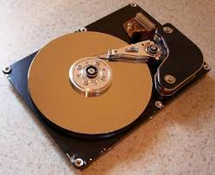
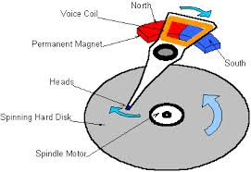
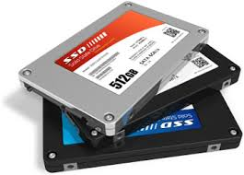

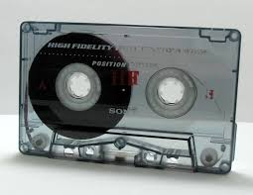
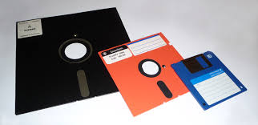
I/O & Storage Layers
Application / Service
High Level I/O
streams
Low Level I/O
handles
Syscall
registers
File System
descriptors
I/O Driver
Commands and Data Transfers
Disks, Flash, Controllers, DMA

Slide 4
Terminology at Different Layers
I/O API and
syscalls
Variable-Size Buffer
Memory Address
Logical Index, Typically 4 KB
File System
Block
Flash Trans. Layer
Hardware Devices
Sector(s)
Sector(s)
Sector(s)
Phys. Block
Phys Index., 4KB
Physical Index,
512B or 4KB
Erasure Page
HDD
SSD

Slide 5
User vs. System View of a File
User’s view:
Durable Data Structures
System’s view (system call interface):
Collection of bytes (UNIX)
Oblivious to specific data structures user wants to store
System’s view (inside OS):
File is a collection of blocks

Slide 6

Building a File System
Classic OS situation
Take limited hardware interface (array of blocks) and provide a more convenient/useful interface with:
Naming: Find file by name, not block numbers
Organize file names with directories
Organization: Map files to blocks
Protection: Enforce access restrictions
Reliability: Keep files intact despite crashes, hardware failures, etc.
File (Bytes)
File
System

Slide 7
What does the file system need?
Track free disk blocks
Need to know where to put newly written data
Track which blocks contain data for which files
Need to know where to read a file from
Track files in a directory
Find list of file's blocks given its name
Where do we maintain all of this?
Somewhere on disk

Slide 8
Data Structures on Disk
Bit different than data structures in memory
Access a block at a time
Can't efficiently read/write a single word
Have to read/write full block containing it
Ideally want sequential access patterns
Durability
Ideally, file system is in meaningful state upon shutdown
This obviously isn't always the case…

Slide 9
Tracking Free Blocks
Bitmap stored at fixed block #
Bit i is 0 if free, 1 if allocated
First fit: Scan sequentially until find a 0
Rewrite whole block to update
Isn't this slow?
Make faster by caching in memory
Finding free block: sequential access pattern

Slide 10
Basic File System Components
File path
Directory
Structure
File Index
Structure
File number
Data blocks
…

Slide 11
Components of a file system
file name
file number
offset
Storage block
directory
index structure
open performs Name Resolution
Translates pathname into a “file number”
Used as an “index” to locate the blocks
Creates a file descriptor in PCB within kernel
Returns a file descriptor (int) to user process
read, write, seek, and sync operate on handle
Mapped to file descriptor and to blocks

Slide 12
Directory
A hierarchical structure
Each directory entry is a collection of file name to file number mappings
Some of these mappings could be subdirectories: simply a link to another collection of mappings
Directories actually form a DAG, not just a tree. Why?
Hard Link: Mapping from name to file number
File number could be pointed to by multiple names (in different directories)
Soft link: Mapping from one name to another

Slide 13
Hard Links
Can we put the same file # in multiple directories?
Unix: Yes! Hard Link
Add first hard link when file is initially created
Create extra links with the link syscall
Remove links with unlink
inode maintains reference count
When 0, free inode and blocks
/usr
/usr/lib
/usr/lib4.3
/usr/lib/foo
/usr/lib4.3/foo

Slide 14
Soft Links (Symbolic Links)
Normal directory entry: <file name, file #>
Symbolic link: <source file name, dest. file name>
OS looks up destination file name each time program accesses source file name
Lookup can fail (error result from open)
Unix: Create soft links with symlink syscall

Slide 15
File
Named permanent storage
Contains
Data: Blocks on disk somewhere
Metadata (Attributes)
Owner, size, last opened, …
Access rights
Data blocks
…
File handle
File descriptor
File object (index)
Position

Slide 16
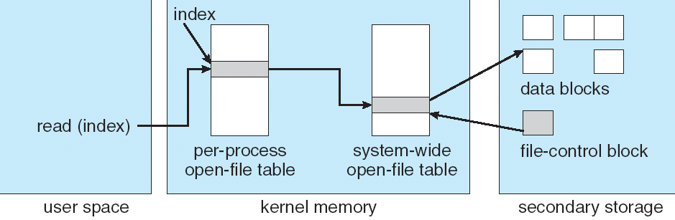
File System Structures
read/write system calls:
Use file handle to locate file's index structure
Perform appropriate reads or writes

Slide 17
With that…how do we provide a generic filesystem?

Slide 18
FAT: (File Allocation Table)
FAT
Disk Blocks
File number
0:
0:
Simple way to store blocks of a file: Linked List structure
File number is just the first block
One entry in table per data block
FAT contains pointer to the next block for each entry (or special END value)
31:
File 31, Block 0
File 31, Block 1
File 31, Block 2
N-1:
N-1:
memory

Slide 19
FAT: (File Allocation Table)
FAT
Disk Blocks
0:
0:
File number
Example: read file 31, block 2
Index into FAT with file num
Follow linked list to block 2
Read block from disk into mem.
31:
File 31, Block 0
File 31, Block 1
File 31, Block 2
N-1:
N-1:
memory

Slide 20
FAT Free Space Tracking
FAT
Disk Blocks
0:
0:
Entries in table corresponding to free block have value 0
Must scan through FAT to find free space
File 31, Block 0
File 31, Block 1
Free
File 31, Block 2
N-1:
N-1:

Slide 21
FAT: Expanding a File
Find a new free block
Link it in with its predecessor
FAT
Disk Blocks
0:
0:
File 31, Block 0
File 31, Block 1
File 31, Block 3
Free
File 31, Block 2
N-1:
N-1:

Slide 22
Storing the FAT
Saved to disk when system is shut down
Copied into memory when OS is running
Makes accesses, updates fast
Otherwise lots of random reads to locate the blocks of a file
When drive is formatted, make all FAT entries 0
FAT
Disk Blocks
File 1 number
0:
0:
31:
File 31, Block 0
File 31, Block 1
File 63, Block 1
File 31, Block 3
63:
File 63, Block 0
File 2 number
File 31, Block 2
N-1:
N-1:

Slide 23
FAT Assessment
Used all over the place
MS-DOS
Windows (sometimes)
External drives
Super simple
Can implement in firmware
E.g., digital cameras, embedded devices
FAT
Disk Blocks
File 1 number
0:
0:
31:
File 31, Block 0
File 31, Block 1
File 63, Block 1
File 31, Block 3
63:
File 63, Block 0
File 2 number
File 31, Block 2
N-1:
N-1:

Slide 24
Maximum Sizes in FAT
What is the maximum size of a FAT file system?
Table entry indexes are 32 bits, top 4 bits are reserved
2²⁸ * 2¹² = 2⁴⁰ = 1 TB
What is the maximum size of a FAT file?
A file's size in bytes is represented by a 4-byte int
2³² bytes = 4 GB

Slide 25
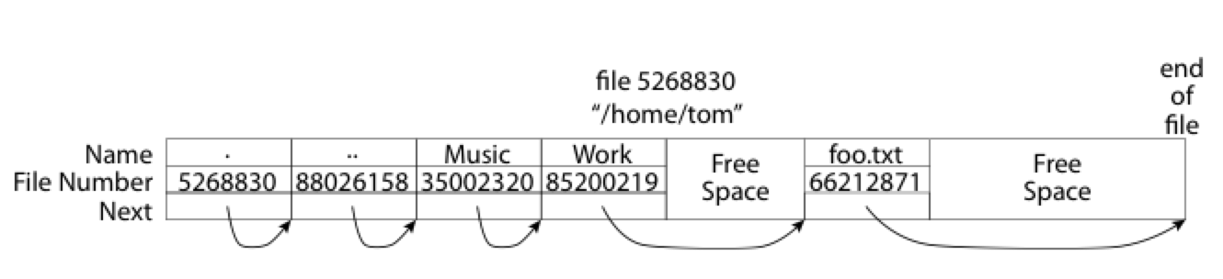
What About Directories?
Essentially a file containing file names to file numbers
Free space for new entries
In FAT: file attributes are kept in directory
Each directory a linked list of entries
Where do you find root directory ( “/” )?

Slide 26
Directory Structure (cont’d)
How many disk accesses to resolve /my/book/count?
Read in first data block for root dir (fixed spot on disk)
Table of file name/index pairs. Search linearly – ok since directories typically very small
Look up my's file number in FAT table
Read in first data block for my; search for book
Look up book's file number in FAT table
Read in first data block for book search for count
Look up count's file number in FAT table

Slide 27
FAT Security Holes
FAT has no notion of access rights
Any user can access any file
Freely look up file blocks from its number

Slide 28
How do we design better file systems?
Helps to know what use cases we are optimizing for
"Ancient" systems design wisdom: "Optimize for the common case"

Slide 29
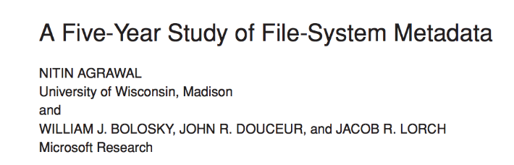
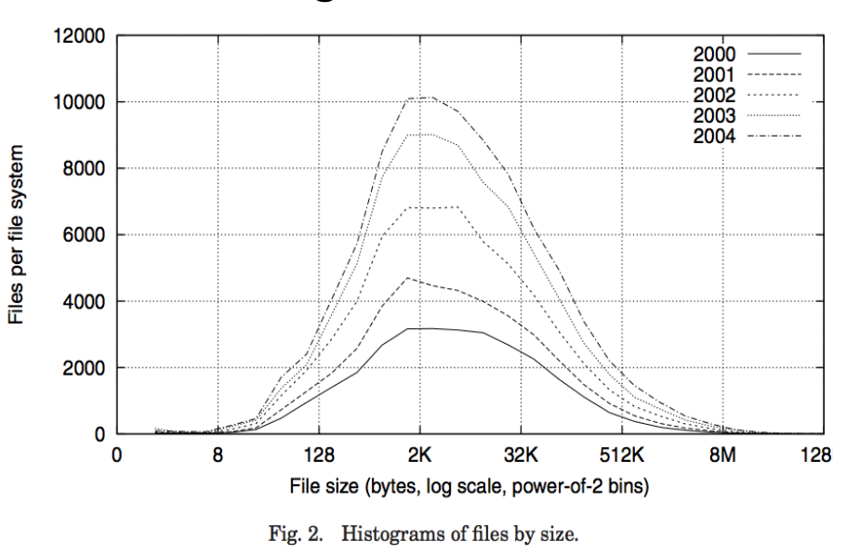
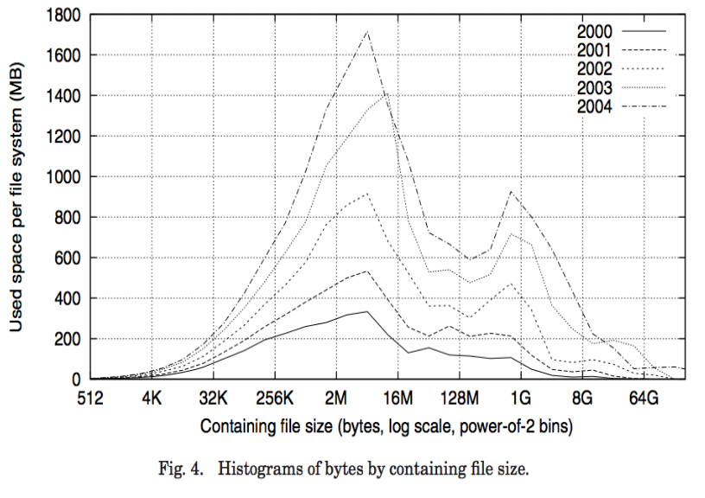
Empirical Characteristics of Files

Slide 30
Empirical Characteristics of Files
Most files are small
Most of the space is occupied by rare, big files
Most file opens are read-only
Most files short-lived (e.g., application-specific temporary files)
Most file accesses are sequential

Slide 31
Unix FFS: inode File Structure

Slide 32
BSD FFS: inode File Structure
Array on disk at a well-known block number
Reserved when disk is formatted

Slide 33
File Attributes
User
Group
9 basic access control bits
- UGO x RWX
Setuid bit
- execute at owner permissions rather than user
Setgid bit
- execute at group’s permissions

Slide 34
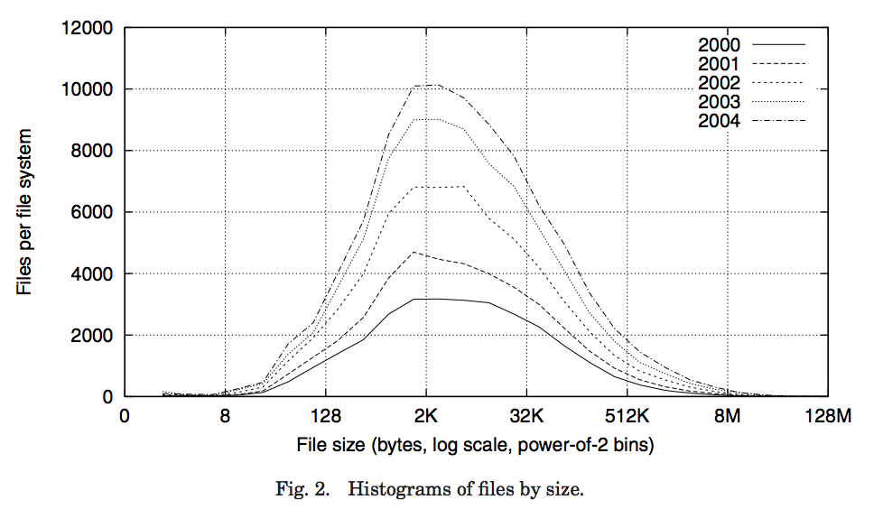
Data Storage
Small files: 12 pointers direct to data blocks
Direct pointers
4kB blocks ⇒ sufficient for files up to 48KB

Slide 35
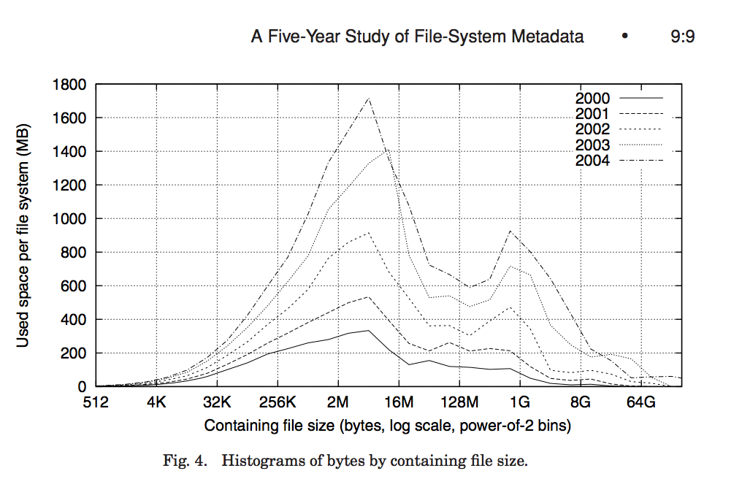
Data Storage
Large files: 1,2,3 level indirect pointers
Indirect pointers
- point to a disk block
containing only pointers
- 4 kB blocks => 1024 ptrs
=> 4 MB @ level 2
=> 4 GB @ level 3
=> 4 TB @ level 4
48 KB
+4 MB
+4 GB
+4 TB

Slide 36
Fast File System
Origin of the inode concept still used in modern Linux filesystems (e.g., ext4)
File number is index into inode array
Multi-Level Index Structure
Great for small to large files
Asymmetric tree with fixed-size blocks

Slide 37
Fast File System
Metadata associated with file itself (in inode) rather than its directory mapping
Enables hard/soft links
Locality heuristics for HDDs
Keep blocks from same file in same physical region of disk to minimize seek, rotational delay
Same for files in same directory
Arguably less significant in age of SSDs

Slide 38
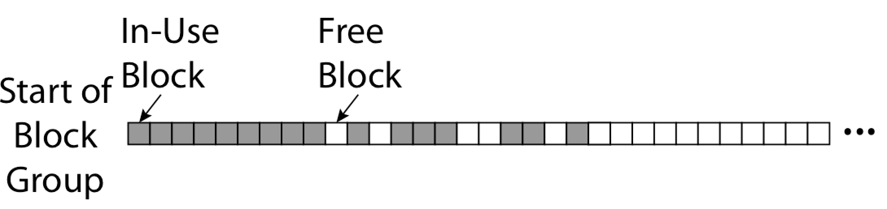
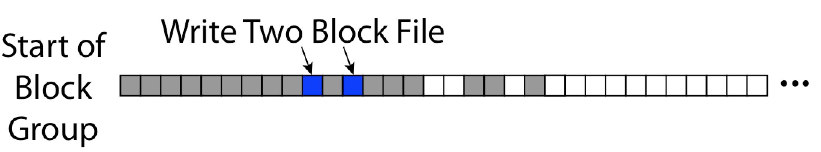
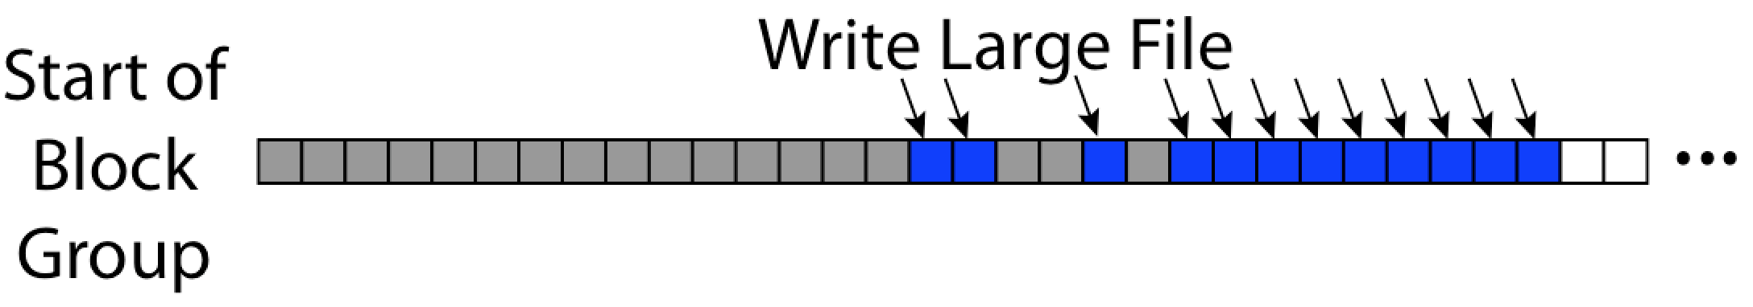
FFS First Fit Block Allocation
Fills in the small holes at the start of block group
Avoids fragmentation, leaves contiguous free space at end

Slide 39
FFS Assessment
Efficient storage for large and small files
Locality for both file contents and metadata
Inefficient for tiny files
E.g., a one-byte file requires 8KB of space on disk: inode and data block
Inefficient encoding for contiguous ranges of blocks belonging to same file (e.g. blocks 4815 – 162342)

Slide 40
Summary
File System maps files and directories onto blocks within persistent storage
FAT: File number indexes into simple table, find blocks by traversing linked list
FFS Key Innovation: inode file index structure
Asymmetric, multi-level tree
One block per leaf of tree

Slide 41


Slide 42
A Bit More on Directories
Directories are just specialized files
Contents: List of pairs <file name, file number>
libc support
DIR * opendir (const char *dirname)
struct dirent * readdir (DIR *dirstream)
/usr
/usr/lib
/usr/lib4.3
/usr/lib/foo
/usr/lib4.3/foo

Slide 43
Large Directories: B Trees

Slide 44
B Tree
Balanced trees suitable for storing on disk
Like balanced binary tree, but many more than 2 children
Why? Remember we read/write in blocks
Make node roughly size of a block – manipulate in one disk operation
Sorted list of child nodes for each internal node of tree

Slide 45
New Technology File System (NTFS)
Default on modern Windows systems
Instead of FAT or inode array: Master File Table
Max 1 KB size for each table entry
Each entry in MFT contains metadata plus
File's data directly (for small files)
A list of extents (start block, size) for file's data
For big files: pointers to other MFT entries with more extent lists

Slide 46
NTFS Small File
Create time, modify time, access time,
Owner id, security specifier, flags (RO, hidden, sys)
data attribute
Attribute list

Slide 47
NTFS Medium File

Slide 48
Why Extents?
FFS: List of fixed size blocks
For larger files, we want their contents to be in contiguous blocks anyways
Idea: Store starting block and number of subsequent contiguous blocks
File made of 1000 sequential blocks
Extents: Just one metadata entry
Blocks: 1000 entries (plus indirect pointer!)

Slide 49
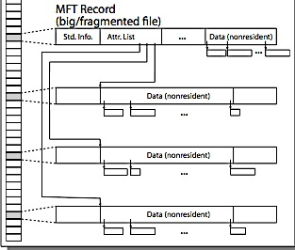
NTFS Multiple Indirect Blocks

Slide 51
NTFS Directories
Directories implemented as B Trees
File's number identifies its entry in MFT
MFT entry always has a file name attribute
Human readable name, file number of parent dir
Hard link? Multiple file name attributes in MFT entry

Slide 52
Important “ilities”
Availability: probability that the system can accept and process requests
99.9% probability of being up: “3-nines of availability”
Durability: the ability of a system to recover data despite faults
For data: don't forget anything because of crashes
Doesn’t necessarily imply availability: information on pyramids was very durable, but could not be accessed until discovery of Rosetta Stone
Reliability: the ability of a system or component to perform its required functions under stated conditions for a specified period of time (IEEE definition)
Usually stronger than simply availability: up and working correctly
Includes availability, security, fault tolerance/durability
Must make sure data survives system crashes, disk crashes, other problems

Slide 53
Threats to File System Durability
Small defects in HDD or SSD hardware
Controllers use error-correcting codes
Some bits can be lost but use redundant data to recover missing values in block/sector
Replicate data across multiple disks/locations
Lose power before moving data from memory to disk (e.g., File Allocation Table?)
Lose power while writing data to disk

Slide 54
File System Reliability: (Different from Block-level reliability)
What can happen if disk loses power?
Operations in progress may be partially complete or lost
What if disk was in middle of a block write?
Having multiple copies doesn’t necessarily protect us
No protection against writing bad state
What if one of the copies doesn't get updated?
File system needs durability (at a minimum!)
Data previously stored can be retrieved (maybe after some recovery step), regardless of failure

Slide 55
Storage Reliability Challenge
Single logical file operation can involve updates to multiple physical disk blocks (e.g. creating a file)
Allocating free data block, allocating inode, updating dir.
At physical level, operations complete one at a time
How do we guarantee file system is in a sane state even if a crash interrupts these steps?

Slide 56
Approach #1: Careful Ordering
Sequence operations in a specific order
Design sequence to be interrupted safely
Recovery after crash:
Read data structures to see if any operations were in progress at failure time
Clean up/finish them as needed
Approach taken in FAT, FFS, and many applications (Microsoft Word)

Slide 57
FFS: Create a File
Normal operation:
Allocate data block
Write data block
Allocate inode
Write inode block
Update bitmap of free blocks and inodes
Update directory with file name → inode number
Update modify time for directory
Recovery:
Scan inode table
If any unlinked files (not in any directory), delete or put in lost & found dir
Compare free block bitmap against inode trees
Scan directories for missing update/access times
Time proportional to disk size

Slide 58
More General Approach
Use transactions for atomic updates
Ensure that multiple related operations performed atomically
If a crash occurs in middle, state of system should reflect all or none of the operations
Most modern file systems use transactions to safely update their internals

Slide 59
Key Concept: Transaction
Closely related to critical sections for manipulating shared data structures
Extend concept of an atomic update from memory to persistent storage
Atomically update multiple persistent data structures
transaction
consistent state 1
consistent state 2

Slide 60
Typical Transaction Structure
Begin a transaction – get transaction id
Do a bunch of updates
If any fail along the way, roll-back
Or, if any conflicts with other transactions, roll-back
Commit the transaction

Slide 61
Journaling File Systems
Don't modify data structures on disk directly
Write each update as transaction recorded in a log
Commonly called a journal or intention list
Also maintained on disk (allocate blocks for it when formatting)
Once changes are in the log, they can be safely applied
e.g. modify inode pointers and directory mapping
Garbage collection: once a change is applied, remove its entry from the log

Slide 62
Example: Creating a File
Find free data block(s)
Find free inode entry
Find dirent insertion point
-----------------------------------------
Write map (i.e., mark used)
Write inode entry to point to block(s)
Write dirent to point to inode
Free space map
Data blocks
…
Inode table
Directory
entries

Slide 63
Ex: Creating a file (as transaction)
Find free data block(s)
Find free inode entry
Find dirent insertion point
---------------------------------------------------------
[log] Write map (used)
[log] Write inode entry to point to block(s)
[log] Write dirent to point to inode
Free space map
Data blocks
…
Inode table
Directory
entries
tail
head
done
pending
start
commit
Log: in non-volatile storage (Flash or on Disk)

Slide 64
"Redo Log" – Replay Transactions
After Commit
All access to file system first looks in log
Eventually copy changes to disk
Free space map
Data blocks
…
Inode table
Directory
entries
tail
tail
tail
tail
tail
head
done
start
commit
pending
Log: in non-volatile storage (Flash or Disk)

Slide 65
Crash During Logging – Recover
Upon recovery scan the log
Detect transaction start with no commit
Discard log entries
Disk remains unchanged
Free space map
Data blocks
…
Inode table
Directory
entries
tail
head
done
pending
start
Log: in non-volatile storage (Flash or on Disk)

Slide 66
Recovery After Commit
Scan log, find start
Find matching commit
Redo it as usual
Or just let it happen later
Free space map
Data blocks
…
Inode table
Directory
entries
tail
head
done
pending
start
commit
Log: in non-volatile storage (Flash or on Disk)

Slide 67
Journaling Summary
Why go through all this trouble?
Updates atomic, even if we crash:
Update either gets fully applied or discarded
All physical operations treated as a logical unit
Isn't this expensive?
Yes! We're now writing all data twice (once to log, once to actual data blocks in target file)
Modern filesystems journal metadata updates only
Record modifications to file system data structures
But apply updates to a file's contents directly

Slide 68
Copy-on-Write (CoW) File Sys.
To change a file:
Write new version of data block
Propagate changes "upwards" through FS tree structure
Write new copy of indirect blocks (if necessary)
Write new copy of inode
Write new copy of directory entry pointing to new inode copy
Change does not take effect unless we finish last step – provides atomicity and durability

Slide 69
CoW with Smaller-Radix Blocks
old version
new version
Write

Slide 70
CoW with Smaller-Radix Blocks
old version
new version

