Slide 1
CS6456: Graduate Operating Systems
Brad Campbell – bradjc@virginia.edu
https://www.cs.virginia.edu/~bjc8c/class/cs6456-f19/
Slides modified from CS162 at UCB

Slide 2
Reverse Page Mapping: "Coremap"
Mapping from physical page frame # to all of its mappings in virtual address spaces
Example uses:
Scanning accessed/dirty bits of all of frame's PTEs
Marking a page as not present in all PTEs that refer to it when evicting the page to disk

Slide 3
Coremap
Physical Memory
Frame 1
Page Table Entry
Proc. 1
Frame 2
Frame 3
Page Table Entry
Proc. 1
⋮
Page Table Entry
Proc. 2
Frame n
Page Table Entry
Proc. 1

Slide 4
Binding Instructions and Data to Memory
Process view of memory
Physical addresses
data1: dw 32
…
start: lw r1,0(data1)
jal checkit
loop: addi r1, r1, -1
bnz r1, loop …
checkit: …
0x0300 00000020
… …
0x0900 8C2000C0
0x0904 0C000280
0x0908 2021FFFF
0x090C 14200242
…
0x0A00

Slide 5
Binding Instructions and Data to Memory
Physical
Memory
0x0000
0x0300
00000020
Process view of memory
Physical addresses
data1: dw 32
…
start: lw r1,0(data1)
jal checkit
loop: addi r1, r1, -1
bnz r1, loop …
checkit: …
0x0300 00000020
… …
0x0900 8C2000C0
0x0904 0C000280
0x0908 2021FFFF
0x090C 14200242
…
0x0A00
0x0900
8C2000C0
0C000340
2021FFFF
14200242
0xFFFF

Slide 6
Execute Second Instance of Program?
Physical
Memory
0x0000
0x0300
App X
Process view of memory
Physical addresses
data1: dw 32
…
start: lw r1,0(data1)
jal checkit
loop: addi r1, r1, -1
bnz r1, loop …
checkit: …
0x0300 00000020
… …
0x0900 8C2000C0
0x0904 0C000280
0x0908 2021FFFF
0x090C 14200242
…
0x0A00
0x0900
?
0xFFFF

Slide 7
Execute Second Instance of Program?
Physical Memory
0x0000
0x0300
App X
Process view of memory
Physical addresses
data1: dw 32
…
start: lw r1,0(data1)
jal checkit
loop: addi r1, r1, -1
bnz r1, loop …
checkit: …
0x1300 00000020
… …
0x1900 8C2004C0
0x1904 0C000680
0x1908 2021FFFF
0x190C 14200642
…
0x1A00
0x0900
0x1300
00000020
0x1900
8C2004C0
0C000680
2021FFFF
14200642
0xFFFF

Slide 8
When do we decide on addresses?
At compile time?
Tricky – we don't know state of physical memory when program is executed
At load time?
Scan through binary and modify addresses
Expensive – what if we have a large program?
Still using physical addresses directly
At run time? Translation
Modify addresses issued by CPU on the fly

Slide 9
Uniprogramming
No translation
No protection
Application can access any physical address directly
Application always runs at same location
0xFFFFFFFF
Operating
System
Valid 32-bit
Addresses
Application
0x00000000
Not just illusion of dedicate machine, it really is a dedicated machine!

Slide 10
Primitive Multiprogramming
No translation
No protection
Programs need to use different address ranges
Rely on loader to modify addrs at execution time
Common on early operating systems
0xFFFFFFFF
Operating
System
Application2
0x00020000
Application1
0x00000000

Slide 11
Multiprogramming with Protection
0xFFFFFFFF
Operating
System
BoundAddr=0x10000
0x00020000
BaseAddr=0x20000
Application2
Application1
0x00000000
Hardware Support: Base and Bound Registers
Access outside of range: Error! (Unless in Kernel Mode)
Modify from kernel mode only
Kernel loads register values from PCB when context switch occurs

Slide 12
Loading Executable Into Memory
disk (huge)
memory
info
data
code
exe
View so far: OS copies each segment into memory
Then set up registers, jump to start location

Slide 13
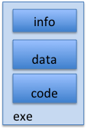
New View: Create Address Space
disk (huge, TB)
VAS – per process
kernel
stack
stack
heap
heap
data
data
code
One (very conservative) method: Every page in address space is backed by disk
Just allocate space on disk, let a page fault trigger a load into memory

Slide 14
New View: Create Address Space
disk (huge, TB)
VAS – per process
kernel
stack
stack
heap
heap
data
data
code
Note that we do not need an extra copy of read-only data already contained in a file
Executable code, memory mapped files (soon)

Slide 15
New View: Create Address Space
disk (huge, TB)
VAS – per proc.
PT
memory
kernel
stack
user page
frames
stack
heap
heap
user pagetable
data
data
kernel code & data
code
User page table maps entire virtual address space
One per process, distinguishes present from absent pages
OS needs to store mapping from virtual page to disk location

Slide 16
New View: Create Address Space
disk (huge, TB)
VAS – per proc.
PT
memory
kernel
stack
user page
frames
stack
heap
heap
user pagetable
data
data
kernel code & data
code
Backing Store
Cache

Slide 17
Provide Backing Store for VAS
disk (huge, TB)
VAS 1
PT 1
memory
kernel
stack
stack
stack
heap
user page
frames
heap
heap
data
VAS 2
PT 2
data
code
user pagetable
data
kernel
code
stack
kernel code & data
heap
data
code

Slide 18
A Page Fault
disk (huge, TB)
VAS 1
PT 1
memory
kernel
stack
stack
stack
heap
user page
frames
heap
heap
data
VAS 2
PT 2
data
code
user pagetable
data
kernel
code
stack
kernel code
& data
heap
data
active process & PT
code

Slide 19
A Page Fault: Find and Start Load
disk (huge, TB)
VAS 1
PT 1
memory
kernel
stack
stack
stack
heap
user page
frames
heap
heap
data
VAS 2
PT 2
data
code
user pagetable
data
kernel
code
stack
kernel code & data
heap
data
active process & PT
code

Slide 20
A Page Fault: Switch During IO
disk (huge, TB)
VAS 1
PT 1
memory
kernel
stack
stack
stack
heap
user page
frames
heap
heap
data
VAS 2
PT 2
data
code
user pagetable
data
kernel
code
stack
kernel code & data
heap
data
active process & PT
code

Slide 21
On Page Fault: Update PTE
disk (huge, TB)
VAS 1
PT 1
memory
kernel
stack
stack
stack
heap
user page
frames
heap
heap
data
VAS 2
PT 2
data
code
user pagetable
data
kernel
code
stack
kernel code & data
heap
data
active process & PT
code

Slide 22
Eventually Reschedule Faulting Thread
disk (huge, TB)
VAS 1
PT 1
memory
kernel
stack
stack
stack
heap
user page
frames
heap
heap
data
VAS 2
PT 2
data
code
user pagetable
data
kernel
code
stack
kernel code & data
heap
data
active process & PT
code

Slide 23
File IO
File IO so far: Explicit transfer between buffers in process address space to regions of a file
Overhead: multiple copies in memory, syscalls
Alternative: Map file directly into an empty region of a process address space
Implicitly page in file when we read it
Write to file and eventually page it out
Executable file is treated this way when we execute a process!

Slide 24
Using Paging to mmap Files
Process
virtual address
physical address
MMU
page#
PT
instruction
frame#
offset
retry
page fault
exception
Read File contents
from memory!
Operating System
Create PT entries
for mapped region
as “backed” by file
Page Fault Handler
File
scheduler
mmap() file to region of VAS

Slide 25
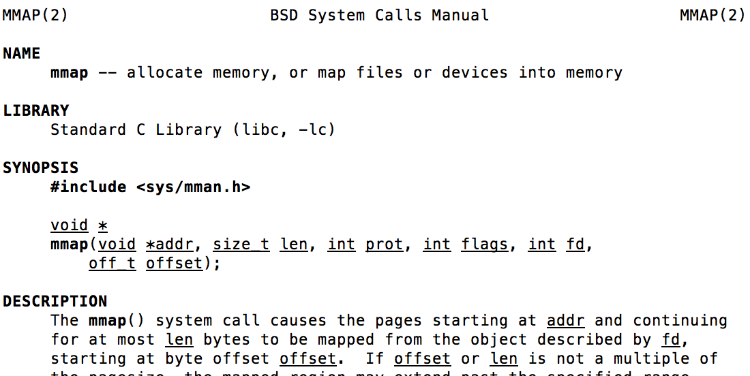
mmap system call
May map specific region or let the system find one for you
Tricky to know where a free region even would be…

Slide 26
mmap Example
#include <sys/mman.h> /* also stdio.h, stdlib.h, string.h, fcntl.h, unistd.h */
int something = 162;
int main (int argc, char *argv[]) {
int myfd;
char *mfile;
printf("Data at: %16lx\n", (long unsigned int) &something);
printf("Heap at : %16lx\n", (long unsigned int) malloc(1));
printf("Stack at: %16lx\n", (long unsigned int) &mfile);
/* Open the file */
myfd = open(argv[1], O_RDWR | O_CREAT);
if (myfd < 0) { perror("open failed!");exit(1); }
/* map the file */
mfile = mmap(0, 10000, PROT_READ|PROT_WRITE, MAP_FILE|MAP_SHARED, myfd, 0);
if (mfile == MAP_FAILED) {perror("mmap failed"); exit(1);}
printf("mmap at : %16lx\n", (long unsigned int) mfile);
puts(mfile);
strcpy(mfile+20,"Let's write over it");
close(myfd);
return 0;
}
$ ./mmap test
Data at: 105d63058
Heap at : 7f8a33c04b70
Stack at: 7fff59e9db10
mmap at : 105d97000
This is line one
This is line two
This is line three
This is line four
$ cat test
This is line one
ThiLet's write over its line three
This is line four

Slide 27
Sharing through Mapped Files
VAS 1
VAS 2
0x000…
0x000…
instructions
instructions
data
data
File
heap
heap
Memory
stack
stack
OS
OS
0xFFF…
0xFFF…

Slide 28
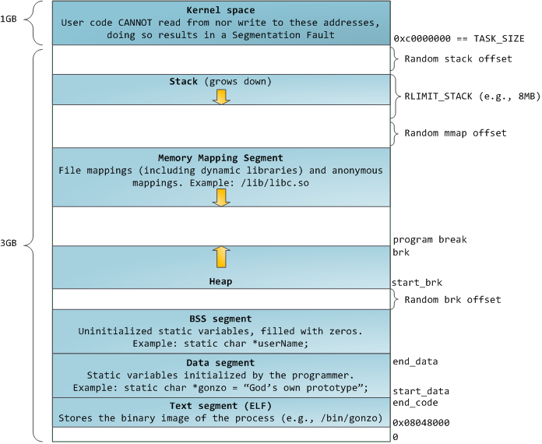
32-bit x86 Linux Virtual Memory Layout

Slide 29
32-bit x86 Linux Memory Layout
Memory Mapped Files
Extra stacks for multithreaded processes
Shared Libraries
Some Memory Allocations

Slide 30
32-bit x86 Linux Memory Layout
ASLR: Address Space Layout Randomization
Make it harder to exploit bugs to compromise system

Slide 31
32-bit x86 Linux Memory Layout
Kernel mapped into every process's address space
Protection bits: pages can't be accessed in user mode
Why? Faster than changing address space on every switch to kernel mode

Slide 32
Linux Virtual memory map
0xFFFFFFFF
0xFFFFFFFFFFFFFFFF
Kernel Addresses
1GB
Kernel Addresses
128TiB
896MB Physical
64 TiB Physical
0xC0000000
User Addresses
0xFFFF800000000000
3GB Total
Empty
Space
“Canonical Hole”
0x00007FFFFFFFFFFF
128TiB
User
Addresses
0x00000000
0x0000000000000000
32-Bit Virtual Address Space
64-Bit Virtual Address Space

Slide 33
Linux Virtual memory map
0xFFFFFFFF
0xFFFFFFFFFFFFFFFF
Kernel Addresses
1GB
Kernel Addresses
128TiB
896MB Physical
One-to-One maps of "bottom" of Physical Memory
64 TiB Physical
0xC0000000
User Addresses
0xFFFF800000000000
3GB Total
Empty
Space
“Canonical Hole”
0x00007FFFFFFFFFFF
128TiB
User
Addresses
0x00000000
0x0000000000000000
32-Bit Virtual Address Space
64-Bit Virtual Address Space

Slide 34
Linux Virtual memory map
0xFFFFFFFF
0xFFFFFFFFFFFFFFFF
Kernel Addresses
1GB
Kernel Addresses
128TiB
896MB Physical
Can temporarily map higher physical addresses
64 TiB Physical
0xC0000000
User Addresses
0xFFFF800000000000
3GB Total
Empty
Space
“Canonical Hole”
0x00007FFFFFFFFFFF
128TiB
User
Addresses
0x00000000
0x0000000000000000
32-Bit Virtual Address Space
64-Bit Virtual Address Space

Slide 35
January 2018 - Meltdown
Possible to inspect contents of kernel memory if it's mapped into address space (even as user!)

Slide 36
Meltdown Overview
r0, r1: temps
r2: kernel address we wish to read
r3: start of probe_array
ldr r0 <- [r2]
sll r0 <- r0, #12
add r1 <- r3, r0
ldr r1 <- [r1]
<= but doesn’t this raise an exception??!?
Notes:
flush+reload attack
exn can’t be raised until Commit

Slide 37
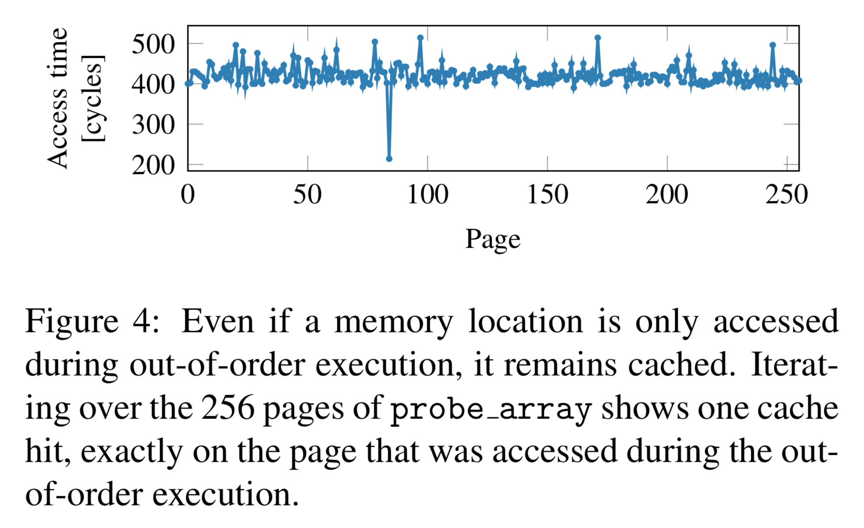
Meltdown Cache Timing Attack
Notes:
real side channels are noisy
Meltdown throughput: 500KB/sec

Slide 38
January 2018 - Meltdown
Fix: Kernel Page Table Isolation
Use entirely different page tables when in user mode vs. when in kernel mode
Problem: Address space change whenever an interrupt or syscall occurs!
Change page tables
Flush TLB unless it is tagged
Reduced Performance, depends on syscall workload

Slide 39


Slide 40
Interprocess Communication
Thus far, we've said the following:
Hard to cooperate across processes because they're inherently isolated (separate addr. spaces)
But this is good for protection
Easy to cooperate among threads because they share an address space
But this is bad for protection
Have to use synchronization primitives like locks

Slide 41
Interprocess Communication
Allow two (or more) processes to exchange information with each other
Why use this approach rather than multithreading?
Keep most of the benefits of process isolation
Expose processes to each other only through a carefully structured interface
Ex: Google Chrome Design

Slide 42
We've Already Seen Some IPC
Two processes share a file (e.g. both mmap it)
Needs some synchronization, must structure file layout
Con: Still involves entire kernel IO infrastructure
What if file is only temporary, needed while processes are running?
Create a pipe
read and write on set of file descriptors.
Still limited in how much can be written at once.

Slide 43
Another IPC option
Open a socket to 127.0.0.1 (localhost)
Nice if we ever want to deploy process on remote machine later on
But lots of extra work: Packet/header assembly, checksum calculation, TCP ACKs, etc.

Slide 44
IPC Example: Pipes
Use classic file-related syscalls: read, write
But avoid the overhead of actually interacting with kernel IO subsystem
Instead: writes/reads manipulate a buffer of memory maintained by the kernel

Slide 45
Pipe Syscall
PIPE(2) Linux Programmer's Manual
NAME
pipe, pipe2 - create pipe
SYNOPSIS
#include <unistd.h>
int pipe(int pipefd[2]);
DESCRIPTION
pipe() creates a pipe, a unidirectional data channel that can be used for interprocess communication. The array pipefd is used to return two file descriptors referring to the ends of the pipe. pipefd[0] refers to the read end of the pipe. pipefd[1] refers to the write end of the pipe.
Data written to the write end of the pipe is buffered by the kernel until it is read from the read end of the pipe.

Slide 46
Using Pipes – Common Pattern
Process calls pipe with 2-int array
array[0]: Read-only
array[1]: Write-only
fork()
Each pipe fd is unidirectional – parent and child each close the "end" they don't need

Slide 47
Using Pipes
int pipe_fds[2];
pid_t cpid;
pipe(pipe_fds);
cpid = fork();
if (cpid > 0) {
close(pipe_fds[0]); // Close read-only end
char *msg = "Hello, World!";
write(pipe_fds[1], msg, 13);
close(pipe_fds[1]);
waitpid(cpid, NULL, 0);
} else {
close(pipe_fds[1]); // Close write-only end
char buf[1024];
int nread = read(pipe_fds[0], &buf, 1023);
buf[nread] = '\0';
printf("Parent Sent: %s\n", buf);
close(pipe_fds[0]);
}

Slide 48
Using Pipes
Parent
Child
write pipe_fds[1]
read pipe_fds[0]
Kernel
Remember producer-consumer problem?
Pipe's buffer has maximum size
Write to full pipe blocks until space available
Read from empty pipe blocks until data available
Read from pipe with no writers returns 0
Write to pipe with no readers prompts SIGPIPE

Slide 49
UNIX Domain Sockets
Open a socket connection with a local process
Use familiar write/read calls to communicate
But don't incur usual overhead of networking
Optimized for processes on same machine

Slide 50
Using Unix Domain Sockets
Still need same sequence of syscalls: socket, bind, listen, accept to act as a server
But socket address now corresponds to an object in local machine's filesystem
Specify path on bind
Why this approach?
Filesystem gives us a namespace: any process can specify path on connect (doesn't need to be a child of server)
Filesystem enforces permissions

Slide 51
Using Unix Domain Sockets
#include <sys/un.h>
…
int fd;
struct sockaddr_un un;
un.sun_family = AF_UNIX;
strcpy(un.sun_path, "/home/oski/demo.socket");
fd = socket(AF_UNIX, SOCK_STREAM, 0);
bind(fd, (struct sockaddr*)&un, sizeof(un));

Slide 52
Many Other Forms of IPC
Named Pipes (FIFOs): Pipe interface, but given a name in the file system (man 3 mkfifo)
Named semaphores (man sem_open)
Message Queues (man 7 mq_overview)
And more…

Slide 53
Summary
Alternate view of loading a program: allocate space on disk, load in pages only when needed
Memory-Mapped IO: Map contents of file into virtual address space, store/load instead of read/write
Inter-Process Communication: Structured sharing
Pipes: Read/write ordered, in-memory buffer
Unix Domain Sockets: Avoid networking overhead

Slide 54
C Concurrency and Synchronization
Standard approach: use pthreads, protect access to shared data structures
Shared Memory Paradigm
One pitfall: consistently unlocking a mutex
int Rtn() { lock.acquire(); … if (exception) { lock.release(); return errCode; } … lock.release(); return OK; }

Slide 55
Other Languages and Threading
Many other mainstream languages also focus on threads and shared memory
But offer useful libraries and built-in features to make our lives easier
Thread management libraries
Thread pools
Safer lock management
Objects as monitors

Slide 56
C++ Lock Guards
#include <mutex>
int global_i = 0;
std::mutex global_mutex;
void safe_increment() {
std::lock_guard<std::mutex> lock(global_mutex);
…
global_i++;
// Mutex released when 'lock' goes out of scope
}

Slide 57
Python with Keyword
More versatile than we'll show here (can be used to close files, server connections, etc.)
with lock: # Automatically calls acquire()
some_var += 1
…
# release() called however we leave block

Slide 58
Java Support for Synchronization
class Account { private int balance; public Account (int initialBalance) { balance = initialBalance; }
public synchronized int getBalance() { return balance; }
public synchronized void deposit(int amount) { balance += amount; } }
Every Java object has an associated lock for synchronization:
Lock is acquired on entry and released on exit from synchronized method
Lock is properly released if exception occurs inside synchronized method

Slide 59
Java Support for Synchronization
Along with a lock, every object has a single condition variable associated with it
To wait inside a synchronized method:
void wait();
void wait(long timeout);
To signal while in a synchronized method:
void notify();
void notifyAll();

Slide 60
Newish programming language: Go
"Goroutines": Lightweight, user-level threads
Channels: Named message queues for communication among threads
Key Idea: Prefer message passing over shared memory

Slide 61
Go
Why this approach?
Efficiency of a shared address space
Tolerates many threads in one program
Passing data through channels: no need for explicit synchronization
Sender passes ownership to receiver

Slide 62
Go Channels
type chan struct {
qcount uint // total data in the queue
dataqsiz uint // size of the circular queue
buf unsafe.Pointer // array of dataqsiz elements
elemsize uint16
closed uint32
elemtype *_type // element type
sendx uint // send index
recvx uint // receive index
recvq waitq // list of recv waiters
sendq waitq // list of send waiters
lock mutex
}

Slide 63
Go Channels
dataqsiz
buf
qcount

Slide 64
Go Channels
buf
recvx
Next slot to read from
sendx
Next slot to write to

Slide 65
Go Channels
Rules much like for pipes
Synchronization handled for us
Use atomic ops or acquire channel's mutex
Send: If recvq non-empty, pass value to first waiter and wake it up
Otherwise, append element to buffer at sendx
Send when full buffer (qcount == dataqsize)
Put thread on sendq
Schedule another thread

Slide 66
Go Channels
Recv: If buffer non-empty, read from recvx
If thread on sendq, append its element to buffer, remove it from queue, mark as ready again
Recv when empty buffer (qcount == 0)
Put thread on recvq
Schedule another thread

Slide 67
Go Channels
Closing a channel much like closing a pipe
All waiting readers woken up, "receive" zero value
All waiting writers woken up, panic (~exception) occurs in each
What if we give a channel a buffer length of 0?
Synchronous channel
Send blocks until another thread receives

Slide 68
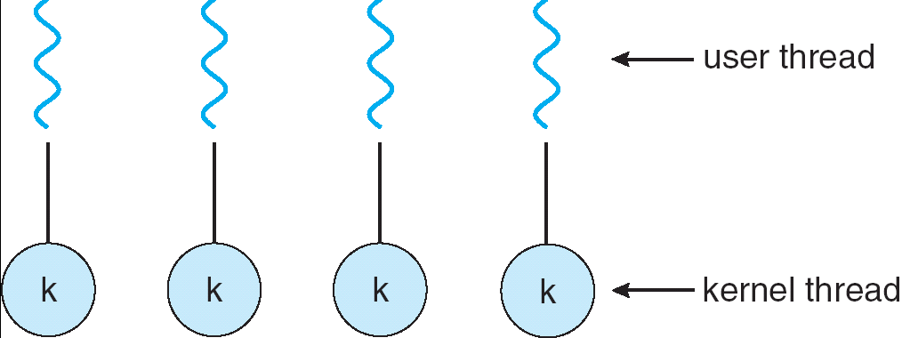
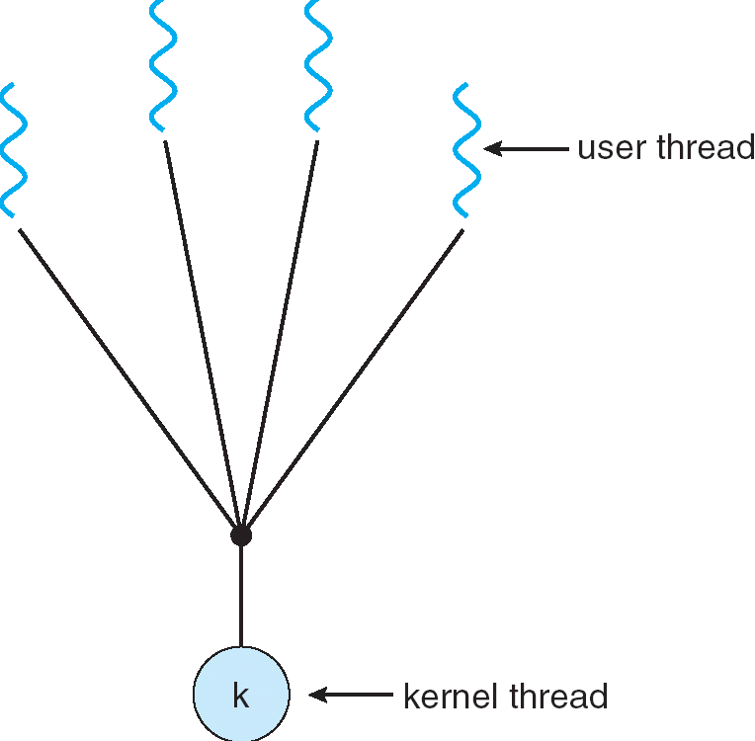
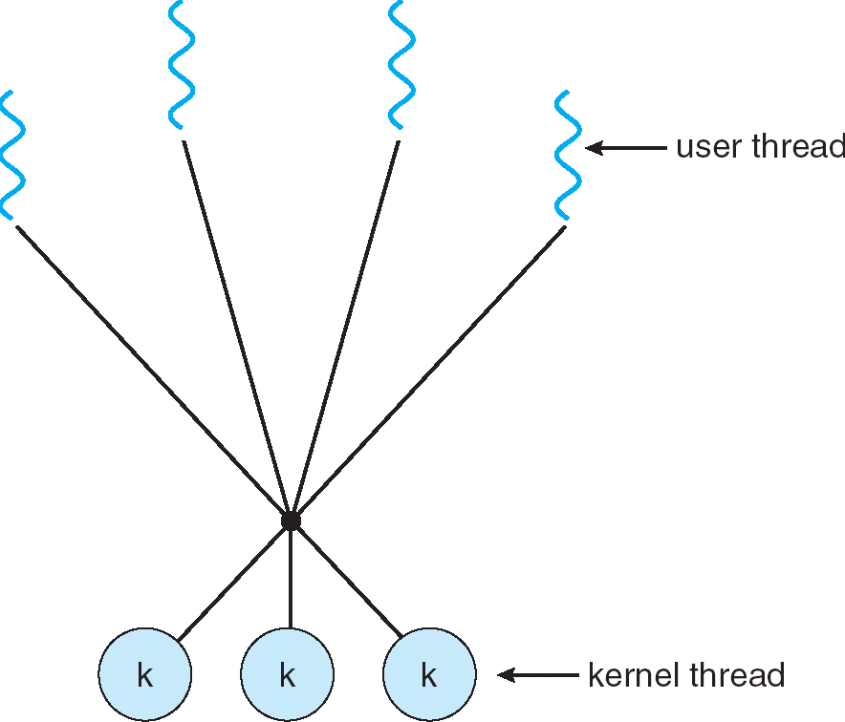
Remember this Slide?
Simple One-to-One
Threading Model
Many-to-One
Many-to-Many

Slide 69
User-Mode Threads: Problems
One user-level thread blocks on syscall: all user-level threads relying on same kernel thread also block
Kernel cannot intelligently schedule threads it doesn’t know about
Multiple Cores?
No pre-emption: User-level thread must explicitly yield CPU to allow someone else to run

Slide 70
Go User-Level Thread Scheduler
Global Run Queue
Newly created goroutines
Local Run Queue
Local Run Queue
Local Run Queue
OS Thread (M)
OS Thread (M)
OS Thread (M)
…
CPU Core
CPU Core
CPU Core

Slide 71
Go User-Level Thread Scheduler
Why this approach?
1 OS (kernel-supported) thread per CPU core: allows go program to achieve parallelism not just concurrency
Fewer OS threads? Not utilizing all CPUs
More OS threads? No additional benefit
We’ll see one exception to this involving syscalls
Keep goroutine on same OS thread: affinity, nice for caching and performance

Slide 72
Cooperative Scheduling
No pre-emption => goroutines must yield to allow another thread to run
Programmer does not need to do this explicitly
Go runtime injects yields at safe points in execution
Sending/receiving with a channel
Acquiring a mutex
Making a function call
But your code can still tie up the scheduler in "tight loops" (Go's developers are working on this…)

Slide 73
Dealing with Syscalls
Local Run Queue
What if a goroutine wants to make a blocking syscall?
Example: File I/O
Running Grtn.
OS Thread (M1)
CPU Core

Slide 74
Dealing with Syscalls
While syscall is blocking, allocate new OS thread (M2)
M1 is blocked by kernel, M2 lets us continue using CPU
Local Run Queue
OS Thread
(M2)
CPU Core
Blocking Grtn.
OS Thread (M1)

Slide 75
Dealing with Syscalls
Syscall completes: Put invoking goroutine back on queue
Keep M1 around in a spare pool
Swap it with M2 upon next syscall, no need to pay thread creation cost
Local Run Queue
Running Grtn.
OS Thread
(M2)
Blocking Grtn.
CPU Core
OS Thread (M1)

