Slide 1
CS6456: Graduate Operating Systems
Brad Campbell – bradjc@virginia.edu
https://www.cs.virginia.edu/~bjc8c/class/cs6456-f19/

Slide 2
Client-Server Models
Client 1
Client 2
Server
***
Client n
Many clients accessing a common server
All intelligence in the server

Slide 3
Sockets
Socket: An abstraction of a network I/O queue
Mechanism for inter-process communication
Embodies one side of a communication channel
Same interface regardless of local or remote
First introduced in 4.2 BSD Unix
Most operating systems (Linux, Mac OS X, Windows) provide this, even if they don’t copy rest of UNIX I/O
Standardized by POSIX

Slide 4
Sockets
Looks just like a file with a file descriptor
read adds to queue, write removes from it
Bidirectional: one queue in each direction
Some operations do not work, e.g. lseek
Same abstraction for any kind of network
Local (within same machine)
The Internet (TCP/IP, UDP/IP)
Things “no one” uses anymore (OSI, Appletalk, IPX, …)

Slide 5

Silly Echo Server
Client (issues requests)
Server (performs operations)
gets(fd,sndbuf, …);
User
requests
write(fd, buf,len);
n = read(fd,buf,);
wait
print
write(fd, buf,);
responses
n = read(fd,rcvbuf, );
print

Slide 6
Echo client-server example
void client(int sockfd) {
int n;
char sndbuf[MAXIN]; char rcvbuf[MAXOUT];
getreq(sndbuf, MAXIN); /* prompt */
while (strlen(sndbuf) > 0) {
write(sockfd, sndbuf, strlen(sndbuf)); /* send */
memset(rcvbuf,0,MAXOUT); /* clear */
n=read(sockfd, rcvbuf, MAXOUT-1); /* receive */
write(STDOUT_FILENO, rcvbuf, n); /* echo */
getreq(sndbuf, MAXIN); /* prompt */
}
}
void server(int consockfd) {
char reqbuf[MAXREQ];
int n;
while (1) {
memset(reqbuf,0, MAXREQ);
n = read(consockfd,reqbuf,MAXREQ-1); /* Recv */
if (n <= 0) return;
n = write(STDOUT_FILENO, reqbuf, strlen(reqbuf));
n = write(consockfd, reqbuf, strlen(reqbuf)); /* echo*/
}
}

Slide 7
Prompt for input
char *getreq(char *inbuf, int len) {
/* Get request char stream */
printf("REQ: "); /* prompt */
memset(inbuf,0,len); /* clear for good measure */
return fgets(inbuf,len,stdin); /* read up to a EOL */
}

Slide 8
Socket Creation and Connection
File systems: permanent objects
Files exist independently of processes
Sockets are transient, tied to particular processes (the two endpoints!)
Creation and communication is more complex
Form two-way byte streams between processes
Possibly worlds away

Slide 9
IP Namespaces
Hostnames,
Ex: www.berkeley.edu
DNS Name, String
IP Address
169.229.216.200 (IPv4, 32-bit Integer)
2607:f140:0:81::f (IPv6, 128-bit Integer)
Port Number (Demultiplex different processes on same host)
0-1023 typically reserved for administrator (superuser/sudo)
0-49151 are “well known” numbers for specific services
443 for HTTPS, 22 for SSH
49152-65535 (2¹⁵+2¹⁴ to 2¹⁶-1) are “dynamic”/”private”
Automatically allocated by the OS

Slide 10
Socket Setup over TCP/IP
Server
Socket
Request Connection
new
socket
socket
socket
connection
Client
Server
Special kind of socket: server socket
Has file descriptor
Can’t read or write
Two operations:
listen(): Start allowing clients to connect
accept(): Create a new socket for a particular client

Slide 11
Socket Setup over TCP/IP
Server
Socket
Request Connection
new
socket
socket
socket
connection
Client
Server
5-Tuple identifies each connection:
Source IP Address
Destination IP Address
Source Port Number
Destination Port Number
Protocol (always TCP here)
Server port is “well known”
Where does client get its port number from?
Recall: dynamic/private port range

Slide 12
Sockets in concept
Server
Create Server Socket
Client
Create Client Socket
Bind it to an Address
(host:port)
Connect it to server (host:port)
Listen for Connection
Accept syscall()
Connection Socket
Connection Socket
write request
read request
read response
write response
Close Client Socket
Close Connection Socket
Close Server Socket

Slide 13
Client Protocol
char *hostname; char* portname;
int sockfd;
struct addrinfo *server;
struct hostent *server;
server = buildServerAddr(hostname, portname);
// Create a TCP socket
// server->ai_family: AF_INET (IPv4) or AF_INET6 (IPv6)
// server->ai_socktype: SOCK_STREAm (byte-oriented)
// server->ai_protocol: IPPROTO_TCP
sockfd = socket(server->ai_family, server->ai_socktype, server->ai_protocol)
// Connect to server on port
connect(sockfd, server->ai_addr, server->ai_addrlen);
// Carry out Client-Server protocol
client(sockfd);
/* Clean up on termination */
close(sockfd);
freeaddrinfo(server);

Slide 14
Server Protocol (Version 1)
/* Create Socket to receive requests */
lstnsockfd = socket(server->ai_family, server->ai_socktype,
server->ai_protocol);
/* Bind socket to port */
bind(lstnsockfd, server->ai_addr, server->ai_addrlen);
/* Listen for incoming connections */
listen(lstnsockfd, MAXQUEUE);
while (1) {
/* Accept incoming connection, obtaining a new socket for it */
consockfd = accept(lstnsockfd, NULL, NULL);
server(consockfd);
close(consockfd);
}
close(lstnsockfd);

Slide 15
What is a Protocol?
A protocol is an agreement on how to communicate
Syntax: Format, order messages are sent and received
Semantics: Meaning of each message
Often described by a state machine

Slide 16
Networking Challenge
Many different applications
Email, Web, Online Games, etc.
Many different network styles and technologies
Wireless, Wired, Optical, etc.
How do we organize all of this complexity?

Slide 17
Networking Challenge
Application
Skype
SSH
NFS
HTTP
Transmission
Media
Coaxial
cable
Fiber
optic
Packet
Radio
Re-implement every application for every technology?
No

Slide 18
Networking Challenge
Application
Skype
SSH
NFS
HTTP
Sockets
UDP/IPv4
UDP/IPv6
TCP/IPv4
TCP/IPv6
Transmission
Media
Coaxial
cable
Fiber
optic
Re-implement sockets for every technology?
No

Slide 19
Layering
Complex services from simpler ones
Physical and Link Layers (Wi-Fi, Ethernet, …)
Unreliable, local exchange of limited-size frames
Network (IP) – routing between local networks
Unreliable, global exchange of limited-size packets
Transport (e.g., TCP) – Glue
Reliable (with retries), ordering, stream of bytes
Application – Everything on top of sockets

Slide 20
The Internet Hourglass
SMTP
HTTP
DNS
NTP
Applications
TCP
UDP
Transport
Waist
IP
Data Link
Ethernet
SONET
802.11
Physical
Copper
Fiber
Radio
The Hourglass Model

Slide 21
Implications of Hourglass
There is only one Network-Layer Protocol: IP
Allows networks to interoperate
Above IP: Applications function on all networks
Below IP: Change network’s construction without disturbing applications
One drawback: Changing IP itself (e.g. transitioning to IPv6) very involved

Slide 22
End-to-End Principal
Seen as a guiding principle of the Internet
Some types of network functionality can only be correctly implemented end-to-end
Reliability, security, etc.
Implementing complex functionality in the network:
Doesn’t necessarily reduce complexity on end hosts
Does increase network complexity
Imposes a cost on all applications, even if they don’t need the functionality

Slide 23
Example: Reliable File Transfer
Solution 1: make each step reliable, and then concatenate them
Solution 2: end-to-end check and try again if necessary
Host A
Host B
Appl.
Appl.
OS
OS
OK

Slide 24
Summary: Network Layers
Link Layer (local network)
Send frames addressed to neighboring machines
Ethernet, Wi-Fi
Network layer (connecting local networks)
Forwarding between local networks
Send packets addressed to machines anywhere
IP
Transport Layer (making streams)
Turn sequence of packets into reliable byte stream
TCP

Slide 25
Glue: Adding Functionality
Physical Reality: Frames | Abstraction: Stream
Limited Size | Arbitrary Size
Unordered (sometimes) | Ordered
Unreliable | Reliable
Machine-to-Machine | Process-to-Process
Only on Local Area Net | Routed Anywhere
Asynchronous | Synchronous

Slide 26
Glue: Adding Functionality
Physical Reality: Frames | Abstraction: Stream
Limited Size | Arbitrary Size
Unordered (sometimes) | Ordered
Unreliable | Reliable
Machine-to-Machine | Process-to-Process
Only on Local Area Net | Routed Anywhere
Asynchronous | Synchronous
Network Layer: IP

Slide 27
Internet: Network of Networks
Hierarchy of Networks: Scales to millions of hosts
Other
subnets
subnet1
Router
Transcontinental
Link
Router
Other
subnets
Router
subnet3
subnet2

Slide 28
Internet Protocol Features
Routing – an IP packet goes anywhere
Just need the destination IP address
Fragmentation – split big messages into smaller pieces
Think about downloading a file
Maximum size 64K
Reassemble at destination
Hides differences in physical layers
Multiple protocols running on top
ICMP, TCP, UDP, …

Slide 29
Internet Protocol "Non-Features"
Unreliable Delivery ("Best Effort")
IP packet delivery not guaranteed
May be lost by underlying physical layer (e.g., radio noise)
May be dropped in transit
Out-of-order/duplicate delivery
Tolerance of physical layer retrying transmission
Tolerance of multiple paths

Slide 30
Glue: Adding Functionality
Physical Reality: Frames | Abstraction: Stream
Limited Size | Arbitrary Size
Unordered (sometimes) | Ordered
Unreliable | Reliable
Machine-to-Machine | Process-to-Process
Only on Local Area Net | Routed Anywhere
Asynchronous | Synchronous
Transport Layer: TCP

Slide 31
Ordered Messages: Problem
Want to divide a message into packets
Think about downloading a file over IP
64K max packet size
IP might reorder these packets
Imagine receiving the end of a file before the beginning!

Slide 32
Ordered Messages: Solution
Simulate ordered messages on top of unordered messages
Assign each packet a sequence number: 0, 1, 2, 3, …
If packets arrive out of order, hold on to them
Deliver them in order to user (through socket interface)
Example: Hold on to #3 until #2 arrives, etc.

Slide 33
Reliable Message Delivery: Problem
All physical networks can garble or drop packets
Physical hardware problems (bad wire, bad signal)
Therefore, IP can garble or drop packets
It doesn't repair this itself (end-to-end principle!)
Building reliable message delivery
Confirm that packets aren't garbled
Confirm that packets arrive exactly once

Slide 34
Using Acknowledgements
A
B
A
B
Packet
Packet
Timeout
ack
Packet
ack
Checksum: Detect garbled packets
Receiver sends a packet to acknowledge when a packet received and ungarbled
No acknowledgement? Resend after timeout
What if acknowledgement dropped?
Packet is resent (wasteful), second chance to acknowledge

Slide 35
What about duplicates?
Recall: Sequence Number
Simplest Version: Alternating Bit Protocol
Send only one packet at a time
Poor performance
A
B
Pkt #0
Ack #0
Pkt #1
Ack #1
Pkt #0
Ack #0

Slide 36
Window-Based Acknowledgements
Windowing protocol (not quite TCP)
Send up to N packets without ack
Allows pipelining of packets
N limits queue size
Both source and destination need to store N packets (why?)
Each packet has sequence number
ACK says "Received all packets up to number X"
Advances window
A
B
pkt#0
N=5
pkt#4
Queue
ack#0
ack#4

Slide 37
Sliding Window
0 1 2 3 4 5 6 7
ACK 0
0 1 2 3 4 5 6 7
Window represents packets:
That might need to be re-sent (dropped, garbled)
That receiver needs to buffer (in-order delivery to user)

Slide 38
Window-Based Acknowledgement
Packet lost?
Resent after timeout (no ACK received)
Acknowledgement lost?
Packet resent, causing ACK to be resent, too
Discard out-of-order packets?
If no, need some way to indicate holes in window

Slide 39
Transmission Control Protocol (TCP)
Stream in:
Stream out:
Router
Router
zyxwvuts
gfedcba
Reliable byte stream between two processes on different machines, over the Internet
Bi-directional: two streams for every connection
Fragments byte streams into packets, hands those to IP
Window-based acknowledgement protocol
Automatically retransmits lost packets
Adjusts rate of transmission to avoid congestion
How? Window Size

Slide 40
TCP Windows and Seq. Numbers
Sequence Numbers
Sent
acked
Sent
not acked
Not yet
sent
Sender
Received
Given to app
Received
Buffered
Not yet
received
Receiver
Sender has three regions:
Sent and acknowledged
Sent and not acknowledged
Not yet sent

Slide 41
TCP Windows and Seq. Numbers
Receiver has three regions:
Received and acknowledged
Received and buffered
Not yet received
Sequence Numbers
Sent
acked
Sent
not acked
Not yet
sent
Sender
Received
Given to app
Received
Buffered
Not yet
received
Receiver

Slide 42
Window-Based Acknowledgements
100
140
190
230
260
300
340
380
400
Seq:100
Size:40
Seq:140
Size:50
Seq:190
Size:40
Seq:230
Size:30
Seq:260
Size:40
Seq:300
Size:40
Seq:340
Size:40
Seq:380
Size:20
A:100/300
Seq:100
A:140/260
Seq:140
A:190/210
Seq:230
A:190/210
Seq:260
A:190/210
Seq:300
A:190/210
Retransmit!
Seq:190
A:340/60
Seq:340
A:380/20
Seq:380
A:400/0

Slide 43

TCP fast retransmit
Host A
Host B
Seq=92, 8 bytes of data
Seq=100, 20 bytes of data
X
ACK=100
timeout
ACK=100
ACK=100
ACK=100
Seq=100, 20 bytes of data
fast retransmit after sender
receipt of triple duplicate ACK

Slide 44
Congestion
Too much data trying to flow through some part of the network
IP's solution: Drop packets
Bad for TCP
Lots of retransmission – wasted work
Lots of waiting for timeouts – underutilized connection

Slide 45
Congestion Avoidance
Solution: Adjust Window Size
AIMD: Additive Increase, Multiplicative Decrease
When packet dropped (missed ack), cut window size in half
If no timeouts, slowly increase window size by 1 for each acknowledgement received

Slide 46
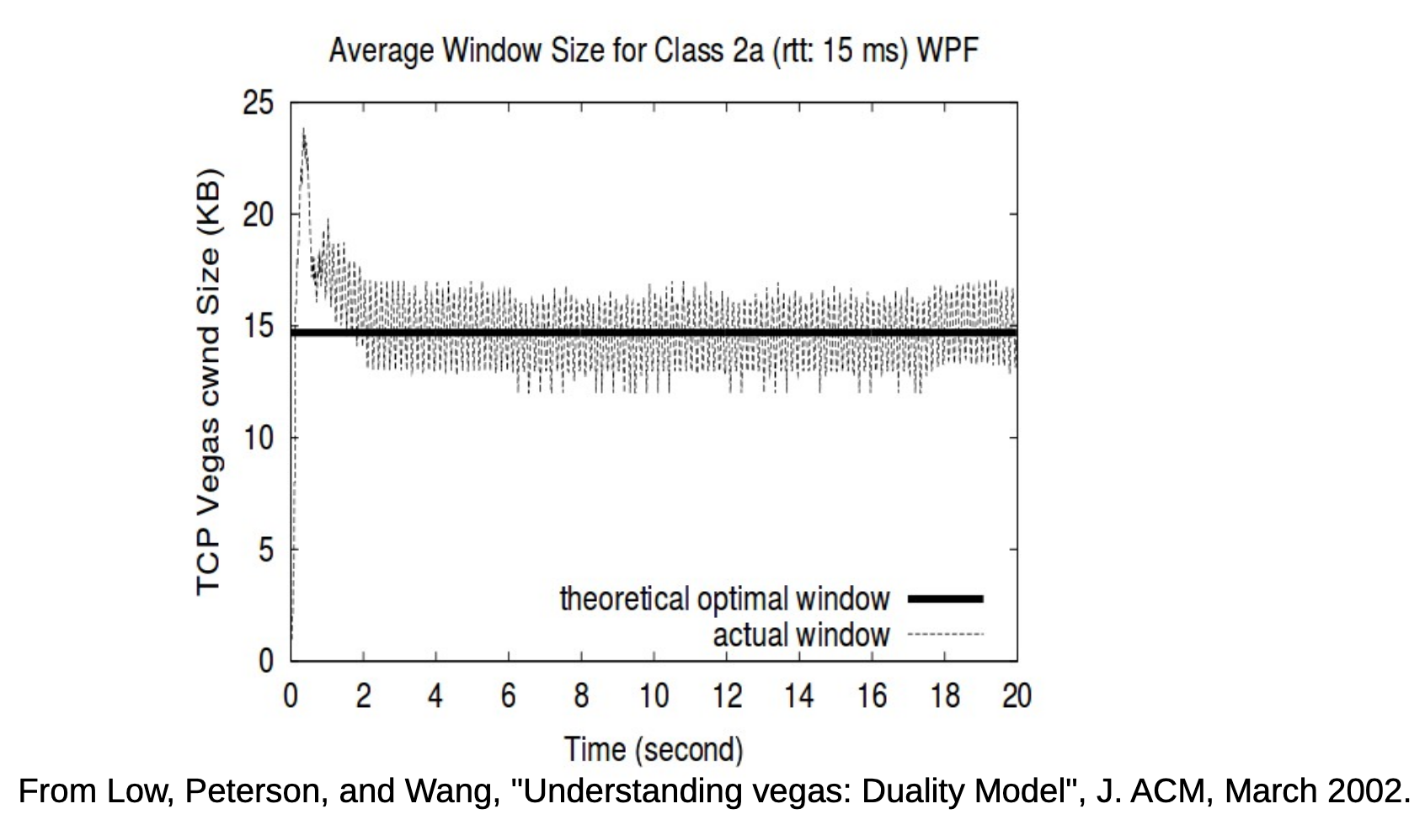
Congestion Avoidance: Changing Window

Slide 47
Summary: Network Layers
Link Layer (local network)
Send frames addressed to neighboring machines
Ethernet, Wi-Fi
Network layer (connecting local networks)
Forwarding between local networks
Send packets addressed to machines anywhere
IP
Transport Layer (making streams)
Turn sequence of packets into reliable byte stream
TCP

Slide 48
Summary: TCP
Use sequence numbers to solve out-of-order delivery problem
Use acknowledgements to solve reliable delivery problem
For better utilization, allow a window of unacknowledged packets
Adjust window size in response to perceived congestion events

Slide 49
IPv4 addressing: introduction
IP address: 32-bit identifier for host, router interface
interface: connection between host/router and physical link
router’s typically have multiple interfaces
host typically has one or two interfaces (e.g., wired Ethernet, wireless 802.11)
IP addresses associated with each interface
223.1.1.1
223.1.2.1
223.1.1.2
223.1.1.4
223.1.2.9
223.1.1.3
223.1.3.27
223.1.2.2
223.1.3.1
223.1.3.2
223.1.1.1 = 11011111 00000001 00000001 00000001
223
1
1
1

Slide 50
IPv4 addressing: CIDR
CIDR: Classless InterDomain Routing
subnet portion of address of arbitrary length
address format: a.b.c.d/x, where x is # bits in subnet portion of address
subnet
part
host
part
11001000 00010111 00010000 00000000
200.23.16.0/23

Slide 51
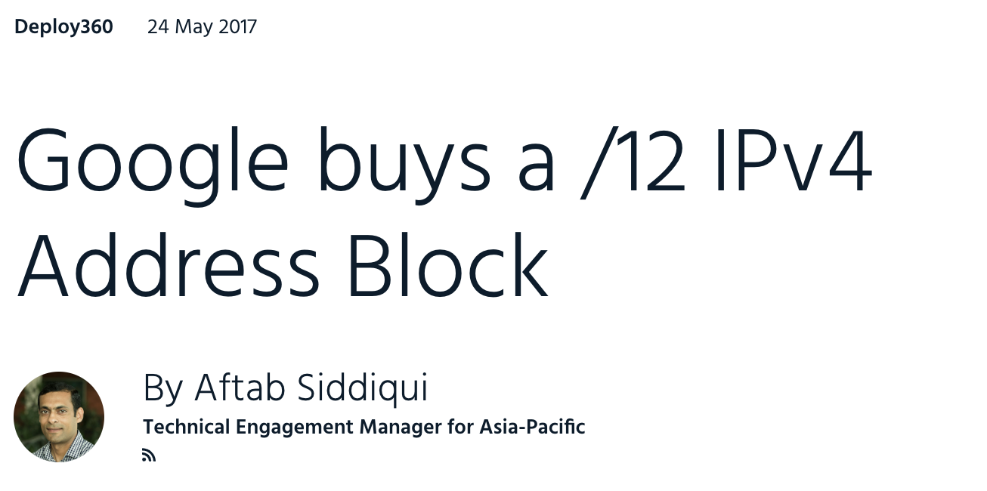
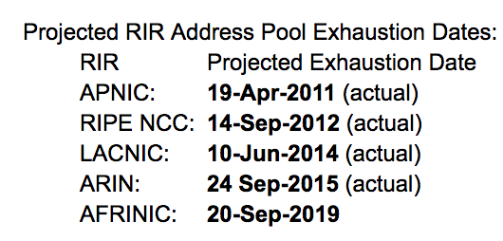
How many IPv4 addresses are left?
https://ipv4.potaroo.net
Available /8 address blocks

Slide 52
IPv6 datagram format
priority: identify priority among datagrams in flow
flow Label: identify datagrams in same “flow”.
(concept of “flow” not well defined).
next header: identify upper layer protocol for data
ver
pri
flow label
payload len
next hdr
hop limit
source address
(128 bits)
destination address
(128 bits)
data
32 bits

Slide 53
IPv6 Addresses
Similar to IPv4 addresses, but 128 bits
Example:
2601:5c2:300:c062:14a7:efa1:78b5:e8a
CIDR still applies:
2601:5c2:300:c062:14a7:efa1:78b5:e8a/64
Subnets are commonly 64 bits! A local network can support 2⁶⁴ devices.
No need for DHCP (although it still exists)
Devices can choose their own address (stateless autoconfiguration). Collisions are unlikely with 2⁶⁴ addresses.
Zero groups can be omitted:
2601:0000:0000:0000:0000:0000:0000:0008/16
2601::8/16
prefix

Slide 54
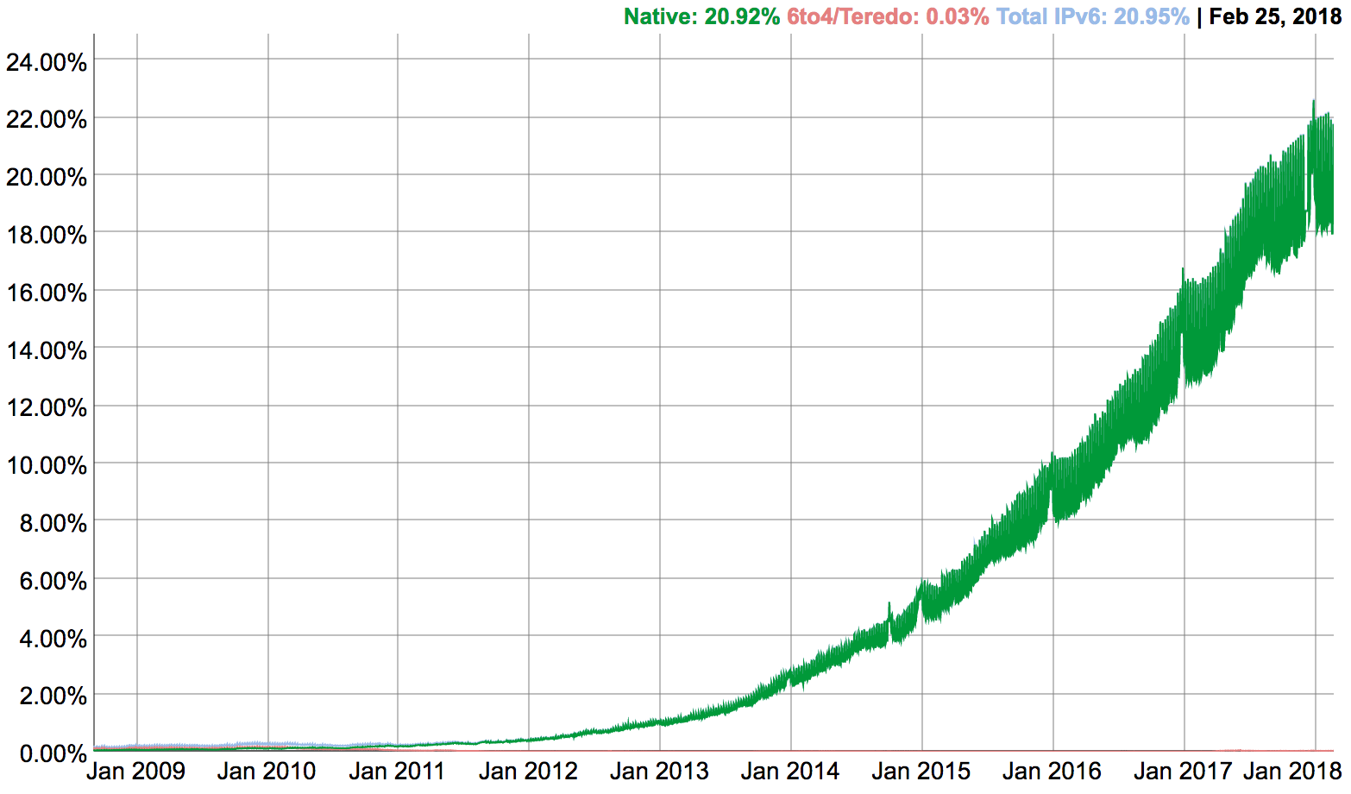
IPv6: adoption
Google: 25% of clients access services via IPv6 (Jan, 2019)
NIST: 1/3 of all US government domains are IPv6 capable
Long (long!) time for deployment, use
20 years and counting!
think of application-level changes in last 20 years: WWW, Facebook, streaming media, Skype, …
Why?

Slide 55
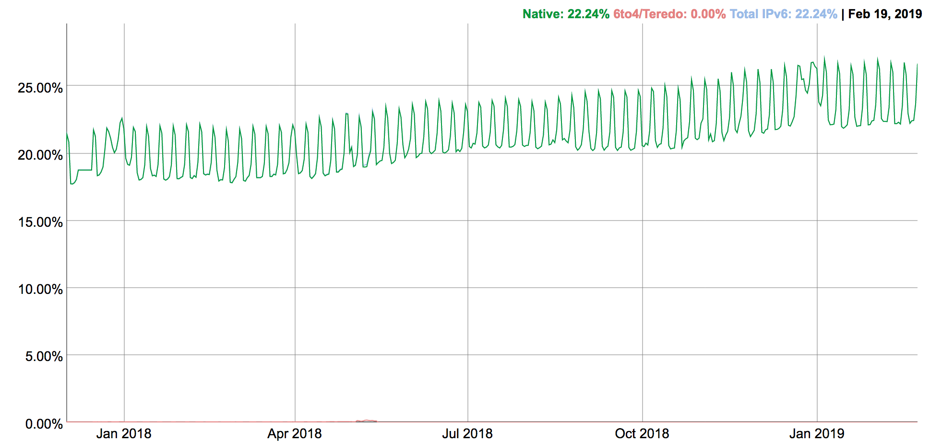
IPv6: adoption (2019 update)

Slide 56
IPv6 for IoT?
Reality: already 10s of billions of devices
IPv6 address space (2¹²⁸) would enable an IP address per device.
IoT devices could directly interact with the Internet, and use familiar protocols.
However, power and software complexity issues make it challenging to run full IPv6 stacks on IoT devices.
Security challenges?
Networking challenges?

Slide 57
NAT: network address translation
motivation: local network uses just one IP address as far as outside world is concerned:
range of addresses not needed from ISP: just one IP address for all devices
can change addresses of devices in local network without notifying outside world
can change ISP without changing addresses of devices in local network
devices inside local net not explicitly addressable, visible by outside world (a “security” plus)

Slide 58
NAT: network address translation
rest of
Internet
local network
(e.g., home network)
10.0.0/24
10.0.0.1
10.0.0.4
10.0.0.2
138.76.29.7
10.0.0.3
all datagrams leaving local
network have same single source NAT IP address: 138.76.29.7 but, different source port numbers
datagrams with source or
destination in this network
have 10.0.0/24 address for
source, destination (as usual)

Slide 59
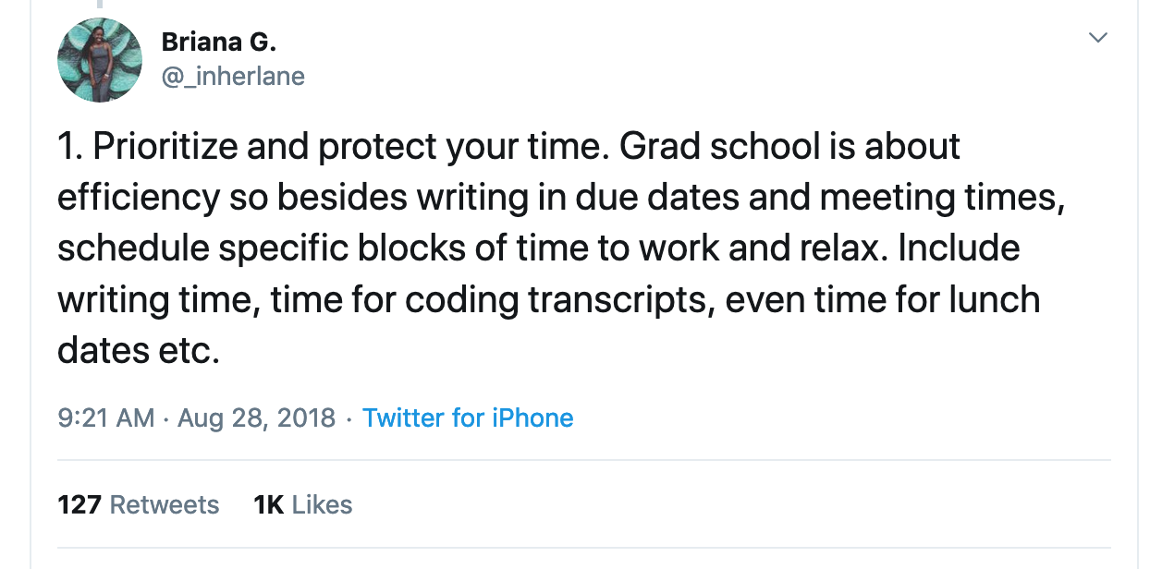
https://twitter.com/_inherlane/status/1034430721971118081

Slide 60

HTTP overview
HTTP: hypertext transfer protocol
Web’s application layer protocol
client/server model
client: browser that requests, receives, (using HTTP protocol) and “displays” Web objects
server: Web server sends (using HTTP protocol) objects in response to requests
HTTP request
PC running
Firefox browser
HTTP response
HTTP request
server
running
Apache Web
server
HTTP response
iphone running
Safari browser

Slide 61
HTTP overview (continued)
uses TCP:
client initiates TCP connection (creates socket) to server, port 80
server accepts TCP connection from client
HTTP messages (application-layer protocol messages) exchanged between browser (HTTP client) and Web server (HTTP server)
TCP connection closed
HTTP is “stateless”
server maintains no information about past client requests
aside
protocols that maintain “state” are complex!
past history (state) must be maintained
if server/client crashes, their views of “state” may be inconsistent, must be reconciled

Slide 62
Method types
HTTP/1.0:
GET
POST
HEAD
asks server to leave requested object out of response
HTTP/1.1:
GET, POST, HEAD
PUT
uploads file in entity body to path specified in URL field
DELETE
deletes file specified in the URL field

Slide 63
HTTP request message
two types of HTTP messages: request, response
HTTP request message:
ASCII (human-readable format)
carriage return character
request line
(GET, POST,
HEAD commands)
line-feed character
GET /index.html HTTP/1.1\r\n
Host: www.cs.virginia.edu\r\n
User-Agent: Firefox/3.6.10\r\n
Accept: text/html,application/xhtml+xml\r\n
Accept-Language: en-us,en;q=0.5\r\n
Accept-Encoding: gzip,deflate\r\n
Accept-Charset: ISO-8859-1,utf-8;q=0.7\r\n
Keep-Alive: 115\r\n
Connection: keep-alive\r\n
\r\n
header
lines
carriage return,
line feed at start
of line indicates
end of header lines

Slide 64
HTTP response message
status line
(protocol
status code
status phrase)
HTTP/1.1 200 OK\r\n
Date: Sun, 26 Sep 2010 20:09:20 GMT\r\n
Server: Apache/2.0.52 (CentOS)\r\n
Last-Modified: Tue, 30 Oct 2007 17:00:02 GMT\r\n
ETag: "17dc6-a5c-bf716880"\r\n
Accept-Ranges: bytes\r\n
Content-Length: 2652\r\n
Keep-Alive: timeout=10, max=100\r\n
Connection: Keep-Alive\r\n
Content-Type: text/html; charset=ISO-8859-1\r\n
\r\n
data data data data data ...
header
lines
data, e.g.,
requested
HTML file

Slide 65
HTTP response status codes
status code appears in 1st line in server-to-client response message.
some sample codes:
200 OK
request succeeded, requested object later in this msg
301 Moved Permanently
requested object moved, new location specified later in this msg (Location:)
400 Bad Request
request msg not understood by server
404 Not Found
requested document not found on this server
505 HTTP Version Not Supported

Slide 66
DNS: domain name system
people: many identifiers:
SSN, name, passport #
Internet hosts, routers:
IP address (32/128 bit) - used for addressing hosts and routers
“name”, e.g., www.yahoo.com - used by humans
Q: how to map between IP address and name, and vice versa?
Domain Name System:
distributed database implemented in hierarchy of many name servers
application-layer protocol: hosts, name servers communicate to resolve names (address/name translation)
note: core Internet function, implemented as application-layer protocol

Slide 67
DNS: services, structure
DNS services
hostname to IP address translation
host aliasing
canonical, alias names
mail server aliasing
load distribution
replicated Web servers: many IP addresses correspond to one name
why not centralize DNS?
single point of failure
traffic volume
distant centralized database
maintenance
A: doesn’t scale!

Slide 68
DNS: a distributed, hierarchical database
Root DNS Servers
…
…
com DNS servers
org DNS servers
edu DNS servers
yahoo.com
DNS servers
pbs.org
DNS servers
vatech.edu
DNS servers
virginia.edu
DNS servers
amazon.com
DNS servers
client wants IP for www.amazon.com; 1st approximation:
client queries root server to find .com DNS server
client queries .com DNS server to get amazon.com DNS server
client queries amazon.com DNS server to get IP address for www.amazon.com

Slide 69
DNS name resolution example
root DNS server
host at cs.virginia.edu wants IP address for cs.berkeley.edu
2
3
TLD DNS server
4
iterated query:
contacted server replies with name of server to contact
“I don’t know this name, but ask this server”
5
local DNS server
uvaarpa.virginia.edu
7
6
1
8
authoritative DNS server
ns.cs.berkeley.edu
requesting host
cs.virginia.edu
cs.berkeley.edu
(23.253.180.102)

Slide 70
DNS records
DNS: distributed db storing resource records (RR)
RR format: (name, value, type, ttl)
type=A
name is hostname
value is IP address
type=CNAME
name is alias name for some “canonical” (the real) name
www.ibm.com is really
servereast.backup2.ibm.com
value is canonical name
type=NS
name is domain (e.g., foo.com)
value is hostname of authoritative name server for this domain
type=MX
value is name of mailserver associated with name

Slide 71
DNS protocol, messages
query and reply messages, both with same message format
2 bytes
2 bytes
msg header
identification: 16 bit # for query, reply to query uses same #
flags:
query or reply
recursion desired
recursion available
reply is authoritative
identification
flags
# questions
# answer RRs
# authority RRs
# additional RRs
questions (variable # of questions)
answers (variable # of RRs)
authority (variable # of RRs)
additional info (variable # of RRs)

Slide 72
Puzzle: DNS True/False
A DNS name (e.g. microsoft.com) may be associated with multiple IP addresses, but each IP address can only be associated with a single DNS name.
False
DNS caching reduces the time to resolve an IP address and reduces DNS traffic on the internet.
True
If all root servers fail, no DNS names can be resolved to IP addresses.
False
If a record for a DNS name is updated, no clients will receive the old record after the change.
False

