Slide 1
CS6456: Graduate Operating Systems
Brad Campbell – bradjc@virginia.edu
https://www.cs.virginia.edu/~bjc8c/class/cs6456-f19/

Slide 2
File transfer example
Say you want to copy a file reliably across network
Requirement: Read of file on machine A should return same data as on machine B
One implementation
Copy file across network
Can verify by copying file, then re-reading and computing checksum (E.g., CRC or better yet SHA-1)
Another implementation
Build a perfectly reliable network
Build perfectly reliable routers
Build perfectly reliable disks, network cards, etc.
Build perfectly reliable Operating System

Slide 3
Example 1: Multics source code disaster
MIT had “reliable” network in multics era
Gateways used a checksum on each hop
Would catch any transmission errors
Programmers assumed network reliable
Since no transmission errors, file copy was simple. . .
Turned out one of the gateways was flaky
Exchanged a byte pair one in 10⁶ times it copied bytes
Corrupted vast quantities of multics source code
Required checking against source code printouts to fix!
So should have checked end-to-end anyway
Link-by-link checksums weren’t really useful

Slide 4
Example 2: ARPANET delivery guarantees
Original ARPANET sent one message at a time
Receiver responded with RFNM (request for next message)
Network won’t let you send next message until RFNM
Turns out not to be useful
Applications don’t care if message was received
Care if message was acted upon
E.g., Want to know mail message has been spooled, not just read from network
Had to send app.-level acknowledgments anyway
App.-level ack makes RFNM totally redundant

Slide 5
Example 3: Voting
Requirement: Vote counted should be vote intended by user
Okay in old-fashioned voting systems
User filled out paper ballot, checked contents
In worst case could look at ballots by hand
Failure 1 (Florida): Paper ballot not human readable
So users don’t notice hanging chads, etc.
Failure 2 (e-voting): Users have no idea what computer is doing, no paper record at all
Already evidence of serious flaws in voting machines
Voters would have no way of detecting this!

Slide 6
Takeaways
Instinctively we like modularity & clean interfaces
Which means putting functionality in low-level abstractions
Examples:
Reliable communication
In-order communication
Secure communication
But correct applications can’t really exploit this
So low-level functionality might be redundant
Or might be insufficient
Or might be harmful – E.g., sending real-time audio over a reliable, in-order delivery channel

Slide 7
End-to-End Principle
Implementing complex functionality in the network:
Doesn’t reduce host implementation complexity
Does increase network complexity
Probably imposes delay and overhead on all applications, even if they don’t need functionality
However, implementing in network can enhance performance in some cases
e.g., very lossy link

Slide 8
Conservative Interpretation of E2E
Don’t implement a function at the lower levels of the system unless it can be completely implemented at this level
Or: Unless you can relieve the burden from hosts, don’t bother

Slide 9
Moderate Interpretation
Think twice before implementing functionality in the network
If hosts can implement functionality correctly, implement it in a lower layer only as a performance enhancement
But do so only if it does not impose burden on applications that do not require that functionality
This is the interpretation we are using
Is this still valid?
What about Denial of Service?
What about privacy against intrusion?
Perhaps there are things that must be in the network?

Slide 10
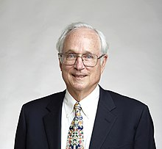
“Hints for Computer System Design” --- Butler Lampson, 1983
Based on author’s experience in systems design
Founding member of Xerox PARC (1970)
Currently Technical Fellow at MSR and adjunct prof. at MIT
Winner of ACM Turing Award (1992). IEEE Von Neumann Medal (2001)
Was involved in the design of many famous systems, including databases and networks

Slide 11
Butler’s “big” Principle
Identify basic building blocks
They should be useful, flexible
But minimal: Pare down until nothing can be removed
Then find the critical path
… and optimize the heck out of it!

Slide 12
Hints written in 1983
Have systems changed in ~35 years?

Slide 13
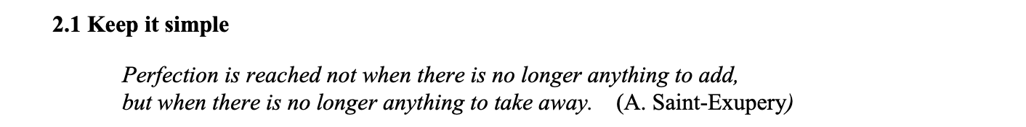
Functionality
Among other operations, there is a procedure FindNamedField that finds the field with a given name. One major commercial system for some time used a FindNamedField procedure that ran in time O(n²), where n is the length of the document.

Slide 14
Today
Small groups
Each group is either a “pro” or “con” group
Pro: Agree with Lampson
Con: Take a contrary viewpoint to Lampson
We will consider different “hints”
Groups work together to strategize arguments for their side
One person takes notes for the group
Then we discuss as a class
Everyone must take notes at least once
Submit to collab

Slide 15

Page 7
When a low level of abstraction allows something to be done quickly, higher levels should not bury this power inside something more general.

Slide 16

Page 8
As long as it is cheap to pass control back and forth, an interface can combine simplicity, flexibility and high performance by solving only one problem and leaving the rest to the client.

Slide 17

Page 9

Slide 18
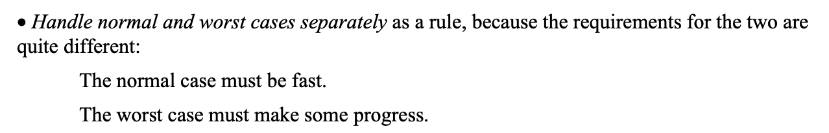
Page 12

Slide 19
Page 13

Slide 20

Page 18

Slide 21
Page 20

