Slide 1
CS6456: Graduate Operating Systems
Brad Campbell – bradjc@virginia.edu
https://www.cs.virginia.edu/~bjc8c/class/cs6456-f19/

Slide 2
Remote Procedure Call (RPC)
Raw messaging is a bit too low-level for programming
Must wrap up information into message at source
Must decide what to do with message at destination
May need to sit and wait for multiple messages to arrive
Another option: Remote Procedure Call (RPC)
Calls a procedure on a remote machine
Client calls: remoteFileSystem→Read("rutabaga");
Translated automatically into call on server: fileSys→Read("rutabaga");

Slide 3
RPC Implementation
Request-response message passing (under covers!)
“Stub” provides glue on client/server
Client stub is responsible for “marshalling” arguments and “unmarshalling” the return values
Server-side stub is responsible for “unmarshalling” arguments and “marshalling” the return values.
Marshalling involves (depending on system)
Converting values to a canonical form, serializing objects, copying arguments passed by reference, etc.

Slide 4
RPC Information Flow
bundle
args
Client
(caller)
call
Client
Stub
send
Packet
Handler
return
receive
unbundle
ret vals
mbox2
Machine A
Network
Network
Machine B
bundle
ret vals
mbox1
Server
(callee)
return
Server
Stub
send
Packet
Handler
call
receive
unbundle
args
Notes:
…so from the perspective of the calling code on the client, this just looks like a regular procedure call.

Slide 5
RPC Details
Equivalence with regular procedure call
Parameters ⇔ Request Message
Result ⇔ Reply message
Name of Procedure: Passed in request message
Return Address: mbox2 (client return mail box)
Stub generator: Compiler that generates stubs
Input: interface definitions in an “interface definition language (IDL)”
Contains, among other things, types of arguments/return
Output: stub code in the appropriate source language
Code for client to pack message, send it off, wait for result, unpack result and return to caller
Code for server to unpack message, call procedure, pack results, send them off
Notes:
…
- You might imagine that this stub code, to marshal arguments and make requests over the network, looks similar for many different remote function calls. We can actually generate it automatically, with a compiler!

Slide 6
RPC Details
Cross-platform issues:
What if client/server machines are different architectures/ languages?
Convert everything to/from some canonical form
Tag every item with an indication of how it is encoded (avoids unnecessary conversions)

Slide 7
Problems with RPC: Non-Atomic Failures
Different failure modes in dist. system than on a single machine
Consider many different types of failures
User-level bug causes address space to crash
Machine failure, kernel bug causes all processes on same machine to fail
Some machine is compromised by malicious party
Before RPC: whole system would crash/die
After RPC: One machine crashes/compromised while others keep working
Can easily result in inconsistent view of the world
Did my cached data get written back or not?
Did server do what I requested or not?

Slide 8
Problems with RPC: Performance
Cost of Procedure call « same-machine RPC « network RPC
Means programmers must be aware that RPC is not free
Caching can help, but may make failure handling complex

Slide 9
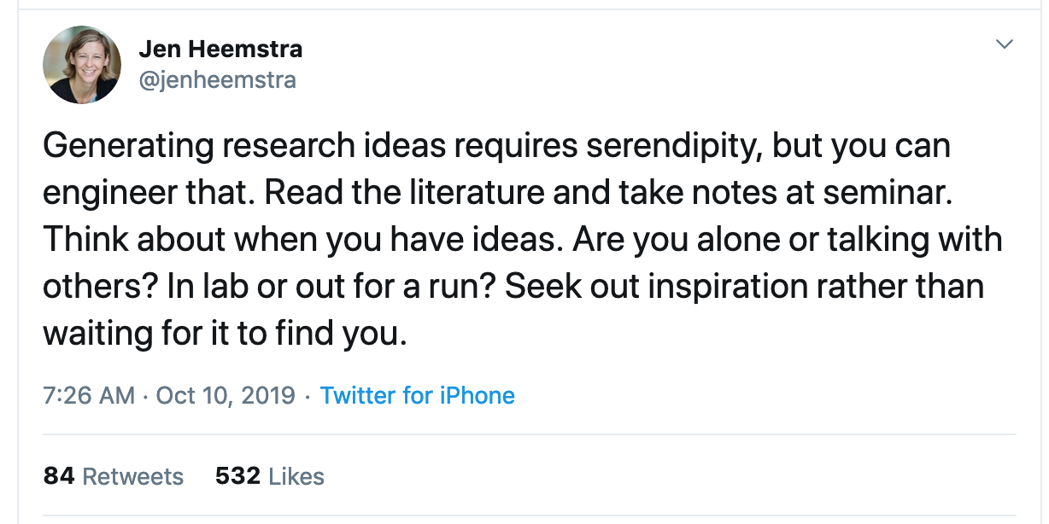

Slide 10
Important “ilities”
Availability: the ability of the system to accept and process requests
Durability: the ability of a system to recover data despite faults
Reliability: the ability of a system or component to perform its required functions under stated conditions for a specified period of time (IEEE definition)

Slide 11
One Approach: Geographic Replication
Highly durable: Hard to destroy all copies
Highly available for reads: Just talk to any copy
What about for writes? Need every copy online to update all together?
Replica/Frag #1
Replica/Frag #2
Replica/Frag #n

Slide 12
Centralized vs Distributed
Server
Client/Server Model
Peer-to-Peer Model
Centralized System: Major functions performed on one physical computer
Distributed System: Physically separate computers working together to perform a single task

Slide 13
Parallel vs Distributed
Distributed: different machines responsible for different parts of task
Usually no centralized state
Usually about different responsibilities or redundancy
Parallel: different parts of same task performed on different machines
Usually about performance

Slide 14
Distributed: Why?
Simple, cheaper components
Easy to add capability incrementally
Let multiple users cooperate (maybe)
Physical components owned by different users
Enable collaboration between diverse users

Slide 15

The Promise of Dist. Systems
Availability: One machine goes down, overall system stays up
Durability: One machine loses data, but system does not lose anything
Security: Easier to secure each component of the system individually?

Slide 16
Distributed: Worst-Case Reality
Availability: Failure in one machine brings down entire system
Durability: Any machine can lose your data
Security: More components means more points of attack

Slide 17
Distributed Systems Goal
Transparency: Hide "distributed-ness" from any external observer, make system simpler
Types
Location: Location of resources is invisible
Migration: Resources can move without user knowing
Replication: Invisible extra copies of resources (for reliability, performance)
Parallelism: Job split into multiple pieces, but looks like a single task
Fault Tolerance: Components fail without users knowing

Slide 18
Challenge of Coordination
Components communicate over the network
Send messages between machines
Need to use messages to agree on system state
This issue does not exist in a centralized system

Slide 19
CAP Theorem
Originally proposed by Eric Brewer (Berkeley)
Consistency – changes appear to everyone in same sequential order
Availability – can get a result at any time
Partition Tolerance – system continues to work even when one part of network can't communicate with the other
Impossible to achieve all 3 at the same time (pick two)

Slide 20
CAP Theorem Example
What do we do if a network partition occurs?
Prefer Availability: Allow the state at some nodes to disagree with the state at other nodes (AP)
Prefer Consistency: Reject requests until the partition is resolved (CP)
Partition B
Partition A

Slide 21
Consistency Preferred
Block writes until all nodes able to agree
Consistent: Reads never return wrong values
Not Available: Writes block until partition is resolved and unanimous approval is possible

Slide 22
What about AP Systems?
Partition occurs, but both groups of nodes continue to accept requests
Consequence: State might diverge between the two groups (e.g., different updates are executed)
When communication is restored, there needs to be an explicit recovery process
Resolve conflicting updates so everyone agrees on system state once again

Slide 23
General’s Paradox
Two generals located on opposite sides of their enemy’s position
Can only communicate via messengers
Messengers go through enemy territory: might be captured
Problem: Need to coordinate time of attack
Two generals lose unless they attack at same time
If they attack at same time, they win

Slide 24
General’s Paradox
Can messages over an unreliable network be used to guarantee two entities do something simultaneously?
No, even if all messages go through
11 am ok?
General 1
Yes, 11 works
General 2
So, 11 it is?
Yeah, but what if you
Don’t get this ack?

Slide 25
Two-Phase Commit
We can’t solve the General’s Paradox
No simultaneous action
But we can solve a related problem
Distributed Transaction: Two (or more) machines agree to do something or not do it atomically
Extra tool: Persistent Log
If machine fails, it will remember what happened
Assume log itself can’t be corrupted

Slide 26
Two-Phase Commit: Setup
One machine (coordinator) initiates the protocol
It asks every machine to vote on transaction
Two possible votes:
Commit
Abort
Commit transaction only if unanimous approval

Slide 27
Two-Phase Commit: Preparing
Agree to Commit
Machine has guaranteed that it will accept transaction
Must be recorded in log so machine will remember this decision if it fails and restarts
Agree to Abort
Machine has guaranteed that it will never accept this transaction
Must be recorded in log so machine will remember this decision if it fails and restarts

Slide 28
Two-Phase Commit: Finishing
Commit Transaction
Coordinator learns all machines have agreed to commit
Apply transaction, inform voters
Record decision in local log
Abort Transaction
Coordinator learns at least on machine has voted to abort
Do not apply transaction, inform voters
Record decision in local log

Slide 29
Formalizing Two-Phase Commit
N workers (replicas): actually perform transaction
One coordinator (may also serve a worker)
Asks each worker to vote on transaction
Tells every machine result of the vote (workers don’t need to ask each other)

Slide 30
Messages in Two-Phase Commit
Coordinator → Worker
VOTE-REQ
Worker → Coordinator
VOTE-COMMIT
VOTE-ABORT
Coordinator → Worker
GLOBAL-COMMIT
GLOBAL-ABORT

Slide 31
Messages in Two-Phase Commit
Coordinator → Worker
VOTE-REQ
Worker → Coordinator
VOTE-COMMIT
VOTE-ABORT
Coordinator → Worker
GLOBAL-COMMIT
GLOBAL-ABORT
No taking back: always logged before sending
Actual result of transaction attempt

Slide 32
Detailed Algorithm
Coordinator Algorithm
Worker Algorithm
Coordinator sends VOTE-REQ to all workers
Wait for VOTE-REQ from coordinator
If ready, send VOTE-COMMIT to coordinator
If not ready, send VOTE-ABORT to coordinator
And immediately abort
If receive VOTE-COMMIT from all N workers, send GLOBAL-COMMIT to all workers
If doesn’t receive VOTE-COMMIT from all N workers, send GLOBAL-ABORT to all workers
If receive GLOBAL-COMMIT then commit
If receive GLOBAL-ABORT then abort

Slide 33
Example: Failure-Free 2PC
coordinator
VOTE-REQ
GLOBAL-COMMIT
worker 1
worker 2
VOTE-COMMIT
worker 3
time

Slide 34
Example: Failure-Free 2PC
coordinator
VOTE-REQ
VOTE-ABORT
GLOBAL-ABORT
worker 1
worker 2
VOTE-COMMIT
worker 3
time

Slide 35
Example of Worker Failure
INIT
WAIT
coordinator
ABORT
COMM
timeout
GLOBAL-ABORT
VOTE-REQ
worker 1
VOTE-COMMIT
worker 2
worker 3
time

Slide 36
Example of Coordinator Failure (1)
INIT
READY
coordinator
ABORT
COMM
VOTE-REQ
timeout
worker 1
VOTE-ABORT
worker 2
timeout
timeout
worker 3

Slide 37
Example of Coordinator Failure
INIT
READY
ABORT
COMM
coordinator
restarted
VOTE-REQ
worker 1
VOTE-COMMIT
GLOBAL-ABORT
worker 2
block waiting for coordinator
worker 3

Slide 38
Failure Recovery
Nodes need to know what state they are in when they come back from a failure
How? Log events on local hard disk
Then we have the following recovery rules:
Coordinator aborts transaction if it was in the INIT, WAIT, or ABORT states
Coordinator commits transaction if it was in COMMIT
Worker aborts if in INIT or ABORT states
Worker commits if it was in COMMIT state
Worker asks coordinator what to do if in READY state

Slide 39
Blocking for Coordinator to Recover
A worker waiting for global decision can ask fellow workers about their state
If another worker is in ABORT or COMMIT state then coordinator must have sent GLOBAL-*
Thus, worker can safely abort or commit, respectively
If another worker is still in INIT state then both workers can decide to abort
If all workers are in ready, need to BLOCK (don’t know if coordinator wanted to abort or commit)
INIT
Recv: VOTE-REQ
Send: VOTE-ABORT
Recv: VOTE-REQ
Send: VOTE-COMMIT
READY
Recv: GLOBAL-ABORT
Recv: GLOBAL-COMMIT
ABORT
COMMIT

Slide 40
Blocking
What if both coordinator and a worker fail?
The remaining workers can still consult each other
But they can’t reach a conclusion on what to do!
Why?
If all workers in INIT, we still don’t know state of failed worker w
w may have been first to be notified of a commit, and then coordinator and w crashed

Slide 41
Blocking for Coordinator
What if both coordinator and a worker fail?
The remaining workers can still consult each other
But they can’t reach a conclusion on what to do!
This problem motivated Three Phase Commit

Slide 42
Paxos: fault tolerant agreement
Paxos lets all nodes agree on the same value despite node failures, network failures and delays
High-level process:
One (or more) node decides to be the leader
Leader proposes a value and solicits acceptance from others
Leader announces result or try again

Slide 43
Google Spanner
James C. Corbett, Jeffrey Dean, Michael Epstein, Andrew Fikes, Christopher Frost, J. J. Furman, Sanjay Ghemawat, Andrey Gubarev, Christopher Heiser, Peter Hochschild, Wilson Hsieh, Sebastian Kanthak, Eugene Kogan, Hongyi Li, Alexander Lloyd, Sergey Melnik, David Mwaura, David Nagle, Sean Quinlan, Rajesh Rao, Lindsay Rolig, Yasushi Saito, Michal Szymaniak, Christopher Taylor, Ruth Wang, and Dale Woodford. 2012. Spanner: Google's globally-distributed database. In Proceedings of the 10th USENIX conference on Operating Systems Design and Implementation (OSDI'12). USENIX Association, Berkeley, CA, USA, 251-264.

Slide 44
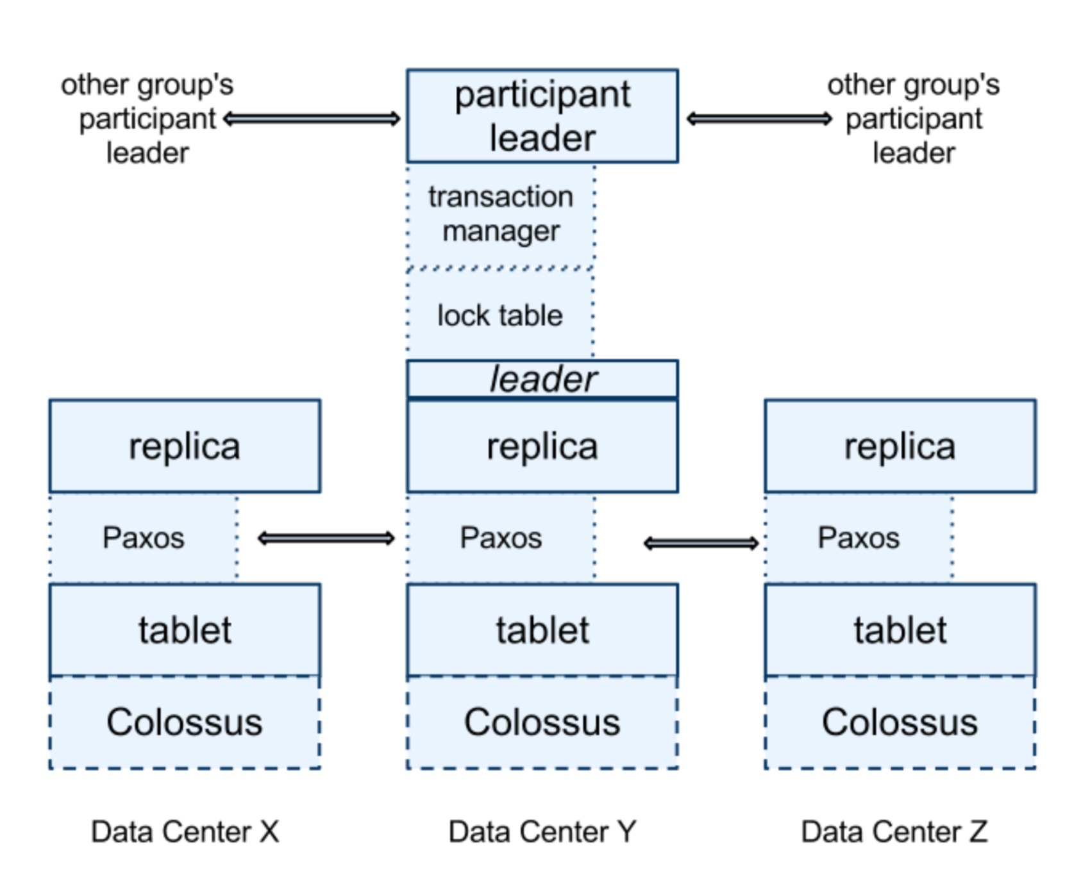
Basic Spanner Operation
Data replicated across datacenters
Paxos groups support transactions
On commit:
Grab Paxos lock
Paxos algorithm decides consensus
If all agree, transaction is committeed

Slide 45
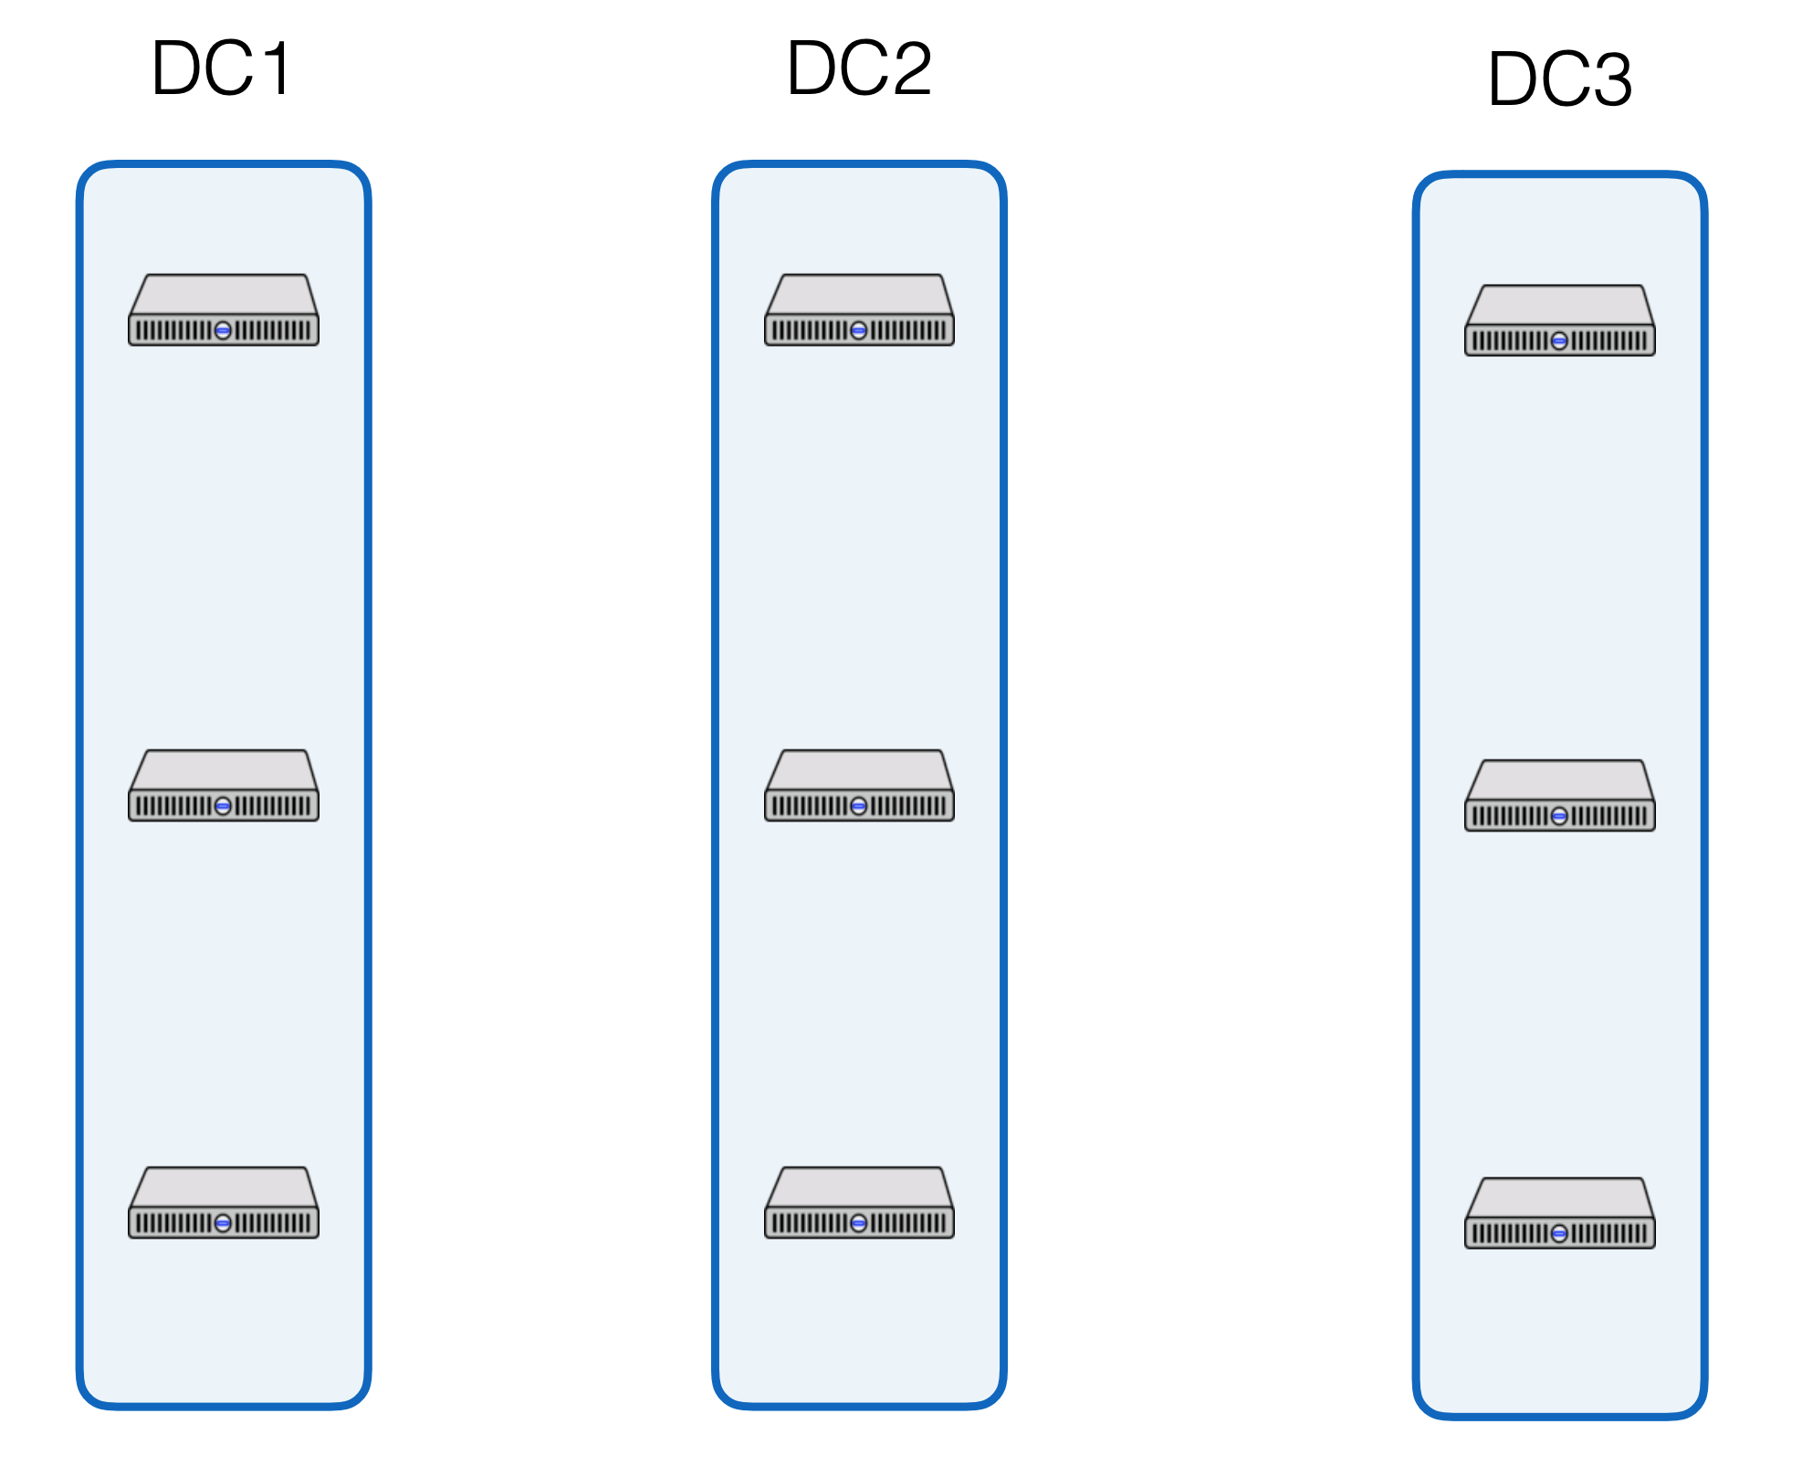
Spanner Operation
Paxos
Paxos
2PC

Slide 46
Base operation great for writes…
What about reads?
Reads are dominant operations
e.g., FB’s TAO had 500 reads : 1 write [ATC 2013]
e.g., Google Ads (F1) on Spanner from 1? DC in 24h: 21.5B reads 31.2M single-shard transactions 32.1M multi-shard transactions
Want efficient read transactions

Slide 47
Make Read-Only Txns Efficient
Ideal: Read-only transactions that are non-blocking
Arrive at shard, read data, send data back
Goal 1: Lock-free read-only transactions
Goal 2: Non-blocking stale read-only txns

Slide 48
TrueTime
“Global wall-clock time” with bounded uncertainty
ε is worst-case clock divergence
Timestamps become intervals, not single values
TT.now()
time
earliest
latest
2*ε
Consider event e_{now} which invoked tt = TT.now():
Guarantee: tt.earliest <= t_{abs}(e_{now}) <= tt.latest

Slide 49
Timestamps and TrueTime
Acquired locks
Release locks
T
Pick s > TT.now().latest
s
Wait until TT.now().earliest > s
Commit wait
average ε
average ε
Key: Need to ensure that all future transactions will get a higher timestamp
Commit wait ensures this
Notes:
Pick s > TT.now().latest ensures s, the commit time, is > the start time of the transaction (just like read-only transactions)
Commit wait, until TT.now().earliest > s, ensures that s is < the end time of the transaction
(DRAW NEXT PART OUT ON BOARD)
Now a read-only transaction that starts after a transactions end will definitely see it, without locks!:
txn_end < read_begin (definition)
read_begin < s_read (picking of s_read)
s_txn < txn_end (commit wait)
=> s_txn < s_read, read_only transaction will see all required transactions, without locks!!

Slide 50
Commit Wait and Replication
Start
consensus
Achieve
consensus
Notify
followers
Acquired locks
Release locks
T
Pick s
Commit wait done

Slide 51
Read-only optimizations
Given global timestamp, can implement read-only transactions lock-free (snapshot isolation)
Step 1: Choose timestamp s_{read} = TT.now.latest()
Step 2: Snapshot read (at s_{read})
Can be served by any up-to-date replica

Slide 52
TrueTime for Read-Only Txns
Assign all transactions a wall-clock commit time (s)
All replicas of all shards track how up-to-date they are with t_{safe}: all transactions with s < t_{safe} have committed on this machine
Goal 1: Lock-free read-only transactions
Current time ≤ TT.now.latest()
s_{read} = TT.now.latest()
wait until s_{read} < t_{safe}
Read data as of s_{read}
Goal 2: Non-blocking stale read-only txns
Similar to above, except explicitly choose time in the past
(Trades away consistency for better perf, e.g., lower latency)

Slide 53
Commit wait
What does this mean for performance?
Larger TrueTime uncertainty bound
longer commit wait
Longer commit wait
locks held longer
can’t process conflicting transactions
lower throughput
i.e., if time is less certain, Spanner is slower!

Slide 54
Question
If you notice unacceptable performance using Spanner, how could you improve it?

