Slide 1
CS6456: Graduate Operating Systems
Brad Campbell – bradjc@virginia.edu
https://www.cs.virginia.edu/~bjc8c/class/cs6456-s20/

Slide 2
Embedded OS: Three Key Requirements
Sharing Resources
Fixed HW capabilities, diverse software
Abstractions → overhead
Shared state?
Memory <--> HW tradeoff
Memory ownership
Making the most of limited RAM, storage, energy
Cost of safety
Handling Concurrency
Managing Limited Resources
Need concurrency
Handling interrupts, multiple software components

Slide 3
Embedded hardware characteristics
Resource constrained
10s KB RAM
100s KB flash
50-100 MHz CPU
Limited energy
Hardware
Single core
No MMU
Heavily relies on interrupts
Deployment
Unattended operation
Many separate operations

Slide 4
This week
How do OSes differ on resource constrained devices deployed in the physical world?
Challenges
Limited HW capability, time, energy
Limited space to store OS code
No virtual memory
No user monitor
Opportunities
Simpler hardware
Fixed tasks?
Relaxed latency requirements?

Slide 5
Embedded General Purpose OS Exploration
Two embedded operating systems
TinyOS
Tock
Three questions
How do they enable resource sharing?
How do they manage concurrency?
How do they manage limited resources?

Slide 6
TinyOS

Slide 7
TinyOS solution
Support concurrency
event-driven architecture
Software modularity
application = scheduler + graph of components
A component contains commands, event handlers, internal storage, tasks
nesC language to facilitate this
Efficiency: get done quickly and then sleep
Static memory allocation

Slide 8
TinyOS computational concepts
Events
Time critical
Caused by interrupts (Timer, ADC, Sensors)
Short duration
Commands
Request to a component to perform service (e.g, start sensor reading)
Non-blocking, need to return status
Postpone time-consuming work by posting a task (split phase w/ callback event)
Can call lower-level commands
Tasks
Time flexible (delayed processing)
Run sequentially by TOS Scheduler
Run to completion with respect to other tasks
Can be preempted by events

Slide 9
TinyOS Execution Model

Slide 10
Concurrency
Two threads of execution
Tasks
deferred execution
tasks cannot preempt other tasks
Hardware event handler: respond to interrupts
Interrupts can preempt tasks
Scheduler
Two level scheduling
interrupts (vector) and tasks (queue)
Task queue is FIFO
Scheduler puts processor to sleep when no event/command is running and task queue is empty

Slide 11
TinyOS Execution Model (revisited)

Slide 12
TinyOS Theory of Execution: Events & Tasks
Consequences of an event
Runs to completion
Preempt tasks
What can an event do?
signal events
call commands
post tasks
Consequences of a task
No preemption mechanism
Keep code as small execution pieces to not block other tasks too long
To run a long operations, create a separate task for each operation, rather than using on big task
What can initiate (post) tasks?
Command, event, or another task

Slide 13
Interface : provides & uses
Provides: Exposes functionality to others
Uses: Requires another component
Interface provider must implement commands
Interface user must implement events
Commands
Events
Event
Commands
Provides
Interface_A
Interface_B
configuration|module
Functions
Frame
Uses
Interface_C
Command
Event

Slide 14
Applications consist of components “wired” together
Application: graph of components
Main component
init, start, stop
first component executed
Other components
Components
modules
configurations
Interfaces: point of access to components
uses
provides
Application
Component D
Component
A
Component
C
Component
B
Component F
Component
E
configuration

Slide 15
Example: Blink Configuration
configuration Blink {
}
implementation {
components Main, BlinkM, SingleTimer, LedsC;
Main.StdControl -> SingleTimer.StdControl;
Main.StdControl -> BlinkM.StdControl;
BlinkM.Timer -> SingleTimer.Timer;
BlinkM.Leds -> LedsC;
}

Slide 16
Example: Blink Module
module BlinkM {
provides {
interface StdControl;
}
uses {
interface Timer;
interface Leds;
}
}
implementation {
command result_t StdControl.init() {
call Leds.init();
return SUCCESS;
}
command result_t StdControl.start() {
// Start a repeating timer that fires every 1000ms
return call Timer.start(TIMER_REPEAT, 1000);
}
command result_t StdControl.stop() {
return call Timer.stop();
}
event result_t Timer.fired() {
call Leds.yellowToggle();
return SUCCESS;
}
}

Slide 17
TinyOS Compilation
Number of resource uses known at compile time
Memory statically allocated
All TinyOS files merged into one .c file
Existing C compilers then just have to compile one file
More optimization possibilities

Slide 18
TinyOS summary
Component-based architecture
Provides reusable components
Application: graph of components connected by “wiring”
Three computational concepts
Event, command, task
Tasks and event-based concurrency
Tasks: deferred computation, run to completion and do not preempt each other
Tasks should be short, and used when timing is not strict
Events: run to completion, may preempt tasks
Events signify completion of a (split-phase) operation or events from the environment (e.g., hardware, receiving messages)
Today
Not too much active development
NesC too much overhead
Hardware has improved

Slide 19
Contiki

Slide 20
Events vs. Threads
An old debate!
Why events?
Why threads?
Contiki chooses threads

Slide 21
Protothreads
Programmers get a thread-like interface
Only one stack shared among all protothreads
Protothreads run until they either:
Block
Execution state is saved
Scheduler is invoked
Exit
Implemented in C
Hack using C macros

Slide 22
Hello World in Contiki
#include "contiki.h"
#include <stdio.h> /* For printf() */
PROCESS(hello_world_process, "Hello world process");
AUTOSTART_PROCESSES(&hello_world_process);
PROCESS_THREAD(hello_world_process, ev, data)
{
PROCESS_BEGIN(&wait); printf("Hello, world\n");
PROCESS_YIELD(&wait);
printf("Hello, world again\n");
PROCESS_END();
}

Slide 23
Ad-hoc software libraries
Impressive implementation of embedded software
Networking
IP and IPv6 stacks
MAC layers
TCP and UDP
CoAP
Software
FTP, HTTP, MQTT
Many sensor drivers
Tradeoff:
Integration is more difficult

Slide 24
Interfaces exist through function pointers
 | /*
 | * The structure of a network driver in Contiki.
 | */
 | struct network_driver {
 | char *name;
 | /** Initialize the network driver */
 | void (* init)(void);
 | /** Callback for getting notified of incoming packet. */
 | void (* input)(void);
 | };

Slide 25
Contiki
Accessible as it is written in C
https://github.com/contiki-os/contiki
Pretty much a ghost town these days
Fork: https://github.com/contiki-ng/contiki-ng
Opportunity to prune old cruft

Slide 26
Today
Three embedded operating systems
TinyOS
Contiki
Tock
Three questions
How do they enable resource sharing?
How do they manage concurrency?
How do they manage limited resources?

Slide 27


Slide 28
Tock

Slide 29
Tock: Embedded Devices are Multiprogrammed
Multiple users running applications concurrently
Applications updated dynamically
Small payloads better
Buggy updates shouldn’t brick devices
Security sensitive devices want least privilege

Slide 30

Syscall interface allows kernel to manage application access to resources
Processes
(Any Language)
C App Ported to Tock
App written in Rust
[Service] BLE Environmental Sensing Profile
while(1)
😈
Untrusted
(isolated by the MPU and preemptively scheduled)
Syscall Interface
libtock
libtock-rs
libtock
libnrf
Kernel (Rust)
yield, memop, IPC
Thread
Virt. Timer
BLE
Temp. Sensor
Untrusted
(unsafe forbidden)
Capsules
6LoWPAN
SD Card
Console
SI7021
Core Kernel
Scheduler, Process management, etc.
Standardized Hardware Interface Layer (HIL)
Trusted
(unsafe allowed for MMIO, PIC, etc.)
Microcontroller-specific Peripheral Drivers
SPI
RNG
Timer
ADC
GPIO
I2C
UART
AES
DAC
USB
Hardware
CPU
SPI
RNG
Timer
ADC
GPIO
I2C
UART
AES
DAC
USB

Slide 31
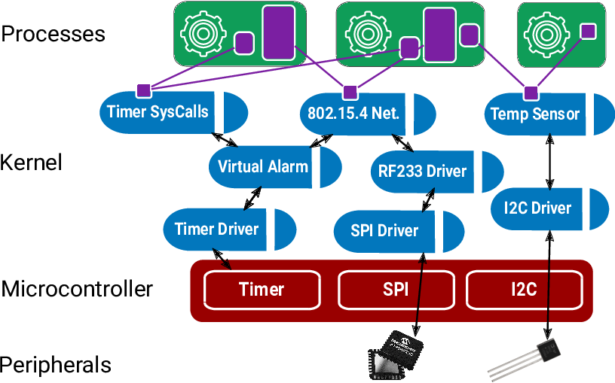
Different isolation primitives for an embedded OS
Processes: Use the Memory Protection Unit
Capsules: Type-safe Rust API for safe driver development
Grants: Bind dynamic kernel resources to process lifetime

Slide 32
Tock’s Isolation Mechanisms
Processes
Standalone executable in any language
Isolation enforced at runtime
Higher overhead
Applications
Time sliced
Totally untrusted
Capsules
Rust code linked into kernel
Isolation enforced at compile-time
Lower overhead
Used for device drivers, protocols, timers...
Cooperatively scheduled
Trusted for liveness, not safety

Slide 33
Multiple capsules enable resource sharing
Syscall Interface
UDP
Temperature
RF233
SI7021
Virtual SPI
SPI

Slide 34
Multiple applications presents a new challenge: resource exhaustion
How many userland processes will there be?
or
How much memory should we allocate for them?
Or, should we do dynamic memory allocation?

Slide 35
The kernel and processes have separate memory allocations. A kernel that allows allocations would have a heap, as shown.
Kernel
RAM
Allocation
Process
RAM
Allocation
Heap
Heap
Process
Accessible
Memory
Data
Data
Stack
Stack
Flash
Code
Flash
Code

Slide 36
Tock supports multiple applications, each with their own memory allocations.
Kernel
RAM
Allocation
Heap
Heap
Heap
Data
Data
Data
Stack
Stack
Stack
Flash
Code
Code
Code

Slide 37
Apps are allowed to use their memory region as they see fit. For example, one app may need more heap space, another may need more stack space.
Heap
Kernel
RAM
Allocation
Heap
Heap
Data
Data
Data
Stack
Stack
Stack
Flash
Code
Code
Code

Slide 38
If one app exhausts its memory space, for example by making its heap too large, it will fault and the kernel can terminate just that app.
Heap
Heap
Kernel
RAM
Allocation
Heap
Data
Data
Data
Stack
Stack
Stack
Flash
Code
Code
Code

Slide 39
However, what happens when the app requests services from the kernel? For example, if process #1 wants the kernel to schedule a timer for it, the kernel must allocate state for that.
Kernel
RAM
Allocation
Heap
P1 timer allocation
Heap
Heap
Data
Data
Data
Stack
Stack
Stack
Flash
Code
Code
Code

Slide 40
Allocating state for app requests in kernel memory works for a little while…
Heap
P1 allocation
P2 allocation
Kernel
RAM
Allocation
Heap
Heap
Data
Data
Data
Stack
Stack
Stack
Flash
Code
Code
Code

Slide 41
But what happens when the kernel no longer has room for all of the requests? What is the kernel’s recourse? Reboot and hope it doesn’t happen again?
Heap
P1 allocation
P2 allocation
P2 allocation
P2 allocation
P2 allocation
P2 allocation
Kernel
RAM
Allocation
Heap
Heap
Data
Data
Data
Stack
Stack
Stack
Flash
Code
Code
Code

Slide 42
To address this, Tock introduces grants, which are regions of application memory space that the kernel uses to store the app-specific kernel state. The grant region is not accessible to the process, and the kernel does not support dynamic memory allocation.
Kernel
Accessible
Memory
Data
Grant section
Stack
Kernel
RAM
Allocation
Process
RAM
Allocation
Heap
Process
Accessible
Memory
Data
Stack
Flash
Code
Flash
Code

Slide 43
As processes want to use kernel resources, the state for those resources is allocated from the grant region in each process.
Data
Grant section
Timer1 allocation
BLE allocation
Grant section
Timer1 allocation
Timer2 allocation
Stack
Kernel
RAM
Allocation
Heap
Heap
Data
Data
Stack
Stack
Flash
Code
Code
Code

Slide 44
If one process requests too many resources, its grant section will exhaust its available memory, and the kernel can safely terminate just that process.
Data
Grant section
Timer1 allocation
BLE allocation
Grant section
Timer1 allocation
Timer2 allocation
Timer3 allocation
Timer4 allocation
Timer5 allocation
Stack
Kernel
RAM
Allocation
Heap
Heap
Data
Data
Stack
Stack
Flash
Code
Code
Code

Slide 45
The Rust type system and closures prevents using the grant region of terminated processes.
fn enter<'a, F>(&'a self, pid: ProcId, f: F) → where
F: for<'b> FnOnce(&'b mut T)
// Can’t operate on timer data here
timer_grant.enter(process_id, |timer| {
// Can operate on timer data here
if timer.expiration > cur_time {
timer.fired = true;
}
});
// timer data can’t escape here

Slide 46
Tock
Pushing towards a general purpose OS on embedded HW
“Users” not statically known at compile time
Grants enable dynamic memory without crashing the kernel

Slide 47
Today
Three embedded operating systems
TinyOS
Contiki
Tock
Three questions
How do they enable resource sharing?
How do they manage concurrency?
How do they manage limited resources?

Slide 48
Real Time OS

Slide 49
What does “Real Time” mean?
In computing broadly
Real time = the time measured by a physical clock
Real time operation generally means the execution keeps up with the pace of events
A speech or video sample of 1 second, if processed in 1 second or in less
In real time systems
Task execution meets specific deadlines

Slide 50
Real Time Operating System
Real Time Tasks
Process control in industrial plants
Robotics
Air Traffic control
Telecommunications
Weapon guidance system e.g. Guided missiles
Medical diagnostic and life support system
Automatic engine control system
Real time data base
Mars Rovers
Curiosity : OS – VxWorks, Processor BEA’s RAD 750

Slide 51
Terms and definitions
Release time (or ready time): This is the time instant at which a task(process) is ready or eligible for execution
Schedule Time: This is the time instant when a task gets its chance to execute
Completion time: This is the time instant when task completes its execution
Deadline: This is the instant of time by which the execution of task should be completed
Runtime: The time taken without interruption to complete the task, after the task is released

Slide 52
Terms and Definitions
Tardiness: Specifies the amount of time by which a task misses its deadline. Its is equal to the difference between completion time and deadline
Laxity: Is defined as deadline minus remaining computation time. The laxity of task is the maximum amount of time it can wait and still meets its deadline

Slide 53
Soft and Hard Real Time tasks
Hard real time task:
Task must complete before or at deadline.
Value of completing the task after deadline is zero.
Software real time
Missing deadline incurs a penalty
Penalty increases as tardiness increases

Slide 54
Examples
Types of Real Time Tasks
Hard Real-time task
Air traffic control
Vehicle subsystems control
Nuclear power plant control
Soft Real-time Task
Multimedia transmission and reception
Networking, telecom (cellular) networks
Web sites and services
Computer games.
Firm Real Task
Periodic Task
Aperiodic Task
Sporadic Task
Preemptible/Non-Preemptible Tasks

Slide 55
Scheduling concerns
Scheduling constraints for real time operating systems:
Number of tasks
Resource Requirements
Release Time
Execution time
Deadlines
Period
Simplifying assumption: execution time and deadline known, tasks execute at fixed intervals
Goal: determine a schedule where all tasks meet their deadlines

Slide 56
Off Line Scheduling (Pre runtime scheduling)
Generate scheduling information prior to system execution (Deterministic System Model)
This scheduling is based on:
Release time
Deadlines
Execution
Disadvantage: Inflexibility, if any parameter changes, the policy will have to be recomputed
Real Time Scheduling
Off-line
On-line
Static Priority
Dynamic Priority
Pre-emptive
Non Pre-emptive
Planning Based
Best Effort

Slide 57
On-Line Scheduling
Number and types of tasks, associated parameters are not known in advance.
Scheduling must accommodate dynamic changes
Online Scheduling are of two types:
Static Priority
Dynamic Priority
Real Time Scheduling
Off-line
On-line
Static Priority
Dynamic Priority
Pre-emptive
Non Pre-emptive
Planning Based
Best Effort

Slide 58
Real-Time Scheduling
Real-time tasks execute repeatedly (usually are periodic) under some time constraint
Task
Task
Task
Time
0ms
5ms
10ms
E.g., a task is released to execute every 5 msec,
and each invocation has a deadline of 5 msec
Separate priority range from the nice priorities for CFS:
Priorities are from 1 (low) to 99 (high), highest ones need root

Slide 59
Conflicts with traditional kernel scheduling
Deadlines vs. fairness
For example, if a user accessed the kernel: “can you guarantee my task will run for 1 second at every 5 second interval?”
Challenges:
Linux uses proportional sharing – so the answer is highly dependent on other system activity
What if another process boosts its priority?
What if another process is starved?

Slide 60
Real-Time OS Support
Goal is to achieve predictable execution:
Other sources of uncertainty (and solutions):
Interrupts (can mask some interrupts)
Migrations (can pin tasks to cores)
OS latency, jitter, and kernel non-preemptibility (real-time scheduling)
Ideal:
Real world:
Preempt
Migrate

Slide 61
Five real-time scheduling classes
First-in, First-out scheduling
Round robin scheduling
Preemptive fixed priority scheduling
Most frequent first
Earliest deadline first

Slide 62
FIFO Scheduling
First-in, First-out scheduling
The first enqueued task of highest priority executes to completion
A task will only relinquish a processor when it completes, yields, or blocks
Only a higher priority SCHED_FIFO or SCHED_RR task can preempt a SCHED_FIFO task
all others will be starved as it runs
Task 1
Task 2
Task 3
Time

Slide 63
Round Robin Scheduling
Round-robin scheduling
Same as SCHED_FIFO but with timeslices
Among tasks of equal priority:
Rotate through all tasks
Each task gets a fixed time slice
Only a higher priority SCHED_FIFO or SCHED_RR task can preempt a SCHED_FIFO
Tasks of equal priority preempt each other after timeslice expiration
Task 1
Task 2
Task 3
Task 1
Task 2
Task 3
Task 1
Task 2
Task 3
Time

Slide 64
Preemptive Fixed Priority Scheduling
High Priority Task
Time
Low Priority Task

Slide 65
Preemptive Fixed Priority Scheduling
High Priority Task
Time
Low Priority Task

Slide 66
Preemptive Fixed Priority Scheduling
High & low priority jobs arrived together
High & low priority jobs arrived together
High Priority Task
Time
Low Priority Task

Slide 67
Preemptive Fixed Priority Scheduling
High priority job is executed first
High Priority Task
Time
Low Priority Task

Slide 68
Preemptive Fixed Priority Scheduling
High Priority Task
Low priority job is executed later
Time
Low Priority Task

Slide 69
Preemptive Fixed Priority Scheduling
High priority job arrived
High Priority Task
Time
Low Priority Task

Slide 70
Preemptive Fixed Priority Scheduling
Preempts low priority job
High Priority Task
Time
Low Priority Task

Slide 71
Preemptive Fixed Priority Scheduling
High Priority Task
Lower priority job resumes later
Time
Low Priority Task

Slide 72
Preemptive Fixed Priority Scheduling
High Priority Task
Time
Low Priority Task

Slide 73
Preemptive Fixed Priority Scheduling
High Priority Task
Time
Low Priority Task

Slide 74
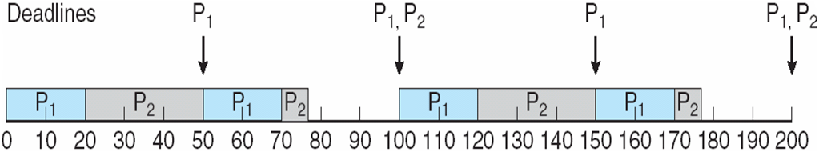
Rate Montonic Scheduling
A priority is assigned based on the inverse of its period
Shorter periods = higher priority
Longer periods = lower priority
P₁ is assigned a higher priority than P₂.

Slide 75
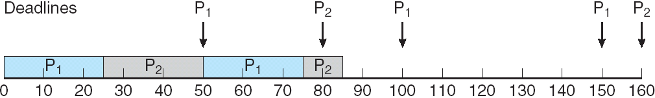
Missed Deadlines with Rate Monotonic Scheduling

Slide 76
EDF Scheduling
Earliest Deadline First (EDF) scheduling
Simple, yet effective
Whichever task has next deadline gets to run
Theory exists to analyze such systems
Task 1
Deadline: 5 Exec time: 4
Task 2
Deadline: 8 Exec time: 3
Task 3
Deadline: 12 Exec time: 2
Task 1
Task 2
Task 3
Time 0
5
8
12

Slide 77
Earliest Deadline First
EDF is also optimal
If the utility is <= 1 then EDF will create a schedule
Can transform any feasible schedule into an EDF one
But this is based on assumptions
Perfect periodic tasks, zero overhead, independence

Slide 78
EDF Seem Ideal
Easy to implement, optimal, …
But only in an ideal world
If the workload is briefly non-schedulable
Then both fail dramatically and unpredictably
Choices are based on deadlines, not importance
Work hard to display MPG rather than firing airbag
Work only with idealized situations
We need to relax the simplifying conditions

Slide 79
The ARPA-MT Embedded Project
Focuses on providing specialized, time predictable, power efficient systems for hard real time systems
Uses a multiprocessor based implementation
Design process focused on WCET determinism, task scheduling and resource assignment
Xilinx XC3S1500 Spartan-3 FPGA used in implementation
Oliveira, A. S. R.; Almeida, L; Ferrari, A. B.; , "The ARPA-MT Embedded SMT Processor and Its RTOS Hardware Accelerator," IEEE Transactions on Industrial Electronics

Slide 80
Increasing Execution Time Determinism
Uses a simple pipelining for instructions from each task and avoids complex superscalar techniques
Simultaneous task execution using SMT
Fine-grained time sharing of the processor
Interleaving order of issued instructions from tasks reduces global processor stalls caused by data and control hazards
Increasing processor availability by reducing context switching and operating system overhead using an “Operating System Co-Processor”
Insight: push scheduling logic into hardware

Slide 81
The ARPA-MT Processors
Three Processors:
Design based off the MIPS32 architecture using SMT
Focus will be on Co-Processor-2
CPU – MIPS32
Integer instruction set
Co-Processor-0
Memory manager
Exception Processing
Co-Processor-2
RTOS hardware support
Interrupt handling
Uses the five tradition pipeline stages (IF, ID, EX, MA, WB)
High resolution real-time clock
Notes:
MIPS32 chosen for its simplicity and tool availability
CPU duplicates the IF and ID stages for each thread within the processor (SMT)

Slide 82
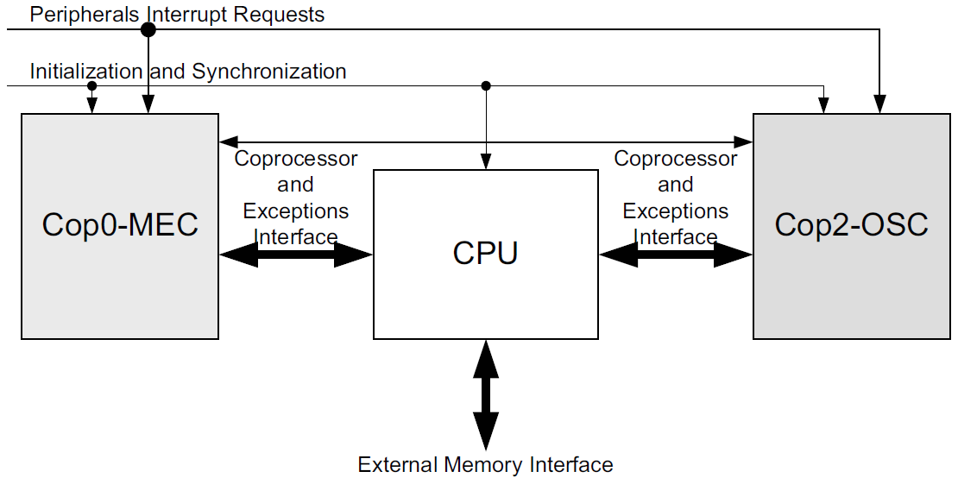
Processor Architecture

Slide 83
Co-Processor-2: The Task Handling Unit
All tasks are managed by a module called the Task Handling Unit
The Task Handling Unit performs the following:
Task handling
Implementation of specialized instructions
Scheduling
Dispatching
Management of interrupts
Timing constraints verification
Table storage for task parameters (TCB)

Slide 84
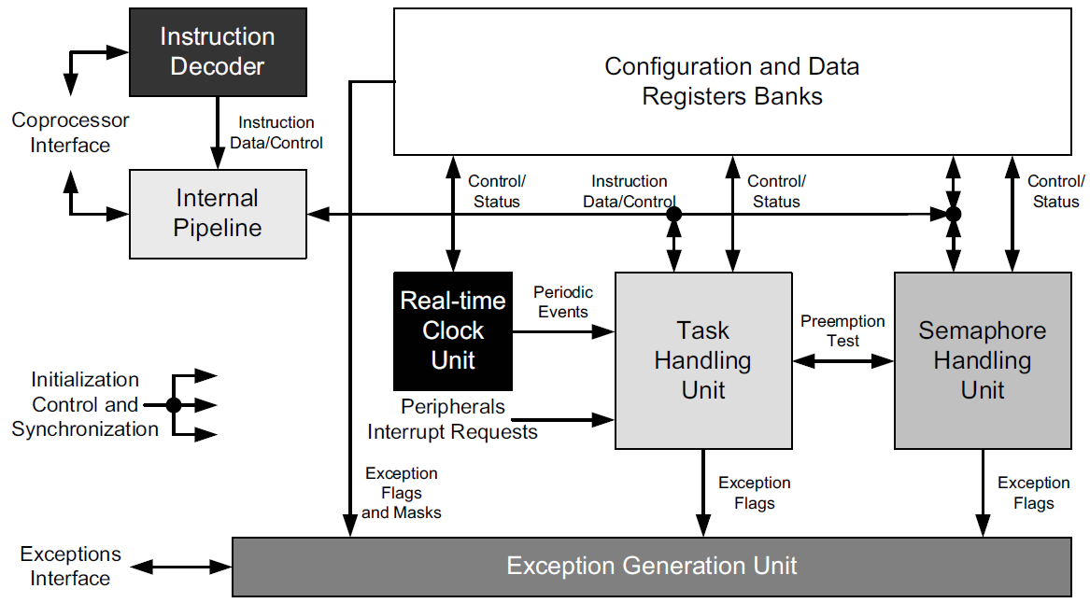
Co-Processor-2: Block Diagram

Slide 85
Co-Processor-2: Time & Event Management
A task can be event or time triggered
The Real-time Clock Unit
Generates periodic events assigned by the programmer
Triggers other scheduled tasks (most likely garbage handling)
External events are managed again by the Task Handling unit

Slide 86
Co-Processor-2: Task Management [5]
Application timing constraints are transparent to this processor allowing for real-time task management
Hard real-time tasks can be periodic or aperiodic
Task are synchronized using:
Pre-emption (LIFO or stack resource synchronization)
Binary semaphores (for simple access to shared resources)
Notes:
All task types: non-real time, soft-real time and hard-real time were considered in the design

Slide 87
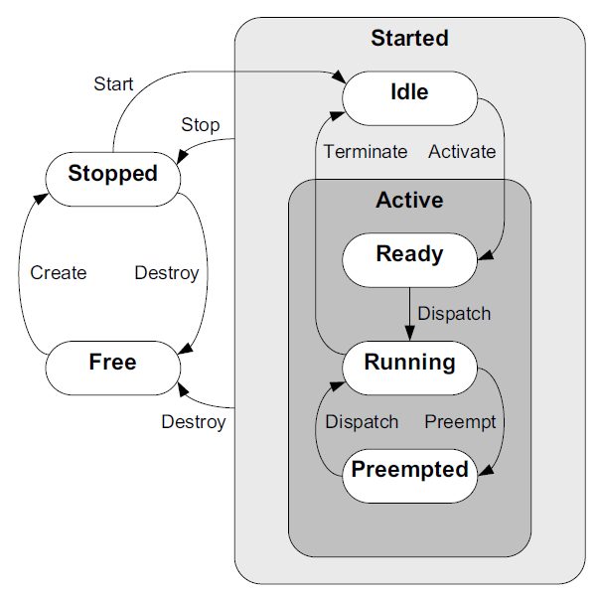
Co-Processor-2: Task States and Transitions [5]
Two important states are excluded from this processors design
Blocked
Suspended/sleeping
Blocking is bad
Wait/Sleep states can be simulated using timers
Notes:
Pre-emption: LIFO protocol used to lock and unlock a shared resource. A running task is only pre-empted an active task has all the resources it needs. Non-blocking.
The pre-emption strategy:
Reduces the blocking time of tasks with high priority
Prevents deadlocks
Allows for the use of RM and EDF (discussed in next slide)
“Blocking is bad” – there’s more to this statement
Blocking doesn’t make sense for Stack Resource Policy (SRP) protocol used for shared resources (synchronization)

Slide 88
Co-Processor-2: Scheduling [5]
Scheduling is done in hardware using priority criticality
Scheduling Decisions (in ascending order of priority):
Non real-time: First Come First Serve (FCFS)
Soft real-time: Rate Monotonic policy (RM)
Hard real-time: Earliest Deadline First (EDF)
In the case of EDF:
As a task comes closer to its deadline, its priority is raised
Maximizes processor utilization and ensure deadlines met

Slide 89
Co-Processor-2: Time & Event Management [5]
A task can be event or time triggered
The Real-time Clock Unit
Generates periodic events assigned by the programmer
Triggers other scheduled tasks (most likely garbage handling)
External events are managed again by the Task Handling unit

Slide 90
Mixed Criticality

Slide 91
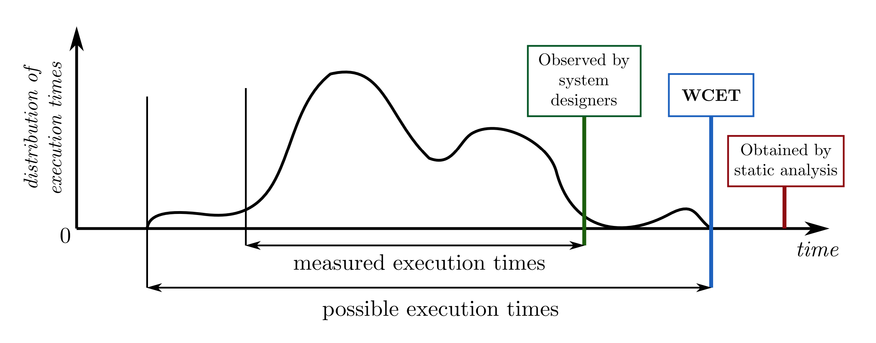
Real time systems: all about guarantees
A lot of real time scheduling is based on assumptions
Periodic tasks
Known priorities
Known runtimes
What happens when we don’t know how long something will execute?
Runtime can vary
Still want to meet deadlines
Mixed criticality embraces this uncertainty

Slide 92
Mixed Criticality - The Vestal Model
Introduces the notion that confidence in a software task’s Worst Case Execution Time (WCET) C is proportional to its criticality
Higher criticality. Higher analysis effort. More pessimistic WCET.
CA ≥ CB ≥ CC ≥ CD ≥ CE
Focusing on a dual criticality system…academic works and models that build off Vestal’s seminal work essentially treat each task as having a WCET for each criticality.
High DAL tasks => C_{HI} and C_{LO}
Low DAL tasks => C_{LO}
The question is how to utilise the spare execution time – [CHI - CLO]
Notes:
Vestal’s work noted that low DAL tasks have been developed against lighter standards, therefore we have less confidence in their WCET
We would extend this to also state we have less confidence in their correct operation
However the potential uses for MCS go beyond simply supporting ‘less important’ tasks.
We have a number of tasks we would consider to be high criticality, because of the effect their failure would have the on the system, however we can afford for them to be disabled for short periods of time. For instance recording error logs in non-volatile memory, a time consuming but still important process.
Therefore it is very important that we address exactly what we mean by a ‘low-DAL’ task
Ultimately it provides two main advantages - cost reduction and flexibility
Less processors, easier proof of schedulability

Slide 93
Mixed Criticality intuition
Sometimes requires this much time
Typically only requires this amount of time
However we don’t want to be wrong, so we say it needs this much time
Task 1
Time
The longer the difference here, then implicitly the higher the criticality

Slide 94
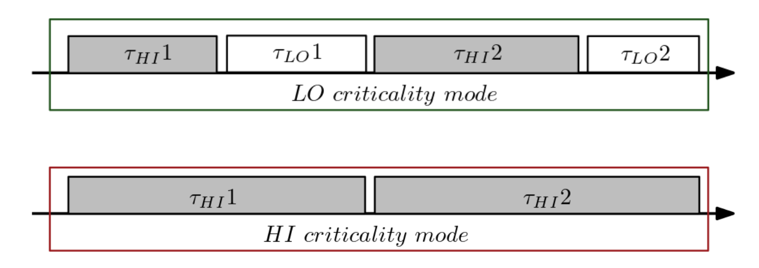
LO and HI criticality modes
Ci(LO): Max. observed execution time (system designers).
Ci(HI): Upper-bounded execution time (static analysis).

Slide 95
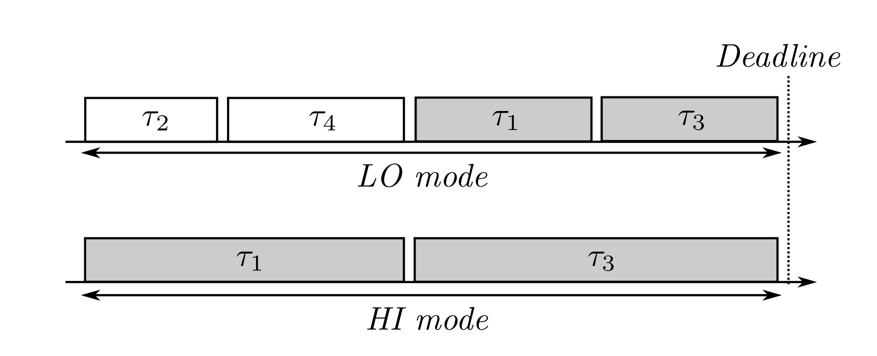
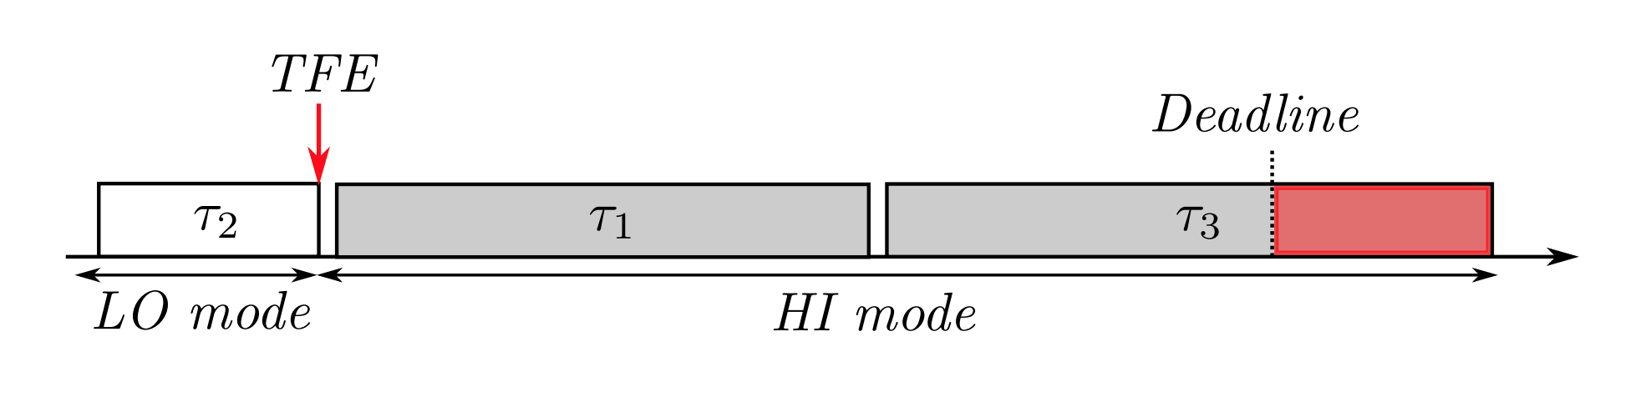
Scheduling with mode changes

Slide 96
Mixed criticality systems
Integrating real-world issues into real time systems
Interesting use of uncertainty to guide design decisions

Slide 97
Robust Mixed-Criticality
Normal mode
F hi-criticality tasks can exceed C_{LO}
Resilient mode
Up to M tasks can exceed C_{LO}
Each robust task can skip up to S jobs
High-criticality mode
Low-criticality tasks are not released
On an idle tick the counters for jobs skipped (JF) are reset
If C_{Hi} is exceeded then there is a power cycle

Slide 98
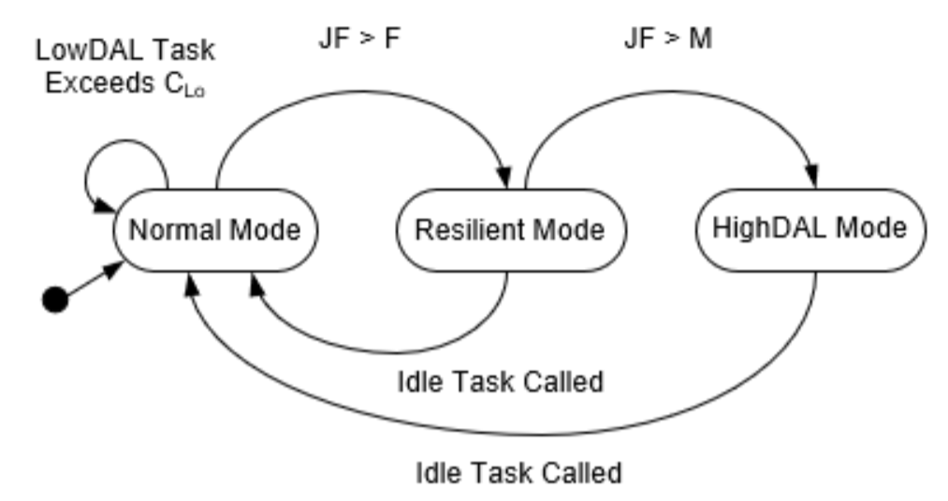
Robust Mixed Criticality
A robust task is one that can safely drop a non-started job
A fault is measured when one task overruns its C_{LO}
JF Records the number of Job Failures
An error is registered when one or many tasks fail to comply with their timing requirements
A resilient system is one which employs graceful degradation (if necessary through the control of robust tasks) in order to cope with one or many faults, thus aiming to avoid errors.
Notes:
Remind that AMC will never come back from HighDAL mode

Slide 99
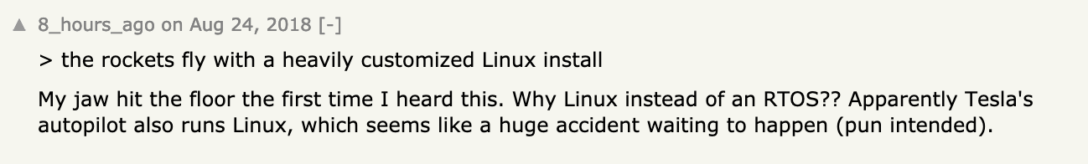

Slide 100
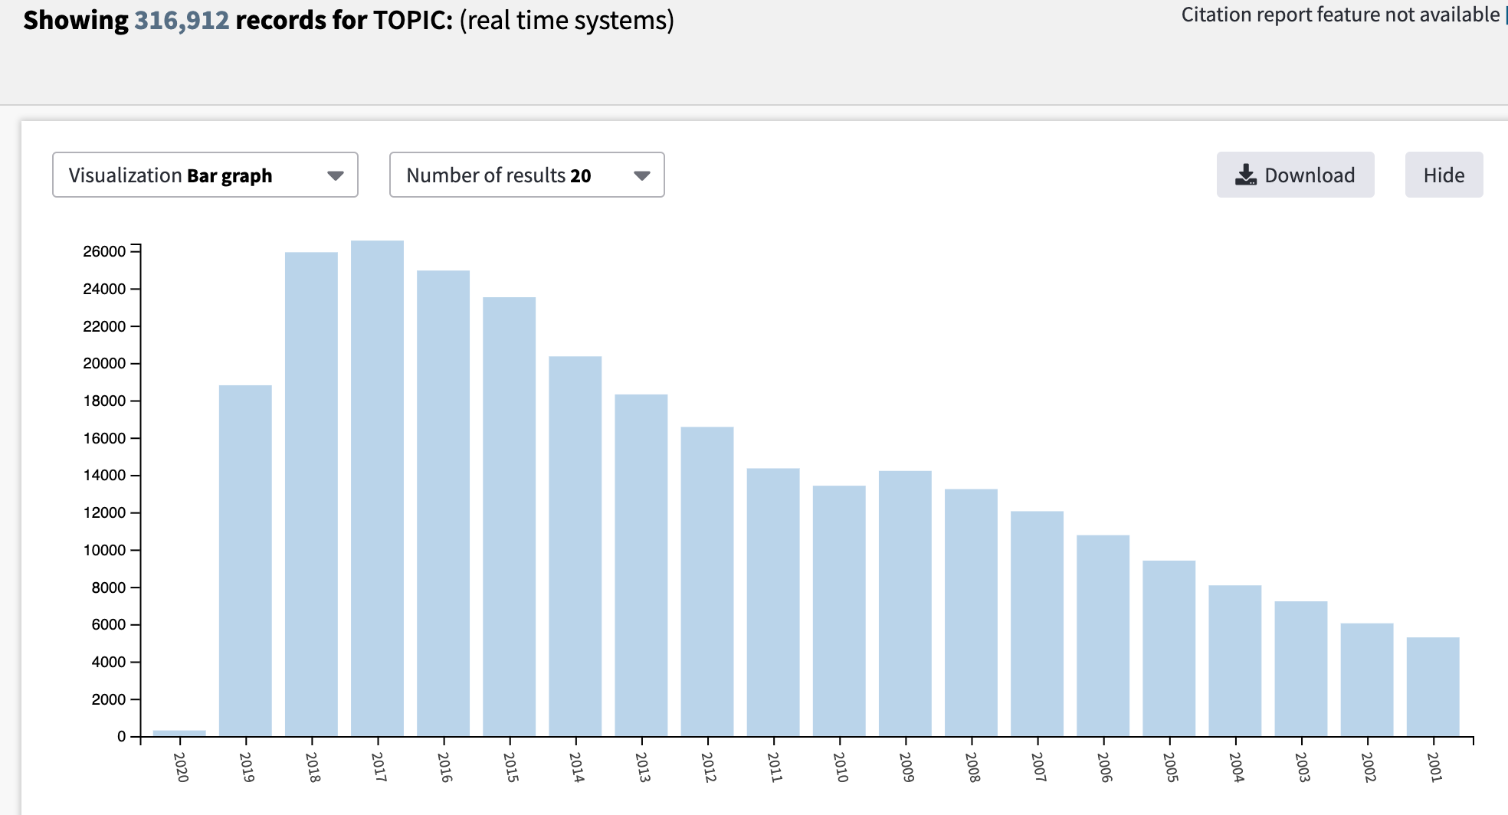
RTOS Publications
time

