Slide 1
CS6456: Graduate Operating Systems
Brad Campbell – bradjc@virginia.edu
https://www.cs.virginia.edu/~bjc8c/class/cs6456-f19/

Slide 2


Slide 3
Protection vs. Security
Protection: mechanisms for controlling access of programs, processes, or users to resources
Page table mechanism
Round-robin schedule
Data encryption
Security: use of protection mechanisms to prevent misuse of resources
Misuse defined with respect to policy
E.g.: prevent exposure of certain sensitive information
E.g.: prevent unauthorized modification/deletion of data
Need to consider external environment the system operates in
Most well-constructed system cannot protect information if user accidentally reveals password – social engineering challenge

Slide 4
Security Requirements
Authentication
Ensures that a user is who is claiming to be
Data integrity
Ensure that data is not changed from source to destination or after being written on a storage device
Confidentiality
Ensures that data is read only by authorized users
Non-repudiation
Sender/client can’t later claim didn’t send/write data
Receiver/server can’t claim didn’t receive/write data

Slide 5
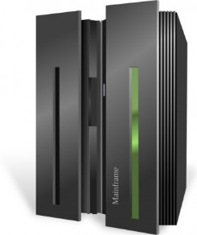



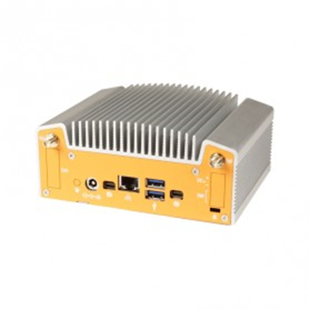

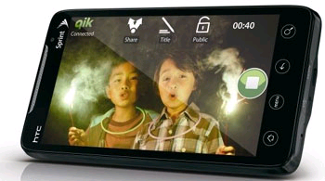
Why are Data Breaches so Frequent?
Really Large TCB
Really Large TCB
h
h
SSL
SSL
SSL
Full OS TCB
State of the art: AdHoc boundary construction!
Protection mechanisms are “roll-your-own” and different for each application
Use of encrypted channels to “tunnel” across untrusted domains
Data is typically protected at the Border rather than Inherently
Large Trusted Computing Base (TCB): huge amount of code must be correct to protect data
Make it through the border (firewall, OS, VM, container, etc…) data compromised!
What about data integrity and provenance?
Any bits inserted into “secure” environment get trusted as authentic

Slide 6
Securing Communication: Cryptography
Cryptography: communication in the presence of adversaries
Studied for thousands of years
See the Simon Singh’s The Code Book for an excellent, highly readable history
Central goal: confidentiality
How to encode information so that an adversary can’t extract it, but a friend can
General premise: there is a key, possession of which allows decoding, but without which decoding is infeasible
Thus, key must be kept secret and not guessable

Slide 7
Using Symmetric Keys
Same key for encryption and decryption
Achieves confidentiality
Vulnerable to tampering and replay attacks
Plaintext (m)
m
Internet
Encrypt with
secret key
Decrypt with
secret key
Ciphertext

Slide 8
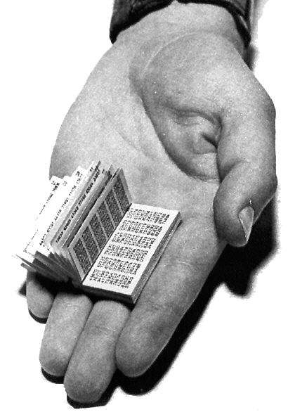
Symmetric Keys
Can just XOR plaintext with the key
Easy to implement, but easy to break using frequency analysis
Unbreakable alternative: XOR with one-time pad
Use a different key for each message

Slide 9
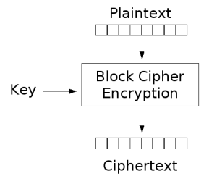
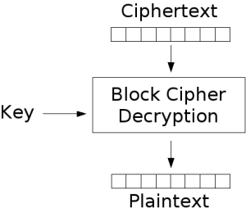
Block Ciphers with Symmetric Keys
Block cipher algorithms encrypt blocks of data
Works with a block size (e.g., 64 bits)
Can encrypt blocks separately:
Same plaintext⇒same ciphertext
Much better:
Add in counter and/or link ciphertext of previous block

Slide 10
Symmetric Key Ciphers - DES & AES
Data Encryption Standard (DES)
Developed by IBM in 1970s, standardized by NBS/NIST
56-bit key (decreased from 64 bits at NSA’s request)
Still fairly strong other than brute-forcing the key space
But custom hardware can crack a key in < 24 hours
Today many financial institutions use Triple DES
DES applied 3 times, with 3 keys totaling 168 bits
Advanced Encryption Standard (AES)
Replacement for DES standardized in 2002
Key size: 128, 192 or 256 bits
How fundamentally strong are they?
No one knows (no proofs exist)

Slide 11
Authentication in Distributed Systems
What if identity must be established across network?
Need way to prevent exposure of information while still proving identity to remote system
Many of the original UNIX tools sent passwords over the wire “in clear text”
E.g.: telnet, ftp, yp (yellow pages, for distributed login)
Result: Snooping programs widespread
What do we need? Cannot rely on physical security!
Encryption: Privacy, restrict receivers
Authentication: Remote Authenticity, restrict senders
Network
PASS: gina

Slide 12
Authentication via Secret Key
Main idea: entity proves identity by decrypting a secret encrypted with its own key
K – secret key shared only by A and B
A can asks B to authenticate itself by decrypting a nonce, i.e., random value, x
Avoid replay attacks (attacker impersonating client or server)
Vulnerable to man-in-the middle attack
A
B
E(x, K)
Notation: E(m,k) – encrypt message m with key k
x

Slide 13
Secure Hash Function
Fox
Hash
Function
DFCD3454BBEA788A
751A696C24D97009
CA992D17
Hash Function: Short summary of data (message)
For instance, h₁=H(M₁) is the hash of message M₁
h₁ fixed length, despite size of message M₁
Often, h₁ is called the “digest” of M₁
Hash function H is considered secure if
It is infeasible to find M₂ with h₁=H(M₂); i.e., can’t easily find other message with same digest as given message
It is infeasible to locate two messages, m₁ and m₂, which “collide”, i.e. for which H(m₁) = H(m₂)
A small change in a message changes many bits of digest/can’t tell anything about message given its hash
The red fox
runs across
the ice
Hash
Function
52ED879E70F71D92
6EB6957008E03CE4
CA6945D3

Slide 14
Integrity: Cryptographic Hashes
Basic building block for integrity: cryptographic hashing
Associate hash with byte-stream, receiver verifies match
Assures data hasn’t been modified, either accidentally – or maliciously
Approach:
Sender computes a secure digest of message m using H(x)
H(x) is a publicly known hash function
Digest d = HMAC (K, m) = H (K | H (K | m))
HMAC(K, m) is a hash-based message authentication function
Send digest d and message m to receiver
Upon receiving m and d, receiver uses shared secret key, K, to recompute HMAC(K, m) and see whether result agrees with d

Slide 15
Using Hashing for Integrity
plaintext (m)
corrupted msg
m
NO
=
digest’
Internet
Digest
HMAC(K,m)
Digest
HMAC(K,m)
Encrypted Digest
Unencrypted Message
Can encrypt m for confidentiality

Slide 16
Standard Cryptographic Hash Functions
MD5 (Message Digest version 5)
Developed in 1991 (Rivest), produces 128 bit hashes
Widely used (RFC 1321)
Broken (1996-2008): attacks that find collisions
SHA-1 (Secure Hash Algorithm)
Developed in 1995 (NSA) as MD5 successor with 160 bit hashes
Widely used (SSL/TLS, SSH, PGP, IPSEC)
Broken in 2005, government use discontinued in 2010
SHA-2 (2001)
Family of SHA-224, SHA-256, SHA-384, SHA-512 functions
HMAC’s are secure even with older “insecure” hash functions

Slide 17
Key Distribution
How do you get shared secret to both places?
For instance: how do you send authenticated, secret mail to someone who you have never met?
Must negotiate key over private channel
Exchange code book/key cards/memory stick/others
Could use a third party

Slide 18
Third Party: Authentication Server (Kerberos)
Notation:
K_{xy} is key for talking between x and y
(…)^{K} means encrypt message (…) with the key K
Clients: A and B, Authentication server S
Usage:
A asks server for key:
A→S: [Hi! I’d like a key for talking between A and B]
Not encrypted. Others can find out if A and B are talking
Server returns session key encrypted using B’s key
S→A: Message [ Use K_{ab} (This is A! Use K_{ab})^{Ksb} ] ^{Ksa}
This allows A to know, “S said use this key”
Whenever A wants to talk with B
A→B: Ticket [ This is A! Use K_{ab} ]^{Ksb}
Now, B knows that K_{ab} is sanctioned by S
Key
Server
Req Ticket
Ticket
Ticket
Secure Communication

Slide 19
Authentication Server Continued [Kerberos]
Details
Both A and B use passwords (shared with key server) to decrypt return from key servers
Add in timestamps to limit how long tickets will be used to prevent attacker from replaying messages later
Also have to include encrypted checksums (hashed version of message) to prevent malicious user from inserting things into messages/changing messages

Slide 20
Asymmetric Encryption (Public Key)
Idea: use two different keys, one to encrypt (e) and one to decrypt (d)
A key pair
Crucial property: knowing e does not give away d
Therefore e can be public: everyone knows it!
If Alice wants to send to Bob, she fetches Bob’s public key (say from Bob’s home page) and encrypts with it
Alice can’t decrypt what she’s sending to Bob …
… but then, neither can anyone else (except Bob)

Slide 21
Public Key / Asymmetric Encryption
Sender uses receiver’s public key
Advertised to everyone
Receiver uses complementary private key
Must be kept secret
Plaintext
Plaintext
Internet
Encrypt with
public key
Decrypt with
private key
Ciphertext

Slide 22
Public Key Encryption Details
Idea: K_{public} can be made public, keep K_{private} private
Gives message privacy (restricted receiver):
Public keys (secure destination points) can be acquired by anyone/used by anyone
Only person with private key can decrypt message
What about authentication?
Use combination of private and public key
Alice→Bob: [(I’m Alice)^{Aprivate} Rest of message]^{Bpublic}
Provides restricted sender and receiver
But: how does Alice know that it was Bob who sent her B_{public}? And vice versa…
Insecure Channel
B_{public}
B_{private}
A_{private}
A_{public}
Alice
Insecure Channel
Bob

Slide 23
Public Key Cryptography
Invented in the 1970s
Revolutionized cryptography
(Was actually invented earlier by British intelligence)
How can we construct an encryption/decryption algorithm using a key pair with the public/private properties?
Answer: Number Theory
Most fully developed approach: RSA
Rivest / Shamir / Adleman, 1977; RFC 3447
Based on modular multiplication of very large integers
Very widely used (e.g., ssh, SSL/TLS for https)
Also mature approach: Eliptic Curve Cryptography (ECC)
Based on curves in a Galois-field space
Shorter keys and signatures than RSA

Slide 24
Properties of RSA
Requires generating large, random prime numbers
Algorithms exist for quickly finding these (probabilistic!)
Requires exponentiation of very large numbers
Again, fairly fast algorithms exist
Overall, much slower than symmetric key crypto
One general strategy: use public key crypto to exchange a (short) symmetric session key
Use that key then with AES or such
How difficult is recovering d, the private key?
Equivalent to finding prime factors of a large number
Many have tried - believed to be very hard (= brute force only)
(Though quantum computers could do so in polynomial time!)
Notes:
Shor’s algorithm is polynomial in log N

Slide 25
Simple Public Key Authentication
Each side need only to know the other side’s public key
No secret key need be shared
A encrypts a nonce (random num.) x
Avoid replay attacks, e.g., attacker impersonating client or server
B proves it can recover x, generates second nonce y
A can authenticate itself to B in the same way
A and B have shared private secrets on which to build private key!
We just did secure key distribution!
Many more details to make this work securely in practice!
A
B
E({x, A}, Public_{B})
E({x, y, B}, Public_{A})
E({y, A}, Public_{B})
Notation: E(m,k) – encrypt message m with key k

Slide 26
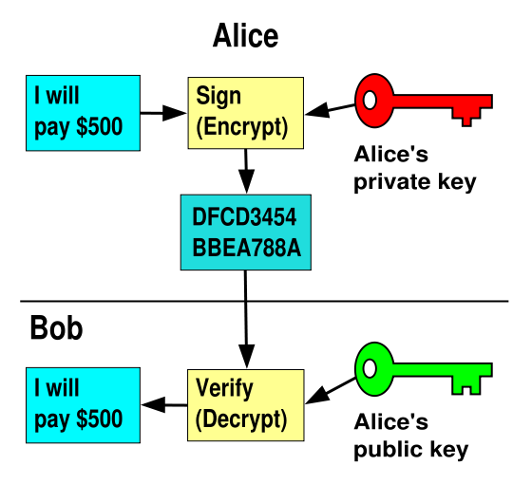
Non-Repudiation: RSA Crypto & Signatures
Suppose Alice has published public key KE
If she wishes to prove who she is, she can send a message x encrypted with her private key KD (i.e., she sends E(x, KD))
Anyone knowing Alice’s public key KE can recover x, verify that Alice must have sent the message
It provides a signature
Alice can’t deny it: non-repudiation
Could simply encrypt a hash of the data to sign a document that you wanted to be in clear text
Note that either of these signature techniques work perfectly well with any data (not just messages)
Could sign every datum in a database, for instance
I will pay Bob $500
I will pay Bob $500

Slide 27
Digital Certificates
How do you know K_{E} is Alice’s public key?
Trusted authority (e.g., Verisign) signs binding between Alice and K_{E} with its private key KV_{private}
C = E({Alice, K_{E}}, KV_{private})
C: digital certificate
Alice: distribute her digital certificate, C
Anyone: use trusted authority’s KV_{public}, to extract Alice’s public key from C
D(C, KV_{public}) = D(E({Alice, K_{E}}, KV_{private}), KV_{public}) = {Alice, K_{E}}

Slide 28
Summary of Our Crypto Toolkit
If we can securely distribute a key, then
Symmetric ciphers (e.g., AES) offer fast, presumably strong confidentiality
Public key cryptography does away with (potentially major) problem of secure key distribution
But: not as computationally efficient
Often addressed by using public key crypto to exchange a session key
Digital signature binds the public key to an entity

Slide 29

Putting It All Together - HTTPS
What happens when you click on https://www.amazon.com?
https = “Use HTTP over TLS”
SSL = Secure Socket Layer
TLS = Transport Layer Security
Provides security layer (authentication, encryption) on top of TCP
Fairly transparent to applications

Slide 30
HTTPS Connection (SSL/TLS) (cont’d)
Browser
Amazon
Browser (client) connects via TCP to Amazon’s HTTPS server
Client sends over list of crypto protocols it supports
Server picks protocols to use for this session
Server sends over its certificate
(all of this is in the clear)
Hello. I support
(TLS+RSA+AES128+SHA2) or
(SSL+RSA+3DES+MD5) or …
Let’s use
TLS+RSA+AES128+SHA2
Here’s my cert
~1 KB of data

Slide 31
Inside the Server’s Certificate
Name associated with cert (e.g., Amazon)
Amazon’s RSA public key
A bunch of auxiliary info (physical address, type of cert, expiration time)
Name of certificate’s signatory (who signed it)
A public-key signature of a hash (SHA-256) of all this
Constructed using the signatory’s private RSA key, i.e.,
Cert = E(H_{SHA256}(KA_{public}, www.amazon.com, …), KS_{private}))
KA_{public}: Amazon’s public key
KS_{private}: signatory (certificate authority) private key
…

Slide 32
Validating Amazon’s Identity
How does the browser authenticate certificate signatory?
Certificates of several certificate authorities (e.g., Verisign) are hardwired into the browser (or OS)
If can’t find cert, warn user that site has not been verified
And may ask whether to continue
Note, can still proceed, just without authentication
Browser uses public key in signatory’s cert to decrypt signature
Compares with its own SHA-256 hash of Amazon’s cert
Assuming signature matches, now have high confidence it’s indeed Amazon … assuming signatory is trustworthy
DigiNotar CA breach (July-Sept 2011): Google, Yahoo!, Mozilla, Tor project, Wordpress, … (531 total certificates)
Notes:
Wikipedia: DigiNotar was a Dutch certificate authority owned by VASCO Data Security International.^{[1]} On September 3, 2011, after it had become clear that a security breach had resulted in the fraudulent issuing of certificates, the Dutch government took over operational management of DigiNotar's systems.^{[2]} That same month, the company was declared bankrupt. (Wikipedia)

Slide 33
Certificate Validation
Certificate
E(H_{SHA256}(KA_{public}, www.amazon.com, …), KS_{private})),
KA_{public}, www.amazon.com, …
E(H_{SHA256}(…), KS_{public}))
(recall, KS_{public} hardwired)
H_{SHA256}(KA_{public}, www.amazon.com, ..)
H_{SHA256}(KA_{public}, www.amazon.com, …)
H_{SHA256}(KA_{public}, www.amazon.com, …)
No
=
Validation failed
Yes
Validation successful
Can also validate using peer approach: https://www.eff.org/observatory

Slide 34
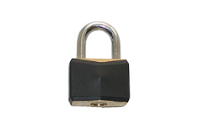
HTTPS Connection (SSL/TLS) cont’d
Browser
Amazon
Here’s my cert
Browser constructs a random session key K used for data communication
Private key for bulk crypto
Browser encrypts K using Amazon’s public key
Browser sends E(K, KA_{public}) to server
Browser displays
All subsequent comm. encrypted w/ symmetric cipher (e.g., AES128) using key K
E.g., client can authenticate using a password
~1 KB of data
K
E(K, KA_{public})
Agreed
K
E(password …, K)
E(response …, K)

Slide 35
Hardware Security
Definition: implement security protection mechanisms in hardware
E.g., design trusted hardware, as opposed to (in addition to) trusted software
Software security: software protect software!
Vulnerable to attacks
Is the antivirus/hardware untouched?
Easy infiltration
Fast spread
Hardware security: hardware protect software
Attacks need physical access
Software infiltration much more difficult

Slide 36
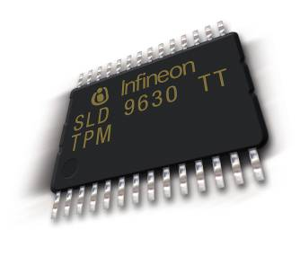
Trusted Platform Module (TPM)
A chip integrated into the hardware platform
It is a separate, trusted co-processor
“The TPM represents a separate trusted coprocessor, whose state cannot be compromised by potentially malicious host system software.”
IBM Research Report
Notes:
The hardware part of TC
Will require O/S support also.
Currently about $5.00 for desktop chips
$7.00 for notebook chips
The real key is that the TPM can’t be compromised by other software processes

Slide 37
Goals
TPMs allow a system to:
Gather and attest system state
Store and generate cryptographic data
Prove platform identity
Prevents unauthorized software
Helps prevent malware

Slide 38
TPM Components
Root key
PKI private keys could be stored in the chip
PK signatures calculated in the chip itself, never visible outside
Random number generators
SHA-1 encryption
Monotonic counters
Process isolation (encrypted I/O, prevents keystroke loggers, screen scrapers)

Slide 39
Limitations
Advanced features will require O/S support
Potential for abuse by Software vendors
Co-processor or Cop-processor?
“Trusted Computing requires you to surrender control of your machine to the vendors of your hardware and software, thereby making the computer less trustworthy from the user’s perspective” - Ross Anderson
The TPM's most controversial feature is attestation, the ability to measure the state of a computer and send a signed message certifying that particular hardware or software is or isn't present.
Notes:
x
x
x
x

Slide 40
Real-World Applications
Hard drive encryption
BitLocker in Windows 8
Trustworthy OS
Google’s Chromebook use TPM to prevent firmware rollback
Potential applications:
DRM
Fighting pirate software

Slide 41
BitLocker™ Drive Encryption
BitLocker™ Drive Encryption gives you improved data protection on your Windows
Notebooks – Often stolen, easily lost in transit
Desktops – Often stolen, difficult to safely decommission
Servers – High value targets, often kept in insecure locations
All three can contain very sensitive IP and customer data
Designed to provide a transparent user experience that requires little to no interaction on a protected system
Prevents thieves from using another OS or software hacking tool to break OS file and system protections
Prevents offline viewing of user data and OS files
Provides enhanced data protection and boot validation through use of a Trusted Platform Module (TPM)

Slide 42
BitLocker™ Drive Encryption Architecture Static Root of Trust Measurement of boot components

Slide 43



Disk Layout And Key Storage
OS Volume Contains
Encrypted OS
Encrypted Page File
Encrypted Temp Files
Encrypted Data
Encrypted Hibernation File
Where’s the Encryption Key?
SRK (Storage Root Key) contained in TPM
SRK encrypts FVEK (Full Volume Encryption Key) protected by TPM/PIN/USB Storage Device
FVEK stored (encrypted by SRK) on hard drive in the OS Volume
3
OS Volume
2
FVEK
1
SRK
System
System Volume Contains:
MBR, Boot manager, Boot Utilities
(Unencrypted, small)

Slide 44




Spectrum of Protection
Ease of Deployment / Maintenance
BitLocker™ offers a spectrum of protection, allowing an organization to customize according to its own needs
TPM Only
“What it is”
Protects Against:
Most SW attacks
Vulnerable To:
Hardware attacks
User Must:
N/A
No user impact
TPM + PIN
“What it is + what you know”
Protects Against:
Many HW attacks
Vulnerable To:
Hardware attacks
User Must:
Enter PIN to boot
TPM + USB
“What it is + what you have”
Protects Against:
HW attacks
Vulnerable To:
Stolen USB key
User Must:
Protect USB key
USB Only
“What you have”
Protects Against:
HW attacks
Vulnerable To:
Stolen USB key
No boot validation
User Must:
Protect USB key

Slide 45
Intel SGX: Goals
Extension to Intel processors that support:
Enclaves: running code and memory isolated from the rest of system
Attestation: prove to local/remote system what code is running in enclave
Minimum TCB: only processor is trusted
nothing else: DRAM and peripherals are untrusted
⇒ all writes to memory are encrypted

Slide 46
Applications
Server side:
Storing a Web server HTTPS secret key:
key only opened inside an enclave
⇒ malware cannot get the key
Running a private job in the cloud: job runs in enclave
Cloud admin cannot get code or data of job
Client side:
Hide anti-virus (AV) signatures:
AV signatures are only opened inside an enclave
not exposed to adversary in the clear
Hide proprietary ML models:
Speech detection on smart home devices
Models secret and hidden from competitors

Slide 47
Intel SGX: how does it work?
An application defines part of itself as an enclave
Untrusted part
Enclave
create enclave
(isolated memory)
Process memory

Slide 48
Intel SGX: how does it work?
An application defines part of itself as an enclave
Untrusted part
Enclave
enclave code runs
using enclave data
create enclave
call TrustedFun
67g35bd954bt
Process memory
Notes:
Data is stored encrypted in DRAM. Processor prevents access to data in cache outside of enclave.

Slide 49
Intel SGX: how does it work?
An application defines part of itself as an enclave
Untrusted part
Enclave
enclave data only
accessible to code
in enclave
create enclave
call TrustedFun
67g35bd954bt
Process memory

Slide 50
How does it work?
Part of process memory holds the enclave:
low
enclave
high
app
code
enclave
code
enclave
data
OS
Process memory
Enclave code and data are stored encrypted in main memory
Processor prevents access to cached enclave data outside of enclave.

Slide 51
Creating an enclave: new instructions
ECREATE: establish memory address for enclave
EADD: copies memory pages into enclave
EEXTEND: computes hash of enclave contents (256 bytes at a time)
EINIT: verifies that hashed content is properly signed
if so, initializes enclave (signature = RSA-3072)
EENTER: call a function inside enclave
EEXIT: return from enclave

Slide 52
Provisioning enclave with secrets: attestation
The problem: enclave memory is in the clear prior to activation (EINIT)
How to get secrets into enclave?
Remote Attestation (simplified):
E(pk, data)
report: contains hash(code)
Intel’s app enclave
pk, sk
pk, report
enclave
data
Intel’s quoting enclave
sk
cert = [pk, report]
validate cert

Slide 53
SGX Summary
SGX: an architecture for managing secret data
Intended to process data that cannot be read by anyone, except for code running in enclave
Attestation: proves what code is running in enclave
Minimal TCB: nothing trusted except for x86 processor
Not suitable for legacy applications

Slide 54
An example application
Data science on federated data:
MPC protocol
dataset1
result
dataset2
Can we run analysis on union(dataset1, dataset2) ??
For simple computations, can use multiparty computation (MPC)

Slide 55
An example application
Data science on federated data:
enclave
pk, cert
pk, cert
analysis code
E(pk, data1)
E(pk, data2)
dataset1
untrusted environment
dataset2
For more complex analysis, can use (secure) hardware enclave

Slide 56
An example application
Data science on federated data:
enclave
pk, cert
pk, cert
data1
data2
E(pk, data1)
E(pk, data2)
dataset1
dataset2
result
For more complex analysis, can use (secure) hardware enclave

Slide 57
SGX insecurity: side channels
DRAM memory
enclave
memory bus
(enc data)
OS
processor
Attacker controls the OS. OS sees lots of side-channel info:
Memory access patterns
State of processor caches as enclave executes
State of branch predictor
All can leak enclave data.
Difficult to block.

Slide 58
SGX insecurity: (2) extract quoting key
Intel’s quoting enclave
attestation
data
sk
Attestation: proves to 3rd party what code is running in enclave
Quoting sk stored in Intel enclave on untrusted machines
What if attacker extracts sk from some quoting enclave?
Can attest to arbitrary non-enclave code
… see Foreshadow attack and Intel’s response

Slide 59
The Spectre attack
Speed vs. security in HW
[slides credit: Paul Kocher]

Slide 60
Memory caches (4-way associative)
Caches hold local (fast) copy of recently-accessed 64-byte chunks of memory
CPU
Sends address, Receives data
MEMORY
CACHE
MAIN MEMORY
Big, slow
e.g. 16GB SDRAM
Set | Addr | Cached Data ~64B
0 | F0016280 31C6F4C0 339DD740 614F8480 | B5 F5 80 21 E3 2C.. 9A DA 59 11 48 F2.. C7 D7 A0 86 67 18.. 17 4C 59 B8 58 A7..
1 | 71685100 132A4880 2A1C0700 C017E9C0 | 27 BD 5D 2E 84 29.. 30 B2 8F 27 05 9C.. 9E C3 DA EE B7 D9.. D1 76 16 54 51 5B..
2 | 311956C0 002D47C0 91507E80 55194040 | 0A 55 47 82 86 4E.. C4 15 4D 78 B5 C4.. 60 D0 2C DD 78 14.. DF 66 E9 D0 11 43..
3 | 9B27F8C0 8E771100 A001FB40 317178C0 | 84 A0 7F C7 4E BC.. 3B 0B 20 0C DB 58.. 29 D9 F5 6A 72 50.. 35 82 CB 91 78 8B..
4 | 6618E980 BA0CDB40 89E92C00 090F9C40 | 35 11 4A E0 2E F1.. B0 FC 5A 20 D0 7F.. 1C 50 A4 F8 EB 6F.. BB 71 ED 16 07 1F..
Address:
132E1340
Addr: 2A1C0700
Data:
AC 99 17 8F 44 09..
hash(addr) to map to cache set
Fast
2A1C0700
Data: 9E C3 DA EE B7 D3..
Addr: 132E1340
Reads change system state:
Read to newly-cached location is fast
Read to evicted location is slow
Data: AC 99 17 8F 44 09..
Slow
Addr: 132E1340
Fast
Evict to make room
132E1340
AC 99 17 8F 44 09..
Data: AC 99 17 8F 44 09..

Slide 61
Speculative execution
CPUs can guess likely program path and do speculative execution
Example:
if (uncached_value == 1) // load from memory
a = compute(b)
Branch predictor guesses if() is ‘true’ (based on prior history)
Starts executing compute(b) speculatively
When value arrives from memory, check if guess was correct:
Correct: Save speculative work ⇒ performance gain
Incorrect: Discard speculative work ⇒ no harm (?)
Notes:
Prior history: branch predictor.

Slide 62
Architectural Guarantee
Register values eventually match result of in-order execution
Speculative Execution
CPU regularly performs incorrect calculations, then deletes mistakes
Is making + discarding mistakes the same as in-order execution?
The processor executed instructions that were not supposed to run!!
The problem: instructions can have observable side-effects

Slide 63
Conditional branch (Variant 1) attack
if (x < array1_size)
y = array2[ array1[x]*4096 ];
Suppose unsigned int x comes from untrusted caller
Execution without speculation is safe:
array2[array1[x]*4096] not eval unless x < array1_size
What about with speculative execution?

Slide 64
Conditional branch (Variant 1) attack
if (x < array1_size)
y = array2[array1[x]*4096];
Memory & Cache Status
array1_size = 00000008
Memory at array1 base:
8 bytes of data (value doesn’t matter) Memory at array1 base+1000:
09 F1 98 CC 90...(something secret)
array2[ 0*4096]
array2[ 1*4096]
array2[ 2*4096]
array2[ 3*4096]
array2[ 4*4096]
array2[ 5*4096]
array2[ 6*4096]
array2[ 7*4096]
array2[ 8*4096]
array2[ 9*4096]
array2[10*4096]
array2[11*4096]
Before attack:
Train branch predictor to expect if() is true (e.g. call with x < array1_size)
Evict array1_size and array2[] from cache
Contents don’t matter
only care about cache status
Uncached
Cached
• • •

Slide 65
Conditional branch (Variant 1) attack
if (x < array1_size)
y = array2[array1[x]*4096];
Memory & Cache Status
array1_size = 00000008
Memory at array1 base:
8 bytes of data (value doesn’t matter) Memory at array1 base+1000:
09 F1 98 CC 90...(something secret)
array2[ 0*4096]
array2[ 1*4096]
array2[ 2*4096]
array2[ 3*4096]
array2[ 4*4096]
array2[ 5*4096]
array2[ 6*4096]
array2[ 7*4096]
array2[ 8*4096]
array2[ 9*4096]
array2[10*4096]
array2[11*4096]
Attacker calls victim with x=1000
Speculative exec while waiting for array1_size:
Predict that if() is true
Read address (array1 base + x) (using out-of-bounds x=1000)
Read returns secret byte = 09 (in cache ⇒ fast )
Contents don’t matter
only care about cache status
Uncached
Cached
• • •

Slide 66
Conditional branch (Variant 1) attack
if (x < array1_size)
y = array2[array1[x]*4096];
Memory & Cache Status
array1_size = 00000008
Memory at array1 base:
8 bytes of data (value doesn’t matter) Memory at array1 base+1000:
09 F1 98 CC 90...(something secret)
array2[ 0*4096]
array2[ 1*4096]
array2[ 2*4096]
array2[ 3*4096]
array2[ 4*4096]
array2[ 5*4096]
array2[ 6*4096]
array2[ 7*4096]
array2[ 8*4096]
array2[ 9*4096]
array2[10*4096]
array2[11*4096]
Attacker calls victim with x=1000
Next:
Request mem at (array2 base + 09*4096)
Brings array2[09*4096] into the cache
Realize if() is false: discard speculative work
Finish operation & return to caller
Contents don’t matter
only care about cache status
Uncached
Cached
• • •

Slide 67
Conditional branch (Variant 1) attack
if (x < array1_size)
y = array2[array1[x]*4096];
Memory & Cache Status
array1_size = 00000008
Memory at array1 base:
8 bytes of data (value doesn’t matter) Memory at array1 base+1000:
09 F1 98 CC 90...(something secret)
array2[ 0*4096]
array2[ 1*4096]
array2[ 2*4096]
array2[ 3*4096]
array2[ 4*4096]
array2[ 5*4096]
array2[ 6*4096]
array2[ 7*4096]
array2[ 8*4096]
array2[ 9*4096]
array2[10*4096]
array2[11*4096]
Attacker calls victim with x=1000
Attacker:
measures read time for array2[i*4096]
Read for i=09 is fast (cached), reveals secret byte !!
Repeat with many x (10KB/s)
Contents don’t matter
only care about cache status
Uncached
Cached
• • •

