Slide 1
CS6456: Graduate Operating Systems
Brad Campbell – bradjc@virginia.edu
https://www.cs.virginia.edu/~bjc8c/class/cs6456-f19/

Slide 2

















Transport services and protocols
application
transport
network
data link
physical
provide logical communication between app processes running on different hosts
transport protocols run in end systems
send side: breaks app messages into segments, passes to network layer
rcv side: reassembles segments into messages, passes to app layer
more than one transport protocol available to apps
Internet: TCP and UDP
logical end-to-end transport
application
transport
network
data link
physical

Slide 3
Transport vs. network layer
network layer: logical communication between hosts
transport layer: logical communication between processes
relies on and enhances network layer services
household analogy:
12 kids in Anicia’s house sending letters to 12 kids in Bill’s house:
hosts = houses
processes = kids
app messages = letters in envelopes
transport protocol = Anicia and Bill who demux to in-house siblings
network-layer protocol = postal service

Slide 4
TCP: Overview RFCs: 793, 1122, 1323, 2018, 2581
point-to-point:
one sender, one receiver
reliable, in-order byte steam:
no “message boundaries”
pipelined:
TCP congestion and flow control set window size
full duplex data:
bi-directional data flow in same connection
MSS: maximum segment size
connection-oriented:
handshaking (exchange of control msgs) inits sender, receiver state before data exchange
flow controlled:
sender will not overwhelm receiver

Slide 5
TCP segment structure
32 bits
URG: urgent data
(generally not used)
counting
by bytes
of data
(not segments!)
source port #
dest port #
sequence number
ACK: ACK #
valid
acknowledgement number
head
len
not
used
U
receive window
A
P
R
S
PSH: push data now
(generally not used)
F
# bytes
rcvr willing
to accept
checksum
Urg data pointer
RST, SYN, FIN:
connection estab
(setup, teardown
commands)
options (variable length)
application
data
(variable length)
Internet
checksum
(as in UDP)

Slide 6
TCP seq. numbers, ACKs
outgoing segment from sender
sequence numbers:
byte stream “number” of first byte in segment’s data
acknowledgements:
seq # of next byte expected from other side
cumulative ACK
Q: how receiver handles out-of-order segments
A: TCP spec doesn’t say, - up to implementer
source port #
dest port #
sequence number
acknowledgement number
rwnd
checksum
urg pointer
window size
N
sender sequence number space
sent
ACKed
sent, not-yet ACKed
(“in-flight”)
usable
but not
yet sent
not
usable
incoming segment to sender
source port #
dest port #
sequence number
acknowledgement number
A
rwnd
checksum
urg pointer

Slide 7

TCP seq. numbers, ACKs
Host A
Host B
User
types
‘C’
Seq=42, ACK=79, data = ‘C’
host ACKs
receipt of
‘C’, echoes
back ‘C’
Seq=79, ACK=43, data = ‘C’
host ACKs
receipt
of echoed
‘C’
Seq=43, ACK=80
simple telnet scenario

Slide 8
TCP: retransmission scenarios
Host A
Host B
Host A
Host B
SendBase=92
Seq=92, 8 bytes of data
Seq=92, 8 bytes of data
timeout
timeout
Seq=100, 20 bytes of data
ACK=100
X
ACK=100
ACK=120
Seq=92, 8 bytes of data
Seq=92, 8
bytes of data
SendBase=100
SendBase=120
ACK=100
ACK=120
SendBase=120
lost ACK scenario
premature timeout

Slide 9
TCP fast retransmit
Host A
Host B
Seq=92, 8 bytes of data
Seq=100, 20 bytes of data
X
ACK=100
timeout
ACK=100
ACK=100
ACK=100
Seq=100, 20 bytes of data
fast retransmit after sender
receipt of triple duplicate ACK

Slide 10
Principles of congestion control
congestion:
informally: “too many sources sending too much data too fast for network to handle”
different from flow control!
manifestations:
lost packets (buffer overflow at routers)
long delays (queueing in router buffers)
a top-10 problem!

Slide 11
TCP congestion control: additive increase multiplicative decrease
approach: sender increases transmission rate (window size), probing for usable bandwidth, until loss occurs
additive increase: increase cwnd by 1 MSS every RTT until loss detected
multiplicative decrease: cut cwnd in half after loss
additively increase window size …
…. until loss occurs (then cut window in half)
AIMD saw tooth
behavior: probing
for bandwidth
cwnd: TCP sender
congestion window size
time

Slide 12
TCP Slow Start
Host A
Host B
when connection begins, increase rate exponentially until first loss event:
initially cwnd = 1 MSS
double cwnd every RTT
done by incrementing cwnd for every ACK received
summary: initial rate is slow but ramps up exponentially fast
one segment
RTT
two segments
four segments
time

Slide 13
Why is TCP fair?
two competing sessions:
additive increase gives slope of 1, as throughout increases
multiplicative decrease decreases throughput proportionally
R
equal bandwidth share
Connection 2 throughput
loss: decrease window by factor of 2
congestion avoidance: additive increase
loss: decrease window by factor of 2
congestion avoidance: additive increase
Connection 1 throughput
R

Slide 14
Network layer: data plane, control plane
Data plane
local, per-router function
determines how datagram arriving on router input port is forwarded to router output port
forwarding function
Control plane
network-wide logic
determines how datagram is routed among routers along end-end path from source host to destination host
two control-plane approaches:
traditional routing algorithms: implemented in routers
software-defined networking (SDN): implemented in (remote) servers
values in arriving
packet header
0111
1
3
2

Slide 15
The Internet network layer
host, router network layer functions:
transport layer: TCP, UDP
routing protocols
path selection
RIP, OSPF, BGP
IP protocol
addressing conventions
datagram format
packet handling conventions
network
layer
forwarding
table
ICMP protocol
error reporting
router “signaling”
link layer
physical layer

Slide 16
IPv4 datagram format
IP protocol version
number
32 bits
total datagram
length (bytes)
header length
(bytes)
head.
len
type of
service
ver
length
for
fragmentation/
reassembly
“type” of data
flgs
fragment
offset
16-bit identifier
max number
remaining hops
(decremented at
each router)
time to
live
upper
layer
header
checksum
32 bit source IP address
upper layer protocol
to deliver payload to
32 bit destination IP address
options (if any)
e.g. timestamp,
record route
taken, specify
list of routers
to visit.
data
(variable length,
typically a TCP
or UDP segment)
how much overhead?
20 bytes of TCP
20 bytes of IP
= 40 bytes + app layer overhead

Slide 17
IPv4 addressing: introduction
223.1.1.1
IP address: 32-bit identifier for host, router interface
interface: connection between host/router and physical link
router’s typically have multiple interfaces
host typically has one or two interfaces (e.g., wired Ethernet, wireless 802.11)
IP addresses associated with each interface
223.1.2.1
223.1.1.2
223.1.1.4
223.1.2.9
223.1.1.3
223.1.3.27
223.1.2.2
223.1.3.1
223.1.3.2
223.1.1.1 = 11011111 00000001 00000001 00000001
223
1
1
1

Slide 18
IPv4 addressing: CIDR
CIDR: Classless InterDomain Routing
subnet portion of address of arbitrary length
address format: a.b.c.d/x, where x is # bits in subnet portion of address
subnet
part
host
part
11001000 00010111 00010000 00000000
200.23.16.0/23

Slide 19
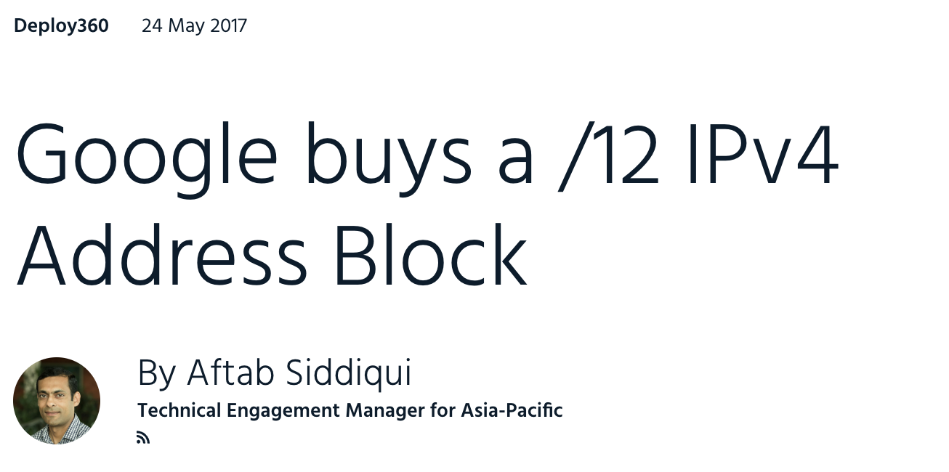
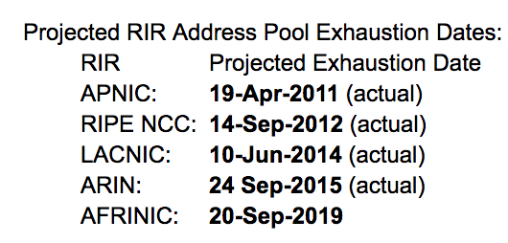
How many IPv4 addresses are left?
https://ipv4.potaroo.net
Available /8 address blocks

Slide 20
NAT: network address translation
motivation: local network uses just one IP address as far as outside world is concerned:
range of addresses not needed from ISP: just one IP address for all devices
can change addresses of devices in local network without notifying outside world
can change ISP without changing addresses of devices in local network
devices inside local net not explicitly addressable, visible by outside world (a “security” plus)

Slide 21
NAT: network address translation
rest of
Internet
local network
(e.g., home network)
10.0.0/24
10.0.0.1
10.0.0.4
10.0.0.2
138.76.29.7
10.0.0.3
all datagrams leaving local
network have same single source NAT IP address: 138.76.29.7 but, different source port numbers
datagrams with source or
destination in this network
have 10.0.0/24 address for
source, destination (as usual)

Slide 22
IPv6 datagram format
priority: identify priority among datagrams in flow
flow Label: identify datagrams in same “flow”.
(concept of “flow” not well defined).
next header: identify upper layer protocol for data
ver
pri
flow label
payload len
next hdr
hop limit
source address
(128 bits)
destination address
(128 bits)
data
32 bits

Slide 23
IPv6 Addresses
Similar to IPv4 addresses, but 128 bits
Example:
2601:5c2:300:c062:14a7:efa1:78b5:e8a
CIDR still applies:
2601:5c2:300:c062:14a7:efa1:78b5:e8a/64
Subnets are commonly 64 bits! A local network can support 2⁶⁴ devices.
No need for DHCP (although it still exists)
Devices can choose their own address (stateless autoconfiguration). Collisions are unlikely with 2⁶⁴ addresses.
Zero groups can be omitted:
2601:0000:0000:0000:0000:0000:0000:0008/16
2601::8/16
prefix

Slide 24
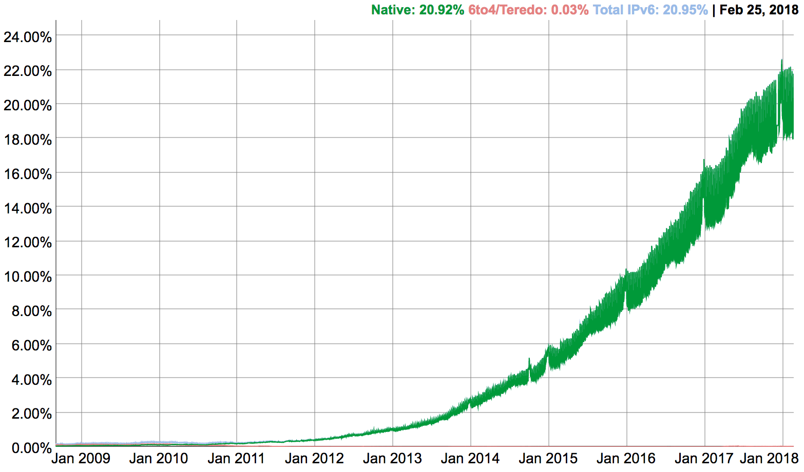
IPv6: adoption
Google: 25% of clients access services via IPv6 (Jan, 2019)
NIST: 1/3 of all US government domains are IPv6 capable
Long (long!) time for deployment, use
20 years and counting!
think of application-level changes in last 20 years: WWW, Facebook, streaming media, Skype, …
Why?

Slide 25
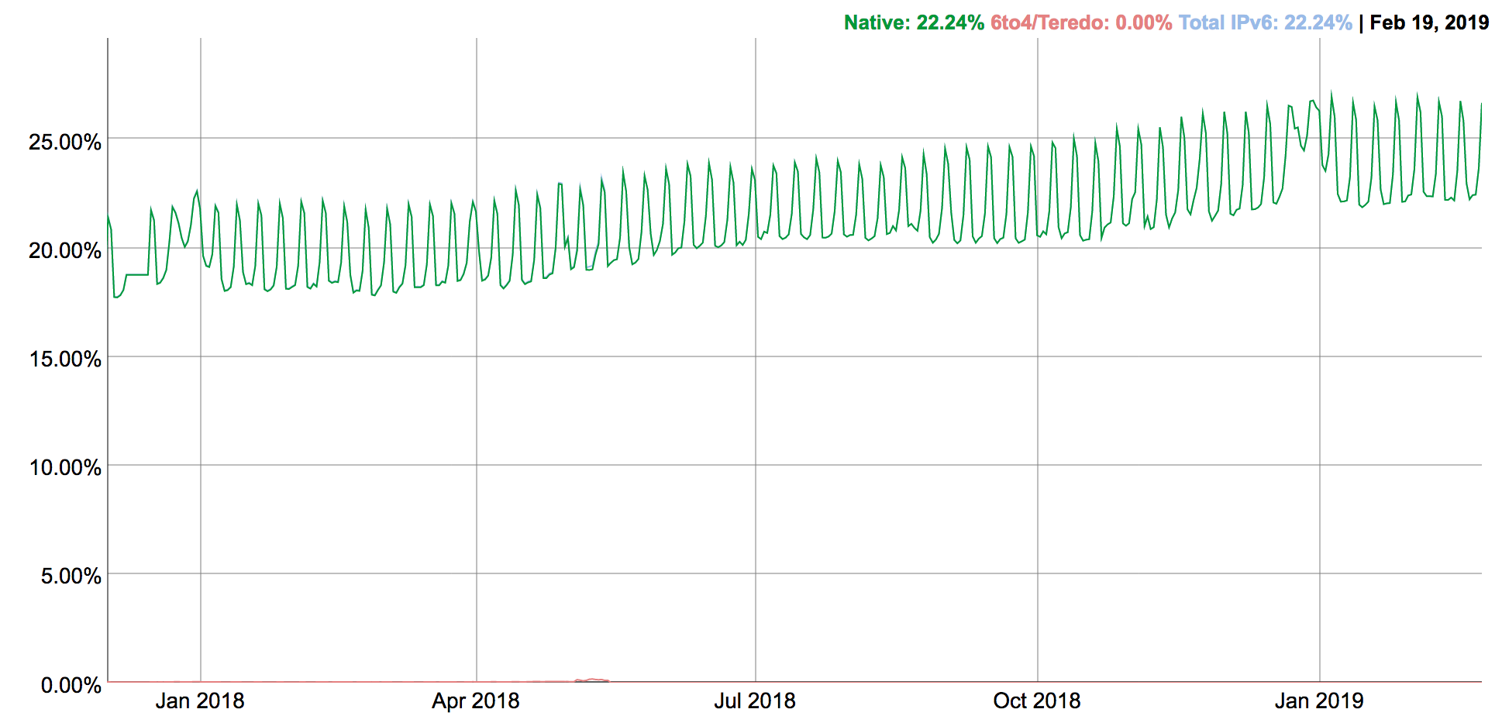
IPv6: adoption (2019 update)

Slide 26
IPv6 for IoT?
Reality: already 10s of billions of devices
IPv6 address space (2¹²⁸) would enable an IP address per device.
IoT devices could directly interact with the Internet, and use familiar protocols.
However, power and software complexity issues make it challenging to run full IPv6 stacks on IoT devices.
Security challenges?
Networking challenges?

Slide 27
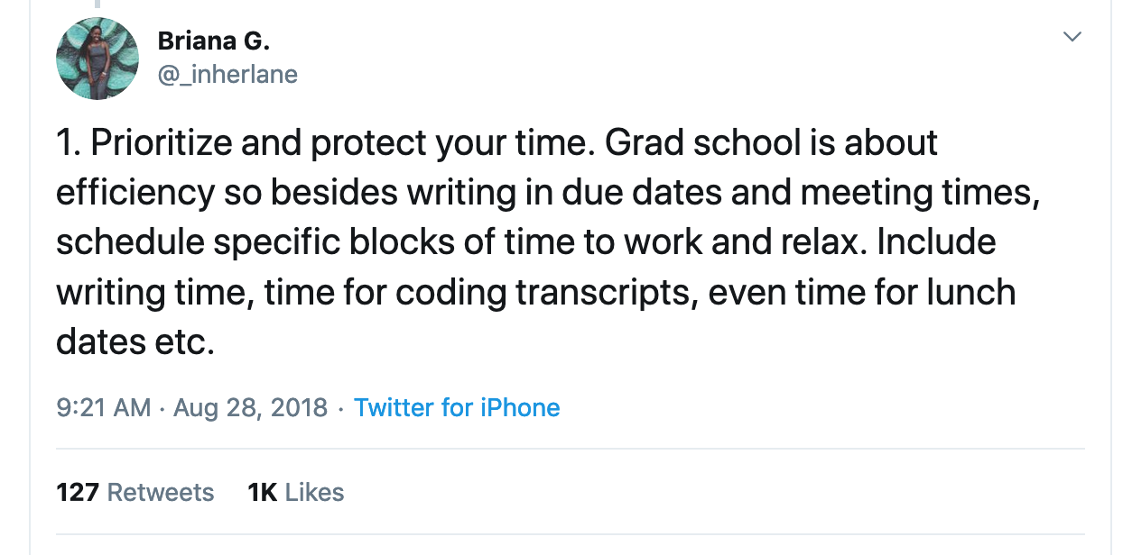
https://twitter.com/_inherlane/status/1034430721971118081

Slide 28
Socket programming with TCP
client must contact server
server process must first be running
server must have created socket (door) that welcomes client’s contact
client contacts server by:
creating TCP socket, specifying IP address, port number of server process
when client creates socket: client TCP establishes connection to server TCP
when contacted by client, server TCP creates new socket for server process to communicate with that particular client
allows server to talk with multiple clients
source port numbers used to distinguish clients (more in Chap 3)
application viewpoint:
TCP provides reliable, in-order
byte-stream transfer (“pipe”)
between client and server

Slide 29
Client/server socket interaction: TCP
server (running on hostid)
client
create socket,
port=x, for incoming request:
serverSocket = socket()
wait for incoming
connection request
TCP
connection setup
create socket,
connect to hostid, port=x
connectionSocket =
serverSocket.accept()
clientSocket = socket()
send request using
clientSocket
read request from
connectionSocket
write reply to
connectionSocket
read reply from
clientSocket
close
connectionSocket
close
clientSocket

Slide 30
Example app: Python TCP client
from socket import *
serverName = 'servername'
serverPort = 12000
clientSocket = socket(AF_INET, SOCK_STREAM)
clientSocket.connect((serverName, serverPort))
sentence = input('Input lowercase sentence:')
clientSocket.send(sentence)
modifiedSentence = clientSocket.recv(1024)
print('From Server: {}'.format(modifiedSentence))
clientSocket.close()
create TCP socket for server, remote port 12000
No need to attach server name, port

Slide 31
Example app: Python TCP server
from socket import *
serverPort = 12000
serverSocket = socket(AF_INET, SOCK_STREAM)
serverSocket.bind(('', serverPort))
serverSocket.listen(1)
print('The server is ready to receive')
while 1:
connSocket, addr = serverSocket.accept()
sentence = connSocket.recv(1024)
capitalizedSentence = sentence.upper()
connSocket.send(capitalizedSentence)
connSocket.close()
create TCP welcoming
socket
server begins listening for incoming TCP requests
loop forever
server waits on accept()
for incoming requests, new socket created on return
read bytes from socket (but not address as in UDP)
close connection to this client (but not welcoming socket)

Slide 32

HTTP overview
HTTP: hypertext transfer protocol
Web’s application layer protocol
client/server model
client: browser that requests, receives, (using HTTP protocol) and “displays” Web objects
server: Web server sends (using HTTP protocol) objects in response to requests
HTTP request
PC running
Firefox browser
HTTP response
HTTP request
server
running
Apache Web
server
HTTP response
iphone running
Safari browser

Slide 33
HTTP overview (continued)
uses TCP:
client initiates TCP connection (creates socket) to server, port 80
server accepts TCP connection from client
HTTP messages (application-layer protocol messages) exchanged between browser (HTTP client) and Web server (HTTP server)
TCP connection closed
HTTP is “stateless”
server maintains no information about past client requests
aside
protocols that maintain “state” are complex!
past history (state) must be maintained
if server/client crashes, their views of “state” may be inconsistent, must be reconciled

Slide 34
Method types
HTTP/1.0:
GET
POST
HEAD
asks server to leave requested object out of response
HTTP/1.1:
GET, POST, HEAD
PUT
uploads file in entity body to path specified in URL field
DELETE
deletes file specified in the URL field

Slide 35
HTTP request message
two types of HTTP messages: request, response
HTTP request message:
ASCII (human-readable format)
carriage return character
request line
(GET, POST,
HEAD commands)
line-feed character
GET /index.html HTTP/1.1\r\n
Host: www.cs.virginia.edu\r\n
User-Agent: Firefox/3.6.10\r\n
Accept: text/html,application/xhtml+xml\r\n
Accept-Language: en-us,en;q=0.5\r\n
Accept-Encoding: gzip,deflate\r\n
Accept-Charset: ISO-8859-1,utf-8;q=0.7\r\n
Keep-Alive: 115\r\n
Connection: keep-alive\r\n
\r\n
header
lines
carriage return,
line feed at start
of line indicates
end of header lines

Slide 36
HTTP response message
status line
(protocol
status code
status phrase)
HTTP/1.1 200 OK\r\n
Date: Sun, 26 Sep 2010 20:09:20 GMT\r\n
Server: Apache/2.0.52 (CentOS)\r\n
Last-Modified: Tue, 30 Oct 2007 17:00:02 GMT\r\n
ETag: "17dc6-a5c-bf716880"\r\n
Accept-Ranges: bytes\r\n
Content-Length: 2652\r\n
Keep-Alive: timeout=10, max=100\r\n
Connection: Keep-Alive\r\n
Content-Type: text/html; charset=ISO-8859-1\r\n
\r\n
data data data data data ...
header
lines
data, e.g.,
requested
HTML file

Slide 37
HTTP response status codes
status code appears in 1st line in server-to-client response message.
some sample codes:
200 OK
request succeeded, requested object later in this msg
301 Moved Permanently
requested object moved, new location specified later in this msg (Location:)
400 Bad Request
request msg not understood by server
404 Not Found
requested document not found on this server
505 HTTP Version Not Supported

Slide 38
DNS: domain name system
people: many identifiers:
SSN, name, passport #
Internet hosts, routers:
IP address (32/128 bit) - used for addressing hosts and routers
“name”, e.g., www.yahoo.com - used by humans
Q: how to map between IP address and name, and vice versa?
Domain Name System:
distributed database implemented in hierarchy of many name servers
application-layer protocol: hosts, name servers communicate to resolve names (address/name translation)
note: core Internet function, implemented as application-layer protocol

Slide 39
DNS: services, structure
DNS services
hostname to IP address translation
host aliasing
canonical, alias names
mail server aliasing
load distribution
replicated Web servers: many IP addresses correspond to one name
why not centralize DNS?
single point of failure
traffic volume
distant centralized database
maintenance
A: doesn’t scale!

Slide 40
DNS: a distributed, hierarchical database
Root DNS Servers
…
…
com DNS servers
org DNS servers
edu DNS servers
yahoo.com
DNS servers
pbs.org
DNS servers
vatech.edu
DNS servers
virginia.edu
DNS servers
amazon.com
DNS servers
client wants IP for www.amazon.com; 1st approximation:
client queries root server to find .com DNS server
client queries .com DNS server to get amazon.com DNS server
client queries amazon.com DNS server to get IP address for www.amazon.com

Slide 41
DNS name resolution example
root DNS server
2
host at cs.virginia.edu wants IP address for cs.berkeley.edu
3
TLD DNS server
4
5
iterated query:
contacted server replies with name of server to contact
“I don’t know this name, but ask this server”
local DNS server
uvaarpa.virginia.edu
7
6
1
8
authoritative DNS server
ns.cs.berkeley.edu
requesting host
cs.virginia.edu
cs.berkeley.edu
(23.253.180.102)

Slide 42
DNS records
DNS: distributed db storing resource records (RR)
RR format: (name, value, type, ttl)
type=A
name is hostname
value is IP address
type=CNAME
name is alias name for some “canonical” (the real) name
www.ibm.com is really
servereast.backup2.ibm.com
value is canonical name
type=NS
name is domain (e.g., foo.com)
value is hostname of authoritative name server for this domain
type=MX
value is name of mailserver associated with name

Slide 43
DNS protocol, messages
query and reply messages, both with same message format
2 bytes
2 bytes
msg header
identification: 16 bit # for query, reply to query uses same #
flags:
query or reply
recursion desired
recursion available
reply is authoritative
identification
flags
# questions
# answer RRs
# authority RRs
# additional RRs
questions (variable # of questions)
answers (variable # of RRs)
authority (variable # of RRs)
additional info (variable # of RRs)

Slide 44
Puzzle: DNS True/False
A DNS name (e.g. microsoft.com) may be associated with multiple IP addresses, but each IP address can only be associated with a single DNS name.
False
DNS caching reduces the time to resolve an IP address and reduces DNS traffic on the internet.
True
If all root servers fail, no DNS names can be resolved to IP addresses.
False
If a record for a DNS name is updated, no clients will receive the old record after the change.
False

