Slide 1
CS6456: Graduate Operating Systems
Brad Campbell – bradjc@virginia.edu
https://www.cs.virginia.edu/~bjc8c/class/cs6456-f19/

Slide 2
Problem
Operating systems are large
They continue to evolve and grow
… and are worked on by many people
(Like all other programs) they contain bugs
How to organize them so that bugs do not
… bring down systems
… impede normal operation
… etc.

Slide 3
Operating System Structures
Monolithic systems
Formerly called “the big mess”
Layered systems
Microkernel based systems
Exokernels

Slide 4
Operating System Structures
Monolithic systems
Formerly called “the big mess”
Layered systems
Microkernel based systems
Exokernels
A faulty driver or component can corrupt any data in kernel
Arbitrary damage
Stop system anywhere
… etc.

Slide 5
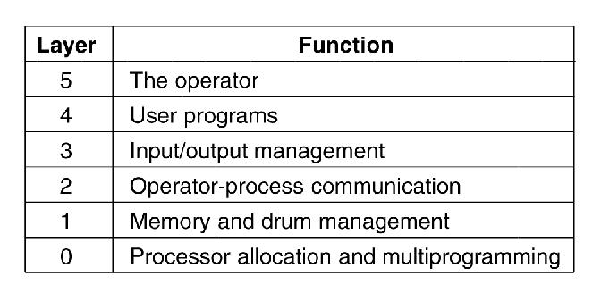
Layered Systems
Figure 1-25. Structure of the THE operating system.

Slide 6
Layered Systems
Simple
Elegant
Incredibly naïve
Figure 1-25. Structure of the THE operating system.

Slide 7
Microkernel — An Organizing Principle
Partition OS kernel into lots of small, independent pieces
Put pieces in separate “processes”
Isolated from each other except for message passing
Keep kernel mode code to a minimum
Concept emerged in 1970s
MACH at CMU (Rick Rashid)
NEXT computer
Apple Mac-OS

Slide 8
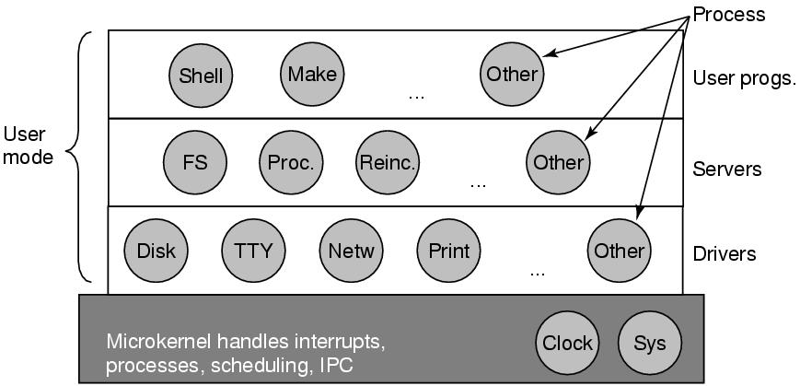
Microkernel Example
Works great on a PDP-11
Memory addressable device registers
Minimal interrupt handling, scheduling, IPC, etc
No virtual memory management
Figure 1-26. Structure of the MINIX 3 system.

Slide 9
Major Advantages
Modularity
Flexibility and extensibility
Easier to replace modules – fewer dependencies
Different servers can implement the same service in different ways
Safety (each server is protected by the OS from other servers)
Servers are largely hardware independent
Correctness
Easier to verify a small kernel
Servers are isolated; errors in one don’t affect others

Slide 10
Major Disadvantages of Early Microkernels
Slow – due to “cross-domain” information transfers?
Server-to-OS, OS-to-server IPC is thought to be a major source of inefficiency
Much faster to communicate between two modules that are both in OS

Slide 11
Microkernel Issues
Virtual memory management
Needs to interact directly with scheduler
Page faults, etc.
Kernel support for user-space threads
Fast I/O devices
Quick, responsive interrupts
Top- and bottom-halves for interrupt handlers
Interprocess communication

Slide 12
Example Systems
Windows NT: introduced HAL layer to support hardware independence.
Other layers not very small
Amoeba (Tanenbaum’s research based OS)
Chorus
Mach (CMU and DARPA) – was the basis for the MAC OS/X and GNU HURD
L4 is a family of publicly available microkernels

Slide 13
Microkernels
A good idea in the 1970s and 80s
Not up to demands of modern processors
Virtual memory
Heavy caching
Not up to demand of modern operating systems
L4 microkernel
“shows that it is possible to achieve well performing μ-kernels through processor-specific implementations of processor-independent abstractions.”

Slide 14
Former Microkernel Resurrection
Mobile phones, PDAs, handheld devices
Fixed or limited functionality
No general purpose files
No dynamic virtual memory
⇒
Simple context switches
All code already in memory
Easy IPC

Slide 15
Motivation for Extensibility
The traditional OS
provides various abstractions of system resources (virtual address spaces, processes, files, interprocess communication)
Provides general-purpose resource management algorithms
System calls define user interface to OS
Able to handle most applications, but handles no applications perfectly because there’s no easy way to specialize the OS to individual needs.
Make operating systems more responsive to applications’ needs; e.g.,
Do your own scheduling
Choose your own page replacement algorithm

Slide 16
Cost of High-Level Abstractions
OS use of high-level abstractions hides info that applications could use to manage their own resources; e.g.
Database systems may be forced to build random-access files on top of the OS file system
Performance and functionality are limited
A large, unmodifiable OS can’t easily incorporate new research developments.

Slide 17


Slide 18
Exokernels
Are a type of OS architecture, not a specific example.
They separate resource allocation & protection (in the kernel) from resource management (done at user level with user-level library operating systems)
Aegis is an example exokernel;
EXOS is an example library OS.

Slide 19
Extensibility Mechanisms
Exokernels rely on application-specific library operating systems to provide user modifications.
SPIN relies on application-specific kernel extensions for the same purpose.
Exokernels are incomplete without a library OS; SPIN is a complete OS that can be modified/extended.

Slide 20
What an Exokernel Does
Multiplexes the hardware directly
Instead of providing an abstraction of the hardware an exokernel makes specific hardware resources directly available to user level applications; e.g., disk blocks instead of files
Provides primitives for secure management of physical resources; applications use them to develop appropriate abstractions.
https://pdos.csail.mit.edu/archive/exo

Slide 21
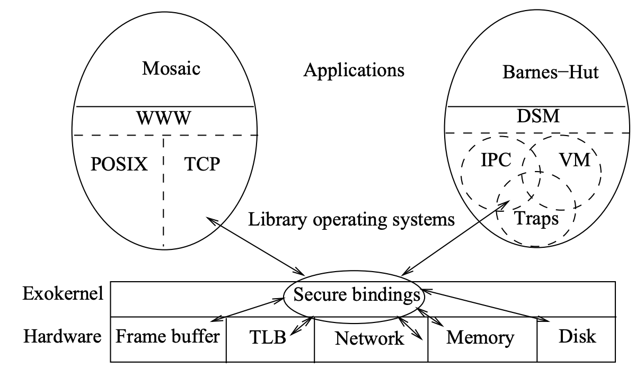
Exokernel Architecture

Slide 22
Secure Bindings
Secure bindings separate resource authorization from resource usage
Protection checks are applied at binding time; checks at resource access time become simple and straightforward.
“Simply put, a secure binding allows the kernel to protect resources without understanding them.”

Slide 23
Library Operating Systems
Untrusted - Built on top of an exokernel
Can be tailored to a set of applications with similar requirements.
Run in user space – fewer system calls to the exokernel => enhanced performance.
Applications can interact with a library OS or interface directly to the exokernel.
Possible to provide a standard interface (e.g. POSIX) for a familiar look.

Slide 24
Summary
Exokernels are responsible for resource allocation/protection, user applications are responsible for resource management.
Exokernel primitives can be implemented efficiently because they are simple
Low-level multiplexing of hardware is fast.
Library OSs enable applications to create appropriate abstractions.
Secure bindings provide protections

Slide 25
The Multikernel: A new OS architecture for scalable multicore systems
New hardware brings diversity
Diversity in systems, diversity in cores, diversity in multiprocessor architectures
How to program with increasingly complex architectures and memory layouts?
Notes:
Previous OS abstractions only had one unit of computation - the CPU. Systems have lots of heterogenous computation hardware: CPUs, GPUs, ASIC/FPGA, programmable NICs….
These different kinds of “processors” should be handled by the OS the same way that CPUs are
Interconnect topology is nearing a breaking point - using message-passing with a single shared interconnect causes serious congestion issues. Using hardware cache coherence to support a shared memory abstraction only exacerbates problems
A multikernel treats the physical system as an interconnected network of cores. OS functionality is implemented as a distributed system using message passing. Shared memory is supported using replication and two-phase commits

Slide 26
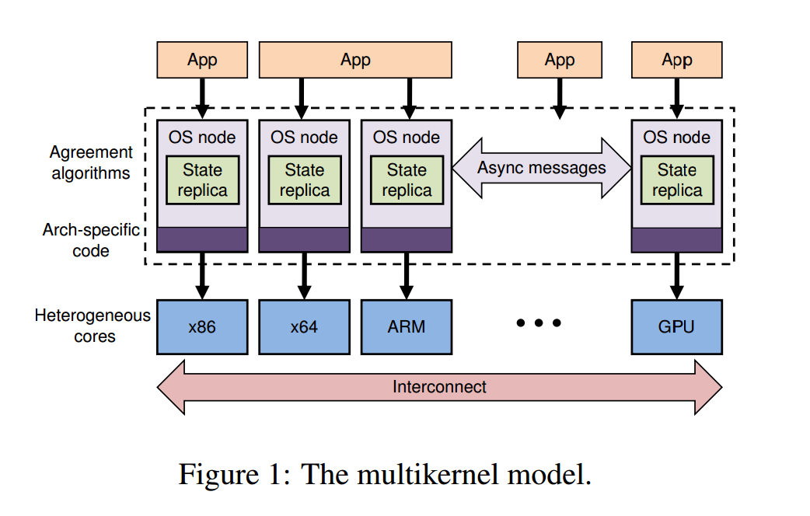

Slide 27
Multikernel Key Points
Make all inter-core communication explicit.
Make OS structure hardware-neutral.
View state as replicated instead of shared.

Slide 28
Make all inter-core communication explicit.
Inter-core communiation uses explicit messages
Avoids shared memory
Multiprocessors look more and more like networks
Using messages allows easy pipelining/batching
Makes interconnect use more efficient
Automated analysis/formal verification
Calculi for reasoning about concurrency

Slide 29
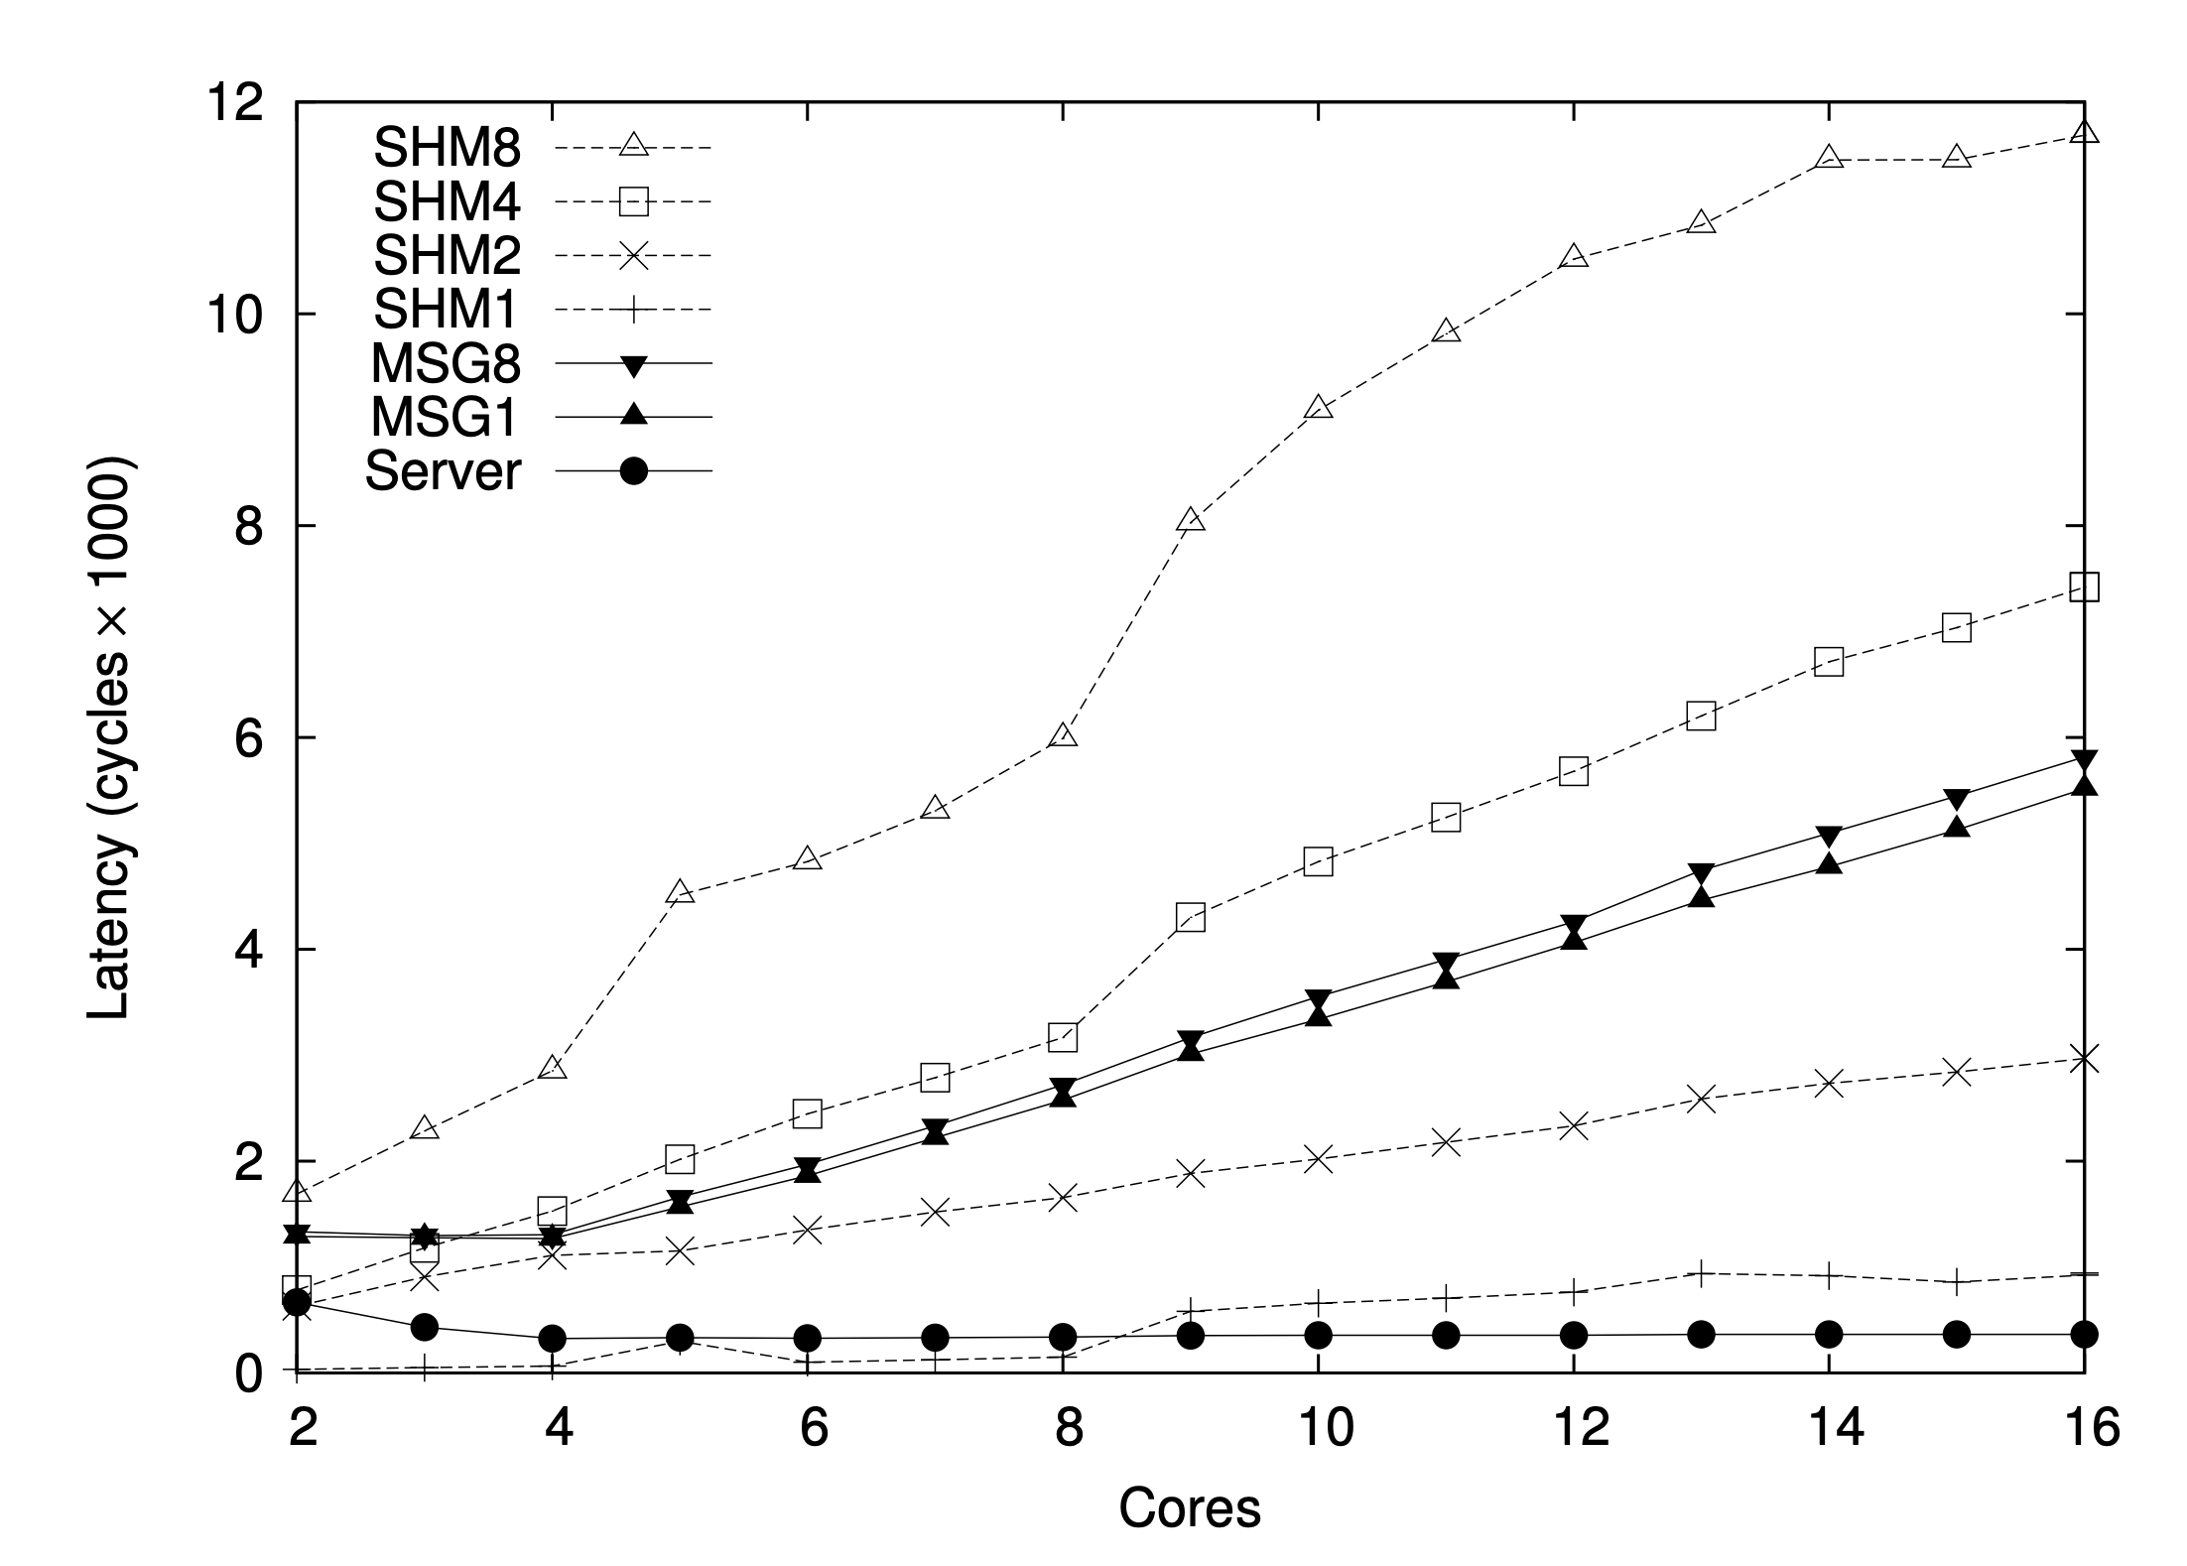
Argument: message passing cheaper than shared memory

Slide 30
Make OS structure hardware-neutral.
Separate OS structure from physical instantiation: abstraction!
Only message transport and hardware interfaces are machine-specific
Minimizes code change to OS
Separate IPC protocols from hardware implementation
Performance/extensibility benefits

Slide 31
View state as replicated instead of shared.
Shared state is accessed as a local replica
Shared state consistency through messages
Consistency reqs tunable using diff protocols
Reduces interconnect traffic and synchronization overhead
Fault-tolerant to failures in CPUs

