Slide 1
CS 162: Operating Systems and Systems Programming
Lecture 2: Multiprogramming & Dual Mode Operation
June 25, 2019
Instructor: Jack Kolb
https://cs162.eecs.berkeley.edu

Slide 2
Recall: What is an OS?
Referee
Resource sharing, protection, isolation
Illusionist: clean, easy to use abstractions
Infinite memory, dedicated machine
Higher level objects: files, users, messages
Masking limitations, virtualization
Glue: Common Services
Storage
Window system
Networking
Authorization

Slide 3
Recall: Virtual Machines
Definition: Software emulation of abstract machine
Programs believe they own the machine
Simulated "hardware" has the features we want
Two types:
Process VM: Run a single program in the VM, e.g. an OS
System VM: Run entire OS & its apps in the VM, e.g. Virtualbox, VMWare, Xen

Slide 4
Recall: Protecting Processes
Use two features offered by hardware:
Dual Mode Operation
Processes run in user or kernel mode
Some operations prohibited in user mode
Address Translation
Each process has a distinct and isolated address space
Hardware translates from virtual to physical addresses
Policy: No program can read or write memory of another program or of the OS

Slide 5
Today: Four Fundamental OS Concepts
Thread: Execution Context
Program Counter, Registers, Execution Flags, Stack
Address space (with translation)
Program's view of memory is distinct from physical machine
Process: an instance of a running program
Address Space + One or more Threads
Dual mode operation / Protection
Only the “system” can access certain resources
Combined with translation, isolates programs from each other

Slide 6

OS Bottom Line: Run Programs
0xFFF…
Executable
Program Source
OS
int main()
{ … ;
}
compiler
data
Load & Execute
stack
editor
Memory
instructions
heap
a.out
data
foo.c
Load instruction and data segments of executable file into memory
Create stack and heap
“Transfer control to program”
Provide services to program
While protecting OS and program
instructions
0x000…
PC:
registers
Processor

Slide 7
Review (61C): Instruction Fetch/Decode/Execute
The instruction cycle
Memory
Processor
next
PC:
Instruction fetch
instruction
Decode
decode
Registers
Execute
ALU
data

Slide 8
Review (61C): What happens during program execution?
Addr 2³²-1
R0
…
R31
F0
…
F30
PC
…
Data1
Data0
Inst237
Inst236
…
Inst5
Inst4
Inst3
Inst2 Inst1
Inst0
Fetch
Exec
Execution sequence:
Fetch Instruction at PC
Decode
Execute (possibly using registers)
Write results to registers/mem
PC = Next Instruction(PC)
Repeat
PC
PC
PC
PC
Addr 0

Slide 9
Today: Four Fundamental OS Concepts
Thread: Execution Context
Program Counter, Registers, Execution Flags, Stack
Address space (with translation)
Program's view of memory is distinct from physical machine
Process: an instance of a running program
Address Space + One or more Threads
Dual mode operation / Protection
Only the “system” can access certain resources
Combined with translation, isolates programs from each other

Slide 10
Threads of Control
Definition: A single, unique execution context
Program counter, registers, stack
A thread is executing on a processor when it is resident in that processor's registers
Registers hold the root state of the thread:
The rest is "in memory"
Including program counter – the currently executing instruction
Registers point to thread state in memory:
Stack pointer to the top of the thread's (own) stack

Slide 11
Multiprogramming - Multiple Threads of Control
Thrd. 1
Thrd. 2
Thrd. n
stack
…
heap
Static Data
OS
code
stack
heap
Static Data
code
stack
heap
Static Data
code

Slide 12
Illusion of Multiple Processors
vCPU1
vCPU2
vCPU3
vCPU1
vCPU2
vCPU3
vCPU1
vCPU2
Shared Memory
Time
Threads are virtual cores
Multiple threads: Multiplex hardware in time

Slide 13
Illusion of Multiple Processors
vCPU1
vCPU2
vCPU3
vCPU1
vCPU2
vCPU3
vCPU1
vCPU2
Shared Memory
Time
Contents of virtual core (thread):
Program counter, stack pointer
Registers
Where is it?
On the real (physical) core, or
Saved in memory – called the Thread Control Block (TCB)

Slide 14
Illusion of Multiple Processors
vCPU1
vCPU2
vCPU3
T1
T2
vCPU1
vCPU2
vCPU3
vCPU1
vCPU2
Shared Memory
Time
At T1: vCPU1 on real core, vCPU2 in memory
At t2: vCPU2 on real core, vCPU1 in memory
What happened?
OS Ran [how?]
Saved PC, SP, … in vCPU1's thread control block (memory)
Loaded PC, SP, … from vCPU2's TCB, jumped to PC

Slide 15
Very Simple Multiprogramming
All vCPU's share non-CPU resources
Memory, I/O Devices
Each thread can read/write data of others
Threads can overwrite OS functions
Unusable? No. This approach is used in
Embedded applications
MacOS 1-9/Windows 3.1 (switch only with voluntary yield)
Windows 95-ME (switch with yield or timer)

Slide 16
Today: Four Fundamental OS Concepts
Thread: Execution Context
Program Counter, Registers, Execution Flags, Stack
Address space (with translation)
Program's view of memory is distinct from physical machine
Process: an instance of a running program
Address Space + One or more Threads
Dual mode operation / Protection
Only the “system” can access certain resources
Combined with translation, isolates programs from each other

Slide 17
Second OS Concept: Address Space
Definition: Set of accessible addresses and the state associated with them
2³² = ~4 billion on a 32-bit machine
What happens when you read or write to an address?
Perhaps nothing
Perhaps acts like regular memory
Perhaps causes I/O operation
(Memory-mapped I/O)
Crash
Communicate with another program
0xFFF…
stack
heap
Static Data
code
0x000…

Slide 18
Address Space: In a Picture
0xFFF…
stack
PC:
SP:
heap
Processor
registers
Static Data
instruction
Code Segment
0x000…

Slide 19
Base and Bound w/o Translation
0000…
0000…
code
code
Static Data
Static Data
heap
heap
stack
0100…
stack
Base
0010…
1000…
1000…
code
>=
Program
address
1010…
Static Data
heap
Bound
<
1100…
stack
1100…
Requires relocating loader
Still protects OS and isolates program
No addition on address path
FFFF…

Slide 20
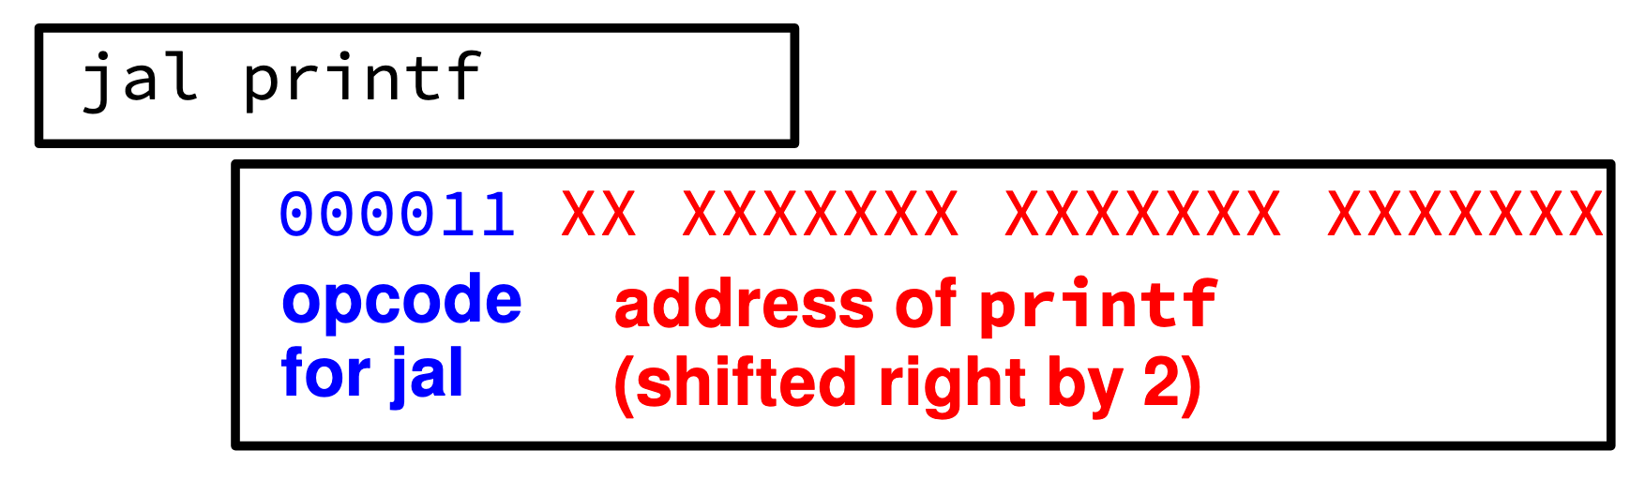
Relocation: Quick Review
Have to modify program instructions when loading
Addresses need to point to the right place!

Slide 21
Address Space Translation
Program operates in an address space that is distinct from the physical memory space of the machine
“physical address”
0x000…
“virtual address”
Processor
translator
Memory
0xFFF…

Slide 22
Base and Bound w/ Translation
0000…
code
0000…
code
Static Data
heap
Static Data
heap
stack
0100…
stack
Base Address
1000…
code
1000…
0010…
Program
address
0010…
Static Data
1010…
heap
Bound
<
stack
1100…
0100…
Can the program touch OS?
Can it touch other programs?
FFFF…

Slide 23
Virtual Address Translation/Paging
Ostensibly introduced in CS 61C
Much more on this later in 162!
Gives every process the whole address range
Breaks memory into pages (~4K chunks)
Allows unallocated "holes" and other tricks

Slide 24
Today: Four Fundamental OS Concepts
Thread: Execution Context
Program Counter, Registers, Execution Flags, Stack
Address space (with translation)
Program's view of memory is distinct from physical machine
Process: an instance of a running program
Address Space + One or more Threads
Dual mode operation / Protection
Only the “system” can access certain resources
Combined with translation, isolates programs from each other

Slide 25
The Process
Definition: execution environment with restricted rights
Address Space with One or More Threads
Owns memory (address space)
Owns file descriptors, file system context, …
Encapsulate one or more threads sharing process resources
Why processes?
Protected from each other!
OS Protected from them
Tradeoff: protection vs. efficiency
Threads more efficient than processes (more later)
Application: one or more processes

Slide 26
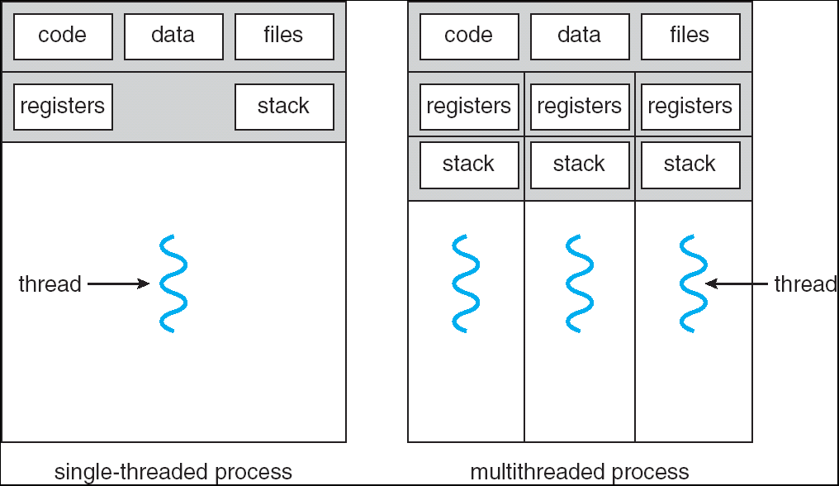
Single and Multithreaded Processes
Threads encapsulate concurrency: “Active” component
Address spaces encapsulate protection: “Passive” part
Keeps buggy program from trashing the system
Why have multiple threads per address space?

Slide 27
Protection
Why?
Reliability: buggy programs only hurt themselves
Security and privacy: trust programs less
Fairness: enforce shares of disk, CPU
Mechanisms:
Address translation: address space only contains its own data
Privileged instructions, registers
Syscall processing (e.g., enforce file access rights)

Slide 28
Today: Four Fundamental OS Concepts
Thread: Execution Context
Program Counter, Registers, Execution Flags, Stack
Address space (with translation)
Program's view of memory is distinct from physical machine
Process: an instance of a running program
Address Space + One or more Threads
Dual mode operation / Protection
Only the “system” can access certain resources
Combined with translation, isolates programs from each other

Slide 29
Dual Mode Operation: HW Support
1 bit of state (user/kernel mode bit)
Certain actions only permitted in kernel mode
User->Kernel mode sets kernel mode, saves user PC
Only transition to OS-designated addresses
OS can save the rest of the user state if necessary
Kernel->User mode sets user mode, restores user PC

Slide 30
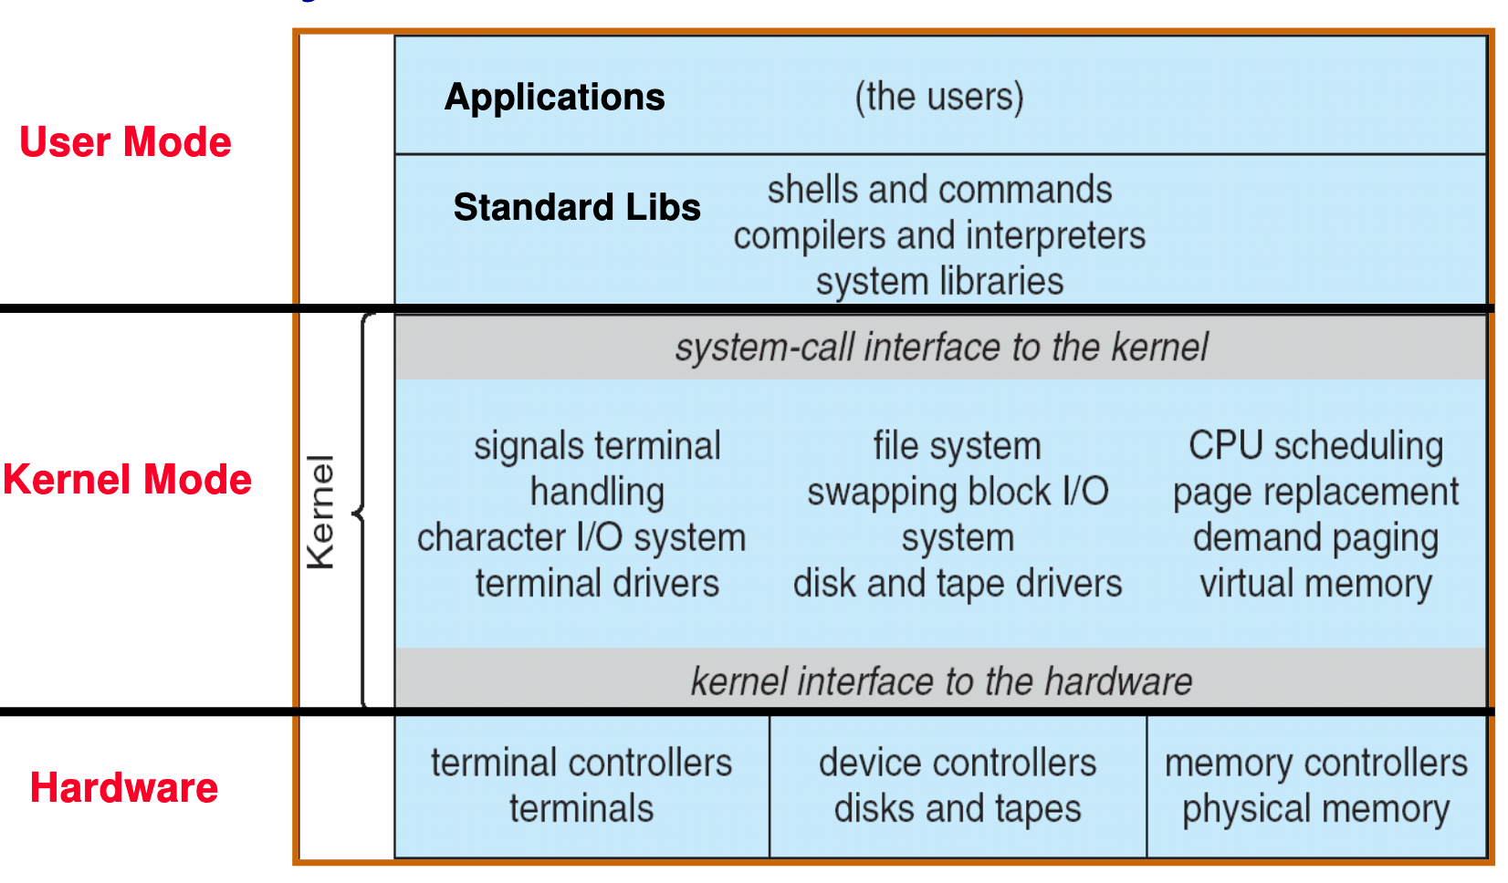
UNIX Structure

Slide 31
Break

Slide 32
User/Kernel (Privileged) Mode
User Mode
interrupt
exception
syscall
rtn
rfi
Kernel Mode
exit
exec
Limited HW access
Full HW access

Slide 33
3 Types of U→K Mode Switches
System Call (syscall)
"Function call" into the kernel
Example: exit, read
Kernel reads syscall id # and arguments from user registers
Interrupt
External asynchronous events: Timer, I/O
Trap or Exception
Special event in process
Protection violation (segfault), divide by zero
All 3 are an implicit transfer of control

Slide 34
Where do mode transfers go?
Cannot let user program specify (why?)
Solution: Interrupt Vector
Address and properties of each interrupt handler
interrupt number (i)
intrpHandler_i () {
…
}

Slide 35
Implementing Safe Kernel Mode Transfers
Carefully constructed kernel code packs up the user process state and sets it aside
Must handle weird/buggy/malicious user state
Syscalls with null pointers
Return instruction out of bounds
User stack pointer out of bounds
Should be impossible for buggy or malicious user program to cause the kernel to corrupt itself
User program should not know interrupt has occurred (transparency)

Slide 36
The Kernel Stack
Interrupt handlers want a stack
System call handlers want a stack
Can't just use the user stack [why?]

Slide 37
The Kernel Stack
Solution: two-stack model
Each OS thread has kernel stack (located in kernel memory) plus user stack (located in user memory)
Place to save user registers during interrupt

Slide 38
Before Interrupt

Slide 39
During Interrupt

Slide 40
Kernel System Call Handler
Vector through well-defined syscall entry points!
Table mapping system call number to handler
Locate arguments
In registers or on user (!) stack
Copy arguments
From user memory into kernel memory – carefully checking locations!
Protect kernel from malicious code evading checks
Validate arguments
Protect kernel from errors in user code
Copy results back
Into user memory – carefully checking locations!

Slide 41
Hardware support: Interrupt Control
Interrupt processing not visible to the user process:
Occurs between instructions, restarted transparently
No change to process state
What can be observed even with perfect interrupt processing?
Interrupt Handler invoked with interrupts ‘disabled’
Re-enabled upon completion
Non-blocking (run to completion, no waits)
Pack up in a queue and pass off to an OS thread for hard work
wake up an existing OS thread

Slide 42
Hardware support: Interrupt Control
OS kernel may enable/disable interrupts
On x86: CLI (disable interrupts), STI (enable)
Atomic section when select next process/thread to run
Atomic return from interrupt or syscall
HW may have multiple levels of interrupts
Mask off (disable) certain interrupts, eg., lower priority
Certain Non-Maskable-Interrupts (NMI)
e.g., kernel segmentation fault
Also: Power about to fail!

Slide 43
How do we take interrupts safely?
Interrupt vector
Limited number of entry points into kernel
Kernel interrupt stack
Handler works regardless of state of user code
Interrupt masking
Handler is non-blocking
Atomic transfer of control
“Single instruction”-like to change:
Program counter
Stack pointer
Memory protection
Kernel/user mode
Transparent restartable execution
User program does not know interrupt occurred

Slide 44
Today: Four Fundamental OS Concepts
Thread: Execution Context
Program Counter, Registers, Execution Flags, Stack
Address space (with translation)
Program's view of memory is distinct from physical machine
Process: an instance of a running program
Address Space + One or more Threads
Dual mode operation / Protection
Only the “system” can access certain resources
Combined with translation, isolates programs from each other

Slide 45
Putting It Together: Mode Transfer & Translation
Mode transfer should change address translation mapping
Examples:
Ignore base and bound in kernel mode
Page tables with "kernel mode only" bits

Slide 46
Base & Bound: OS Loads Process
0000…
Proc 1
Proc 2
Proc n
code
…
Static Data
OS
heap
stack
sysmode
1
1000…
code
Base
xxxx …
0000…
Static Data
Bound
xxxx…
FFFF…
heap
uPC
xxxx…
stack
1100…
PC
code
3000…
regs
Static Data
…
heap
stack
3080…
FFFF…

Slide 47
Base & Bound: About to Switch
0000…
Proc 1
Proc 2
Proc n
code
RTU
…
Static Data
OS
heap
stack
sysmode
1
1000…
code
Base
1000 …
0000…
Static Data
Bound
1100…
FFFF…
heap
uPC
0001…
stack
1100…
PC
code
3000…
regs
00FF…
Static Data
…
heap
Privileged Inst: set special registers
RTU
stack
3080…
FFFF…

Slide 48
Simple B&B: User Code Running
0000…
Proc 1
Proc 2
Proc n
code
…
Static Data
OS
heap
stack
sysmode
0
1000…
code
Base
1000 …
Static Data
Bound
1100…
heap
uPC
xxxx…
stack
1100…
PC
code
3000…
regs
Static Data
…
heap
stack
3080…
FFFF…

Slide 49
Base & Bound: Handling Interrupt
0000…
Proc 1
Proc 2
Proc n
code
…
Static Data
OS
heap
stack
sysmode
1
1000…
code
Base
1000 …
0000…
Static Data
Bound
1100 …
FFFF…
heap
uPC
0000 1234
stack
1100…
PC
IntrpVector[i]
code
3000…
regs
00FF…
Static Data
Save registers and set up system stack
…
heap
stack
3080…
FFFF…

Slide 50
How do we switch between processes?
We already have all the necessary machinery!
Just requires two mode transfers

Slide 51
Base & Bound: Switch User Process
0000…
Proc 1
Proc 2
Proc n
code
RTU
…
Static Data
OS
heap
stack
sysmode
1
1000…
code
Base
3000 …
0000…
Static Data
Bound
0080 …
FFFF…
heap
uPC
0000 0248
stack
1100…
PC
0001 0124
code
3000…
Need to save registers of Proc 1 and restore those of Proc 2
Static Data
…
heap
stack
3080…
FFFF…

Slide 52
Base & Bound: Switch User Process
0000…
Proc 1
Proc 2
Proc n
code
RTU
…
Static Data
OS
heap
stack
sysmode
0
1000…
code
Base
1000 …
0000…
Static Data
Bound
1100 …
FFFF…
heap
uPC
xxxxxx
stack
1100…
PC
0000 100
code
3000…
Static Data
…
heap
stack
3080…
FFFF…

Slide 53
Representing Processes: PCB
0000…
Proc 1
Proc 2
Proc n
code
RTU
…
Static Data
OS
heap
stack
sysmode
0
1000…
code
Base
1000 …
0000…
Static Data
Bound
1100 …
FFFF…
heap
1000 …
uPC
xxxxxx
1100 …
stack
1100…
PC
0000 100
0000 1234
code
3000…
regs
Static Data
…
heap
00FF…
stack
3080…
FFFF…

Slide 54
Process Control Block
Kernel representation of each process
Status (running, ready, blocked)
Register state (if not running)
Thread control block(s)
Process ID
Execution time
Memory translations
Scheduler maintains a data structure of PCBs
Scheduling algorithm: Which process should the OS run next?

Slide 55
Scheduler
if ( readyProcesses(PCBs) ) {
nextPCB = selectProcess(PCBs);
run( nextPCB );
} else {
run_idle_process();
}
Scheduling: Mechanism for deciding which processes/threads receive the CPU
Lots of different scheduling policies provide …
Fairness or
Realtime guarantees or
Latency optimization or ..

Slide 56
Putting it together: web server
Server
4. parse request
9. format reply
request
buffer
reply
buffer
network
socket
read
3. kernel
copy
10. network
socket
write
5. file
read
8. kernel
copy
syscall
syscall
Kernel
wait
RTU
11. kernel copy
from user buffer
to network buffer
RTU
interrupt
interrupt
2. copy arriving
packet (DMA)
12. format outgoing
packet and DMA
6. disk
request
7. disk data
(DMA)
Hardware
Network
interface
Disk interface
Request
Reply

Slide 57
Conclusion: Four OS Concepts
Thread: Execution Context
Program Counter, Registers, Execution Flags, Stack
Address space (with translation)
Program's view of memory is distinct from physical machine
Process: an instance of a running program
Address Space + One or more Threads
Dual mode operation / Protection
Only the “system” can access certain resources
Combined with translation, isolates programs from each other

