Slide 1
CS 162: Operating Systems and Systems Programming
Lecture 3: Process Management, Threads, and Concurrency
June 26, 2019
Instructor: Jack Kolb
https://cs162.eecs.berkeley.edu

Slide 2
Recall: Process
Execution environment with restricted rights
Address Space with One or More Threads
Owns file descriptors, file system context, …
Encapsulate one or more threads sharing process resources
Protected from each other
Compromise: sharing harder, less efficient
OS protected from processes

Slide 3
Recall: Illusion of Multiple Processors
vCPU1
vCPU2
vCPU3
T1
T2
vCPU1
vCPU2
vCPU3
vCPU1
vCPU2
Shared Memory
Time
Threads are virtual cores
At T1: vCPU1 on real core, vCPU2 in memory
At t2: vCPU2 on real core, vCPU1 in memory
What happened?
OS Ran [how?]
Saved PC, SP, … in vCPU1's thread control block (memory)
Loaded PC, SP, … from vCPU2's TCB, jumped to PC

Slide 4
Recall: Base and Bound w/ Translation
0000…
code
0000…
code
Static Data
heap
Static Data
heap
stack
0100…
stack
Base Address
1000…
code
1000…
0010…
Program
address
0010…
Static Data
1010…
heap
Bound
<
stack
1100…
0100…
FFFF…

Slide 5
"Lifecycle" of an Instruction
Programmer writes C source code
e.g. printf("%d\n", 4815);
Programmer compiles their C code
gcc -o myProgram myProgram.c
Calling printf: "call" 0x1623 (simplification)
Now we have a binary file sitting on disk
Run program: OS loads file's code and data into a new address space (./myProgram in shell)
call instruction located somewhere within instruction region of process memory image
When program reaches call, we need to fetch next instruction from proper address in memory

Slide 6
"Lifecycle" of an Instruction
No Protection
B&B w/o Trans.
Base = 0x1000
Binary File
call 0x1623
call 0x1623
Loaded in Memory
call 0x1623
call 0x2623
Retrieve Next Instruction From:
0x1623
0x2623

Slide 7
"Lifecycle" of an Instruction
B&B w/o Trans.
B&B w/ Trans.
Base = 0x1000
Base = 0x1000
Binary File
call 0x1623
call 0x1623
Loaded in Memory
call 0x2623
call 0x1623
Retrieve Next Instruction From:
0x2623
0x2623

Slide 8
Problems with Base & Bound
How much space do we initially give a process?
Unused Space: Internal Fragmentation

Slide 9
Problems with Base & Bound
What if we have to expand an address space?
May not be adjacent space available
Copy entire region over to a larger empty region
Slow!

Slide 10
Problems with Base & Bound
Where do we place a new address space in physical memory?
External Fragmentation: Enough free space in total, but not in any one, contiguous region

Slide 11
Recall: Switching Processes (1)
0000…
Proc 1
Proc 2
Proc n
code
…
Static Data
OS
heap
stack
sysmode
1
1000…
code
Base
1000 …
0000…
Static Data
Bound
1100 …
FFFF…
heap
uPC
0000 1234
stack
1100…
PC
IntrpVector[i]
code
3000…
regs
00FF…
Static Data
Save registers and set up system stack
…
heap
stack
3080…
FFFF…

Slide 12
Recall: Switching Processes (2)
0000…
Proc 1
Proc 2
Proc n
code
RTU
…
Static Data
OS
heap
stack
sysmode
1
1000…
code
Base
3000 …
0000…
Static Data
Bound
3080 …
FFFF…
heap
uPC
0000 3048
stack
1100…
PC
0001 0124
code
3000…
Need to save registers of Proc 2 and restore those of Proc 1
Static Data
…
heap
stack
3080…
FFFF…

Slide 13
Recall: Switching Processes (3)
0000…
Proc 1
Proc 2
Proc n
code
…
Static Data
OS
heap
stack
sysmode
0
1000…
code
Base
3000 …
0000…
Static Data
Bound
3080 …
FFFF…
heap
uPC
xxxx xxxx
stack
1100…
PC
000 0248
code
3000…
Static Data
…
heap
stack
3080…
FFFF…

Slide 14
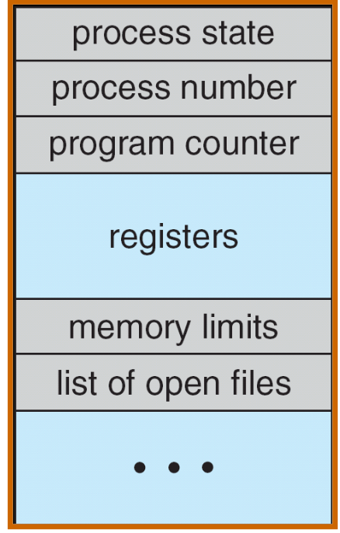
Recall: Process Control Block
Kernel representation of each process
Status (running, ready, blocked)
Register state (if not running)
Thread control block(s)
Process ID
Execution time
Memory translations
Scheduler maintains a data structure of PCBs
Scheduling algorithm: Which process should the OS run next?

Slide 15
Recall: U→K Mode Switches
System Call (syscall)
"Function call" into the kernel
Example: exit, read
Kernel reads syscall id # and arguments from user registers
Interrupt
External asynchronous events: Timer, I/O
Trap or Exception
Special event in process
Protection violation (segfault), divide by zero
All 3 are an implicit transfer of control

Slide 16
Recall: Scheduler
if ( readyProcesses(PCBs) ) {
nextPCB = selectProcess(PCBs);
run( nextPCB );
} else {
run_idle_process();
}
Scheduling: Mechanism for deciding which processes/threads receive the CPU
Lots of different scheduling policies provide …
Fairness or
Realtime guarantees or
Latency optimization or ..

Slide 17
Process Operations
Processes need to manipulate other processes:
Start a new process
Exit
Wait for another process to terminate
Processes need to do various other tasks, e.g., I/O
How? System calls

Slide 18
What does "syscall" really mean?
Application programmers generally don’t write syscalls directly
Can’t in C without inline assembly, etc.
Instead, OS libraries do this on our behalf

Slide 19
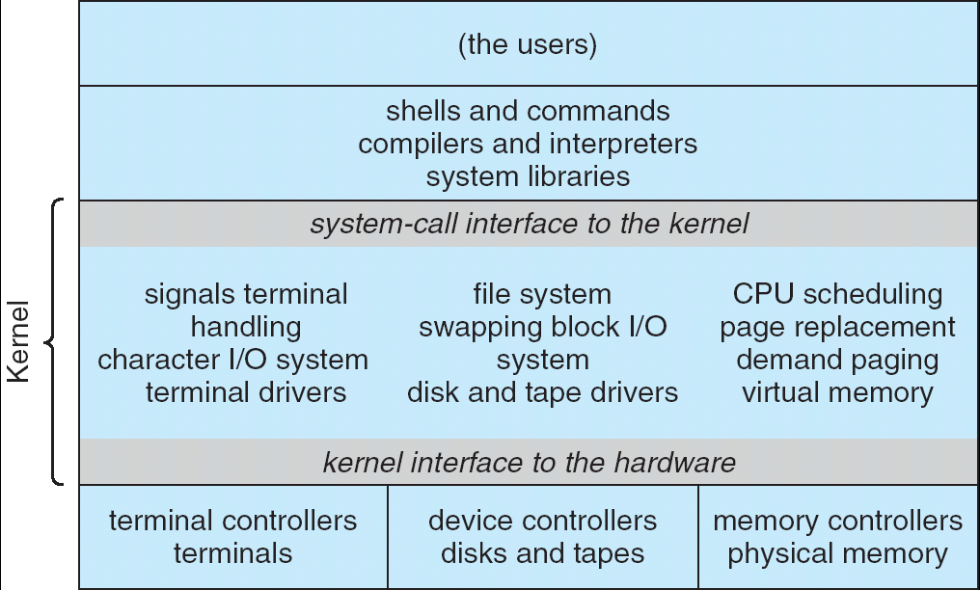
Recall: UNIX System Structure
Applications
User Mode
Standard Libs
Kernel Mode
Hardware

Slide 20
OS Run-Time Library
Proc 1
Proc 2
Proc n
…
OS
Appln
login
Window Manager
…
OS library
OS library
OS library
OS

Slide 21
A Narrow Waist
Word Processing
Compilers
Web Browsers
Email
Databases
Web Servers
Application / Service
Portable OS Library
OS
User
System Call
Interface
System
Portable OS Kernel
Software
Platform support, Device Drivers
Hardware
x86
PowerPC
ARM
PCI
Ethernet (1Gbs/10Gbs)
802.11 a/g/n/ac
SCSI
Graphics
Thunderbolt

Slide 22
POSIX/Unix
Portable Operating System Interface [X?]
Defines “Unix”, derived from AT&T Unix
Created to bring order to many Unix-derived OSs
Interface for application programmers (mostly)

Slide 23
pid.c
#include <stdlib.h>
#include <stdio.h>
#include <unistd.h>
#include <sys/types.h>
int main(int argc, char *argv[]) {
/* get current process’s PID */
pid_t pid = getpid();
printf(“My pid: %d\n”, (int) pid);
exit(0);
}

Slide 24
Process Management
fork – copy the current process
exec – change the program being run by the current process
wait – wait for a process to finish
kill – send a signal (interrupt-like notification) to another process
sigaction – set handlers for signals

Slide 25
Creating Processes
pid_t fork(); -- copy the current process
New process has different pid
Return value from fork(): pid (like an integer)
When > 0:
Running in (original) Parent process
return value is pid of new child
When = 0:
Running in new Child process
When < 0:
Error! Must handle somehow
Running in original process
State of original process duplicated in both Parent and Child!
Memory, File Descriptors (covered later), etc…

Slide 26
What happens when we use fork?
0000…
Parent
Child
code
Static Data
OS
heap
stack
1000 …
sysmode
1
1000…
code
1100 …
Base
1000 …
0000…
Static Data
0000 1234
Bound
1100 …
FFFF…
heap
regs
uPC
0000…
stack
1100…
00FF…
PC
code
3000…
3000 …
Static Data
3080 …
…
heap
0000 1234
stack
3080…
regs
FFFF…
00FF…

Slide 27
fork1.c
#include <stdlib.h>
#include <stdio.h>
#include <unistd.h>
#include <sys/types.h>
int main(int argc, char *argv[]) {
pid_t cpid, mypid;
pid_t pid = getpid(); /* get current processes PID */
printf("Parent pid: %d\n", pid);
cpid = fork();
if (cpid > 0) { /* Parent Process */
mypid = getpid();
printf("[%d] parent of [%d]\n", mypid, cpid);
} else if (cpid == 0) { /* Child Process */
mypid = getpid();
printf("[%d] child\n", mypid);
} else {
perror("Fork failed");
}
}

Slide 28
fork1.c
#include <stdlib.h>
#include <stdio.h>
#include <unistd.h>
#include <sys/types.h>
int main(int argc, char *argv[]) {
pid_t cpid, mypid;
pid_t pid = getpid(); /* get current processes PID */
printf("Parent pid: %d\n", pid);
cpid = fork();
if (cpid > 0) { /* Parent Process */
mypid = getpid();
printf("[%d] parent of [%d]\n", mypid, cpid);
} else if (cpid == 0) { /* Child Process */
mypid = getpid();
printf("[%d] child\n", mypid);
} else {
perror("Fork failed");
}
}

Slide 29
fork1.c
#include <stdlib.h>
#include <stdio.h>
#include <unistd.h>
#include <sys/types.h>
int main(int argc, char *argv[]) {
pid_t cpid, mypid;
pid_t pid = getpid(); /* get current processes PID */
printf("Parent pid: %d\n", pid);
cpid = fork();
if (cpid > 0) { /* Parent Process */
mypid = getpid();
printf("[%d] parent of [%d]\n", mypid, cpid);
} else if (cpid == 0) { /* Child Process */
mypid = getpid();
printf("[%d] child\n", mypid);
} else {
perror("Fork failed");
}
}

Slide 30
fork1.c
#include <stdlib.h>
#include <stdio.h>
#include <unistd.h>
#include <sys/types.h>
int main(int argc, char *argv[]) {
pid_t cpid, mypid;
pid_t pid = getpid(); /* get current processes PID */
printf("Parent pid: %d\n", pid);
cpid = fork();
if (cpid > 0) { /* Parent Process */
mypid = getpid();
printf("[%d] parent of [%d]\n", mypid, cpid);
} else if (cpid == 0) { /* Child Process */
mypid = getpid();
printf("[%d] child\n", mypid);
} else {
perror("Fork failed");
}
}

Slide 31
fork1.c
#include <stdlib.h>
#include <stdio.h>
#include <unistd.h>
#include <sys/types.h>
int main(int argc, char *argv[]) {
pid_t cpid, mypid;
pid_t pid = getpid(); /* get current processes PID */
printf("Parent pid: %d\n", pid);
cpid = fork();
if (cpid > 0) { /* Parent Process */
mypid = getpid();
printf("[%d] parent of [%d]\n", mypid, cpid);
} else if (cpid == 0) { /* Child Process */
mypid = getpid();
printf("[%d] child\n", mypid);
} else {
perror("Fork failed");
}
}

Slide 32
fork_race.c
int i;
cpid = fork();
if (cpid > 0) {
for (i = 0; i < 10; i++) {
printf("Parent: %d\n", i);
// sleep(1);
}
} else if (cpid == 0) {
for (i = 0; i > -10; i--) {
printf("Child: %d\n", i);
// sleep(1);
}
}
What does this print?
Would adding the calls to sleep matter?

Slide 33
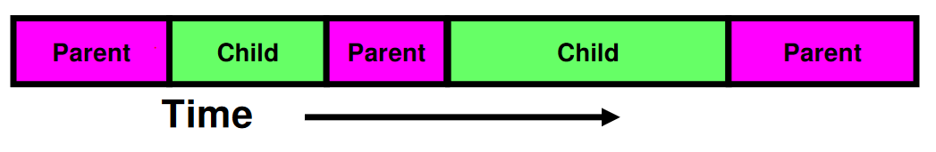
fork_race.c
int i;
cpid = fork();
if (cpid > 0) {
for (i = 0; i < 10; i++) {
printf("Parent: %d\n", i);
// sleep(1);
}
} else if (cpid == 0) {
for (i = 0; i > -10; i--) {
printf("Child: %d\n", i);
// sleep(1);
}
}

Slide 34
Process Management
fork – copy the current process
exec – change the program being run by the current process
wait – wait for a process to finish
kill – send a signal (interrupt-like notification) to another process
sigaction – set handlers for signals

Slide 35
fork2.c
int status;
pid_t tcpid;
…
cpid = fork();
if (cpid > 0) { /* Parent Process */
mypid = getpid();
printf("[%d] parent of [%d]\n", mypid, cpid);
tcpid = wait(&status);
printf("[%d] bye %d(%d)\n", mypid, tcpid, status);
} else if (cpid == 0) { /* Child Process */
mypid = getpid();
printf("[%d] child\n", mypid);
}
…

Slide 36
Process Management
fork – copy the current process
exec – change the program being run by the current process
wait – wait for a process to finish
kill – send a signal (interrupt-like notification) to another process
sigaction – set handlers for signals

Slide 37
fork3.c
…
cpid = fork();
if (cpid > 0) { /* Parent Process */
tcpid = wait(&status);
} else if (cpid == 0) { /* Child Process */
char *args[] = {“ls”, “-l”, NULL};
execv(“/bin/ls”, args);
/* execv doesn’t return when it works.
So, if we got here, it failed! */
perror(“execv”);
exit(1);
}
…

Slide 38
Shell
Job control system
Allows user to create/manage applications to do tasks
User’s wrapper around process management functions
Windows, OS X, Linux all have shells
Homework 1: Make a simple shell for POSIX

Slide 39
Process Management

Slide 40
Process Management
fork – copy the current process
exec – change the program being run by the current process
wait – wait for a process to finish
kill – send a signal (interrupt-like notification) to another process
sigaction – set handlers for signals

Slide 41
inf_loop.c
#include <stdlib.h>
#include <stdio.h>
#include <sys/types.h>
#include <unistd.h>
#include <signal.h>
void signal_callback_handler(int signum) {
printf(“Caught signal!\n”);
exit(1);
}
int main() {
struct sigaction sa;
sa.sa_flags = 0;
sigemptyset(&sa.sa_mask);
sa.sa_handler = signal_callback_handler;
sigaction(SIGINT, &sa, NULL);
while (1) {}
}

Slide 42
Common POSIX Signals
SIGINT – control-C
SIGTERM – default for kill shell command
SIGSTP – control-Z (default action: stop process)
SIGKILL, SIGSTOP – terminate/stop process
Can’t be changed with sigaction
Why?

Slide 43
Break

Slide 44
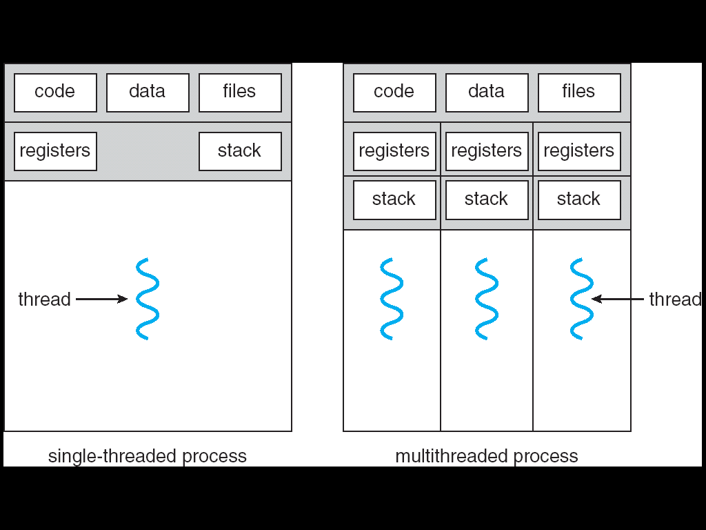
Starting Point: Traditional UNIX Process
Process: OS abstraction of what is needed to run a single program
Sequential program execution stream
Sequential stream of execution (thread)
State of CPU registers
Protected resources
Contents of Address Space
I/O state (more on this later)
Single-threaded – no concurrency

Slide 45
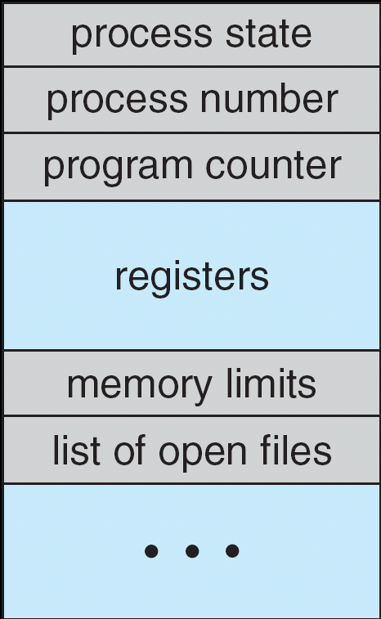
Multiplexing Processes
Snapshot of each process in its PCB
Only one active at a time (per core…)
Give out CPU to different processes
Scheduling
Policy Decision
Give out non-CPU resources
Memory/IO
Another policy decision
Process Control
Block

Slide 46
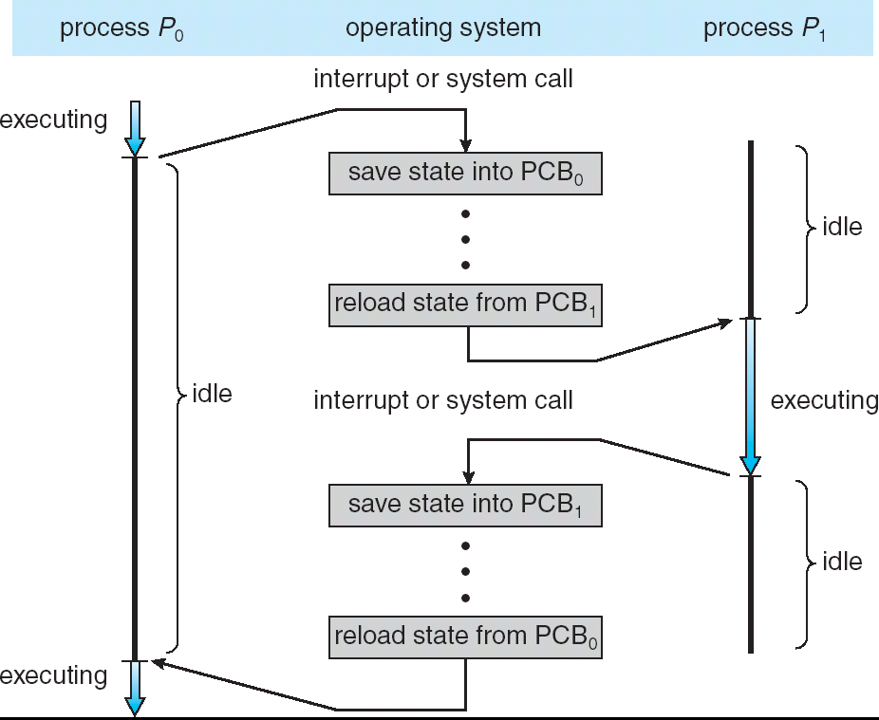
Context Switch

Slide 47
Context Switch
Overhead!

Slide 48
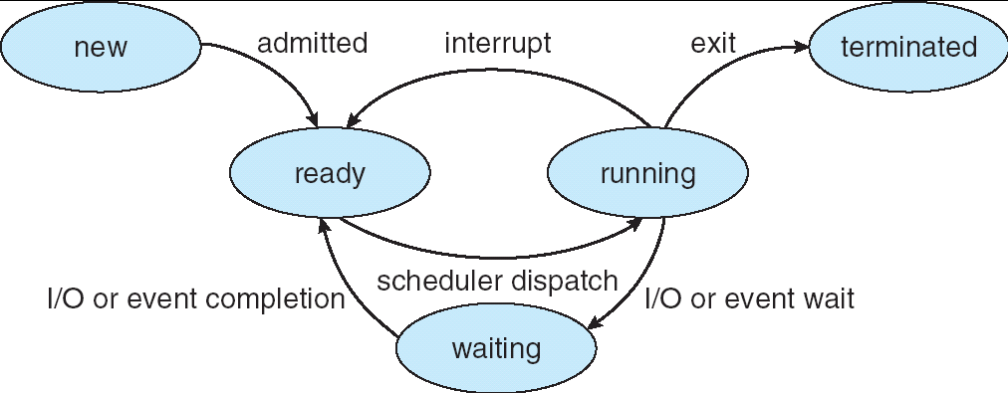
Lifecycle of a Process
As a process executes, it changes state:
new: being created
ready: waiting to run
running: instructions executing on the CPU
waiting: waiting for some event to occur (e.g., keypress)
terminated: finished execution

Slide 49
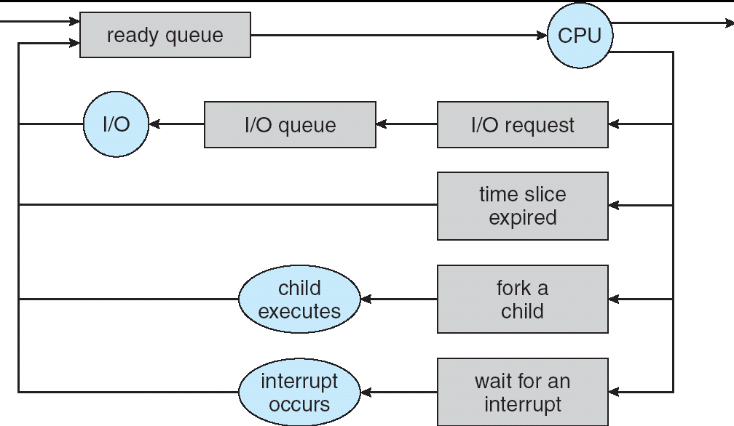
Scheduling: All About Queues
PCBs move from queue to queue
Scheduling: which order to remove from queue
Much more on this soon

Slide 50
Modern Processes: Multiple Threads
Thread: execution stream within a process
Used to be called "lightweight processes"
Shares address space with other threads belonging to the same process
Why separate concepts of threads and processes?
Threads: Concurrency
Processes: Protection

Slide 51
Single vs. Multithreaded Processes

Slide 52
So does the OS schedule processes or threads?
We've been talking about processes assuming the "old model" -> one thread per process
And many textbooks say this as well
Usually it's really: threads (e.g., in Linux)
More on some of these issues tomorrow
One point to notice: switching threads vs. switching processes incurs different costs:
Switch threads: Save/restore registers
Switch processes: Change active address space too!
Expensive
Disrupts caching

Slide 53
Thread vs. Process State
Process-wide state:
Memory contents (global variables, heap)
I/O bookkeeping
Thread-"private" state:
CPU registers including program counter
Execution stack
Kept in Thread Control Block

Slide 54
Execution Stack Review
A(int tmp) {
if (tmp<2)
B();
printf(tmp);
}
B() {
C();
}
C() {
A(2);
}
A(1);
A: tmp=1
ret=exit
B: ret=A+2
C: ret=b+1
A: tmp=2
ret=C+1
Stack
Pointer
Stack Growth
Stack holds temporary results
Used to implement recursion

Slide 55
Shared vs. Per-Thread State

Slide 56
Memory Footprint: Two Threads
Stack 1
Two sets of CPU registers
Two sets of Stacks
Issues:
How do we position stacks relative to each other?
What maximum size should we choose for the stacks?
What happens if threads violate this?
How might you catch violations?
Stack 2
Address Space
Heap
Global Data
Code

Slide 57
Silly Example for Threads
Imagine the following program:
main() {
ComputePI(“pi.txt”);
PrintClassList(“classlist.txt”);
}
What is the behavior here?
Program would never print out class list
Why? ComputePI would never finish

Slide 58
Adding Threads
Version of program with Threads (loose syntax):
main() {
thread_fork(ComputePI, “pi.txt” ));
thread_fork(PrintClassList, “classlist.txt”));
}
thread_fork: Start independent thread running given procedure
What is the behavior here?
Now, you would actually see the class list
This should behave as if there are two separate CPUs
CPU1
CPU2
CPU1
CPU2
CPU1
CPU2
Time

Slide 59
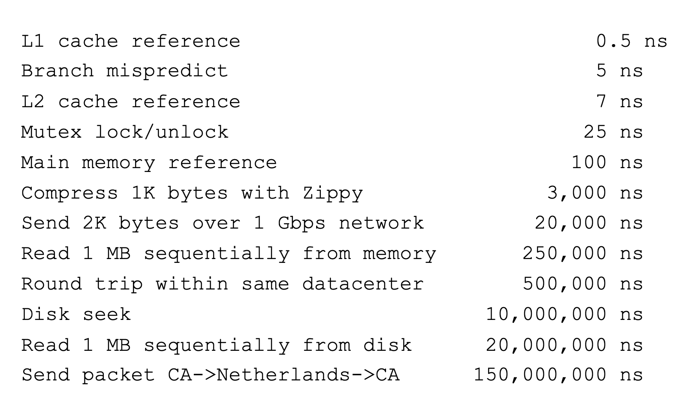
More Practical Motivation
Back to Jeff Dean's "Numbers everyone should know"
Handle I/O in separate thread, avoid blocking other progress

Slide 60
Better Example for Threads?
Imagine the following program:
main() {
…
ReadLargeFile(“pi.txt”);
RenderUserInterface();
}
What is the behavior here?
Still respond to user input
While reading file in the background

Slide 61
Actual Thread Operations in Pintos
thread_create(name, priority, func, args)
Create a new thread to run func(args)
thread_yield()
Relinquish processor voluntarily
thread_join(thread)
Wait (put in queue) until thread exits, then return
thread_exit
Quit thread and clean up, wake up joiner if any

Slide 62
Dispatch Loop
Loop {
RunThread();
ChooseNextThread();
SaveStateOfCPU(curTCB);
LoadStateOfCPU(newTCB);
}
Conceptually all the OS executes
Infinite Loop
When would we ever "exit?"
Can we assume some thread is always ready?

Slide 63
Dispatch Loop
Loop {
RunThread();
ChooseNextThread();
SaveStateOfCPU(curTCB);
LoadStateOfCPU(newTCB);
}
How to run a new thread?
Load thread's registers into CPU
Load its environment (address space, if in different process)
Jump to thread's PC
How does dispatch loop get control again?
Thread returns control voluntarily – yield, I/O
External events: thread is preempted

Slide 64
Voluntarily Giving Up Control
I/O – e.g. keypress
Waiting for a signal from another thread
Thread makes system call to wait
Thread executes thread_yield()
Relinquishes CPU but puts calling thread back on ready queue

Slide 65
Stack for Yielding Thread
ComputePI
yield
Trap to OS
kernel_yield
Stack growth
run_new_thread
switch
Cyan = User Stack; Red = Kernel Stack
run_new_thread() {
newThread = PickNewThread();
switch(curThread, newThread);
ThreadHouseKeeping(); /* Do any cleanup */
}

Slide 66
Stack for Yielding Thread
ComputePI
yield
Trap to OS
kernel_yield
Stack growth
run_new_thread
switch
Cyan = User Stack; Red = Kernel Stack
run_new_thread() {
newThread = PickNewThread();
switch(curThread, newThread);
ThreadHouseKeeping(); /* Do any cleanup */
}
Scheduling: Policy Decision

Slide 67
Stack for Yielding Thread
ComputePI
yield
Trap to OS
kernel_yield
Stack growth
run_new_thread
switch
Cyan = User Stack; Red = Kernel Stack
run_new_thread() {
newThread = PickNewThread();
switch(curThread, newThread);
ThreadHouseKeeping(); /* Do any cleanup */
}

Slide 68
What Do the Stacks Look Like?
Consider the following code blocks:
func A() {
B();
}
func B() {
while(TRUE) {
yield();
}
}
Two threads, S and T, each run A
Thread S
Thread T
A
A
B(while)
B(while)
Stack growth
yield
yield
run_new_thread
run_new_thread
switch
switch
Thread S's switch returns to Thread T's (and vice versa)

Slide 69
The Context Switch Itself
Switch(tCur,tNew) {
/* Unload old thread */
TCB[tCur].regs.r7 = CPU.r7;
…
TCB[tCur].regs.r0 = CPU.r0;
TCB[tCur].regs.sp = CPU.sp;
TCB[tCur].regs.retpc = CPU.retpc; /*return addr*/
/* Load and execute new thread */
CPU.r7 = TCB[tNew].regs.r7;
…
CPU.r0 = TCB[tNew].regs.r0;
CPU.sp = TCB[tNew].regs.sp;
CPU.retpc = TCB[tNew].regs.retpc;
return; /* Return to CPU.retpc */
}

Slide 70
Summary
Variety of process management syscalls
fork, exec, wait, kill, sigaction
Process consists of two pieces
Address Space (Protection)
One or more threads (Concurrency)
Scheduling: Threads move between queues
Threads: multiple stacks per address space
Context switch: Save/Restore registers, "return" from new thread's switch routine

