Slide 1
CS6501 – Embedded OS
TinyOS and nesC
TinyOS
nesC

Slide 2
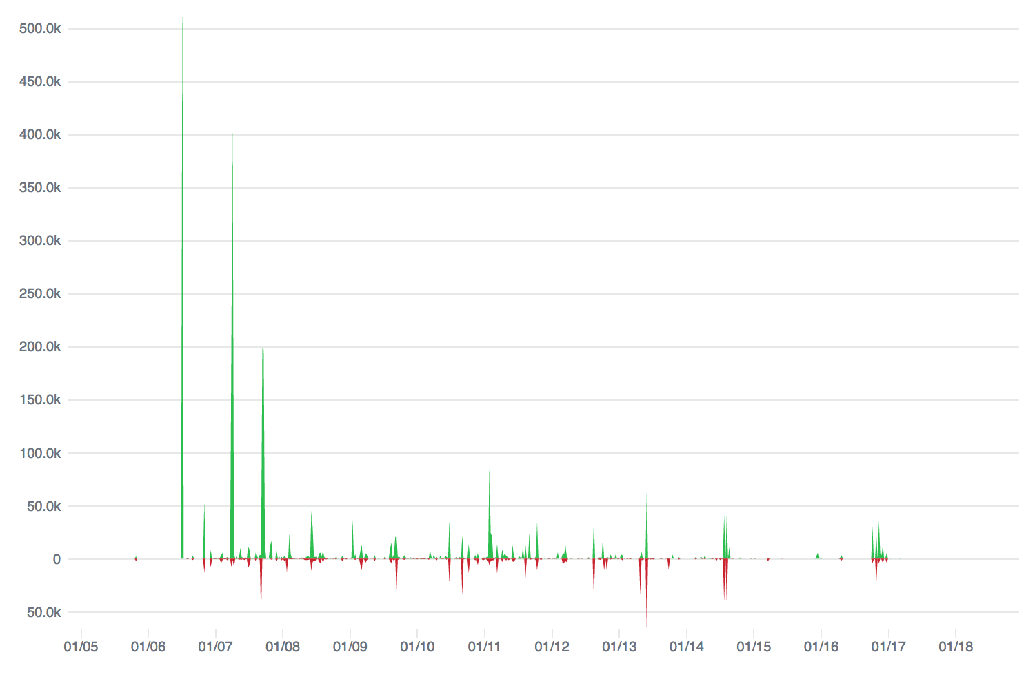
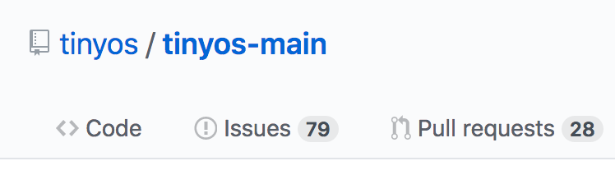
TinyOS and nesC
TinyOS: operating system for sensor networks
nesC: Programming language for sensor networks

Slide 3
Why TinyOS?
Traditional OSes are not suitable for networked sensors
Characteristics of networked sensors
Small physical size & low power consumption
Software must make efficient use of processor & memory, enable low power communication
Concurrency intensive
Simultaneous sensor readings, incoming data from other nodes
Many low-level events, interleaved w/ high-level processing
Limited physical parallelism (few controllers, limited capability)
Diversity in design & usage
Software modularity – application specific

Slide 4
TinyOS solution
Support concurrency
event-driven architecture
Software modularity
application = scheduler + graph of components
A component contains commands, event handlers, internal storage, tasks
Efficiency: get done quickly and then sleep
Static memory allocation

Slide 5
TinyOS computational concepts
Events
Time critical
Caused by interrupts (Timer, ADC, Sensors)
Short duration
Commands
Request to a component to perform service (e.g, start sensor reading)
Non-blocking, need to return status
Postpone time-consuming work by posting a task (split phase w/ callback event)
Can call lower-level commands
Tasks
Time flexible (delayed processing)
Run sequentially by TOS Scheduler
Run to completion with respect to other tasks
Can be preempted by events

Slide 6
TinyOS Execution Model

Slide 7
Concurrency
Two threads of execution
Tasks
deferred execution
tasks cannot preempt other tasks
Hardware event handler: respond to interrupts
Interrupts can preempt tasks
Scheduler
Two level scheduling
interrupts (vector) and tasks (queue)
Task queue is FIFO
Scheduler puts processor to sleep when no event/command is running and task queue is empty

Slide 8
TinyOS Execution Model (revisited)

Slide 9
TinyOS Theory of Execution: Events & Tasks
Consequences of an event
Runs to completion
Preempt tasks
What can an event do?
signal events
call commands
post tasks
Consequences of a task
No preemption mechanism
Keep code as small execution pieces to not block other tasks too long
To run a long operations, create a separate task for each operation, rather than using on big task
What can initiate (post) tasks?
Command, event, or another task

Slide 10
TinyOS summary
Component-based architecture
Provides reusable components
Application: graph of components connected by “wiring”
Three computational concepts
Event, command, task
Tasks and event-based concurrency
Tasks: deferred computation, run to completion and do not preempt each other
Tasks should be short, and used when timing is not strict
Events: run to completion, may preempt tasks
Events signify completion of a (split-phase) operation or events from the environment (e.g., hardware, receiving messages)

Slide 11
nesC: A programming language for sensor networks
Main features
Support and reflect TinyOS’s design
Support components, event-based concurrency model
Extending C with support for components
Components provide and use interfaces
Application: wiring components using configurations
Whole-program analysis & optimization
Detect race conditions
Static language
No dynamic memory allocation, call-graph fully known at compilation
No multiprogramming
Each mote runs a single application

Slide 12
nesC model
Application: graph of components
Main component
init, start, stop
first component executed
Other components
Components
modules
configurations
Interfaces: point of access to components
uses
provides
Application
Component D
Component
A
Component
C
Component
B
Component F
Component
E
configuration

Slide 13
nesC Component Types
Components
Modules
Configurations
Provides, uses, and implements interface(s)
Contains C-like code
A collection of other components put together by “wiring” syntax.
Does not use C-like code
Can also provide and use interfaces

Slide 14
Why modules and configurations?
Allow a developer to “snap together” applications using pre-build components without additional programming.
For example, a developer could provide a configuration that simply wires together one or more pre-existing modules.
The idea is for developers to provide a set of components, a “library,” that can be re-used in a wide range of applications.

Slide 15
nesC Component
Specification
Identified by the keyword configuration or module
List of interfaces that component
uses, provides
Alias interfaces as new name
Implementation
Identified by the keyword implementation
Defines internal workings
May include other components and associated “wiring”
Generalized component
configuration|module
provides
Interface_A
uses
Interface_B
implementation
Frame
Functions
NOTE: This model applies to both modules and configurations

Slide 16
nesC Configuration – A Bare Minimum Configuration
configuration ConfigurationName {
provides interface …;
uses interface …
}
implementation {
// wiring
……
}
Component
configuration
provides
Interface_A
uses
Interface_B
implementation

Slide 17
nesC Module – A Bare Minimum Module
module ModuleName {
provides interface StdControl;
}
implementation {
// ========== FRAME =========
// ========== FUNCTIONS =====
command result_t StdControl.init() {
return SUCCESS;
}
command result_t StdControl.start() {
return SUCCESS;
}
command result_t StdControl.stop() {
return SUCCESS;
}
}
Component
module
provides
Interface_A
uses
Interface_B
implementation
Frame
Functions

Slide 18
Example: Blink Configuration
configuration Blink {
}
implementation {
components Main, BlinkM, SingleTimer, LedsC;
Main.StdControl -> SingleTimer.StdControl;
Main.StdControl -> BlinkM.StdControl;
BlinkM.Timer -> SingleTimer.Timer;
BlinkM.Leds -> LedsC;
}

Slide 19
Example: Blink Module
module BlinkM {
provides {
interface StdControl;
}
uses {
interface Timer;
interface Leds;
}
}
implementation {
command result_t StdControl.init() {
call Leds.init();
return SUCCESS;
}

Slide 20
Example: Blink Module (cont’d)
command result_t StdControl.start() {
// Start a repeating timer that fires every 1000ms
return call Timer.start(TIMER_REPEAT, 1000);
}
command result_t StdControl.stop() {
return call Timer.stop();
}
event result_t Timer.fired() {
call Leds.yellowToggle();
return SUCCESS;
}
}

Slide 21
nesC Interface
define “public” methods that a component can use
contain one or more commands and/or events
group functionality, e.g.,
Standard control interface
Split-phase operation
interface StdControl {
command void init();
command void start();
command void stop();
}
interface Send {
command void send(TOS_Msg *m);
event void sendDone();
}

Slide 22
Interface : provides & uses
Provides: Exposes functionality to others
Uses: Requires another component
Interface provider must implement commands
Interface user must implement events
Commands
Events
Event
Commands
Provides
Interface_A
Interface_B
configuration|module
Functions
Frame
Uses
Interface_C
Command
Event

Slide 23
nesC Interface Examples
interface StdControl {
command void init();
command void start();
command void stop();
}
module MyAppM {
provides interface StdControl;
uses interface ADC;
uses interface Timer;
uses interface Send;
}
implementation {
…
}
interface ADC {
command void getData();
event void dataReady(int data);
}
interface Timer {
command void start(int interval);
command void stop();
event void fired();
}
Questions: what need to be implemented by MyApp?
interface Send {
command void send(TOS_Msg *m);
event void sendDone();
}

Slide 24
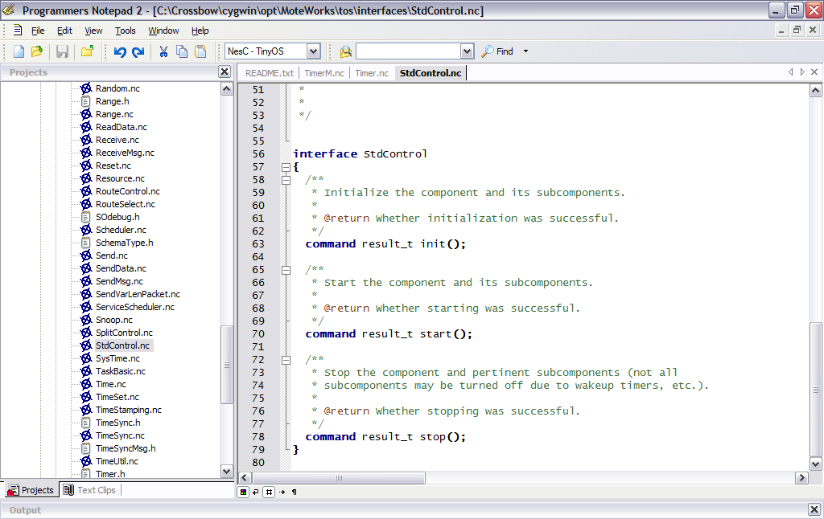
Interfaces: in /MoteWorks/tos/interfaces/

Slide 25
nesC Module Implementation
Frame
Global variables and data
One per component
Statically allocated
Fixed size
Functions
Implementation of:
Commands, events, tasks
Commands and Events
are simply C function calls
Component
module
provides
Interface_A
uses
Interface_B
implementation
Frame
Functions

Slide 26
Frame
module fooM {
provides interface I1;
uses interface I2;
}
implementation {
uint8_t count=0;
command void I1.increment() {
count++;
}
event uint8_t I2.get() {
return count;
}
}
Call I1.increment(); //first call
Call I1.increment(); //second call
signal I2.get(); //return 2
Modules maintain local and persistent state
Module states or variables are statically allocated
Each Module has a separate variable name space
Variables declared in Command and Event are local and allocated on the stack

Slide 27
What can a module do?
module MyAppM {
provides interface StdControl;
uses interface Clock;
…
}
implementation {
command result_t StdControl.init(){
call Clock.setRate(TOS_I1PS, TOS_S1PS);
}…
}
Calling commands
& signaling events
module MyAppM {
…
}
implementation {
task void processing(){
if(state) call Leds.redOn();
else call Leds.redOff();
}
event result_t Timer.fired()
{
state = !state;
post processing();
return SUCCESS;
}…
}
Posting tasks

Slide 28
nesC Configuration
wiring together other components
No code, just wiring
GenericConfiguration.nc
GenericConfiugration.nc
configuration D {
provides interface_A;
uses interface_B;
}
implementation {
components C1, C2;
X = C1.X;
X = C2.X;
}
configuration
provides
Interface_A
uses
Interface_B
implementation
C1
C2
D

Slide 29
nesC Wiring Syntax
Binds (connects) the User to an Provider’s implementation
User.interface -> Provider.interface
Example
MyApp_Timer.Timer -> TimerC.Timer[unique("Timer")];
Connected elements must be compatible
Interface to interface, command to command, event to event
Example: you can only wire interface Send to Send, but cannot connect Send to Receive

Slide 30
Three nesC Wiring Statements
C.nc
Alias or pass through linkage
endpoint₁ = endpoint₂
Direct linkage, style 1
endpoint₁ -> endpoint₂
Direct linkage, style 2
endpoint₁ <- endpoint₂
which is equivalent to: endpoint₂ -> endpoint₁
configuration C {
provides interface X as Xprovider;
uses interface X as Xuser;
}
implementation {
Xuser = Xprovider;
}
D
C
C1
C2
D1
D2

Slide 31
How mote application starts?
int main() {
call hardwareInit(); //init hardware pins
TOSH_sched_init(); //init scheduler
call StdControl.init(); //init user app
call StdControl.start(); //start user app
while(1) {
TOSH_run_task(); //infinite spin loop for task
}
}

Slide 32
nesC Filename Convention
nesC file suffix: .nc
C is for configuration (Clock, ClockC)
“C” distinguishes between an interface and the component that provides it
M is for module (Timer, TimerC, TimerM)
“M” when a single component has both configuration and module

Slide 33
Dealing with Concurrency in nesC
TinyOS two execution threads: Tasks and interrupts
Tasks cannot preempt other tasks
Interrupts can preempt tasks
Race condition
Concurrent update to shared state
Any update to shared state that is reachable from asynchronous code is a potential race condition
Asynchronous code
Code that is reachable from at least one interrupt handler
Synchronous code
Commands, events, or tasks only reachable from tasks

Slide 34
atomic Keyword
atomic: denote a block of code that runs uninterrupted (interrupts disabled)
Prevents race conditions
When should it be used?
Required to update global variables that are referenced in async event handlers
Must use atomic block in all other functions and tasks where variable is referenced
nesC compiler generates warning messages for global variables that need atomic blocks, e.g.,
SensorAppM.nc:44: warning: non-atomic
accesses to shared variable ‘voltage’

Slide 35
atomic Keyword (cont’d)
Disables all interrupts, therefore use with caution and intention
Affects code block within {…} that follows it
Useful for locking a resource
Example
Compiles to:
cli(); // disable interrupts
lda r1, busy // load busy to register
jnz r1, inUse // check busy
str busy, 1 // set busy to true
inUse:
sbi(); // enable interrupts
atomic {
if (!busy)
busy = TRUE;
}
No interrupts will disrupt code flow

Slide 36
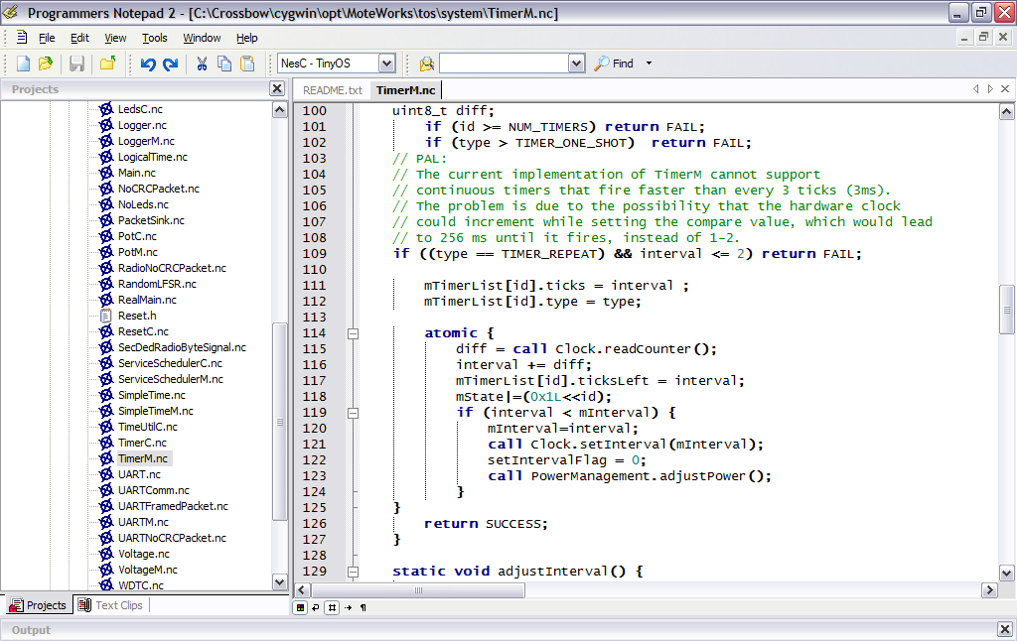
atomic Syntax Example
From MoteWorks/tos/system/TimerM.nc

Slide 37
async Syntax
async attribute used to indicate that command or event is part of an asynchronous flow
async processes are “decoupled” by posting a task (to return quickly)
tinyos-1.x/tos/system/TimerM.nc
async event result_t Clock.fire() {
post HandleFire();
return SUCCESS;
}
Post task “decouples” the async event

Slide 38
nesC Features for Concurrency
post
Puts a function on a task queue
Must be void foo(void)
atomic
Turn off interrupts
async
Use async to tell compiler that this code can be called from an interrupt context – used to detect potential race conditions
norace
Use norace to tell compiler it was wrong about a race condition existing (the compiler usually suggests several false positives)
task void do-work() { //declares a task that does work}
post do-work();

Slide 39
Concurrency Example
module SurgeM {…}
implementation {
bool busy;
norace unit16_t sensorReading;
event result_t Timer.fired() {
bool localBusy;
atomic {
localBusy = busy;
busy = TRUE;
}
if(!localBusy) call ADC.getData();
return SUCCESS;
}

Slide 40
Concurrency Example (cont’d)
task void sendData() {
adcPacket.data = sesnorReading;
call Send.send(&adcPacket, sizeof adcPacket.data);
return SUCCESS;
}
event result_t ADC.dataReady(unit16_t data) {
sensorReading = data;
post sendData();
return SUCCESS;
}
…
}

Slide 41
nesC Keywords
Keyword | Description
component | Building blocks of a nesC application. Can be a module or a configuration
module | A basic component implemented in nesC
configuration | A component made from wiring other components
interface | A collection of event and command definitions
implementation | Contains code & variables for module or configuration
provides | Defines interfaces provided by a component
uses | Defines interfaces used by a module or configuration
as | Alias an interface to another name
command | Direct function call exposed by an interface
event | Callback message exposed by an interface

Slide 42
Appendix: TinyOS Programming Tips
By Phil Levis guide to TinyOS 2.0 Programming Guide
Note: Not all TinyOS 2.0 concepts apply to MoteWorks
Last update: June 28, 2006

Slide 43
TinyOS Programming Hints – Condensed (1 of 4)
Programming Hint 1: It’s dangerous to signal events from commands, as you might cause a very long call loop, corrupt memory and crash your program.
Programming Hint 2: Keep tasks short.
Programming Hint 3: Keep code synchronous when you can. Code should be async only if its timing is very important or if it might be used by something whose timing is important.
Programming Hint 4: Keep atomic sections short, and have as few of them as possible. Be careful about calling out to other components from within an atomic section.
Programming Hint 5: Only one component should be able to modify a pointer’s data at any time. In the best case, only one component should be storing the pointer at any time.

Slide 44
TinyOS Programming Hints – Condensed (2 of 3)
Programming Hint 6: Allocate all state in components. If your application requirements necessitate a dynamic memory pool, encapsulate it in a component and try to limit the set of users.
Programming Hint 7: Conserve memory by using enums rather than const variables for integer constants, and don’t declare variables with an enum type.
*Programming Hint 8: In the top-level configuration of a software abstraction, auto-wire init to MainC. This removes the burden of wiring init from the programmer, which removes unnecessary work from the boot sequence and removes the possibility of bugs from forgetting to wire.
*Programming Hint 9: If a component is a usable abstraction by itself, its name should end with C. If it is intended to be an internal and private part of a larger abstraction, its name should end with P. Never wire to P components from outside your package (directory).
*TinyOS 2.0 specific

Slide 45
TinyOS Programming Hints – Condensed (3 of 4)
Programming Hint 10: Use the as keyword liberally.
Programming Hint 11: Never ignore combine warnings.
Programming Hint 12: If a function has an argument which is one of a small number of constants, consider defining it as a few separate functions to prevent bugs. If the functions of an interface all have an argument that’s almost always a constant within a large range, consider using a parameterized interface to save code space. If the functions of an interface all have an argument that’s a constant within a large range but only certain valid values, implement it as a parameterized interface but expose it as individual interfaces, to both minimize code size and prevent bugs.
Programming Hint 13: If a component depends on unique, then #define a string to use in a header file, to prevent bugs from string typos.
*TinyOS 2.0 specific

Slide 46
TinyOS Programming Hints – Condensed (4 of 4)
*Programming Hint 14: Never, ever use the “packed” attribute.
*Programming Hint 15: Always use platform independent types when defining message formats.
*Programming Hint 16: If you have to perform significant computation on a platform independent type or access it many (hundreds or more) times, then temporarily copying it to a native type can be a good idea.
*TinyOS 2.0 specific

