Slide 1
Communication: SeamBlue, OpenChirp
Nabeel Nasir

Slide 2
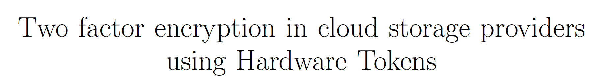
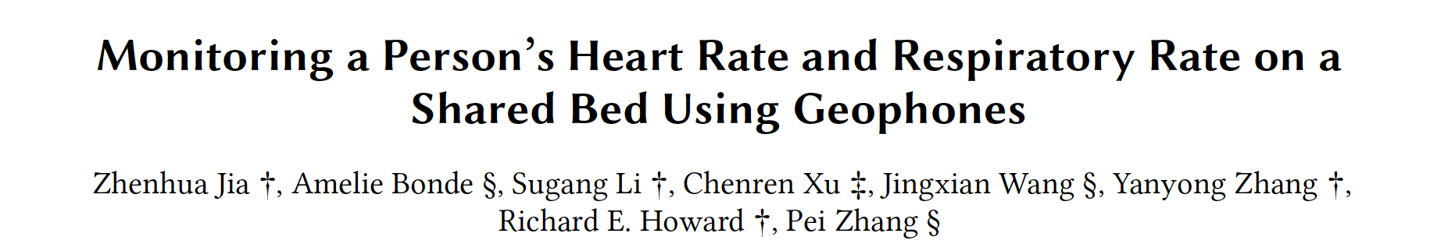




Slide 3
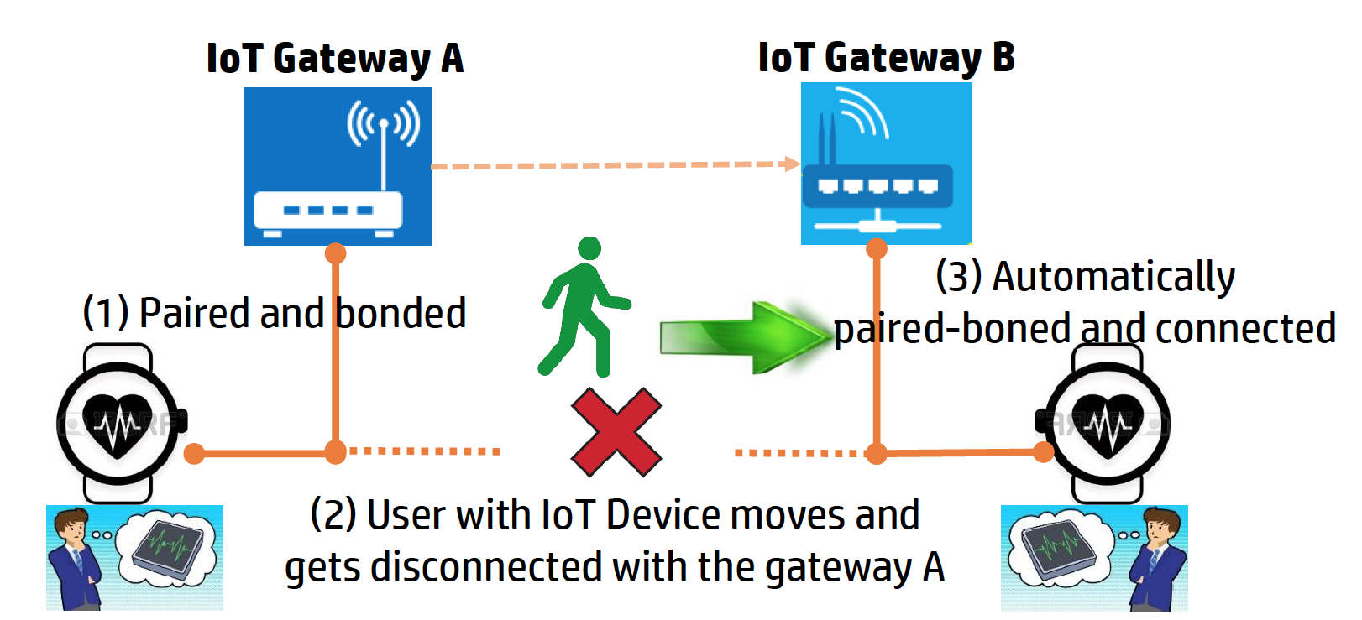
SeamBlue
Without SeamBlue
After displacement, need to
manually identify new gateway
pair
reconnect to new gateway
“mobile” peripheral BLE device
connection migration between gateways

Slide 4
SeamBlue
Pros
Cons
Super useful for applications with wearable devices
No modification of the IoT device code
Static analysis to get state – hacky
Maintenance headache
How do they find movement speed and direction of device?
Turn off device and turn on at another place?
Access Address impersonation
Hard to troubleshoot issues?
Pair to all devices and then do auto-reconnect when out of range
Notes:
Performing static analysis on the library BLE code seems a little hacky. The extracted state information could be subject to change when firmware updates or BLE library updates happen, which is not addressed by the paper.
An integral part of their solution is to evaluate movement speed and direction of an IoT device and then estimate the subsequent gateway under whose range the device might move to. However, there is no discussion on the implementation details about this core piece of their solution. They also gloss over their connection migration success rate in their evaluation section.

Slide 5
SeamBlue - OS Concepts
GW - SeamBlue app on Android OS
Multi-tasking
Read BLE packets and process for normal operation
Check for movement of peripheral device
Pairing state migration
Connection migration
Virtualization
BLE radio
Wi-Fi/LTE radio for connection transfer to other gateways
Use of timers for evaluation of connection transfer
Link Layer packet loss calculation

Slide 6
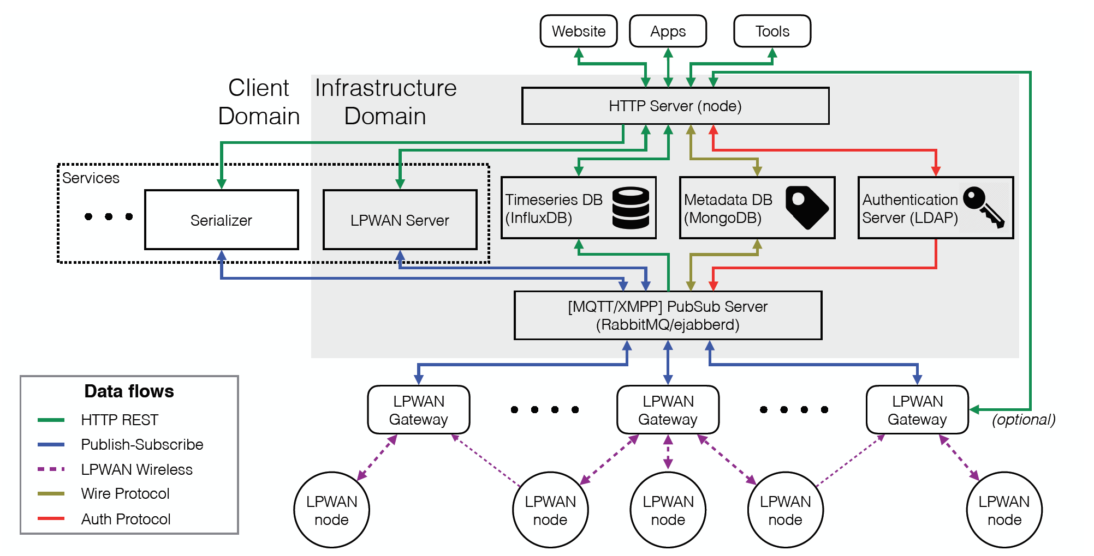
OpenChirp
Low-power, Wide Area Network
Collaborative telemetry
LoRaBug end-devices + LoRaWAN protocol + PubSub server + Goodies
= OpenChirp

Slide 7
OpenChirp
Pros
Cons
Open source design
Remotely registering, managing, and extracting data from the devices
Deep-sleep current of Semtech chip from 20 uA to 287 nA
Amazing battery life (years on 2 AA batteries) + “km” scale range
No comparison with other open LPWANs
Design choices not explained
CC2560 MCU
Semtech SX1276 LoRa radio
TI-RTOS
Notes:
The implementation allows for deploying LoRaWAN devices to the OpenChirp network and then remotely registering, managing, and extracting data from the devices, which will be super useful for large-scale deployments.
The authors have put in extra effort to work on the RF switch shut-off issue on Semtech chips to bring down the deep-sleep current from 20 uA to 287 nA improving power draw significantly.

Slide 8
OpenChirp - OS Concepts
Gateway devices
Watchdog timer for reset (remote deployment)
Full-fledged network stack
LoRaBug device
Configurable kernel
Minimal multi-tasking kernel
Complete network-enabled environment supporting low-energy operations

Slide 9
Discussion
LoRa vs BLE
SeamBlue, OpenChirp, ….
Notes:
LoRa uses license-free sub-gigahertz radio frequency bands like 169 MHz, 433 MHz, 868 MHz (Europe) and 915 MHz (North America)
> 10 km range with low power consumption

