Slide 1
Onboard Intelligence
Xinyu Yang

Slide 2
Challenges?
1. Performance (Accuracy, …)
2. Time (Runtime application?)
3. Memory
4. Energy
5. User experience
6. …

Slide 3
DeepASL

Slide 4
DeepASL
1. Performance (Accuracy, …)
Compelling experiments?
Robustness?
Notes:
Robustness (Age of participants; They are not familiar with ASL; )

Slide 5
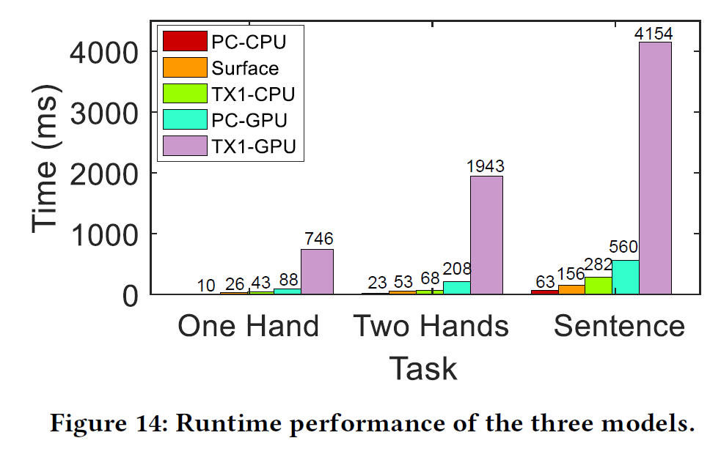
DeepASL
2. Time (Runtime application?)
Notes:
CPU is better than GPU
Time cost on CPUs are less than 282ms.
Do you think 282ms is good enough for this system?

Slide 6
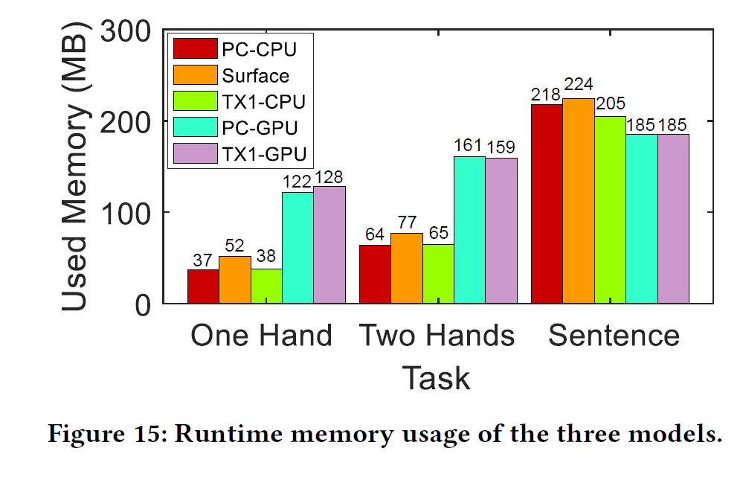
DeepASL
3. Memory

Slide 7
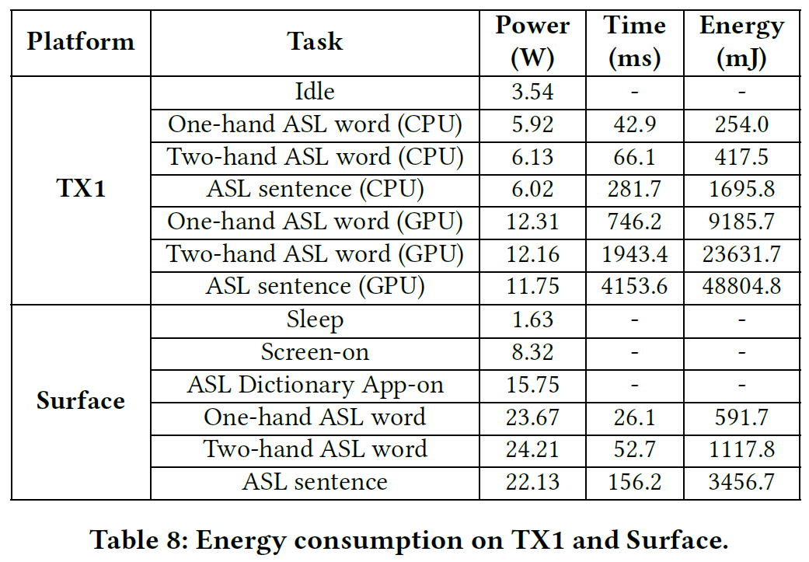
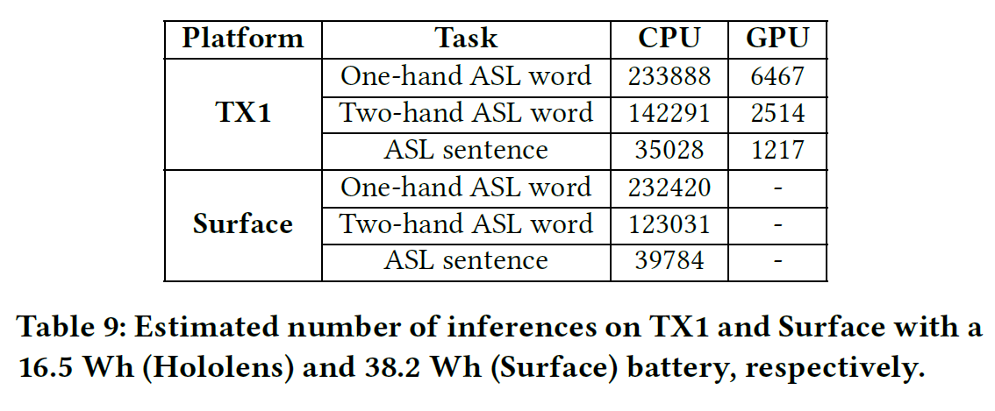
DeepASL
4. Energy
Notes:
Acceptable
Charge mobile devices once/several times a day

Slide 8
DeepASL
5. User experience
Applicable in real life?
People (users, developers, …) are willing to use it?
Notes:
There is still a distance between DeepASL and a real application:
Use of retraining data
Heavy(?)/Too much devices required

Slide 9
DeepASL
Other comments? Strengths/Weaknesses?

Slide 10
SparseSep

Slide 11
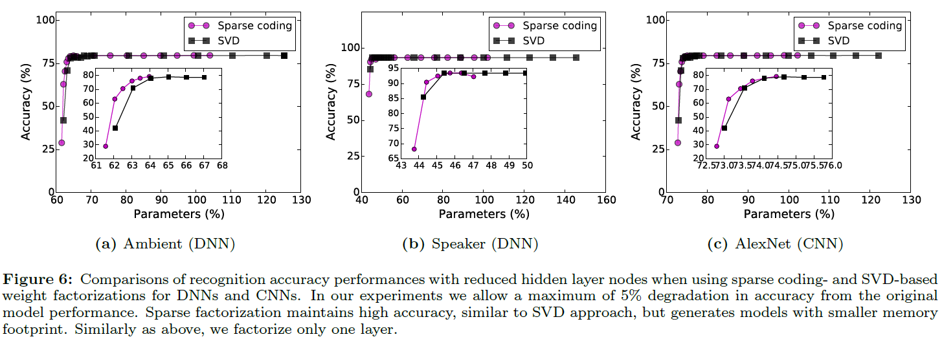
SparseSep
1. Performance (Accuracy, …)
Will it meet the accuracy requirement?
Robustness?
Notes:
I think some applications may require a higher accuracy.

Slide 12
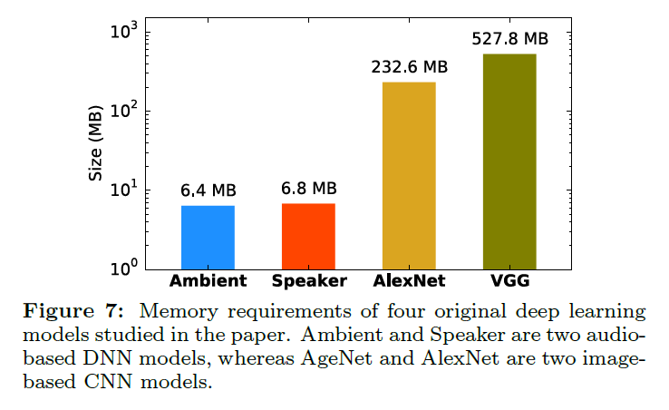
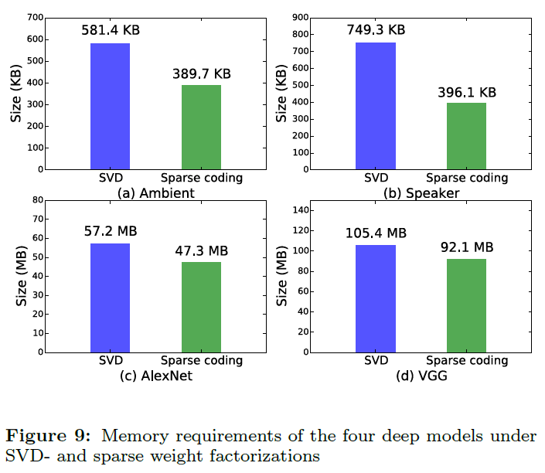
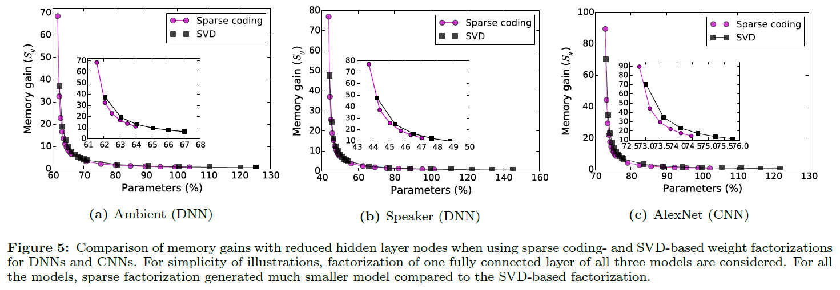
SparseSep
2. Memory
Notes:
Okay. Did some improvement (compared to SVD) but not that impressive.

Slide 13
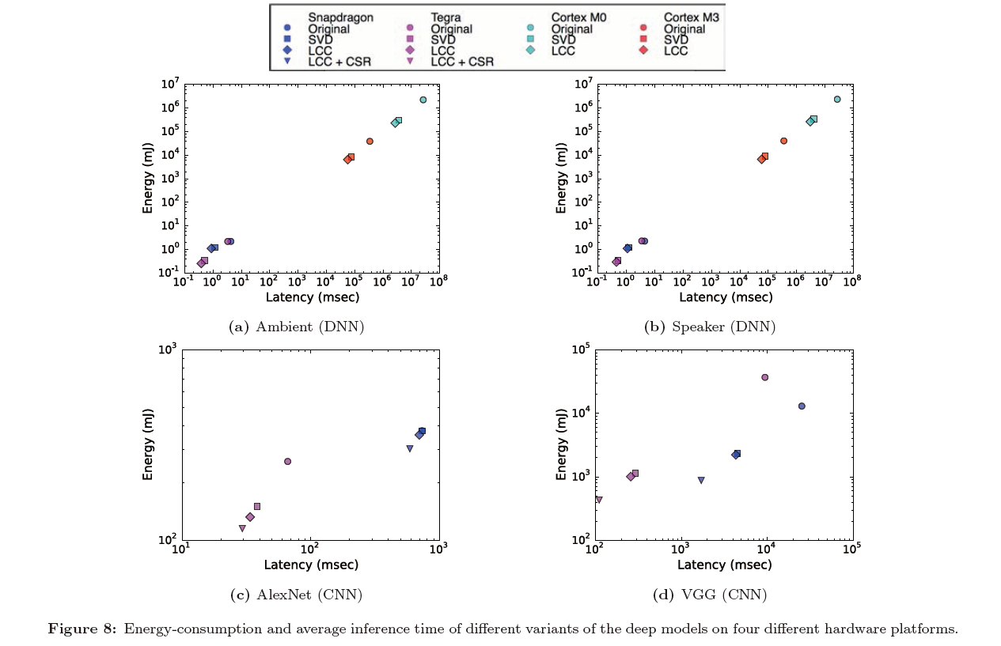
SparseSep
3. Time
Notes:
Good job!
Q: How do you like the experiment of running time?

Slide 14
SparseSep
4. Energy

Slide 15
SparseSep
5. User experience
Applicable in real life?
People (users, developers, …) are willing to use it?
Notes:
Suppose you are going to design an onboard intelligence. Will you use SpareseSep? Why or why not?

Slide 16
SparseSep
Other comments? Strength/Weaknesses?
Notes:
Design problem: no retraining.

