Slide 1
Intermittently Powered Devices
HarvOS and DINO
Eamon Collins

Slide 2
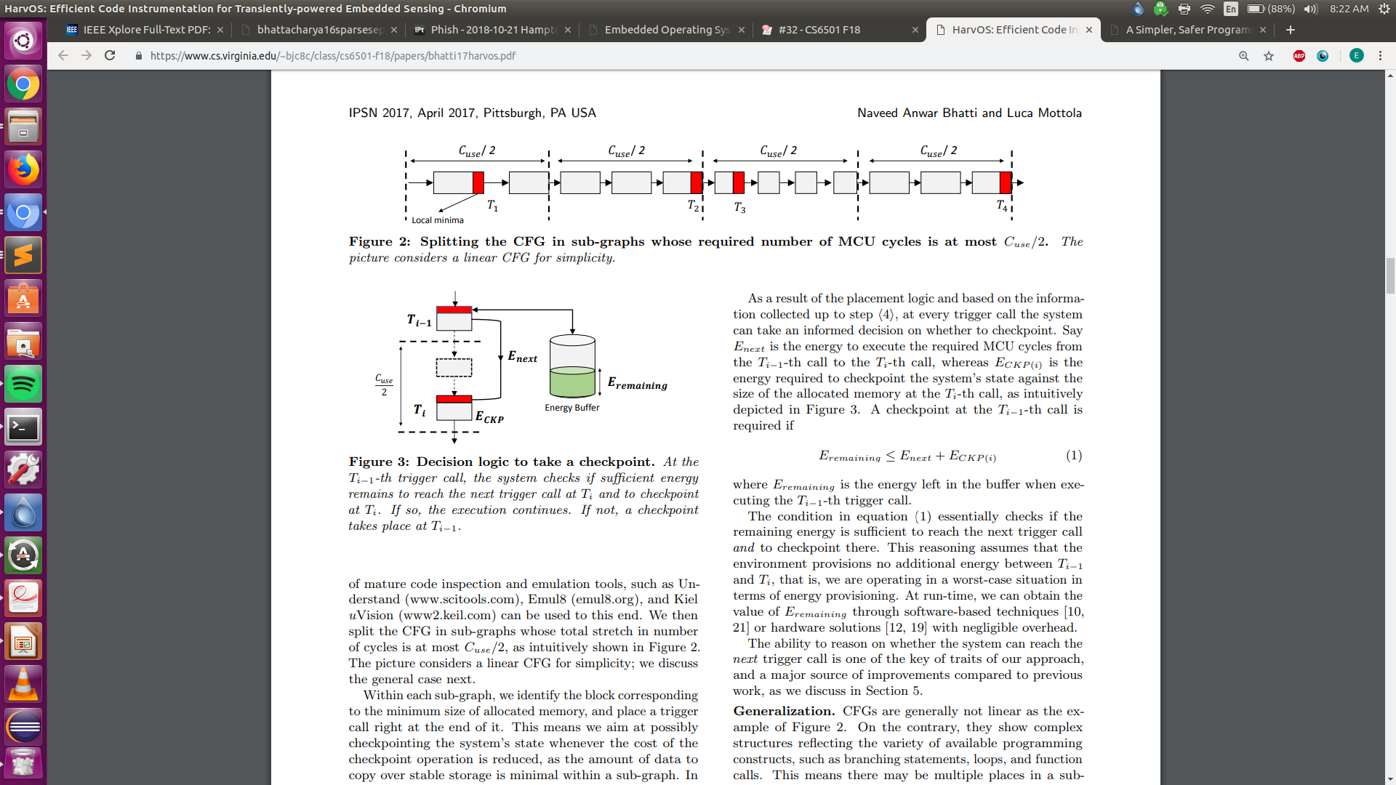
HarvOS
What do you think about the consistent planning for the worst case?
Using greatest memory allocation to calculate E_{CKPmax} , then placing triggers at lowest local memory allocation
Considering max power draw of MCU for C_{MCUmax}
Placing triggers at C_{use}/2
Assuming no energy harvested during program execution
Use most energy consuming path for E_{next}

Slide 3
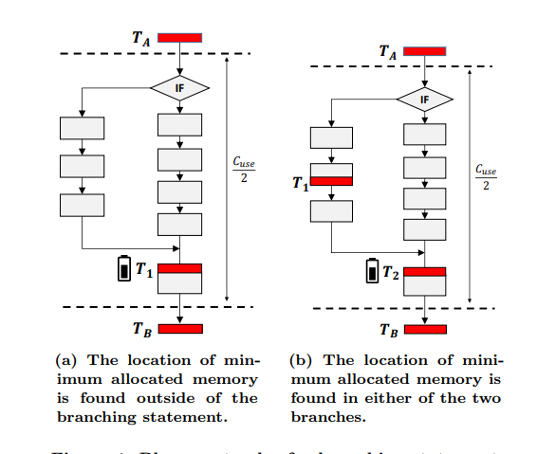
HarvOS
How do they use the ability to probe actual level of energy remaining?
Only to correct their worst case estimate upwards, when it’s possible that their estimate is underestimating energy left returning from a branch

Slide 4
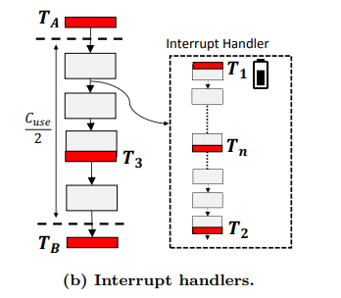
HarvOS
How do you expect HarvOS to function on an interrupt heavy platform?
Mandatory energy probing upon entering handler
Potentially an extra checkpoint at the end

Slide 5
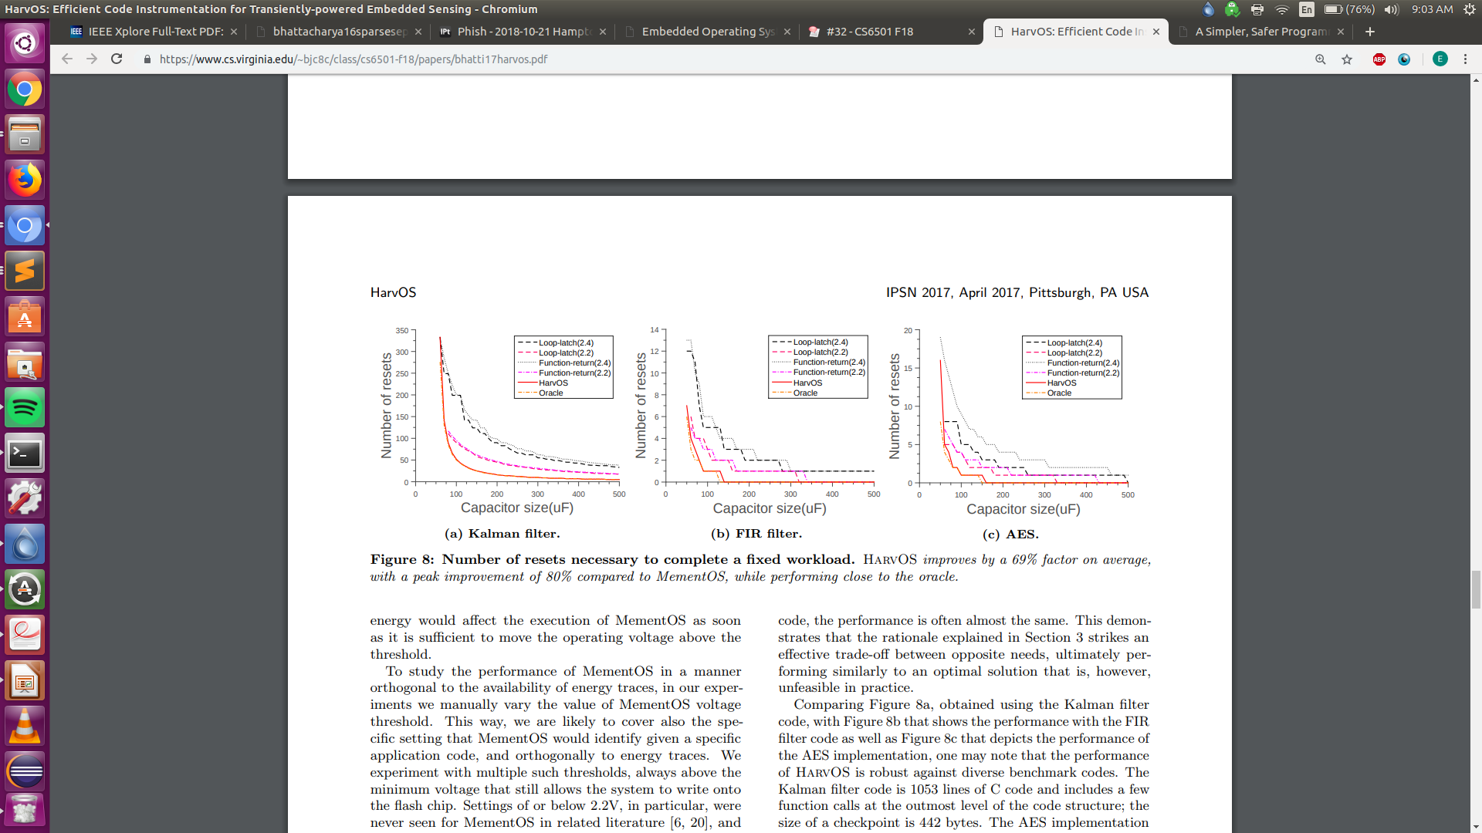
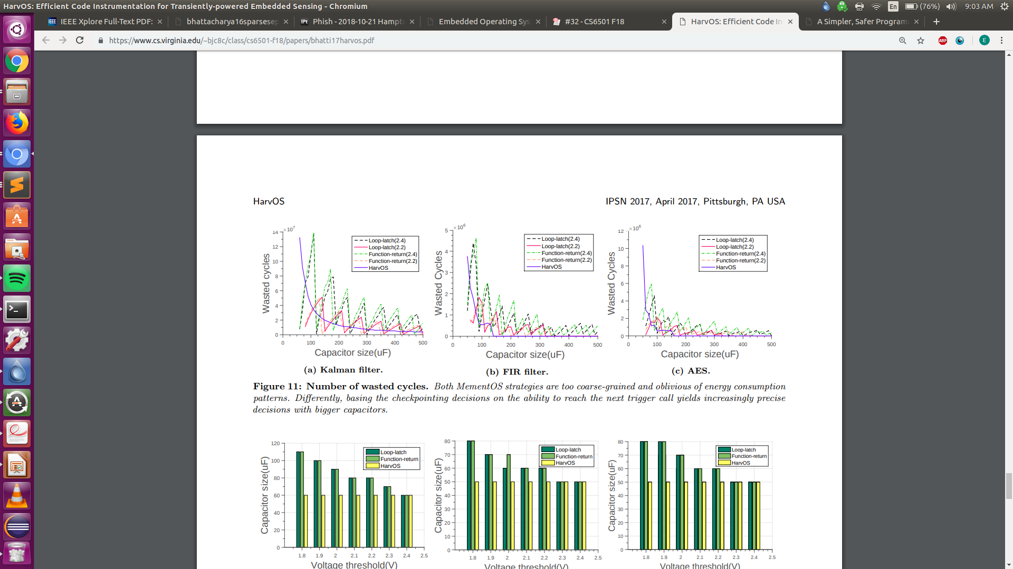
HarvOS
What do you think about the performance of HarvOS?

Slide 6
Death Is Not an Option

Slide 7
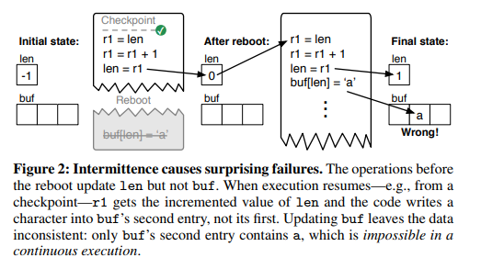
DINO
Why do they say that dynamic checkpointing is insufficient?
Cannot know for certain where the program will resume, non-idempotent operations can be partially performed then repeated from beginning, leaving unpredictable results
Nonvolatile memory not consistent across reboots

Slide 8
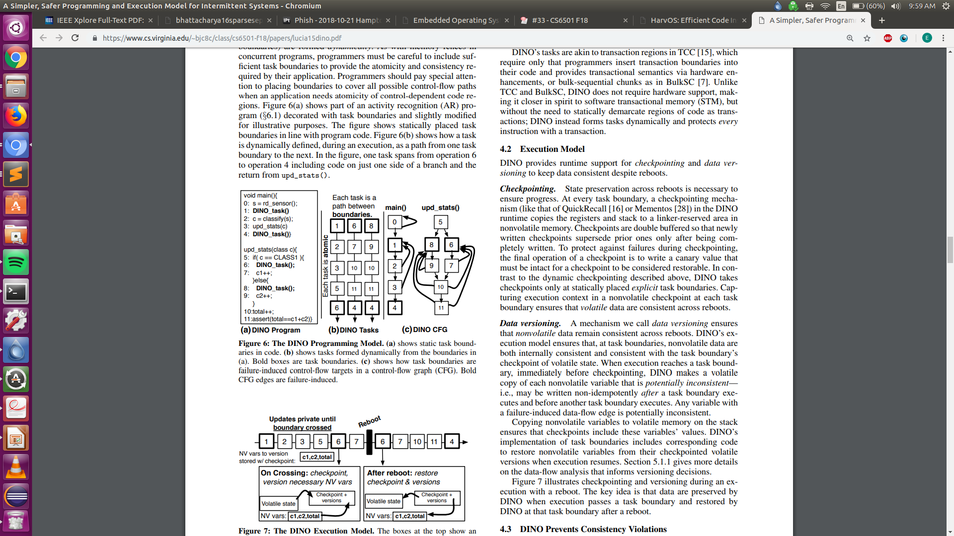
DINO
What makes DINO work?
Atomic tasks
Other tasks can’t see updates until updating task finishes
Task boundaries guarantee consistency of nonvolatile memory with checkpointed state

Slide 9
DINO
Do you think the decision not to use hardware support was a good one?
Think HarvOS’s checking of remaining energy levels and subsequent energy-aware checkpointing
Contrast usefulness with DINO’s reasoning of reduced complexity and wider applicability to existing systems.

