Slide 1
RIOT: One OS to Rule Them All
in the IoT
E. Baccelli, O. Hahm, M. Wählisch, M. Günes, T. C. Schmidt
Céu: Safe System-level Concurrency on Resource-Constrained Nodes
Francisco Sant’Anna, Noemi Rodriguez, Roberto Ierusalimschy,
Olaf Landsiedel, Philippas Tsigas
Notes:
1 min

Slide 2
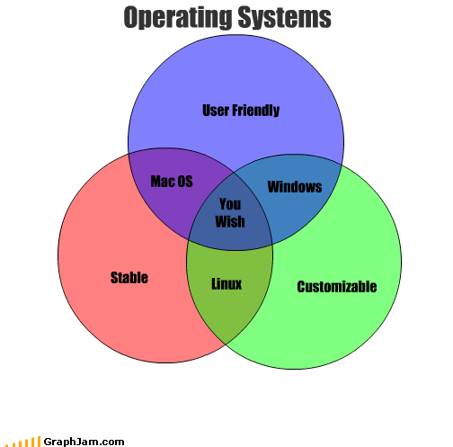
Notes:
2 mins -- is there something like this for IoT OS??

Slide 3
Event Driven Vs Thread Based
What is better for an Embedded OS?
Event Driven
Event triggered
State transitions need to be considered-not necessarily explicit
Circular logic is possible
Thread Based
Runs serially, doesn’t wait for an event
Shared memory
Notes:
15 mins- what are the difference? Which is better? Fill it up while discussing?

Slide 4
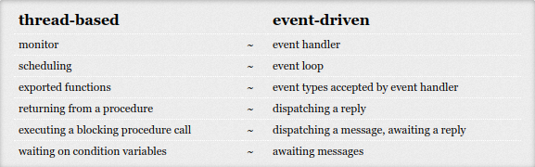

Slide 5
Supports that an Embedded OS should provide?
Notes:
Talk about what we talked in class vs what riot says 20 mins

Slide 6
Does an embedded Operating System really need to support multithreading?
Notes:
10 mins

Slide 7
Novelty of RIOT OS
Is it really better than all the embedded OSes out there?
Notes:
10 mins

Slide 8
Similarities
Differences
Notes:
10 mins

Slide 9
New Programming languages for IoT
Notes:
5 mins are people willing to learn new languages? What’s the cost benefit ratio??

Slide 10
Ceu
NesC
Notes:
10 mins, pros and cons of each

